Slide 1
An Introduction to the National Neighborhood Indicators Partnership (NNIP)
PITTSBURGH, PA
MAY 6, 2015
Notes:
Welcome – this is just to get you oriented before the full meeting starts and have you know some friendly faces.
Introductions
Much of this will sound familiar to those of you who are staff in NNIP partner organizations since this is your day-to-day.

Slide 2
National Neighborhood Indicators Partnership (NNIP)
Collaborative effort between the Urban Institute & local partners in 34 cities
NNIP partners help residents and institutions use data to improve neighborhoods in advocacy, planning, and policymaking.
Notes:
We have a long history and have grown over time, but what we all have in common is… walk through slide.

Slide 3
NNIP History
1980s/1990s: local organizations funded by Jim Gibson through Rockefeller Foundation begin to use data in community organizing
June 1995
First meeting of Urban and first six local intermediaries to discuss partnership
Atlanta, Boston, Cleveland, Denver, Oakland, Providence
June 1996: Urban assessment completed, report published, partnership funded
Notes:
NNIP was not conceived of by Urban, but by local partners.
Started with.. Community Planning and Action Program (CPAP)_ - ocal groups funded by the Rockefeller Foundation to develop local solutions to emerging concerns about concentrated urban poverty in several US cities
NNIP model created by Claudia Coulton in 1992 in Cleveland

Slide 4
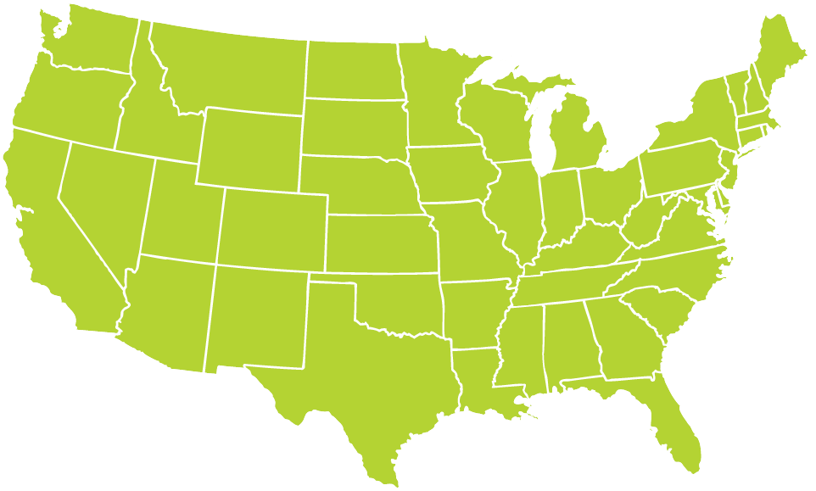
Better Data. Better Decisions. Better Communities.
Notes:
Grown from 6 founding partners to 34, and more on the way.
Pittsburgh joined in 2008.

Slide 5
Success Factors
Trusted and engaged institutions
Relevant and high-quality data
Mission to support use of data for action
Notes:
Because it is easy to get wrapped up in the numbers and colorful maps, we always emphasize that there are three necessary components to NNIP’s success

Slide 6
Trusted and Connected Institutions
Notes:
The partners are housed in various types of institutions –universities, independent nonprofits, local funders. (29% universities, 24% broader mission NFP, 21% partnerships, 15% Info only NFP, 9% funder, 3% local govt)
But whatever the home, they are all respected organizations with a long-term stake in their community.
They are viewed as neutral - not tied to any one political agenda or issue area. Meant to last beyond any particular mayor’s term.
Data providers are confident that confidential data will be handled properly, and audiences are confident of the rigor of the analysis.
Since they are on the ground, they can be responsive to community needs and emerging issues [give example]
Together, the partners are an amazing network for peer learning. Rich base of knowledge to draw from - allows new partners or existing partners tackling new issues to get a jump start from others’ past experiences.

Slide 7
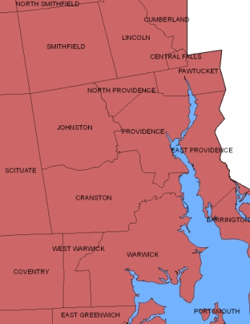
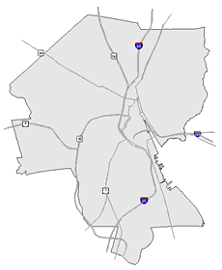
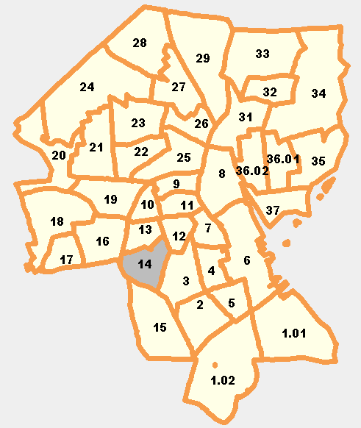
Relevant and High Quality Data
Types of Data
Education
Child care
Births, deaths
TANF, Food Stamps
Health
Crime
Property sales, prices
Foreclosures
REGION
CITY
NEIGHBORHOOD
PARCEL
TRACTS
Notes:
Basic requirement for partners - Assemble, transform and disseminate data
The partners collect data once from police, schools, health department; and add value by clean the data; and develop ngh-level indicators.
Neighborhood-level is key since problems are not evenly distributed across cities and priority issues vary across neighborhoods.
Multiple topics: the ability to cover many issues is critical: residents don’t experience their community in silos and the solutions aren’t siloed either. (obesity example?)
Recurrent: Not just one-time project, but formal agreements to get the data every year or sometimes every day to be ready when need for data arise
Result is a one-stop shop that is a flexible resource for the whole community – much more cost-effective than each nonprofit group trying to do it themselves. There is an economy of scale.
This part is hard work and the systems are built incrementally. Perspective of investment in infrastructure – which requires commitment from partner org and their funders to grow and support the systems over time.

Slide 8
Mission: Data for Local Action
Democratize Information
Facilitate the direct use of data by stakeholders
Serve multiple audiences and purposes
But a central focus on strengthening and empowering low-income neighborhoods
Use information to promote collaboration
Acts as a bridge among public agencies, nonprofits, businesses, resident groups
Notes:
Disseminate passively, but most imptly in partnership with local groups.
Principles and values: The motivation for all the hard work of compiling the data is to get it used - whether for policymaking, community building, program planning.
The founding NNIP partners recognized that not everyone had equal access to information.
Focus started on and still in on low-income nghs that have traditionally not had access to data or skills to use it.
but we found that as NNIP partners matured they were also needed to help citywide nonprofits and even gov’t agencies find and use the data in their work.
Some of the most compelling stories are where data has been used to break down silos – among agencies, sectors, geographies.
Data brings people to the table to develop a common understanding of the issues, and new solutions emerge.
Example: School Readiness project – documented all the systems that work with young kids: health care providers , day care and early education providers, public school system, child advocates, family support services. Gather data and indicators about young children in the community and bring everyone to the same table to help improve outcomes for the kids.
Civic capacity = raising the interest in using data among many types of groups

Slide 9
Interpreting, Communicating, and Engaging with Data: Example from Austin
Notes:
We want to share this example from our partner in Austin TX. Describes how they were able to engage the community around an issue and see operational and policy changes as a result of their work.
Full case study in “Strengthening Communities”
Thank Susan Millea and other CoH staff

Slide 10
COH Approach to Presenting Data
Use multiple sources to understand the problem and potential solutions.
Include community needs and assets.
Admit imperfections and limitations.
Enlist participants to fill out the picture (including tangible and intangible).
Notes:
[INSERT SLIDE ABOUT OVERALL PROCESS?]
CoH had been working on the issue of obesity with the school district and wanted to hold a community forum around the issue to engage parents and school officials. When they present data, they have developed these principles…
Use multiple sources – for obesity, they map the physical fitness scores, but also the parks, health food outlets, and fast food restaurants.
Balance negative indicators with recognition of assets - Examples depending on the topic, but include Playgrounds, Libraries, Faith Communities, but also individuals that serve as community leaders and supports.
Admit the administrative data are incomplete and imperfect – ask the participants to contribute to the data collection process.

Slide 11
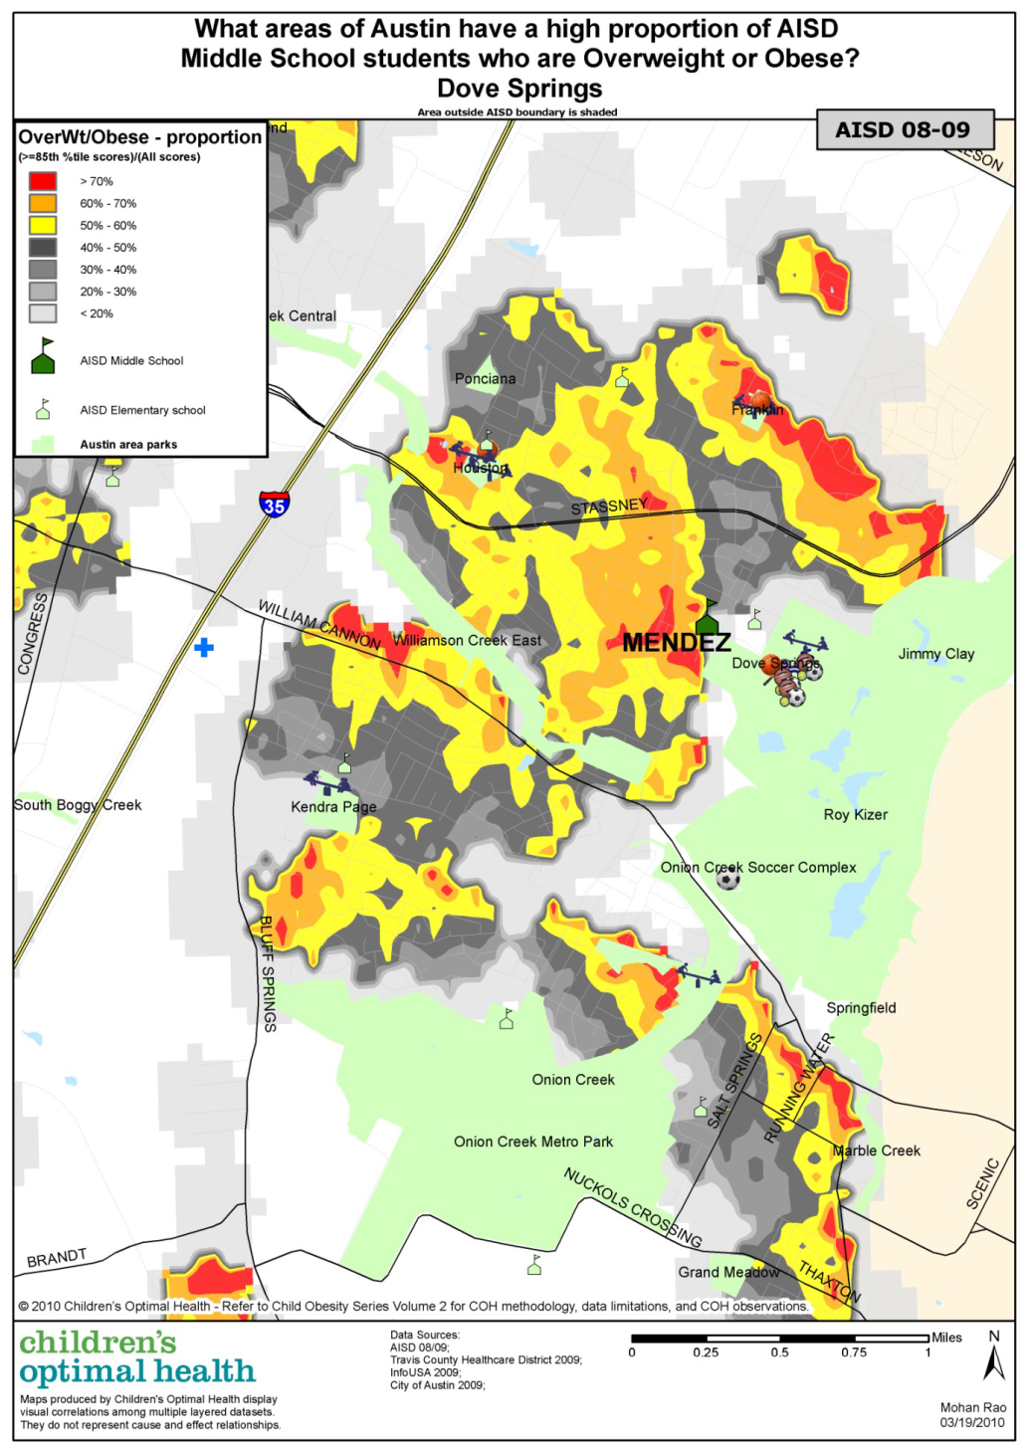
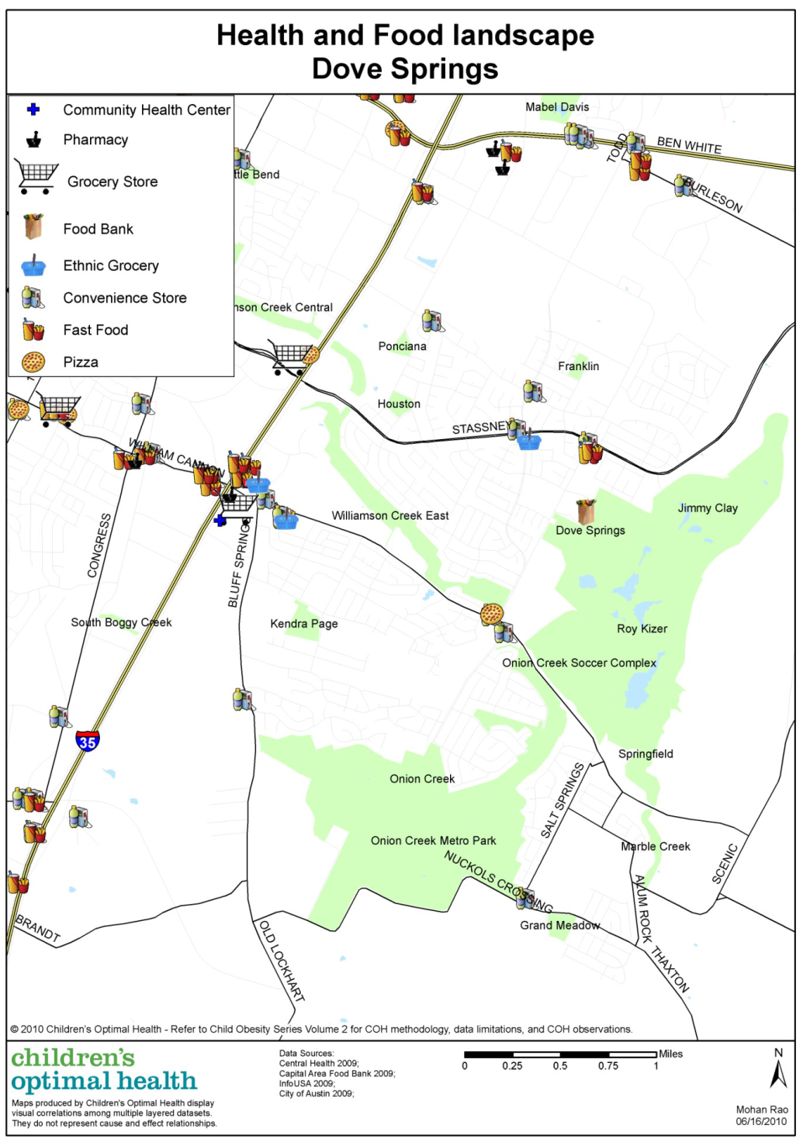
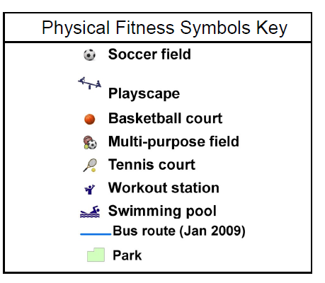
Understanding
the Problem
Notes:
[Taken from the Austin COH website]
COH also zoomed in on neighborhoods (this is Dove Springs) and looked at other related issues like cardiovascular health (proportion map on left) and the health and food landscape in the area (map on right). - give example statistic from map
1) There appear to be very few food outlets located close to where families live.
2) There are only a few food establishments in the Dove Springs area that supply both fresh meat and fresh fruits and vegetables.
3) There appears to be a large amount of green space in this area but not all of it may be accessible for recreational use and appropriate for children to play in.

Slide 12
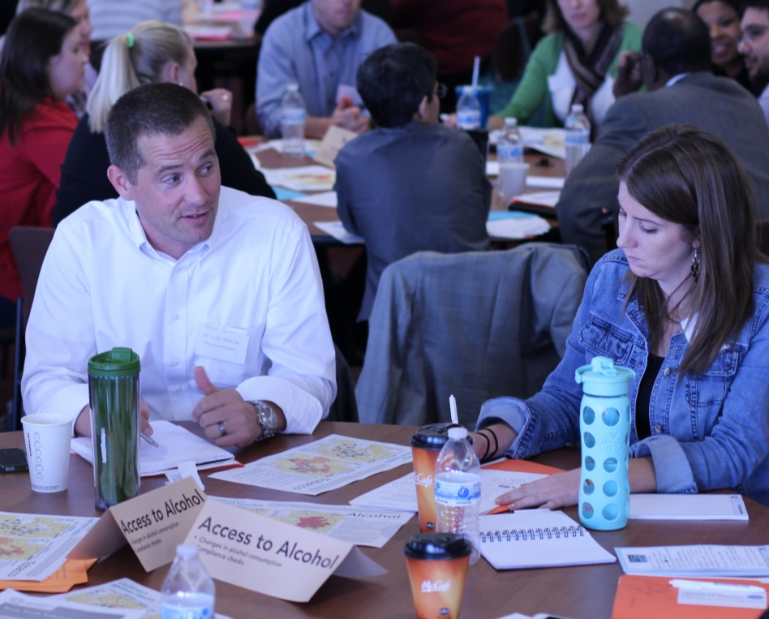
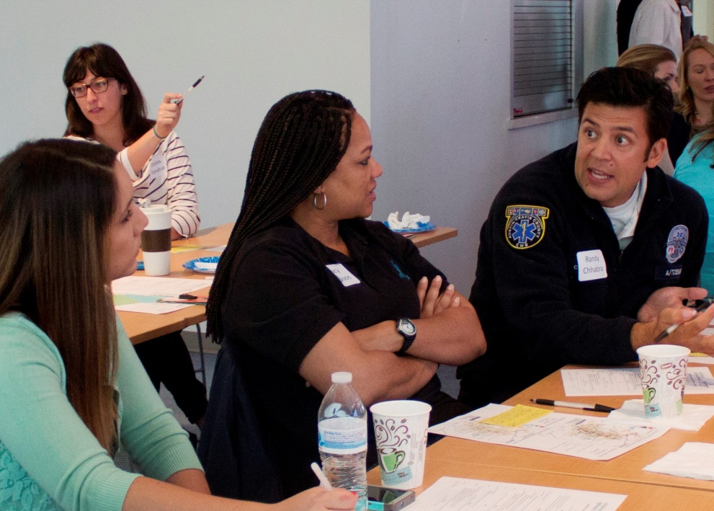
COH Community Summit
Notes:
Format:
“Leave your title at the door.”
Guest speaker – experts like head of the trauma center
Presentation of analysis (primarily maps while I’ll discuss in a minute)
Panel that brings in different voices across issue domains – health, education and across sectors (NP, school agencies, juvenile justice people, advocacy and service groups). For example, in the session on maternal and infant health, an advocacy group help identify a panel of Hispanic and African-Amer. women who had bad experiences with the formal health care providers and talk about why they did not seek OB care. This also helps foster cultural sensitivity.
Small group discussion (4 to 8 people)
Breakout groups – also planned with thought – thematic tables (note “access to alcohol” tent in pic), neighborhood tables, etc. but always the ability to create your own group.
No assignment, but encourage mixing (EMS person in pic)

Slide 13
Operational & Policy Changes
Targeted allocation of resources by City and County to neighborhoods of highest need
City planning added sidewalks and hike/bike trails in neighborhoods with greatest need
AISD School Board includes student health as a core value
Improved physical education and health curriculum in schools
Improved awareness and advocacy around importance of school recess
Notes:
They took a look at how city resources were spent across neighborhoods
Public resources to the neighborhoods – focus on built environment
School system explicit recognition that kids need to be healthy to learn
- Need for PE, recess and health education
Brought more resources –eview case study for outcomes incl fndn funding to expand programs

Slide 14
The NNIP Network

Slide 15
Obligations: Doing the Work at Home
Building and operating information systems with integrated and recurrently updated data on neighborhood conditions
Facilitating and promoting the direct practical use of data by community and city leaders for community building and local policy making
Emphasizing the use of information to build the capacities of institutions and residents in distressed neighborhoods
Notes:
Is this repetitive from the beginning?
Where to mention that all the partners are funded locally?
When organizations go through the application process & are accepted, they commit to three core principles in the work they do locally

Slide 16
Obligations to the NNIP Partnership
Add publications and activities to the NNIP website
Data holdings, analysis, dissemination
Participate actively in work of the Partnership
Best efforts to attend all meetings, conferences, workshops
Make presentations to partners, participate in peer learning
Participate in network planning for specific issues
Update Urban staff via phone on local work twice per year
Promote NNIP principles
Note and promote affiliation with NNIP and its principles in local work and professional activities
Notes:
NNIP is a peer learning network so it’s essential that partners are active participants in the network.

Slide 17
NNIP Leadership Management and Development
2015 Executive Committee
Mark Abraham, New Haven
Bob Gradeck, Pittsburgh
Jeff Matson, Minneapolis
Sheila Martin, Portland
Eleanor Tutt, St. Louis
Max Weselcouch, New York
Executive Committee Duties
Plan partnership activities
Monitor performance of activities
Review/determine policies of the partnership
Notes:
At Urban, we coordinate the network activities, but there is alos an elected Executive Committee.
MENTION UI STAFF – POINT TO CONTACT LIST IN THE BINDER
Mention alumni network?

Slide 18
Joint Work Program– NNIP Partnership
Advance the state of practice
Informing local policy initiatives
Developing tools and guides
Build/strengthen local capacity
Developing capacity in new communities
Services to an expanding network
Influence national context/partnering
Leadership in building the field
Notes:
KP will talk more about this Thursday morning
1. And inform local and national policy

Slide 19
NNIP Cross-site Projects
Topic | Years | Funder
Civic Data & Tech | 2015-17 | John D. and Catherine T. MacArthur Foundation
Integrated Data Systems | 2013-15 | Annie E. Casey Foundation
NNIP and Open Data | 2012-14 | John D. and Catherine T. MacArthur Foundation
Kids and Foreclosure | 2009-12 | Open Society Foundation Annie E. Casey Foundation
School Readiness | 2007-10 | Annie E. Casey Foundation
Foreclosure Crisis | 2008-09 | Fannie Mae
Guiding Land Markets | 2004-08 | Brookings Institution
Reentry Mapping Network | 2001-04 | Annie E. Casey Foundation National Institute of Justice
Older: Neighborhoods and Health, Welfare-to-Work
Notes:
Don’t talk through individual....
One of the ways we hope to influence local policy is through cross-site projects
Note IDS session – often selected through competitive process

Slide 20
Current Network Funding
Annie E. Casey Foundation
General Support/Meeting Costs
Cross-site project on Integrated Data Systems
John D. and Catherine T. MacArthur Foundation
General Support/Meeting Costs
New project on civic data/tech
Notes:
[ADD SLIDE ON HOW TO STAY IN TOUCH – NNIPNews – other CIC, APDU, etc.)

Slide 21
Connect at www.NeighborhoodIndicators.org or @NNIPHQ
Kathy Pettit: kpettit@urban.org; 202-261-5670
Leah Hendey: lhendey@urban.org; 202-261-5856
Notes:
You have your packets which has the agenda for the next three days.
Feel free to ask any questions.

