Slide 1
Better Data. Better Decisions. Better Communities. An Introduction to the National Neighborhood Indicators Partnership (NNIP)
St. Louis NNIP Meeting
April 2 – 4, 2014
Notes:
Introductions...
Today’s presentation – informal, most will sound familiar to staff in partner orgs
Some slides will be repeated in tom’s quick opening presentation, but here go slower – chance to ask questions
NNIP local partners
NNIP partnership
Local stories

Slide 2
National Neighborhood Indicators Partnership (NNIP)
Collaborative effort since June 1995
First meeting of UI and first six local intermediaries to discuss partnership
Atlanta, Boston, Cleveland, Denver, Oakland, Providence
Several funded in 1980s by Jim Gibson through Rockefeller’s Community Planning and Action Projects
June 1996 – UI assessment completed, report published, partnership funded

Slide 3
National Neighborhood Indicators Partnership (NNIP)
1997: Washington, D.C.
1999: Baltimore, Indianapolis, Miami, Milwaukee, Philadelphia
2002: Camden, Chattanooga, Des Moines, Los Angeles, Louisville, New Orleans, Sacramento
2003-05: Seattle, Nashville, Columbus, Dallas, Memphis
2006-07: Grand Rapids, New York, Minneapolis
2008-09: New Haven, Pittsburgh, St. Louis, Detroit
2010: Portland, Kansas City, San Antonio
2012: Austin, Pinellas County... And more to come

Slide 4
LOCAL PARTNERS IN NNIP The defining functions
Building and operating information systems with integrated and recurrently updated data on neighborhood conditions
Facilitating and promoting the direct practical use of data by community and city leaders for community building and local policy making
Emphasizing the use of information to build the capacities of institutions and residents in distressed neighborhoods
Notes:
-

Slide 5
NNIP Success Requires Three Innovations
1) Data and Technology
People relate to data analysis at the neighborhood level.
2) Institutions
Long-term and multifaceted interests
Positioned to maintain trust of data providers and users
3) Progressive Mission: Information for Change
Democratizing Information
Notes:
Technology is only one of the innovations - Problems are not evenly distributed across cities and Priority issues vary across neighborhoods
********
Geography Matters - City-wide trends not helpful for action
Maps are powerful for engaging people. GIS has the power to show relationships – not necessarily statistical cause and effect, but co-existing conditions like vacant housing and crime, obesity and lack of grocery stores or exercise opportunities. Allows you to ask new questions.
Partners generally receive information at the address level and aggregate to varying levels of geography depending on the audience and issue at hand.
Partners cover many issues, recognizing residents don’t experience their community in silos (see list)
They obtain data incrementally – not all partners have everything. (Data inventory)
***************
More important innovation– new institutions in civil society -
Mostly outside of government, often stand-alone nonprofit, university centers, or alliances
But partner with resident groups, nonprofits, government, and other stakeholders
Home Matters –
“Intermediary” – Local Infrastructure
Institutions range from 1-person shop in donated office space to large univ. centers like Polis
Some distance from political forces – not one mayor’s project
Long-term stake in community (versus out-of-town consultants or one-off projects)
Handle data and analysis with integrity & Don’t mislead with maps, Pay attention to confidentiality issues
*************
Paired with progressive missions – using information as a means to empower communities and improve neighborhood conditions

Slide 6
Shared Mission: Information for Change
But a central focus on strengthening, empowering low-income neighborhoods
Work for many clients
Technical assistance to nonprofits
Informing city’s service provision
Market analysis for local retail
Information as a bridge for collaboration among residents, public agencies, nonprofits, businesses
Notes:
Partners are very different in many ways, but we share a set of key principles
Agreed to take on the role of facilitating and promoting the direct practical use of data by community and city leaders in community building and local policy making. Not only writing journal articles.
Systems on the shelf don’t sustain support. A colorful map will be admired, but will not be enough unless it leads to greater understanding or new conversations.
Giving emphasis to using information to build the capacities of institutions and residents in distressed neighborhoods
Importance of interacting with stakeholders around the data – new way to begin conversations

Slide 7
Obligations to the NNIP Partnership:
Continue to meet NNIP standards at home
Perform the basic NNIP functions in full
Submit documentation on accomplishments/lessons
Twice per year – data holdings, analysis, dissemination
Participate actively in work of the Partnership
Best efforts to attend all meetings, conferences, workshops
Make presentations to partners, participate in peer learning
Participate in network planning for specific issues
Promote NNIP principles
Note and promote affiliation with NNIP and its principles in local work and professional activities

Slide 8
Data-Driven Organizing in Pittsburgh’s Homewood Children’s Village
Thanks to Samantha Teixeira & Dr. John Wallace, Jr.
and Bob Gradeck for slides and story
Notes:
Story from our Pittsburgh partner – most of the work was in 2010 – give credit to PNCIS and individuals.
Dr. Wallace led the HCV at the time of this work in 2010.

Slide 9
The Village Approach
Follows the Promise Neighborhood model
Began with “1,000 conversations” to hear residents’ concerns
Learned that vacant and abandoned properties were one of Homewood’s key challenges.
Notes:
Homewood Children’s Village is modeled after the Harlem Children’s Zone, which inspired the Promise Neighborhood movement.
The model emphasizes: engage residents and build community, use proven programs, touch all the children in the neighborhood, and evaluate how things are going along the way.
Homewood is a neighborhood on the far eastside of Pittsburgh, with about 9,200 residents. In addition to a child poverty rate that exceeds 50%, Homewood also has some of the highest violent crime rates and share of vacant and blighted properties.
[http://www.homewoodchildrensvillage.org/aboutus/missionvision/]
Began with listening to the parents about what they wanted to change in their community. Spoke with more than 1000 people to help prioritize their actions.
Housing conditions may not be the first thing that comes to mind for a child intervention, but the Village leaders recognized that their children and families need healthy neighborhoods to thrive.
For example, a brand new school had been built, but kids had to walk by unsecured homes or detour into the street when the sidewalk was overgrown.
On a neighborhood level, abandoned and problem properties attract crime and squatters. They also send an overall message that the neighborhood isn’t kept up.

Slide 10
PNCIS Partnership in HCV Neighborhood Assessment
Research Review & Design
Data Collection & Integration
Data Visualization: MAPS!
Training
Analysis
Policy Action
Notes:
Once they identified the issue, the leaders reached out to our partner in Pittsburgh and came up with this plan.
Research Design: Contacted NNIP partners to review and ID existing property survey instruments including building inspection protocols and neighborhood assessment surveys
Data Integration: data integration strategy (Setting data collection and entry process up so that it could easily be integrated into the PNCIS system). They could them create maps that integrate the community-collected data with other PNCIS data like crime info and code violations
Training: Trained students and community organizing staff to use the results, got into the data driven mindset.
Data Analysis/Community Action: Look at patterns and identify policy mechanism to take action

Slide 11
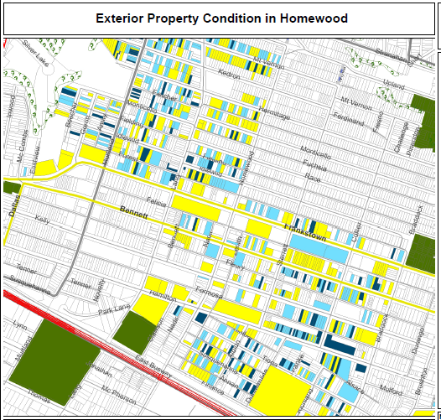
Legend
Exterior and Paint
Good
Fair
Poor
N/A
Notes:
They used the assessors file as the backbone of the system (with property ID, basic characteristics, ownership, and tax delinquency )
Student and residents implemented the property survey, noting the condition of each home.
Here is a map of the resulting data - Yellow is good, light blue is fair, dark blue is poor.
Map was shared and used for data driven organizing and presenting to block clubs.
[check with PNCIS – this is hypothetical or actual? Before and after assessments (does a block club affect the physical condition of a block? etc. ]

Slide 12
Data Driven Organizing
Homewood’s Dirty Thirty:
Used joint database to identify worst properties in the neighborhood
Mobilized residents to call the 311 Response Line and advocate for boarding up the properties
23 of 30 properties were boarded up, torn down, or otherwise improved within about a month
Notes:
Together they came up with a collective action plan. Their data identified properties that were vacant and open to entry. They worked with residents to agree on the worst 30 properties in the area.
Residents in neighborhoods like Homewood have reasons to be skeptical about receiving good city services.
But as the group and armed with the data, they were willing to engage with the system. Within 1 month, more than ¾ of the properties had been attended to.

Slide 13
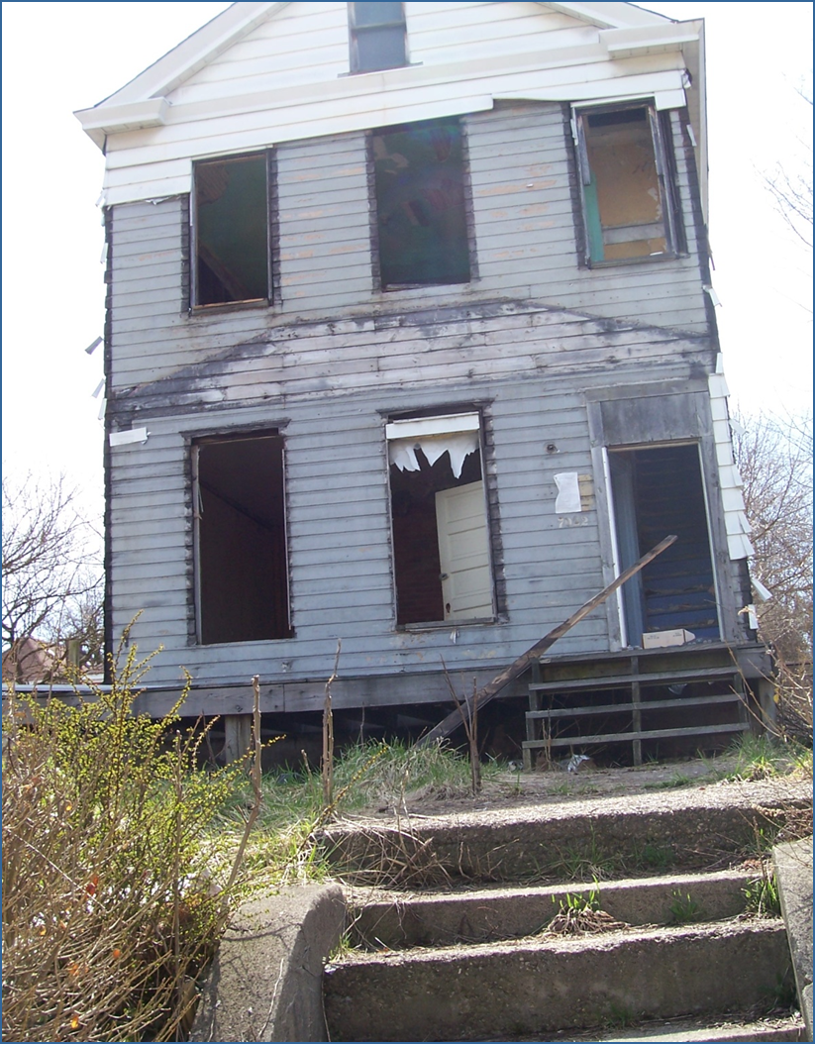
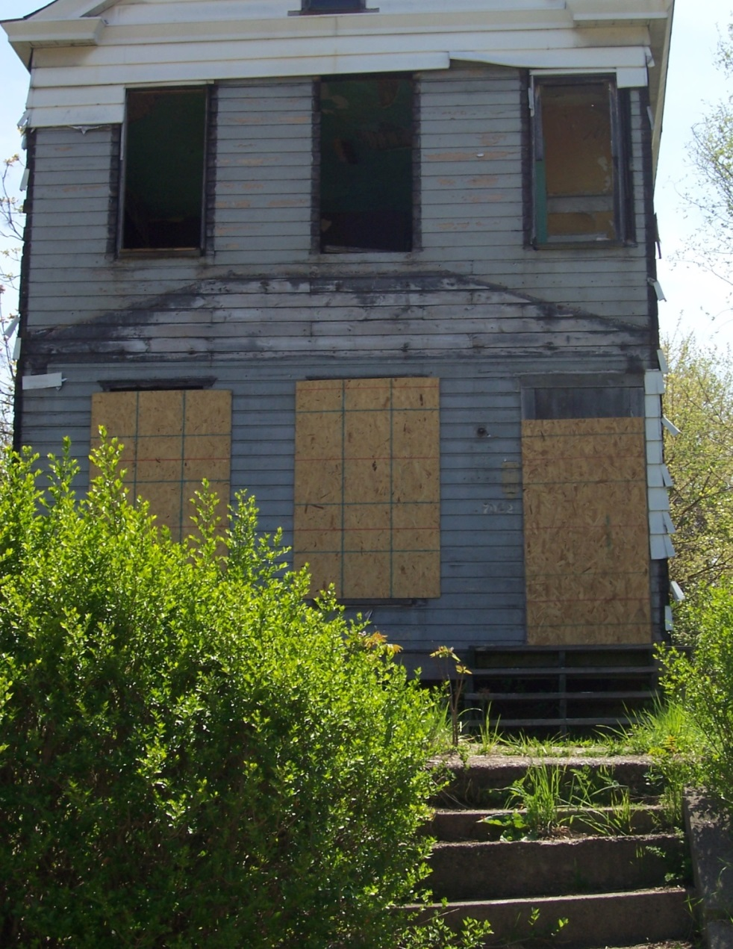
Before
After
Notes:
Here is an example of a property secured by the city

Slide 14
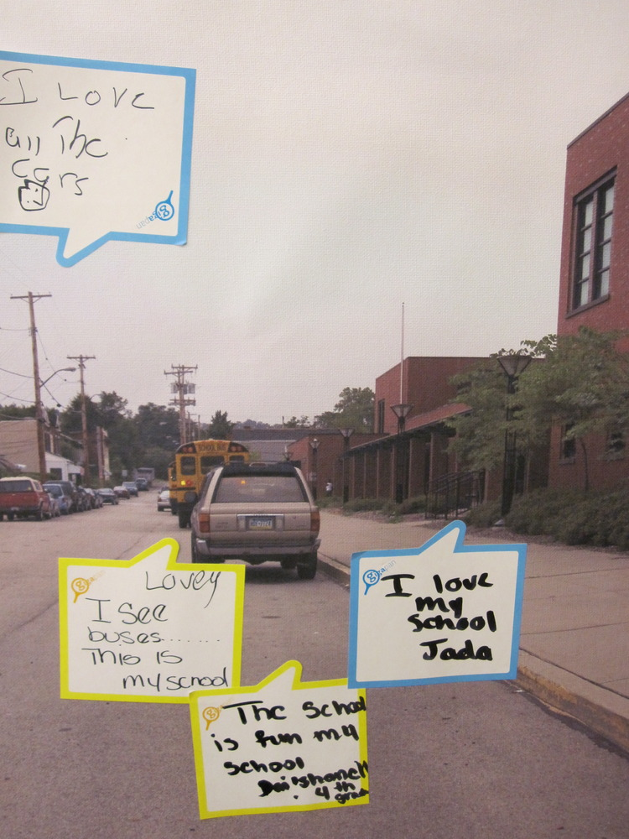
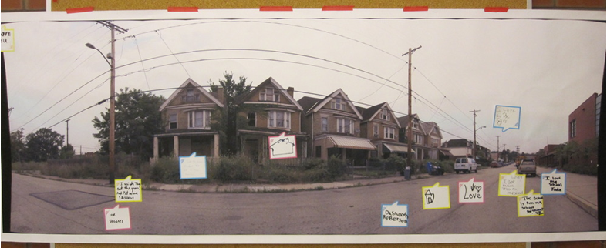
Gigapan
Document neighborhood conditions
Collect input from residents
Notes:
PNCIS recognizes that quantitative data does not capture everything that is important. They use photos to document baseline conditions and the neighborhood as it changes.
They engage school children to talk about what is good and bad about their neighborhood

Slide 15
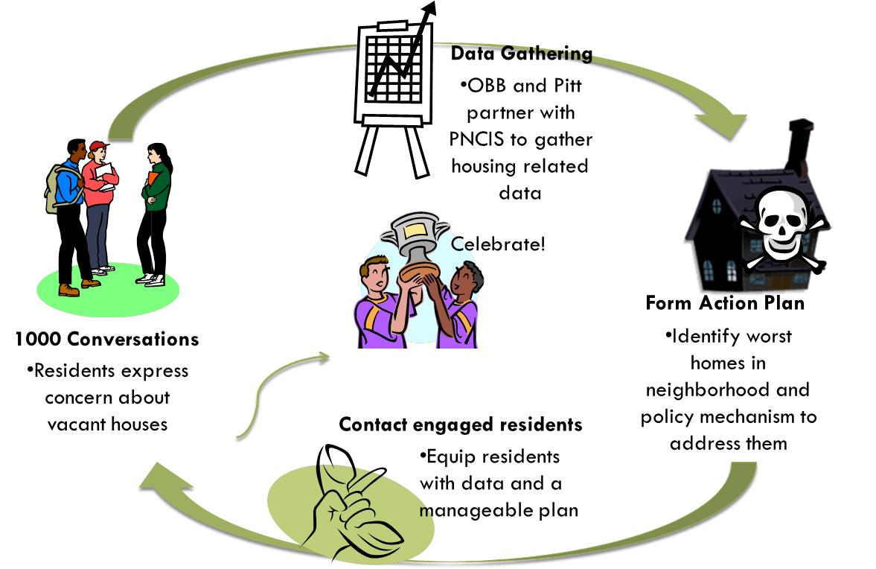
Notes:
So here’s a recap of their process
[walk through steps on slide]
PNCIS partnered with them in all the stages, but the data was nested in a change initiative and directly relevant to their work.

Slide 16
Impact
Bring resources back to the neighborhood to help children and families
Improve built and physical environment
Make the neighborhood a safer place for children
Strengthen residents’ capacity for action
Notes:
Short-term – bring city investment into the ngh and secure the individual properties so that its safer for children (both physical safety and less crime)
Just as important, residents learned they could take collective action to improve their neighborhood
Long-term - improving abandoned homes helps image and raises property values
This is not just a one-time project. Organizations in the community (Operation Better Block) are still accessing the data from the Website – they’re working on a neighborhood plan with the trained their staff
Update as of 6-2013 – PNCIS continues to work with the Children’s Village and provide information in support of property acquisition efforts. They are also discussing new work on a cross-disciplinary health project.
[Note: would be good to find out if the survey data has been/will be updated]

Slide 17
Using Neighborhood Indicators to Identify Need for Youth Services in Indianapolis
INDICATORS IN ACTION:
Notes:
Credit the Polis Center in Indianapolis for both the work and the slides.

Slide 18
Marion County Commission on Youth
EIP Goal:
Reduce the number of children entering the county’s child welfare and juvenile justice systems by improving the coordination of youth services in Marion County.
Co-location of Services:
Organizations serving youth and families in Marion County will partner with community organizations, such as neighborhood centers, schools and churches, to offer various supportive services at common access points.
Notes:
Our partner in Indianapolis is working with the Marion County Commission on Youth (MCCOY) using neighborhood-level data to support their county-wide early intervention and prevention initiative. They are trying to find the best place to co-locate services.
[Additional background: This story started several years ago when the county council commissioned a study on reducing the number of kids in the juvenile system. As part of the assessment and strategic plan they recognized that families were having trouble accessing services – both due to transportation and having to go to several different offices for various services. The report recommended an effort to co-locate services and the Marion County Commission on Youth (MCCOY) was asked with this challenge.]

Slide 19
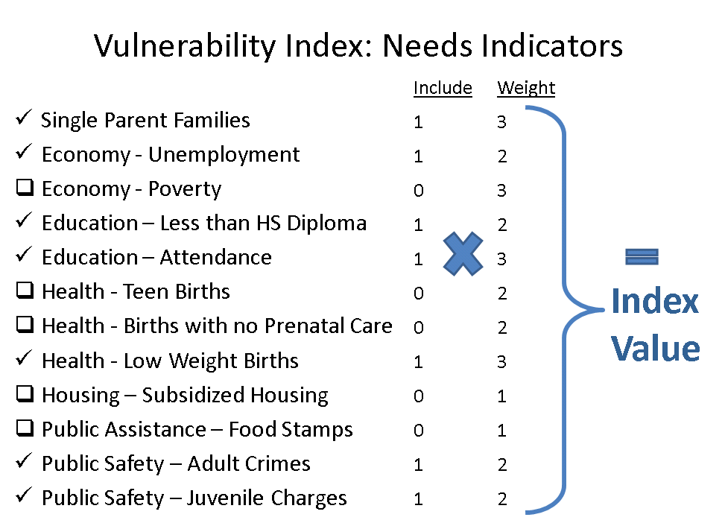
Notes:
The question remained about where to locate such a facilities and which areas had the most need for services. They created a Vulnerability Index and developed weights on the importance of the indicator as a measure of need through consensus among the commission members.

Slide 20
Vulnerability Index
Least Vulnerable
(Lowest Need Areas)
Most Vulnerable (Greatest Need)
Notes:
The end result was a simple way to communicate multiple conditions, an index from 0-26 to indicate the most vulnerable areas.

Slide 21
Notes:
This is the first version of the index – darker colors indicate more need. But this did not narrow it down enough; there were still too many neighborhoods to choose from.

Slide 22
Notes:
The second version flagged tracts that were 2 standard deviations above the county average (versus 1) and did a better job about highlighting the neediest areas.

Slide 23
38th Street
Notes:
conducted a gap analysis, and narrowed down to 2 neighborhoods.
This maps zooms to the center of the map on the previous page and shows Center Township. Their next step was to map existing human services. The committee worked to narrow down lots of asset categories to these couple dozen. There were not a lot of assets in the darkest blue areas and they chose the South East neighborhood and Haughville to work in.

Slide 24
Notes:
They mapped all of the assets in the neighborhoods and met with neighborhood and CDC leaders to engage them in the process - to validate their findings and more importantly to get involved with MCCOY as partners in this process to improve their neighborhood resources.
Accessibility – sidewalks, bus routes
Strategic planning process results:
We need access points that exist within communities, will eliminate some of the transportation barriers and increase immediate access to services
Need more partnerships and collaborations
Need opportunities to partner, share resources and apply for joint funding

Slide 25
Notes:
This area expanded after the community recognized the same assets were just outside the boundary. (blue lines are bus lines)
In February 2012 The Polis Center team met with several community members that we were hoping to recruit for the executive advisory board. They presented their work up to that point to the group and it sparked a lot of good discussion. The group included people from:
Gov’t zoning & planning people. They know some nice tidbits like the fact that if you want to do something like methadone treatment you have a certain zoning variance.
real estate people (they know where some available buildings might be and how to write contracts for leases)
Schools, churches, and other organizations that have existing programs or may want to locate new programs in a colocation building. The desire has never been to compete with these other organizations but to collaborate with and complement them.
From SAVI’s case study : http://savi.org/SAVI/CaseStudies.aspx
“The data from SAVI combined with an in-depth market assessment to determe program and sercies willing and able to co-locate in the near west or southesat, as well as input from community organizaions and the task force ultmately lead to McCoy’s selection of one of the neighborhoods.”
“At the end of 2012, MCCOY selected the Near Westside [Haughville] neighborhood as the site for the center and is now prepared to begin the process of identifying real state opportunities and funders to support the construction and implementation of the center.”
As of 3/2014:
Unfortunately, we still don't have a specific location yet. We're continue to focus on program design while looking for the real estate.

Slide 26
NNIP Leadership MANAGEMENT AND DEVELOPMENT
2014 Executive Committee
Todd Clausen, Milwaukee
Jeff Matson, Minneapolis
Sheila Martin, Portland
Kurt Metzger, Detroit
Eleanor Tutt, St. Louis
Max Weselcouch, New York
Executive Committee Duties
Plan partnership activities
Monitor performance of activities
Review/determine policies of the partnership
Notes:
MENTION UI STAFF – POINT TO CONTACT LIST IN THE BINDER

Slide 27
JOINT WORK PROGRAM – NNIP PARTNERSHIP
Advance the state of practice
Informing local policy initiatives
Developing tools and guides
Build/strengthen local capacity
3. Developing capacity in new communities
4. Services to an expanding network
Influence national context/partnering
5. Leadership in building the field
Notes:
TOM WILL GO THROUGH EACH OF THESE IN DETAIL IN THE FIRST SESSION

Slide 28
NNIP MILESTONES
1999 – cross-site work on welfare reform complete, first guides/reports published
2003 – cross-site work on health complete, expand role of Executive Committee
2006-7 – cross-site work on parcel-level data and prisoner reentry complete, school readiness & success project begun
2008-9 – launched cross-site work on foreclosures, children & foreclosures, Shared Indicators projects begun
2010 – school readiness project complete
2011 – children and foreclosures project complete, launched new website!
2012 – launched Open Data project and Alumni Network, developed NNIP Strategy Paper
2013 – launched Information Campaign; cross-site work on IDS begun
Notes:
Don’t talk through....

Slide 29
CURRENT FUNDING
Annie E. Casey Foundation
- General Support/Meeting Costs
- Cross-site project on Integrated Data Systems
John D. and Catherine T. MacArthur Foundation
- General Support/Meeting Costs
- Support for NNIP “Information Campaign”
- Grant for book “Strengthening Communities with Neighborhood Indicators”
- Grant to explore NNIP’s role in the Open Data movement

Slide 30
Kathy Pettit: kpettit@urban.org 202-261-5670 Leah Hendey: lhendey@urban.org 202-261-5856
Contact information
Notes:
Deleted previous slide 4-2014
Stay in touch
Email Brianna at blosoya@urban.org to join groups.
For everyone
NNIPNews – general listserv for anyone interested in Neighborhood Indicators
Website – www.NeighborhoodIndicators.org
For partners
“Partners-only” access to web site – sites can add own users
NNIP “Key Partners List” – UI distribution list for partner business/announcements
NNIP Google Group – Partner and UI staff discussion group

