Slide 1
What Can the NNIP Website
Do for You?
The uses and tools of NeighborhoodIndicators.org
Kait Franks and Amos Budde
The Urban Institute
The National Neighborhood Indicators Partnership Conference
March 1, 2012 – Portland, OR

Slide 2
IGNITE!
All This In 5 Minutes…
We have a site? Yes!
“What does that mean for me?”
The “Golden Rule” of information sharing
Local / National Credibility

Slide 3
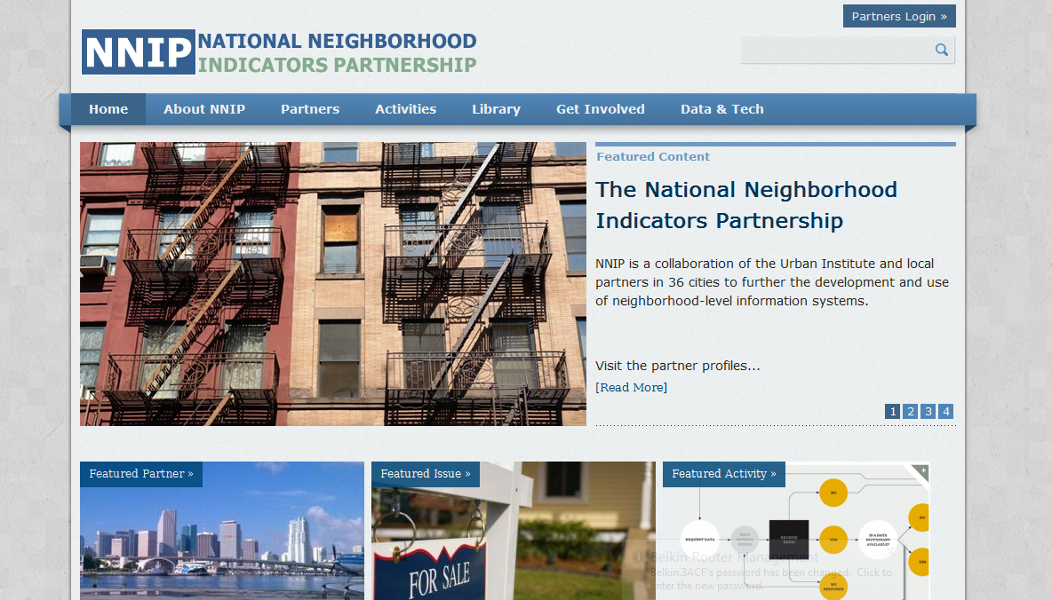
We have a website!!!
It has tons of useful information…
Notes:
On the work you’re doing
Such as the interesting publications you’ve released and the fantastic activities you’re doing in your community

Slide 4
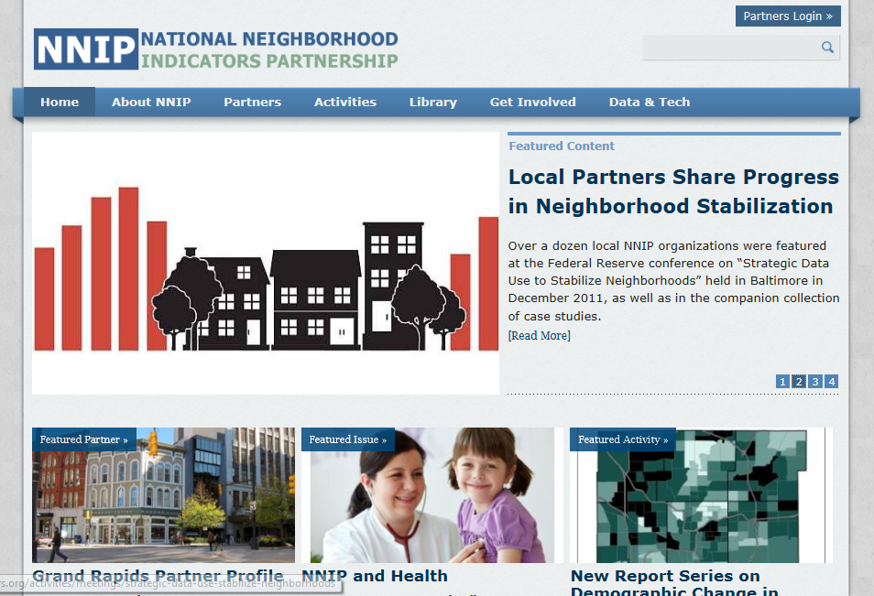
…which comes for YOU.
So log on.
Notes:
But we only know about it when you tell us. And while we can add some information, the best source is from you the partners, so log on!

Slide 5
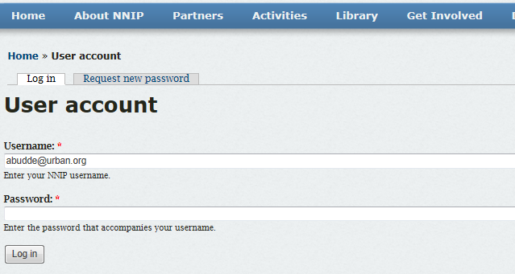
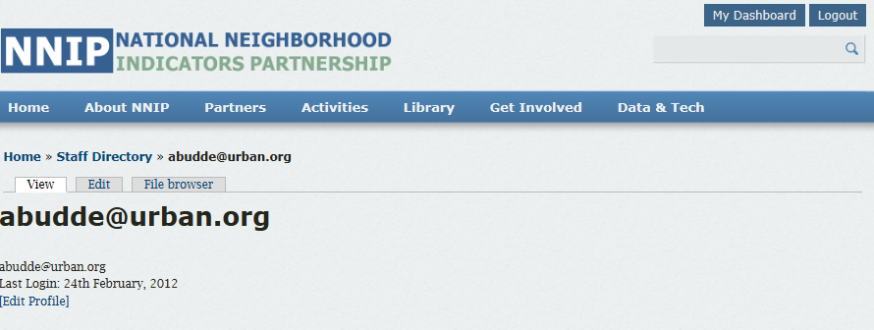
It’s fairly simple.
Notes:
You should have received your username and password, and if you didn’t email us.

Slide 6
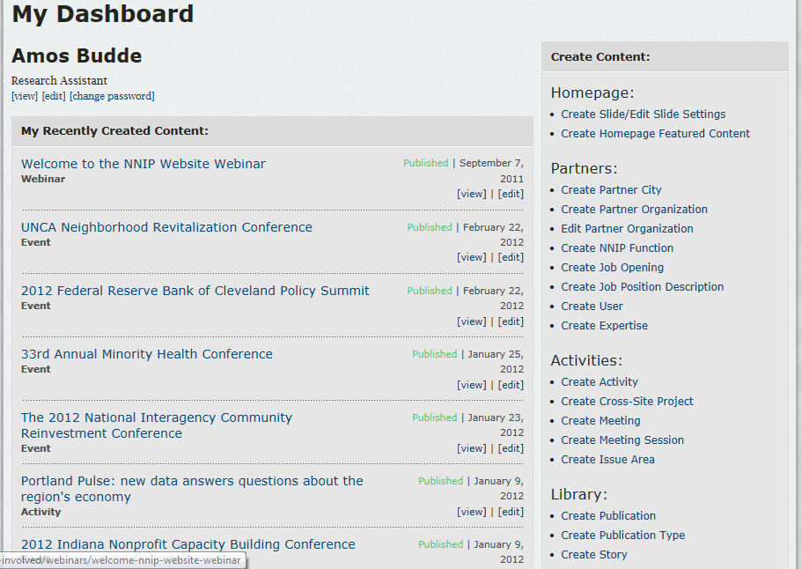
Add an activity or a publication.
Notes:
You can add an activity or publication easily from your dashboard.

Slide 7
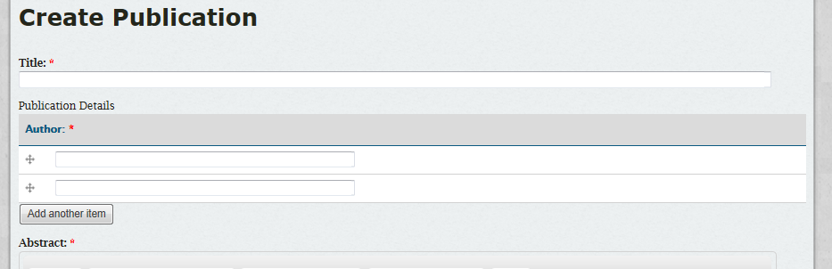
Title
Author
Abstract
Date
Links
Reference to Other Content
Publication Type
Issue Area Tags
Data Source Tags
Notes:
For a publication, all you need are the title, author…, and the content…

Slide 8
“Golden Rule” of Information Sharing:
The more information you share, the more useful the site will be.

Slide 9
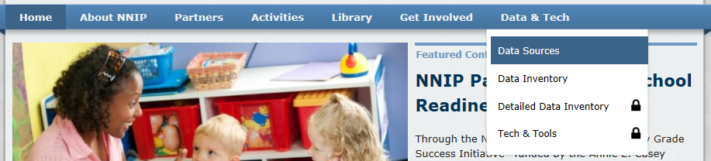
  So what can you learn from the site?
“Has anyone in the partnership worked with this data set?”
“Has anyone in the partnership worked on this issue area?”
“Who has this expertise?”
“What was the name of that awesome person gave that great presentation at the Spring 2012 NNIP Meeting?”
Notes:
Do you ever find yourself asking these questions? Or asking Kathy these questions?

Slide 10
Issue Areas Data Sources
Absenteeism
Affordable Housing
Children
Comprehensive Community Development
Comprehensive Community Indicators
Education
Employment
Equity
Food and Nutrition
Foreclosures
Health
Housing
Housing Markets
Mobility
Open Data
Prisoner Reentry
Promise Neighborhoods
School Readiness
Sustainable Communities (Federal)
Transportation
Vacancy
Others
American Community Survey
Births/Natality
Deaths/Mortality
Decennial Census 2000
Decennial Census 2010
Hospital Records
IRS Individual Tax Statistics
Local Employment Dynamics
National Center for Education Statistics
Property sales/assessment
Student enrollment
Student proficiency
USPS Vacancy Data
ZIP Business Patterns
Others

Slide 11
How does it benefit my organization?
Local level strength
NNIP Partners are lifted up as a model for local data users nationwide
National dissemination of your organization’s work
Attract interested parties from around the country to your site
Notes:
Local level –
NNIP Partners are being lifted up as a model for local data users nation-wide
Attracts interested parties people entire country to your site via your publications, activities, etc…
Strengthens potential for funding
National Level - Increased awareness of NNIP
Better understanding of what we do
Increased potential for cross-site fundin

Slide 12
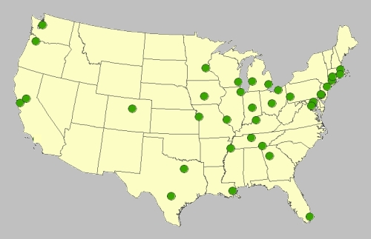
And build the NNIP brand
Increased potential for cross-site projects, and cross-site collaboration
Increased awareness of NNIP, the importance of local information systems, and the work we do with them

Slide 13
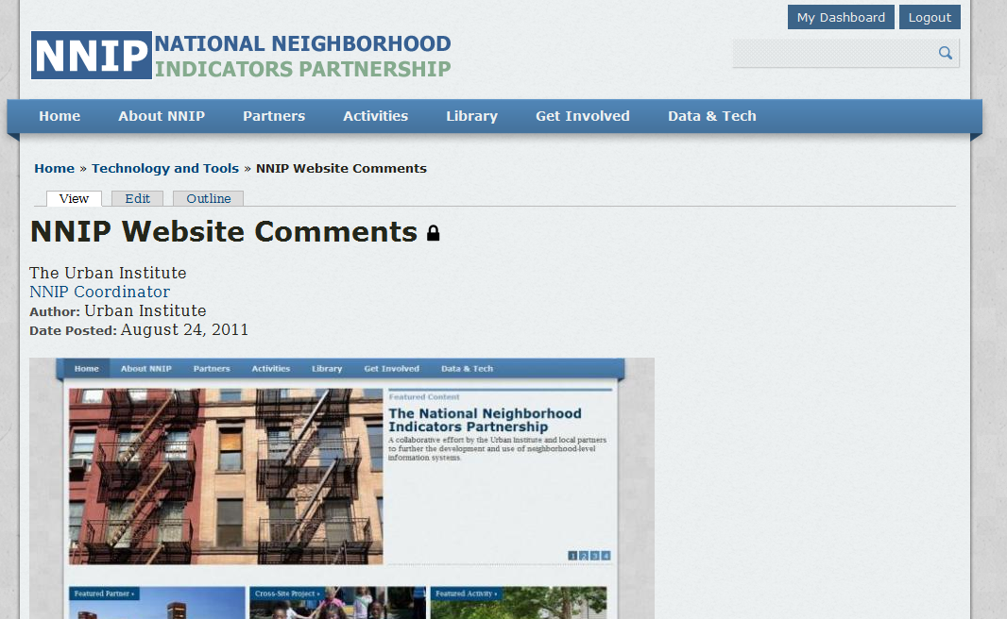
Questions? Comments? Suggestions? Confusion?
Email us!
kfranks@urban.org
abudde@urban.org

