Slide 1
The demolition-foreclosure-equity connection
Michael Schramm
Research Associate, Center on Urban Poverty and Community Development, Case Western Reserve University
Michael Schramm, Director of IT and Research
Cuyahoga Land Bank

Slide 2
* Most of this presentation was created by the Thriving Communities Institute at the Western Reserve Land Conservancy for a Cleveland City Council hearing and briefing

Slide 3
Research Team
Griswold Consulting Group
Case Western Reserve University
Center on Urban Poverty and Community Development
Cuyahoga Land Bank
Calnin Consulting Services
GeoDa Group – Luc Anselin (Arizona State University – Spatial Weights Matrix)
Western Reserve Land Conservancy – Thriving Communities Institute

Slide 4
Primary Purposes of Study
Conduct objective research to test the hypothesis that strategic demolition reduces mortgage foreclosures.
Determine how property values are impacted differently by vacant lots and by distressed properties.
Leverage objective evidence based on findings to support an argument to the U.S. Treasury and White House Economic Advisors that would permit re-allocation of a portion of TARP housing funds for demolition of blighted properties.

Slide 5
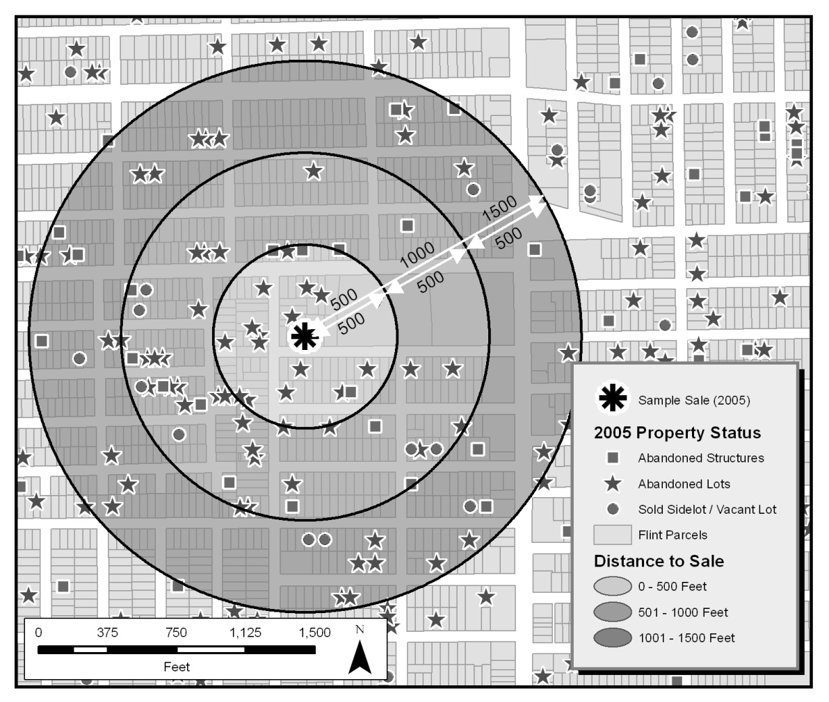
Original Study
Genesee County Land Bank: 2003-2005 (Michigan) [pre real estate crash]
Unique Dataset
Tax-foreclosures
Demolition
Vacant Lots
Counterfactual: Valuing an Urban Demolition Program
435 Demos = $3.5 million
$112 million equity hedge
Value of Investment-Based Programs?
Data Issues

Slide 6
Data Sources
NEO CANDO
Property transfers – County Fiscal Office
Demolitions – municipalities, land bank
Foreclosure filings – Common Pleas Court
Sheriff’s sales – County Sheriff
Tax billing file – County Fiscal Office
Postal vacancies – Semaphore United States Postal Service Address Scrubber
Property characteristics – County Fiscal Office
Quarterly snapshots of each distress indicator from Q2 – 2009 to Q1 – 2013
Distress counted within 500 foot buffer (“Generate Near Table” tool in ArcGIS)

Slide 7
Research Methods
Impact of Demolition on Mortgage-Foreclosure
Neighborhood Distress Index
Pattern-Based Model (Correlation)
Impact of Demolition on Real Estate Equity
Hedonic Pricing Theory
Sales-based valuation
Process-Based Model (Causation)
Predictive simulation

Slide 8
Evidence suggests demolition activity is beneficial in lowering mortgage-foreclosure rates across all neighborhood distress indices.

Slide 9
Submarkets
Place matters.
Cleveland area divided into 4 submarkets:
High functioning;
Moderately functioning;
Weak functioning;
Extremely weak functioning.
Notes:
Poverty levels, vacancy rates, incomes levels and gross rents at the Census Tract level from the U.S. Census Bureau 2010 Census. Property value impacts of proximity to amenities and disamenities can vary across housing submarkets.

Slide 11
Value Impact from Nearby Distressed Properties
Distressed Property Variable | High | Moderate | Weak | Extremely Weak
Vacant lot | -1.0% | -1.0% | -1.2% | *
Vacant structure | -2.6% | -2.2% | * | *
Mortgage foreclosed | -2.6% | -1.6% | +2.4% | +4.1%
Mortgage foreclosed & tax delinquent | * | -4.2% | * | *
Vacant & mortgage foreclosed | * | * | * | *
Vacant, tax delinquent & mortgage foreclosed | * | -8.6% | * | -7.0%
Tax foreclosed | -20.1% | -5.2% | * | *
Vacant & tax foreclosed | -10.8% | -6.5% | * | *
Tax delinquent | -3.8% | -4.0% | -3.6% | -1.6%
Vacant & tax delinquent | -8.6% | -5.1% | * | -2.8%

Slide 12
Findings: Impacts of Distress on Property Values
Different types of distress have different impacts on property value.
Turning distressed structures into vacant lots (demolition) often offers a real estate “equity hedge.”
Impacts of distress vary across submarkets.
Values in higher functioning submarkets are more sensitive to nearby property distress.

Slide 13
Findings: Cost-Benefit of Demolition
Submarket | Return on $1 of demolition
High Functioning | $ 13.45
Moderately Functioning | $ 4.27
Weak and Extremely Weak Functioning | ~ $ - 1*
ACROSS ALL MARKETS | $ 1.40
* Limited statistical significance on key distress variables in weaker submarkets limits predictive power related to demolition, thereby lowering robustness of findings.

Slide 14
Summary
Distressed properties negatively impact property values.
An equity hedge is often identified when distressed structures are turned into vacant lots (demolition).
Demolition of distressed properties has a greater benefit in higher functioning markets.
Evidence suggests that a reduction in foreclosures is related to demolition activity.

Slide 15
End Result Using Data = $$$$
$120 million in unspent federal funds freed up for Demolition (Treasury changed fund allocation based on preliminary study results, Summer, 2013)
$60 Million in Ohio
$100 Million in Michigan
Other states considering
Cuyahoga County considering $50 million in bond funds for demolition

