Slide 1

Integrated Data Systems for an Integrated Practice Model
NNIP Meeting
Providence RI
September, 2012
Notes:
1

Slide 2
Agenda
Origins/Purpose of IDS
Development of IDS
Building Blocks/Content of IDS
Challenges and Next Steps

Slide 3
Our story/everyone’s story
COMPAC 21
A Human Services Department
Human Services Integration Fund
IT to Support Systems
__________
Strong Leadership
Interest
Money
Analytic Capacity
Find the Pain

Slide 4
Multi-System Consumers
Persons served by DHS in 2010,
approximately 202,000 (unduplicated)
 | Under 18 years | 18 years and older
Served by one program office | 60% | 41%
Served by two program offices | 23% | 23%
Served by three program offices | 11% | 15%
Served by four or more program offices | 6% | 21%

Slide 5
DHS Structure
Marc Cherna
Executive Director
Department of Human Services
Terry Lane
Administrative Officer I
Patricia Valentine
Executive Deputy Director
Integrated Program Services
Randolph Brockington
Deputy Director
Administrative and Information Management Services
Karen Blumen
Deputy Director
Office of Community Relations
Erin Dalton
Deputy Director
Office of Data, Analysis, Research and Evaluation
Sue Martone
Acting Deputy Director
Office of Behavioral Health
Mildred Morrison
Administrator
Area Agency on Aging
Marcia Sturdivant-Anderson, PhD
Deputy Director
Children, Youth & Families
Reginald Young
Deputy Director
Community Services
Donald Clark
Deputy Director
Intellectual Disability
Jeanine Rasky
Manager
Multi-Systems Unit
JoAnn Heffron-Hannah
Manager
Independent Living Unit

Slide 6
Organizational Viewpoints
DHS provides an integrated set of services
Consumers are “Consumers of DHS”
Staff work for DHS
Program Offices were created for management purposes
Providers contract with DHS, not Program Offices
DHS data
Community resource

Slide 7
BUILDING BLOCKS
Common ID* ~
Common Intake ~~
Common Assessments ~~
Strong Source Systems* ~
Common Service Offerings *~
Common IT Architecture ~~
Common Practice Philosophy~~
Common Service Plan ~~
Common Payment System ~~
Common Training ~~
Common Program/Fiscal Monitoring ~~
Legal Analysis * ~
* Not optional
~ Stuff we have
~~ Stuff we’re working on
7

Slide 8
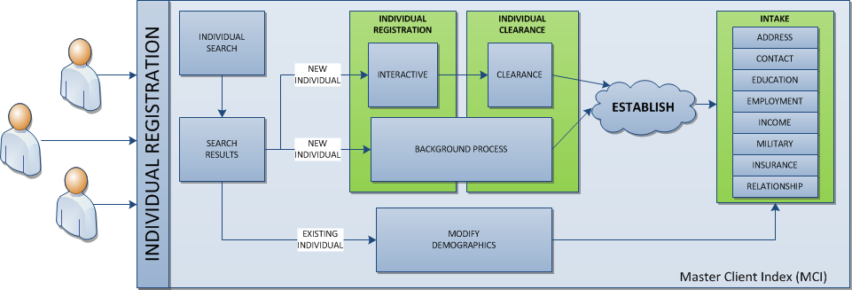
Common ID/Master Client Index
Master Client Index (MCI) is a enterprise repository of key client demographic data for individuals serviced by DHS
DHS applications use the MCI to uniquely identify a individuals serviced by DHS
Individuals are cleared against the database to determine if they are already known or if they are new individuals
Notes:
cut

Slide 9
Common Assessments
Child and Adolescent Needs and Strengths (CANS)
Adult Needs and Strength Assessment (ANSA)
Early Childhood Assessment (CANS-EC)
Ages & Stages
Criminal Justice Screening & Assessment Tools

Slide 10
Common Service offerings
Master Provider Enterprise Repository (MPER) is a enterprise repository of key Provider demographic data for all contracted, non-contracted providers who provide serviced for DHS
DHS applications use MPER to validate contract, services, facilities and rate information to facilitate documentation of services rendered information by Providers
Provider Demographics
Availability
Contracts
Contracted Services
Services
Service Code
Provider Contacts
Address
Facility
Individual
Allocation Statement
Services Description

Slide 11
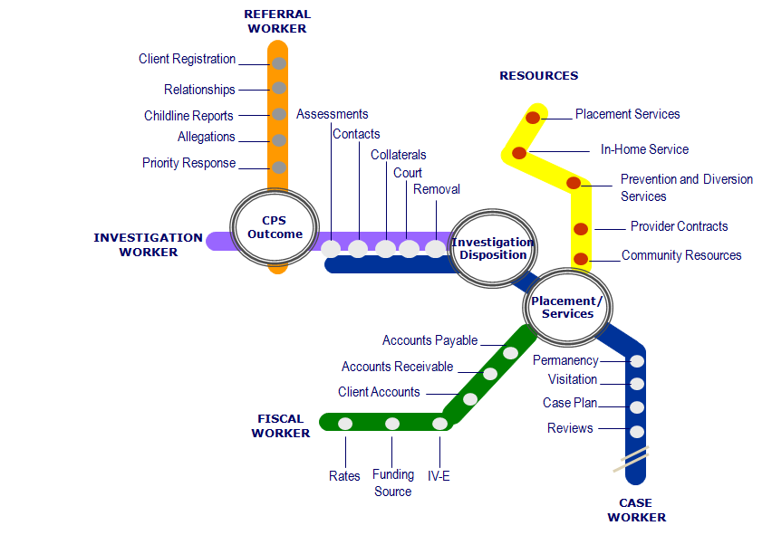
Child Welfare Case Management System (KIDS)
  The repository of record for real-time case management and service information for all CYF clients. KIDS also captures a log of all services rendered to clients regardless of whether the client is CYF active.
  It supports the daily child welfare business processes for the Children Youth and Families.
  It includes complete functionality which aligns initial client contact with a department through assessment, service delivery, provider payment and various client eligibility calculations.

Slide 12
ECAPS
ECAPS is a case management system serving adults and families and includes several assessment and service coordination modules. It primarily serves the DHS offices listed in the below diagram.
MODULES
Office of Community Services
Homeless Management Information Systems (HMIS)
Office of Behavioral Health
IRES
Mental Health Services
Psychiatric Tracking System
Executive Office
Maximizing Participating Project
Forensic Services
Client Registration
Assessments
Provider Management
Service Authorization
Services Rendered
Outcomes Management
FUNCTIONS
Master Client Index (MCI)
ECAPS
Master Provider Enterprise Repository (MPER)
Electronic Client and Provider System (ECAPS)

Slide 13
Jail Collaborative
The Jail Collaborative application is a repository of record for complete, real-time service information for all Jail Collaborative clients, which is a collaboration between DHS, Allegheny County Jail and service providers.
It contains a record of all assessments, notes, referrals, services and outcomes information for the Jail Collaborative program.
Tracks clients services from Jail to community
Stores screening and assessment information
Jail Intake & MCI Registration
Services & Provider(s)
Provider Supplemental Intake Form
Exit Intake
Goals & Outcomes

Slide 14
Data Warehouse Goals
Improve Services to Clients
    Avoid providing information redundantly
    More timely delivery of services
    Holistic view of client
Improve The Ability Of Workers To Perform Their Jobs
    Efficient use of workers’ time (less paper, more use of electronic information, elimination of duplicate paperwork)
    Full view of clients’ needs
    Ability to accurately match services to client needs
Improve Ability To Manage & Administer Program Operations
    Identification of duplication & / or gaps in services provided
    GIS mapping – better identification of geographic needs
    Management information to improve planning & allocation of resources
    Improved consolidation of reports – trends, state, federal
    Better connection between services & fiscal systems
Support the use of this community asset

Slide 15
DATA WAREHOUSE DATA SOURCES
Allegheny County Housing Authority
Allegheny County Jail
Allegheny County Medical
Examiner’s Office
Department of Public Welfare
Housing Authority City of Pittsburgh
Juvenile Probation
Pittsburgh Public Schools
Clairton Public Schools
Pre-trial Services
Adult Probation
Adult/family court
Potential Data Sources
Health Department
Employment & Training
School Districts
Aging
Children, Youth and Families
Community Service Block Grant
Drug & Alcohol
Early Intervention
Family Support Centers
HeadStart
Human Services Development Fund
Homeless/Housing
Low Income House Energy Assistance Program
Maximum Participation Project
Medical Assistance Transportation Program
Mental Health
Mental Retardation
System of Care Initiative

Slide 16
Data Warehouse Timeline
PPS
10/2009
Notes:
16

Slide 17
Data Warehouse Composition
Client Demographics | Provider Information | Service Information | Fiscal Information
Name SSN Gender DOB Address Race Marital Status Education/ Employment Living Arrangement | Services and Specialized Services Offered Location of Services | Service Type Service Location Clients Served | Units of Service Cost of Services
Notes:
17

Slide 18
DataVue: Search Screen
DataVue: Search Screen

Slide 19
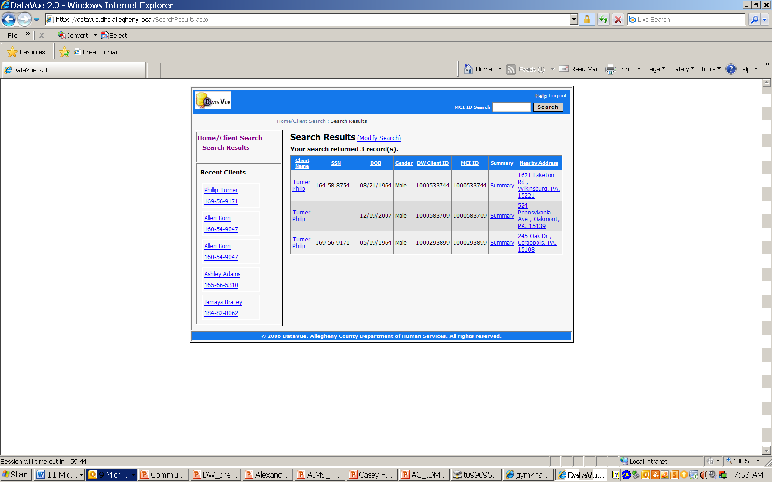
DataVue: Search Screen Results

Slide 20
DataVue: Service Activity

Slide 21
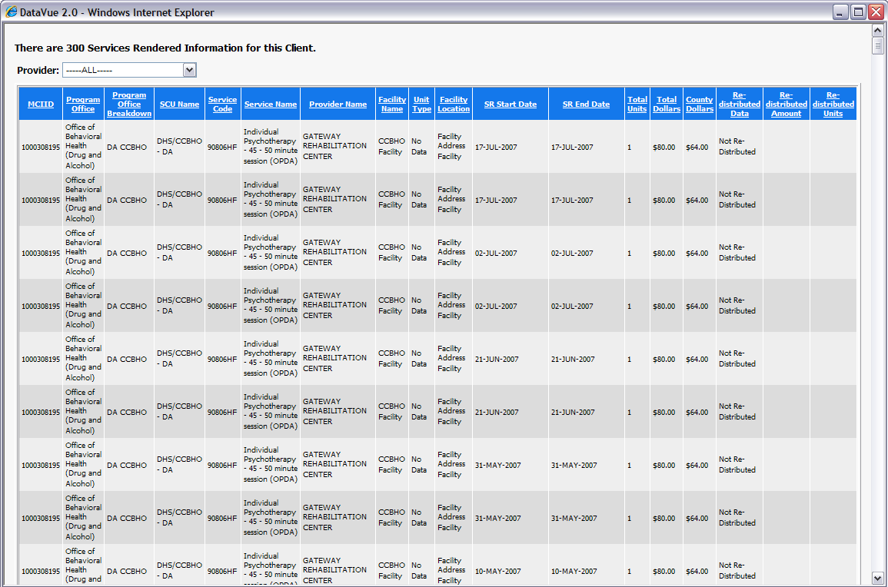
DataVue: Service Rendered and Received Screen

Slide 22
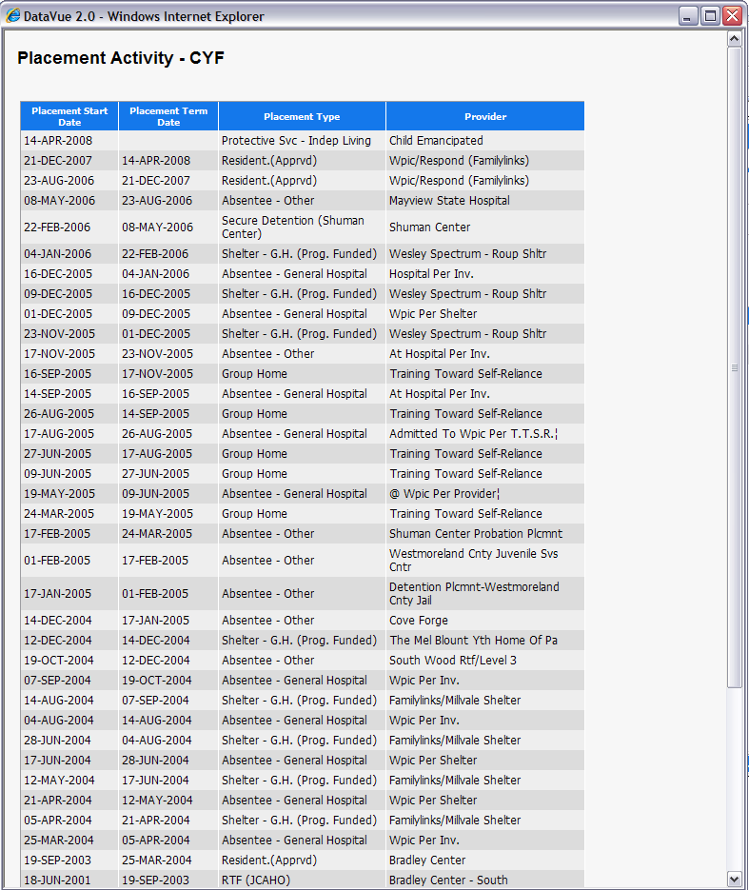
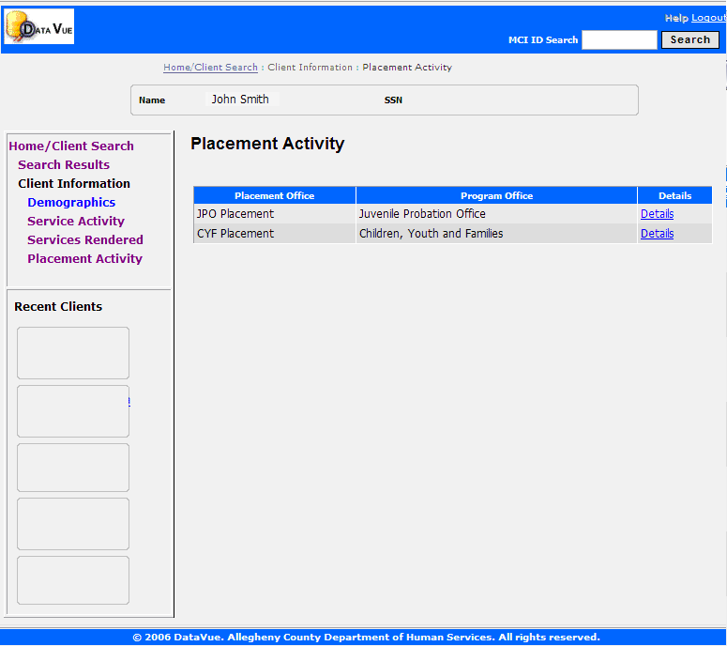
DataVue: Placement Activity Screen
Note: Any personally identifiable information has been hidden or changed

Slide 23
REPORTING TOOLS
DataVue
QuickVue
  Application which provides a cross organizational view of client counts based on the services they receive
  Based on data warehouse data
Cognos Cubes
  Placement and Non-Placement cube available to DHS research staff for analysis
Cognos Query Studio
  Placement data from KIDS data mart available to DHS research staff for analysis
  MPER data available to DHS research staff for analysis
Reporting Portal

Slide 24
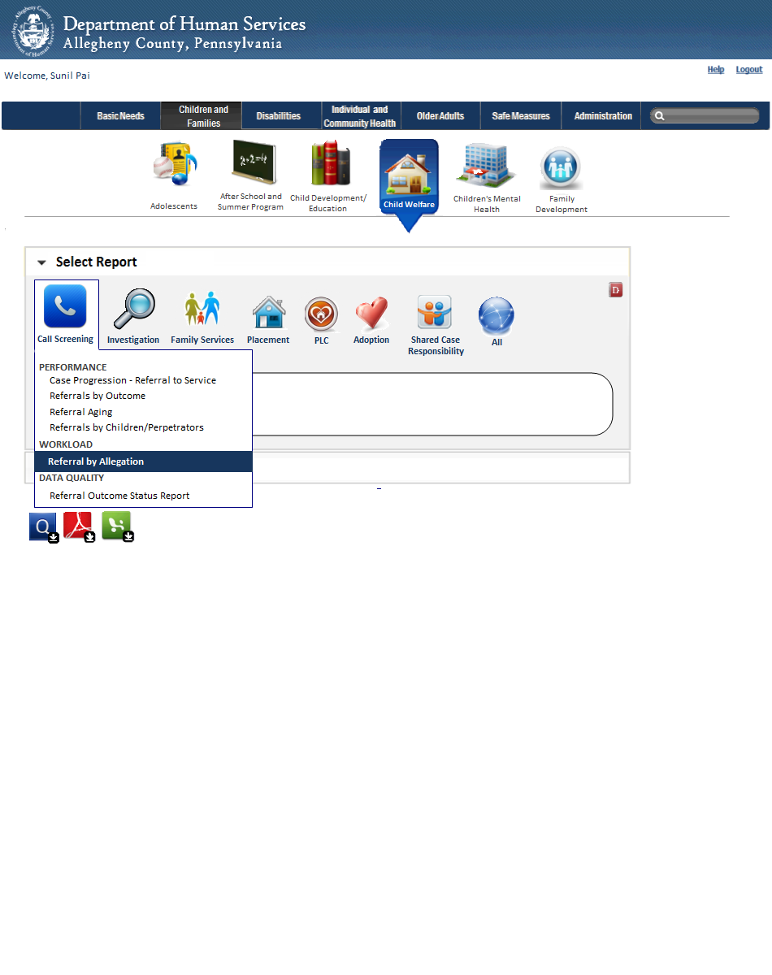
DHS Reporting Portal

Slide 25
The MOU
Allegheny County Department of Human Services (DHS) signed a
Memorandum of Understanding with 3 of the county’s Public School Districts: Pittsburgh Public, Clairton and Woodland Hills (in progress)
Directory Information
Educational outcomes for kids for whom DHS is the legal custodian
Educational outcomes for all other kids – action research agreement
Consent
MOU II

Slide 26
Current and Historic Data are Integrated
School Districts
Personal Identifiers
Achievement
Attendance
Specialized Programs
Standardized Test Results
DHS Data Warehouse
Allegheny County Housing Authority
• Allegheny County Jail
• Allegheny County Medical
Examiner’s Office
• Department of Public Welfare
• Housing Authority City of Pittsburgh
• Juvenile Probation
• Aging
• Children, Youth and Families
• Community Service Block Grant
• Drug & Alcohol
• Early Intervention
• Employment & Training
• Family Support Centers
• HeadStart
• Human Services Development Fund
• Hunger & Housing
• Low Income House Energy Assistance
Program
• Maximum Participation Project
• Medical Assistance Transportation
Program
• Mental Health
• Mental Retardation
• System of Care Initiative

Slide 27
Overlap of Children Served
53 percent (14,450) of PPS Students have prior Human Service involvement
36 percent (9,750) were involved with a Human Service within the last year

Slide 28
Educational Outcome Metrics
GPA
Weighted , cumulative GPAs were used
Attendance
To align with Promise eligibility, students were categorized as “below 90 percent” or “90 percent or above”
Attendance is adjusted for unexcused absences and suspensions; excused absences do not impact attendance level
PSSA Scores
Pennsylvania System of State Assessment in Reading
Promise Eligibility
Students are promise eligible if they have at least 90 percent attendance and a GPA of 2.5 or above
To align with Promise eligibility, students were categorized as “less than 2.5” or “2.5 or above”
In this analysis, “proficient” refers to students with proficient or advanced scores

Slide 29
Educational Outcomes: GPA

Slide 30
Educational Outcomes: Promise Eligibility

Slide 31
Educational Outcomes: Attendance

Slide 32
Educational Outcomes: PSSA Scores

Slide 33
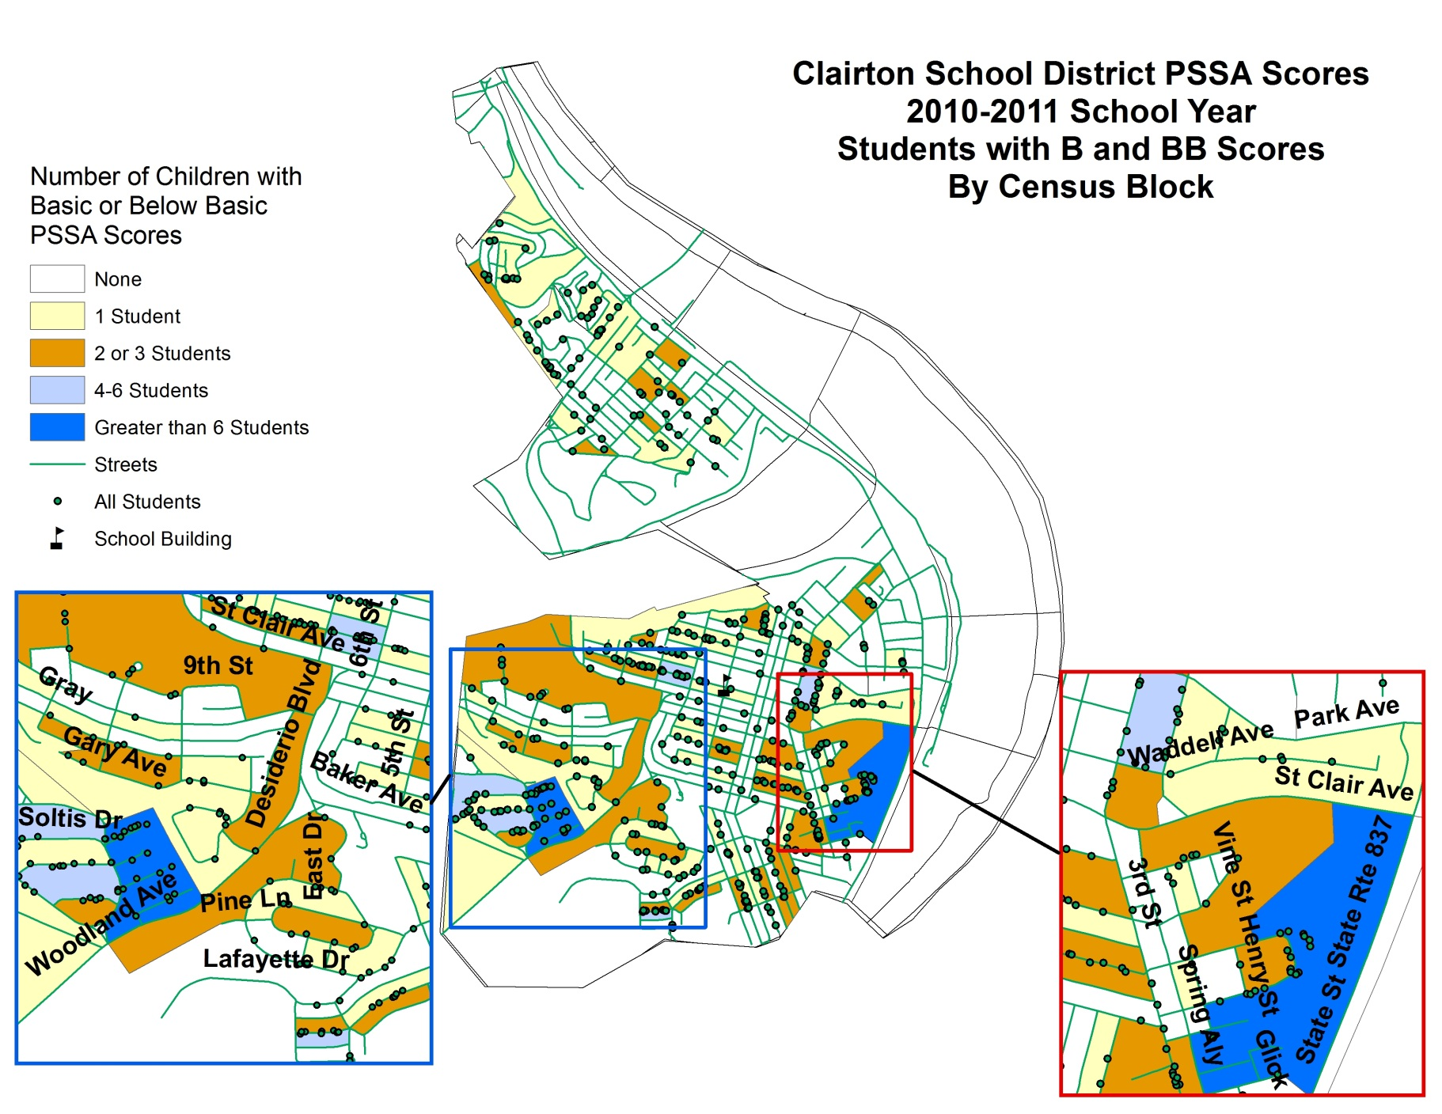
Educational Outcomes: PSSA Scores - Clairton

Slide 34
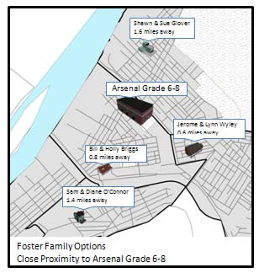
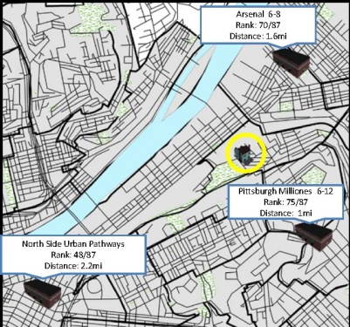
EdMap
A suite of tools that will integrate human services, education, and court data into operational systems to improve education and well-being outcomes for children
Electronic Access to Education Information
Stakeholders gain consistent access to more up-to-date information for all children attending PPS requires new consent tracking and storing infrastructure
Implementation of PA Education Screen
Online process through existing KIDS case management system
Some responses are automatically fulfilled with shared education data
Educational Stability & Quality Tool
Tool to support caseworkers and other involved parties to consider educational well-being issues at time of placement initiation and placement change as well as at times of typical school transition
Reduced administration time by DHS and PPS to obtain records
Built in notification system to proactively address issues early

Slide 35
Thorny issues
Drug & Alcohol data
Sharing detailed data with the courts and probation
Internal/provider culture change
Sharing data with the schools

Slide 36
Challenges
Funding $10 Million Contract
Maintenance
Data Use
Democratization
Legal
NIEM

Slide 37
Next steps
Building Criminal Justice System Infrastructure
Building Workforce System Infrastructure
Public Health Opportunities
Open Government/Public Use

Slide 38


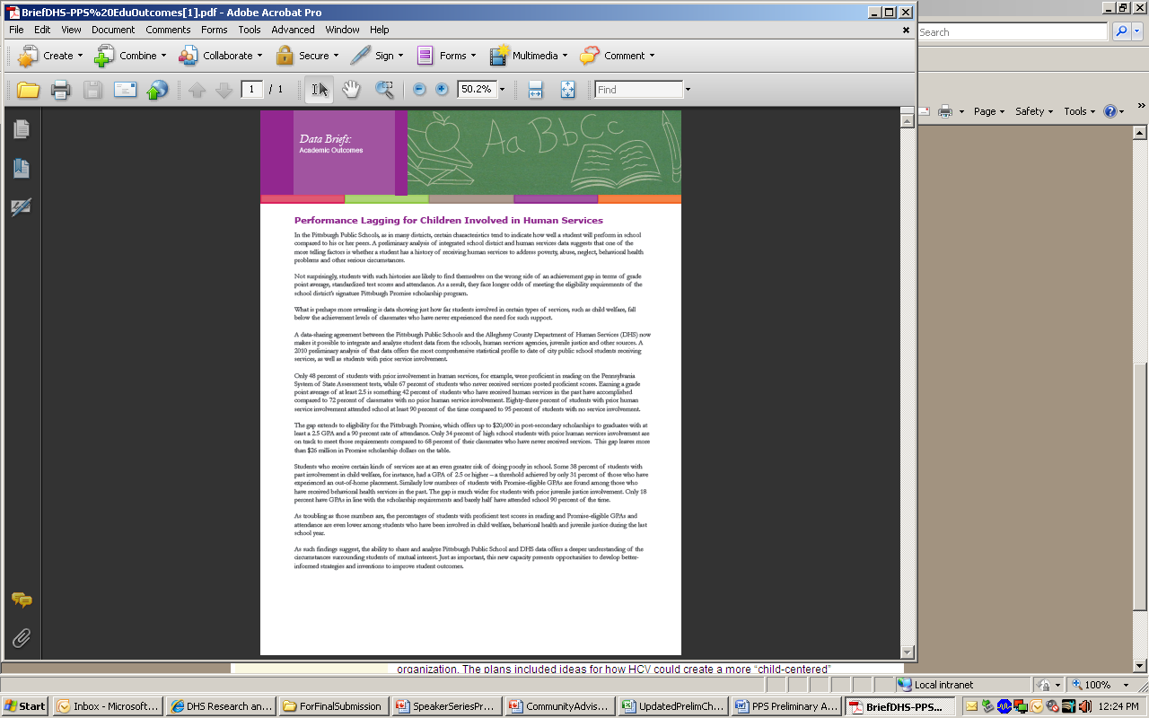
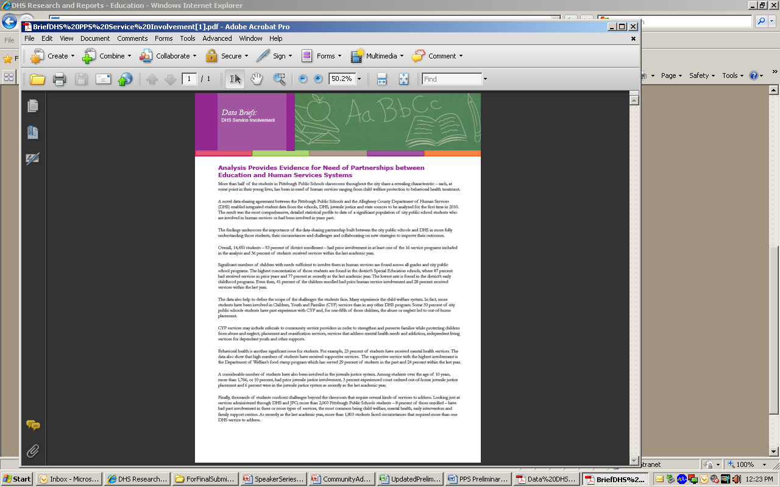
Questions?
Additional Information: http://www.alleghenycounty.us/dhs/research-education.aspx

