Slide 1
Connecting to the
Ohio Longitudinal Data Archive to Help Youth in Cleveland
Leah Hendey
On behalf of Claudia Coulton and her team at the
Center on Poverty and Urban Development
Jack, Joseph and Morton Mandel School of Applied Social Sciences
Case Western Reserve University
Notes:
Thank Claudia (both for the slides and allowing me to present her project).
Even though Claudia was not able to join us, I wanted to share their work in Cleveland between the project intends to demonstrate how data from a local IDS could be used in combination with records from a state IDS, and that information from a state IDS is useful to inform local policy and practice.
Project – How does child welfare and juvenile justice involvement affect high school graduation and early adult outcomes in a 9th grade cohort? Using integrated data for cross-sector planning for at risk youth in Cleveland neighborhoods.
Youth who enter the child welfare system when they are older are more likely to be involved in the juvenile justice system and are very likely at risk for failing to graduate high school on time or matriculate to post-secondary education programs, experience high unemployment rates, and/or experience homelessness and involvement in the criminal justice system.

Slide 2
Cleveland’s NNIP-IDS project: Long term outcomes for youth transitioning out of foster care
Will study 4 cohorts of 9th graders (over 20,000) to compare foster care youth with neighborhood and school peers.
Positive Outcomes
Costly Outcomes
High school completion
Higher education enrollment
Employment and earnings
Juvenile court
Incarceration
Homelessness
TANF
Controlling for risk and protective factors
Disaggregated by school and neighborhood
Notes:
This study will compare positive and negative early adult outcomes for 4 categories of youth:
Those youth aging out of foster care
Juvenile Court involved youth
Dually-involved children
And non-involved comparison group

Slide 3
Community partners and process
Jim Casey Youth Opportunities Initiative Brings together many partners to plan for youth aging out of foster care
  YWCA, YOU, MY COM, DCFS, Juvenile Court, School System
Neighborhood Collaboratives—prevention in child welfare
  AECF Family to Family Initiatives
  Informal networks and community-based organizations
Public systems—Child Welfare, Justice System, Public Schools
Notes:
An important part of the project is the role of the community stakeholders and their partners who will assist in interpreting results and developing policy and practice recommendations.
The Jim Casey Youth Opportunities Initiative, lead by the YWCA, brings together many partners to plan for youth aging out of foster care – by increasing public understanding of their needs, mobilizing communities to take action to support them; and promote improved policies and practices to increase their chances for success in adulthood.
The neighborhood data that will come out of this project will allow the initiative to develop geographically targeted policies and practices for improving outcomes for youth.
The Department of Child and Family Services and their neighborhood collaboratives which were a part of the Annie E. Casey Foundation’s Family to Family Initiative, provide critical support for families involved in the child welfare system and they have been struggling with developing effective interventions for youth ageing out of foster care. This study can better inform those interventions and all for better targeting of resources if youth are concentrated in particular neighborhoods.
Claudia and her team will also be engaging with the public systems and schools around this work.

Slide 4
Conceptual Model
Outcomes
Crime rates
Concentrated disadvantage
Residential instability
College admission
Type of college
Type of majors
TANF
SNAP
Medicaid
School year (Est. N)
2005-06 (7,151)
2006-07 (7,771)
2007-08 (7,016)
Total (21,938)
Nhood
College
Family
9th
G
10th
11th
12th
Individual
Education
Graduation
test
GED
Work
Risk
Attendance
Proficiency test
School mobility
Demographics
Disability
Language
Delinquency
Abuse/Neglect
Out-of-home
placement
Employment
Earnings
Study area: Cleveland Metropolitan School District, OH

Slide 5
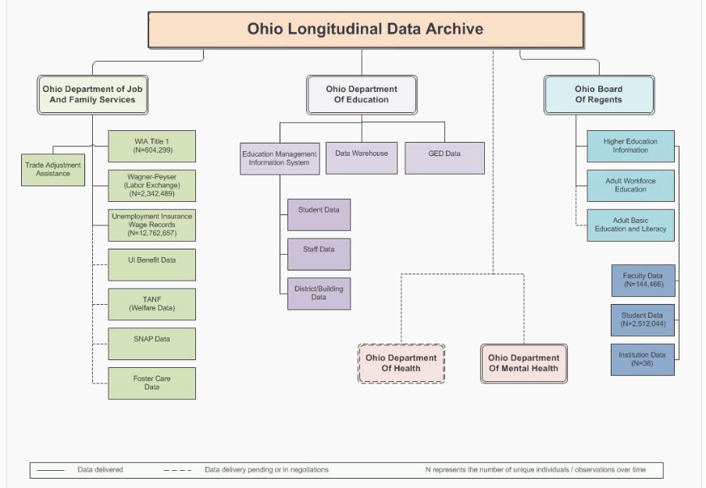
Ohio Longitudinal Data Archive
http://oerc.osu.edu/data/available-data
Notes:
I wanted to say a little bit more about the OLDA – (and give credit to Cathie Walsh for her work on documenting the OLDA)
It’s a project of the Ohio Education Research Center and managed by the Center for Human Resource Research at The Ohio State University. ( CHHR manages NLSY)
Both of our NNIP partners were invited to participate in the Ohio Education Research Center which is a collaboration of six universities and four research organizations. This is the data that Community Research Partners used in their presentation on student mobility last June in Columbus.
It is the SLDS for the state of Ohio and builds off earlier efforts to collect unemployment insurance records. It is now an IDS and is integrating records from the Ohio Department of Jobs and Family Services, the Ohio Board of Regents, The Ohio Department of Mental Health and Addiction Services.
We have recently gone through their process. It takes several months. First you submit a request and provide documentation on IRB approval and data security. Then the agencies give approval. Then you send the SSIDs which are the identifiers. I am not yet sure how the data will be sent since we have not yet gotten to that point. FTP makes sense though.

