Slide 1
Tracking the Housing Crisis in DC: Five Years Later
Presented by:
Leah Hendey
Urban Institute
NeighborhoodInfo DC
November 16, 2012
Community Indicators Consortium
Annual Conference
College Park, Maryland
Notes:
Urban Institute
NeighborhoodInfo DC

Slide 2
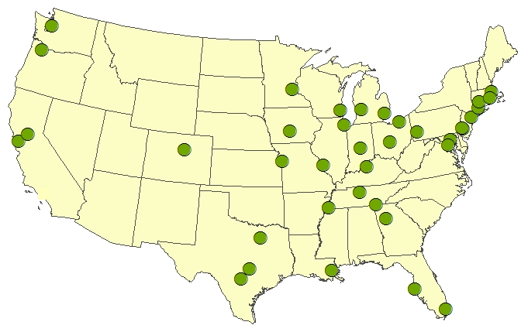
NNIP Mission: Information for Change
Democratizing Information
  Facilitate the direct use of data
  by stakeholders
Work for many clients
  Helping Boys and Girls Club choose a new site
  Working in a cross-sector collaboration to reduce infant deaths
A central focus on strengthening, empowering low-income neighborhoods
Information as a bridge for collaboration among public agencies, nonprofits, businesses
Notes:
Framework based on NNIP model – creative use of local administrative data for promoting positive community change.
UI coordinates the partnership and works nationally to build the field. 37 partners; almost all nongovernment but work with gov partners. Share key principles.
1. Agreed to take on the role of facilitating and promoting the direct practical use of data by community and city leaders in community building and local policy making. Reaction to too much research done about ngh without any value coming back.
2. All partners have a wide variety of partners and audiences since systems on the shelf don’t sustain support. A colorful map will not be enough unless it leads to greater understanding or new conversations. (These are short-term & long-term examples).
3. Giving emphasis to building the capacities of institutions and residents in distressed neighborhoods. Level the playing field by making sure everyone has access to the information
4. Importance of interacting with stakeholders around the data and building ongoing relationships.

Slide 3
Lessons from NNIP
Design indicators for action—not just to passively monitor trends.
Develop indicators at the neighborhood level as well as the city or county as a whole.
Use available indicators but recognize their inadequacies – don’t discount local wisdom.
Place the numbers in the context of images and stories about the issues you care about.
Notes:
1. need to motivate the data collection and analysis to keep the effort going
2. Overall city trends in teen pregnancy won’t help identify where you need to target your efforts. Also, people relate to where they live, gets them engaged right away
3. I love data, but some of it is not so good… Be a critical user of data. For example, code enforcement in many cities is complaint-driven, so sometimes you see more violations in well-off areas that are more likely to demand city action. Doesn’t mean there are fewer problems with dangerous buildings or poorly maintained properties in lower-income parts of the city. Be sure to vet findings with people on the ground.
4. You all could probably teach us something about the last piece of advice. Most effective work combines the numbers analysis with stories of real people and real neighborhoods.

Slide 4
Local Foreclosure Data Sources in the Washington, D.C. Area
DC:
  Office of Tax and Revenue (real property characteristics & sales)
  Recorder of Deeds (notices of foreclosure & completed foreclosures)
Maryland
  Dept. of Labor, Licensing & Regulation (notice of intent to foreclose)
  Maryland PropertyView (sales data)

Slide 5
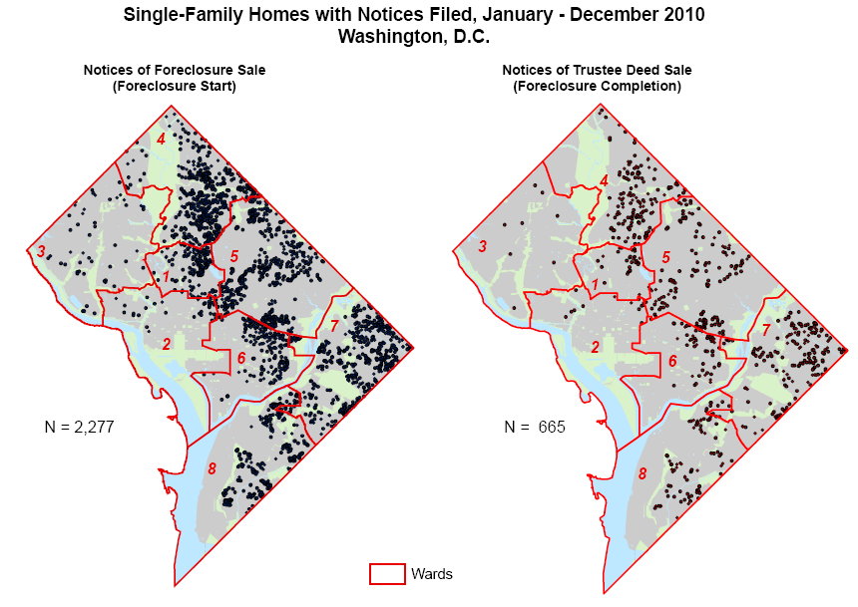
Data motivate action on foreclosure prevention & mitigation
  www.neighborhoodinfodc.org/foreclosure/
Notes:
In 2008, started tracking foreclosure activity in DC through recorder of deeds and real property records.
Testimony before DC Council in 2009; data helped motivate action by city
Infrastructure to track housing market built up over previous 3 years enabled us to respond on this issue
Describe notices: fcl sale, trustee deed sale

Slide 6
Tracking longer foreclosure trends
Notes:
By combining foreclosure notices with real property data, can track more sophisticated trends.
Low 700 homes/condos in fcl in early 2006 to 3,400 in 2010
Fcl starts went from 150-60 to 1,100. A few large developments cause some of the spikes in the data.
Outcomes:
FCL sales: trustee deed notices
Distressed sale: still in FCL, but no trustee deed
FCL avoided: no sale or notice in 1 year or more
FCL mediation law in Nov 2011
Although “inventory” declining, total servicer-reported delinquencies and reported foreclosures have not dropped much.

Slide 7
Rising share of students affected by foreclosure
Notes:
Matched addresses of foreclosure notices with address of students enrolled in public schools. Small but rising share. Attention needed to help those students who might be affected.
In Baltimore and Washington, D.C., parallels the overall foreclosure rates—a dip during the housing boom and then significant increases by 2008 (figure 4).
The share of students affected by foreclosure was slightly lower in Washington, D.C., compared to the other sites. In the 2003–04 school year, 1.2 percent of the public school students were affected by foreclosure. This was down to 0.6 percent in 2005 and 2006, but by 2008–09, 2.2 percent of public school students were affected by foreclosure.

Slide 8
Home Prices Stabilize in DC

Slide 9
City-wide Non-Market Sales Trend
Notes:
By combining parcel level foreclosure data with property sales data we are able to figure which properties become REO (real estate owned) that is retained by the bank or lender after a foreclosure auction. We can then look at the next sale to see when and how long properties are remaining in REO. We hope to do more detailed analysis of this in the future.
Able to identify buyers and sellers. Developed crosswalk of names to banks, GSEs, and other financial institutions so that real estate owned (REO) properties can be identified.

Slide 10
Non-market home sales are a large share of transactions in poorer areas of city
Notes:
This graph is showing the breakdown of non-market sales in DC by Ward. Again you can see that there is tremendous variation across wards. In wards 1, 2, 3, and 6 less that 20% of all sales in the first quarter of 2011 were non-market sales, however, east of the river in wards 7 and 8 about 60% of sales were non market sales, with 18% of sales entering REO through foreclosure (the red bar) and more than a quarter of sales (in dark blue) exiting REO.
At the start of 2011, more than half of the residential property transactions were non-market in wards 7 and 8; over 40 percent in wards 4 and 5. One quarter in W7+8 were properties being sold out of REO; 18 percent entering REO.
These types of sales cause concern for neighborhood development. Could indicate presence of speculators buying properties cheaply.

Slide 11
Weekly lists of new foreclosure notices used for outreach
Public notice data are enhanced by adding additional information, such as property type and address.
Filing date | Document no. | Property type | Square/suffix/lot | Property address
11/03/2010 | 2010094401 | Residential: Single-family home | 5084 0042 | 0342 50TH ST NE
11/03/2010 | 2010094502 | Residential: Single-family home | 5090 0023 | 1938 SHANNON PL SE
11/03/2010 | 2010094603 | Residential: Rental apartment building | 0073 0065 | 8304 13TH ST NW
11/03/2010 | 2010094704 | Residential: Single-family home | 4088 0004 | 4010 25TH ST NE
11/03/2010 | 2010094806 | Residential: Single-family home | 2022 0856 | 3920 14TH ST NW
11/03/2010 | 2010094907 | Residential: Single-family home | 3044 0029 | 2540 7TH ST NE
11/03/2010 | 2010095033 | Residential: Single-family home | 0057 0079 | 1762 10TH ST NW
11/05/2010 | 2010095126 | Residential: Condominium unit | 0040 2220 | 0934 G ST SW Unit: 129
11/05/2010 | 2010095228 | Residential: Condominium unit | 5072 2278 | 1030 FORT DAVIS ST 00202
11/05/2010 | 2010095329 | Residential: Condominium unit | 2044 2034 | 3001 20TH ST NW Unit: 501
Notes:
One of the things we do is to pull down weekly lists of all the new foreclosure notices and combine this data with other information from the Office of Tax and Revenue to attach the property address and type to the record. We then pass this list on to 3 District agencies and a number of nonprofit organizations so that they can do outreach to homeowners about the availability of foreclosure counseling services and inform renters about their rights in the event of a foreclosure.
This outreach is critical to giving homeowners an opportunity to figure out how to best address their default given that DC is a nonjudicial foreclosure state and until the foreclosure mediation legislation was passed in 2010, a foreclosure could occur in as little as 35 to 45 days.

Slide 12
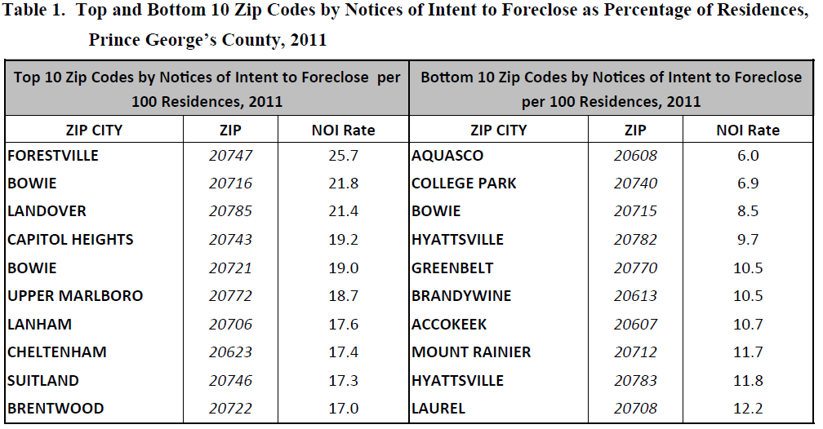
Prince George’s County:
Notice of Intent to Foreclose Rate
Notes:
We recompleted a brief using The Notice of Intent to Foreclose (NOI) data for Prince George’s County, which are collected and disseminated by Maryland’s Department of Labor, Licensing and Regulation (DLLR), and represent a loan-servicing bank’s intention to initiate foreclosure proceedings.
Notices of Intent to Foreclose (NOI) data from Maryland Department of Labor, Licensing, and Regulation (DLLR)
Date of notice, amount to cure, days past due, servicer, type of property
Records have been stripped of all identifying information
Smallest geography is ZIP code level
2011 to present
Using these data we produce:
Quarterly updates on NOIs
Brief “Foreclosures in Prince George's County: 2011” (http://www.urban.org/publications/412625.html)
In 2011, 33,439 single-family detached, townhome, and condominium residences in Prince George’s County received a NOI from a mortgage servicer. More than 1 in 7 (15 percent) of the county’s 219,873 residences entered foreclosure proceedings last year (figure 1)
The story changes significantly however when considering differences by ZIP code. ZIP codes in the southern beltway region and the less-populated eastern part of the county experienced particularly high NOI rates (the percentage of all residences in the ZIP code who received a NOI). For example, ZIP code 20747 (in Forestville) had the highest NOI rate at 25.7 percent, that is, one in every four residences in that ZIP code received a NOI in 2011 (table 1). ZIP code 20716 (in Bowie) ranked second with a rate of 21.8 percent.
Some ZIP codes like 20623 (in Cheltenham) had high rates (17.4 percent) with very few residences (992 total residences). In contrast, ZIP codes like 20772 (in Upper Marlboro) had both high rates (18.7 percent) and many residences receiving a notice (14,579 total residences).
Other ZIP codes, mostly in the northern part of the county, remained relatively unscathed by the crisis. For example, ZIP code 20608 (in Aquasco) had a NOI rate of just 6.0 percent and in 20740 (in College Park), 6.9 percent of residences received a NOI (table 1).

Slide 13
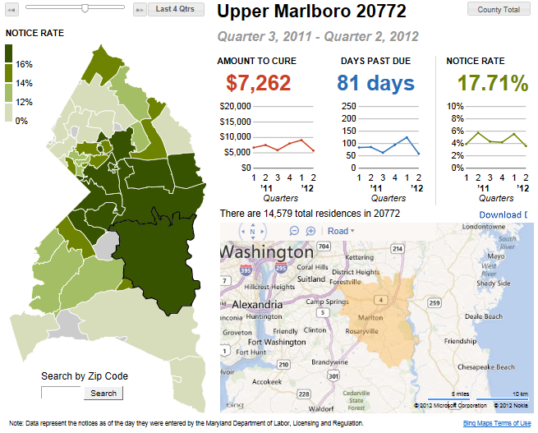
Mapping NOI Data
Notes:
We have also been working on useful data visualizations and have presented the data to the Coallition for Homeownership Preservation.
The data could assist housing counseling agencies in writing effective proposals that demonstrate an understanding of local conditions and need, and thus gain funding, both from local sources and the from the national mortgage settlement.
Currently the data we have access to are not available to us at a low enough geography to help counseling agencies target outreach. However ZIP code level maps and analysis we did of which servicers were initiating foreclosure proceedings and how those were concentrated was shared with DLLR and Maryland DCHD, and the governors office to help inform targeting funding from the foreclosure settlements.

Slide 14
NOIs by Servicer
Top 6 servicers issued 78% of all NOIs (07/2011 - 06/ 2012 ):
  Bank of America* (35.5%)
  Wells Fargo* (14.8%)
  JPMorgan Chase* (14.0%)
  Citi* (6.9%)
  IndyMac Bank (2.9%)
  GMAC* (2.9%)
  *part of the mortgage servicing settlement
Notes:
Top 6 as a share of all NOIs issued in Prince George’s County
Bank of America had the greatest share of NOIs in all ZIP codes in Prince George’s County
Presented to Prince George’s County Foreclosure Task Force (October) & Coalition meeting
DLLR used in a meeting with BOA MD DHCD and Governors Office – how they differ from others – differ when they send out NOIs and how much they owe – generally send out later – 5 months delinquent – more difficult to prevent foreclosure; GMAC (5 months but smaller amounts)
Good practice – send out earlier (don’t let people get as far behind).

Slide 15
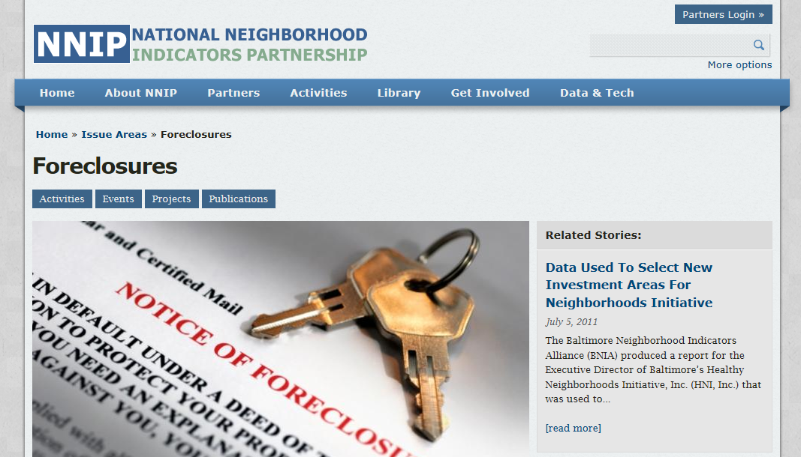
Visit NNIP website for more examples...
  www.neighborhoodindicators.org/issue-area/53

Slide 16
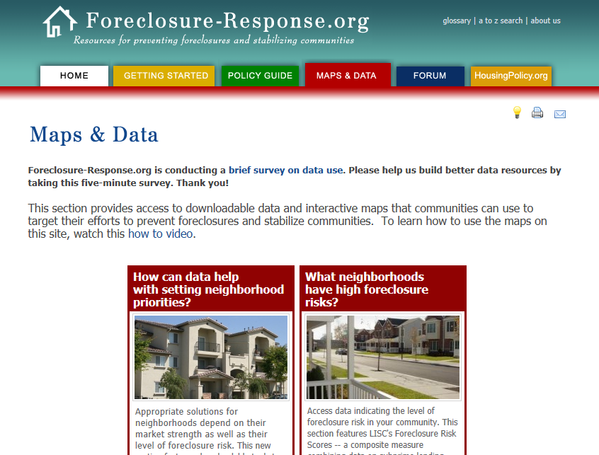
No Local Data?
Visit Foreclosure-Response.org
Notes:
ZIP code level foreclosure risk index
Census Tract data from the Home Mortgage Disclosure Act on High Cost Loans during the height of the bubble and more recent information about mortgage originations and market conditions.
Seriously Delinquency for Metropolitan Areas

Slide 17
Contact information:
  Leah Hendey
  Research Associate
  Urban Institute
  2100 M Street NW
  Washington, DC 20037
  Email: lhendey@urban.org
  Twitter: @NborhoodInfoDC
  Web: www.NeighborhoodInfoDC.org
  www.NeighborhoodIndicators.org

