Slide 1
Pittsburgh Design-a-thon event concept
Bob Gradeck, University of Pittsburgh Center for Social and Urban Research
5/22/2014

Slide 2
Things we’re working on (but not the topic for today’s discussion)…
Regional open data models and portals
Community profiles (with Providence) June Webinar
The survey toolkit – developing standards for community data collection
Housing investor research
Data liberation and transformation (ETL)

Slide 3
Carl DiSalvo’s book Adversarial Design was food for thought
Many examples of how design can be used to challenge beliefs, values, and perceived truth.
http://carldisalvo.com/

Slide 4
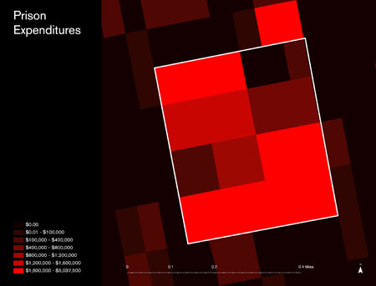
Million Dollar Blocks
Columbia University Spatial Design Lab
Notes:
Columbia U.

Slide 5
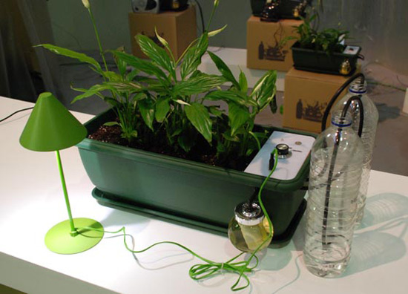
Natural Fuse
haque design + research
Notes:
onsists of a network of electronically assisted plants that act as a power source modulator. the plants all come with a standard household power socket that is limited by the capacity of the plant to offset the carbon footprint of the energy expended. if a single user’s plant isn’t capable of offsetting the device plugged into the socket, the plant can connect to its network of fellow plants via pachube to outsource the carbon-offsetting. the device also has different settings that allows users to take as much energy as they need ‘selfish’ setting or to take only what the plant and its network can offset ‘selfless’. but be careful about being selfish, because if there isn’t enough power for the remotely activated watering system the plant will suffer and won’t be able to offset the carbon as well.

Slide 6
Carl DiSalvo: there are two things that are important for civic hacking.
“The first is to realize that civic hacking is *issue-oriented* - it's not about technology, it's about the situations and their consequences (for good and bad) that draw people together.”
“The second is to realize that it's not hacking, it‘s design. IT may be a kind of ad-hoc design, but it's design nonetheless.”

Slide 7
The Concept…
Get a big bowl, add challenges and problems. Examples could include: crappy landlords, dangerous traffic, community safety, the environment, school funding, voter suppression, etc.
Notes:
tactical urbanism, contestational politics, direct citizen action – book examples

Slide 8
The Concept…
Mix together:
Advocates
Academics
Alcohol
Artists
Community Organizers
Designers
Hackers
Lawyers
Makers
Pizza
Planners
Software Developers
and two eggs
Notes:
tactical urbanism, contestational politics, direct citizen action – book examples

Slide 9
The Concept…
Fold in:
Carl DiSalvo to provide guidance and examples
Notes:
tactical urbanism, contestational politics, direct citizen action – book examples

Slide 10
After the event…
Following the event, there would be separate opportunities for teams to build and implement solutions designed at the event.
Opens up many different partnership opportunities for NNIP members
Code for America Brigades
Hackers and makers
Academics and students
Etc.
Notes:
Start with challenges – don’t limit solutions

Slide 11
Welcome your thoughts and ideas
Structure of the event
Marketing
Challenges
Participants
Lectures and activities
Follow-on implementation
Interested in this in your city? It’s only a concept right now
Bob Gradeck 412-624-9177, rmg44@pitt.edu

