Slide 1
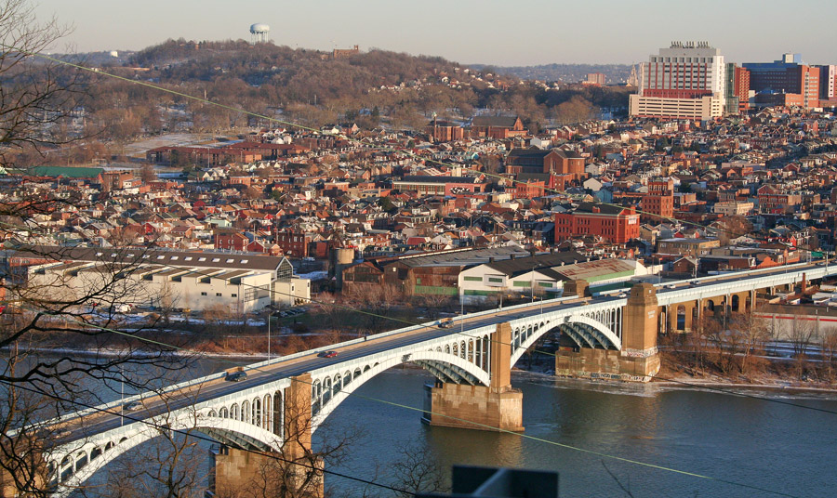



Lawrenceville’s New Resident Survey
September, 2012

Slide 2
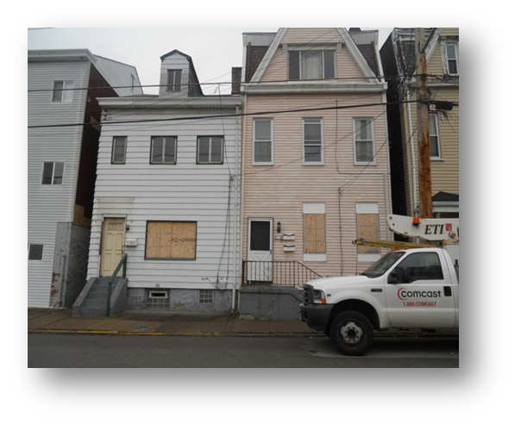
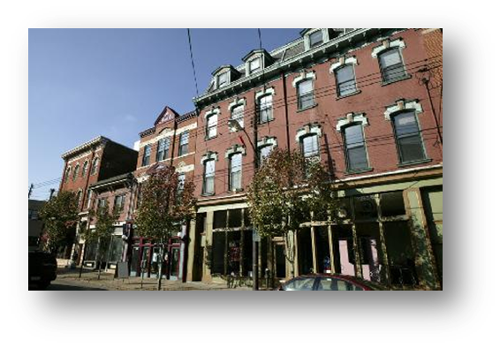
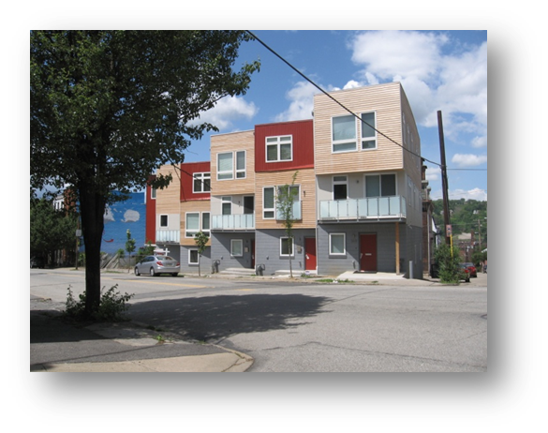
Lawrenceville’s Three Neighborhoods

Slide 3
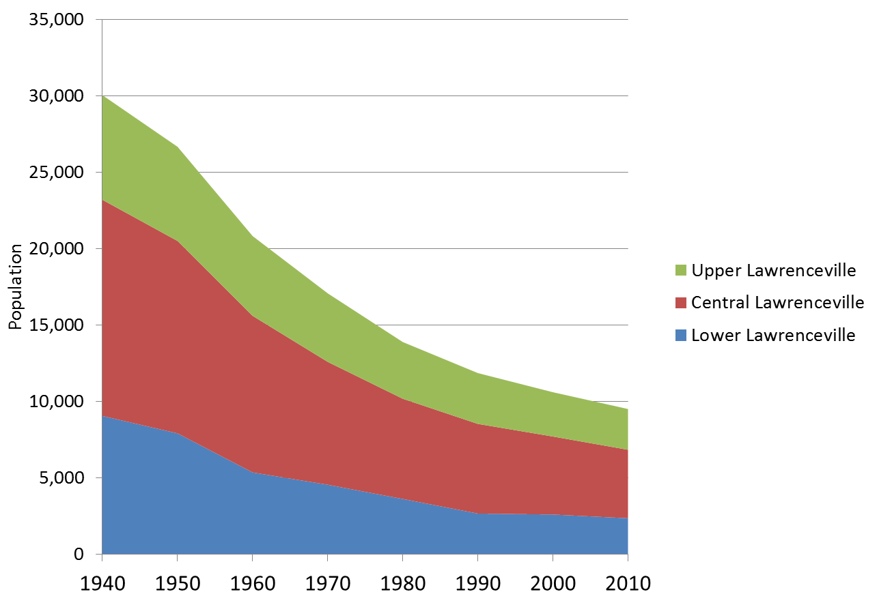
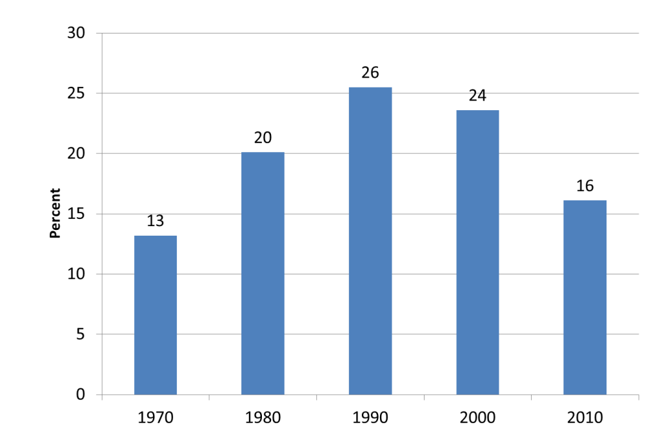
Lawrenceville Population 1940-2010
Population Loss and Aging in Place
Percent of Population Age 65+, 1970-2010
Upper
Central
Lower

Slide 4
Lawrenceville Average Housing Sales Price by Neighborhood, 1995-2010
In 2010 $

Slide 5
Purpose of the Survey
Understand what drives neighborhood change
Document housing search processes
Provide guidance to community development efforts
  Special focus on Upper Lawrenceville

Slide 6

New Resident Survey
Conducted by the University of Pittsburgh Center for Social and Urban Research (UCSUR)
Surveys mailed to homes with a new resident – Mailing list based on marketing lists
2 mailings in Summer/Fall 2011
611 mailed, 191 completed, 31% response rate
Funded by URA

Slide 7
Demographics of Respondents
56% between ages 25-34
80% white
60% female
69% renters
71% with college degree
13% with child under 18

Slide 8
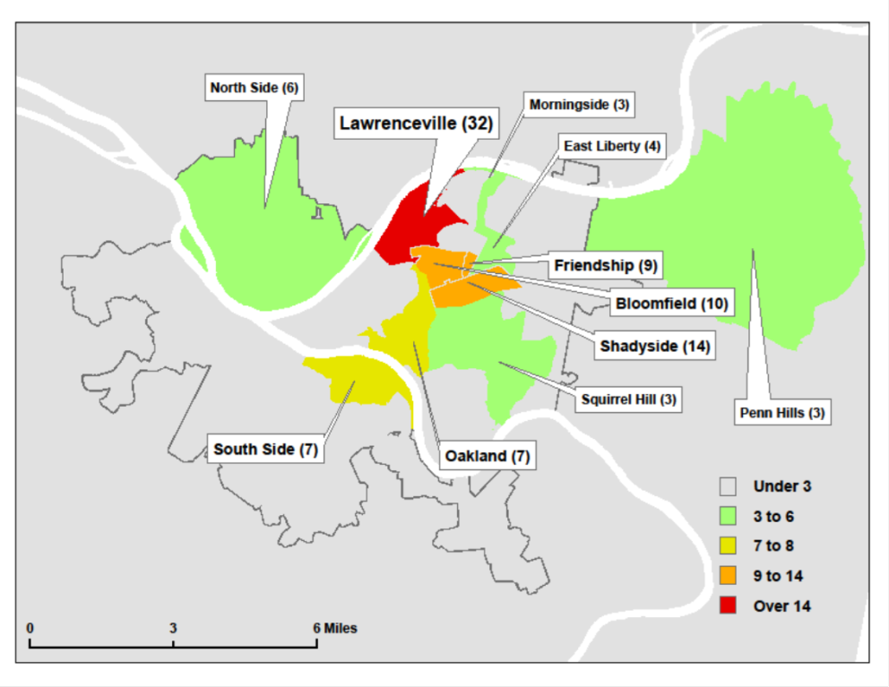
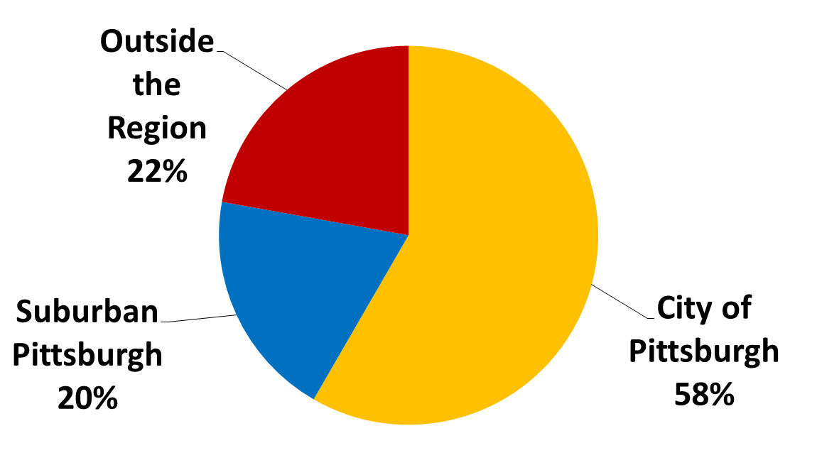
Origin Community of New Resident Survey Respondents
Most-Common Origin Communities of New Resident Survey Respondents

Slide 9
Why Did New Residents Choose Lawrenceville?
Notes:
Cost and proximity

Slide 10
Most-Attractive Aspects of Life in Lawrenceville

Slide 11
Why Did 55 Percent of Respondents Not Consider Upper Lawrenceville in their Housing Search

Slide 12
Why Upper Lawrenceville was Considered… Movers to Upper Lawrenceville

Slide 13
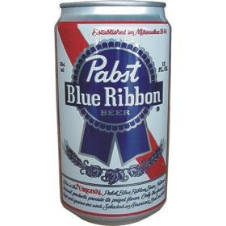
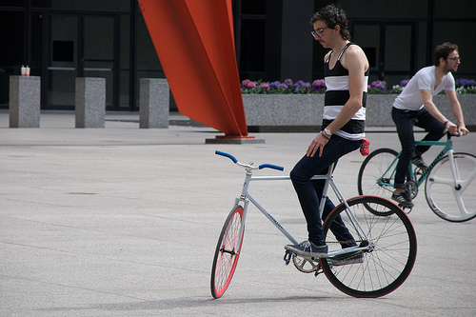
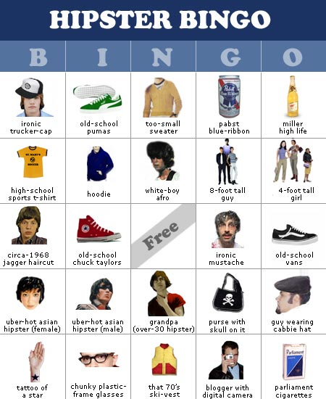
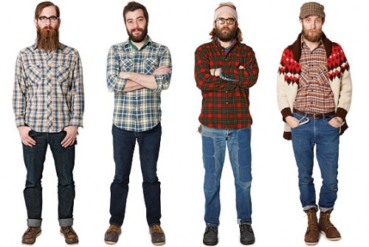
The Hipster Problem…
Three respondents said there were “too many hipsters” in Lawrenceville

Slide 14
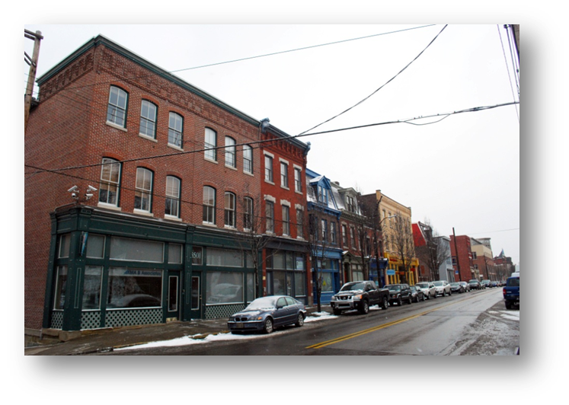
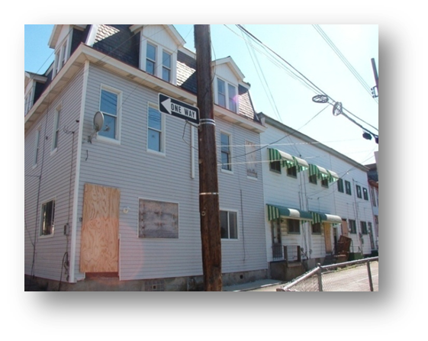
Top Four Suggested Improvements
Lower and Central Lawrenceville | Upper Lawrenceville
1. More business offerings | 1. Improved safety
2. Better parks and recreation | 2. Less trash
3. (tie) Less trash | 3. Better parks and recreation
Improved transportation | 4. Blight

Slide 15
Future Directions for Community Development in Lawrenceville
Upper Lawrenceville planning
Ensure positive rental experiences
Preserve and market affordability
Enhance public safety
Continued Main Street development and arts-related events
Notes:
Create positive rental experiences

