Slide 1
Plans for New Data Stories Transforming Integrated Data Systems Data into Neighborhood Indicators

Slide 2
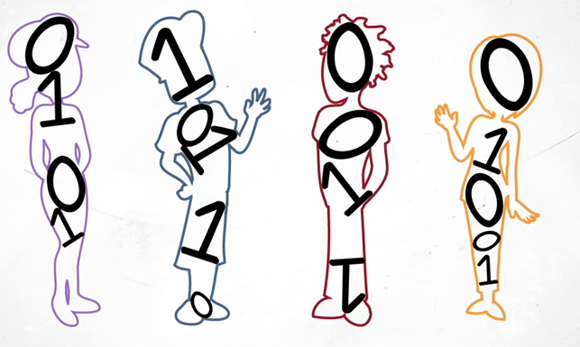
Credit: Virginia Longitudinal Data System

Slide 3
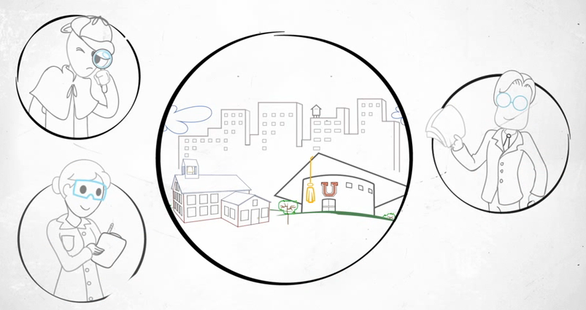

Slide 4
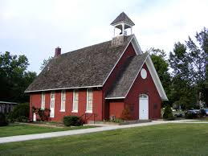

Slide 5
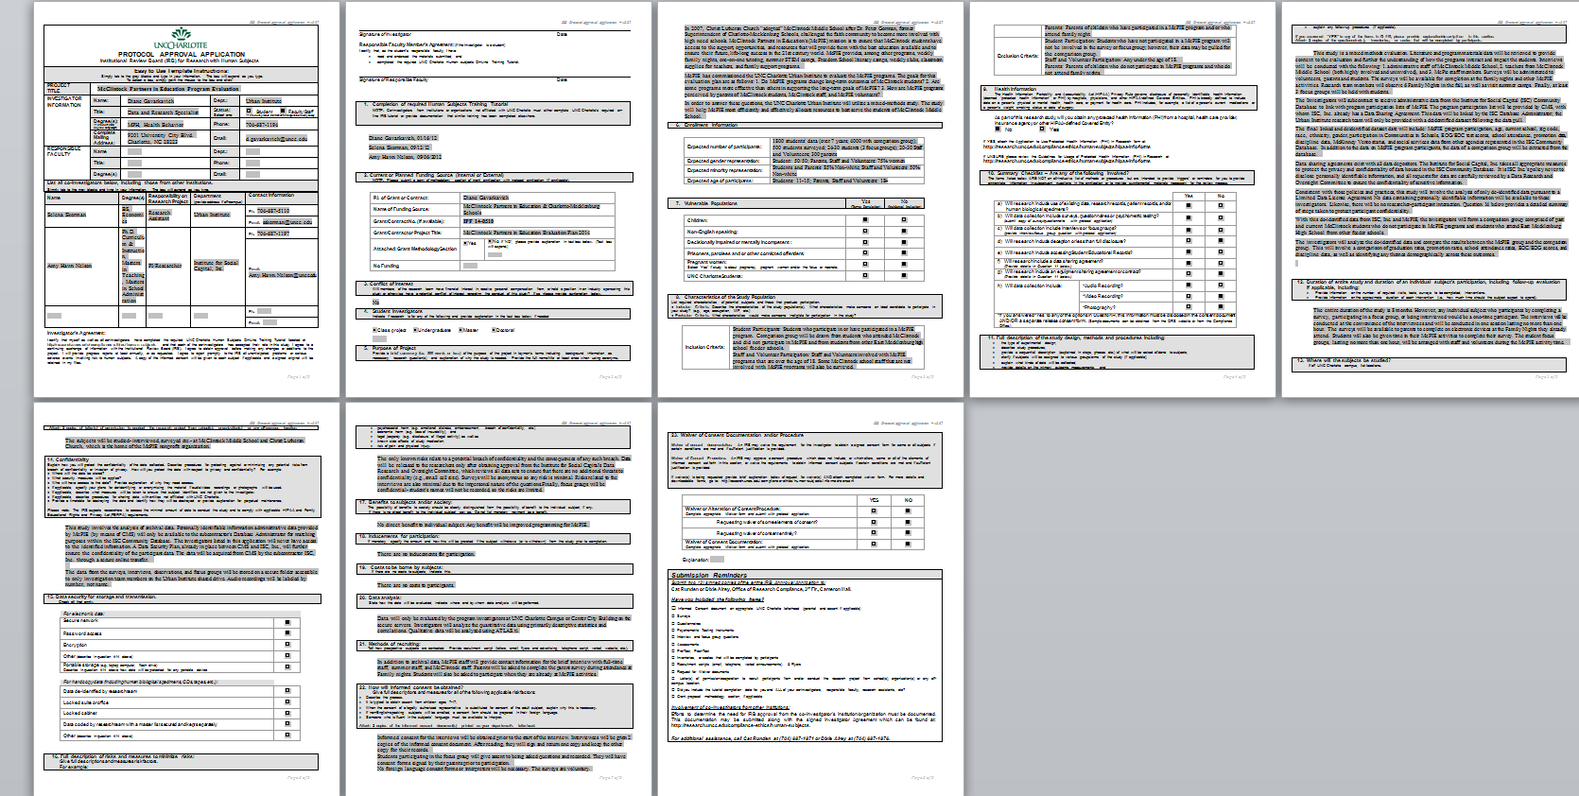
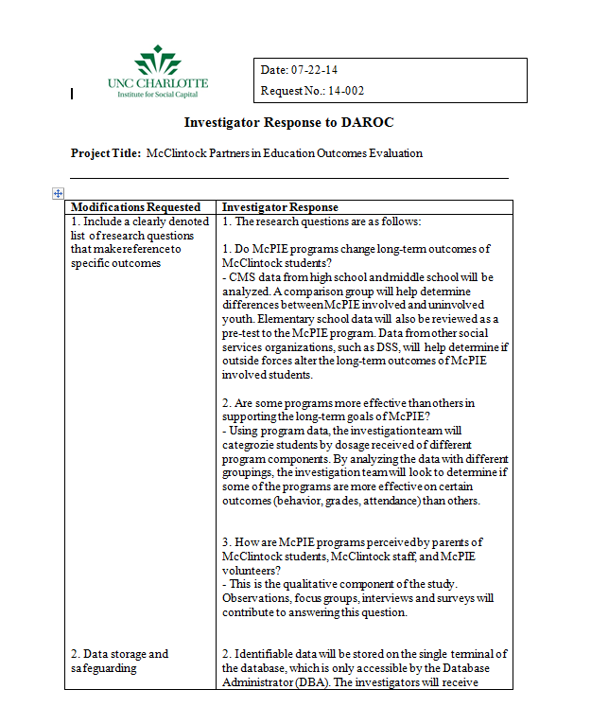
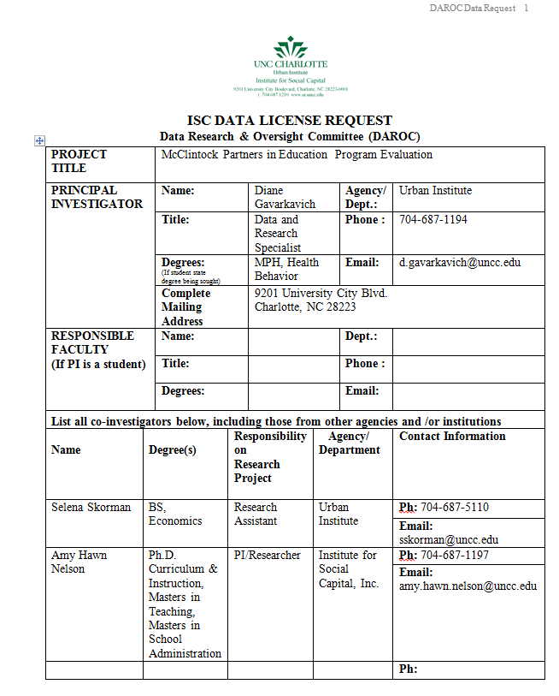
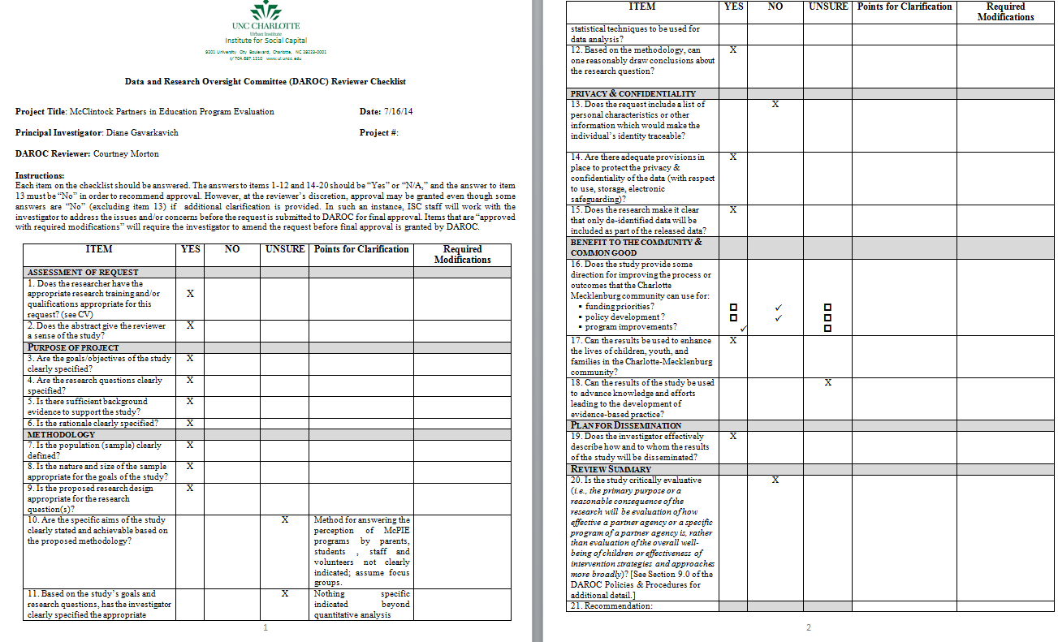
Notes:
Snapshots of IRB, Data licesnse request, daroc etc.

Slide 6
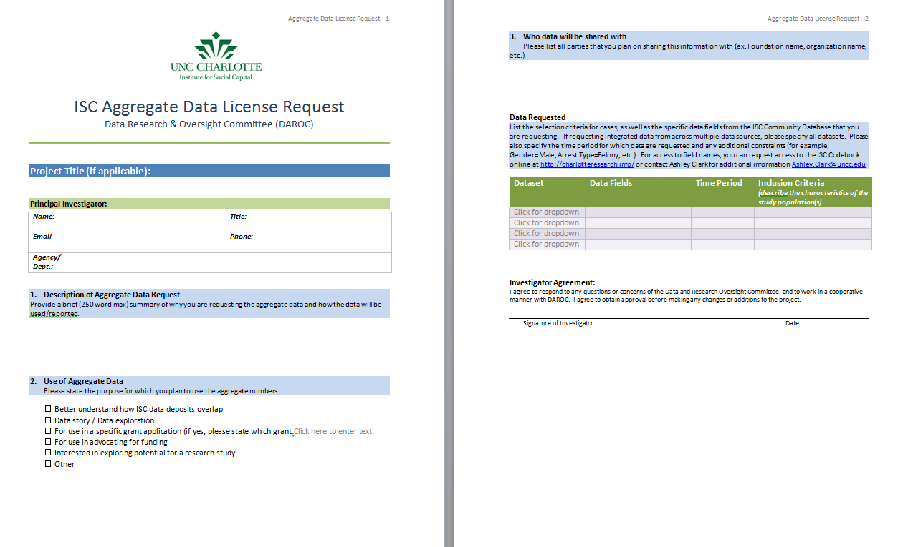
Notes:
Screenshot of data aggregation form

Slide 7
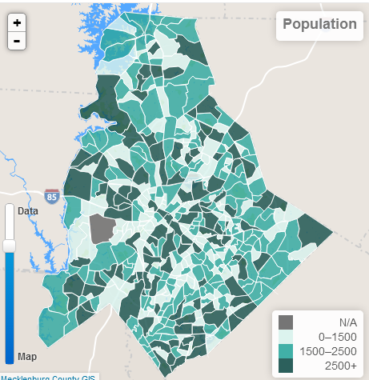
1 0 1 1 1 0 0 0 0 1 1 0 1 0 1 1 0 0 0 0 1 0 1 0 1 0 1 0 1 0 1 0 0 0 1 1 0 1 0 1
1 0 1 1 1 0 0 0 0 1 1 0 1 0 1 1 0 0 0 0 1 0 1 0 0 1 0 0 0 1 1 0 1 0 10 1 0 1 1 1
0 1 0 1 0 1 0 1 0 0 0 1 1 0 1 0 10 1 0 1 1 0 0 0 0 1 0 1 0 0 1 0 1 1 0 0 0 0 1 0

Slide 9
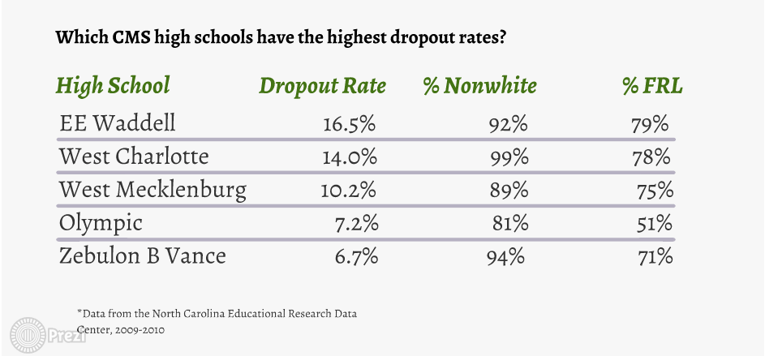
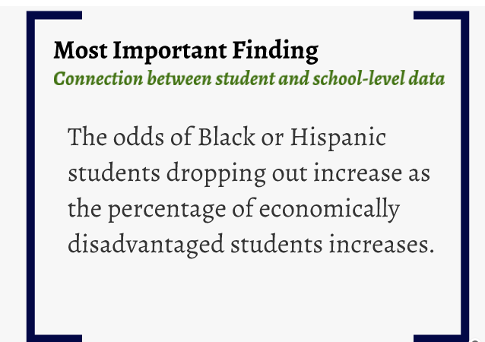

Slide 10
School System
Department of Social Services
Sheriff’s Office

Slide 11
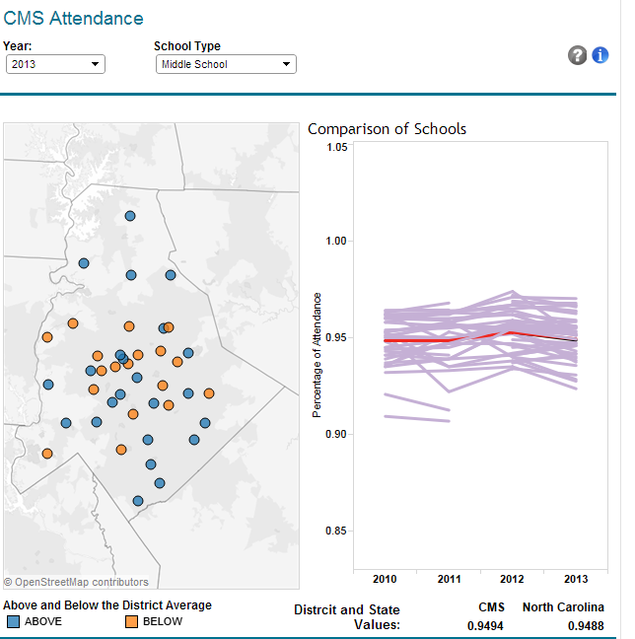
Notes:
A single day absent effects learning- need a finer measurement tool
10 is considered chronic in our school system

Slide 12
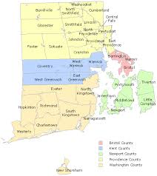
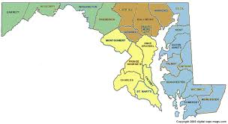
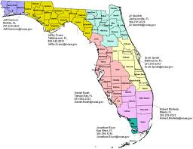
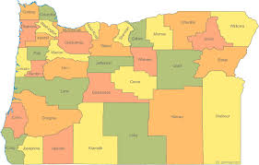
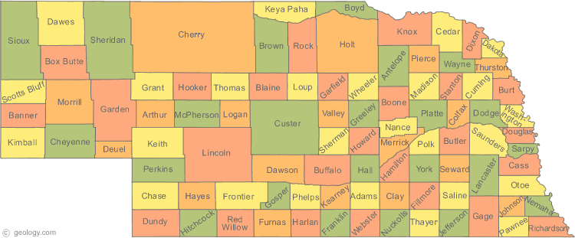

Slide 13
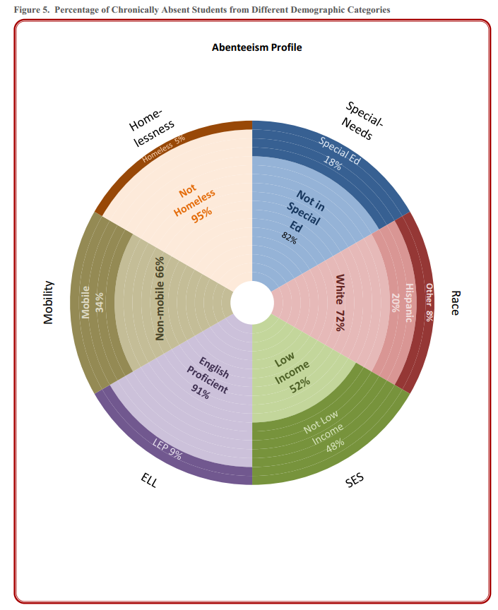
Credit: Utah Education Policy Center

Slide 14
School System
Department of Social Services
Sheriff’s Office

Slide 15
School System
Department of Social Services
Sheriff’s Office

Slide 16
School System
Department of Social Services
Sheriff’s Office

Slide 17
School System
Department of Social Services
Sheriff’s Office

Slide 18
School System
Department of Social Services
Sheriff’s Office

Slide 19
School System
Department of Social Services
Sheriff’s Office
Program for Homeless Youth
Notes:
What ar ethe multi-agency involved individuals and how can we increase efficiency to better servce these individiuals – who are some of our most vulnerable
Cost benefit analysis of figuring this out is huge – prevent – save a lot of money in the long-run

Slide 20
Prevention
Treatment

Slide 21
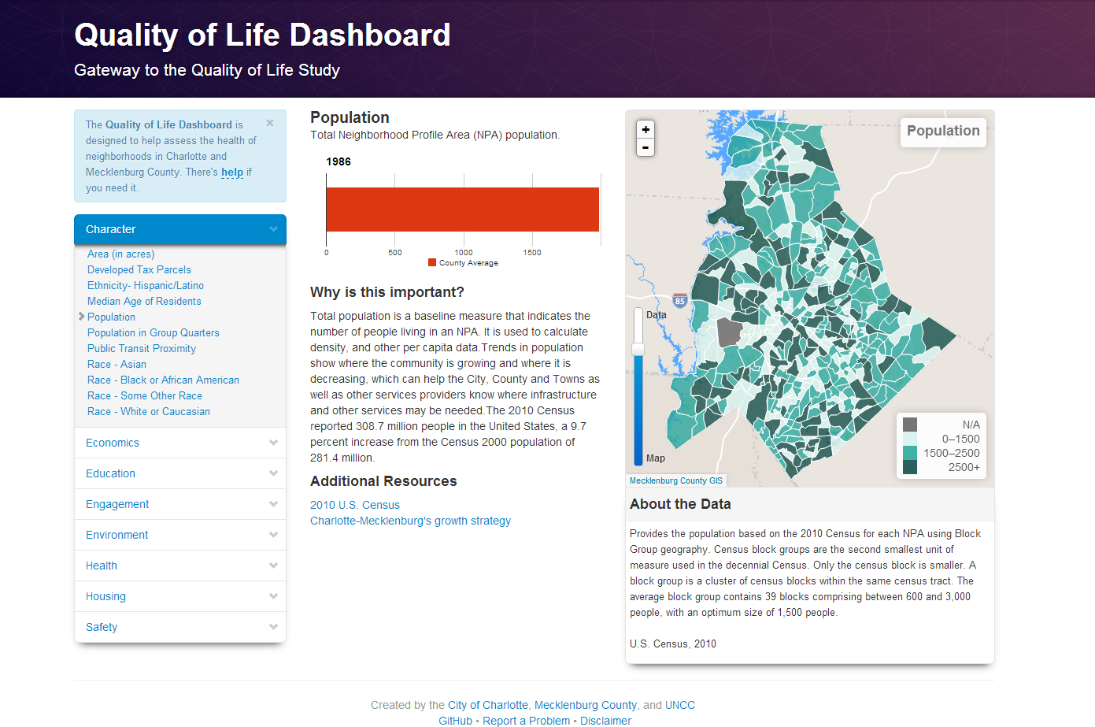

Slide 22
1 0 1 1 1 0 0 0 0 1 1 0 1 0 1 1 0 0 0 0 1 0 1 0 1 0 1 0 1 0 1 0 0 0 1 1 0 1 0 1
1 0 1 1 1 0 0 0 0 1 1 0 1 0 1 1 0 0 0 0 1 0 1 0 0 1 0 0 0 1 1 0 1 0 10 1 0 1 1 1
0 1 0 1 0 1 0 1 0 0 0 1 1 0 1 0 10 1 0 1 1 0 0 0 0 1 0 1 0 0 1 0 1 1 0 0 0 0 1 0

Slide 23
Gain insight into local government agency and nonprofit use
Understand multi-agency utilization
Drive decision-making
Build efficiency
Better serve our most vulnerable populations

Slide 24
Thank You
Questions or Suggestions? d.gavarkavich@uncc.edu

