Slide 1
Tracking Neighborhood Investments
Jeff Matson
jmatson@umn.edu
NNIP Dallas
10/23/15

Slide 2
Outline
East Side Neighborhood Development Corporation (ESNDC) & Dayton’s Bluff Neighborhood Housing Services (DBNHS)
Capitol Improvement Budget (CIB)
Neighborhood STAR Program (STAR)

Slide 3
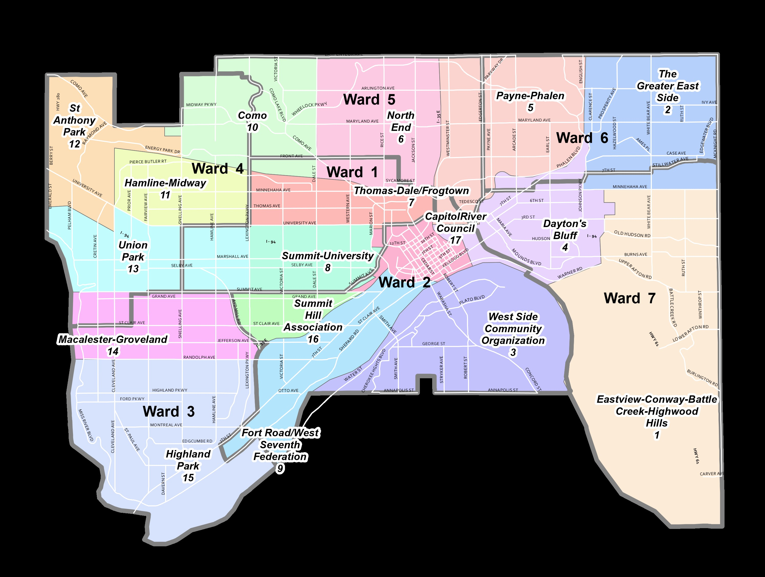
St. Paul’s Eastside
ESNDC
DBNHS

Slide 4
Funding Programs
CIB
Complicated Review Process
Neighborhoods, City Departments, Individuals
STAR
Competitive Grants and Loans
Neighborhood-based
Funded through City Sales Tax
$2-3M per year ($10,000 - $150,000)
15-20 projects
One-to-one match on funding

Slide 5
CIB Process Overview

Slide 6
STAR Process Overview
21 Member Neighborhood STAR Board
(Three from each council district)
Recommendations to City Council and Mayor
Board is appointed by Mayor
Approved by City Council

Slide 7
Three Questions
Who gets funding?
Has the process changed?
Is the Eastside getting its fare share?

Slide 8
Our Role
Sort through budget docs
Geocode projects
Assign projects to one or more planning districts
Population based equity analysis
Look at the process and rankings

Slide 9
CIB Tracking Spreadsheet
Project Submission
Committee Recommendation
Mayor Proposed
Council Approved
Track Rankings
Ratio of submission to approved $

Slide 10
Other Related Projects
Cedar-Riverside NRP
Brooklyn Park Immigrant Organizations
Police Budgets v. capital improvements
Ordinances adversely affecting immigrant communities
Phillips Community Park Equity

Slide 11
Thank you!
Jeff Matson
jmatson@umn.edu

