Slide 1
Understanding Neighborhood Investments
Charlotte, North Carolina
Notes:
We understand the difficulty of asking for and gathering data, particularly from a city. We’re large beasts with lots of data (and many heads), with not many people wrangling it all together. Here’s a look at involvement in projects around us and how its driven some changes internally

Slide 2
Charlotte, NC
Take a peek behind the curtain and see how some projects have impacted our internal processes:
Tracking investments
Answering questions about neighborhood(s)
Placing investments
Notes:
Today’s about process as much as it is about the data and the gaps between it all: The processes, the data, and the sharing of the data with and working with partners/stakeholders
We know these things:
+We are the stewards of some of the most robust information
+We are not the best at many things
+We are much more reactive than we are active

Slide 3
Capital Improvement Planning
Fulfilling Data Requests
Improve Internal Processes
Tracking Area Investments
Notes:
Three quick examples of the type of request, how we deal with them, and how we’re working to do better: improving the processes
Facilitate use of our data (QOL) and their own philanthropic and other private funds being tracked in developing a evaluation plan
Answering questions and working towards preparing our responses in a way to make replication easier
Going through the packaging of every bit of data on neighborhoods possible through CNIP
Main focus will be on the process to feed the first three and understand it’s slow going:
Improving internal processes to increase ability to report on our work in neighborhoods – internal AND external
Internal question: What will make your job easier? Not, “How can we capture all the information in one place?”

Slide 4
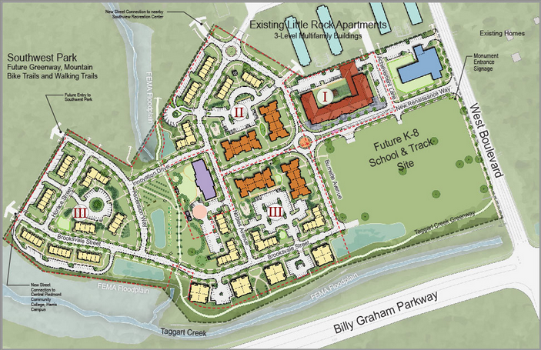
Renaissance West Community Initiative
Impact Area
Private (Permits)
Zoning / Redev
Data
City Operating
HOPE VI ($21m)
City ($7m)
HTF ($5m)
Tax Credits ($24m)
School ($30m)
Child Center ($4m)
New Businesses
Park and Rec
D.S.S.
Health Dept
Funding Source | Amount
Hope VI Funds (2009) | $20,900,000
City of Charlotte | $7,000,000
Housing Trust Funds | $5,000,000
Federal / State Tax Credits | $23,700,000
Child Development Center Operating Reserve* | $5,000,000
Charlotte-Mecklenburg Schools | $30,376,000
Philanthropy $4m for Child Development Center $3.5m Program funding (5 years) $2.5m Operations funding (5 years) | $10,000,000
Total | $101,976,000
Notes:
RWCI is a HOPE VI that started in 2009
The $100million already set aside (blue, left) is simply a starting point to get the program going. Sustaining the program with a full understanding of the investments is why we’re here
Blue is what is known to get the party started
Green we’re helping with
And
Red is the County which has much of the programmatic data.
At this point, it is important to mention that the county got involved with the QOL report in 2010 with the long-term goal of a joint capital improvement program.
And the QOL indicators will track the areas that feed these schools and programs over time.
Funding Source
Amount
Hope VI Funds (2009)
$20,900,000
City of Charlotte
$7,000,000
Housing Trust Funds
$5,000,000
Federal / State Tax Credits
$23,700,000
Child Development Center Operating Reserve*
$5,000,000
Charlotte-Mecklenburg Schools
$30,376,000
Philanthropy
$4m for Child Development Center
$3.5m Program funding (5 years)
$2.5m Operations funding (5 years)
$10,000,000
Total
$101,976,000
Hope VI Redevelopment
Community Center
334 units mixed-income (2:1 affordable:market)
K-8 School (2017)
235 Section 8 units (planned spillovers)
3,000 families on waitlist
“Impact Zone” population is ~2,000
We are seen as a data source (through QOL) as data for evaluation.

Slide 5
Example: Request from Hidden Valley
Email complaint about not doing anything in the neighborhood
Mayor requests all departments provide list of capital and program investments in the neighborhood in past 10 years
April 8 to April 24 to gather all information
+ QOL Explorer Report
Notes:
Our internal wakeup call (instead of hitting snooze)
This is how requests usually work: We receive an ask, then its: “Okay I have my data, what about his and hers, or theirs?” It is scattered and rarely in an easily combinable form; example:
1)April 8, Mayor and others get an email from Hidden Valley leader (a traditionally low-income/SES neighborhood) worried about non-investment and looking the other way
2)Mayor wants to meet with them and have information on investments that have been made over 10 years
3)Three weeks may be exceptionally fast, considering our organization is 15-some departments and we appreciate how unwieldy data gathering projects are. Still not acceptable
4)Timing was perfect--Had to show off the QOL report as a one-stop current conditions look. I’ll come back to this
Even so, our result: Due to multiple departments, countless programs/managers = varying degrees of completeness and timeframes, a hodgepodge of precision and funding data.
Image is what I sent to employees in our department

Slide 6
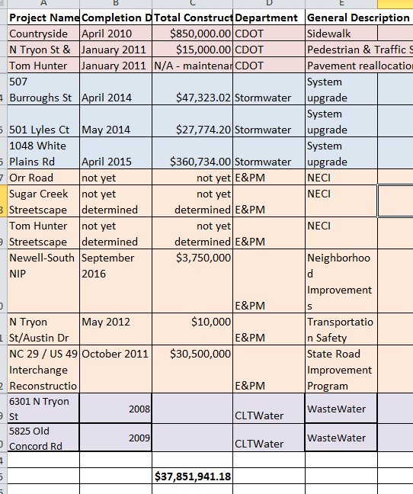
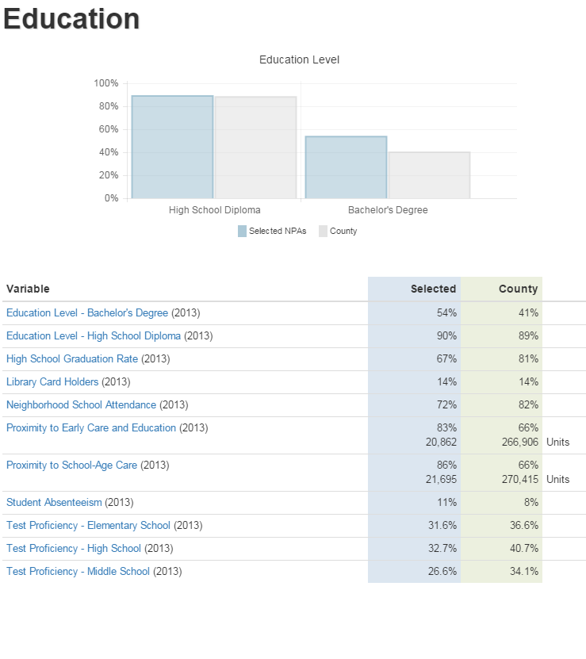
Actual Hidden
Valley Report
QOL Explorer
Report
Notes:
Three weeks of data gathering vs
18 months of building a program to report faster and more flexible
18 months is light-speed in city

Slide 7
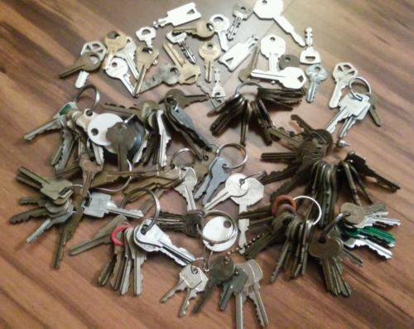
Comprehensive Neighborhood Improvement Program (CNIP)
Newest variant of a program that started in early ‘90s
5 areas receiving $120m capital improvement through 2020
Massive data collection
Multiple Tableau workbooks
220 internal datasets
Current conditions
Capital investments
Private investments
Retail developments
Apartments
Notes:
The request from hidden valley was nearly a year AFTER this – the data gathering for CNIP process.
CNIP is less about inside neighborhoods and more about connections between them.
Massive multi-month data collection: Compiled into multiple tableau workbooks for employees, consultants, public… Done to save money on consultant doing the data gathering (est ~$250k avoided). We had to find the keys to so much data
… and yet it still isn’t that great. It’s missing context and continuity between all the datasets (it is a data dump) and has very little by the way of private investments
The process was painful and missed plenty.
Recently the discussion has turned back into how we can track outcomes - hopefully attributable to the investments (especially when we work directly on redevelopment projects, such as Estland mall redevelopment – 80 acres).

Slide 8
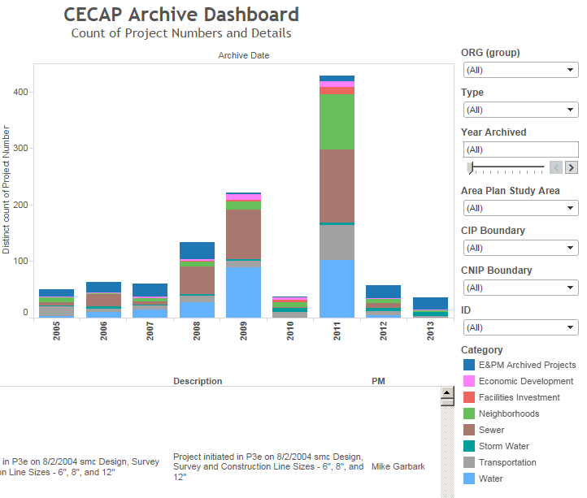
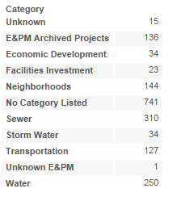
CNIP Dashboard
Notes:
One page from the Tableau workbook
Looks great, but what's the use if the data are fuzzy? The arrows are pointing to nearly 800 projects that aren’t captured with a good category and not even included in this visualization

Slide 9
So what?
We went back to the beginning:
How do we really want to do things?
Early 1990’s was the genesis of both the CNIP program and the Quality of Life Study
Already have open data work underway at enterprise level
We are slow and cumbersome
Reactive
Active
Notes:
Back to the beginning with CNIP and CWAC -- whether it was intentional or not, here we are – compiling how much investment was put into each inner-city neighborhood
Here we are again, with more tools going forward.
QOL used to include capital investments
Open data work is a bit of running before walking internally. “How can we open up datasets that we don’t even know we have?”
Highlight of it all: The QOL report used to show information about hidden valley was replicated for council members and city mangers office. The ability to quickly see what is going on prompted the question: How can we do this and MORE – become active

Slide 10
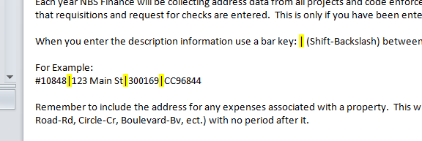
Internal Improvement
Need to start small
Our data sources span from years-old Excel Workbooks to live databases
Timing:
Hidden Valley was tipping point
Departmental ERP team worked to tag all payments to project location
The little wins mean the most:
Notes:
Be more active. Start at home (In Neighborhood and Business Services)
Due to the Hidden Valley request, increase in volume of other requests (from Council, etc), we decided to look at our data collection, storage and retrieval process
Currently we have data and data stewards on all parts of the spectrum – Excel workbooks that are very old to live databases. So we start small, with individual employees: how can we help make your job easier? The answers to that question drive improvements. Asking “When can I have your data” is far less likely to get a helpful response.
And the timing couldn’t have been more perfect:
We used QOL to pull a simple report for the 45 sources to hand to leadership THEN
Leadership wanted more (how do we get live data on all of the other projects just as simply). NBS to do its part.
ERP project payments the keystone to this project! Less guesswork in the $ arena.
Example:The improved process of delimiting the field will save the analyst ~ 2 weeks of work in report running
Bottom line: Neighborhood and Business Services is working to get its house in order to be the model for the rest of the enterprise.

Slide 11
Lessons Learned
Ask the right questions
Be patient
We’re not alone – internally or externally
Celebrate the wins
Notes:
Close: We know it’s tough, especially living inside the beast, and we’re trying to get better – its just a slow process of incremental improvements;
To get to this data utopia:
Pitch the need for data as necessary to make jobs easier not as a data smash and dash. As soon as we framed it as a “we may be able to help you do your job better through analysis” – everything changed
Be patient – city organization is a slow moving beast
Internal groups such as GIS or BI teams know there are improvements to make, and there is a large contingency (Code for Charlotte) outside the organization that wants to help. This is what helps leadership see the need to collaborate more and move the needle
Even things as small as helping one person delimit fields (which then helps others dive into the data) is a win and should be celebrated as even baby steps count.

