Slide 1
CURA Involvement
Vacant House database
Tornado response mapping
Housing Market Index

Slide 2
THE CHALLENGE OF NEIGHBORHOOD STABILIZATION
Foreclosure-Response.org report
Need to target funds efficiently, but easy to make mistakes
Good decisions requires data
2
Notes:
2
Setting Priorities for Neighborhood Stabilization report by Thomas Kingsley and others at the Urban Institute.
The main points they were making were that 1) funds are limited and 2) you must be strategic in both how and where they are applied if you want to see real impact. And to do this they developed a data-driven methodology based on both the strength of the housing market and risk of foreclosure.

Slide 3
ALIGNING POLICIES WITH NEIGHBORHOOD CONDITIONS
3
Notes:
3
LISC created a neighborhood classification matrix based on both Market Strength and Foreclosure Risk and developed a set of suggested strategies depending where you fall. The point here is that some neighborhoods can take care of themselves – those with low foreclosure risk and strong market strength – while others – those with high foreclosure risk and weak market strength – are better served by land banking, selective demolition and secured rental. The focus of reinvestment and home ownership should be in the middle – those neighborhoods that can be saved

Slide 4
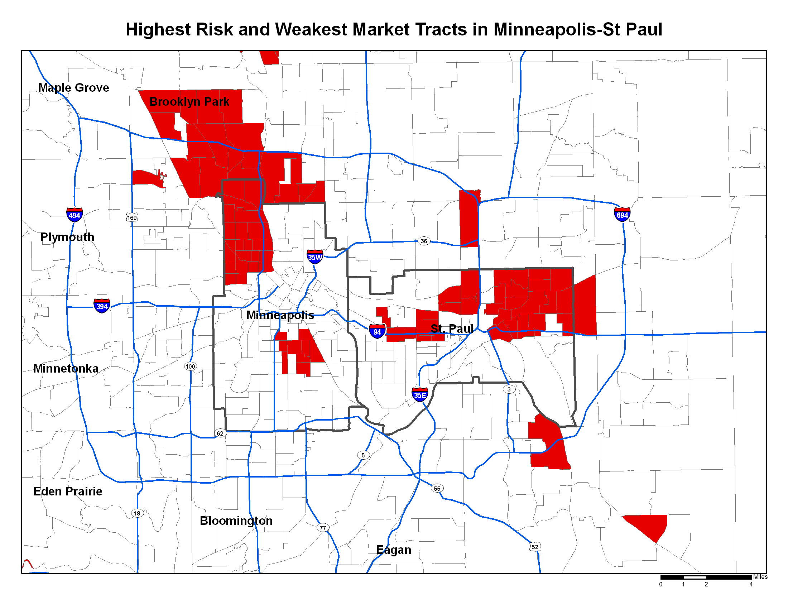
4th Precinct
Notes:
When you look at the LISC analysis the limitations in applying this to the Vacant House project are immediately clear. At a regional scale, almost the entire 4th precinct in falls into that most distressed category (weak market strength & high level of foreclosure) We wanted a more detailed analysis using local block and parcel-level data where possible and a view of what’s happening within north Minneapolis.
LISC variables on page 8 of report

Slide 5
Housing Market Index Variables
Value Retention
Owner-Occupants
Housing Quality Rating
Vacancies
Notes:
I’m going to go over briefly each of the variables that we used to calculate the Housing Market Index
-for all of these, the Land Use categories that we included in this analysis were
Residential, which is typically single family homes but also includes:
Double Bungalow
Condos
Townhouse
Triplex

Slide 6
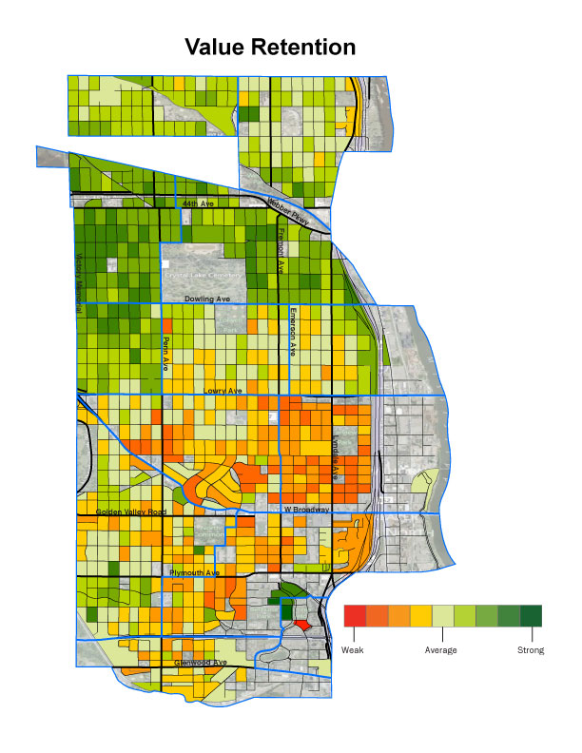
Value Retention
Estimated Market Value (2008 to present)
Captures intangible / undefined drivers of housing market strength
Blocks containing houses that lost the least amount of value are strongest
Notes:
-Average Value Retention of the houses on each block.
-Calculated VR by comparing EMV between end of 2008 and April 2011 (the month for which we have the most recent data).
-Houses reached their peak value in 2008, then almost all lost value, but there’s a lot of variation in loss, and that’s what this variable measures.
VR is a good way to capture intangible drivers of housing market strength (like access to parks and public transportation, the perception of safety, among other things).

Slide 7
Owner-Occupants
Percentage of Owner-Occupants
Incentive to invest / improve properties and stability of neighborhood
House is often the largest investment
Notes:
We looked at the percentage of Owner-Occupants on each block
Our primary assumption: owner-occupants are more likely to invest in the stability and long-term health of their neighborhood
We recognize that renters obviously care about where they live.
But as far as investing monetarily in a house, owner-occupants have more at stake since their homes are often their largest investment
So the higher the % of owner-occupants on a block, the stronger the housing market.

Slide 8
Housing Quality
Average Minneapolis Assessor’s Rating
Blocks with well-maintained houses are more attractive to potential buyers
The higher the rating, the stronger the block
Notes:
We looked at the block-level average score that the Minneapolis Assessor’s Office gave each house
Every 4 years each structure in Minneapolis gets an assessment on its physical quality.
If rationale behind this is that a block full of houses that are structurally sound and well-maintained is indicative of investment on the block.
If the housing stock on the block maintains a relatively high rating from the Assessor’s office, then the block will be more attractive to potential buyers.

Slide 9
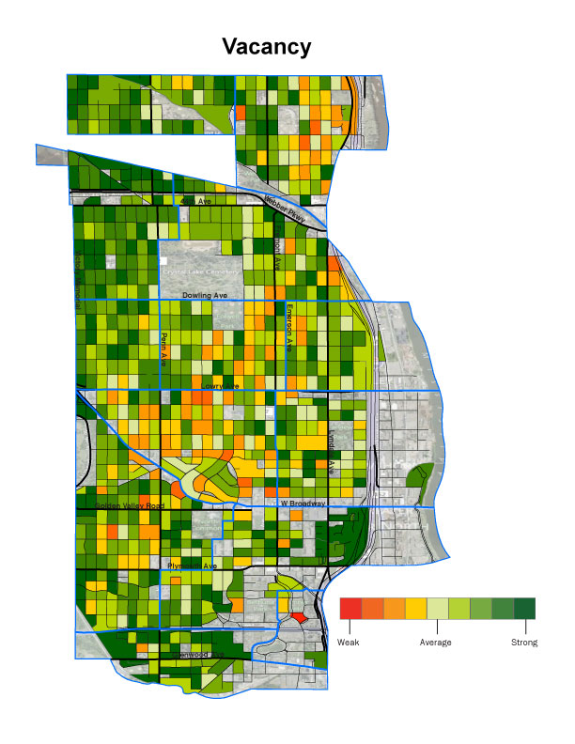
Vacancies
Percentage of residences that are vacant
Too many vacancies can lead to increase in crime, structural and landscaping neglect
The greater the number of vacancies, the less attractive the block
Notes:
Finally, we looked at the percentage of residences that are vacant
While a couple of residential vacancies on a block isn’t necessarily detrimental to a block’s livability, too many vacant houses can be problematic
Too many vacancies can attract crime (with fewer eyes on the street)
Structure and landscaping neglect
And this may diminish the appeal of the houses on the block that are actively for sale.
Fewer vacancies = better

Slide 10
Notes:
The HMI scores are determined by a weighted combination of the four variables. The process for combining them is detailed in the report on pages 7-9.
The idea is that this map will provide another layer of information to help policy makers form housing remediation strategies.
Improvements could be made by adding more variables (housing sales? Permits?)
Areas in red and orange shouldn’t been seen as lost causes but rather as areas of opportunity. I would also refer you to individual neighborhood maps starting on page 11 of the report.

