Slide 1
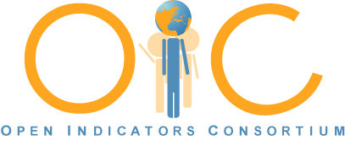
Open Indicators consortium: Evolving to an open source Learning community Weave and beyond
NNIP Meeting
ST LOUIS – April 3, 2014
Notes:
Today I will describe the work of the Open Indicators Consortium and the Weave open source data visualization platform and a sense of how it is being used by different organizations.

Slide 2
Brief History of the Open Indicators Consortium
2008: Seven organizations came together to create their own open source data visualization solution
Formed partnership with UMass Lowell Institute for Perception and Visualization Research
Intense interaction between Weave Users and Developers to guide development
2011: Weave 1.0 Released as Open Source
2014: Now up to 18 members and several hundred on User Group. Weave 2.0 soon.
Working on next stage: OIC as a broader Technical Learning Community
Notes:
All of us who founded the Open indicators Consortium were driven by a desire to bring community data alive in more powerful ways, to inject it into policy and planning work.
Weave’s Lead developer is
Georges Grinstein, head of the UMass Lowell Institute for Visualization & Perception Research

Slide 3
OIC Founding Members
Arizona (State University of Arizona, Innovation and County Indicators)
Metro Atlanta/Atlanta GA ( Neighborhood Nexus Partnership)
Metro Boston/Boston(  Metropolitan Area Planning Council and the Boston Indicators Project at the Boston Foundation)
Metro Chicago/Chicago IL ( Chicago Metropolitan Agency for Planning)
Columbus/Central OH ( Community Research Partners, MORPC)
Connecticut (CERC & CT Data Collaborative (with New Haven Hartford )
Rhode Island (Rhode Island Dept of Education and  the Providence Plan)
Seattle/King County Public Health Department 
NNIP Partners / HUD Sustainable Communities Grantee (7)
Additional Weave funders include NSF, NIST, USAF, IARPA, AstraZeneca, and others
Notes:
Each Founding member invested $150,000 to launch full development of Weave

Slide 4
Others involved in OIC
Other OIC Members
Centers for Disease Control and Prevention, HHS
Center for Houston’s Future
Kansas City - MARC 
MA Dept of Early Education and Care
Michigan Data Collaborative ( Grand Rapids /  Detroit)
Rockford Region Vital Signs
San Antonio Community Information Now 
So. Florida Planning Council
Learning Community Members:
Associated Grant Makers (MA)
Institute of Portland Metropolitan Studies, Portland State U. (OR) 
Utah Community Data Project
San Diego Association of Governments 
NNIP Partners / HUD Sustainable Communities Grantee
Notes:
Primary members joined with a contribution of $75,000.
Thirteen NNIP partners are among these groups and seven HUD Sustainable Communities Grantees

Slide 5
New Features Addressing Identified Needs
Integrating Multiple Open Source Tools– e.g. d3, Cytoscape.
Data Management Capabilities
CKAN Integration – viz tools for Open Data portals
Story Telling – linking views to tell a story
Analyst Workstation - integrates Weave and R statistics program for advanced analysis
Collaboration – built in multiple user collaboration with video, audio, and recording
ADA Compliance–text to describe a visualization
Notes:
These reflect a range of interests– not just indicators projects– as Weave has universal appeal.

Slide 6
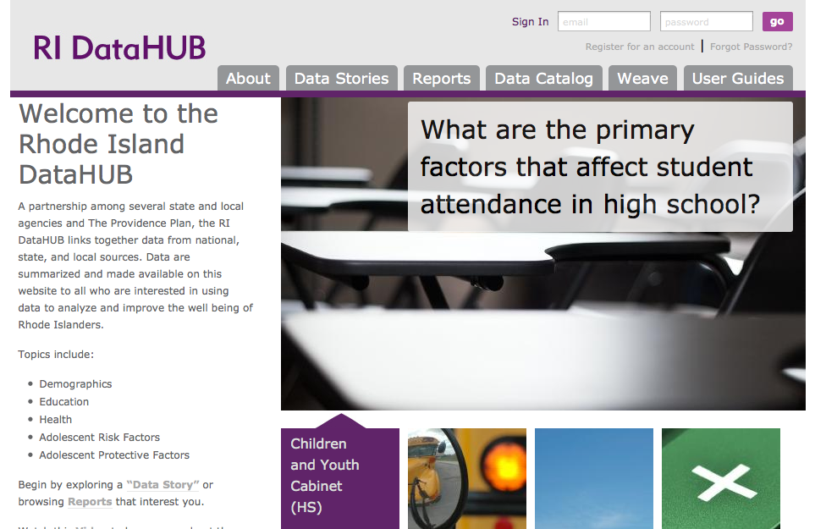
RIDatahub.org
Notes:
The Providence Plan has integrated Weave in to their Data Stories and Reports features on the RI DataHub

Slide 7
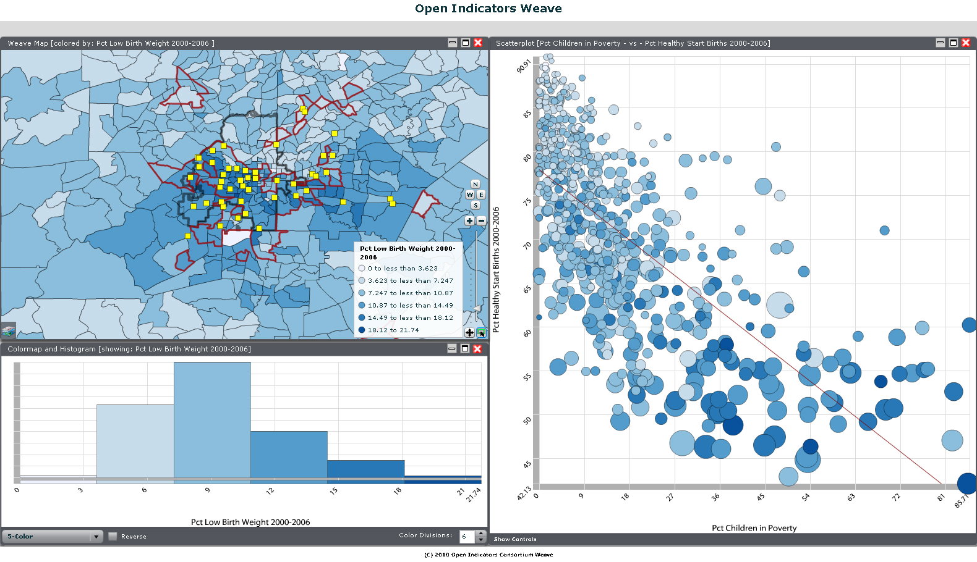
Atlanta Neighborhood Nexus
Relationship of Concentration of Poverty to Healthy Start Births and Low Birth Weight with Head Start locations
Notes:
This shows the relationship between Low Birth Weight on the map and in the scatterplot x is % children in poverty

Slide 8
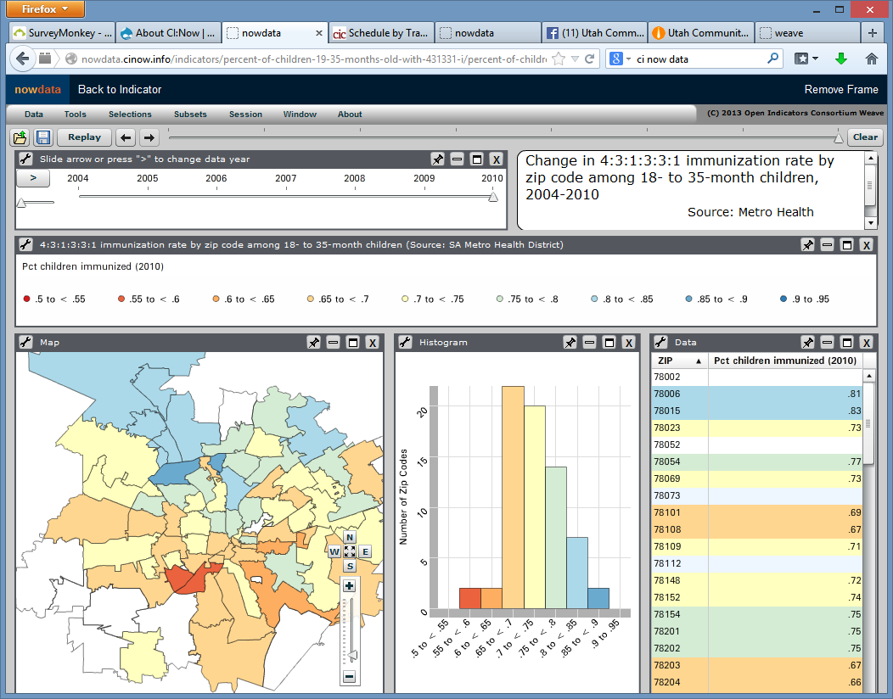
CI:NOW – San Antonio
Examining Immunization Rates by Zip Code
http://nowdata.cinow.info/
Notes:
Community Information NOW – in

Slide 9
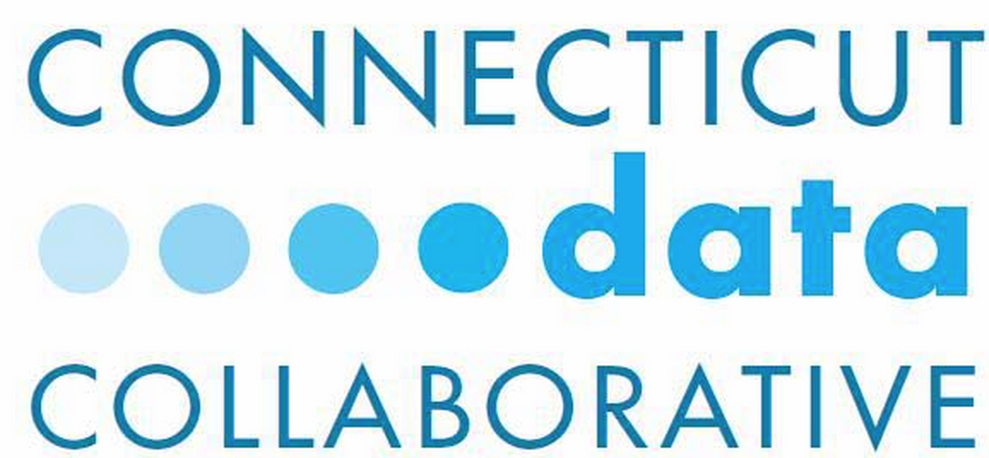
Connecticut – CTData.org
Integrating Many Open Source Tools
Drupal for Web Wrapper
CKAN with PostgreSQL for data management
GITHUB for code and data script repository
Multiple Data Visualization Tools
Highcharts (D3-based tool) for quick charting
Weave for more complex visualizations and exploration
Exploring Floodlight Project for Data Stories
Engaging with State on rollout of new Socrata Portal

Slide 10
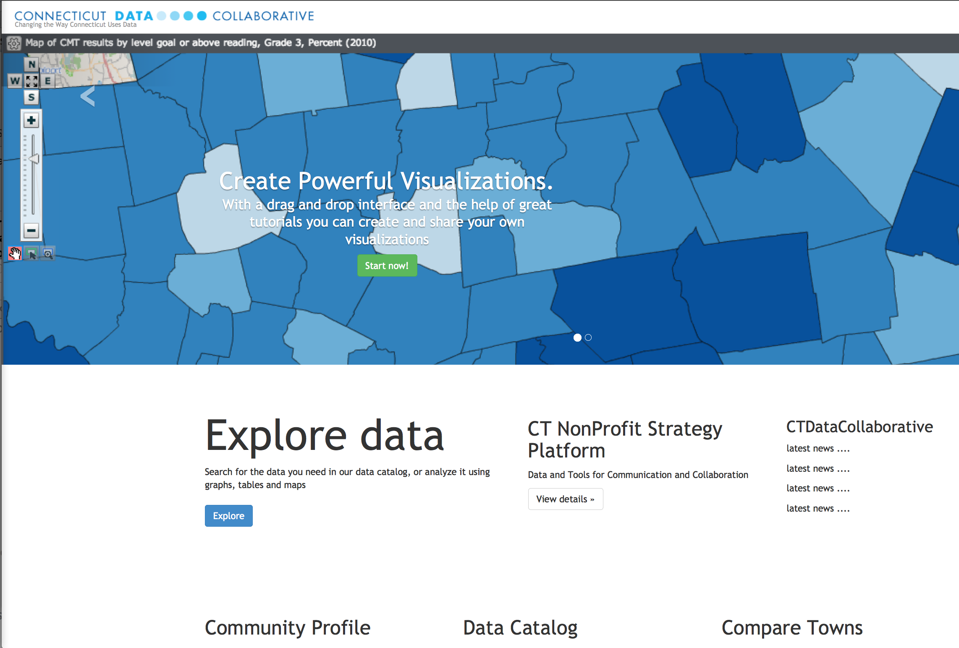
Connecticut Data Collaborative
www.ctdata.org
Notes:
The CT Data Collaborative which I coordinate was an early partner with UMass Lowell in developing Weave.
We tapped into a deep desire for
We articulated a vision to the Co-chairs of the Legislature’s Appropriations Committee of easier access to a wide range of data and the use of visualization tools to bring it to life.
If was our presentation to their committee that led directly to their demand to include the Collaobative in the recently passed state biennial budget.

Slide 11
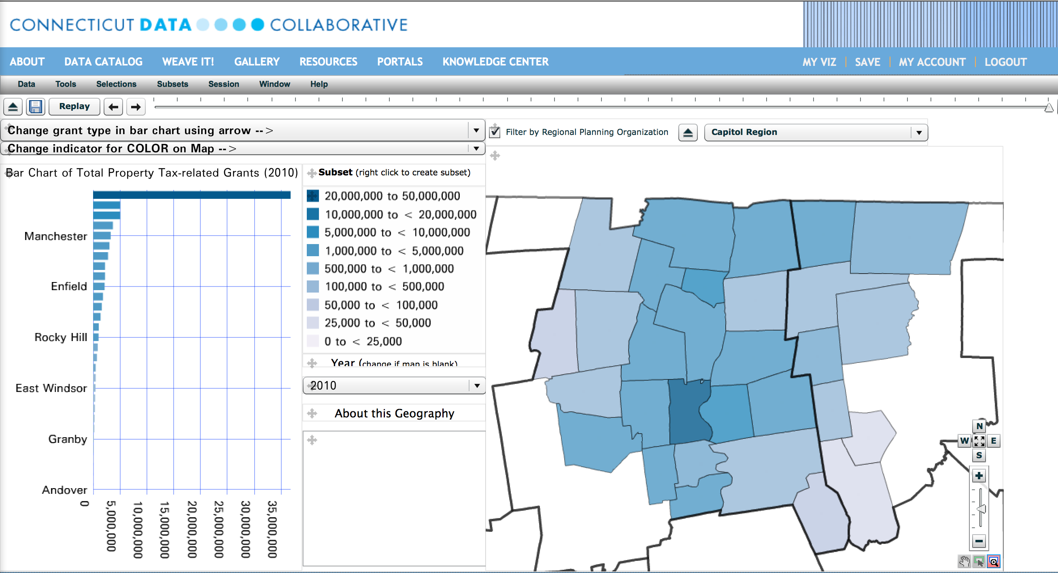

Slide 12
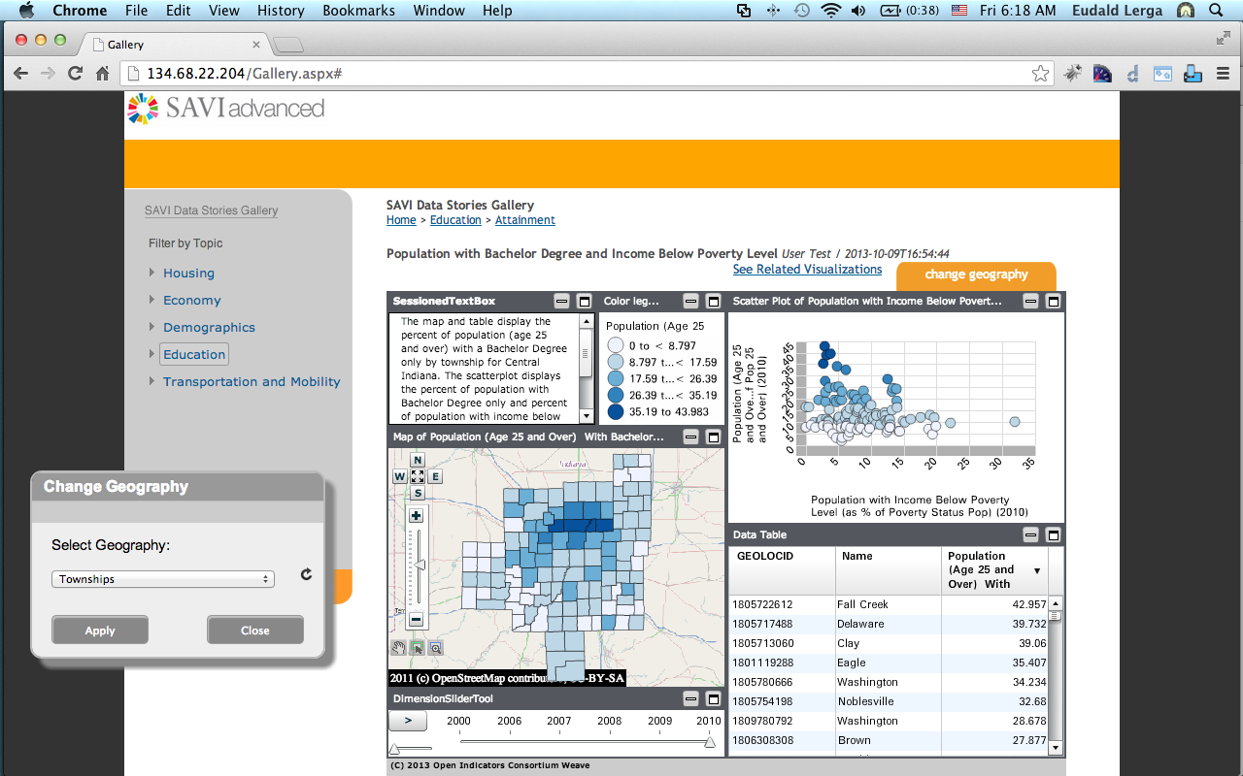
SAVI- Indianapolis – (beta)
Weave installation to create Data Stories

Slide 13
Utah Community Data Project
Found Weave online – open source and free
Developing a series of engaging interactive data explorers
Using Weave to engage partners in education and community planning
http://ucdp.utah.edu/

Slide 14
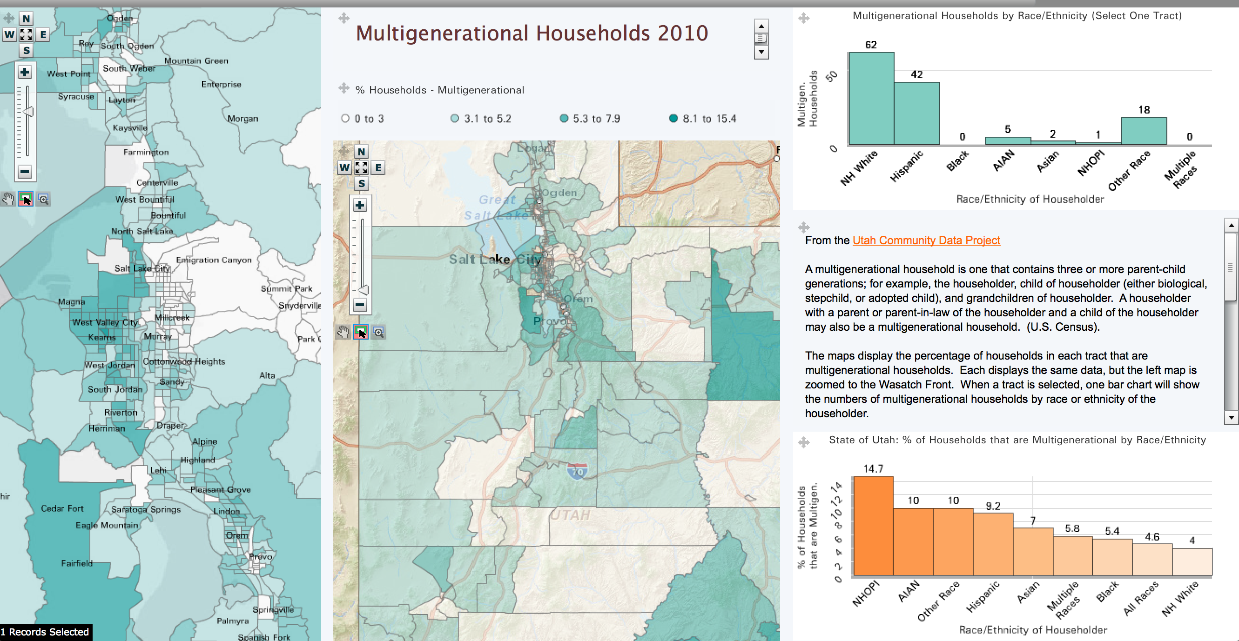
Utah COMMUNITY data project A Series of Data Explorers
Census Tract Explorer combining Regional Map, Zoom in Map, and Bar Chart

Slide 15
Emerging Directions: OIC as a technical learning community for the indicators movement
OIC Members are all developing new tools and approaches to inject data into policy, planning, and action at all levels
Looking to build a technical learning community around data presentation and visualization
Creating a process to identify common needs & strategies to meet them, share work and resources, and develop solutions.
We welcome new members
STAY TUNED!

