Slide 1
Reducing data overload using neighborhood indicators
Presentation for the Association of Public Data Users
Conference September 16-17, 2014
David Epstein
Research Associate
Baltimore Neighborhood Indicators Alliance
Jacob France Institute
University of Baltimore
www.bniajfi.org

Slide 2
Reducing data overload using neighborhood indicators
Isn’t data overload good? (More data!)
How do indicators reduce data overload?
How have indicators reduced data overload in Baltimore?

Slide 3
Isn’t data overload good? (more data!)
(Not really…)

Slide 4
Decision-Making and Data Overload
Herbert Simon won the Nobel Prize in 1978 for his pioneering research into decision-making within organizations.
http://www.nobelprize.org/nobel_prizes/economic-sciences/laureates/1978/simon-facts.html

Slide 5
The rational model of decision-making holds that actors:
List all options;
Determine all the consequences that follow each option;
Comparatively evaluate these sets of consequences
Paraphrasing: Simon 1997(1945), page 77 and 93

Slide 6
The rational model of decision-making holds that actors:
List all options;
Only a subset of all options ever come to mind.
Determine all the consequences that follow each option;
Knowledge of consequences is always fragmentary.
Comparatively evaluate these sets of consequences
Future values can only be imperfectly anticipated.
Paraphrasing: Simon 1997(1945), page 77 and 93

Slide 7
Currently, when faced with decisions:
The problem is not a lack of information but our capacity to attend to all the information available.
We must select the information that is likely to be useful and ignore the rest.
Technology should permit us to absorb information selectively.
Paraphrasing: Simon 1997(1945), page 226
Absorbing selectively…
Image source: http://www.steamfeed.com/state-information-overload/

Slide 8
How do indicators reduce data overload?

Slide 9
“A major initial step…is to extract opportunities and problems from the confusion of the environment—to attend to the right cues.”
Simon 1997(1945), page 123
Break lights alert other drivers to the situation ahead. Similarly, data indicators permit concise summarization of the situation.
http://livinginthepast-hs-and-fpc.blogspot.com/2013/11/just-visiting-victor-countess.html

Slide 10
The Information Pyramid
Indices
Indicators
Analyzed data
Primary data
Phillips (editor) 2005, Community Indicators Measuring Systems, page 4 (reprint of Hammond et al. 1996, page 1)

Slide 11
Functions of indicators
Description
Simplification
Measurement
Trend identification
Clarification
Communication
Catalyst for action
The primary focus of indicator producers
The primary focus of indicator users
Table source: Phillips (editor) 2005, Community Indicators Measuring Systems, page 5, from multiple sources.

Slide 12
How have indicators reduced
data overload in Baltimore?

Slide 13
About BNIA-JFI
BNIA-JFI was born in 2000 after a two-year planning process that included
Citywide nonprofit organizations
City government agencies
Neighborhood associations
Foundations
Gathered together by the Association of Baltimore Area Grantmakers and the Annie E. Casey Foundation.
Longitudinal data (2000 – Present)
Work with non-profits, foundations, universities, researchers, businesses, students, residents
Member of the National Neighborhood Indicators Partnership (NNIP) at Urban Institute

Slide 14
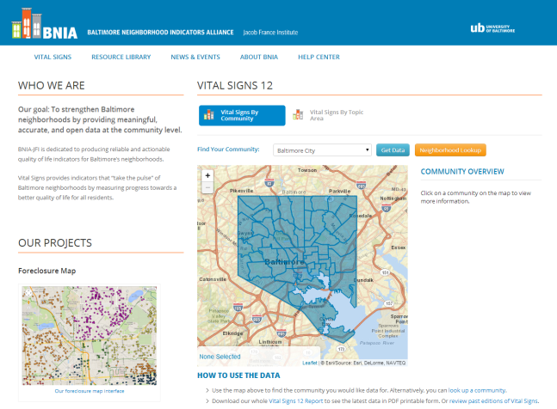
Baltimore Neighborhood Indicators Alliance is a Data Intermediary
Data Cleaning, Geocoding & Linking (when permitted)
CitiStat
Library
And much more!
Police
Schools
Vital Statistics
Users
Users
Users
Users
Users
Users

Slide 15
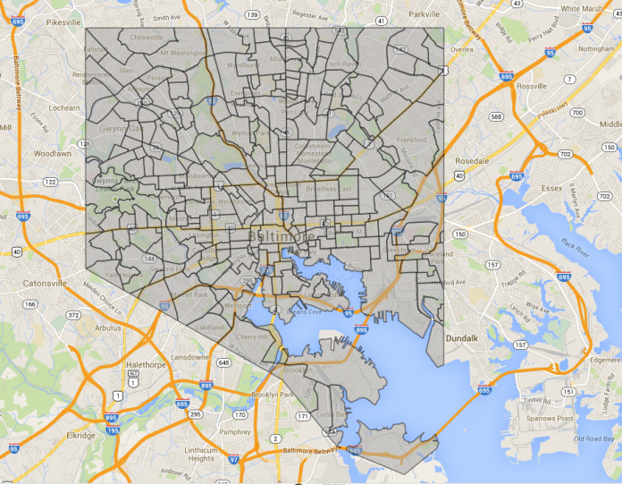
Reducing Data Overload by Reducing the Units of Analysis
(Reducing the number of records / rows)
621K people
236K parcels
278 Neighborhood Statistical Areas
55 Community Statistical Areas

Slide 16
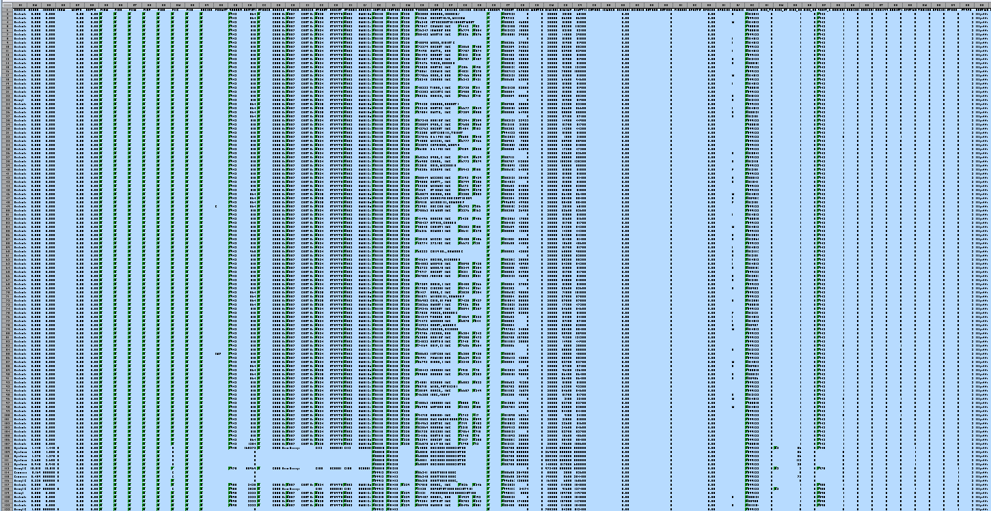
Reducing Data Overload by Reducing the Number of Measures
(Reducing the number of fields / columns)
This field only, as a percentage

Slide 17
http://bniajfi.org/

Slide 19
Percentage of houses that are owner occupied 83.6

Slide 20
The pre-segmented file for this indicator had 235,831 records with 136 fields.
The statewide source has 1,545,103 records with 136 fields.
Percentage of houses that are owner occupied 83.6

Slide 22
BNIA maintains a data sharing agreement with Baltimore City Public Schools and is the only organization in the city to produce education indicators by neighborhood instead of by school.

Slide 23
The attendance file had 88,460 records in 2012 including transfers between schools.
High School Completion Rate 75.8

Slide 24
Thank you! Questions?

