Slide 1
Can Data Drive Policy and Change in Oakland Schools?
Taking Aim at Inequities Confronting
African American Male Students in OUSD
NNIP Providence 2012
Urban Strategies Council www.urbanstrategies.org

Slide 2
Why Focus on African American Males
Academic Achievement: In 2009, 9% of African American male 8th graders and 33% of White male 8th graders were proficient or higher in reading on the National Assessment of Educational Progress.
Graduation: In 2008, the national graduation rate for African American males was 47%, compared to 78% for White males.
Suspensions: In the 2006-07 school year, 19% of Black male students received out-of-school suspensions, compared to 7% of White male students.
Incarceration: In 2001, Black males had a 32% lifetime chance of going to state or federal prison, compared to 6% for White males.
Notes:
All figures are for the U.S.
Source for poverty figures: U.S. Census Bureau, as cited on Kids Count Data Center, Annie E. Casey Foundation. Available online at http://datacenter.kidscount.org.
Note: These data are not available by gender.
Source for academic achievement figures: The 2010 Schott 50 State Report on Public Education and Black Males. Available online at http://blackboysreport.org.
Note: Proficiency on the NAEP is not equivalent to proficiency on the California Standards Test.
Source for graduation figures: The 2010 Schott 50 State Report on Public Education and Black Males. Available online at http://blackboysreport.org.
Note: These graduation rates are calculated differently than the NCES method used for OUSD graduation rates.
Source for suspension figures: Source: The 2010 Schott 50 State Report on Public Education and Black Males. Available online at http://blackboysreport.org.
Source for incarceration figures: US Department of Justice, Bureau of Justice Statistics: Prevalence of Imprisonment in the US Population, 1974-2001. Available online at http://bjs.ojp.usdoj.gov/content/pub/pdf/piusp01.pdf.

Slide 3
African American Male Achievement Initiative
Oakland Unified School District
Urban Strategies Council
East Bay Community Foundation
Initiative aimed at addressing the disparities in educational and social outcomes for African American males in Oakland.
Notes:
Our Role:
Literature Review of Policy & Practice
Deep data analysis
Policy & Practice recommendations

Slide 4
AAMAI Goal Areas
Achievement Gap (English Language Arts and Math)
High School Graduation
Literacy (4th Grade)
Suspension
Attendance
Middle School Holding Power
Juvenile Detention (Incarceration)
Notes:
The thorniest indicators to develop were middle school holding power (because of the need to clarify the term) and incarceration/detention (because of the need to forge a new data-sharing agreement with the Alameda County Probation Department.
For context:
From 6th through 12th grades, nearly one in five OUSD students was an African American Male in 2010-11.
Number of AAM in K-12: 6,415

Slide 5
Students Proficient or Higher in English Language Arts (California Standards Test): Grades 2-11 2005-06 to 2010-11
Source: Oakland Unified School District (OUSD)
Notes:
ACHIEVEMENT GAP (ENGLISH LANGUAGE ARTS)
A large gap exists between the percentage of AAM and White male students in OUSD scoring proficient or advanced in English Language Arts on the California Standards Test.
From 2005-06 through 2010-11, the percentage of AAM proficient or advanced in English Language Arts increased from 16% to 29%.
The percentage of White males proficient or higher increased less dramatically over that time, so the gap between AAM and their White male peers decreased – from 57 percentage points in 05-06 to 49 percentage points in 2010-11.
Exercise caution in interpreting these results, as White male enrollment is concentrated in the elementary grades, when students in all groups tend to be more likely to score proficient or advanced on the CST.
2010-11 Enrollment in Grades 2-11
African American Males: 4,097
White Males: 1,293

Slide 6
Graduation Rate: 2008-09
Source: California Department of Education Research Files (OUSD calculations)
Note: Graduation rate equals the number of graduates divided by graduates plus dropouts in grades 9-12.
Notes:
GRADUATION
When developing indicators, the assumption that we needed to compare outcomes to white males was often invalid- equality without quality is a stupid goal- we had to create realistic but desirable benchmarks and targets as all groups were underperforming.
The AAM graduation rate indicates that fewer than half of 9th graders are graduating from high school four years later.
The AAM graduation rate is lower than the district-wide graduation rate and the rate for White males.
Note: The graduation rate equals the number of graduates divided by graduates plus dropouts in grades 9-12. (National Center for Education Statistics formula)
Number of Graduates: 2008-09
African American Males: 280
White Males: 48
OUSD Total: 1,671

Slide 7
Percentage of Students in All Grades Suspended Once or More, 2005-06 to 2010-11
2015 Target: 5% or fewer
Source: Oakland Unified School District (OUSD)
Note: District average includes African American males.
Notes:
SUSPENSION
The percentage of AAM students suspended once or more hovered around 17-19% from 2005-06 to 2010-11.
The gap between the suspension rate for AAM and White males is very large.
Enrollment in Grades K-12: 2010-11
African American Males: 6,415
White Males: 2,145

Slide 8
Graduation Indicators
Notes:
Informed by research on early warning signs related to risk of dropping out.
OUSD later built out a different early warning set of indicators. Similar.

Slide 9
Off-Course African American Male Students, by Risk Factor & School Level, 2010-11
 | Elementary (877 students) | Middle School (798 students) | High School (504 students)
Chronically Absent | 73% | 38% | 65%
Suspended Once or More | 33% | 73% | 41%**
Poor Academic Performance* | 28% | 41% | 63%
Retained (Left Back) | 7% | 0% | 18%
*Below Basic ELA for Grades 2-5, F in English or Math for Grades 6-8, GPA below C for Grades 9-12
**In our rubric, off-course for high school was defined as having more than one suspension.
Notes:
In which areas are off-course African American boys struggling the most (i.e. are more of them off-course because of academic, attendance, or behavior problems)?
Chronic absence is a key issue for AAM in elementary school and high school , with 73% of off-course AAM in elementary and 65% in high school displaying this risk factor.
Suspension is a key issue for AAM in middle school, with 73% of off-course AAM displaying this risk factor.
Poor academic performance affects nearly half of off-track AAM middle school students, and 63% of off-track high school students.
More than one in six (18%) off-course AAM in high school were left back at the end of the 2010-11 school year.

Slide 10
Percentage Suspended Once or More by School Level OUSD 2010-11

Slide 11
Percentage Suspended by Reason (Grade K-12) OUSD 2010-11
Notes:
Note that this is the percentage of all students suspended for each offense (e.g. 9% of African American boys in OUSD were suspended for disruption/defiance in 2010-11, while 3% of other students were suspended for that offense).

Slide 12
Total Days of Instruction Missed by Males Due to Suspension in OUSD in 2010-11
Notes:
But what does this mean as far as outcomes and chances to learn across our city?

Slide 13
Suspension Recommendations
Accountability
School- and district-level targets
Offense Focus
Accountability plans
Focus interventions on offenses driving disparities
Expand array of interventions
Create district-level intervention team
Use site discipline committees
Records & Data
Track specific behavior
Require reporting of referrals & classroom suspensions
Process

Slide 14
Percentage of Students in All Grades Chronically Absent (Absent 10% of School Days or More) 2006-07 to 2010-11
Source: Oakland Unified School District (OUSD)
Note: OUSD figures include African American males.
Notes:
ATTENDANCE
AAM students are more likely to be chronically absent than OUSD students as a whole.
In 2010-11, the proportion of students who were chronically absent declined, both among AAM and for OUSD overall.
Still, in 2010-11, one in five AAM students missed 10% of school days or more.
In 2010-11, 1,267 AAM students in grades K-12 were chronically absent.

Slide 15
Types of Absences – Elementary Students OUSD 2010-11
Notes:
AAM missed more than twice as many days due to illness, on average, as other students, though illness was the leading cause of days missed for both AAM and non-African American elementary school students. For every absence reason, AAM missed more days than did other students.

Slide 16
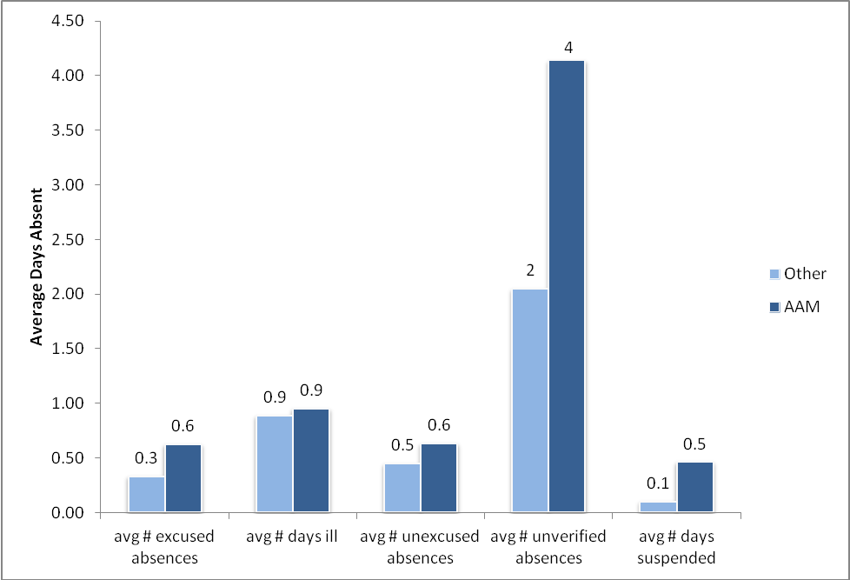
Types of Absences – High School Students OUSD 2010-11
Notes:
At the high school level, unverified absences accounted for more days missed than any other type of absence, both for AAM and other students. AAM missed twice as many days due to unverified absences as did their peers.

Slide 17
Attendance Recommendations
Data and
Procedures
Address early grade chronic
absence among AAM and
support engagement of AAM in
Early Childhood Education programs.
Work with African
American male students and their families to get to school on time and regularly, using local
resources.
Policy and
Procedure
Designate a single senior
administrator responsible for attendance efforts for African American males.
Review and revise
attendance policy with input of African American males and their families.
Student, Family
and Community
Engagement
Explore patterns of tardiness
and truancy for AAMs to see
whether and they are linked
to chronic absence.
Use data disaggregated by
race/ethnicity and gender to track African American male chronic absence, and use it to intervene early.
Make attendance policy and
the connection between
attendance, school
achievement and graduation a
focus of student instruction and family engagement.
Apply standards for absence (excused and
unexcused) and tardiness
equitably to all students.

Slide 18
Impacts: Connecting Data to Policy
Establishing district targets for all schools
Year-round monitoring of disaggregated data
Examining where chronic absence is concentrated
Identifying inspiring outliers
Engaging school leaders through data, professional development, site planning
Using chronic absence as Early Warning indicator
Notes:
Early warning systems to track and support intervention
Clearer data distribution
Policy changes- pilots on suspension alternatives +++

Slide 19
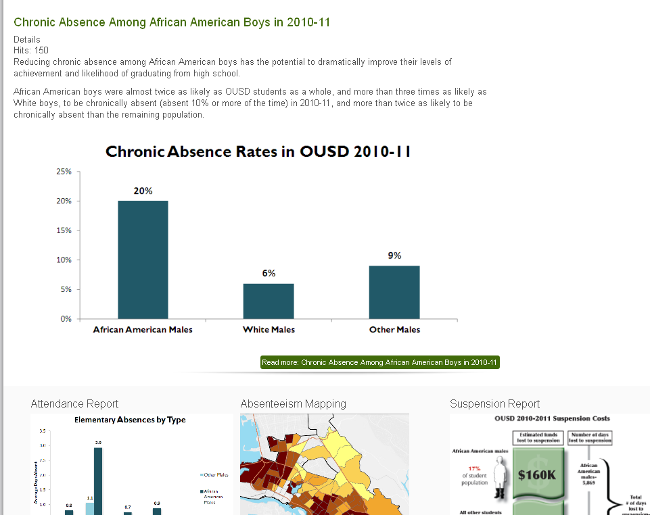
Getting the word out

Slide 20
Reflecting
Define equity and educate the community on its importance
Engage community and ensure leadership is representative of the community
Focus on increasing equity and achievement
Apply targeted universalism
Continually assess for and address equity
Build data systems to support equity and effectively use data
Establish explicit equity outcomes and accountability for achieving them
EQUITY
FRAMEWORK

