Slide 1
Using Data to Spur New Conversations About Public Schools in Pittsburgh
NNIP Meeting
September, 2012
Bob Gradeck
University of Pittsburgh
University Center for Social and Urban Research
Notes:
Albert the Owl

Slide 2
City of Pittsburgh School District
Population, 1980-2010
9% Loss 2000-2010

Slide 3
City of Pittsburgh School District
Population Under Age 18, 1980-2010
25% Loss 2000-2010

Slide 4
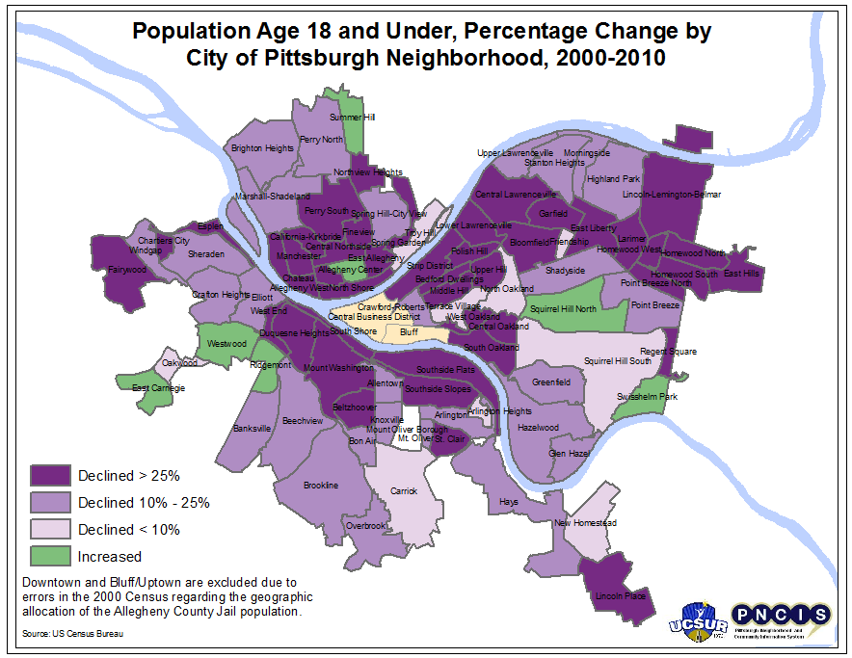

Slide 5
City of Pittsburgh School District
Share of Population Under Age 18 and Share of Households with Children Under Age 18, 1980-2010

Slide 6
Pittsburgh School District
Student Enrollment by School Type and Level, 2011-12 School Year
Type | K-5 | 6-8 | 9-12
Public | 73% | 72% | 68%
Charter | 8% | 7% | 13%
Private | 19% | 21% | 19%
Notes:
25K public, 3K charter, 7k private

Slide 7
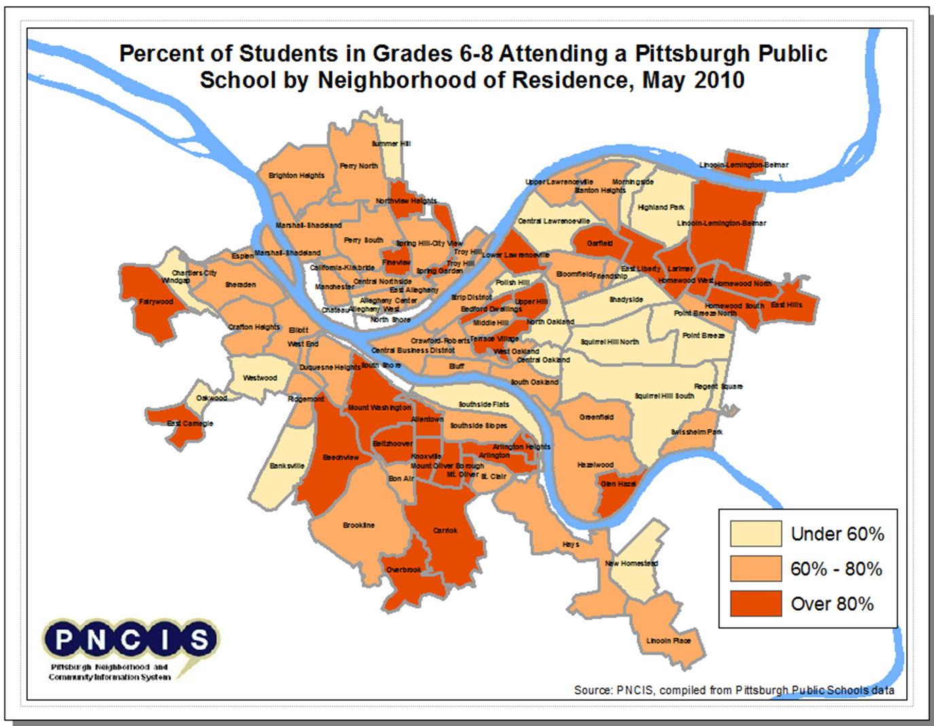
Limited school district capacity to conduct geographic analysis
Opened the door to a working relationship and student data
Provided training to staff
Made maps and shared them
Public school market share by neighborhood
Assigned school market share by neighborhood
Other neighborhood issues affecting students
Notes:
Mascot Skate Image

Slide 8
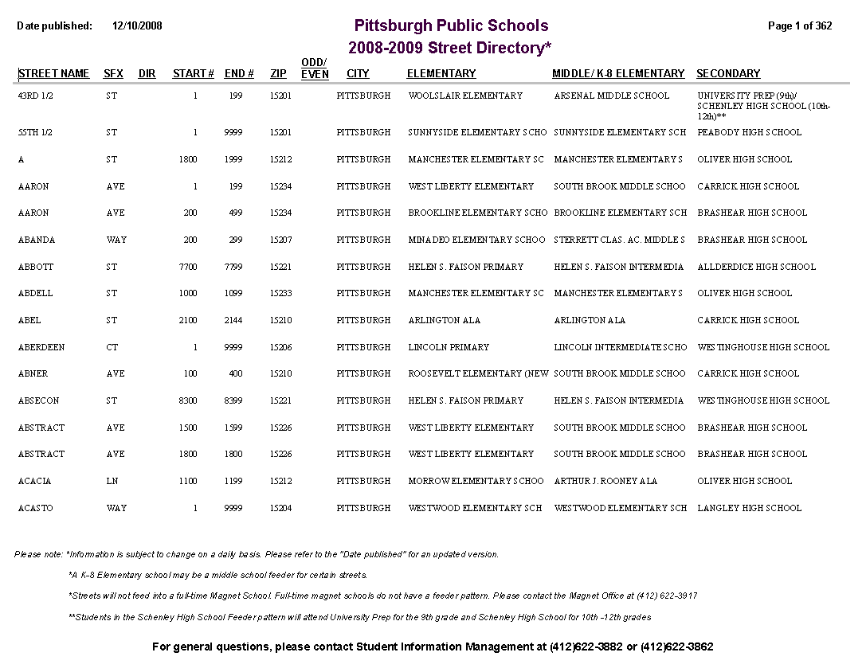
Recent school closings required a redrawing of attendance boundaries
School assignments were not made using maps. It had been easy to make small changes without anyone knowing

Slide 9
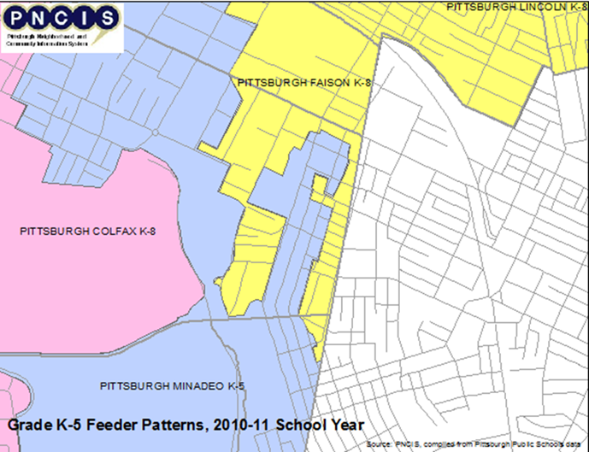
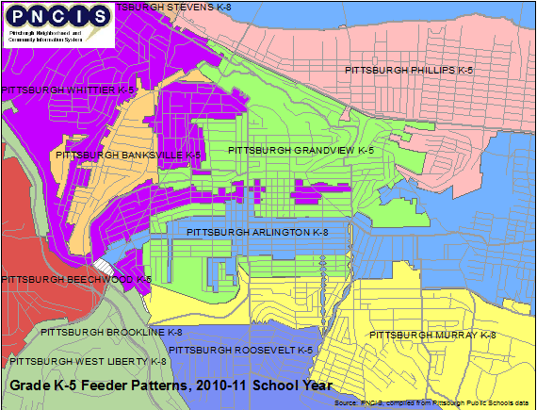
This system led to lots of strange maps…

Slide 10
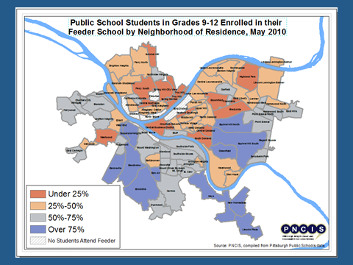
Our analysis was incorporated into criteria for closing schools
Building Condition
Achievement
Enrollment
Market Share

Slide 11
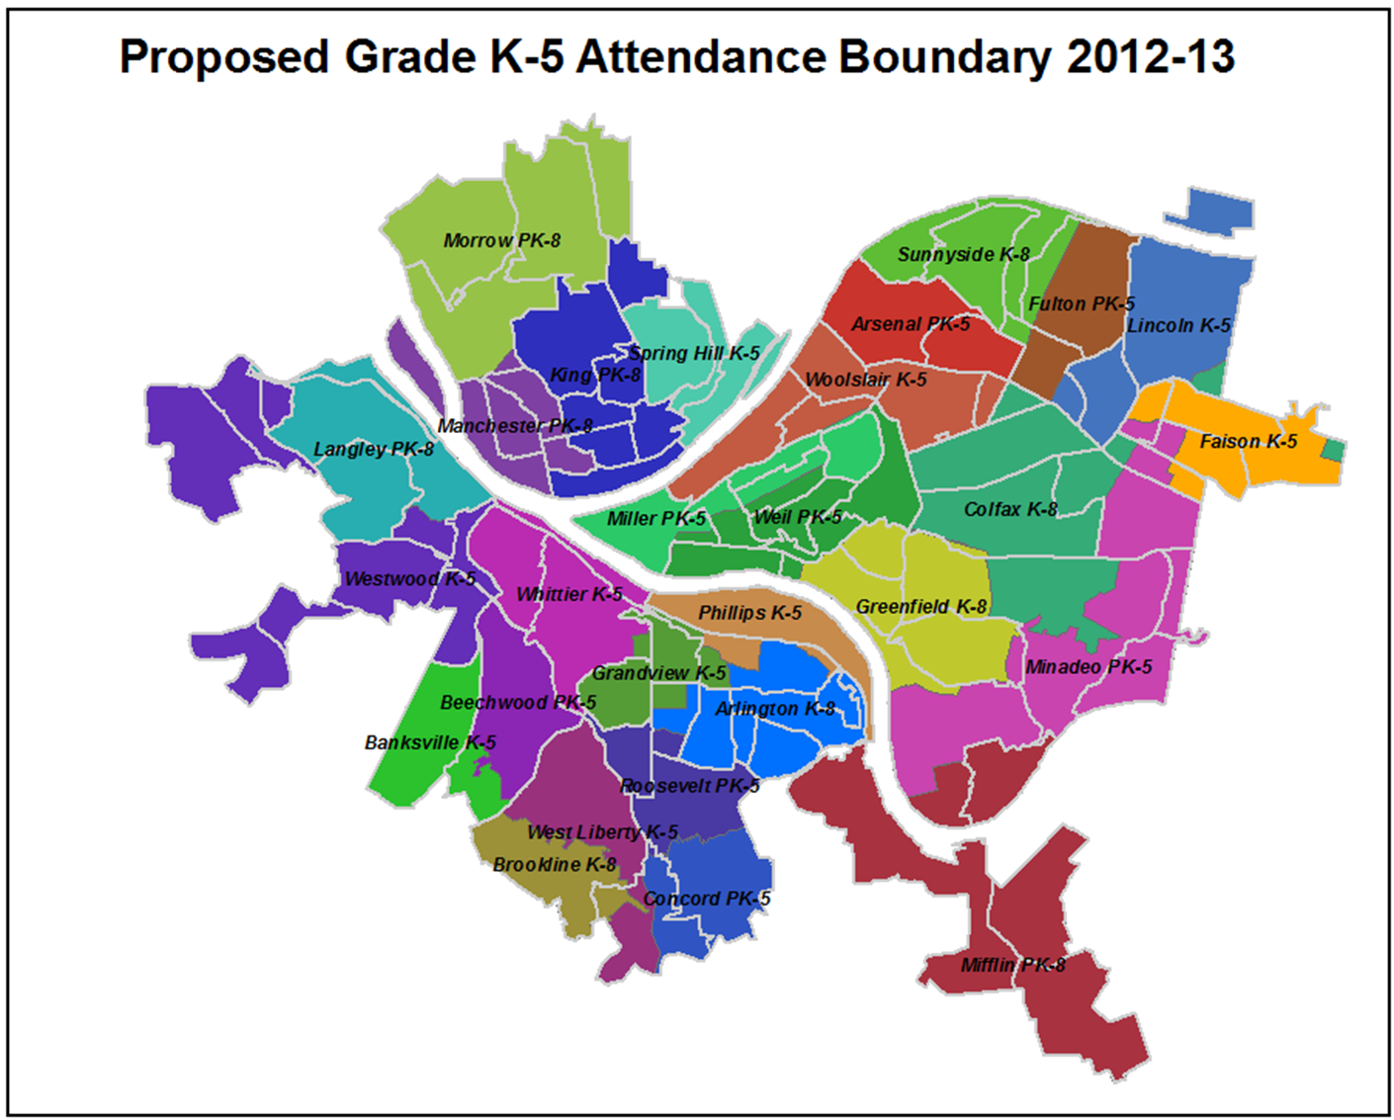
Toward more-rational boundaries
Break boundaries along neighborhood lines or major roads
Consistent K-5, 6-8, and 9-12 boundaries to keep cohorts of children from the same school together during transition years

Slide 12
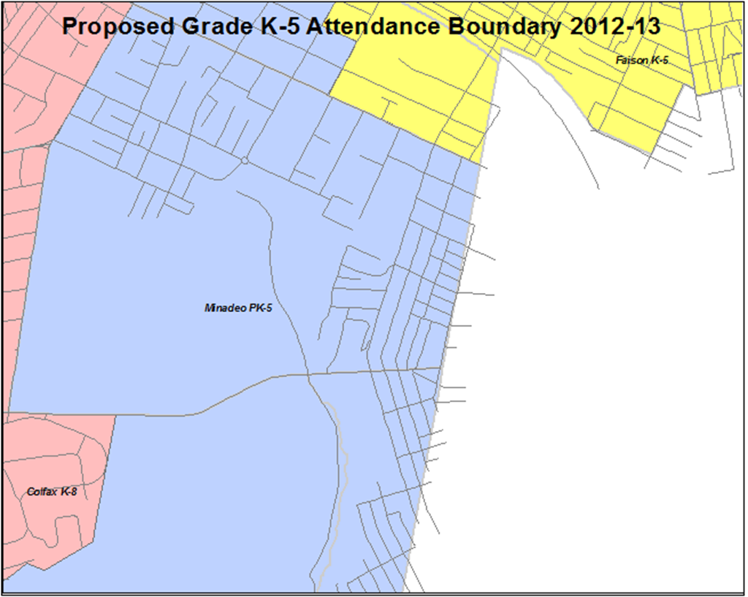
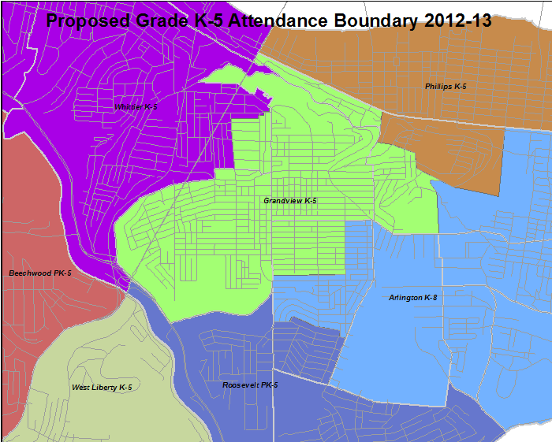
Before and after

Slide 13
New work: Advancing the vision and goals of three organizations:
Pittsburgh Public Schools: Become a “district of choice”
City of Pittsburgh: Attract and retain younger residents
Pittsburgh Promise: Reverse population and enrollment decline in the City

Slide 14
Up to $10,000 per year (up to four years) for postsecondary education
All public and charter graduates eligible in the City of Pittsburgh

Slide 15
Key research questions
How is the Promise affecting Pittsburgh’s housing market dynamics and community stability?
Has the Promise affected how families choose schools?
How can the City’s community development system become better-aligned with the opportunities of the Promise?
Notes:
Mention DHS…

Slide 16
Where we are now…
Convened meeting of community development, governmental, and education organizations to discuss issues related to schools and neighborhoods in March
Have assembled a research team composed of UCSUR, Pitt’s School of Education, and RAND
Preparing proposals at the request of interested funders

