Slide 1
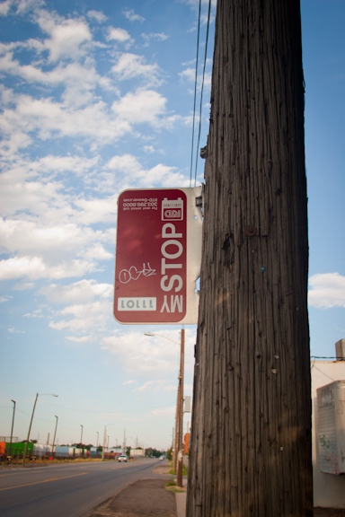
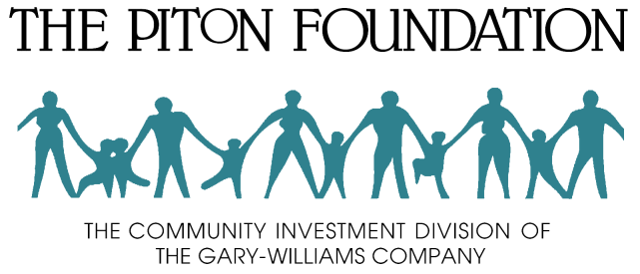
Denver Regional Equity Atlas:
A collaborative information project
Jordan Wirfs-Brock
jbrock@piton.org
@jordanwb
NNIP Parter Meeting
September 13, 2012
Brigid McAuliffe/The Piton Foundation

Slide 2
Mission Statement
The Mile High Connects mission is to ensure that the Metro Denver regional transit system fosters communities that offer all residents the opportunity for a high quality of life.
Partners
Includes local and national private, public and nonprofit organizations.
Anschutz Family Foundation
The Colorado Health Foundation
The Denver Foundation
Enterprise Community Partners
First Bank
The Ford Foundation
FRESC: Good Jobs, Strong Communities
Gates Family Foundation
Housing & Homelessness Funders’ Collaborative
J.P. Morgan Chase
Kaiser Permanente
L.P. Brown Foundation
Linda D. Campbell Fund
Living Cities
Piton Foundation
Reconnecting America
Rose Community Foundation
Surdna Foundation
Urban Land Conservancy
U.S. Bank
Wells Fargo

Slide 3
http://milehighconnects.org/equity-atlas.html
Demographics
Housing
Health
Education
Jobs

Slide 4
For many low income families who choose schools outside their neighborhoods, public transportation is their only way to get there. Of the 787 public schools in the metro area, 24.5% are located within a mile of existing or planned FasTracks stations. But the quality of those schools is, generally, lower than the metro area as a whole:
For all metro public schools, 85.4% are rated as “Performance” or “Improvement,” the two highest SPF categories. But for schools within one mile of stations, only 76.0% are in the top two categories.
Among the top quarter of schools, only 15.4% are within a mile of stations.

Slide 6
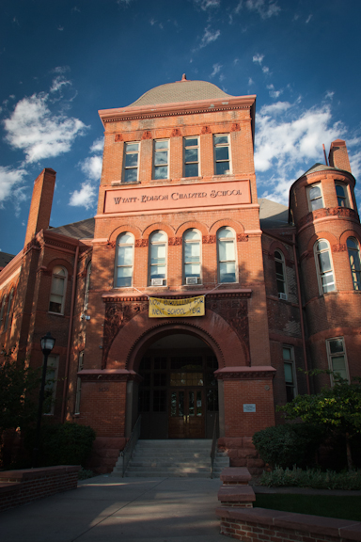
Brigid McAuliffe/The Piton Foundation

Slide 7
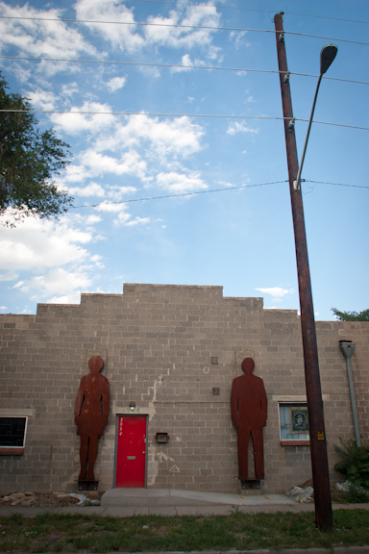
Action Steps & Recommendations
Increase outreach to education decision-makers to reinforce the importance of transit.
Encourage brick-and-mortar investments in early childhood centers and K-12 schools to locate near transit lines.
Prioritize improving school performance for schools located within a half-mile of transit.
Create intergovernmental relationships between school districts to plan for highly-mobile, low-income students.
Provide last-mile connections between schools and transit stations.
Brigid McAuliffe/The Piton Foundation

