Slide 1
Income Inequality and Change in Connecticut’s neighborhoods: Brought to you by DataHaven and NCDB
Mary Buchanan, Project Manager
mary@ctdatahaven.org
New Haven, Connecticut
DATAHAVEN
Data for Community Action

Slide 2
Neighborhood Segregation – Summary
High number of neighborhoods that are both economically segregated areas AND racially segregated
2x more affluent & segregated neighborhoods than poor & segregated neighborhoods in CT
Racially and economically segregated neighborhoods more highly concentrated in CT than in most other large metro areas
DATAHAVEN
Data for Community Action

Slide 3
Neighborhood Segregation - Methodology
Census tracts defined as:
Racially Concentrated Area of Affluence (RCAA)
90% or more of population is white
Median household income is at least 4 times federal poverty line (FPL) (adjusted for cost of living)
Racially Concentrated Area of Poverty (RCAP):
Less than 50% of population is white
40% or more of population has a household income below FPL
Near-Racially Concentrated Area of Poverty (Near RCAP):
Less than 50% of population is white
20% or more of population has a household income below FPL
Based on methodology from University of Minnesota
DATAHAVEN
Data for Community Action

Slide 4
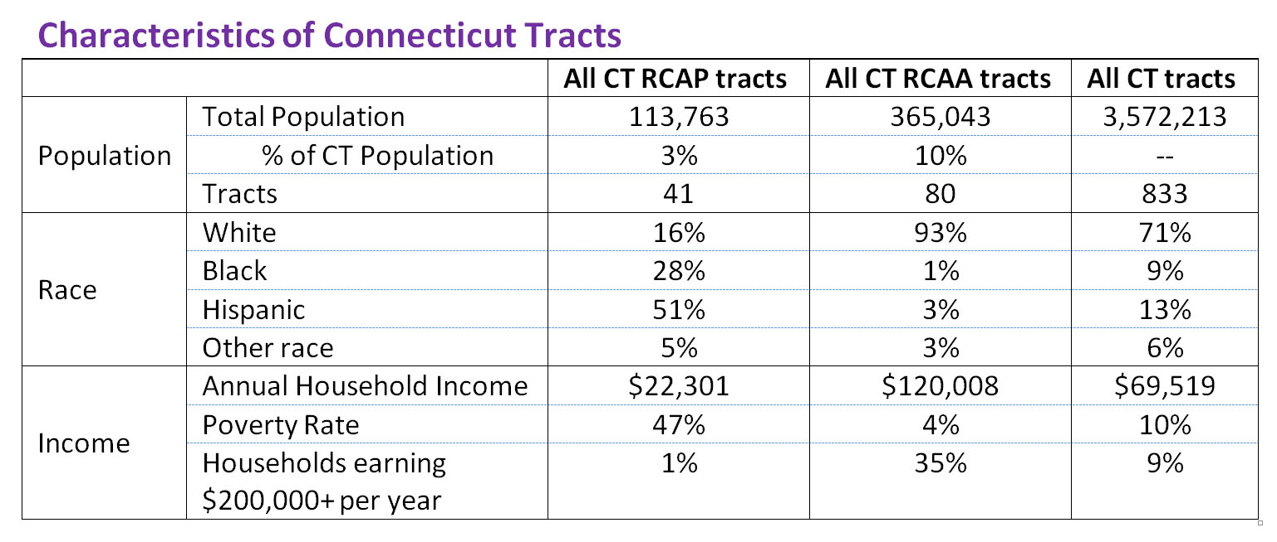
Neighborhood Segregation – Findings
13% of CT population lives in segregated neighborhood
3% poor, majority non-white vs. 10% wealthy, majority white
Affluent, white neighborhood household income = $120,008/yr
~ 5.5x more than poor, non-white neighborhood income
~1.75x more than state average
DATAHAVEN
Data for Community Action

Slide 5
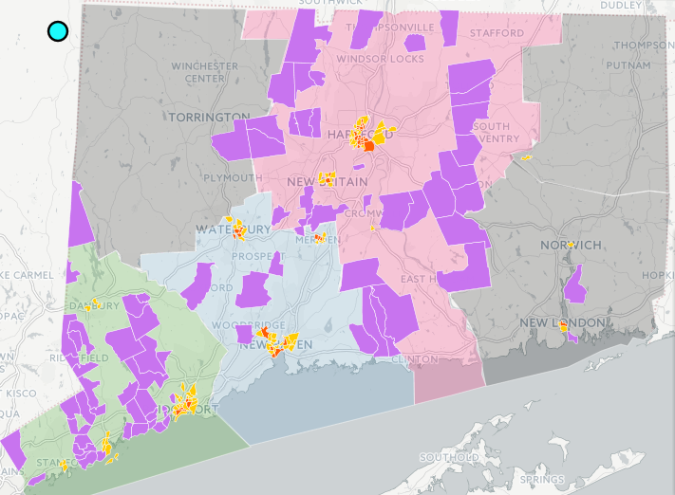
Neighborhood Segregation – Findings
RCAPs in urban centers
RCAAs in peripheral suburban towns
Rural areas devoid of segregated areas
RCAAs and RCAPs rarely border each other
Fairfield County 7x more wealthy neighborhoods than poor ones
DATAHAVEN
Data for Community Action

Slide 6
Neighborhood Segregation – Findings
13% of CT population in segregated areas vs. 6% national metro sample
Fairfield Co. & Hartford have highest shares of population in rich, white neighborhoods
17% and 13% respectively
Hartford & New Haven have relatively high shares of population in poor, non-white neighborhoods
5% and 5% respectively
DATAHAVEN
Data for Community Action

Slide 7
Neighborhood Segregation – Findings
Higher concentration of households earning at least $200,000/yr in CT than in other metros
27% of top-earning households in CT live in neighborhoods that are wealthy and majority white
Compared to 10% in national metro sample
Highest concentration of wealthy households in RCAAs in Fairfield County and Hartford
DATAHAVEN
Data for Community Action

Slide 8
Neighborhood Segregation – Findings
Some CT cities have high shares of poor people also living in concentrated poverty neighborhoods (“Double Jeopardy”)
In CT, 15% of people in poverty live in neighborhoods that are poor and racially segregated
Compared to 12% in national metro sample
High concentration of poor in RCAPs in Hartford and New Haven
DATAHAVEN
Data for Community Action

Slide 9
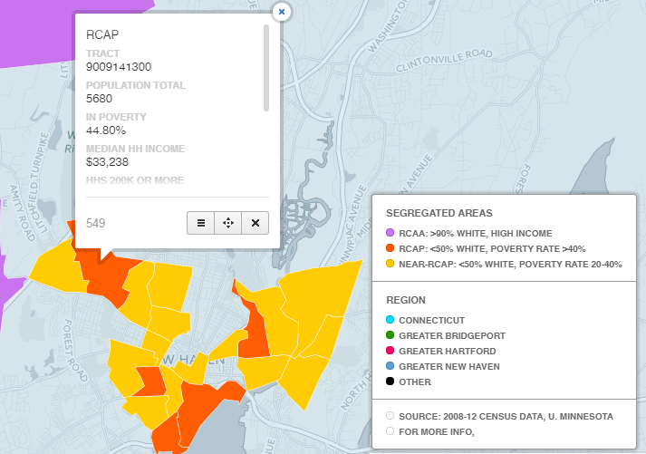
Neighborhood Segregation - Presentation and Coverage
Interactive map of neighborhoods on CartoDB
CT Mirror: Connecticut has more concentrated poverty (and wealth) than most metros
New Haven Register: Data show Connecticut remains segregated, but work being done to lessen it
DATAHAVEN
Data for Community Action

Slide 10
Neighborhood Income Change - Summary
From 1980 to 2013
The share of CT residents living in middle-income neighborhoods decreased
The share of CT residents living in areas of concentrated wealth or poverty grew
By 2013, of CT residents, 25% lived in “extreme-income” neighborhoods
Very Affluent, Concentrated Poverty
DATAHAVEN
Data for Community Action

Slide 11
Neighborhood Income Change - Methodology
Census Tracts categorized by population in poverty and average family income
Very Affluent neighborhood: average family income (AFI) for census tract is at least 1.5x state average
Concentrated Poverty: at least 20% of population lives in poverty
Near State Average: AFI is between 0.8 and 1.25x state average
Neighborhood Change Database provided data for 1980, 1990, 2000
ACS provided data for 2013
DATAHAVEN
Data for Community Action

Slide 12
Neighborhood Income Change - Findings
From 1980 to 2013, a 28% decrease in percent of CT residents living in neighborhoods with income near state average
56% of all residents in 1980 vs. 40% in 2013
A 30% increase in percent of CT residents living in neighborhoods with extreme income
19% of all residents in 1980 vs. 25% in 2013
DATAHAVEN
Data for Community Action

Slide 13
Neighborhood Income Change - Findings
Extreme-income neighborhood change, 1980 to 2013
47% increase in percent of CT residents living in very affluent neighborhoods
7% of all residents in 1980 vs. 10% in 2013
20% increase in percent of CT residents living in concentrated poverty neighborhoods
12% of all residents in 1980 vs. 15% in 2013
A 66% increase in percent of poor CT residents living in concentrated poverty neighborhoods
3% of all residents in 1980 vs. 4% in 2013
DATAHAVEN
Data for Community Action

Slide 14
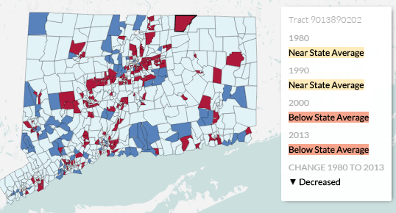
Neighborhood Income Change - Findings
Urban and Suburban areas impacted by change
Growth of very affluent neighborhoods in Fairfield County and other peripheral suburban areas
Growth of concentrated poverty in cities and inner suburbs
Neighborhood income in “rural” areas stable from 1980-2013
DATAHAVEN
Data for Community Action

Slide 15
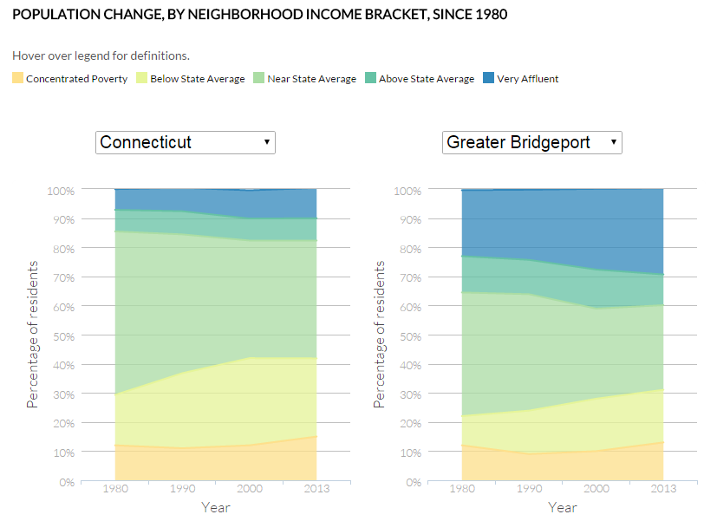
Neighborhood Income Change - Presentation and Coverage
CT Mirror: In last 35 years, a significant drop in middle-income neighborhoods
Interactive map of neighborhoods created by CT Mirror
Interactive regional comparison created by CT Mirror
DATAHAVEN
Data for Community Action

Slide 16
Neighborhood Income Follow-ups
Potential extensions of these analyses include:
Characteristics of “Rebounding neighborhoods”
In depth regional analyses for community assessment reports - 2016 Community Index
Greater New Haven and Lower Naugatuck Valley regions
Other suggestions ? Questions ?
Contact Mary at mary@ctdatahaven.org
DATAHAVEN
Data for Community Action

