Slide 1
Stronger Together: Data Collaboratives and Partnerships
Knowledge for Equity Conference
November 14, 2012
Kathy Pettit, Urban Institute/NNIP
Todd Clausen, Nonprofit Center of Milwaukee

Slide 2
Today’s presentation
Lessons from NNIP
Types of Indicators
Uses of Data
Real World Examples
Exercise

Slide 3
Lessons from NNIP
Notes:
Model and examples

Slide 4
National Neighborhood
Indicators Partnership (NNIP)
Collaborative effort since 1995
  Urban Institute & local partners; now 37 cities
  Local partners build and operate neighborhood information systems for their communities
  UI coordinates network and plans joint activities
Local success required three innovations
  1. Data and technology
  2. Institutions
  Using information for change

Slide 5
National Neighborhood Indicators Partners
Atlanta
Austin
Baltimore
Boston
Camden
Chattanooga
Chicago
Cleveland
Columbus
Dallas
Denver
Des Moines
Detroit
Grand Rapids
Hartford
Indianapolis
Kansas City
Louisville
Memphis
Miami
Milwaukee
Minneapolis-St. Paul
Nashville
New Haven
New Orleans
New York City
Oakland
Philadelphia
Pinellas County Pittsburgh
Portland
Providence
Sacramento
Saint Louis
San Antonio
Seattle
Washington, DC

Slide 6
Data from Many Local Sources
Neighborhood level
Employment
Births, deaths
Crimes
TANF, Food Stamps
Child care
Health
Schools
Parcel level
Prop. sales, prices
Prop. ownership
Code violations
Assessed values
Tax arrears
Vacant/abandoned
City/CDC plans

Slide 7
Data from Other Sources
National Data Sources
American Community Survey
Local Employment Dynamics
Housing + Transportation Costs
Home Mortgage Disclosure Act
Original Data Collection
Property conditions
Asset/deficit mapping
Community/school surveys
Program service data
Client surveys
Focus groups
Ethnography
Community journalism

Slide 8
New Types of Institutions
Mostly outside of local government
  Nonprofits, university centers, alliances
  Four include metropolitan planning councils
But partner with resident groups, nonprofits, government, and other stakeholders
Long-term and multifaceted interests
Positioned to maintain trust of data providers and users

Slide 9
Shared Mission:
Information for Change
“Democratizing Information”
  Facilitate the direct use of data by stakeholders
Data serves many varied audiences and purposes
But a central focus on strengthening and empowering low-income neighborhoods
Information promotes collaboration
  Acts as a bridge among public agencies, nonprofits, businesses

Slide 10
Data Informs Wide Range of Health Issues
Hospitalization patterns
Maternal and infant Health
Obesity
Mental health
Traffic safety
Food Security
Healthy housing (asthma, lead)
Social determinants of health
Notes:
Higher level policy and neighborhood programs

Slide 11
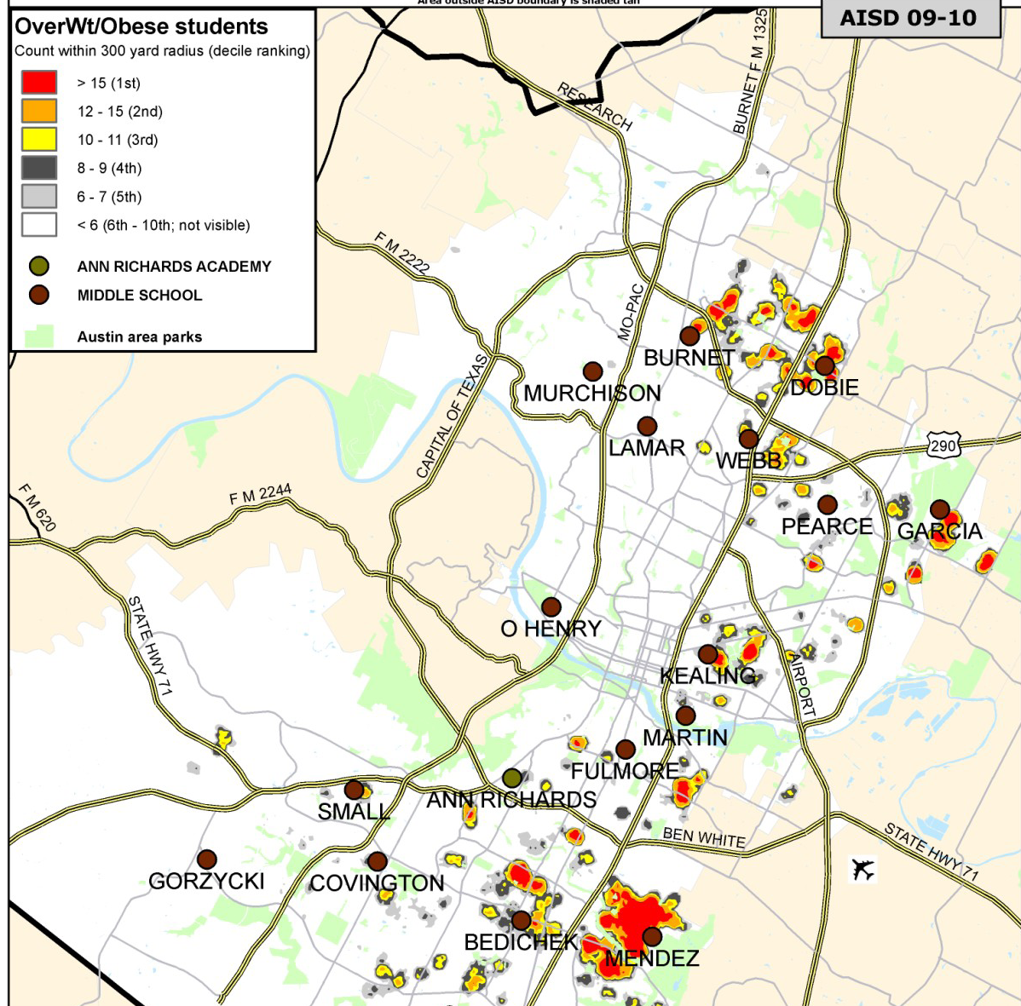
S
Percent Overweight or Obese Students in Austin
Source: Children’s Optimal Health

Slide 12
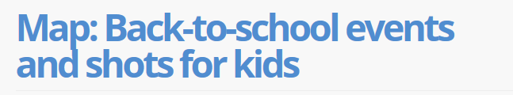
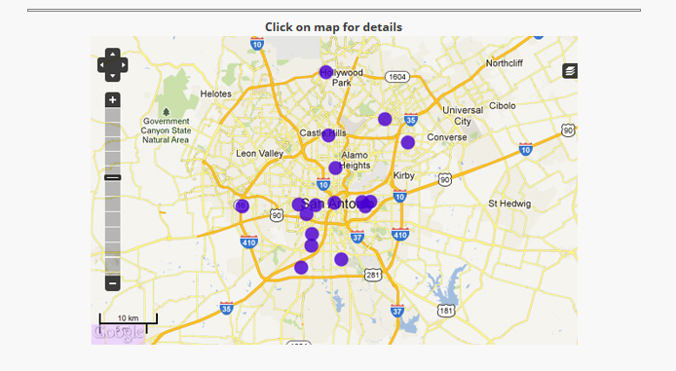
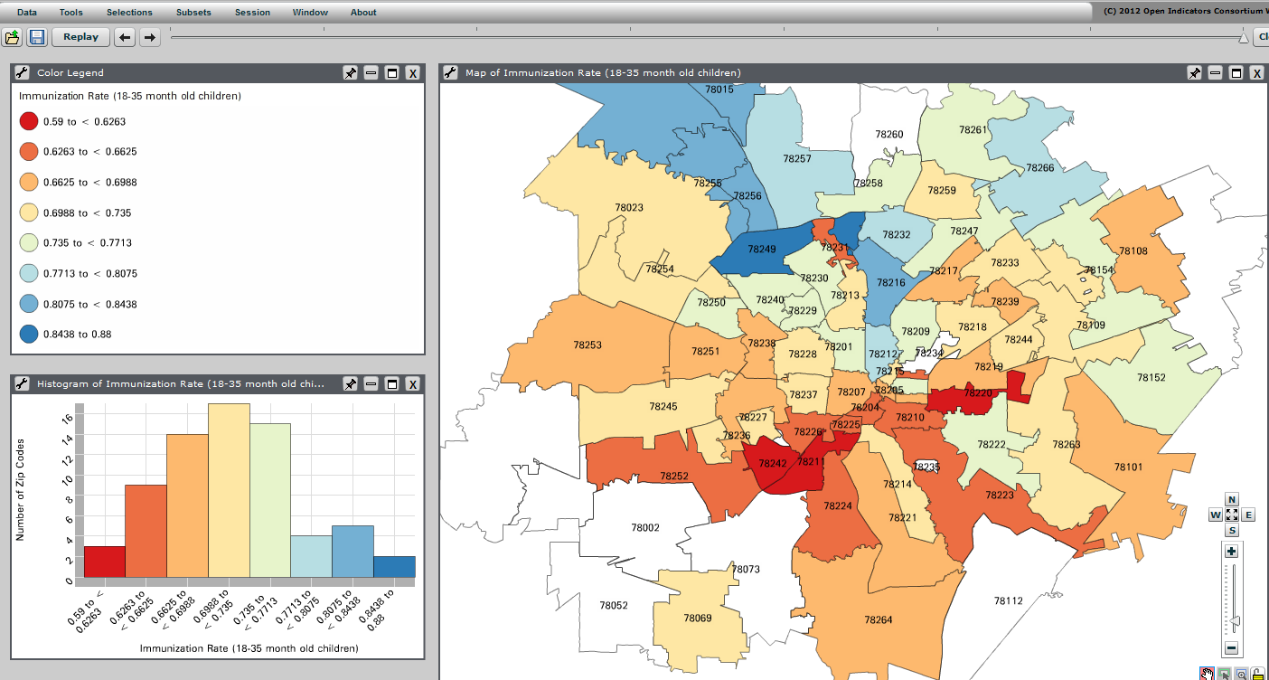
Source: CI:Now in San Antonio

Slide 13
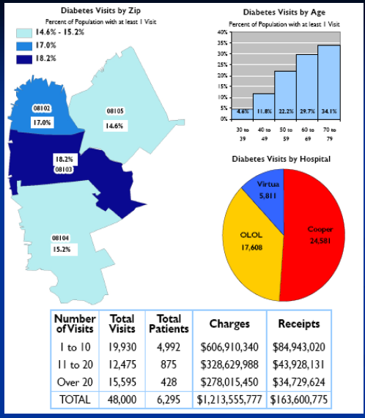
Addressing Diabetes in Neighborhoods
Source: CamConnect in Camden, NJ
Notes:
CamConnect, our Camden NNIP partner, had close relationship with hospitals from the beginning – their offices were in donated space.
All 3 hospitals in the city wanted to understand their patients better and were concerned about rising costs of health care for uninsured people. They agreed to share their patient billing data with CamConnect, including both Emergency department visits and inpatient hospitalizations. Careful privacy protections.
Geocoded the data and did probabilistic matching to match patients who visited multiple hospitals. They found 38,000 Unique patients across institutions, found that Approx one-half of the City population used the ER/hospital in one year. They worked with the Camden Healthcare Coalition to dive into specific manageable diseases – here is 1 example of diabetes. These maps helped the Citywide Diabetes Collaborative focus their outreach efforts for classes on how to better manage the illness.

Slide 14


The “Stream”
Change structures, policies and institutional practices that maintain inequities
Change policies/systems and programs to provide community conditions that support health
and well being
Change individual behaviors/treat problems resulting from stress
and poor health
Affordable
Housing
Good Paying Jobs
Access to Healthy Foods & Physical Activity
Incarceration
Obesity
Pro-Equity Policies
Safe Neighborhoods
Quality Education
Address Structural Racism and Privilege
Access to Healthcare
Homelessness
Healthy Environment
Untreated Mental Illness
Access to Transportation
Low Birth Weight
Poor Health Status
Societal Level
Community Level
Individual and Family Level
wwww.kingcounty.gov/equity
Notes:
Realities for advancing equity
Need more upstream strategies while continuing to work effectively downstream which requires:
Improved community involvement in designing solutions and shaping policy
Working across departments, service systems and jurisdictions
Gear up for the long haul . . . this issue won’t be solved overnight (or in one year)
Foster organizational buy-in and capacity – that is, all employees understand these issues/concepts and have a support structure that enables them to address health equity/racial disparities

Slide 15
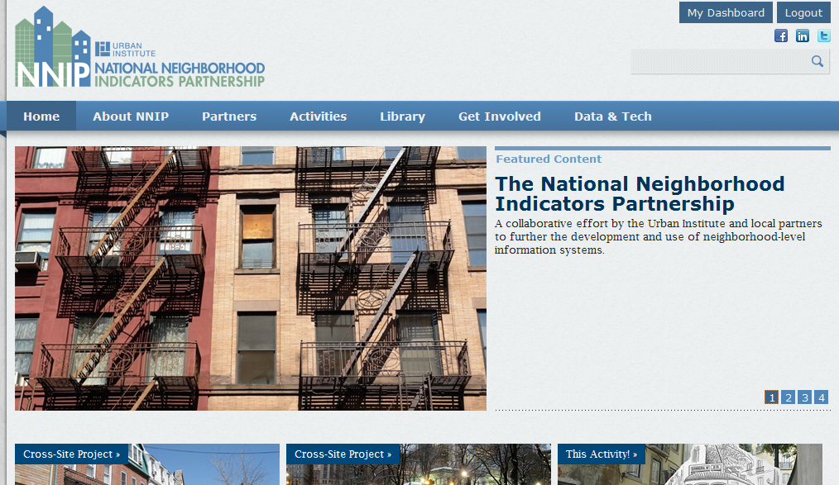
NNIP Web Site

Slide 16
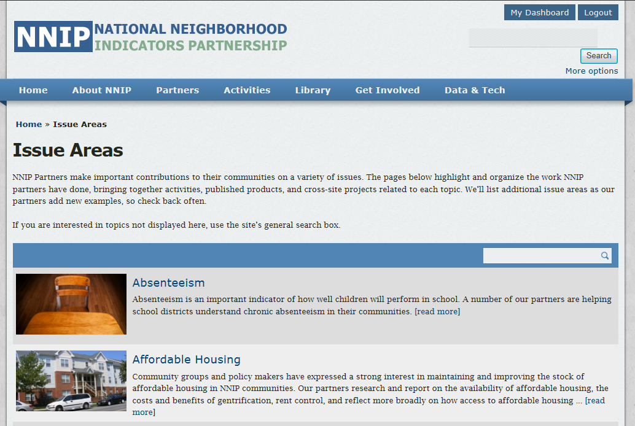
www.neighborhoodindicators.org

Slide 17
Types of Indicators

Slide 18
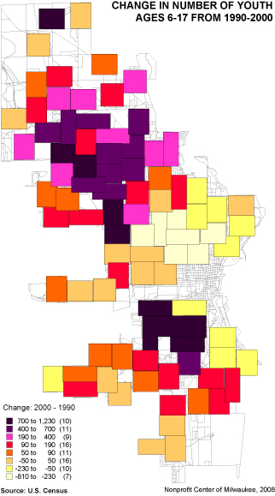
Collaborative Data Partners Can Help Show…
Population trends, demographic patterns
Housing trends
Risk Indicators
Challenges in neighborhoods
Community assets
Client service patterns

Slide 19
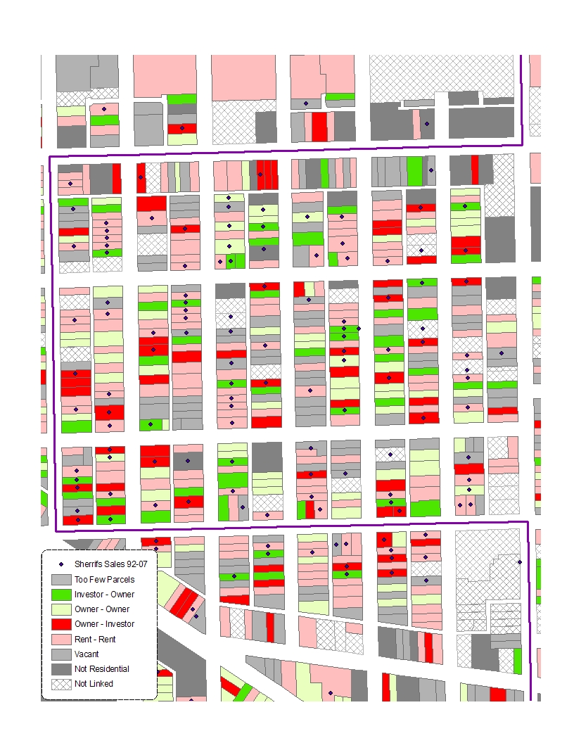
Collaborative Data Partners Can Help Show…
Population trends, demographic patterns
Housing trends
Risk Indicators
Challenges in neighborhoods
Community assets
Client service patterns

Slide 20
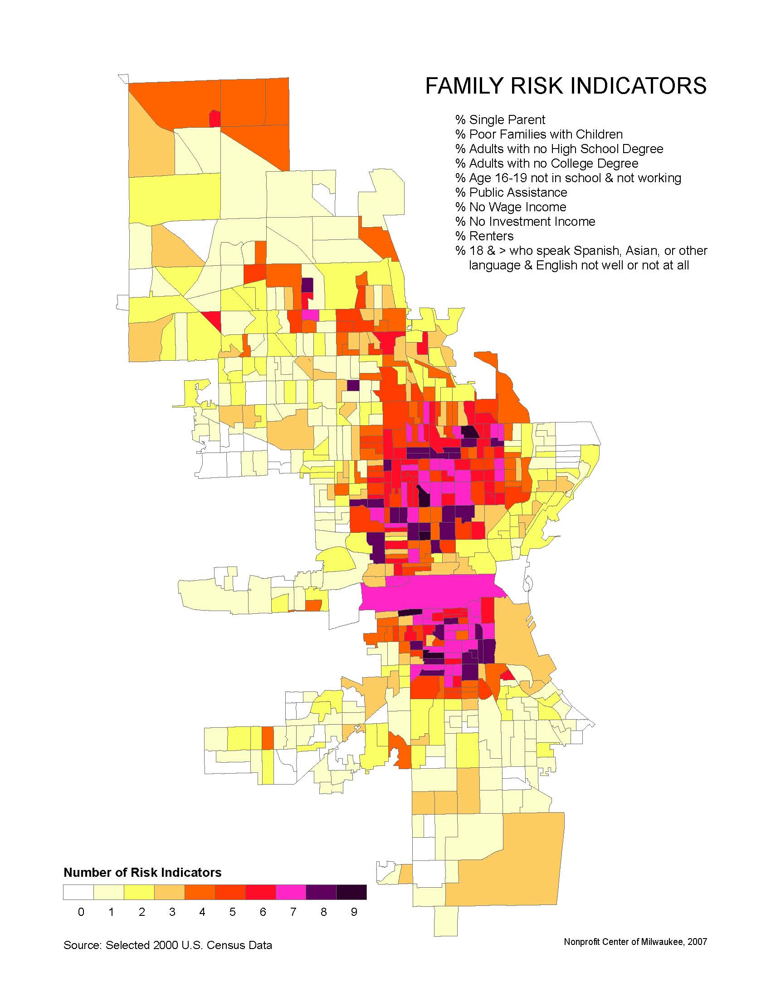
Collaborative Data Partners Can Help Show…
Population trends, demographic patterns
Housing trends
Risk Indicators
Challenges in neighborhoods
Community assets
Client service patterns

Slide 21
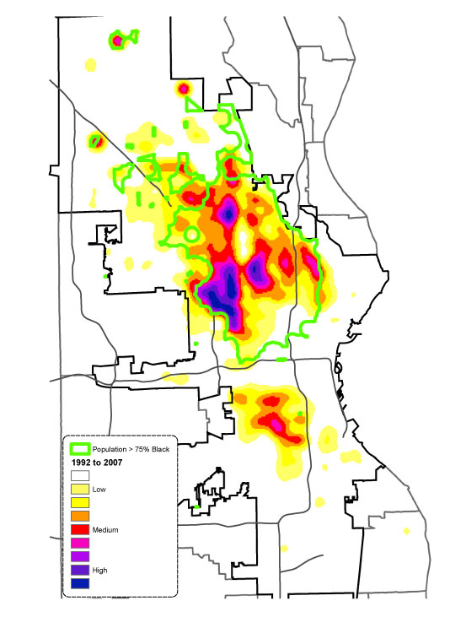
Collaborative Data Partners Can Help Show…
Population trends, demographic patterns
Housing trends
Risk Indicators
Challenges in neighborhoods
Community assets
Client service patterns

Slide 22
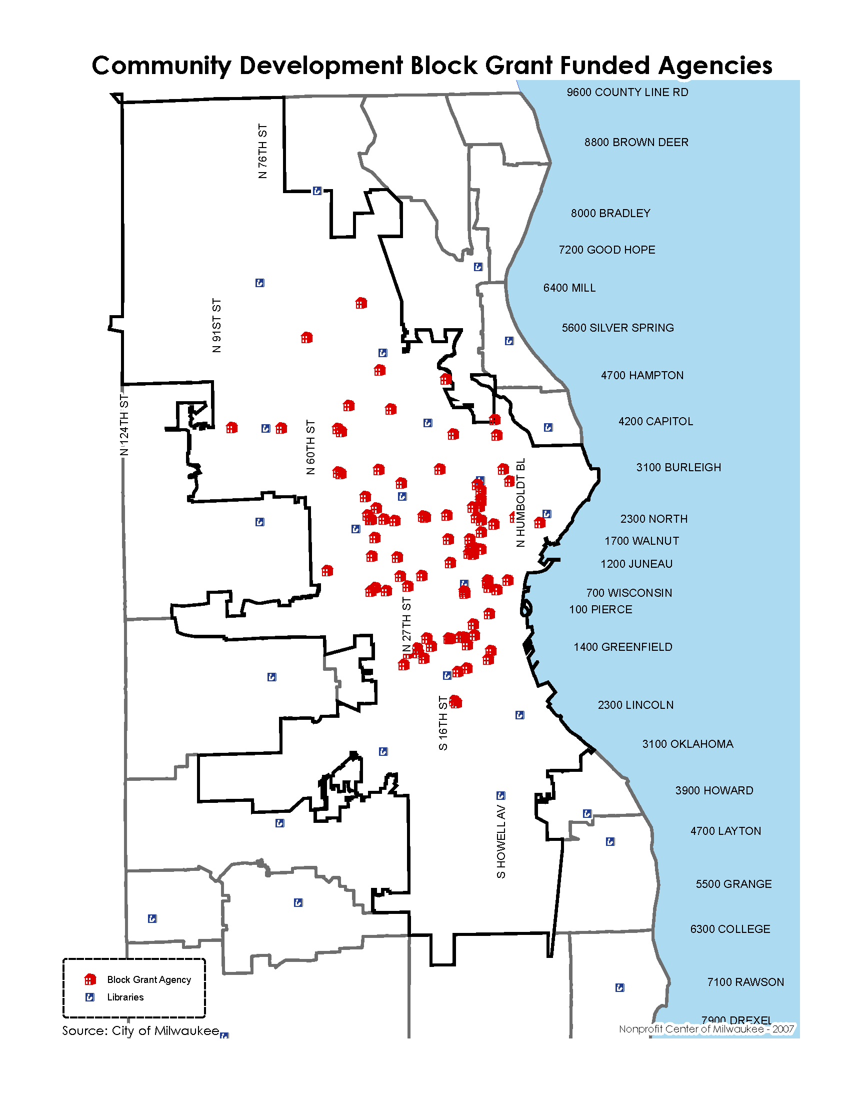
Collaborative Data Partners Can Help Show…
Population trends, demographic patterns
Housing trends
Risk Indicators
Challenges in neighborhoods
Community assets
Client service patterns

Slide 23
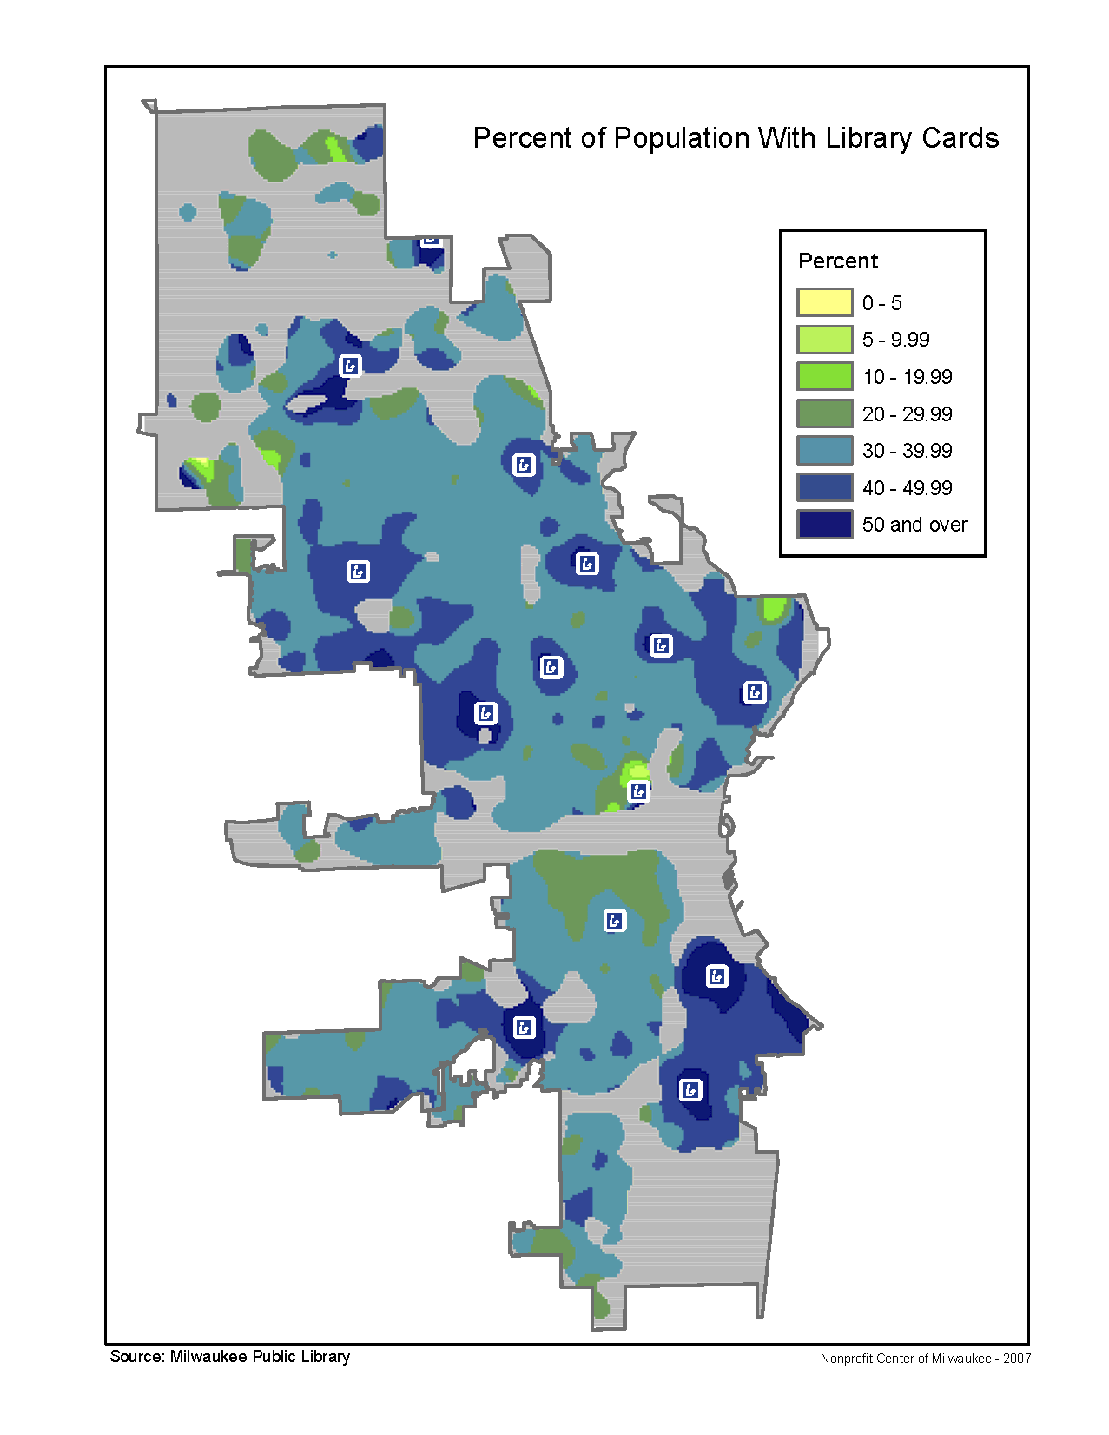
Collaborative Data Partners Can Help Show…
Population trends, demographic patterns
Housing trends
Risk Indicators
Challenges in neighborhoods
Community assets
Client service patterns

Slide 24
Uses of Data

Slide 25
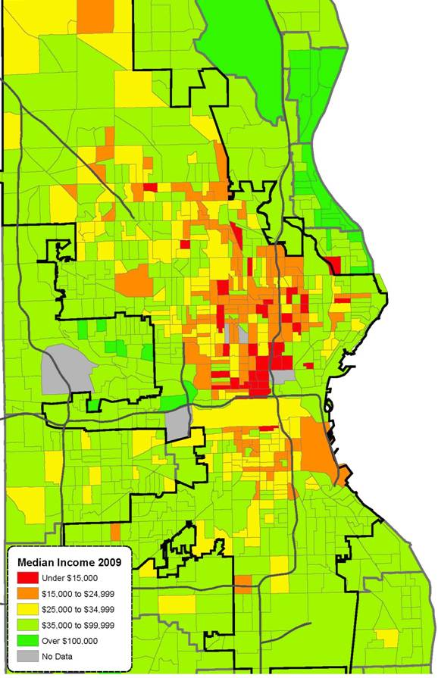
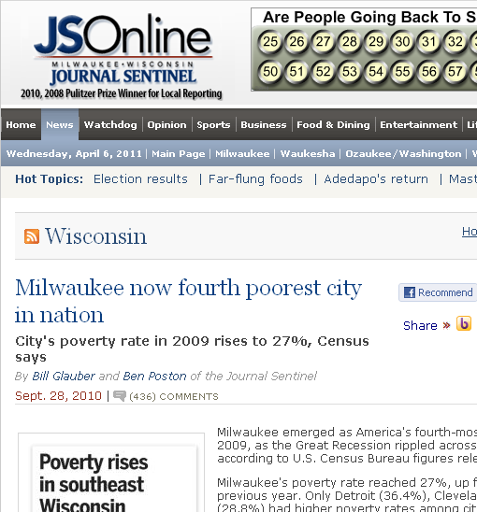
Using Data
  Fundraising - grant and proposal writing
  Profiling neighborhood conditions
  Quantifying issues and justifying programs
  Program Evaluation
  Persuade others of critical issues
Notes:
Hopefully you are already using the Census to learn about your service area and the communities you serve, but here are a few more ways nonprofits can take advantage of this great resource.
In the fundraising arena,
inclusion of Census facts and figures can help you communicate more effectively with your funders and the community through improving the quality of your applications and proposals. If you can clearly identify the size and scope of your target population, you can better demonstrate your understanding which will set you apart from your peers.
These can also help persuade funders and political leaders to act on issues critical to your community.
As an example...

Slide 26
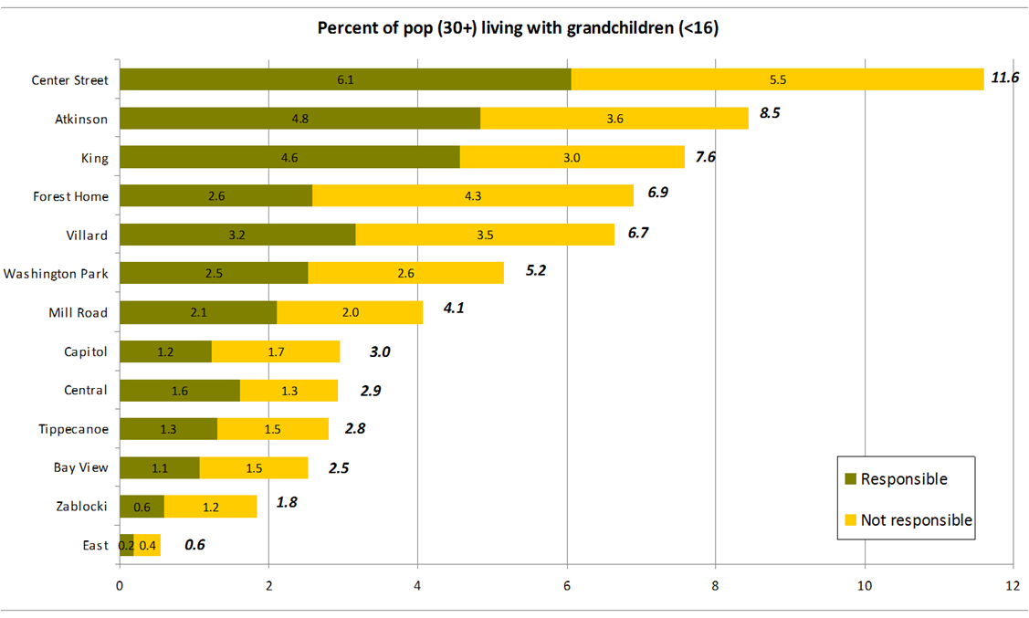
Several north side Milwaukee Public Library Districts have high incidence of "grandfamilies"...
Notes:
In Milwaukee the director of a north side Community Development organization was faced with the loss of his neighborhood library branch. In working with him on other issues we discovered a high percentage of grand-families - that is grandparents caring for their grandchildren - all across the north side of Milwaukee and particularly in his service area.

Slide 27
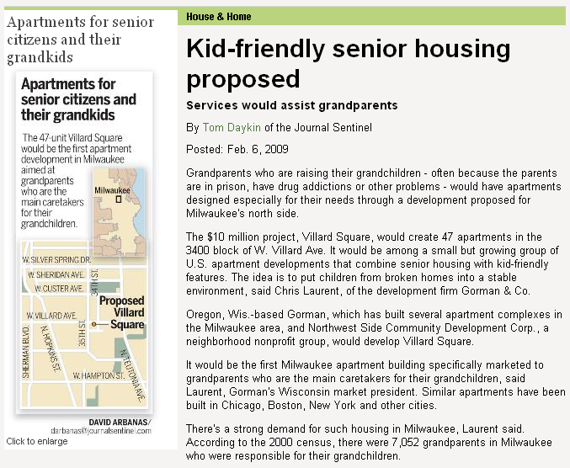
Data lead a local CDC Director to successfully advocate $10 Million Library / Grandfamily Housing Development!
Source: Milwaukee Journal Sentinel
Notes:
This lead to the idea of creating a solution to serve this population and also prevented the loss of the neighborhood library.
Aggressive exploration of funding and a partnership between the City, the CDC and a local developer lead to the creation of a ten million dollar combined Library and grand-family housing project that is going to be seeing occupancy before the end of the year.

Slide 28
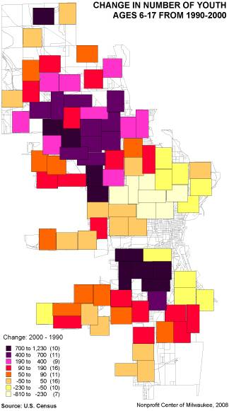
Data to Help You With:
Strategic planning
  new locations
  new programming needs
Shifting populations may
require shifts in service
provision
  need to hire more Spanish Speakers
Determine outreach areas
  under-served areas
  similar client demographics
Notes:
So how can you as nonprofit directors and staff use Census information?
One of the most important to me is in your Strategic Planning, particularly environmental scans.
For example, many large cities particularly in the rust belt are seeing their central cities empty out and likely all of you have heard the plight of the City of Detroit which lost over 25% of it's population over the past decade. We are also seeing Hispanics growing in number within our communities.
These shifting populations may now mean your current service locations are potentially no longer in areas of greatest need.
Also, these changes in the makeup of your community may require a new mix of programming and the services provided by your organization, or even a shift in the boundaries of your current service area.

Slide 29
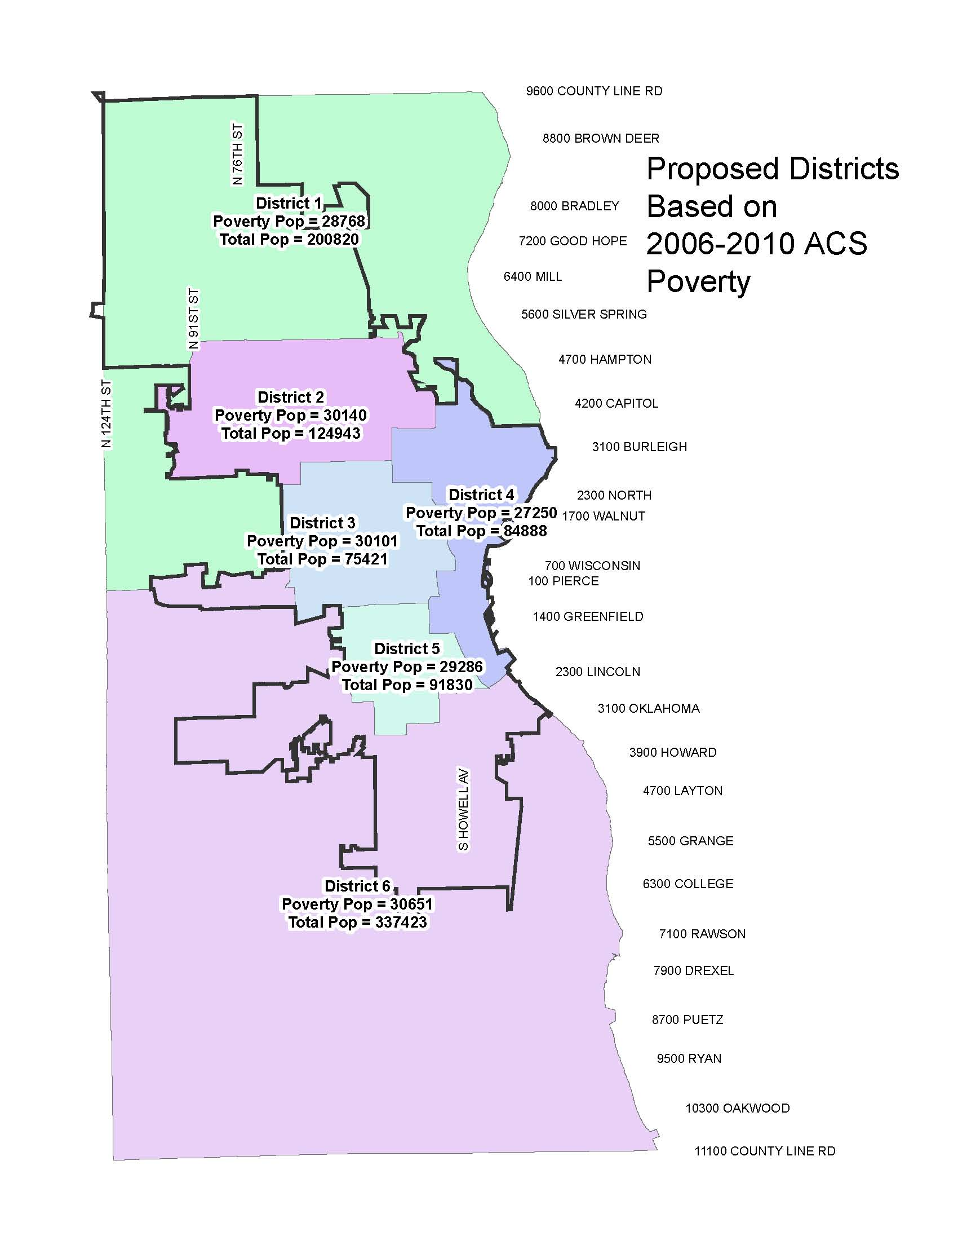
Equitable Representation
Creation of Service Areas meeting your target demographic

Slide 30
For more information
Web sites: www.neighborhoodindicators.org
Kathy Pettit: kpettit@urban.org, (202) 261-5670
  Todd Clausen: tclausen@nonprofitmilwaukeecenter.org
  (414) 344-3933

Slide 31
Real World Examples

Slide 32
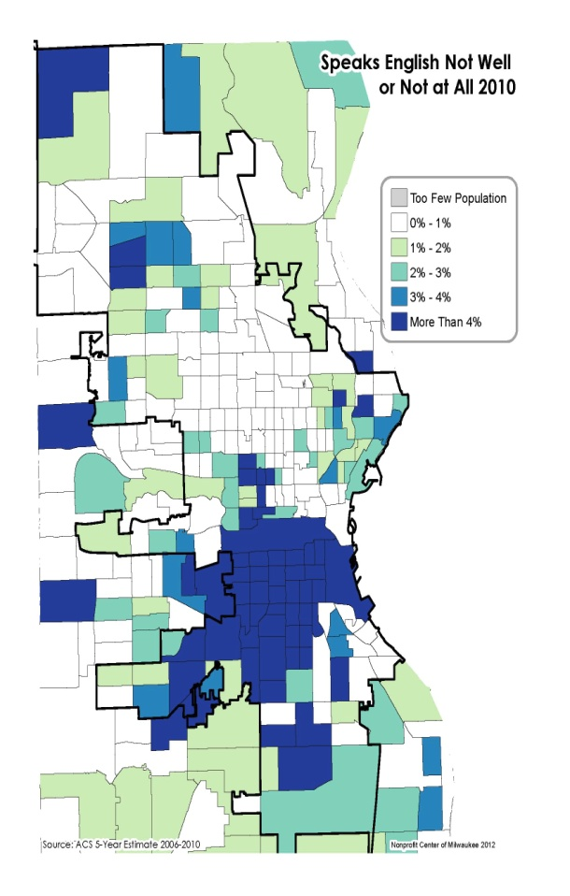
Example Projects
Community/ Market Assessment
Client Service Patterns
Census Demographics
Data Pre-processing/ Geocoding
Notes:
In Terri Anne's previous slides we saw the incredibly rich range of socio-demographic information available from the Census Bureau that takes you beyond the number on your city limits sign to income, employment and race.

Slide 33
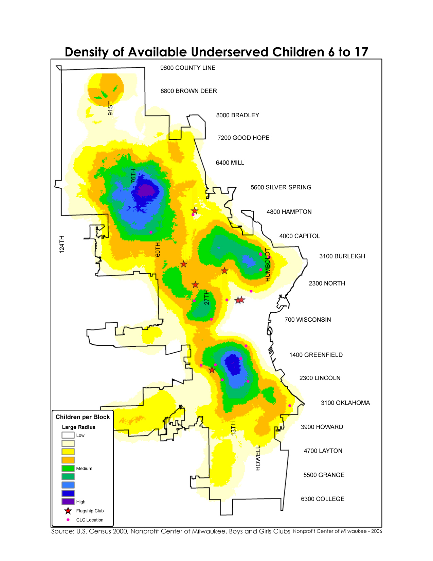
Client Service Patterns
Boys and Girls Clubs

Slide 35
example
City of Milwaukee Health Department – Births Spatial Analysis

Slide 36
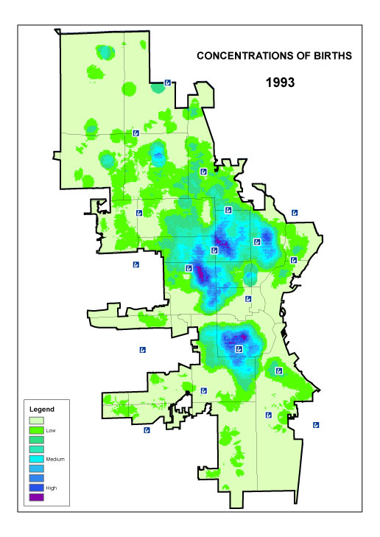
Concentrations of
Births in 1993
In the early 1990’s there were several neighborhoods with high concentrations of births – the near West Side, the near South side and central North.

Slide 37
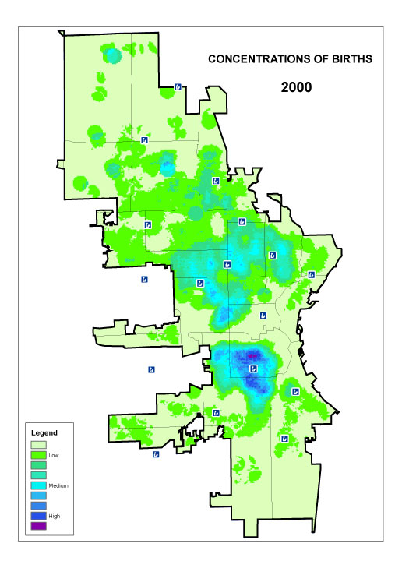
Concentrations of
Births in 2000
By 2000, the North side concentrations had diminished and concentrations on the near South side remained high.

Slide 38
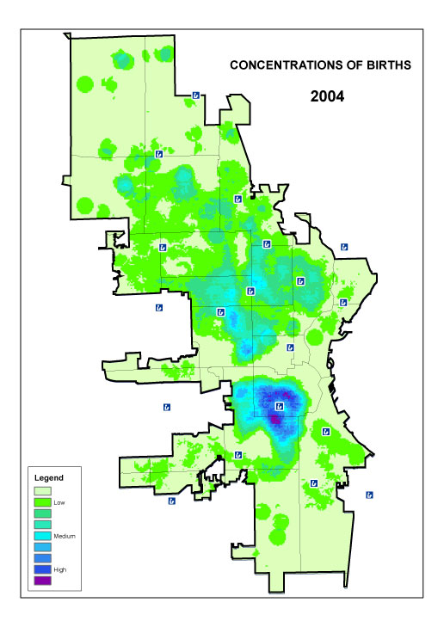
Concentrations of
Births in 2004
Flow…
By 2004, the concentration of births on the South side had intensified and expanded southward. Births on the North side remained more dispersed.
Predictions?

Slide 39
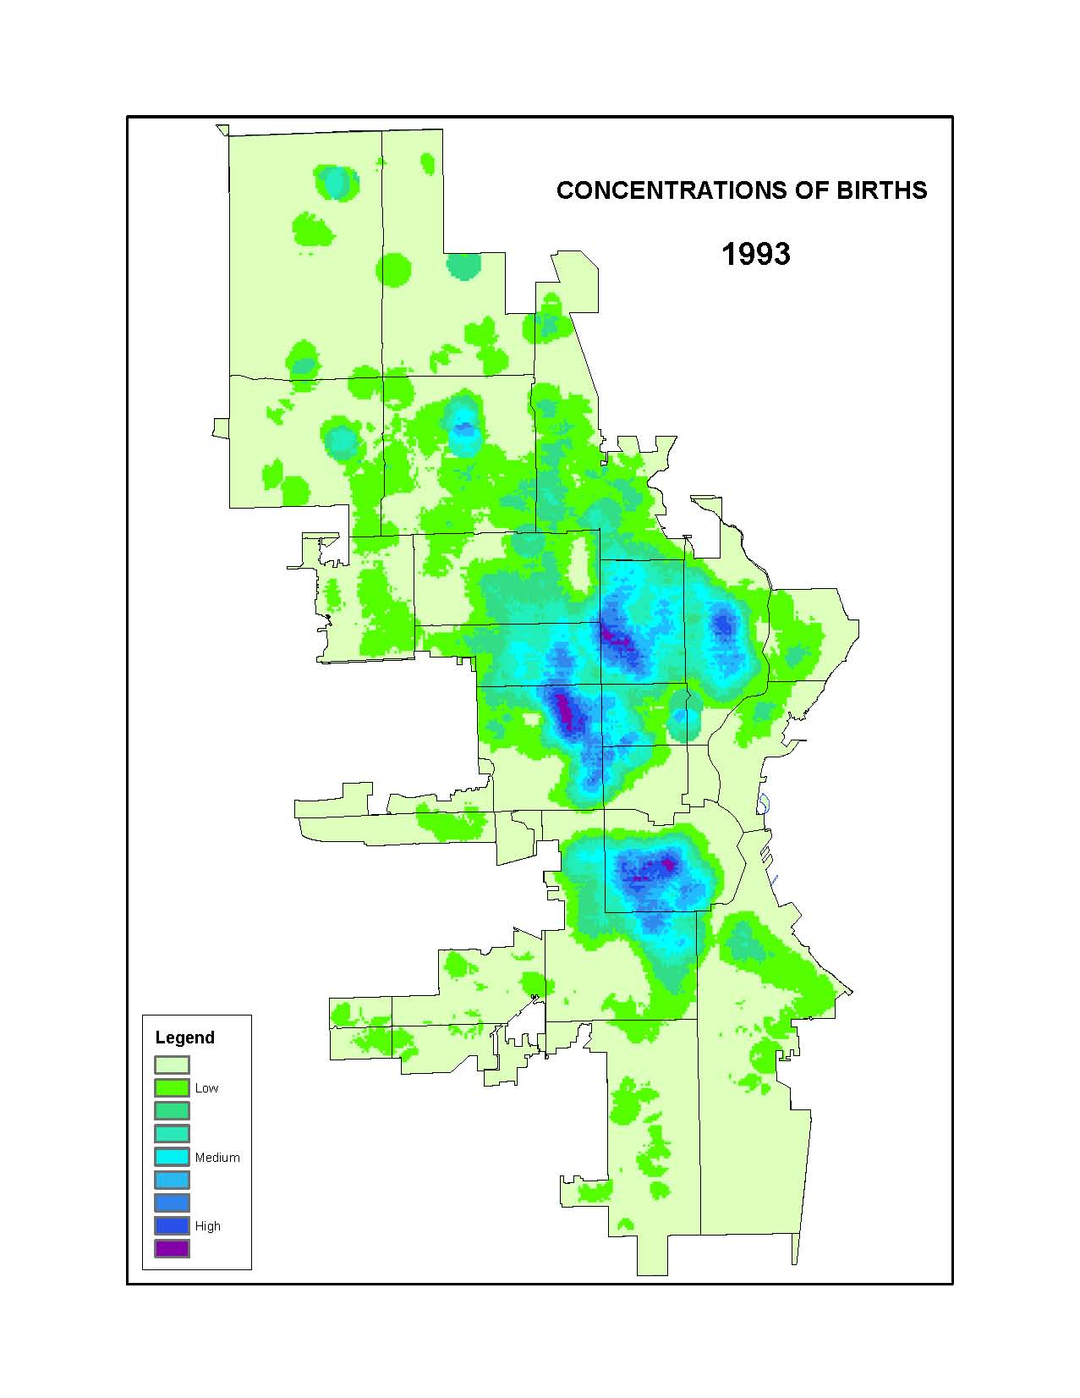
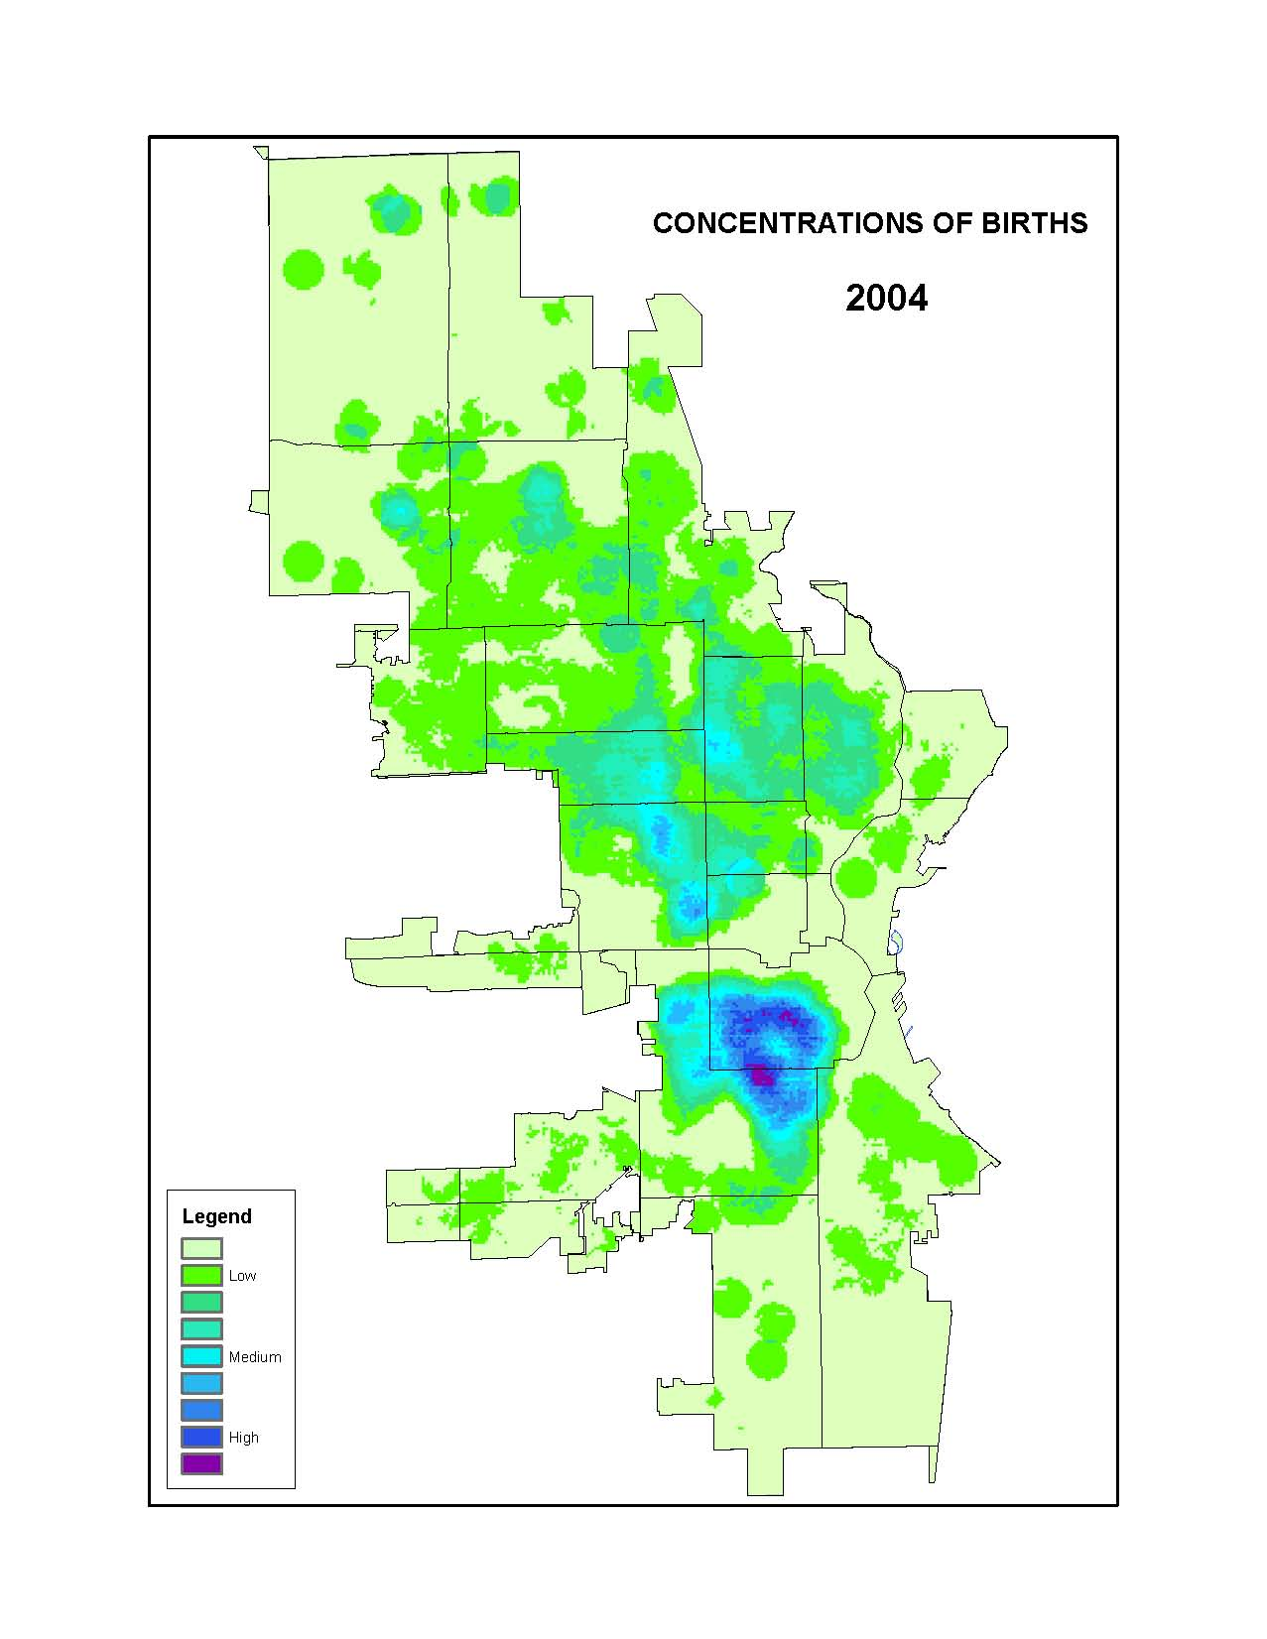
CHANGING BIRTH TRENDS AFFECT PROGRAM PLANNING

Slide 40
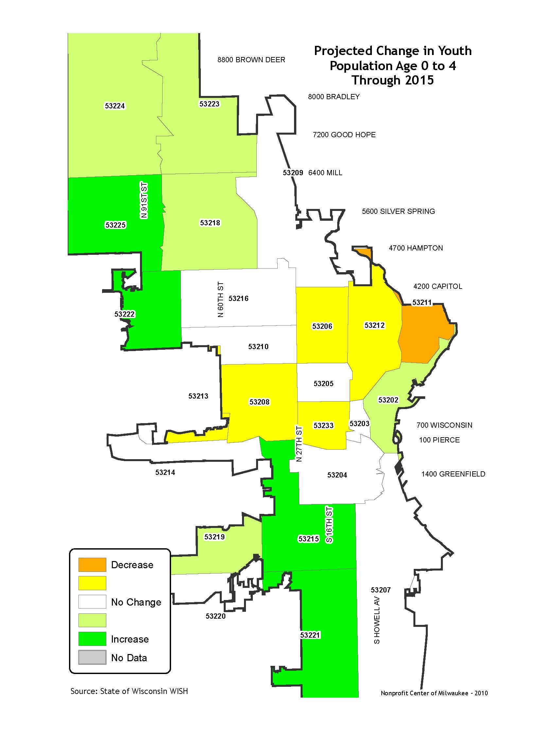
Fewer Youth...
A big story is also the change in populations under 18...
Youth populations are down 73% in the city over the period 2000-2010.
Source: Wisconsin WISH, U.S. Census 2010
Nonprofit Center of Milwaukee 2010

Slide 41
example
City of Milwaukee Health Department – Childhood Lead Testing

Slide 42
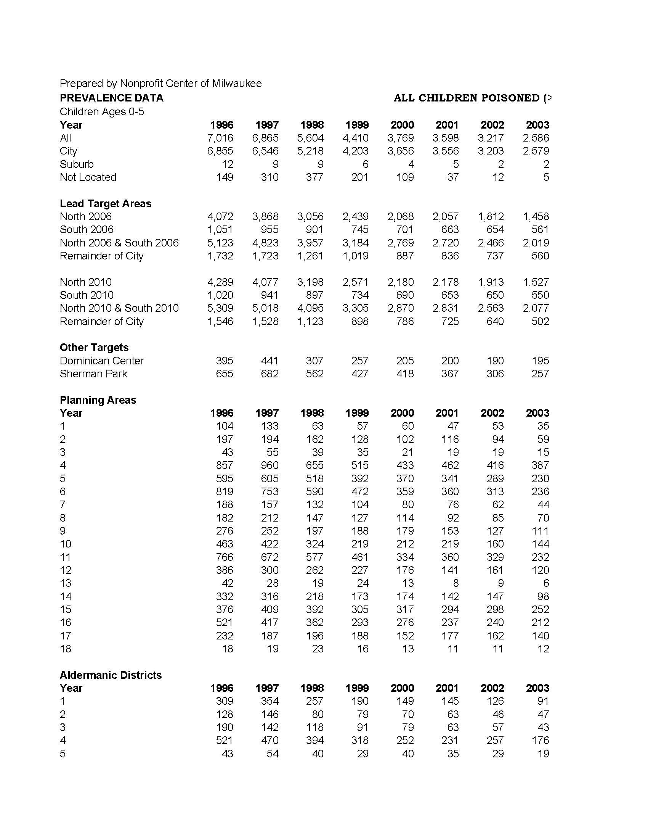

Slide 43
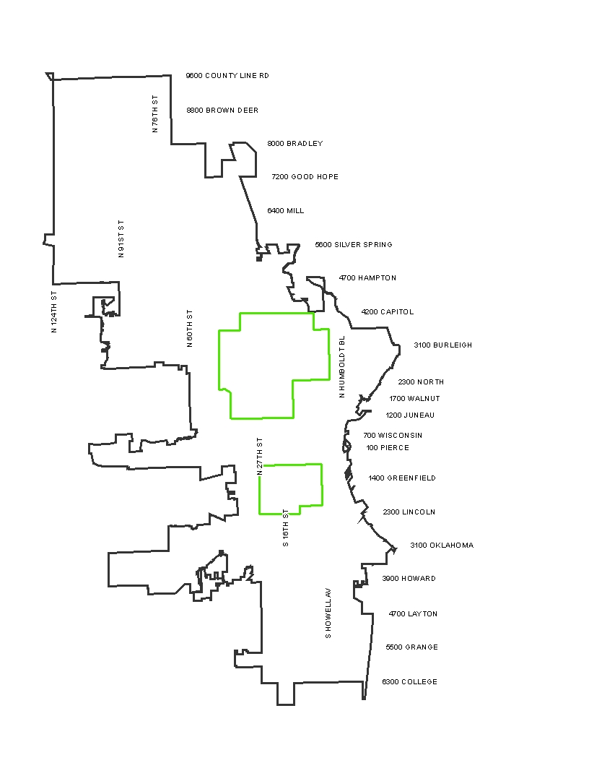

Slide 44
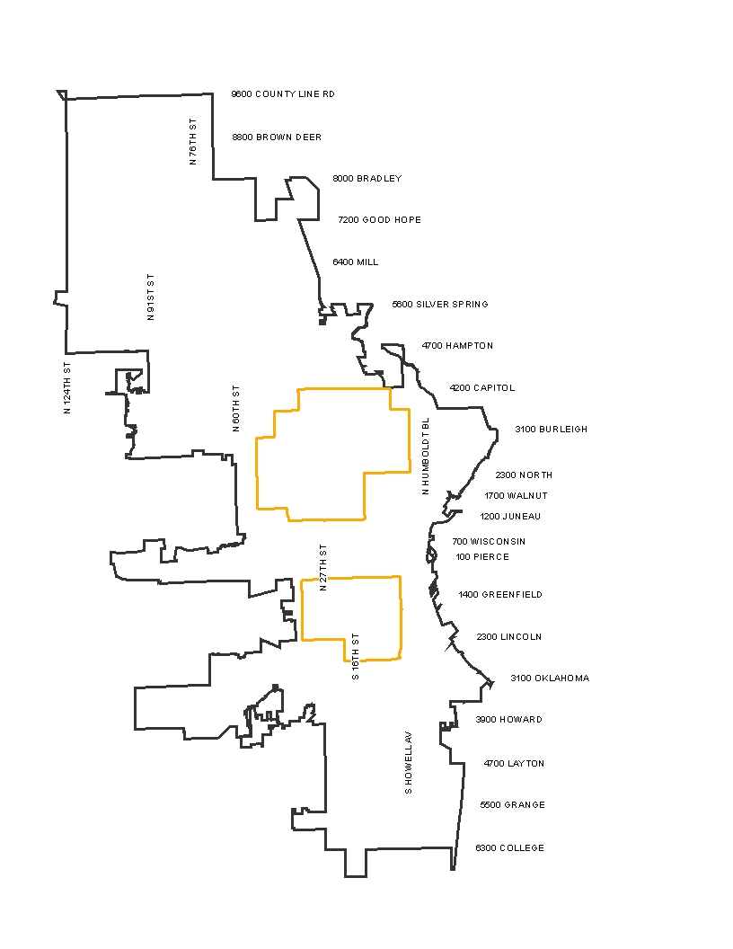

Slide 45
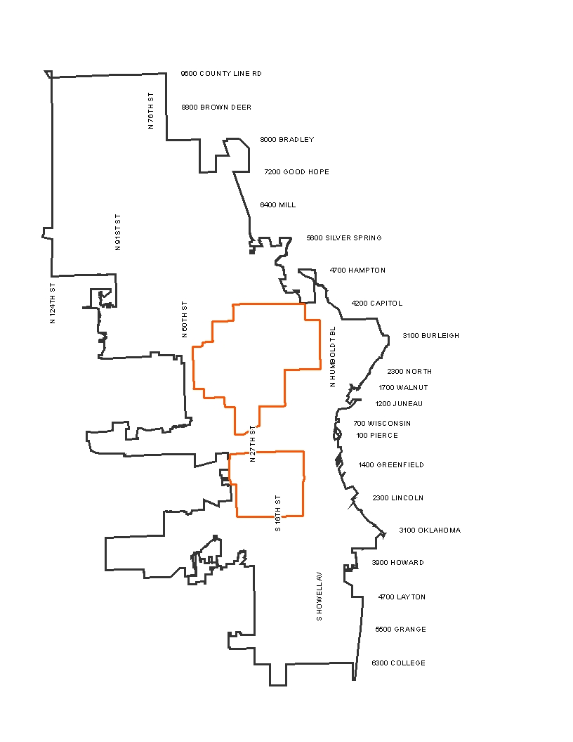

Slide 46
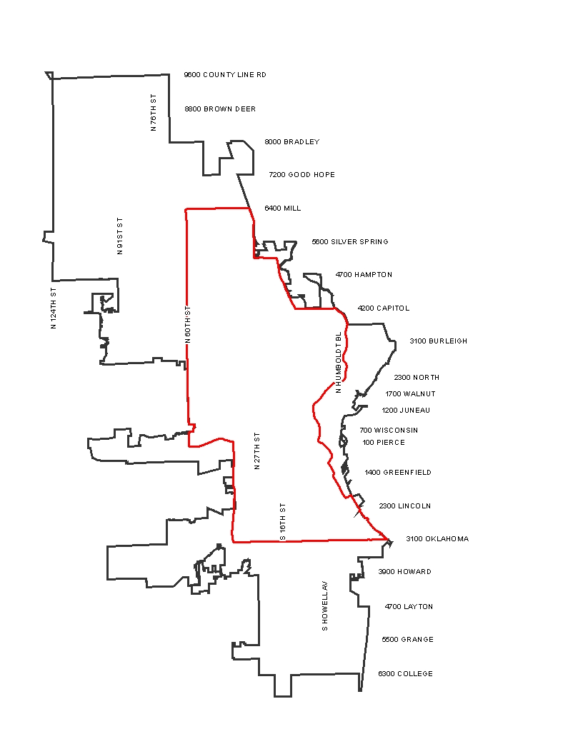

Slide 47
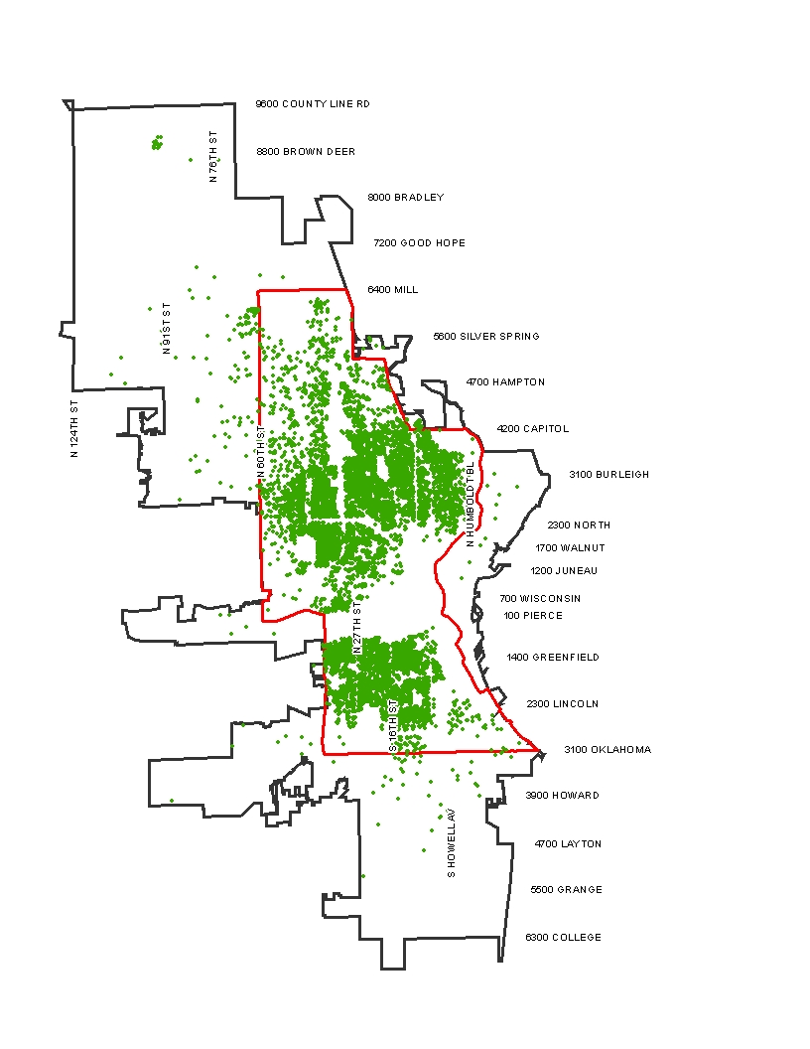

Slide 48
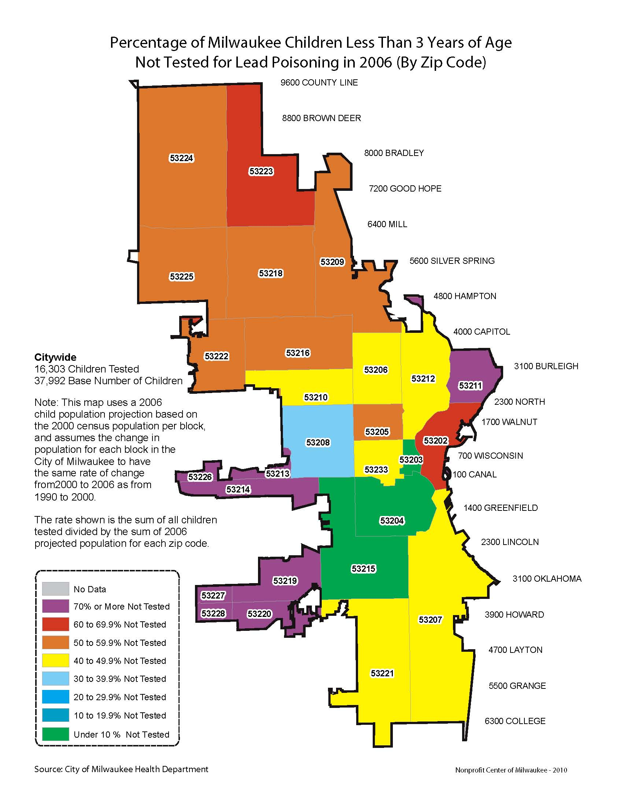

Slide 49
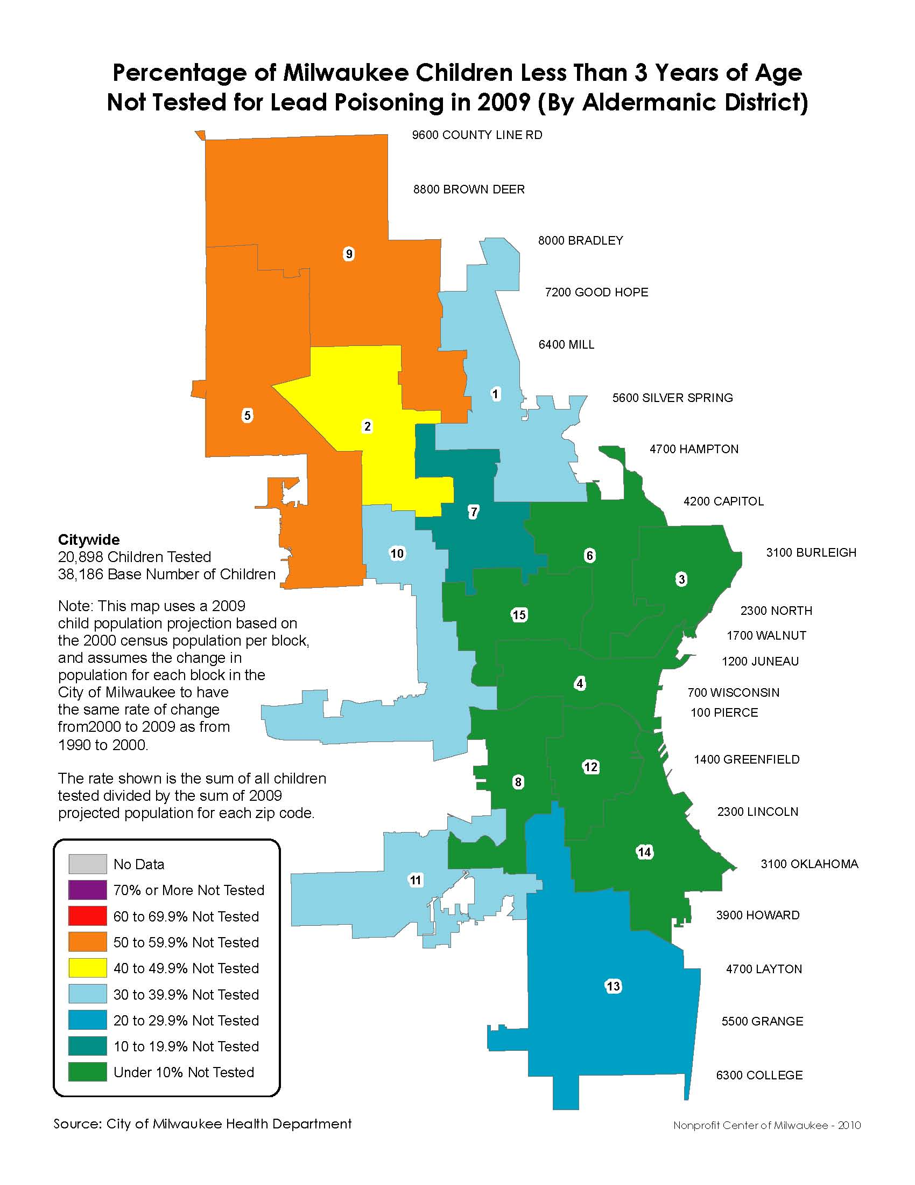

Slide 50
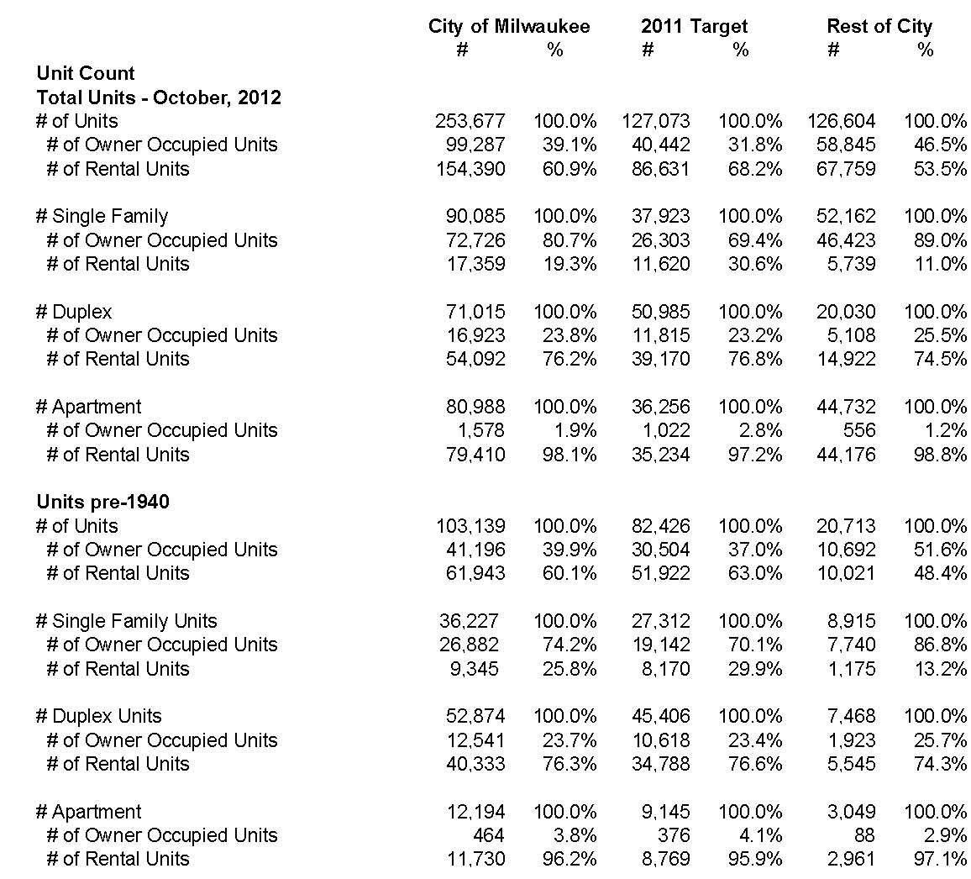
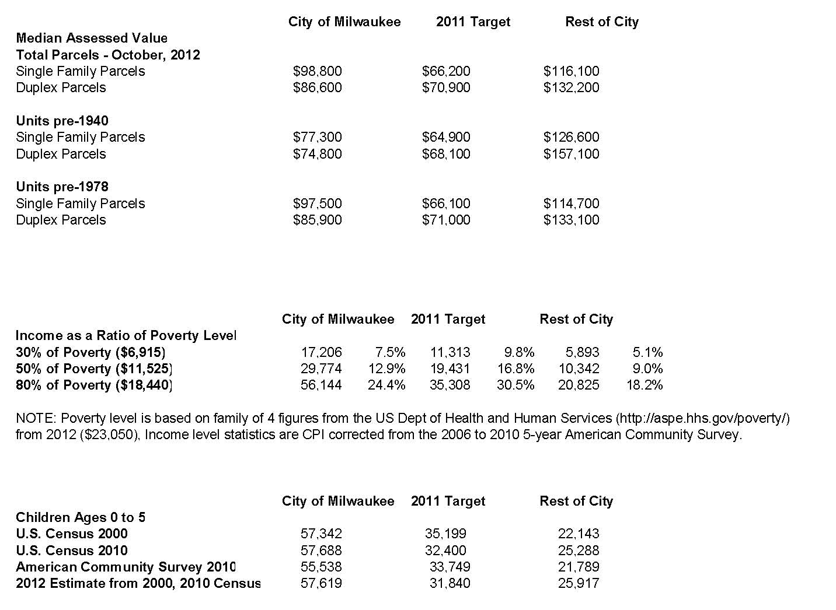

Slide 51
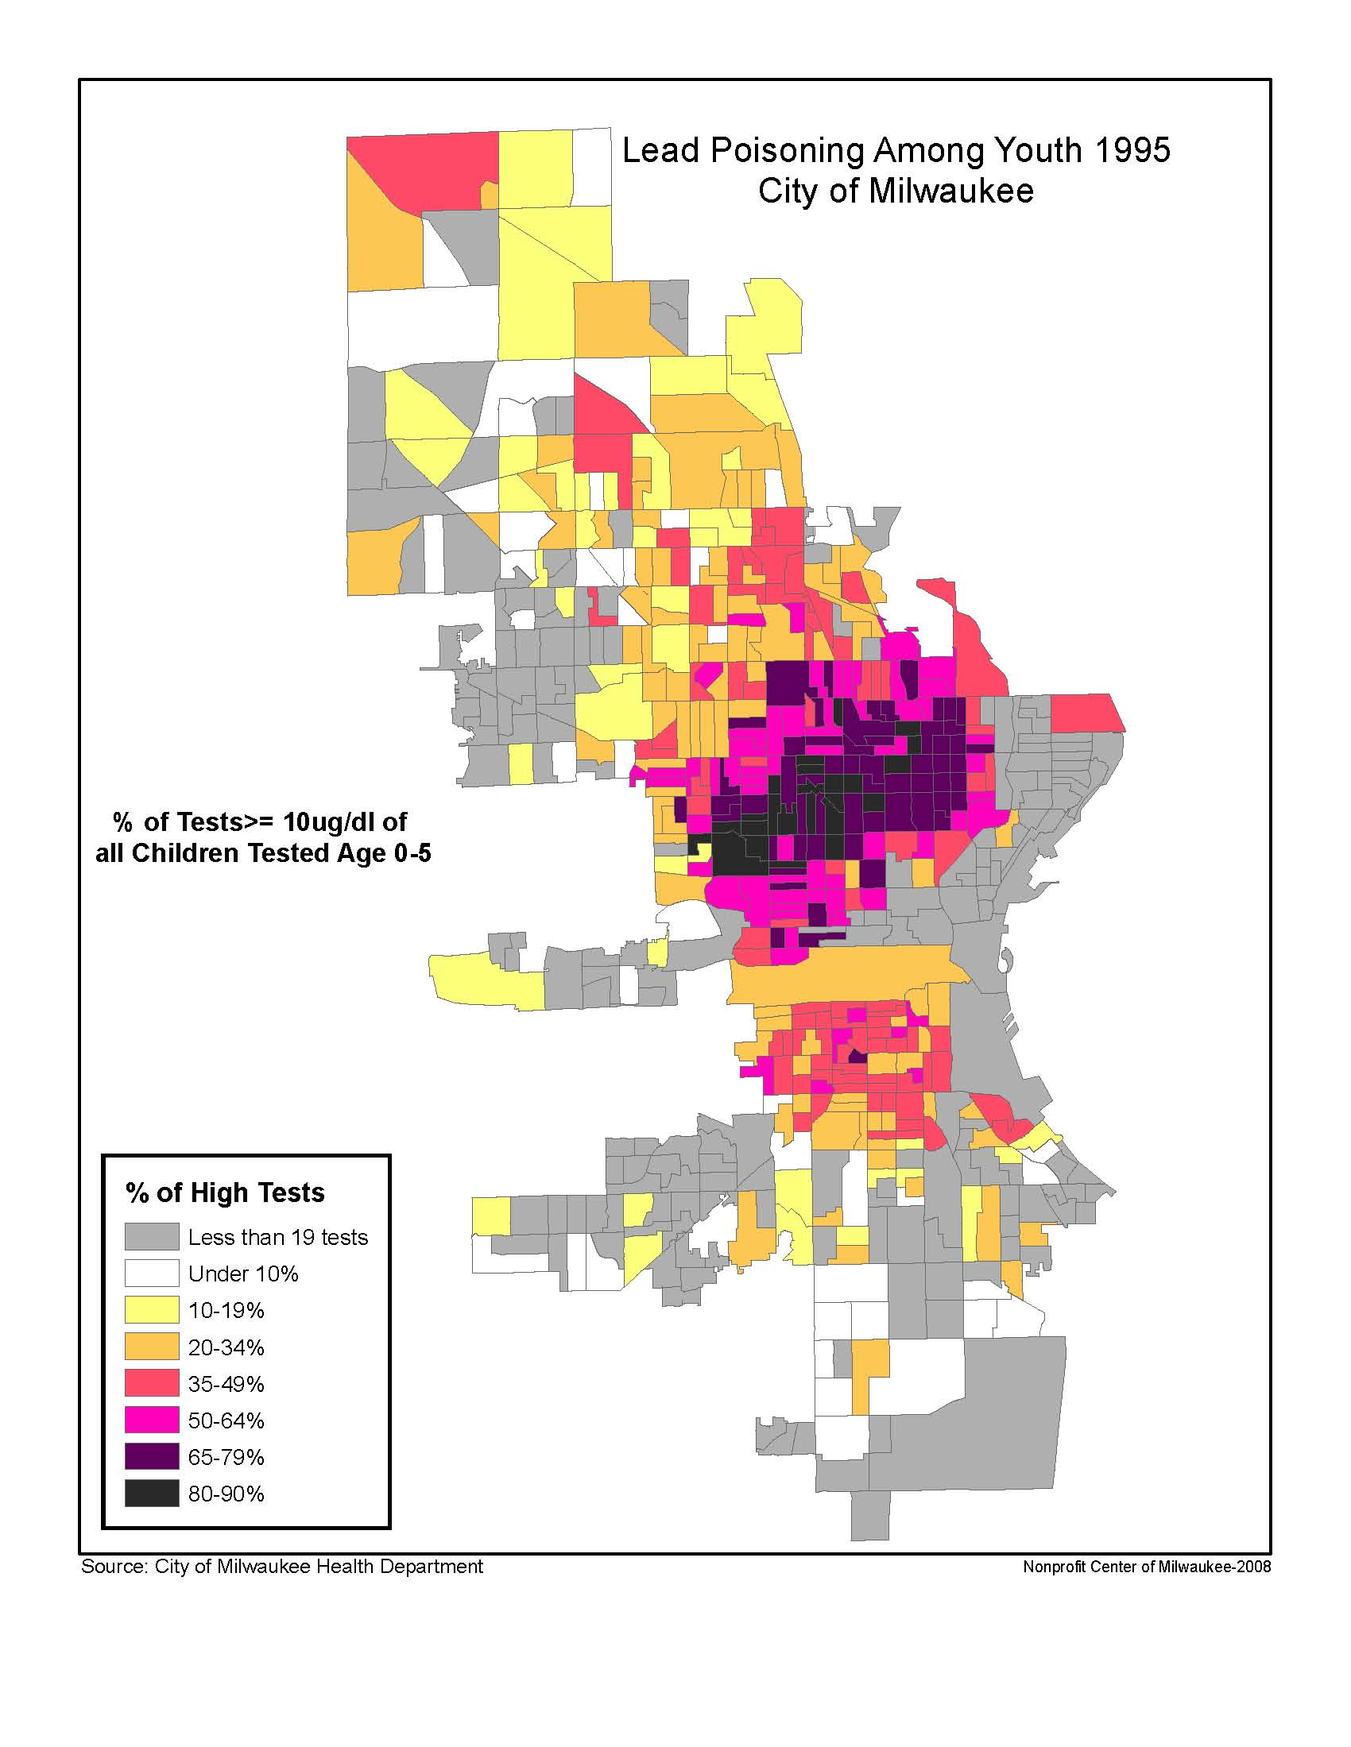

Slide 52
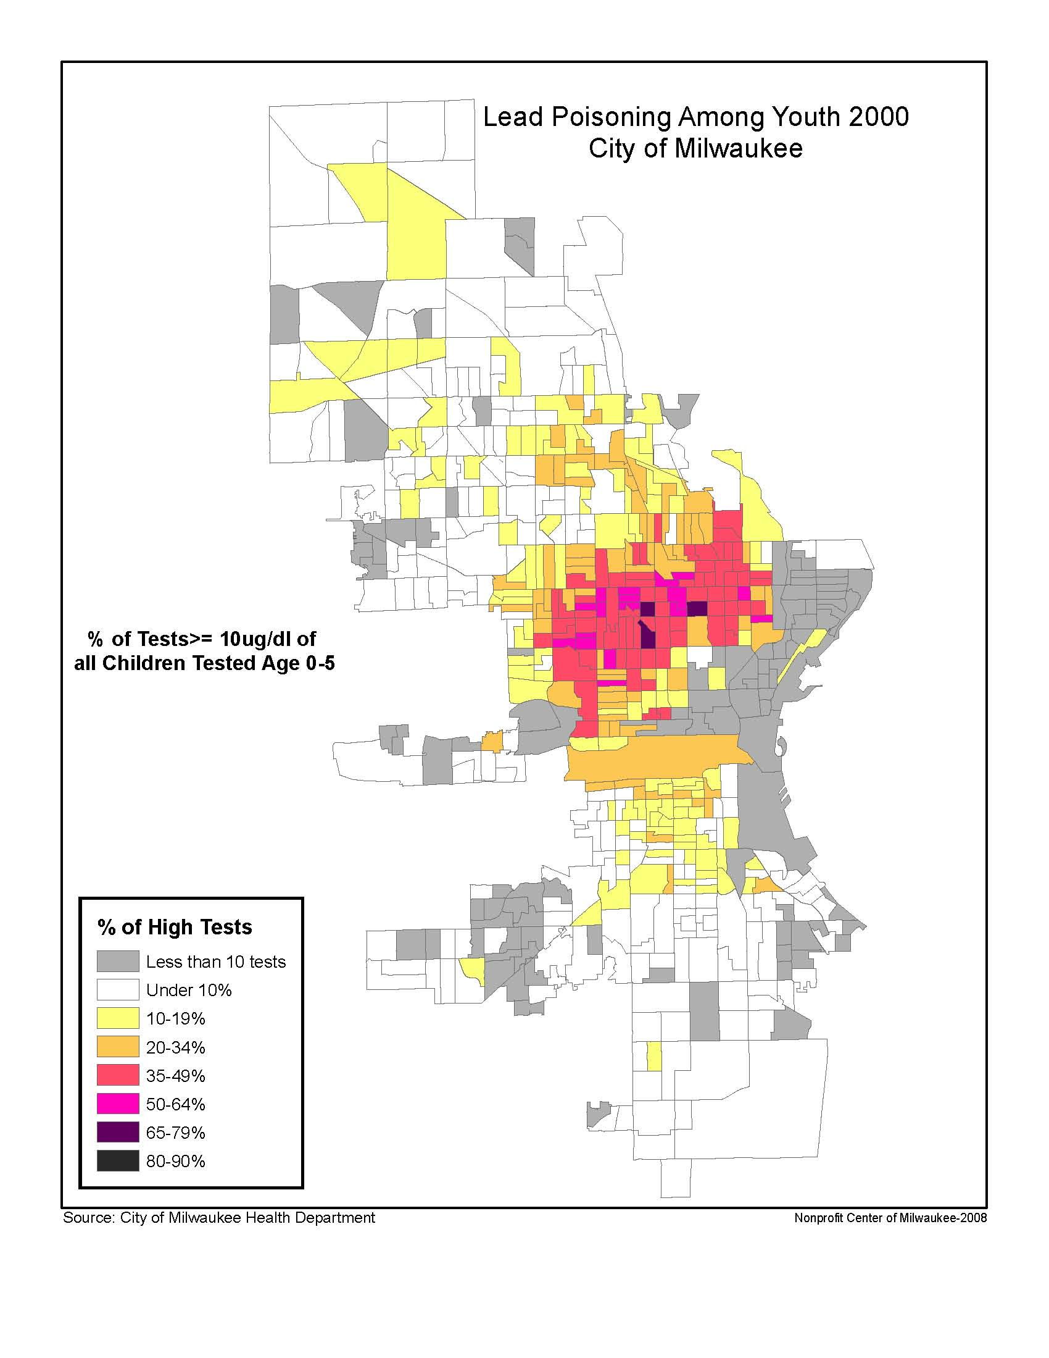

Slide 53
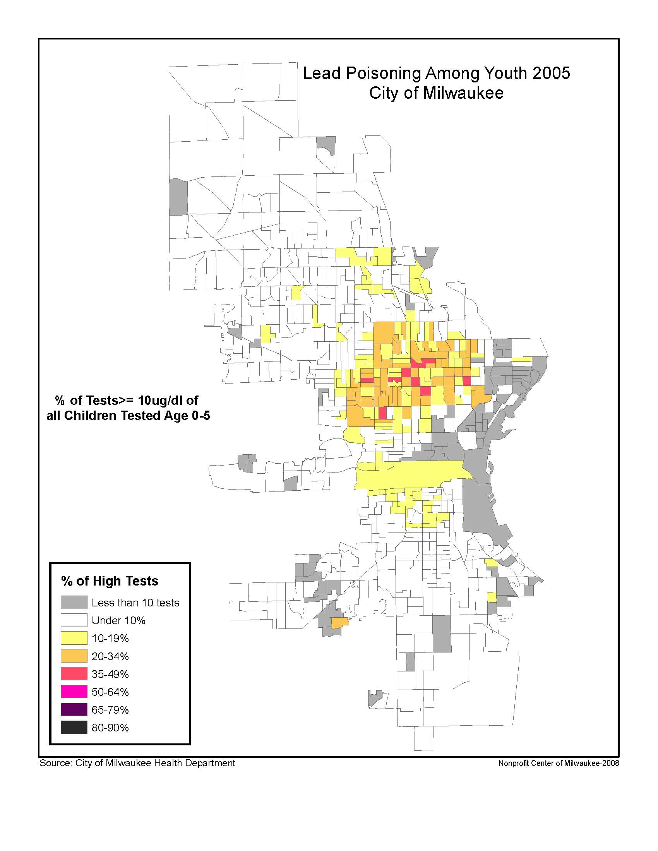

Slide 54
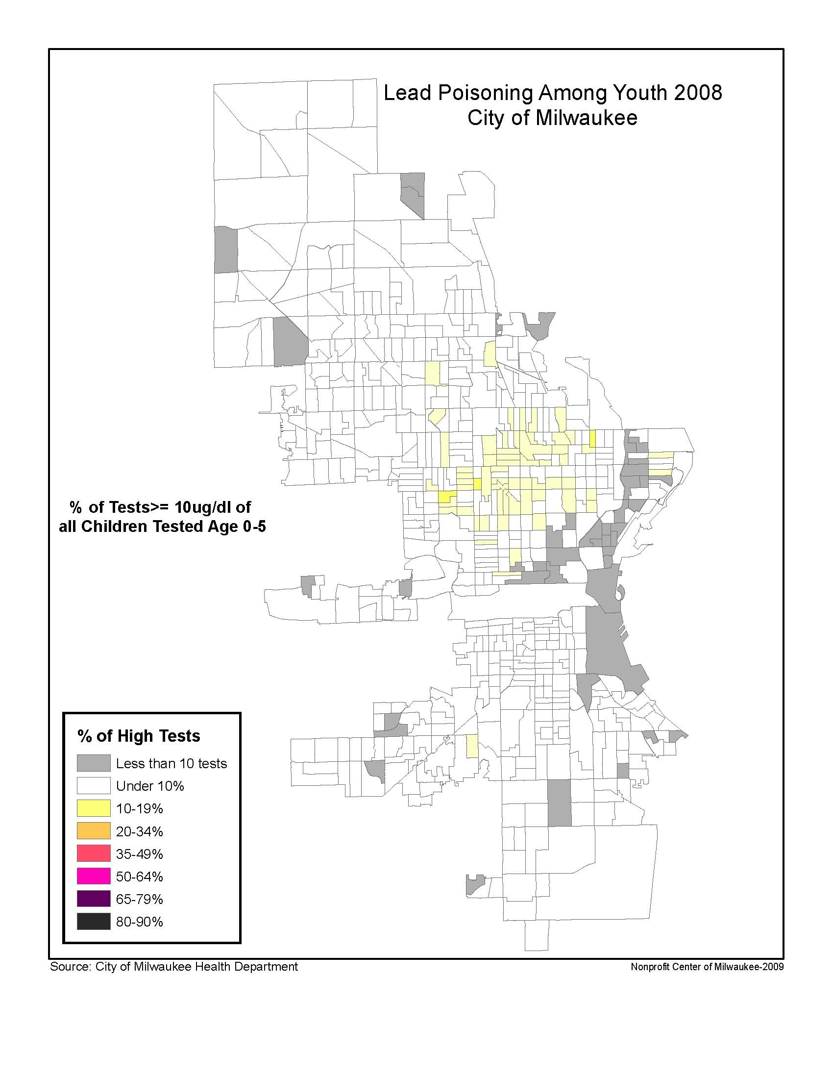

Slide 55

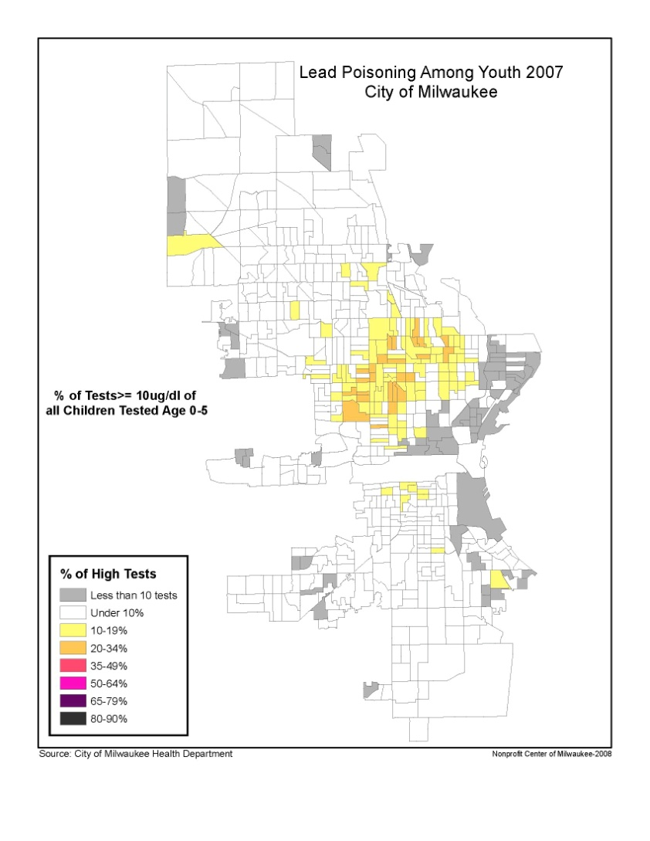
CITY AND COMMUNITY WORKING TOGETHER REDUCE LEAD POISONING

Slide 56
example
WIC Program Spatial Analysis

Slide 57
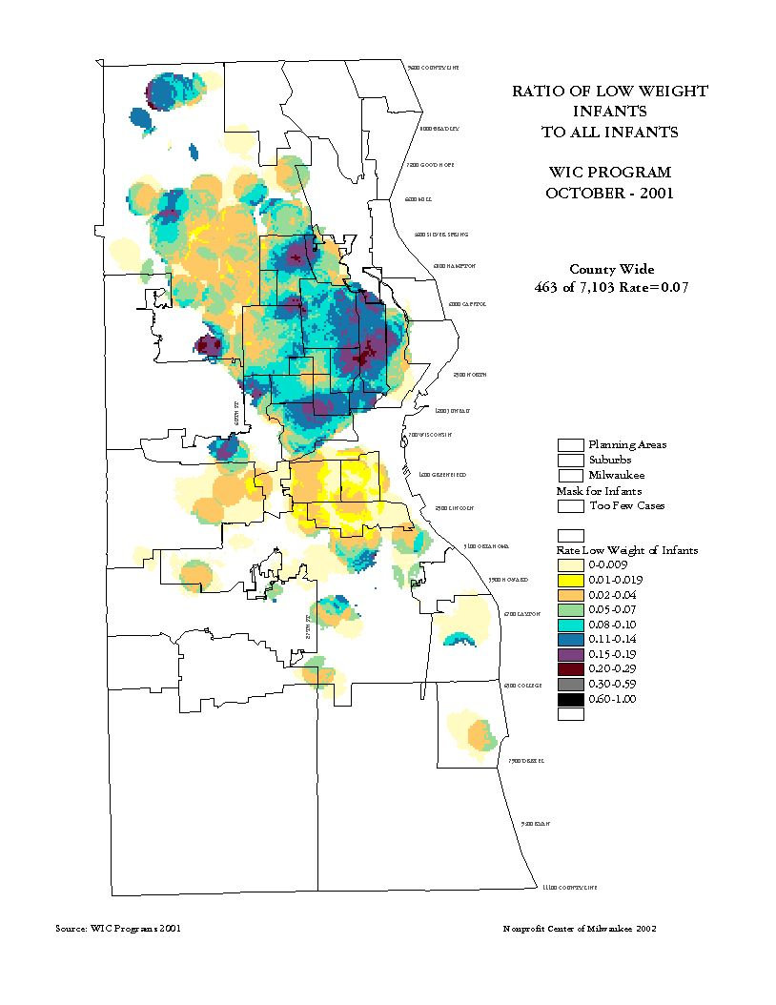

Slide 58
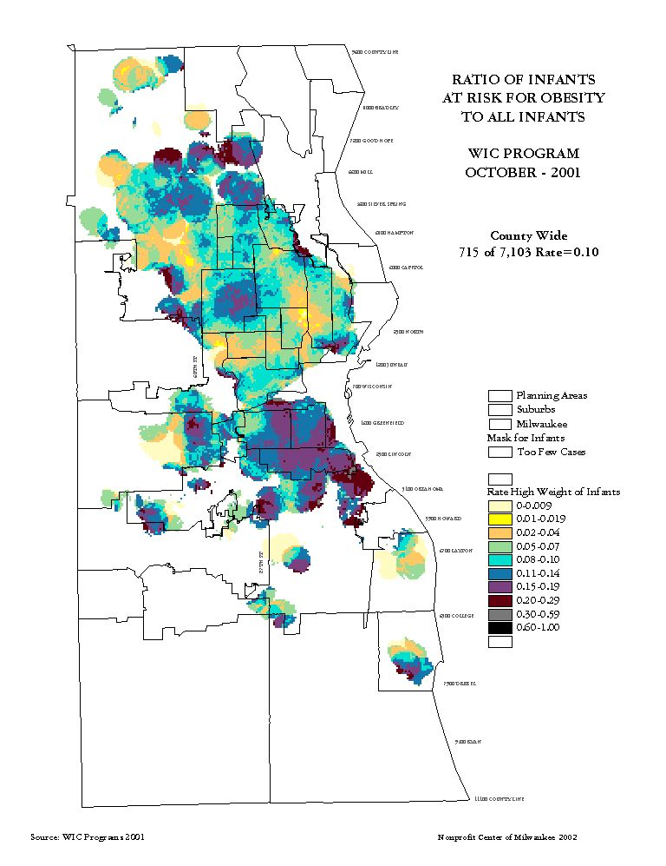

Slide 59
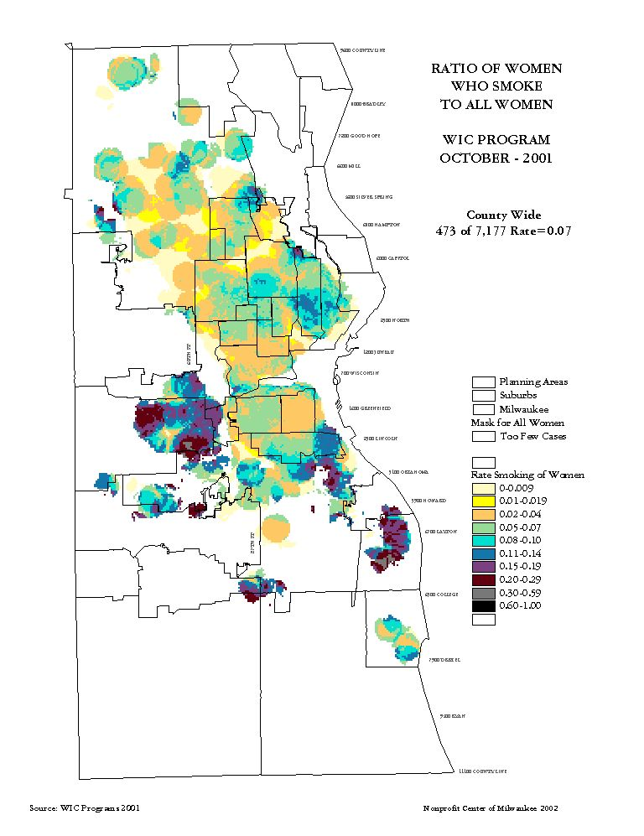

Slide 60
example
Census Demographics

Slide 61
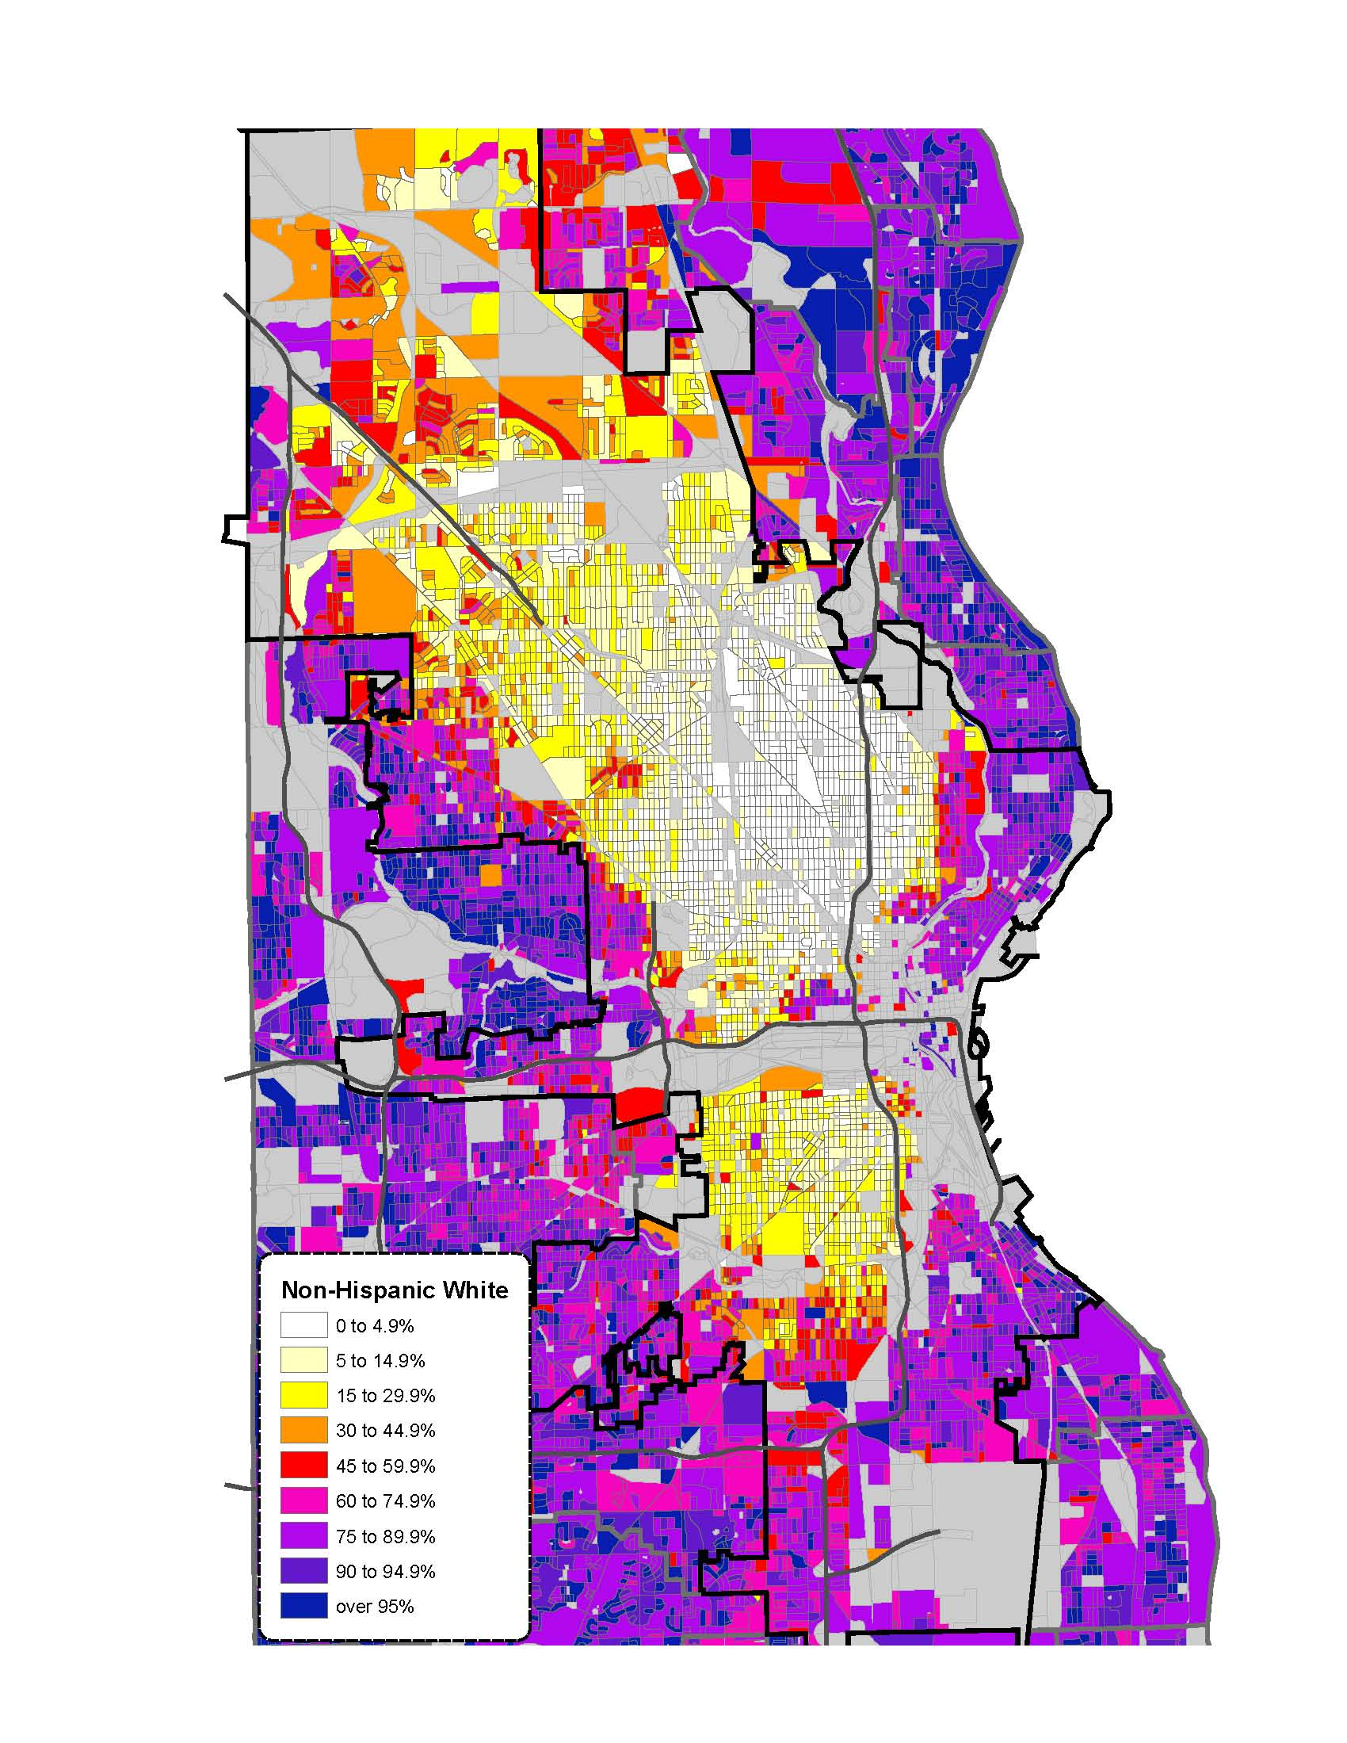
Non-Hispanic White
Population Distribution 2010
White Flight continued through the decade of the 2000’s to Waukesha, Washington and Ozaukee Counties with access to easy home mortgages and an increase in green field housing development.
White population dropped nearly 20% in the City of Milwaukee from 2000 to 2010…
Change 2000 to 2010:
City of Milwaukee: -18.7%
Milwaukee County: -11.7%
State of Wisconsin: +1.2%
Source: U.S. Census 2010
Nonprofit Center of Milwaukee 2010

Slide 62
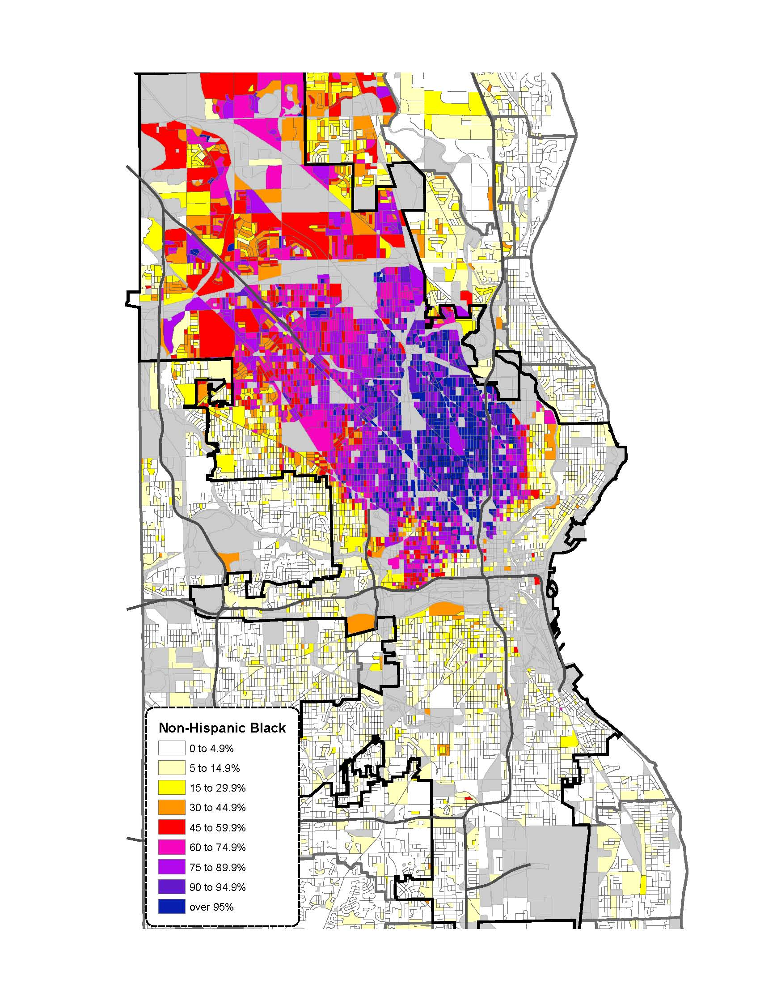
African American
Population Distribution
2010
The African American community is highly segregated – among the highest concentrations in the nation.
Areas in the north continue to be increasingly African-American – but these neighborhoods are not the usual “urban grid” of contiguous blocks. Diversity is decreasing across the Northwest side and individual subdivisions continue to be more segregated.
Change 2000 to 2010:
City of Milwaukee: +5.8%
Milwaukee County: +8.9%
Source: U.S. Census 2010
Nonprofit Center of Milwaukee 2010

Slide 63
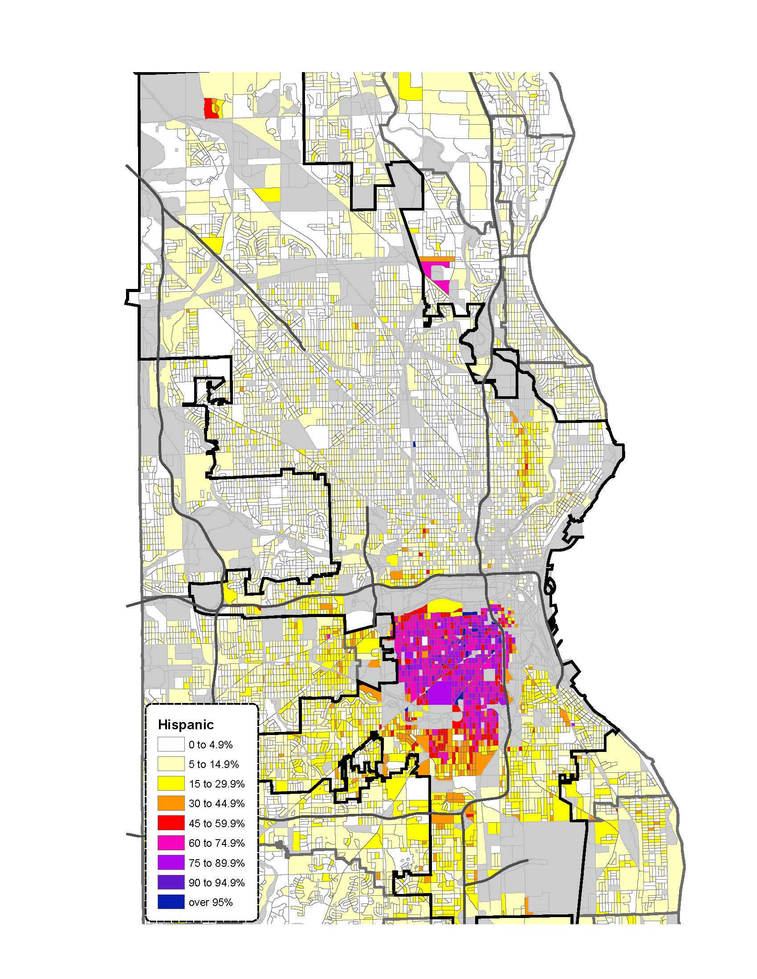
Hispanic
Population Distribution
2010
Hispanic residents are less highly concentrated on the near South side than in previous Census years while their numbers are the fastest growing of any group.
The Puerto Rican community along Holton Avenue is aging and diminishing in number as Hispanics in generally moving to the south west and into the suburbs of West Milwaukee and West Allis.
Hispanic population grew…
Change 2000 to 2010:
City of Milwaukee: +43.8%
Milwaukee County: +52.9%
State of Wisconsin: +74.2%
Source: U.S. Census 2010
Nonprofit Center of Milwaukee 2011

Slide 64
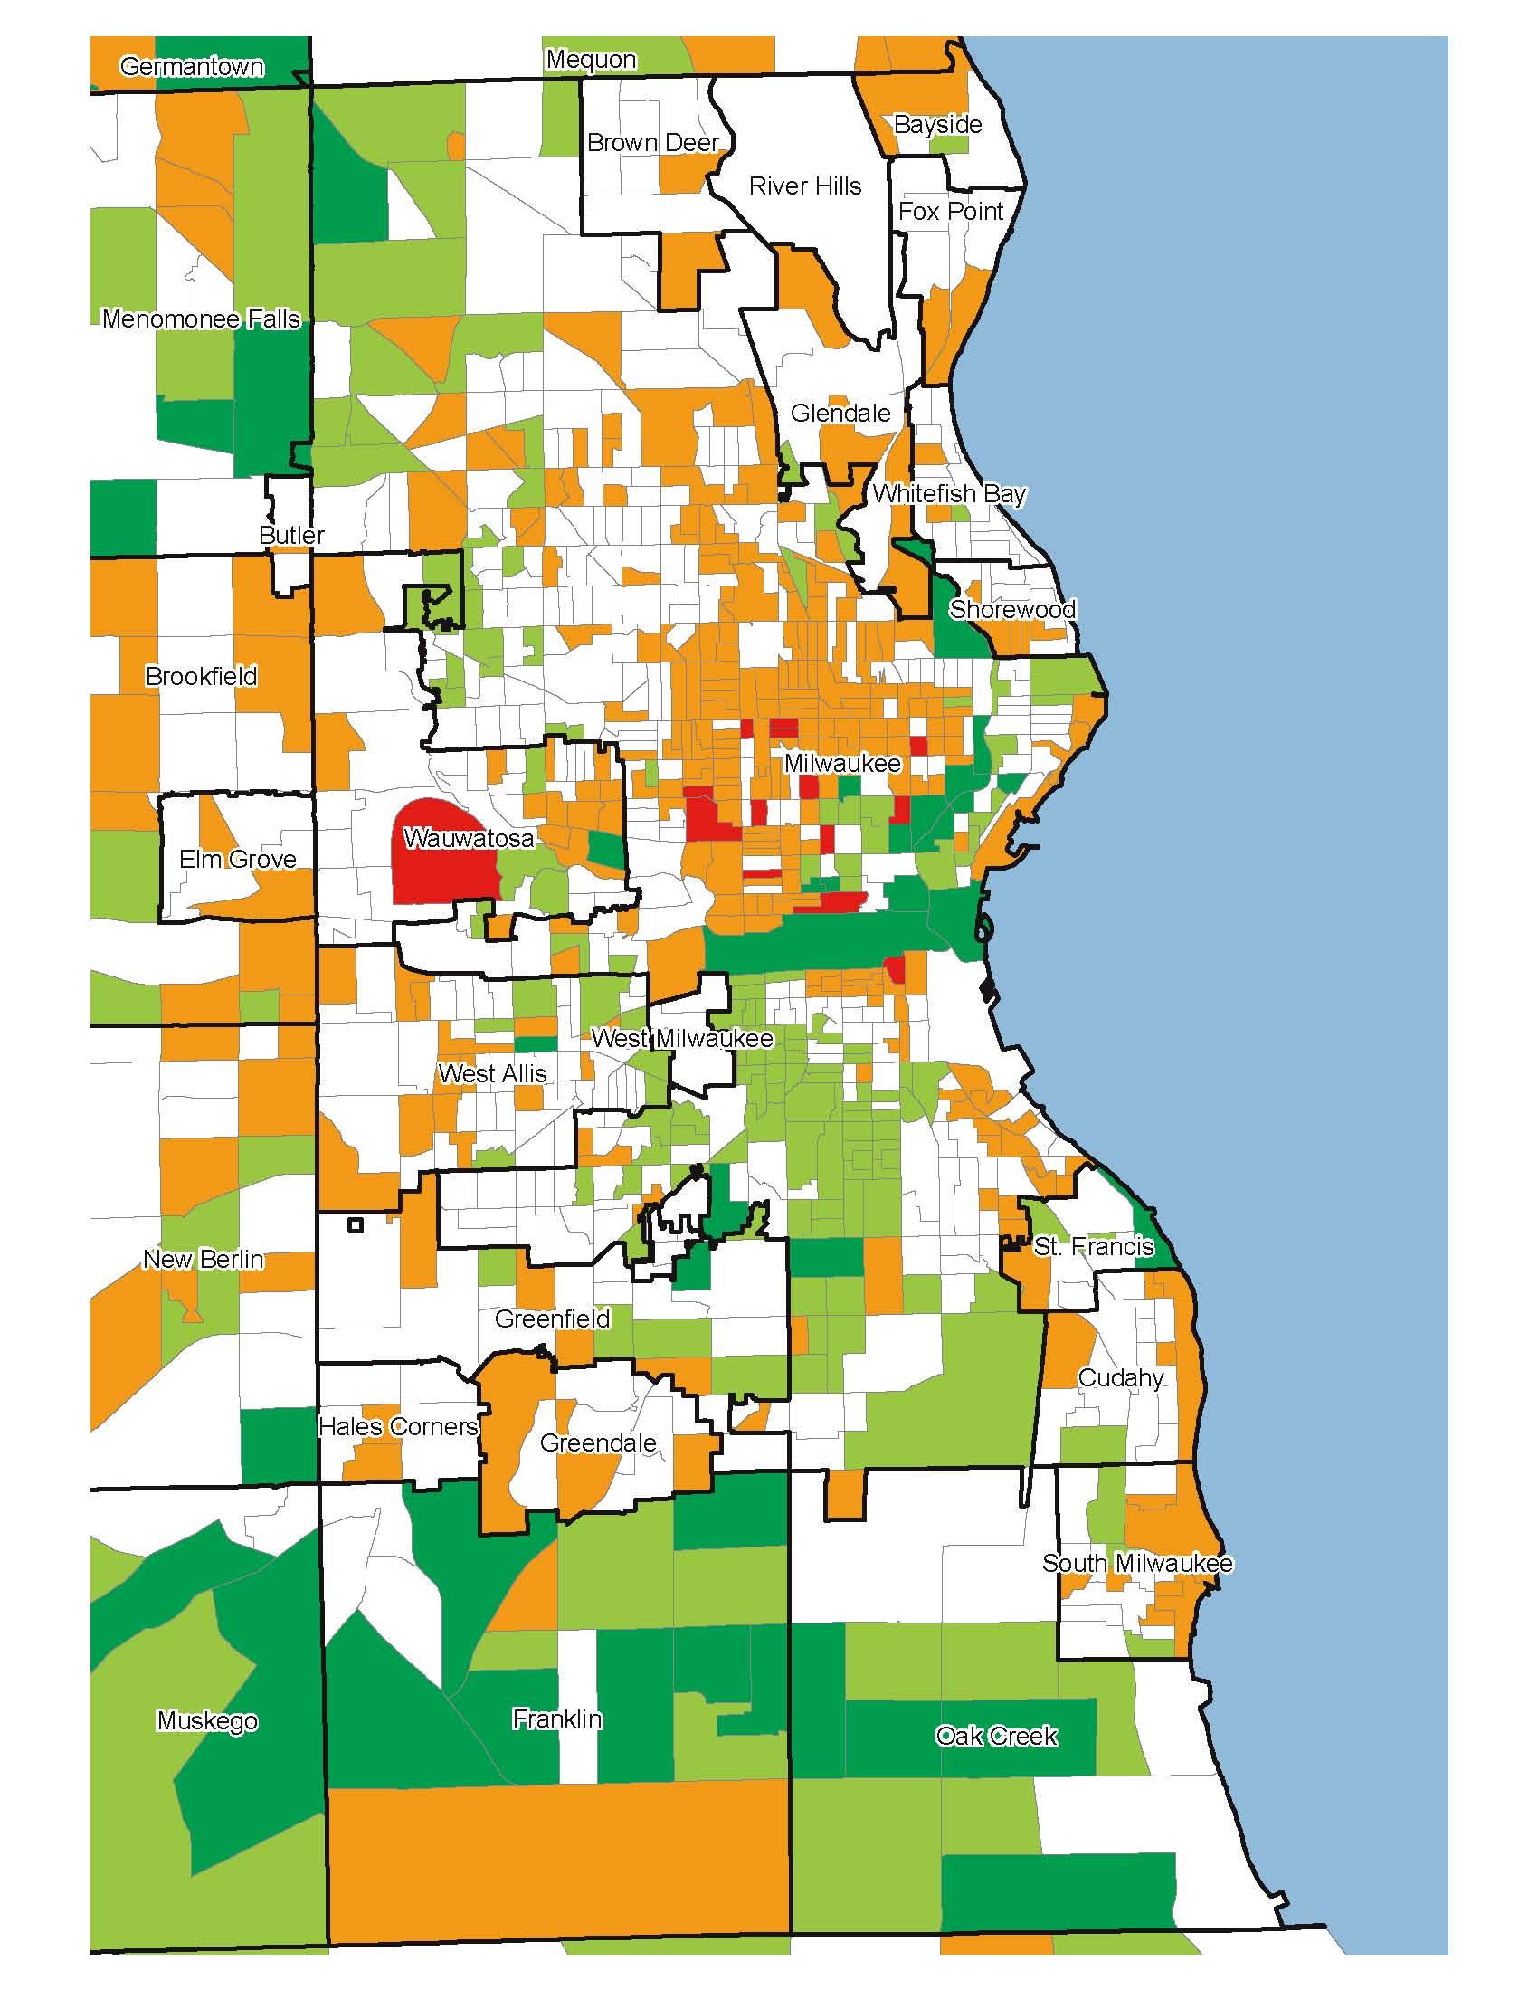
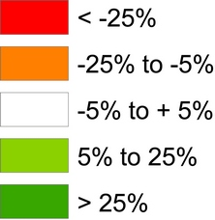
Milwaukee County
Population Change
Source: U.S. Census 100 Percent Count
Nonprofit Center of Milwaukee 2010

Slide 65
Risk Indicators
Many areas of Milwaukee’s central city face challenges that affect the futures of our children.
Charlie Bruner – Child and Family Policy Center

Slide 66

Linguistically Isolated Households are located throughout the city
The primary concentration is Hispanic households on the near West side. Asian communities are more concentrated on the West side, but also found in other areas. Indo-European households are more concentrated on the lower East side.
19.2% of Milwaukee city residents speak a language other than English
Source: U.S. Census

Slide 67

Child Densities by Block
The density differences can be dramatic.
This map specifies the number of children per average city block (rather than children per mile).
The solid yellow blocks nearer the edges of the city have 1 to 9 children per block.
The solid orange blocks in the center of the city have 25 to 49 children per block.
Red and purple colors represent over 50 children per block, note several apartment clusters around the county.
Source: U.S. Census 2010
Nonprofit Center of Milwaukee 2012

Slide 68

Educational Attainment:
Adults With No High School Diploma
Over 19% of Milwaukee city residents have no High School Diploma.
In parts of the near South side, more than 65% of adults do not have a high schools degree. Proportions are above half for many near North and South side Census Tracts.
In 2010 just 21.4% of Milwaukee city residents had a bachelors degree or higher.
Source: U.S. Census

Slide 69
Exercise
Stronger Together

Slide 70
Who’s Working on Data in
Your Community?
  University professors and students (especially through cross-discipline centers)
  Dedicated data/research nonprofits
  Other nonprofits with data capacity
  Regional Council of Governments
  United Ways or foundations
  Private firms/individuals
Notes:
NNIP model is longer-term strategy – happy to talk with anyone one-on-one interested in establishing NNIP functions in their community. The rest of this presentation is more about short-term strategies – what you can do when you get home
Types of Partner Institutions

Slide 71
Questions???

