Slide 1
Strengthening Local Capacity For Data-Driven Decisionmaking
Kathy Pettit and Jake Cowan
November 21, 2014
Data Driven Connecticut 2014
Notes:
Introduce myself – thank you for inviting me

Slide 2
National Neighborhood Indicators Partnership
Collaborative effort of Urban Institute and local partners since 1995.
NNIP partners help local actors use neighborhood data to improve communities through policy, planning, and advocacy.
Success based on:
Trusted and engaged institutions
Relevant and high-quality data across topics
Mission to support use of data for local action
Notes:
MODEL is not the focus today, but happy to answer questions or talk after the session
Bullet 1: Started with 6 partners, now at 35
Institutions:
The partners are housed in various types of institutions – universities, independent nonprofits, local funders.
But whatever the home, they are all respected organizations with a long-term stake in their community. They are viewed as neutral and people believe the data and analysis that is published.
Data: at the core of the work…
Partners all agree to collect local government data that is
1) Ngh-level (conditions vary across a city or region, citywide data doesn’t help you to target efforts)
2) On a range of issues – housing, schools, crime, etc. (need to understand ngh issues and interventions holistically)
3) Over time (to understand trends and be responsive when issues arise).
There is an economy of scale to having one group provide the service for the community.
Mission:
NNIP partners’ values drive all the hard work of acquiring and organizing the data. The point is to get the information used - whether for policymaking, community building, program planning.
At the start, the founding NNIP partners recognized that not everyone had equal access to information. Focus began with and remains on low-income nghs that have traditionally not had access to data or training to use them.
Alt 2nd bullet: All partners regularly assemble, organize and transform neighborhood-level data to support local decisionmaking.

Slide 3
Why Open Data?
Effective public policy
Effective planning/programs outside of government
Efficient delivery of government services
Transparency and accountability
Informed public engagement
Business development
Notes:
When people talk about open data, they are more likely to think about the last three goals…
From NNIP and Urban’s perspective, the first three goals are as important outcomes of open data and should be used in judging its success.
Example: Hartford’s GIS director Brett (check last name and title) had been working on publishing to their new open data portal for 6 months driven by the goals of good government practices. But when it came time for the city to apply for a federal Promise Zone grant, his job in supplying information was much easier because the data was already organized.

Slide 4
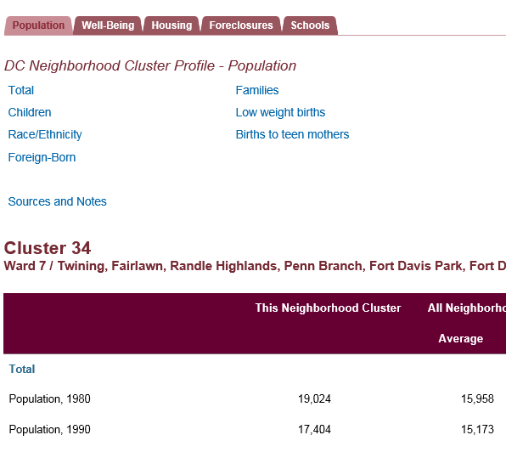
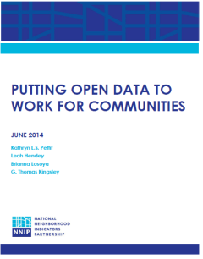
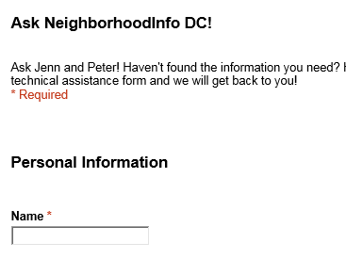
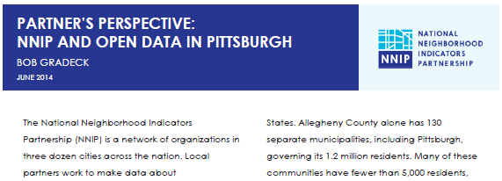
Notes:
We’ve been working to connect the older world of neighborhood indicators with the open data players. We completed a two-year project scanning the open data environment in our partner cities and seeing if and how open data was translating to community action. (Paper and case studies available) and are staring a project with Living Cities and national Code for America to marry civic tech and community data. Opportunity for new allies in the work – leverage each others talents.
Urban, under the leadership of Peter Tatian and Leah Hendey, is the NNIP partner in the Washington DC area since 20XX. We have shared basic information on line, and provide ad hoc TA to anyone looking to use the data. Most of the focus has been on in-depth analysis to support DC nonprofits, govt agencies and the Council of Governments. Work around housing and schools in particular

Slide 5
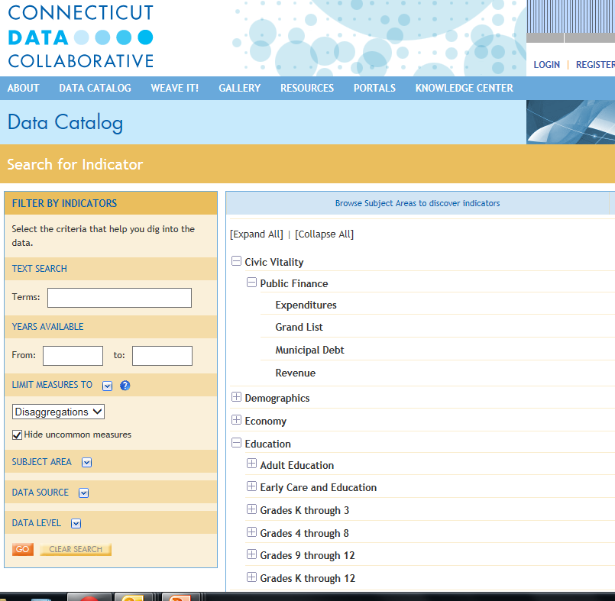
So you have lots of data… what else is needed?
Notes:
As I travel around the country to conferences, this is the question I’m hearing more and more – it is a good sign of maturity in the field, and gives us a different set of work to do.

Slide 6
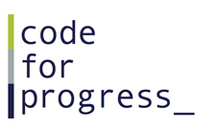
Community-focused Technology
Notes:
Connection to civic tech and open data
A lot of progress has been made – national groups with progressive missions about improving society – bridging the racial and gender gap in technology. In a few cases, staff at partner organizations also lead their Code for America brigades.
From NNIP, Cura: Tech – new program in the Twin Cities – technologists and community groups team up to propose ideas that would help residents and groups in low-income neighborhoods. They provide rounds of seed funding to get started. Examples (should be verified): web site/app to facilitate local shopping (Somali scarf shop) or idea about simplifying the application to become a credentialed small and minority owned business.

Slide 7
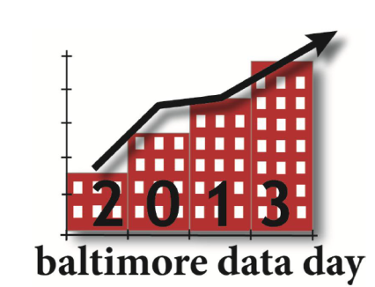
Community-building and Training
Notes:
These are some of what’s going on today (walk through examples if time). We can do a better job of sharing lessons from different strategies – whether day-long events or formal curriculum.

Slide 8
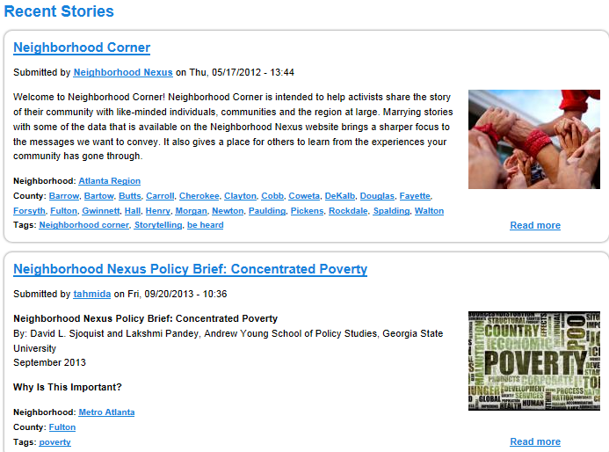
Storytelling
Notes:
Jake calls this celebrating success. One person said that the nonprofits just need ideas about how the data can be helpful in their day-to-day work. How to connect to the missions of the organizations and peer examples are inspirational and practical.

Slide 9
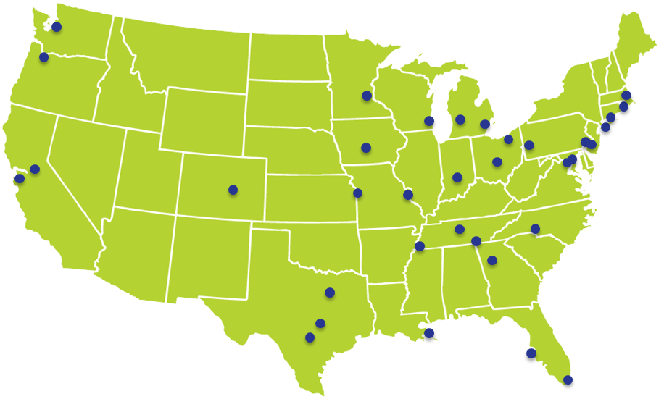
Translators and Navigators
Notes:
To make this all happen, we need people who can cross disciplines and sectors.
Here are some of our NNIP partners that make it happen
Conversant with government operations, politics, community concerns, and the technical data side
Connect people locally and to national networks
Encourage you to step into this role - we need to figure out how to cultivate these skills – university programs, professional development

Slide 10
Local Examples
Notes:
We’ll go through these pretty quickly – we hope you will add your own examples.

Slide 11
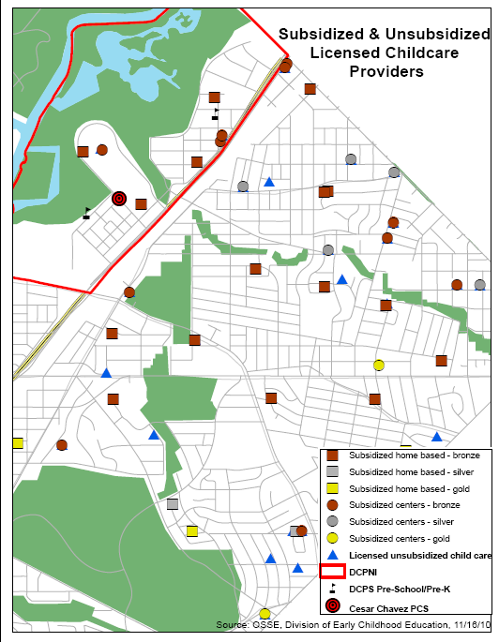
Map Resources & Analyze Gaps
Source: NeighborhoodInfo DC
Notes:
Example from the NeighborhoodInfo DC work to support the DC Promise Ngh in Kenilworth Parkside, which won Dept of Ed. Grant in 201X
Goal is high-quality early education, so needed to know what was already available near the ngh.
This map was a first step showing location and capacity (total capacity of 22 infants and 102 older children)
But then layered on quality ratings – issue was not necessarily the number of slots but the lack of good programs.
Admin data not enough, More work to be done using qualitative methods
Are these used by families in the neighborhood (surveys and focus groups)
How strong are the curriculums? What kinds of programs do they offer?
Resulted in two-pronged approach –
Recruited new rigorous early child development program to open in the neighborhood
Created programs to help existing centers and home care providers provide better services
11

Slide 12
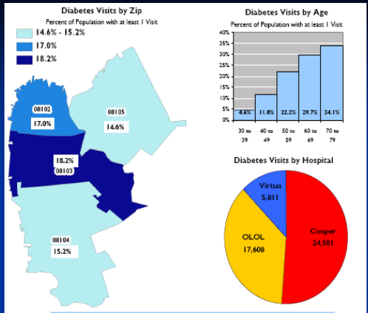
Plan Community Health Programs
Source: CamConnect
Notes:
CamConnect, our Camden NNIP partner, had close relationship with hospitals from the beginning.
All 3 hospitals in the city wanted to understand their patients better and were concerned about rising costs of health care for uninsured people. After years of negotiation, they agreed to share their patient billing data with CamConnect, including both Emergency department visits and inpatient hospitalizations. Careful privacy protections and lots of work to harmonize the data.
Geocoded the data and did probabilistic matching to match patients who visited multiple hospitals. They found 38,000 Unique patients across institutions, found that approx one-half of the City population used the ER/hospital in one year. At the individual level, they ideitifed people who used the ER often, and assigned them a nurse practioner contact that could work with them one-on-one about their health issues (which likely crossed into housing, family situation, etc.).
Also helped with community-level interventions. They worked with the Camden Healthcare Coalition to dive into specific manageable diseases – here is 1 example of diabetes. These maps helped the Citywide Diabetes Collaborative focus their outreach efforts for classes on how to better manage the illness.
(now data is handled by Camden Healthcare Coalition who helps others interested in doing this work, still close partners with CamConnect).
12

Slide 13
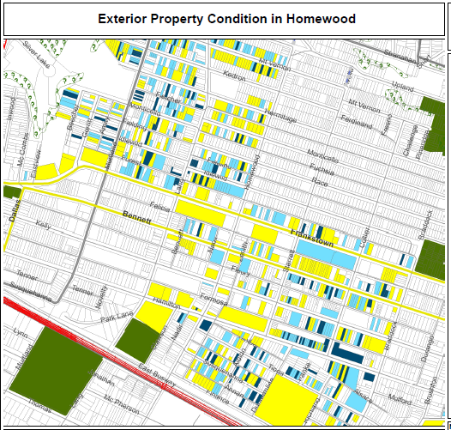
Collect original data
Legend
Exterior and Paint
Good
Fair
Poor
N/A
Notes:
A lot of potential in community collected and cross-sourced data.
In Pittsburgh, they began with the assessors file as the backbone of the system (with property ID, basic characteristics, ownership, and tax delinquency )
Student and residents implemented the property survey, noting the condition of each home.
Here is a map of the resulting data - Yellow is good, light blue is fair, dark blue is poor.
NEW TEXT: Confirm this is the Homewood example: The neighbors prioritized the 30 worst properties that they wanted the city to board up. One focus was blocks that kids had to walk past on their way to the elementary school. Within a month 2X of 30 were secured or improved. Showed that city listened to the collective voice of the community. PNCIS now working on a standard for collecting this type of data across the region with the online tool from “localdata” (CfA spinoff) so that the information can roll up, be compared across ngh and time.
OLD TEXT: Map was shared and used for data driven organizing and presenting to block clubs.
[check with PNCIS – this is hypothetical or actual? Before and after assessments (does a block club affect the physical condition of a block? etc. ]

Slide 14
Frame, Choose,
and Track
Community Goals
Notes:
The earlier examples were more concrete, other efforts are more long-term, like Community Indicators Projects.
Boston was a Sust Communities grantee – wanted to educate the region (particularly the suburban towns) about how the region’s economic growth was tied to the question about equity
They used the “state of equity” report to start the community conversation and frame the issues. Eventually, they were able to get the towns to agree to having extra points for projects that addresses equity issues in the local re-granting program.
Community indicator projects build a common understanding of trends, and can shift how people think about issues, what’s politically possible.
Like Progress Points in Hartford or Greater New Haven Community well-being index

Slide 15
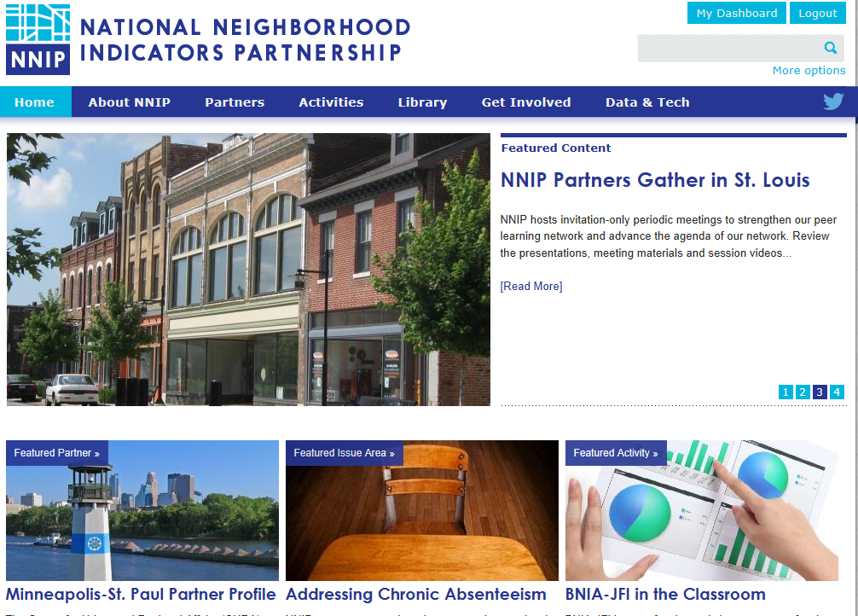
www.neighborhoodindicators.org
Notes:
Mention listserve and Twitter

Slide 16
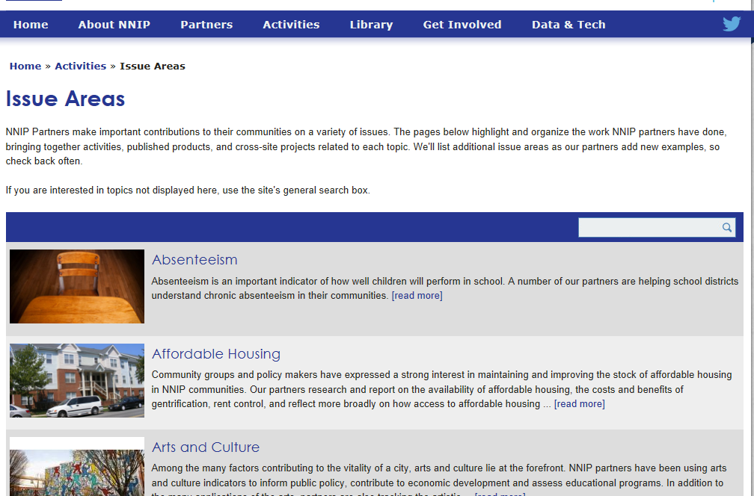

Slide 17
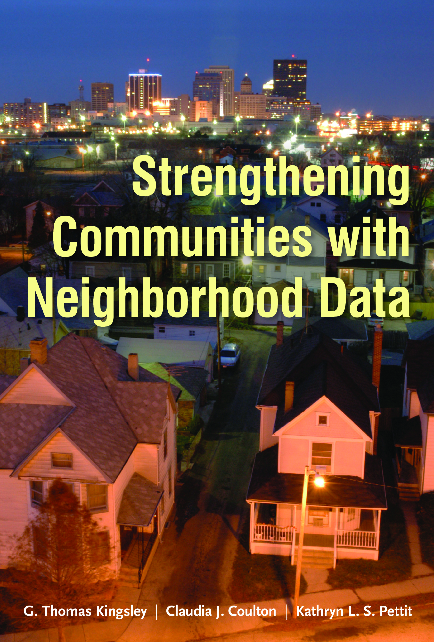
TWO NEW BOOKS ON DATA AND COMMUNITY ACTION
Notes:
Not only about NNIP – free ebook
Webcast
Strengthening Communities with Neighborhood Data(11/12 webcast)
MacArthur supported
Essays on Cleveland, Twin Cities, Portland
Case studies and examples from Austin, Camden, Dallas, and many more
What Counts: Harnessing Data for America’s Communities (12/4 event/webcast)
Edited volume with San Francisco Federal Reserve and RWJ support

Slide 18
Follow us on Twitter @NNIPHQ
For more information about NNIP, visit www.neighborhoodindicators.org or
email Kathy Pettit at kpettit@urban.org

