Slide 1
Potential of Integrated Data to Engage Communities in Collective Action
Claudia Coulton
Distinguished University Professor
Co-Director
Center on Urban Poverty & Community Development
Notes:
Governments at many levels provide services that affect population well-being. Children and youth in particular are served by school districts, city programs, county, state and federal services. Non-profit organizations serve these children and families too. Although these entities often “touch” the same individuals, their record and data systems don’t connect. How can we as a community and society manage toward smart investments in effective programs and better results for children and youth when the data we need to guide our action sit in separate silos? Integrated data systems are beginning to show the way.

Slide 2
Topics
Promise of “BIG DATA” to show the way to cost-effective solutions for urban communities
What we have built in the Cleveland area
Local example of the NNIP-IDS project
Three City Project on Child Welfare-Juvenile Justice
What are we learning about building collaborative applications of Big Data —national and local
Notes:
We hear a lot today about the “Big Data” revolution. Companies are mining digital data to enhance their markets and profits in so many ways. App developers are capitalizing on the digital revolution and consumers are readily taking up these products. Perhaps less well known is a movement in some places to link data across agencies serving urban areas to support community-engaged action for social change. Today I will talk about what we have been doing in Cleveland, in conjunction with NNIP and other national partners, to break down data silos so that communities can work together to produce efficient and cost effective results. Finally, I will touch upon some of what we are learning regarding the challenges and promise of this work.

Slide 3
Potential of “big social data” to enhance know-how gets push at national and local levels
Available longitudinal records data generate rigorous evidence at low cost
Foundations ask, How can IDS drive data informed local action?
Pay for
Success
Local initiatives rely on integrated data for planning and evaluation
Operation
Prevent
Notes:
Just in the last year or two the potential of big data to improve public policy has gotten national attention. National Science Foundation has announced funding to support the science underlying the analysis of big data. NIH is giving priority to funding randomized controlled trials of innovative social programs that rely on longitudinal integrated administrative records data rather than expensive original data collection. Both of these moves are geared toward learning more about what works and learning it cheaper and quicker.
Recently the Mac Arthur Foundation and Annie E. Casey Foundations have begun investing in making sure that these data innovations actually improve social policy and the effectiveness of government and non-profit services in communities and regions. These foundations want to figure out what it takes at the state and local level to build the integrated data systems, make them practical and useful, and change the culture and practices of data utilization in the government and non-profit sectors.

Slide 4
Integrated Data Systems (IDS) Break Down Data Silos to track individuals
IDS link records from multiple agencies to track inputs and outcomes for individuals
Built on data sharing agreements, strict privacy protection, and common interest in social benefit
http://www.flickr.com/photos/14900968@N03/5175861391/
USES
Plan for target populations and program innovations
Mobilize work toward joint outcomes
Capture cost benefit across systems
Notes:
Integrated data systems are the cornerstone for all of these aspirations. Not surprisingly, there are many elements to building these systems, making them function effectively, fulfilling their promise through broad utilization and making them sustainable. The challenges are administrative, technical and political.

Slide 5
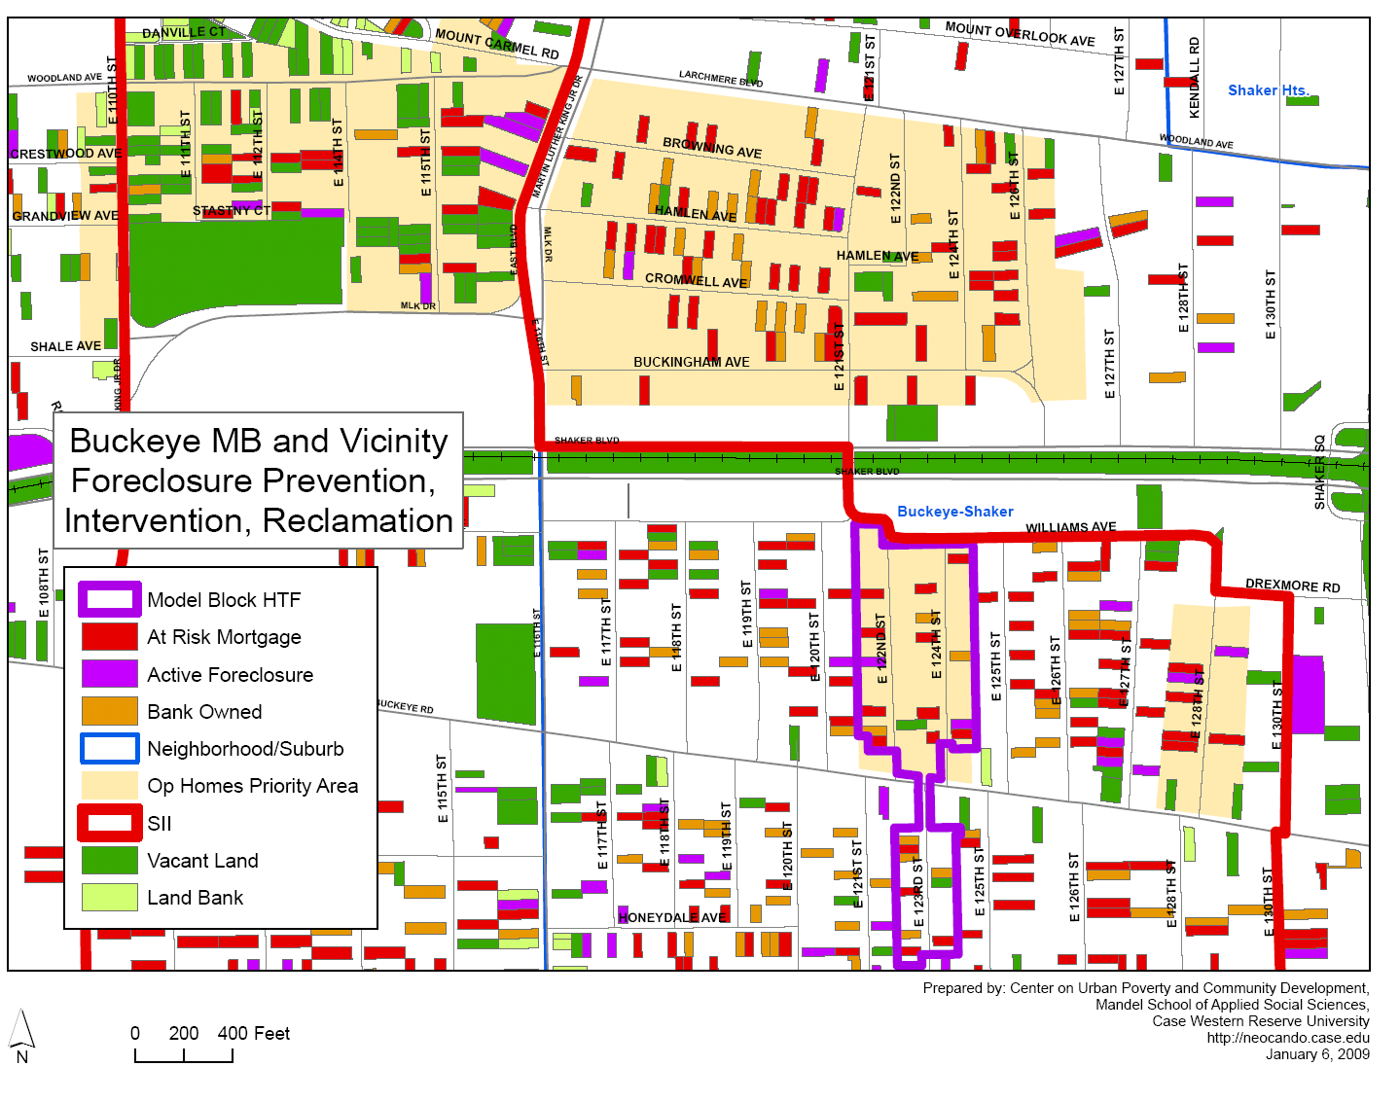
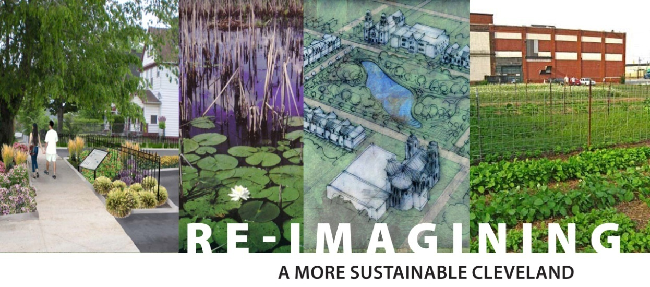
Neighborhood Indicators Systems support comprehensive planning
Records from multiple sources linked to track properties or neighborhoods
Neighborhood indicators across sectors can be linked to IDS records for contextual effects

Slide 6
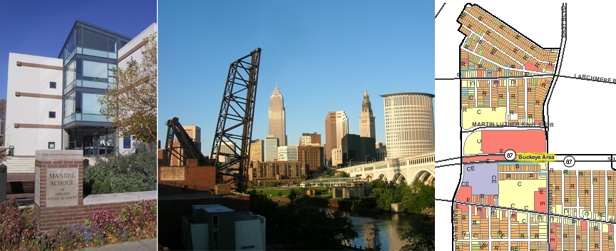
Cleveland applications use IDS and Neighborhood Indicators Systems
Notes:
Now I would like to provide a brief overview of IDS developments here.

Slide 7
IDS: ChildHood Integrated Longitudinal Data (CHILD) system
Uses periodic data integration model
Gradual development over many years by data partners working on collaborative projects
Started with focus on young children, recently adding older youth, transition to adulthood and linked parent records
Covers all children in Cuyahoga County born since 1992
Notes:
I will begin with what we are calling CHILD system. The Center on Urban Poverty and Community Development has built and currently operates this system—we are the curators of the data, but the system relies on many data partners and community supporters. The Cuyahoga County Invest in Children Program has been a key supporter and most responsible for the system in its current form. However, the Center began working on record linkage and the use of integrated data through earlier partnerships and projects as well.
First, in the 90s, Cleveland’s Health Department received a large federal grant to reduce infant mortality in 16 neighborhoods. The program was carried out by outreach workers in multiple community agencies, prenatal clinics run by several health systems, health department workers and hospitals providing obstetrical services. It was not practical to get all of these partners to put their records in a common data base, so the idea of record extraction and linkage was adopted. Birth and death certificates were also linked in to complete the risk and outcome tracking required by the grant. The results were used for ongoing program improvement. That and subsequent work with administrative records from government agencies has been the basis of support for an ever growing system.
Now the system covers all children in Cuyahoga County who were born since 1992. New data sources continue to be added to the system. These additions are enabled by project funding for specific target groups and problems. A challenge is how to sustain the system beyond project funding so as not to loose what has been built and what is a tremendous resource beyond any particular project.

Slide 8
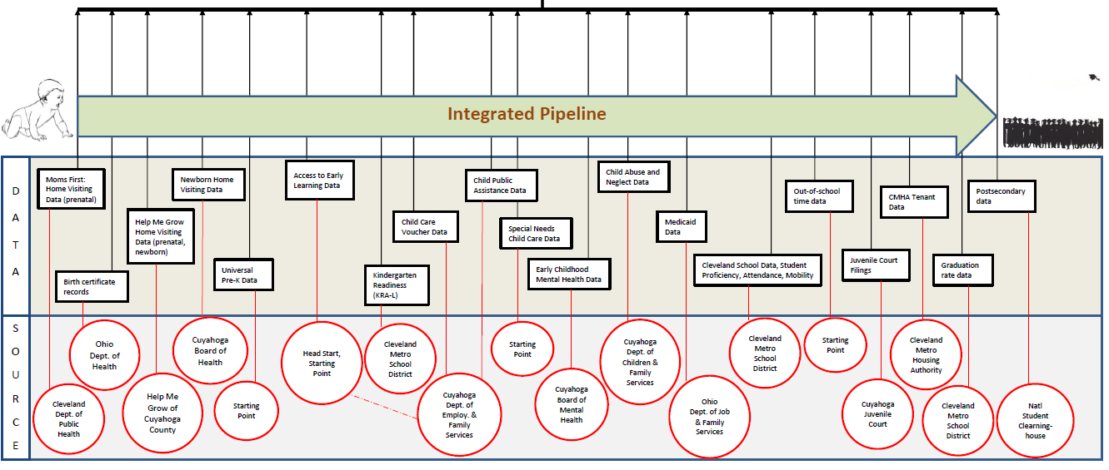
CHILD tracks individuals across developmental stages and multiple programs

Slide 9
CHILD system – links data and creates multiple identifier “register”
State Health Records
Justice System
Records
Birth certificate
Lead levels
Juvenile Court
County Jail
ID1
ID2
Public
Assists
ID6
CHILD System
ID3
Public
Education
Common ID
(ECIID)
Medicaid
Food Stamp
TANF
Child care subsidies
Pre-K
K-12
Test scores
Proficiency test
High school graduation
Higher education
ID4
ID5
Social
Services
Child
Welfare
Child care supports
Home visiting
Homeless services
Abuse/neglect reports
Foster care
Notes:
Now I would like to tell you a little bit more about how the child system works. Partner agencies extract various types of individual records from their systems. The digital records are transmitted to the Center where they go through a cleaning and linking process. They are assigned a unique identifier by the CHILD system, and this serves as the connection to each child’s record across data sources. The “backbone” of the system links children’s IDs across multiple systems, a set of parent IDs across systems and an address history concatenated from the various records.

Slide 10
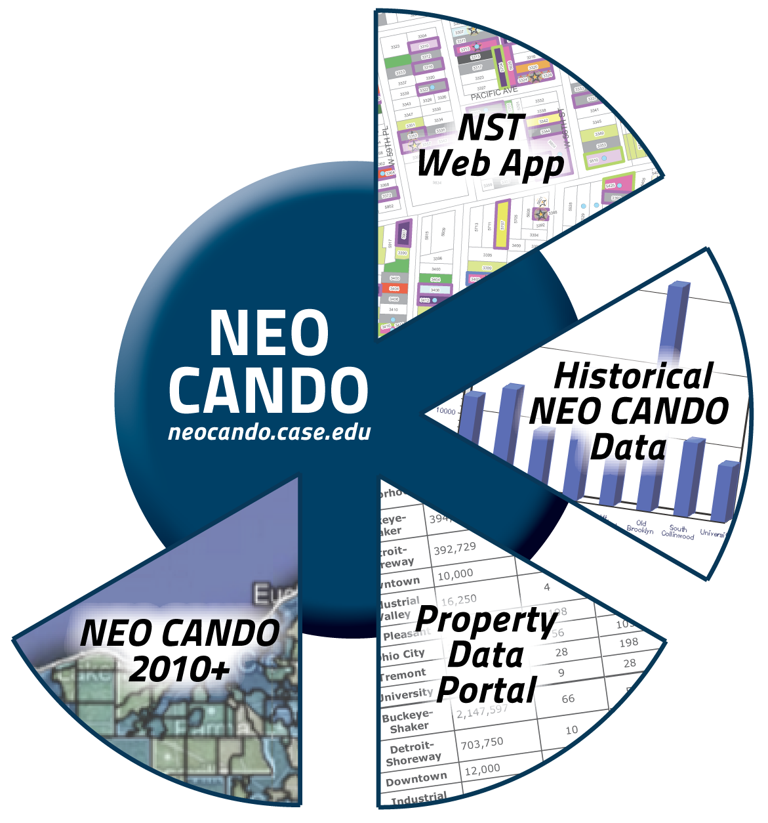
Neighborhood indicators system: NEO CANDO
Neighborhood indicators—tracks neighborhoods, census tracts, catchment areas—indicators from 20 data sources for 25 years
Parcels—housing, property, transactional data (e.g. sales, foreclosure filings, code violations, etc.)
Notes:
The integrated data from this system have been used very effectively by the Invest in Children initiative (The Inform, Influence and Impact report on our web site provides many examples of program and policy improvement driven by the data). I want to share a couple of more recent examples of the data use that go beyond IIC.
In partnership with the Cleveland Metropolitan School District and the Ohio Education Research Center, we are taking a look at the early childhood risk and success factors in Kindergarten readiness and 3rd grade literacy. The IDS allows us to select four cohorts of entrants into Kindergarten and look back in our data to their birth and forward in our data to the 3rd grade. The IDS contains many data elements that are indicative of events and programs that have the potential to influence school success, and these are readily pulled together for the analysis. Clearly, if the study had to be done without the IDS it would have been terribly costly and could only have been done for a small sample rather than the entire population in CMSD kindergarten.

Slide 11
Cleveland’s NNIP-IDS project: Long term outcomes for youth transitioning out of foster care
Will study 4 cohorts of 9th graders (over 20,000) to compare foster care youth with neighborhood and school peers?
Positive Outcomes
Costly Outcomes
High school completion
Higher education enrollment
Employment and earnings
Juvenile court
Incarceration
Homelessness
TANF
Controlling for risk and protective factors
Disaggregated by school and neighborhood

Slide 12
Community partners and process
Jim Casey Project- Brings together many partners to plan for youth aging out of foster care
YWCA, YOU, MY COM, DCFS, Juvenile Court, School System
Neighborhood Collaboratives—prevention in child welfare
AECF family to family initiatives
Informal networks and community-based organizations
Public systems—Child Welfare, Justice System, Public Schools

Slide 13
Conceptual Model
Outcomes
Crime rates
Concentrated disadvantage
Residential instability
College admission
Type of college
Type of majors
TANF
SNAP
Medicaid
School year (Est. N)
2005-06 (7,151)
2006-07 (7,771)
2007-08 (7,016)
Total (21,938)
Nhood
College
Family
9th
G
10th
11th
12th
Individual
Education
Graduation
test
GED
Work
Risk
Attendance
Proficiency test
School mobility
Demographics
Disability
Language
Delinquency
Abuse/Neglect
Out-of-home
placement
Employment
Earnings
Study area: Cleveland Metropolitan School District, OH

Slide 14
Use linked data from multiple systems
CHILD system
OLDA
Educational Outcomes
KRA-L score
3rd grade reading proficiency
Attendance
Child Context
Demographic
Low birth weight
Age at kindergarten
Disability
Family Context
TANF/SNAP/ Medicaid
Mother’s education
Teen mother
Child maltreatment
Foster care
Service Context
Home visiting
Head Start
Preschool
Universal Pre-K
Mobility
School / Residential
Educational Outcomes
KRA-L score
3rd grade reading proficiency
Attendance
School Context
School characteristics
Mobility
School
Data Integration
(State Student ID)
Data Integration
(ECIID)
NEO CANDO
Neighborhood context
Concentrated disadvantage
Immigrant concentration
Crime
Data Integration
(Census tract)
Notes:
As shown in this diagram, the study mainly relies on data from the CHILD system. Additionally, we are able to link to information in NEO CANDO about the child’s neighborhood context. For those children that attend CMSD kindergarten but later move to another school district in Ohio, we are able to retrieve records from OLDA (Ohio Longitudinal Data Archive) through our partners at Ohio Education Research Center at Ohio State University.

Slide 15
NNIP-IDS Project from State to Local
Level
Area
Project
Data
Data provider
State
Ohio
OLDA
Students LDS
Higher Education
UI wage record
County
Cuyahoga
CHILD
System /
NEO CANDO
IDS for children and youth
Neighborhood indicators
Local
Cleveland
Neigh-
borhoods
Nhood
IDS
project
CMSD
DCFS
Juvenile Court
Nhood collabs.

Slide 16
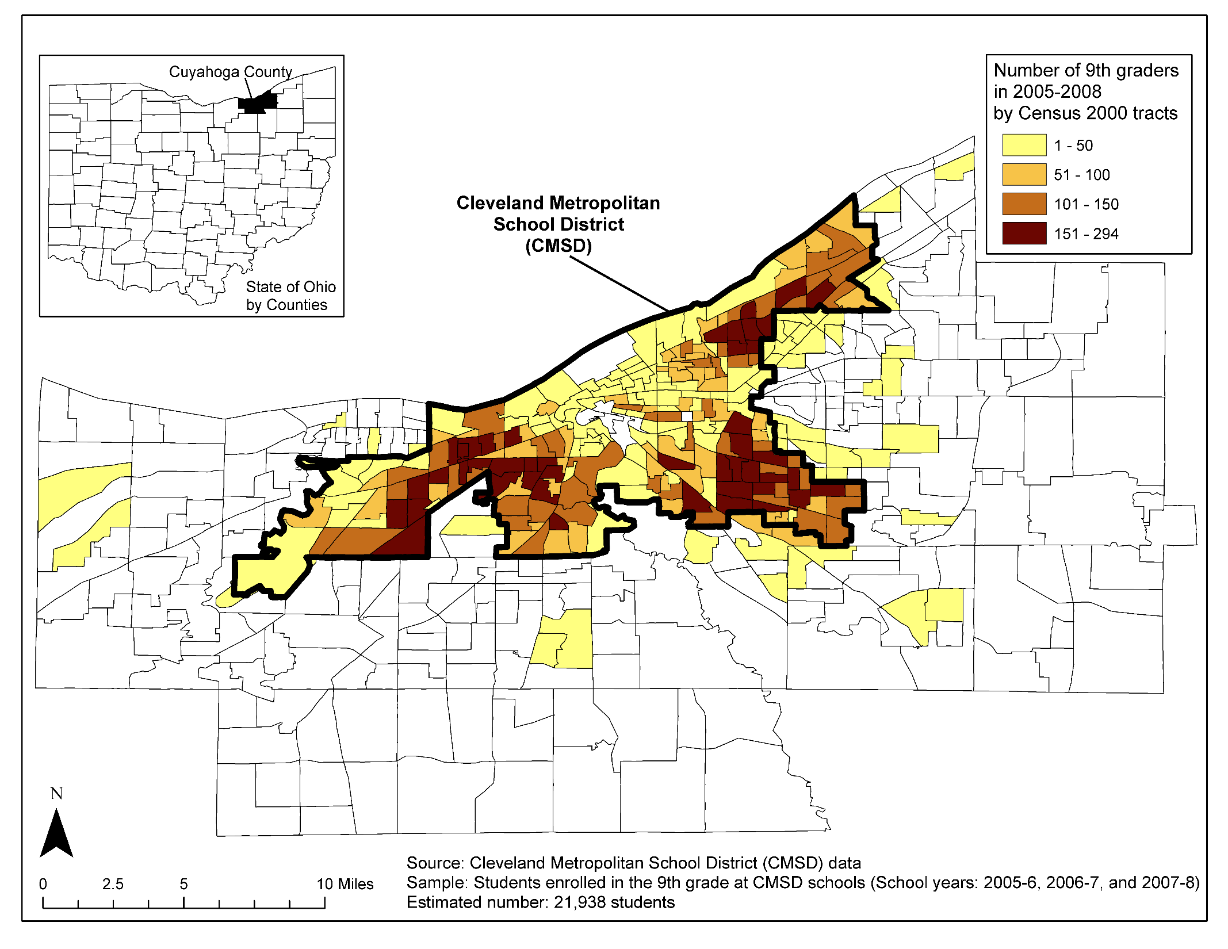

Slide 17
3-City Study of Child Welfare-Juvenile Justice Cross Over
Chicago
Cleveland
New York City
Concern about cross over, but not examined on a local system level
Purpose of study—to see whether this can be examined at system level across locales
Followed cohorts of foster care entrants through age 18 through both systems using IDS data
Notes:
The integrated data from this system have been used very effectively by the Invest in Children initiative (The Inform, Influence and Impact report on our web site provides many examples of program and policy improvement driven by the data). I want to share a couple of more recent examples of the data use that go beyond IIC.
In partnership with the Cleveland Metropolitan School District and the Ohio Education Research Center, we are taking a look at the early childhood risk and success factors in Kindergarten readiness and 3rd grade literacy. The IDS allows us to select four cohorts of entrants into Kindergarten and look back in our data to their birth and forward in our data to the 3rd grade. The IDS contains many data elements that are indicative of events and programs that have the potential to influence school success, and these are readily pulled together for the analysis. Clearly, if the study had to be done without the IDS it would have been terribly costly and could only have been done for a small sample rather than the entire population in CMSD kindergarten.

Slide 18
3-City Study of Child Welfare-Juvenile Justice Cross Over
Chicago
Cleveland
New York City
Examined time to cross over by age at first foster care entry using counting process survival models
Looked at demographic predictors, as well as foster care spells and placement type
Sites differed in cross over rates:
Chicago—12%
Cleveland—26%
New York City—16%
Notes:
The integrated data from this system have been used very effectively by the Invest in Children initiative (The Inform, Influence and Impact report on our web site provides many examples of program and policy improvement driven by the data). I want to share a couple of more recent examples of the data use that go beyond IIC.
In partnership with the Cleveland Metropolitan School District and the Ohio Education Research Center, we are taking a look at the early childhood risk and success factors in Kindergarten readiness and 3rd grade literacy. The IDS allows us to select four cohorts of entrants into Kindergarten and look back in our data to their birth and forward in our data to the 3rd grade. The IDS contains many data elements that are indicative of events and programs that have the potential to influence school success, and these are readily pulled together for the analysis. Clearly, if the study had to be done without the IDS it would have been terribly costly and could only have been done for a small sample rather than the entire population in CMSD kindergarten.

Slide 19
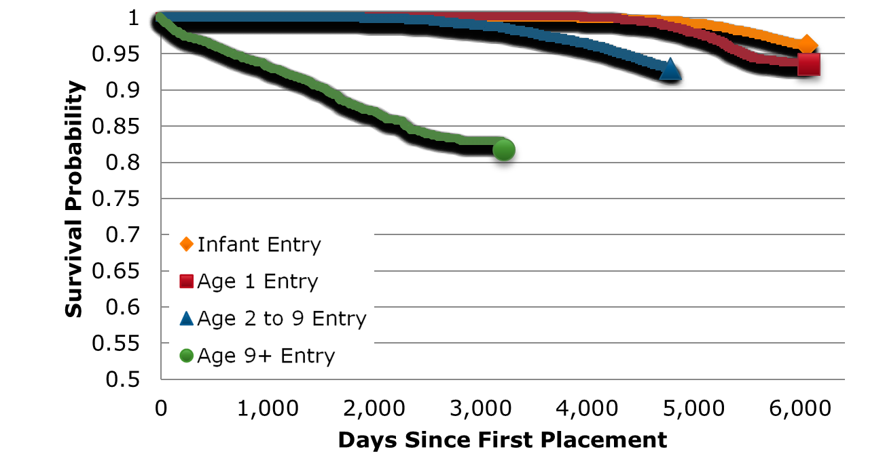
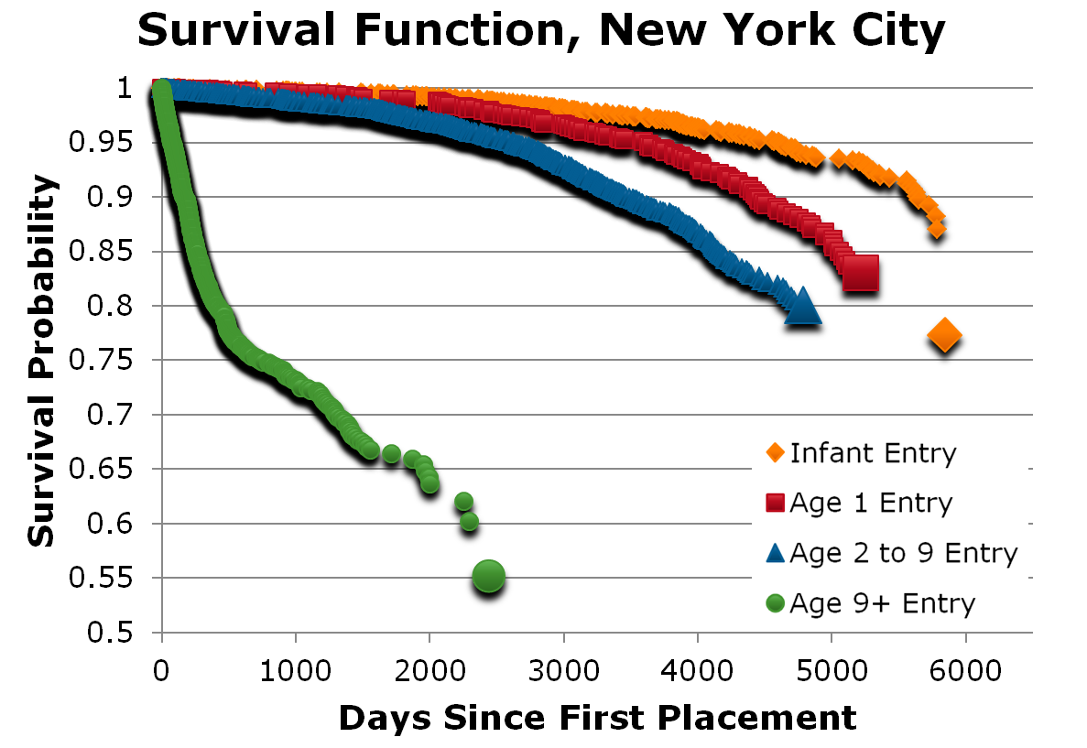
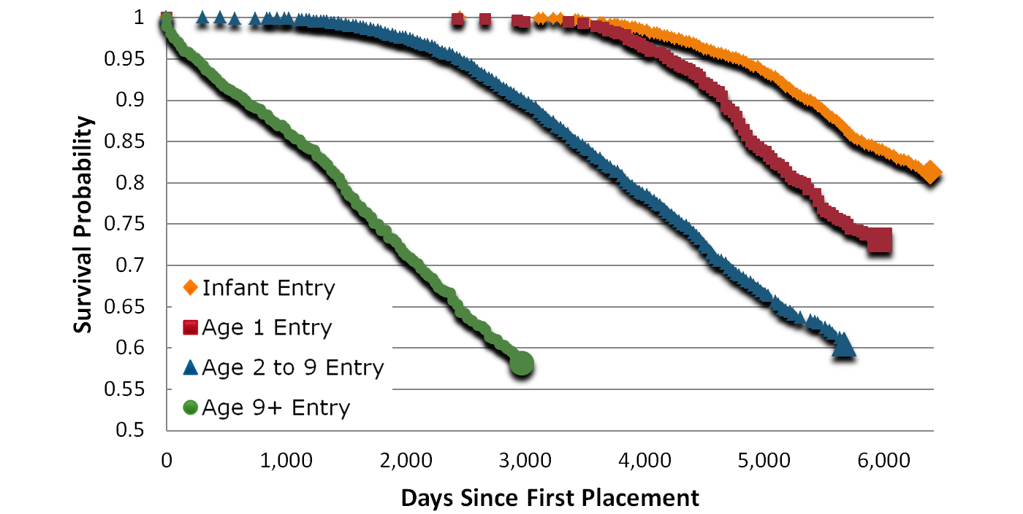
Survival curves differ by age of first placement
Chicago, IL
New York, NY
Cleveland, OH
Notes:
The integrated data from this system have been used very effectively by the Invest in Children initiative (The Inform, Influence and Impact report on our web site provides many examples of program and policy improvement driven by the data). I want to share a couple of more recent examples of the data use that go beyond IIC.
In partnership with the Cleveland Metropolitan School District and the Ohio Education Research Center, we are taking a look at the early childhood risk and success factors in Kindergarten readiness and 3rd grade literacy. The IDS allows us to select four cohorts of entrants into Kindergarten and look back in our data to their birth and forward in our data to the 3rd grade. The IDS contains many data elements that are indicative of events and programs that have the potential to influence school success, and these are readily pulled together for the analysis. Clearly, if the study had to be done without the IDS it would have been terribly costly and could only have been done for a small sample rather than the entire population in CMSD kindergarten.

Slide 20
3-City Study of Child Welfare-Juvenile Justice Cross Over
Chicago
Cleveland
New York City
Risk factors both similar and different across places
Race, gender age persist across the board
More placement spells always produce greater risk
Effect of type of placement (time varying) differs by site—children in Cleveland at greatest risk when they are back home, but not in other sites
Notes:
The integrated data from this system have been used very effectively by the Invest in Children initiative (The Inform, Influence and Impact report on our web site provides many examples of program and policy improvement driven by the data). I want to share a couple of more recent examples of the data use that go beyond IIC.
In partnership with the Cleveland Metropolitan School District and the Ohio Education Research Center, we are taking a look at the early childhood risk and success factors in Kindergarten readiness and 3rd grade literacy. The IDS allows us to select four cohorts of entrants into Kindergarten and look back in our data to their birth and forward in our data to the 3rd grade. The IDS contains many data elements that are indicative of events and programs that have the potential to influence school success, and these are readily pulled together for the analysis. Clearly, if the study had to be done without the IDS it would have been terribly costly and could only have been done for a small sample rather than the entire population in CMSD kindergarten.

Slide 21
Learnings: Strengths of IDS based studies
Population, not sample, based
Avoid sampling error & self-selection into studies
Large numbers permit neighborhood breakouts
Long term follow up possible
Lower cost & little attrition
Do not have to wait years for results
Can capture costs and some societal benefits
Notes:
The integrated data from this system have been used very effectively by the Invest in Children initiative (The Inform, Influence and Impact report on our web site provides many examples of program and policy improvement driven by the data). I want to share a couple of more recent examples of the data use that go beyond IIC.
In partnership with the Cleveland Metropolitan School District and the Ohio Education Research Center, we are taking a look at the early childhood risk and success factors in Kindergarten readiness and 3rd grade literacy. The IDS allows us to select four cohorts of entrants into Kindergarten and look back in our data to their birth and forward in our data to the 3rd grade. The IDS contains many data elements that are indicative of events and programs that have the potential to influence school success, and these are readily pulled together for the analysis. Clearly, if the study had to be done without the IDS it would have been terribly costly and could only have been done for a small sample rather than the entire population in CMSD kindergarten.

Slide 22
Learnings: Community partner engagement
Community readiness to apply information
Already of concern
Stakeholders see some common agenda
Timing is important
Useful types of information
Identifying risk and high cost groups
Surfacing cross system issues and impact
Showing trends and results of action
Notes:
The integrated data from this system have been used very effectively by the Invest in Children initiative (The Inform, Influence and Impact report on our web site provides many examples of program and policy improvement driven by the data). I want to share a couple of more recent examples of the data use that go beyond IIC.
In partnership with the Cleveland Metropolitan School District and the Ohio Education Research Center, we are taking a look at the early childhood risk and success factors in Kindergarten readiness and 3rd grade literacy. The IDS allows us to select four cohorts of entrants into Kindergarten and look back in our data to their birth and forward in our data to the 3rd grade. The IDS contains many data elements that are indicative of events and programs that have the potential to influence school success, and these are readily pulled together for the analysis. Clearly, if the study had to be done without the IDS it would have been terribly costly and could only have been done for a small sample rather than the entire population in CMSD kindergarten.

Slide 23
Learnings: Public policy applications
Social impact bonds
Assess potential government cost savings to structure the deal
Establish the counterfactual
Observe cross system costs and impact estimates
Collective impact management
E.g. Promise neighborhoods “pipeline”
Choice neighborhoods housing, people and place outcomes
Comparative effectiveness
Community mobilization
Notes:
The integrated data from this system have been used very effectively by the Invest in Children initiative (The Inform, Influence and Impact report on our web site provides many examples of program and policy improvement driven by the data). I want to share a couple of more recent examples of the data use that go beyond IIC.
In partnership with the Cleveland Metropolitan School District and the Ohio Education Research Center, we are taking a look at the early childhood risk and success factors in Kindergarten readiness and 3rd grade literacy. The IDS allows us to select four cohorts of entrants into Kindergarten and look back in our data to their birth and forward in our data to the 3rd grade. The IDS contains many data elements that are indicative of events and programs that have the potential to influence school success, and these are readily pulled together for the analysis. Clearly, if the study had to be done without the IDS it would have been terribly costly and could only have been done for a small sample rather than the entire population in CMSD kindergarten.

Slide 24
State
Data
Thank you!
Q / A
County
Data
Local
Data
Contact Information: Claudia Coulton, Ph.D. (claudia.coulton@case.edu)
Resources
Center on Urban Poverty & Community Development: http://povertycenter.case.edu/
NEO CANDO: http://neocando.case.edu/

