Slide 1
Connecting People and Place: Improving Communities through Integrated Data Systems Public School Absenteeism in Pittsburgh, PA
Cross-site Project of the National Neighborhood
Indicators Partnership and Annie E. Casey Foundation
Sabina Deitrick, PhD
University Center for Social and Urban Research
University of Pittsburgh
UAA annual meeting, San Antonio, TX
20 March 2014

Slide 2
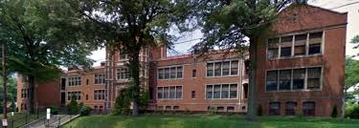
This presentation:
School Absenteeism and this project
Integrated Data System
Allegheny County Department of Human Services Data Warehouse
Pittsburgh Neighborhood and Community Information System
Early results
Project going forward

Slide 3
Pittsburgh Public Schools Chronic Absenteeism
School change in top 10
School change in bottom 10

Slide 4
Policy problem: School absenteeism
Much work done on student attendance (Chang & Romero, 2008)
Chronic absenteeism (≥10% missed school days for any reason)
Students miss learning opportunities
School performance suffers as students progress through school
Exhibit academic and other problems
Traditional school views
Truancy and “unlawful/unexcused” absences and policies
“Average Daily Attendance” – doesn’t unveil individual impacts
Awareness and “School Attendance Matters”
Conference to build awareness and develop solutions among professionals
October 2013 – University of Pittsburgh and Allegheny County United Way
Notes:
Impacts begin even in Kindergarten
Low income children with asthma 80% more likely to miss more than seven days of school in a year from asthma than are middle class kids with asthma.

Slide 5
Results of Action Plans to work together
Top In-School Factors
Bullying
Teacher/student relations
School structure/culture
Academics
Lack of transportation
Top Out-of-School Factors
Lack of parent support/urgency
Basic needs not met
Home/family issues
Health issues (family included)
Violent/unsafe community
Lack of transportation
Notes:
Other factors important by different districts –
Hunger, Stress, readiness skills, embarrassment, negative perceptions towards schools, inconsistent suspension policies
Out of school – permissive parenting, parent’s mental health, community of adults encouraging absences, peer pressure, magistrate inconsistency, violence, community distress, housing, kids with adult responsibilities, poverty
When we start to dig into this group setting and factors that the action plans came up with, we see a lot of “neighborhorhood factors” Planning factors, as well as individual, family factors.

Slide 6
Data Warehouse Timeline
Allegheny County Department of Human Services Data Warehouse
DHS signed a MOU
with the three school districts:
Directory information
Educational outcomes for kids:
DHS is legal custodian
All other kids action research
agreement
Consent
PPS
10/2009
Notes:
6

Slide 7
DATA WAREHOUSE DATA SOURCES
Allegheny County Department of Human Services Data Warehouse
Allegheny County Housing Authority
Allegheny County Jail
Allegheny County Medical Examiner’s Office
Department of Public Welfare
Housing Authority City of Pittsburgh
Juvenile Probation
Pittsburgh Public Schools
Clairton Public Schools
Pre-trial Services
Adult Probation
Adult/family court
Aging
Children, Youth and Families
Community Service Block Grant
Drug & Alcohol
Early Intervention
Family Support Centers
HeadStart
Human Services Development Fund
Homeless/Housing
Low Income House Energy Assistance Program
Maximum Participation Project
Medical Assistance Transportation Program
Mental Health
Mental Retardation
System of Care Initiative
Source: Allegheny County Department of Human Services

Slide 8
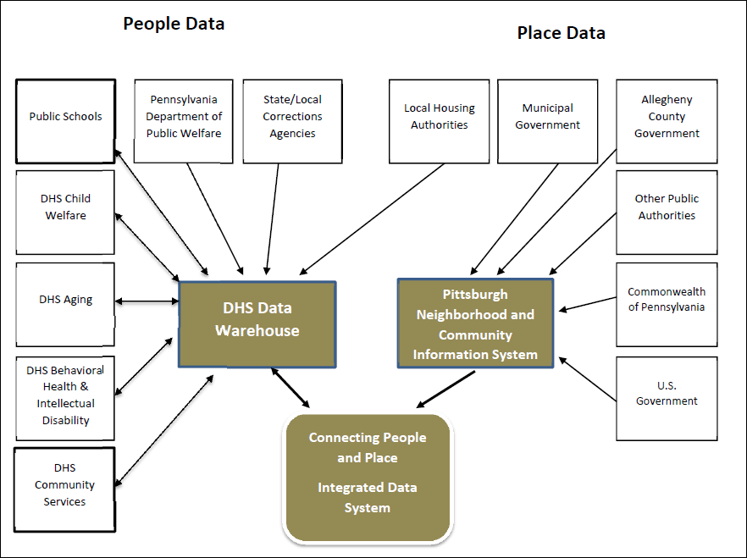
Connecting People and Place -- Data Sharing between DHS Data Warehouse and PNCIS

Slide 9
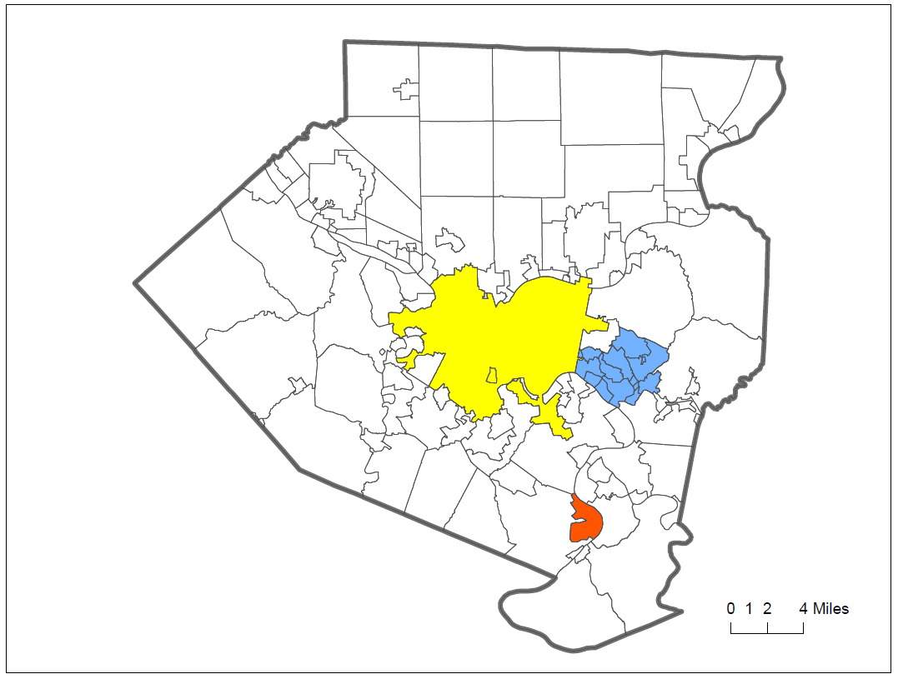
Allegheny County School Districts in Study
Woodland Hills School District
Students: 3,992; free or reduced lunch = 70%
Schools: 8
K-6=5; K-8=1; 7-8=1;
high school=1
Pittsburgh Public Schools
Students: 26,292; free or reduced lunch = 70%
Schools: 56
K-5=23; K-8=14; 6-8=7; high schools=4; other=8
Clairton City School District
Students: 792; free or reduced lunch = 87%
Schools: Elementary and middle/high school)
Source: PA Department of Education 2012-13 School-Year Profiles

Slide 10
Kids in Human Services
Prior involvement with Human Services
53% of Pittsburgh Public Schools students
60% of Woodland Hills School District
64% of Clairton School District
Involvement with Human Services in past year (2012)
36% Pittsburgh Public Schools
46% for both Woodland Hills and Clairton students

Slide 11
Preliminary Results
Students with DHS involvement in 2012 were 41% - 85% more likely to have worse attendance than students who did not.
Living in public housing was not a significant for K – 4th graders, but students from 5th – 12th grade were 15% - 29% more likely to have worse attendance than those who did not.
Students in 6th – 12th grades with juvenile justice involvement were 114% - 164% more likely to have worse attendance than those not involved in juvenile justice.
While attendance by race of student (black/white) is significantly different, when accounting for other predictors, black students between 3rd – 8th grade were less likely to have worse attendance.

Slide 12
Research Question Framework
Factor | Community | School | Property | Family | Student
Safety | Crime Ex-offenders | Incidents Bullying Building condition | Vacant property Property condition Code violations | Specific incidents Involvement with justice system | Involvement with justice system Walking paths
Instability |  | Teacher turnover Principal turnover | Tax delinquency Foreclosure Vacant property Affordability Home ownership status Financial distress | Relocation Homelessness Change in composition Parent in prison Finances | School change Mode of travel
Health | Pollution Teen births Food availability | Building condition | Age of housing Housing condition Public housing |  | Mode of travel
School | Poverty Race | Principal stability Suspension policies Teacher attendance Student performance Special education |  | Participation in school activities | Poverty Race Special education
Employment | Labor force participation |  |  | Employed family members Transit access | Work patterns and industry

Slide 13
Human Services Data Sharing Community Stakeholders Group

Slide 14
Community engagement in research
Steps engaged in so far and to be engaged in:
Identification of primary intended users and formation of place-based design & advisory group
Situational analysis
Focusing the inquiry
Stakeholder engagement
Partner interests
Additional methods
Connecting findings into district action systems for planning, policy, design and implementation
Notes:
Critical element to facilitate use of research and evaluation is incorporating users and use context from the outset. The anticipated “action System” is identified and individuals from that system are recruited to help shape the inquiry. They are interested and knowledgeable.
Situational analysis – current system in place, research from broader literature, past system experiences from the topics and past barriers
Identify intended

