Slide 1
Community Profiles
Providence/Pittsburgh Cross-City Collaboration
June 19, 2014

Slide 2
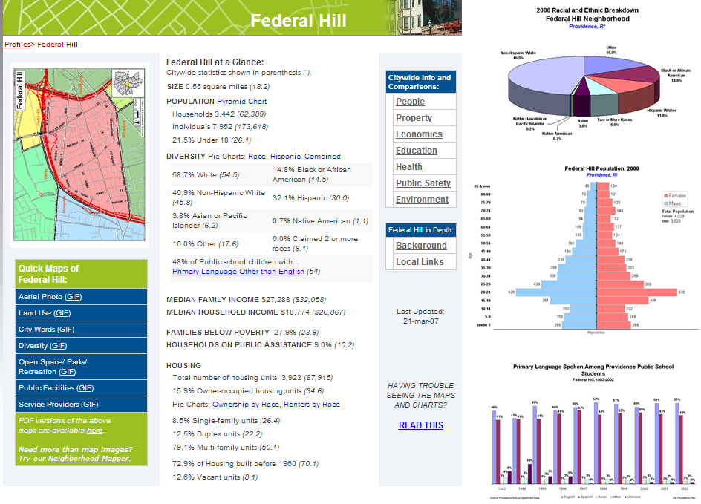
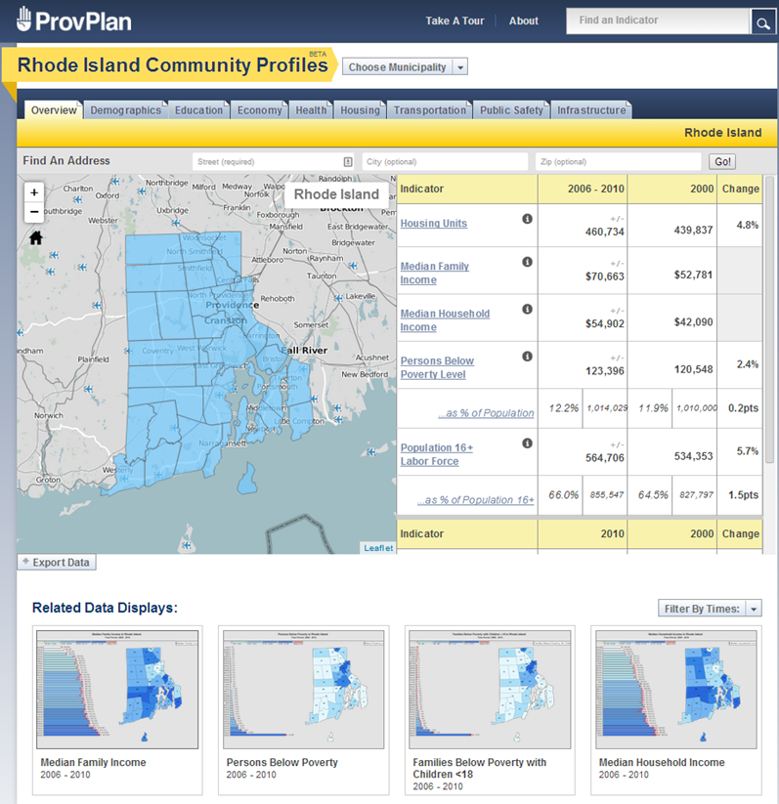
Providence Plan Profiles History
2007
2013

Slide 3
Pittsburgh situation
Great demand for profiles
Many ad-hoc requests from community
Several neighborhood-specific reports for funders
Not operating efficiently
No software development capacity

Slide 4
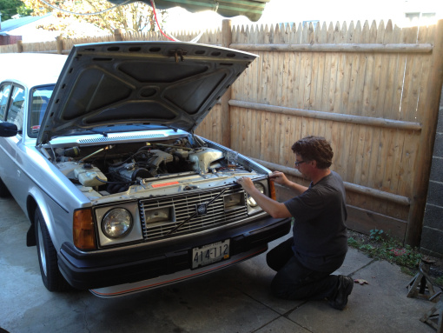
Our interest in the Providence Plan
Open source
Rely on experience of Providence Plan
Opportunities for broad cross-city collaboration

Slide 5
Partnership with Allegheny County Department of Human Services
Funded through Human Services Integration Fund ($112,000)
Visualizing community information important to internal and external audiences
Relieves burden of external requests for info.

Slide 6
Allegheny County Department of Human Services: Integrated Data System
External Sources
Allegheny County Housing Authority
Allegheny County Jail
Allegheny County Medical
Examiner’s Office
Department of Public Welfare
Housing Authority City of Pittsburgh
Juvenile Probation
Pittsburgh Public Schools + 12 additional County School Districts
Pre-trial Services
Adult/family court
Potential Data Sources
Health Department
Vital Statistics Data
Early Childhood (PELICAN)
Post Secondary Education
Employment & Training
Adult Probation (forthcoming)
Internal Sources
Aging
Children, Youth and Families
Community Service Block Grant
Drug & Alcohol
Early Intervention (partial)
Family Support Centers
HeadStart (partial)
Human Services Development Fund
Homeless/Housing
Low Income House Energy Assistance Program
Medical Assistance Transportation Program
Mental Health
Intellectual Disabilities
System of Care Initiative

Slide 7
Indicator selection process in Pittsburgh
Step 1: Top-down
NNIP Shared Indicators Framework
Scans of other cities in NNIP and CIC
Common requests to DHS & UCSUR (and Providence Plan)
Regional priorities
Available data
Step 2: Bottom-up (this summer)
Roundtables of domain experts
Public input
Notes:
Will share our work

Slide 8
Indicator creation process
Handled through the administrative console
Just a few minutes per indicator
Multiple years and geographies at the same time
Several denominators for same indicator
Metadata

Slide 9
CSV file format
Required fields in BLUE (4)
Indicator fields in TAN
Table includes all levels of geography

Slide 10
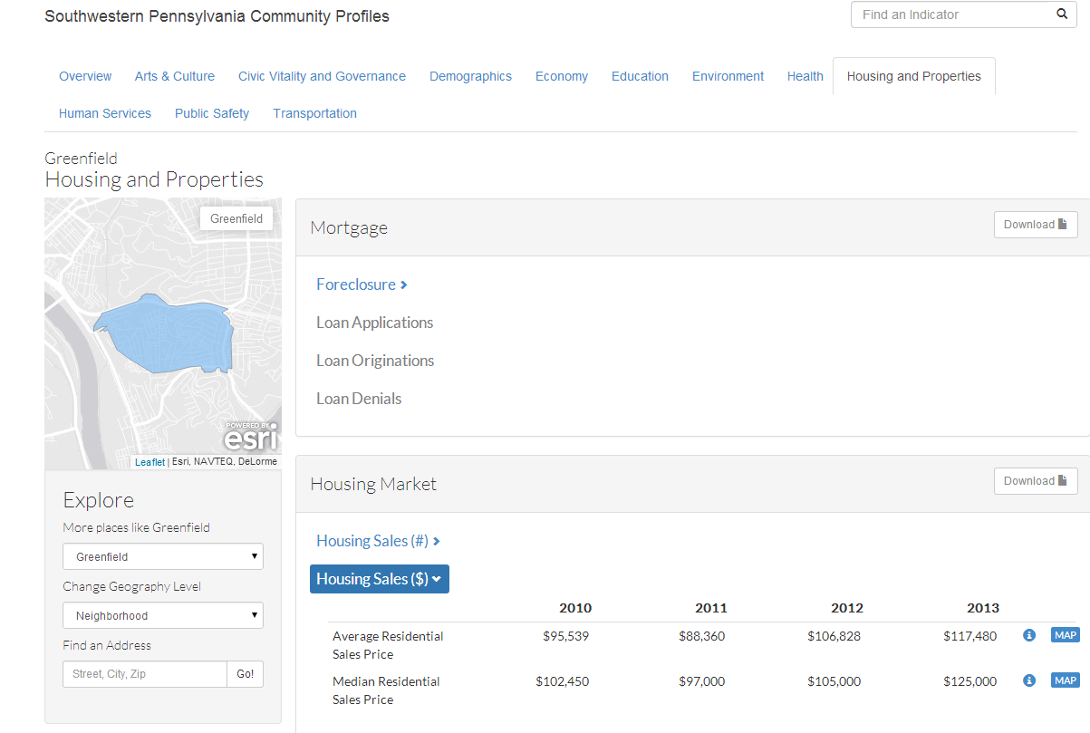
Site taxonomy
Domain
Subdomain
Group
Indicator

Slide 11
Providence/Pittsburgh partnership
Build on 1st edition of product
Adapt to additional geography
Add API retrieval capability
Additional years available in comparison tables
Print-friendly formats
Site layout and navigation
Easy upload via administrative interface (CSV or API)
Improvement to code and documentation

Slide 12
Demo

Slide 13
Future directions for the site
Incorporate additional functionality from other open source projects like Census Reporter
Data displays
Graphs/charts
Reliability Index for MOEs
More...

Slide 14
Help needed from NNIP partners
Collecting user stories?
Reporting use statistics?
Training models (train the trainers)?
How have your profiles been used?
Users
Data
Applications
Indicator ideas welcome!

