Slide 1
Strategic Communications:
Our use of media and our new website
Presented by:
Ben Horwitz
April 4, 2014
Notes:
We have thought through communications a number of ways. First, we have worked with consultants on our message around who we are and what we do. That helped us articulate clearly our strengths and the impacts we have had. We also go to great lengths to make our reports compelling in a number of ways:
- We create clear and easy to read graphics that go through a formal process and are not just off the shelf Excel graphics.
- We work diligently on writing for a lay audience in a manner that makes the data engaging and accessible.
- But the two things I want to focus on here, are our recently completed new website and our use of the media to expand the impact of our reports.

Slide 2
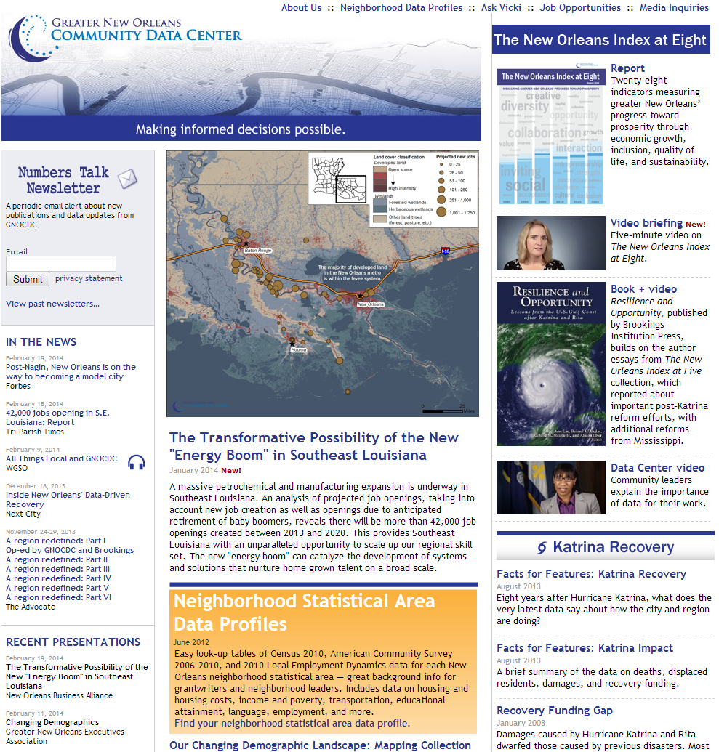
We started our work to redesign our website with an audience analysis.
Notes:
We started our work to redesign our website with an audience analysis. In that analysis, we determined we have several distinct audiences.
1. Decisionmakers (nonprofit, public, and private decisionmakers for all issues we study)
2. Media (they come to us looking for data points and fact checking, and we build relationships with them so that they will be interested in disseminating our research when we release it)
3. Funders (they what info about who we are and what we do to help decide whether to fund us, and they want our website to be a place where they can point to the work they have funded)
4. Community members and community-focused nonprofits (these are people primarily interested in the neighborhood data and by providing this data to them effectively and efficiently we bolster our credibility with the community)
We do have other audiences that go to our website such as students or peers from around the country, but they are not a primary audience of our work.

Slide 3
Our key objectives of our website include leveraging our limited resources and enabling incidental learning.
Notes:
And, in that process, we determined that we have several key objectives.
Key objectives of the web site:
To ensure that our web site extends our limited human resources...we designed some key elements to answer 80% of the questions visitors have (neighborhood stats, Katrina facts for features). Ask Vicki is available to receive custom questions for the remaining 20% of visitor questions. The information architecture of our web site is critical in that key pieces of high demand data must be easy to find and usable for visitors with lower technical capabilities--to ensure that the web site is fulfilling its role of efficiently disseminating high demand/low impact data (and users are not "asking Vicki" for data that is already on the web site).

Slide 4
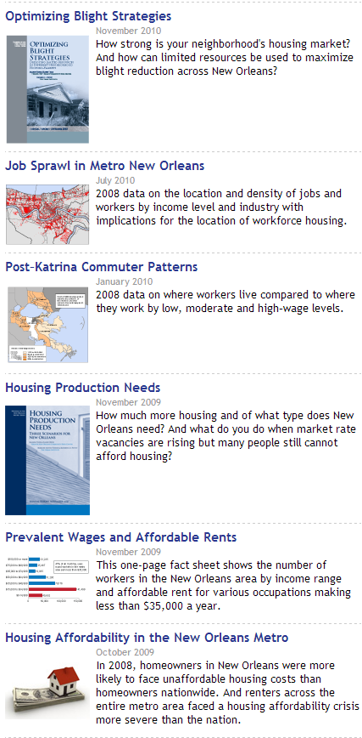
Our key objectives of our website include leveraging our limited resources and enabling incidental learning.
Notes:
2. To enable incidental learning...where someone who came for one piece of information would find something related that they didn’t know would be useful. For instance, someone coming to look for blight research may stumble upon our report on affordable housing and understand some of the interconnections between the two (and have a better understanding of the housing/land use landscape).

Slide 5
Our key objectives of our website include leveraging our limited resources and enabling incidental learning.
Notes:
3. To promote the use of our research to decisionmakers and community members so that more people are aware of the city/regional context and can better identify opportunities and key challenges to address.

Slide 6
The website has several key functions such as providing a location for our reports.
4. Media
3. Who we are
2. High impact
data analysis
5. Credibility
High demand/
low impact
Notes:
We meet these objectives by creating a website with these key functions.
1. It efficiently disseminates high demand/low impact data to interested parties and community members using minimal staff resources, such as:
a. Neighborhood level stats
b. Frequently requested stats on Katrina impact and recovery
2. It provides a place for our high impact data analysis to be made readily available so decisionmakers can find it after they've heard about it from broadcast media or in-person presentations, specifically:
a. The New Orleans Index
b. Action-oriented research on demographic trends, economic trends, housing, and more topics in future.
3. It provides key information about who we are and what we do for funders and others who want to understand our background, history, motivations, and purposes.
4. It enables media to effectively and quickly contact us, so that we build relationships with them.
5. It builds our credibility with the community by not only publishing their most frequently requested neighborhood level stats, but also by allowing them to ask questions from a real person via "Ask Vicki."

Slide 7
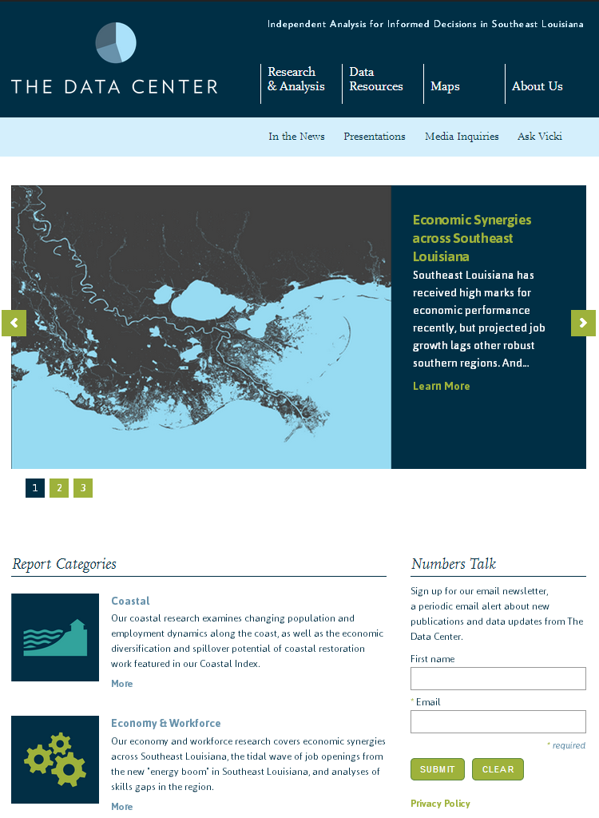
Our new website leverages a lot of the work that NNIP partners are doing.
New brand
Navigation
Featured reports
E-newsletter
Go to research categories
Notes:
With our website redesign, we focused on our first three audiences mentioned earlier, while making sure that we maintained all of the key functions and objectives. We also believe that we have made it even easier for community members and community-focused nonprofits by grouping all of this basic data they might want together in one section of the website.
For both the visual redesign and information architecture of the website, we leveraged a lot of the work that NNIP partners are doing. We recognized that it had been 8 years since our last update and it was time for another.
Moreover, the impetus for the website redesign was the change in our brand and a bit to our target audience. Our work has expanded beyond New Orleans to include all of Southeast Louisiana. We needed a new website and brand that conveyed that we covered more than just New Orleans. We needed to do this to gain credibility in the surrounding areas so that we are not seen as outsiders.
So we have changed our name to the Data Center.
- As our target audience expanded, we knew we needed a new brand. And, because we have these two distinct main user groups of decisionmakers and community members, we contemplated splitting into two websites so that the research and analysis could be one page and the baseline data on the other. But, we recognized that indeed there is a lot of crossover between the two groups. Often people working in City Hall or other organizations may need the baseline data while their bosses want the research! So, we wanted to include everything on one website.
[walk through home page]. And the website is mobile enabled so that it automatically adjusts based on the user’s screen size. This is critical as we’ve seen the percent of users coming from a mobile device increase by 1% each month such that it was 19% in January of this year.

Slide 8
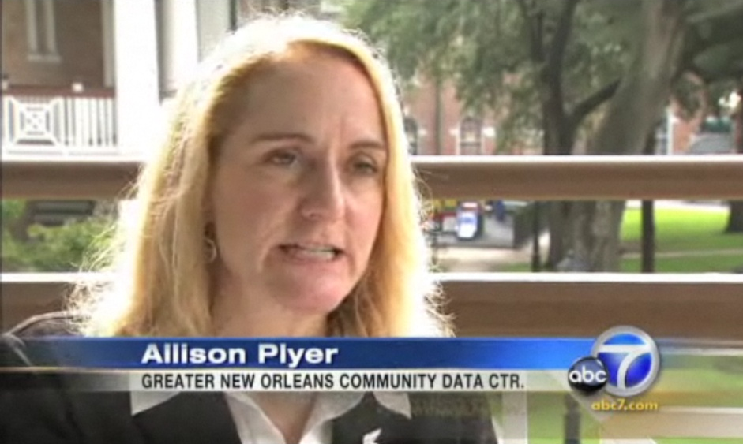
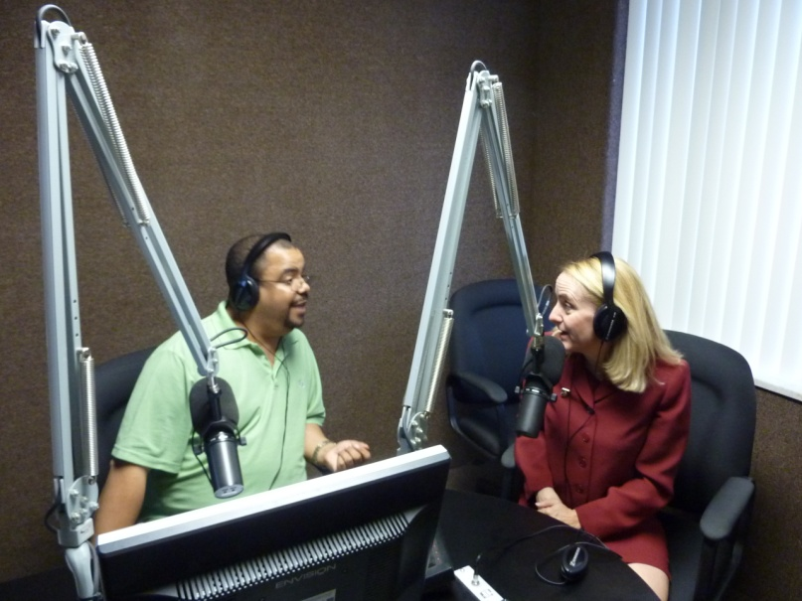
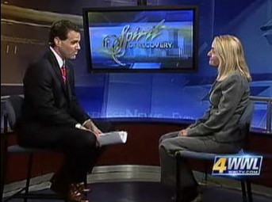
Different media outlets help reach different audiences.
Notes:
While data on the digital divide isn't as widely available as we'd like, we know that roughly 30-40% of households in New Orleans lack internet in the home. So a web-only dissemination method is incomplete.
We see the website as only 25% of that strategy and use presentations and meetings in the community to further disseminate data. However, we know media also play a critical role in closing the digital divide and reaching across our community.
And, we know that different media outlets have different audiences. So exposure on the different media outlets is critical to democratizing data and analysis. For example, the local NPR station is a great way to inform local funders and board members while local tv and talk radio tend to reach grassroots and neighborhood folks. To help expand our reach of our reports, we spend a little bit of time (roughly an hour) culling email addresses from local media websites. Then we send out a news release out whenever we release a new report or analysis. We have found that while they might not cover the great accomplishments of the organization, they do cover the findings from the report.

Slide 9
Reporters are people too.
Be extremely responsive for fact checking type requests.
Media work on tight deadlines and expect and require a fast response.
Occasional emails complementing them to strengthen the relationship.
Be responsive, complementary, and polite.
http://toolkit.opportunityagenda.org/documents/oa_toolkit.pdf
Notes:
And, we know that reporters are people too. We of course are nice to them and are extremely responsive for fact checking type requests. We have found that media tend to expect and require a fast response, so when we are contacted by media we respond right away. We have found that they are always on a deadline of "today" and that our motto of "anytime, anywhere" works the best.
- And, we find that sending them occasional emails complementing them on their coverage helps to strengthen the relationship, motivating them to interview us in the future.
- The more they like the more they'll cover your reports. Be responsive, complementary, and polite.
We also have started a monthly show with our local NPR, and have established a relationship between a local online newspaper and our NPR radio station. For that, we provide them with some additional data support when necessary and help them do more in-depth coverage of local issues that are often highlighted in our reports.

Slide 10
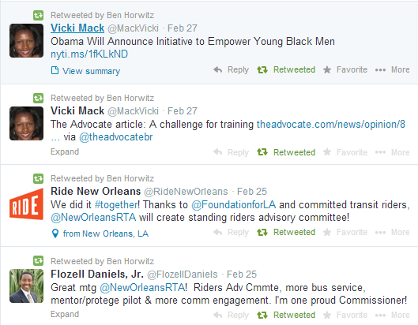
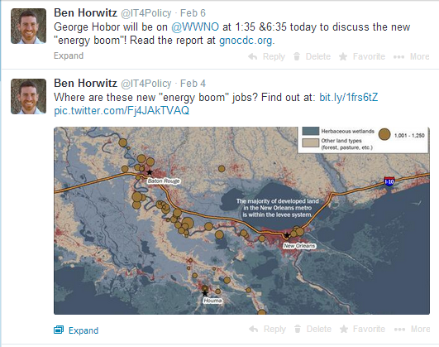
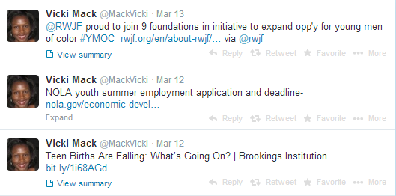
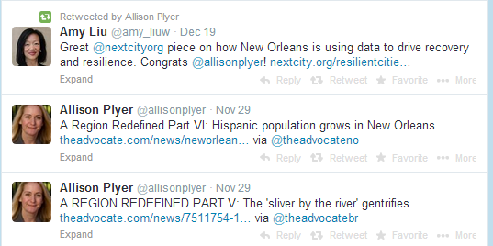
We’ve also dabbled a bit into twitter.
Notes:
As lagniappe as we say (or that 13th bagel included in a baker's dozen), we have started to dabble in social media informed by what others partners are doing. We use our own twitter accounts, try to post regularly, and follow (And recruit followers) in our specific topics that we work in. So my colleague Vicki who works on Youth is trying to build a following amongst the whole community working to serve youth. One of the main reasons why we have started to engage so thoroughly in twitter is because it is a medium that is much more widely-used in the African American community and has the possibility to reach a wider, more diverse audience.
If this is of interest to people, I’d be happy to take any questions about this strategy as well.

Slide 11
Strategic Communications:
Our use of media and our new website
Presented by:
Ben Horwitz
April 4, 2014

