Slide 1
HUD Neighborhood Opportunity Indicators
Rob Collinson
3/1/2012

Slide 2
Presentation Structure
Conceptualizing Neighborhood Opportunity
Operationalizing Opportunity Dimensions
Disparities in Exposure/Access
Visualizing Opportunity Indicators
Summary

Slide 3
“Far too often, we can predict a family’s overall health, even their life expectancy by knowing their zip code”
– Shaun Donovan, Secretary for Housing and Urban Development

Slide 4
Neighborhood Opportunity Concepts
Neighborhood Effects
Outcomes-oriented
Focus of most academic literature
MTO, SOHUD Quote
“Most Empirical conclusions regarding neighborhood effect mechanisms should be treated as provisional at best” – G. Galster
Quality of Life
Focus of many on-the-ground practitioners
Emphasizes elements of community that may be desirable for a neighborhood, but unimportant for individual life outcomes

Slide 5
Understanding Neighborhood Opportunity: Challenges
Neighborhood Sorting
Consistent Measurement
Non-Linearity in Neighborhood Effects
Peers v. Neighborhoods
What are the inputs
Relative vs. Absolute
Definition of Neighborhood

Slide 6
HUD approach to Neighborhood Opportunity Indicators
Developed to examine differential access/exposure across population groups
Multi-dimensional, not comprehensive
Focus on measurable assets and stressors
Considers differences across population groups (e.g opportunity for whom)
Informational, not deterministic

Slide 7
Operationalizing Opportunity Dimensions
Schools (Institutional)
Poverty (Social-Interactive)
Job Proximity(Geographical)
Transit (Geographical)
Health Hazards (Environmental)
Human Capital (Social-Interactive)

Slide 8
Operationalzing Opportunity Indicators: Data Elements
Opportunity Dimensions [Geography] | Variables | Source
Poverty Index | Family Poverty Rate | ACS 2006-2010
[Tract] | Pct. Households Receiving Public Assistance | ACS 2006-2010
School Proficiency Index | School Math Proficiency / State Math Proficiency | Dept. of Education
[Block Group] | School Reading Proficiency / State Reading Proficiency | Dept. of Education
 | School Attendance Areas | SABINS
Human Capital Index | Unemployment Rate | ACS 2006-2010
[Tract] | Labor force Participation Rate | ACS 2006-2010
 | Pct. with a Bachelor's or higher | ACS 2006-2010
Job Access Index[1] | Blockgroup-level Job Counts | LED, 2009
[Block Group] | Blockgroup-level Job Worker Counts | LED, 2009
 | Origin-Destination Flows | LED, 2009
Rail Transit Access | Distance to nearest rail station | DOT’s TOD database
[Block Group]
Health Hazards Exposure Index [2] | TRI Facility | EPI TRI 2010
[Block Group] | Toxicity Score RSEI | EPA RSEI, 2007
[1] Job access is measured based on a gravity model
[2] Health Hazards Exposure is measured based on a gravitational model of exposure to toxicity

Slide 9
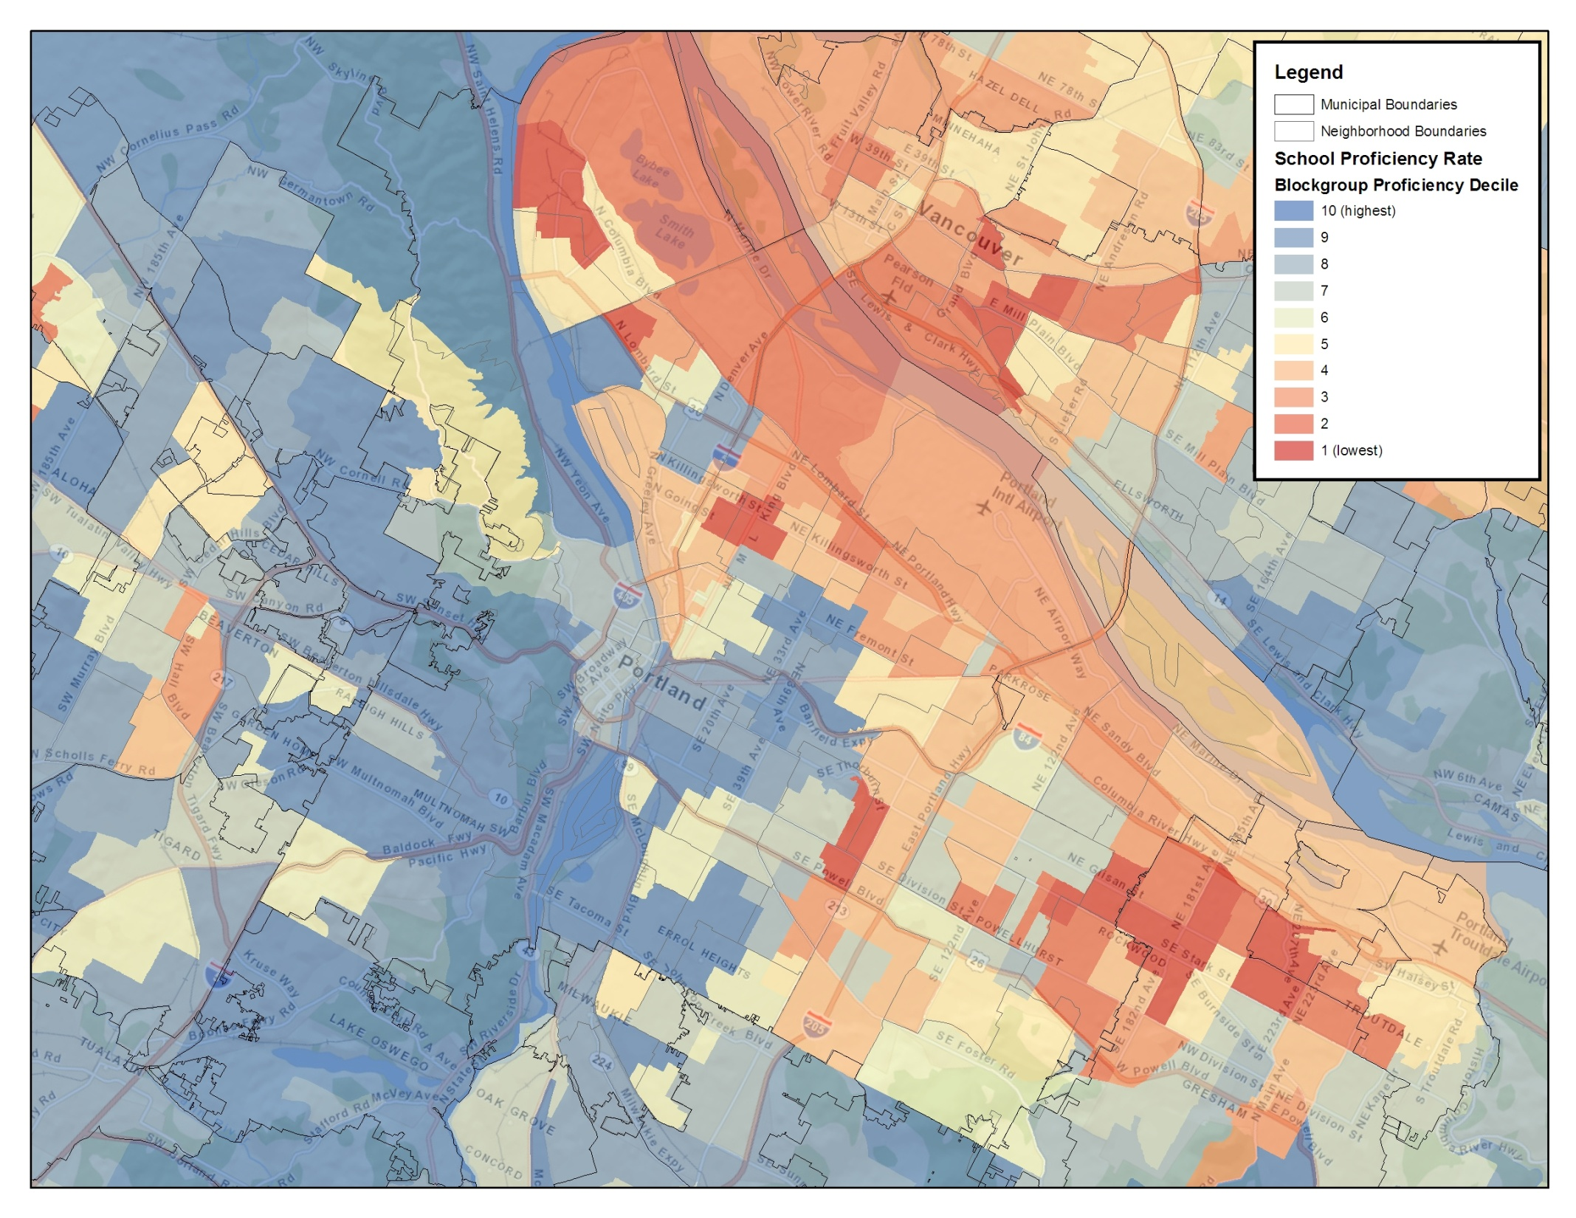
Neighborhood School Proficiency (Portland)

Slide 10
Neighborhood School Proficiency (Portland)

Slide 11
Low-Skill Job Access(Portland)

Slide 12
Low-Skill Job Access(Portland)

Slide 13
 | White Not-Hispanic | Black | Hispanic/Latino | Asian |  | White- Black Difference | White-Hispanic Difference | White-Asian
Adults, No Children
Poverty | 5.37 | 3.89 | 4.84 | 5.64 |  | 1.48 | 0.53 | -0.28
Human Capital | 5.54 | 5.23 | 5.33 | 6.10 |  | 0.31 | 0.21 | -0.56
Job Access | 6.24 | 6.52 | 6.61 | 6.53 |  | -0.27 | -0.36 | -0.28
Schools | 6.77 | 5.34 | 6.51 | 6.96 |  | 1.44 | 0.27 | -0.19
Transit Access | 3.24 | 4.55 | 4.05 | 4.32 |  | -1.31 | -0.81 | -1.09
Health Hazards Exposure | N/A | N/A | N/A | N/A |  | N/A | N/A | N/A
Poor Adults, No Children
Poverty | 4.60 | 3.15 | 3.56 | 4.53 |  | 1.46 | 1.05 | 0.07
Human Capital | 4.81 | 4.42 | 4.06 | 5.20 |  | 0.39 | 0.75 | -0.39
Job Access | 5.96 | 6.00 | 6.09 | 5.51 |  | -0.04 | -0.13 | 0.45
Schools | 6.42 | 4.88 | 5.44 | 6.38 |  | 1.53 | 0.98 | 0.04
Transit Access | 3.20 | 4.08 | 3.55 | 4.00 |  | -0.88 | -0.34 | -0.79
Health Hazards Exposure | N/A | N/A | N/A | N/A |  | N/A | N/A | N/A
Non-Poor/Poor Differential - Adults, No Children
Poverty | 0.77 | 0.74 | 1.28 | 1.12
Human Capital | 0.73 | 0.81 | 1.27 | 0.90
Job Access | 0.28 | 0.52 | 0.52 | 1.01
Schools | 0.36 | 0.45 | 1.07 | 0.58
Transit Access | 0.03 | 0.47 | 0.50 | 0.33
Health Hazards Exposure | N/A | N/A | N/A | N/A
Children in Families
Poverty | 5.91 | 3.76 | 4.13 | 6.01 |  | 2.15 | 1.78 | -0.10
Human Capital | 5.48 | 4.68 | 4.26 | 6.11 |  | 0.80 | 1.22 | -0.63
Job Access | 5.14 | 5.49 | 5.80 | 4.95 |  | -0.35 | -0.66 | 0.19
Schools | 6.87 | 5.00 | 5.59 | 7.01 |  | 1.87 | 1.27 | -0.14
Transit Access | 2.12 | 3.45 | 3.25 | 2.72 |  | -1.33 | -1.13 | -0.60
Health Hazards Exposure | N/A | N/A | N/A | N/A |  | N/A | N/A | N/A
Poor Children
Poverty | 4.10 | 2.41 | 2.99 | 4.04 |  | 1.69 | 1.10 | 0.06
Human Capital | 4.14 | 3.74 | 3.54 | 4.88 |  | 0.40 | 0.60 | -0.74
Job Access | 5.50 | 5.66 | 5.90 | 4.95 |  | -0.17 | -0.40 | 0.55
Schools | 5.92 | 4.22 | 5.07 | 6.21 |  | 1.70 | 0.85 | -0.29
Transit Access | 2.45 | 3.97 | 3.35 | 3.80 |  | -1.52 | -0.90 | -1.35
Health Hazards Exposure | N/A | N/A | N/A | N/A |  | N/A | N/A | N/A
Non-Poor/Poor Differential - Children
Poverty | 1.81 | 1.35 | 1.13 | 1.97
Human Capital | 1.34 | 0.94 | 0.72 | 1.23
Job Access | -0.36 | -0.17 | -0.10 | 0.00
Schools | 0.95 | 0.78 | 0.53 | 0.79
Transit Access | -0.33 | -0.52 | -0.10 | -1.08
Health Hazards Exposure | N/A | N/A | N/A | N/A
Portland CBSA

Slide 14
 | White Not-Hispanic | Black | Hispanic/Latino | Asian |  | White- Black Difference | White-Hispanic Difference | White-Asian
Adults, No Children
Poverty | 5.37 | 3.89 | 4.84 | 5.64 |  | 1.48 | 0.53 | -0.28
Human Capital | 5.54 | 5.23 | 5.33 | 6.10 |  | 0.31 | 0.21 | -0.56
Job Access | 6.24 | 6.52 | 6.61 | 6.53 |  | -0.27 | -0.36 | -0.28
Schools | 6.77 | 5.34 | 6.51 | 6.96 |  | 1.44 | 0.27 | -0.19
Transit Access | 3.24 | 4.55 | 4.05 | 4.32 |  | -1.31 | -0.81 | -1.09
Health Hazards Exposure | N/A | N/A | N/A | N/A |  | N/A | N/A | N/A
Poor Adults, No Children
Poverty | 4.60 | 3.15 | 3.56 | 4.53 |  | 1.46 | 1.05 | 0.07
Human Capital | 4.81 | 4.42 | 4.06 | 5.20 |  | 0.39 | 0.75 | -0.39
Job Access | 5.96 | 6.00 | 6.09 | 5.51 |  | -0.04 | -0.13 | 0.45
Schools | 6.42 | 4.88 | 5.44 | 6.38 |  | 1.53 | 0.98 | 0.04
Transit Access | 3.20 | 4.08 | 3.55 | 4.00 |  | -0.88 | -0.34 | -0.79
Health Hazards Exposure | N/A | N/A | N/A | N/A |  | N/A | N/A | N/A
Non-Poor/Poor Differential - Adults, No Children
Poverty | 0.77 | 0.74 | 1.28 | 1.12
Human Capital | 0.73 | 0.81 | 1.27 | 0.90
Job Access | 0.28 | 0.52 | 0.52 | 1.01
Schools | 0.36 | 0.45 | 1.07 | 0.58
Transit Access | 0.03 | 0.47 | 0.50 | 0.33
Health Hazards Exposure | N/A | N/A | N/A | N/A
Children in Families
Poverty | 5.91 | 3.76 | 4.13 | 6.01 |  | 2.15 | 1.78 | -0.10
Human Capital | 5.48 | 4.68 | 4.26 | 6.11 |  | 0.80 | 1.22 | -0.63
Job Access | 5.14 | 5.49 | 5.80 | 4.95 |  | -0.35 | -0.66 | 0.19
Schools | 6.87 | 5.00 | 5.59 | 7.01 |  | 1.87 | 1.27 | -0.14
Transit Access | 2.12 | 3.45 | 3.25 | 2.72 |  | -1.33 | -1.13 | -0.60
Health Hazards Exposure | N/A | N/A | N/A | N/A |  | N/A | N/A | N/A
Poor Children
Poverty | 4.10 | 2.41 | 2.99 | 4.04 |  | 1.69 | 1.10 | 0.06
Human Capital | 4.14 | 3.74 | 3.54 | 4.88 |  | 0.40 | 0.60 | -0.74
Job Access | 5.50 | 5.66 | 5.90 | 4.95 |  | -0.17 | -0.40 | 0.55
Schools | 5.92 | 4.22 | 5.07 | 6.21 |  | 1.70 | 0.85 | -0.29
Transit Access | 2.45 | 3.97 | 3.35 | 3.80 |  | -1.52 | -0.90 | -1.35
Health Hazards Exposure | N/A | N/A | N/A | N/A |  | N/A | N/A | N/A
Non-Poor/Poor Differential - Children
Poverty | 1.81 | 1.35 | 1.13 | 1.97
Human Capital | 1.34 | 0.94 | 0.72 | 1.23
Job Access | -0.36 | -0.17 | -0.10 | 0.00
Schools | 0.95 | 0.78 | 0.53 | 0.79
Transit Access | -0.33 | -0.52 | -0.10 | -1.08
Health Hazards Exposure | N/A | N/A | N/A | N/A
Portland CBSA

Slide 15
Portland CBSA
 | White Not-Hispanic | Black | Hispanic/Latino | Asian |  | White- Black Difference | White-Hispanic Difference | White-Asian
Adults, No Children
Poverty | 5.37 | 3.89 | 4.84 | 5.64 |  | 1.48 | 0.53 | -0.28
Human Capital | 5.54 | 5.23 | 5.33 | 6.10 |  | 0.31 | 0.21 | -0.56
Job Access | 6.24 | 6.52 | 6.61 | 6.53 |  | -0.27 | -0.36 | -0.28
Schools | 6.77 | 5.34 | 6.51 | 6.96 |  | 1.44 | 0.27 | -0.19
Transit Access | 3.24 | 4.55 | 4.05 | 4.32 |  | -1.31 | -0.81 | -1.09
Health Hazards Exposure | N/A | N/A | N/A | N/A |  | N/A | N/A | N/A
Poor Adults, No Children
Poverty | 4.60 | 3.15 | 3.56 | 4.53 |  | 1.46 | 1.05 | 0.07
Human Capital | 4.81 | 4.42 | 4.06 | 5.20 |  | 0.39 | 0.75 | -0.39
Job Access | 5.96 | 6.00 | 6.09 | 5.51 |  | -0.04 | -0.13 | 0.45
Schools | 6.42 | 4.88 | 5.44 | 6.38 |  | 1.53 | 0.98 | 0.04
Transit Access | 3.20 | 4.08 | 3.55 | 4.00 |  | -0.88 | -0.34 | -0.79
Health Hazards Exposure | N/A | N/A | N/A | N/A |  | N/A | N/A | N/A
Non-Poor/Poor Differential - Adults, No Children
Poverty | 0.77 | 0.74 | 1.28 | 1.12
Human Capital | 0.73 | 0.81 | 1.27 | 0.90
Job Access | 0.28 | 0.52 | 0.52 | 1.01
Schools | 0.36 | 0.45 | 1.07 | 0.58
Transit Access | 0.03 | 0.47 | 0.50 | 0.33
Health Hazards Exposure | N/A | N/A | N/A | N/A

Slide 16
 | White Not-Hispanic | Black | Hispanic/Latino | Asian |  | White- Black Difference | White-Hispanic Difference | White-Asian
Adults, No Children
Poverty | 5.37 | 3.89 | 4.84 | 5.64 |  | 1.48 | 0.53 | -0.28
Human Capital | 5.54 | 5.23 | 5.33 | 6.10 |  | 0.31 | 0.21 | -0.56
Job Access | 6.24 | 6.52 | 6.61 | 6.53 |  | -0.27 | -0.36 | -0.28
Schools | 6.77 | 5.34 | 6.51 | 6.96 |  | 1.44 | 0.27 | -0.19
Transit Access | 3.24 | 4.55 | 4.05 | 4.32 |  | -1.31 | -0.81 | -1.09
Health Hazards Exposure | N/A | N/A | N/A | N/A |  | N/A | N/A | N/A
Poor Adults, No Children
Poverty | 4.60 | 3.15 | 3.56 | 4.53 |  | 1.46 | 1.05 | 0.07
Human Capital | 4.81 | 4.42 | 4.06 | 5.20 |  | 0.39 | 0.75 | -0.39
Job Access | 5.96 | 6.00 | 6.09 | 5.51 |  | -0.04 | -0.13 | 0.45
Schools | 6.42 | 4.88 | 5.44 | 6.38 |  | 1.53 | 0.98 | 0.04
Transit Access | 3.20 | 4.08 | 3.55 | 4.00 |  | -0.88 | -0.34 | -0.79
Health Hazards Exposure | N/A | N/A | N/A | N/A |  | N/A | N/A | N/A
Non-Poor/Poor Differential - Adults, No Children
Poverty | 0.77 | 0.74 | 1.28 | 1.12
Human Capital | 0.73 | 0.81 | 1.27 | 0.90
Job Access | 0.28 | 0.52 | 0.52 | 1.01
Schools | 0.36 | 0.45 | 1.07 | 0.58
Transit Access | 0.03 | 0.47 | 0.50 | 0.33
Health Hazards Exposure | N/A | N/A | N/A | N/A
Children in Families
Poverty | 5.91 | 3.76 | 4.13 | 6.01 |  | 2.15 | 1.78 | -0.10
Human Capital | 5.48 | 4.68 | 4.26 | 6.11 |  | 0.80 | 1.22 | -0.63
Job Access | 5.14 | 5.49 | 5.80 | 4.95 |  | -0.35 | -0.66 | 0.19
Schools | 6.87 | 5.00 | 5.59 | 7.01 |  | 1.87 | 1.27 | -0.14
Transit Access | 2.12 | 3.45 | 3.25 | 2.72 |  | -1.33 | -1.13 | -0.60
Health Hazards Exposure | N/A | N/A | N/A | N/A |  | N/A | N/A | N/A
Poor Children
Poverty | 4.10 | 2.41 | 2.99 | 4.04 |  | 1.69 | 1.10 | 0.06
Human Capital | 4.14 | 3.74 | 3.54 | 4.88 |  | 0.40 | 0.60 | -0.74
Job Access | 5.50 | 5.66 | 5.90 | 4.95 |  | -0.17 | -0.40 | 0.55
Schools | 5.92 | 4.22 | 5.07 | 6.21 |  | 1.70 | 0.85 | -0.29
Transit Access | 2.45 | 3.97 | 3.35 | 3.80 |  | -1.52 | -0.90 | -1.35
Health Hazards Exposure | N/A | N/A | N/A | N/A |  | N/A | N/A | N/A
Non-Poor/Poor Differential - Children
Poverty | 1.81 | 1.35 | 1.13 | 1.97
Human Capital | 1.34 | 0.94 | 0.72 | 1.23
Job Access | -0.36 | -0.17 | -0.10 | 0.00
Schools | 0.95 | 0.78 | 0.53 | 0.79
Transit Access | -0.33 | -0.52 | -0.10 | -1.08
Health Hazards Exposure | N/A | N/A | N/A | N/A
Portland CBSA

Slide 17
 | White Not-Hispanic | Black | Hispanic/Latino | Asian |  | White- Black Difference | White-Hispanic Difference | White-Asian
Adults, No Children
Children in Families
Poverty | 5.91 | 3.76 | 4.13 | 6.01 |  | 2.15 | 1.78 | -0.10
Human Capital | 5.48 | 4.68 | 4.26 | 6.11 |  | 0.80 | 1.22 | -0.63
Job Access | 5.14 | 5.49 | 5.80 | 4.95 |  | -0.35 | -0.66 | 0.19
Schools | 6.87 | 5.00 | 5.59 | 7.01 |  | 1.87 | 1.27 | -0.14
Transit Access | 2.12 | 3.45 | 3.25 | 2.72 |  | -1.33 | -1.13 | -0.60
Health Hazards Exposure | N/A | N/A | N/A | N/A |  | N/A | N/A | N/A
Poor Children
Poverty | 4.10 | 2.41 | 2.99 | 4.04 |  | 1.69 | 1.10 | 0.06
Human Capital | 4.14 | 3.74 | 3.54 | 4.88 |  | 0.40 | 0.60 | -0.74
Job Access | 5.50 | 5.66 | 5.90 | 4.95 |  | -0.17 | -0.40 | 0.55
Schools | 5.92 | 4.22 | 5.07 | 6.21 |  | 1.70 | 0.85 | -0.29
Transit Access | 2.45 | 3.97 | 3.35 | 3.80 |  | -1.52 | -0.90 | -1.35
Health Hazards Exposure | N/A | N/A | N/A | N/A |  | N/A | N/A | N/A
Non-Poor/Poor Differential - Children
Poverty | 1.81 | 1.35 | 1.13 | 1.97
Human Capital | 1.34 | 0.94 | 0.72 | 1.23
Job Access | -0.36 | -0.17 | -0.10 | 0.00
Schools | 0.95 | 0.78 | 0.53 | 0.79
Transit Access | -0.33 | -0.52 | -0.10 | -1.08
Health Hazards Exposure | N/A | N/A | N/A | N/A
Portland CBSA

Slide 18
Neighborhood School Proficiency (Portland)

Slide 20
Disparities in Access/Exposure
Neighborhood Rail Transit Access (Portland)

Slide 21
Disparities in Access/Exposure

Slide 22
Table
Chicago, IL | White Not-Hispanic | Black | Hispanic/Latino | Asian |  | White- Black Difference | White-Hispanic Difference | White-Asian
Adults, No Children
Poverty | 6.50 | 3.31 | 4.59 | 6.12 |  | 3.18 | 1.91 | 0.37
Human Capital | 6.86 | 3.67 | 5.22 | 7.55 |  | 3.19 | 1.63 | -0.69
Job Access | 6.24 | 5.48 | 6.19 | 6.83 |  | 0.77 | 0.06 | -0.58
Schools | 7.00 | 3.81 | 5.04 | 6.68 |  | 3.20 | 1.96 | 0.33
Transit Access | 4.17 | 5.80 | 5.24 | 5.86 |  | -1.63 | -1.07 | -1.69
Health Hazards Exposure | 5.66 | 4.67 | 4.02 | 4.09 |  | 0.99 | 1.64 | 1.57
Composite | 6.77 | 3.67 | 4.77 | 6.99 |  | 3.10 | 2.00 | -0.22
Poor Adults, No Children
Poverty | 5.53 | 2.36 | 3.55 | 5.07 |  | 3.18 | 1.99 | 0.46
Human Capital | 5.97 | 2.58 | 4.03 | 6.11 |  | 3.39 | 1.94 | -0.14
Job Access | 5.95 | 5.14 | 5.71 | 6.22 |  | 0.81 | 0.24 | -0.27
Schools | 6.42 | 3.11 | 4.26 | 6.46 |  | 3.31 | 2.16 | -0.04
Transit Access | 4.14 | 5.77 | 4.92 | 4.94 |  | -1.63 | -0.78 | -0.80
Health Hazards Exposure | 5.78 | 4.35 | 4.20 | 4.63 |  | 1.43 | 1.58 | 1.15
Composite | 5.90 | 2.70 | 3.60 | 5.75 |  | 3.19 | 2.29 | 0.15
Non-Poor/Poor Differential - Adults, No Children
Poverty | 0.96 | 0.96 | 1.04 | 1.05
Human Capital | 0.89 | 1.09 | 1.19 | 1.44
Job Access | 0.29 | 0.33 | 0.48 | 0.61
Schools | 0.58 | 0.69 | 0.78 | 0.21
Transit Access | 0.03 | 0.03 | 0.32 | 0.92
Health Hazards Exposure | -0.12 | 0.32 | -0.18 | -0.54
Composite | 0.88 | 0.97 | 1.17 | 1.24
Children in Families
Poverty | 7.15 | 3.27 | 4.38 | 6.67 |  | 3.88 | 2.76 | 0.48
Human Capital | 6.94 | 3.18 | 4.31 | 7.18 |  | 3.76 | 2.63 | -0.24
Job Access | 5.53 | 5.03 | 5.45 | 5.78 |  | 0.50 | 0.08 | -0.26
Schools | 7.76 | 3.69 | 4.66 | 7.46 |  | 4.07 | 3.10 | 0.30
Transit Access | 2.93 | 4.81 | 4.23 | 3.06 |  | -1.87 | -1.30 | -0.13
Health Hazards Exposure | 7.09 | 5.15 | 4.83 | 6.08 |  | 1.94 | 2.26 | 1.01
Composite | 7.12 | 3.22 | 3.98 | 6.72 |  | 3.90 | 3.13 | 0.40
Poor Children
Poverty | 5.41 | 2.11 | 3.42 | 4.91 |  | 3.30 | 1.99 | 0.50
Human Capital | 5.45 | 2.35 | 3.86 | 5.72 |  | 3.10 | 1.59 | -0.27
Job Access | 5.57 | 5.06 | 5.61 | 5.85 |  | 0.51 | -0.04 | -0.28
Schools | 6.81 | 2.98 | 4.22 | 6.47 |  | 3.82 | 2.59 | 0.34
Transit Access | 2.96 | 5.37 | 4.67 | 3.77 |  | -2.41 | -1.71 | -0.81
Health Hazards Exposure | 6.86 | 4.62 | 4.48 | 5.29 |  | 2.24 | 2.38 | 1.58
Composite | 5.65 | 2.46 | 3.46 | 5.23 |  | 3.19 | 2.19 | 0.42
Non-Poor/Poor Differential - Children
Poverty | 1.74 | 1.17 | 0.96 | 1.76
Human Capital | 1.49 | 0.83 | 0.45 | 1.46
Job Access | -0.04 | -0.03 | -0.16 | -0.07
Schools | 0.95 | 0.70 | 0.45 | 0.99
Transit Access | -0.03 | -0.56 | -0.44 | -0.71
Health Hazards Exposure | 0.23 | 0.53 | 0.35 | 0.79
Composite | 1.46 | 0.75 | 0.52 | 1.48

Slide 23
Table
Chicago, IL | White Not-Hispanic | Black | Hispanic/Latino | Asian |  | White- Black Difference | White-Hispanic Difference | White-Asian
Children in Families
Poverty | 7.15 | 3.27 | 4.38 | 6.67 |  | 3.88 | 2.76 | 0.48
Human Capital | 6.94 | 3.18 | 4.31 | 7.18 |  | 3.76 | 2.63 | -0.24
Job Access | 5.53 | 5.03 | 5.45 | 5.78 |  | 0.50 | 0.08 | -0.26
Schools | 7.76 | 3.69 | 4.66 | 7.46 |  | 4.07 | 3.10 | 0.30
Transit Access | 2.93 | 4.81 | 4.23 | 3.06 |  | -1.87 | -1.30 | -0.13
Health Hazards Exposure | 7.09 | 5.15 | 4.83 | 6.08 |  | 1.94 | 2.26 | 1.01
Composite | 7.12 | 3.22 | 3.98 | 6.72 |  | 3.90 | 3.13 | 0.40
Poor Children
Poverty | 5.41 | 2.11 | 3.42 | 4.91 |  | 3.30 | 1.99 | 0.50
Human Capital | 5.45 | 2.35 | 3.86 | 5.72 |  | 3.10 | 1.59 | -0.27
Job Access | 5.57 | 5.06 | 5.61 | 5.85 |  | 0.51 | -0.04 | -0.28
Schools | 6.81 | 2.98 | 4.22 | 6.47 |  | 3.82 | 2.59 | 0.34
Transit Access | 2.96 | 5.37 | 4.67 | 3.77 |  | -2.41 | -1.71 | -0.81
Health Hazards Exposure | 6.86 | 4.62 | 4.48 | 5.29 |  | 2.24 | 2.38 | 1.58
Composite | 5.65 | 2.46 | 3.46 | 5.23 |  | 3.19 | 2.19 | 0.42
Non-Poor/Poor Differential - Children
Poverty | 1.74 | 1.17 | 0.96 | 1.76
Human Capital | 1.49 | 0.83 | 0.45 | 1.46
Job Access | -0.04 | -0.03 | -0.16 | -0.07
Schools | 0.95 | 0.70 | 0.45 | 0.99
Transit Access | -0.03 | -0.56 | -0.44 | -0.71
Health Hazards Exposure | 0.23 | 0.53 | 0.35 | 0.79
Composite | 1.46 | 0.75 | 0.52 | 1.48

Slide 24
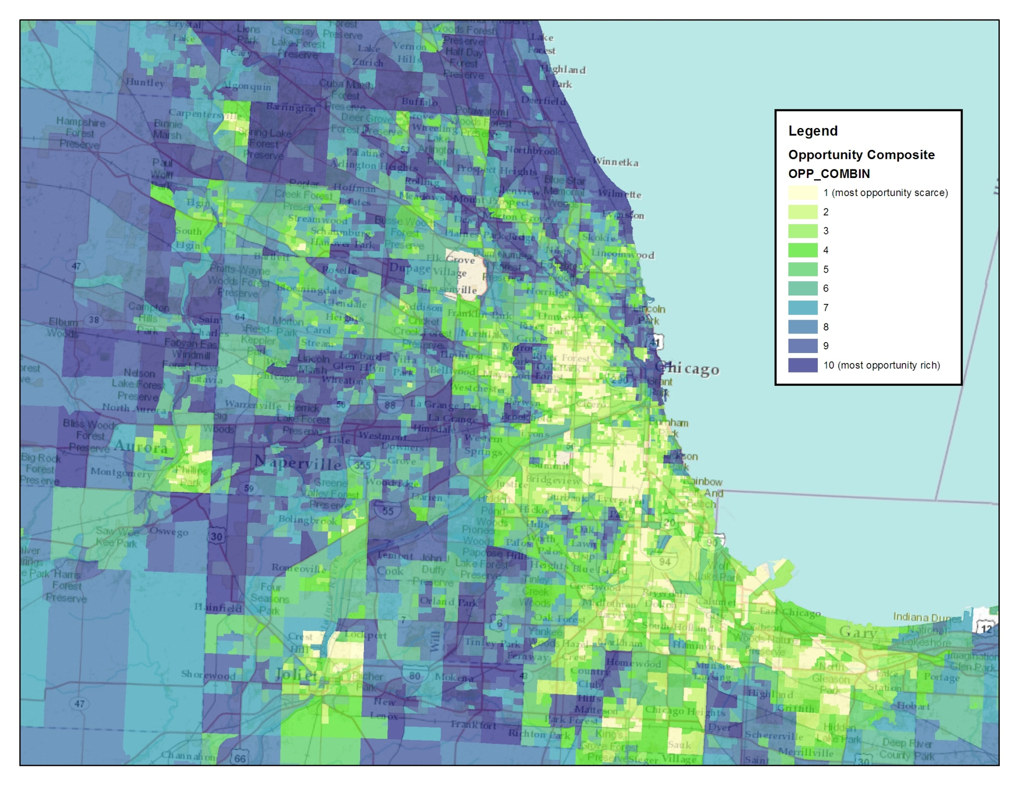
Composite Index, Chicago

Slide 25
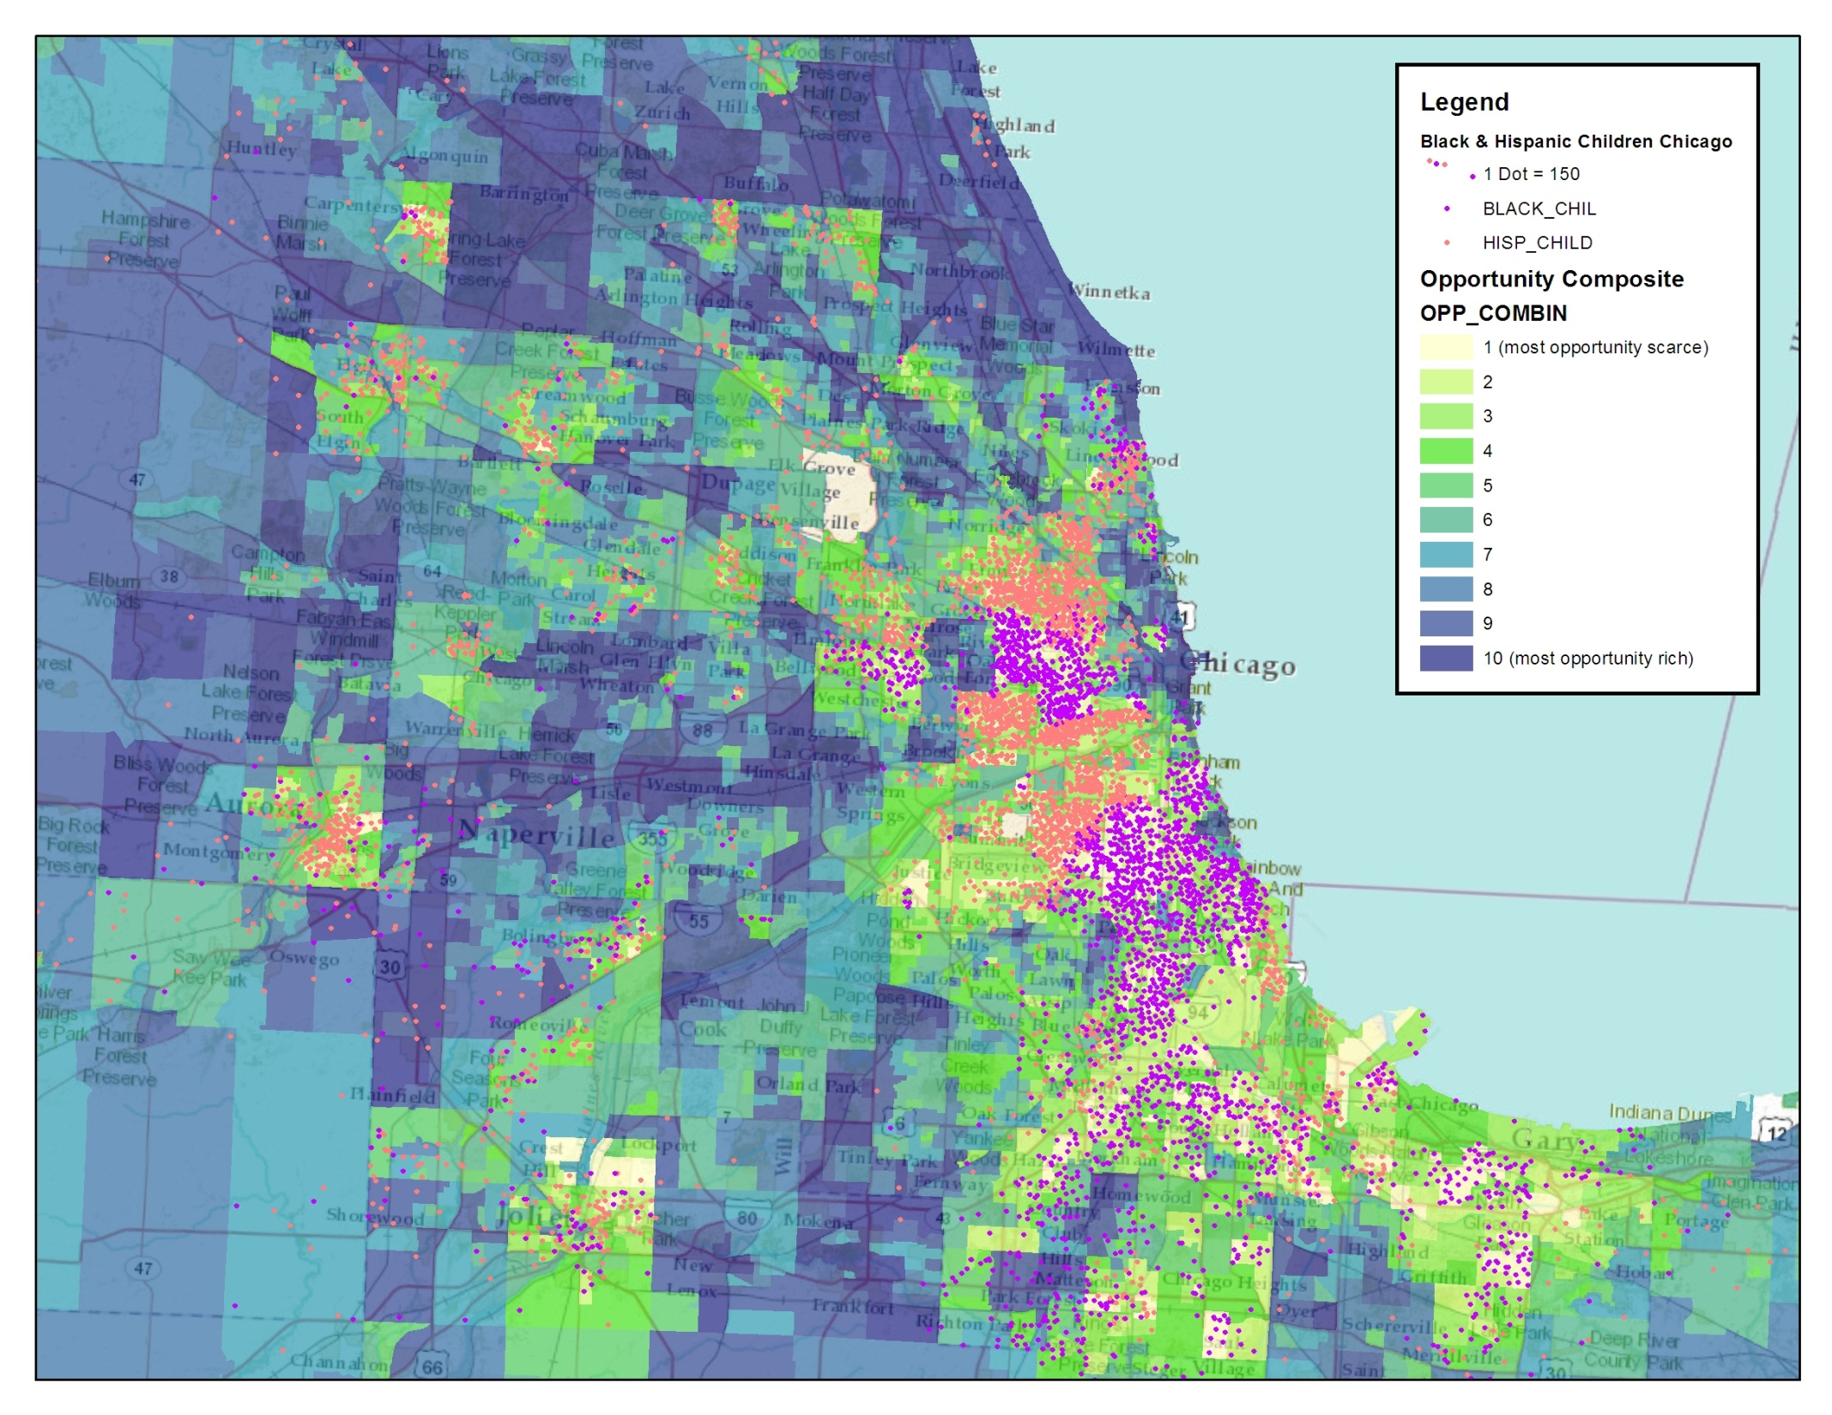
Composite Index, Chicago

Slide 26
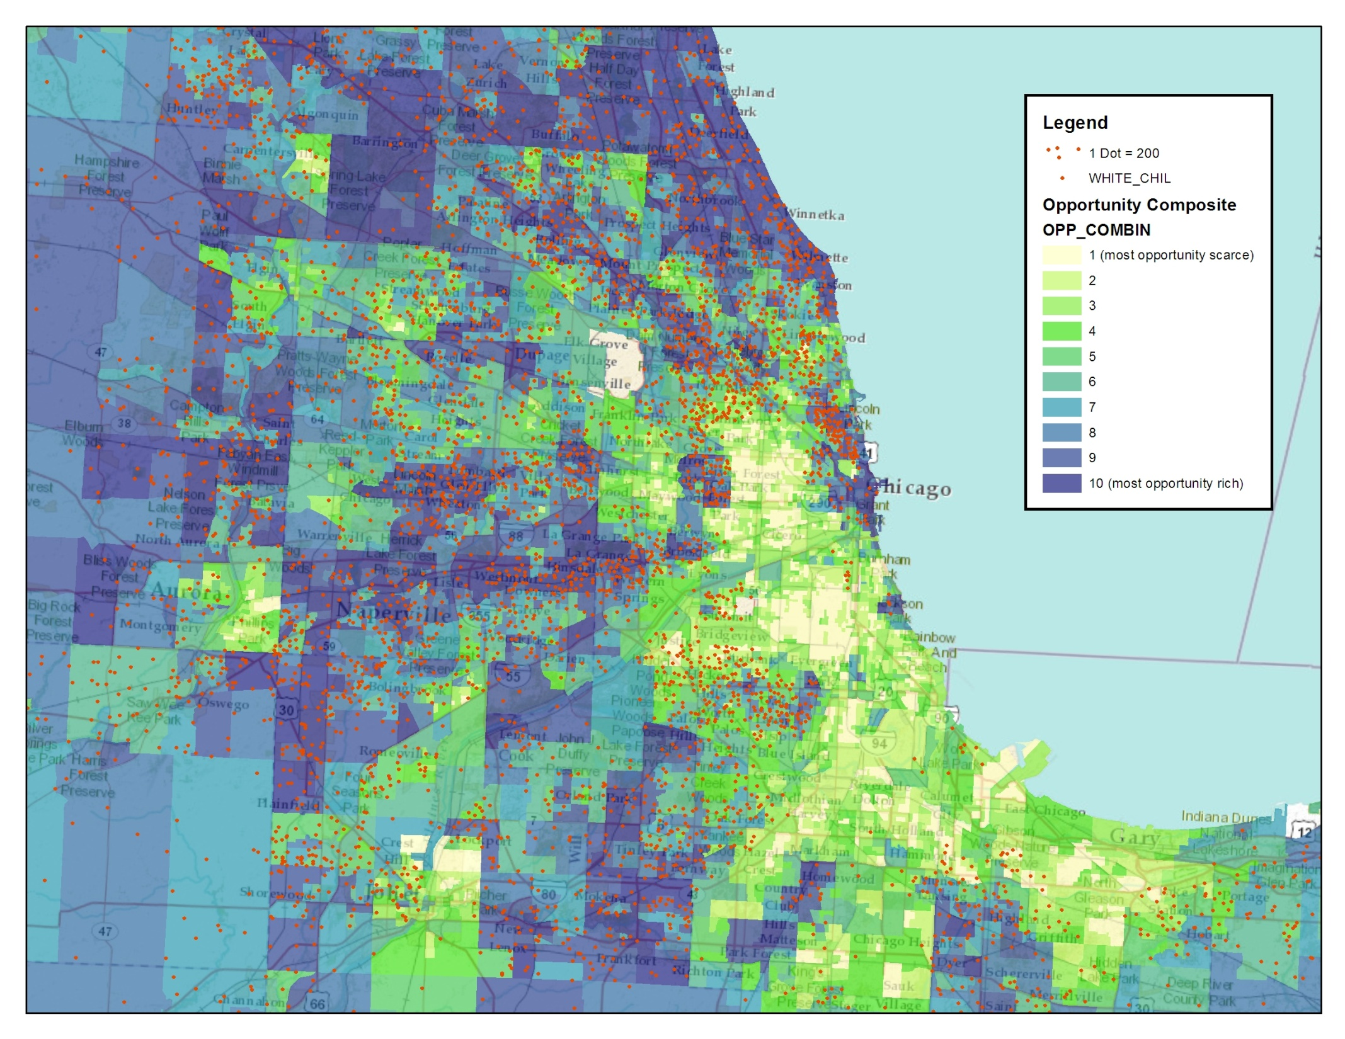
Composite Index, Chicago

Slide 27
Summary
HUD is committed to raising the baseline of neighborhood data for communities across the country – particularly those not lucky enough to have an NNIP organization
HUD’s Neighborhood Opportunity Indicators are informational, designed to spark a dialogue, not dictate decision-making
HUD is hopeful that by making these types of neighborhood indicators consistently and broadly available, it will increase the quality and quantity of research on issues of place
HUD is planning to release the first batch of this data on a web-based platform in summer of 2012

