Slide 1
Place-based Initiatives and Integrated Data Systems:
^{What’s Happening in Cleveland}
Taryn Gress and Beth Anthony
Center on Urban Poverty and Community Development

Slide 2
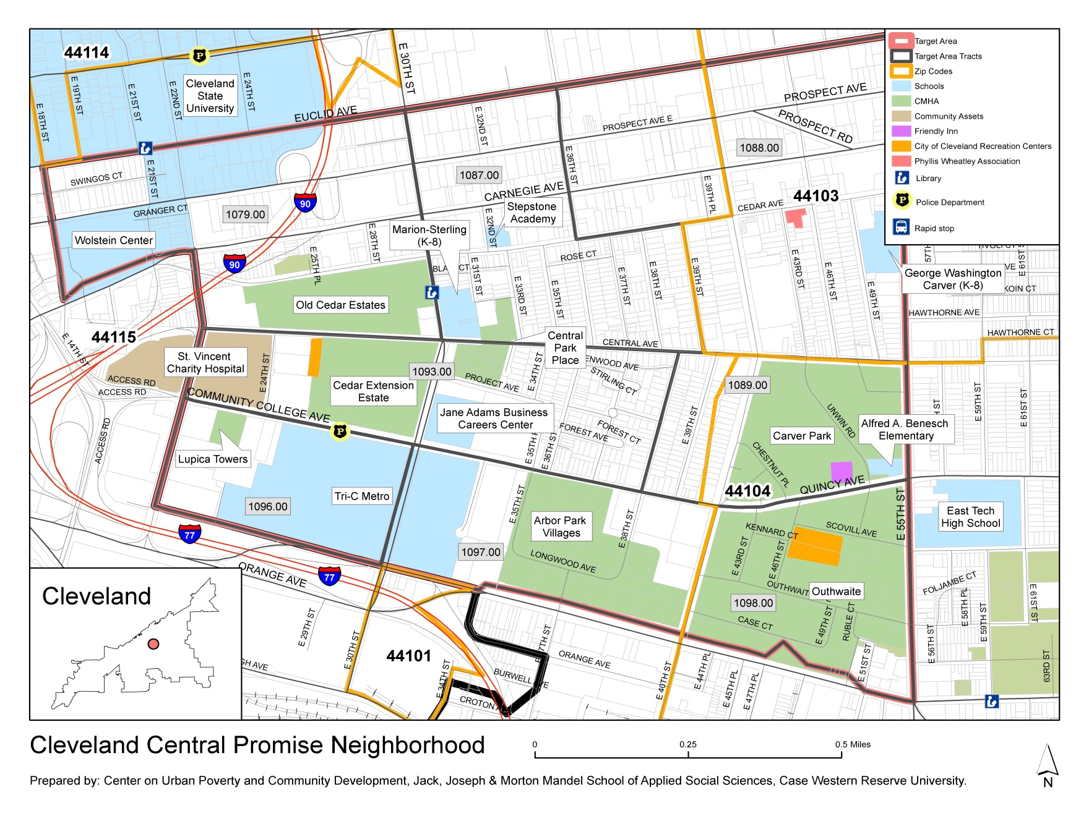
Cleveland’s Central Neighborhood

Slide 4
Need for Place-based IDS
Base of analysis from which quarterly, bi-annual and longitudinal reports can be generated
Feed scorecards and dashboards to communicate status to stakeholders
Provide program managers with the opportunity to assess performance and adjust program implementation.

Slide 5
Central’s Place-based IDS

Slide 6
Data Inputs:
ChildHood Integrated Longitudinal Data (CHILD) System:
Includes all children born in Cuyahoga County since 1992
Draws on routinely available administrative data to monitor program delivery and outcomes
Brings together data at the individual child level for longitudinal analyses
Now expanding to reflect experiences throughout childhood

Slide 7
IDS provides longitudinal perspective
Cle
Dept. of
Public Health
Moms First
Home Visiting
(Prenatal)
Cuyahoga
Dept. of
Employment & Family Services
Out-of-Home
Placement
Cuyahoga
Dept. of
Employment & Family Services
Child Care
Voucher
Head Start,
Starting Point
Access to
Early Learning
Starting Point
Out-of-school time
Cuyahoga
Juvenile
Court
Juvenile
Court Filing
Ohio
Dept. of
Health
Birth
Certificates
Cuyahoga
Dept. of
Employment & Family Services
Child Abuse
& Neglect
Cuyahoga
Dept. of
Employment & Family Services
Medicaid
Starting Point
Universal
Pre-K
Cleveland
Metropolitan
Housing Authority
CMHA
Tenant
Birth - Early Childhood - School Age - Youth - Young Adult
Help Me Grow
Cuyahoga
County
Help Me
Grow
Home Visiting
Cuyahoga
Board of
Mental Health
Early
Childhood Mental Health
Cuyahoga
Dept. of
Employment & Family Services
Public Assistance
Cleveland
Metropolitan
School District
Kindergar-
ten Readiness
(KRA-L)
Cleveland
Metropolitan
School District
Ohio Graduation
Test
Cuyahoga
Board of
Health
Newborn
Home Visiting
Starting Point
Special
Needs
Child Care
Cuyahoga
Dept. of
Employment & Family Services
SNAP
Cleveland
Metropolitan
School District
Public
School
National
Student
Clearing house
Postsecondary
Data
Data Integration
Source
Longitudinal Pipeline
Notes:
Animation 1st: I make a longitudinal window from birth to young adult
2nd: We can get a variety of data.
3rd: We can obtain these data sets from various governments and agencies.
Yellow boxes are local data. Blue boxes are County data. Red boxes are State or national-wide data.
4th: We can make one data system, IDS.

Slide 8
Additional Data Inputs:
ETO: social service program data
TAAG: tenant records and case management data
Neighborhood Data: address or neighborhood level (using geocodes such as block group, census tract, or other geography)
Neighborhood Surveys: direct measures to monitor components of quality of life

