Slide 1
Advancing the Common Good in Education, Income and Health
Community Indicators Consortium – Impact Summit
November 2012

Slide 2
Result of our time together is for you to better understand United Way’s transition to collective impact and the early results

Slide 3
United Way’s Transformation to Community/Collective Impact
1918
1970
1990
2003
2009
operational funding to agencies
program funding, and
agencies report activity
program
funding, and
agencies report outcomes & activities
results-based
accountability model for funding decisions
community level change and collective impact

Slide 4
Why Community Impact Model
Conditions have changed and donors want:
Their dollars to be invested to change specific community level conditions
Their advocacy efforts to inform change in specific community level conditions
Their volunteer efforts to impact specific level community conditions

Slide 5
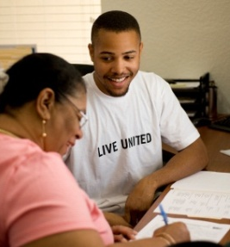
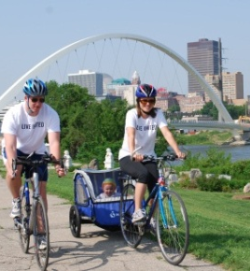
Advancing the Common Good: Goals for 2020
EDUCATION:
Cut by half the number of high school students who do not graduate on time
INCOME:
Cut by half the number of lower-income families who are financially unstable
HEALTH:
Cut by half the number of adults and youth who are living unhealthy lifestyles

Slide 6
Roadmap
Year 1:
Research Scan on successful strategies to help in reaching United Way Goals (White Papers, Strategy Maps)
Refined performance measures
In prior years, programs provided data based upon how well they did based upon their mission, now funded strategies provide outcomes based upon how well they are helping United Way meet our community goals for 2020.
Investments in technology to measure outcome and build capacity
Efforts to Outcomes (ETO)
Results Scorecard

Slide 7
Roadmap (cont.)
Year 2 & 3:
Developed Alignment Maps to help align investment decisions for current funded strategies
Identified those strategies that directly contribute to the goals and those that influence the goals
Identify gaps
Focus new investment decisions on those strategies that directly contribute to the goals and fill gaps
More programs are using ETO
Our programs have benefited from defining performance measures and the process of reporting outcomes. It has helped us find a common focus and track our own progress toward achieving our goals.
-Partner

Slide 8
Results
Collective results for similar strategies that are funded by United Way
Working with community collaborations to expand collective results in the community
Identifying gaps in the work and looking for partners to fill the gaps

Slide 9
Results, cont.
Central Iowa Employers and Donors were pleased with the movement to the Community Impact Model
Donors want to know that their donation of money, time, and energy are benefiting others
Pleased with accountability, transparency, and efficiency
Increased Campaign - $25,603,189
Continue to be #1 in Metro 1B overall per capita giving ($47.17)
Increased Donors – 36,963
Started a new Tocqueville Society for Women’s Leadership
Leaderhsip Giving and Affinity Group membership increase
I very much like the results oriented goals of the new campaign.
-Donor

Slide 10
Thank You!
Questions?

