Slide 1

Rethinking Revitalization: A Data Driven Approach to Addressing the Foreclosure Crisis
Jeff Matson
CIC Impact Summit
Nov. 16, 2012

Slide 2
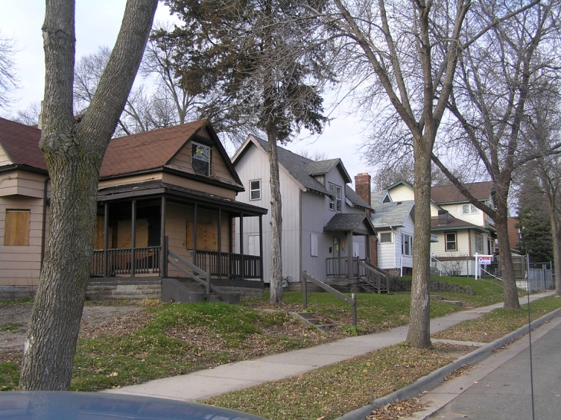
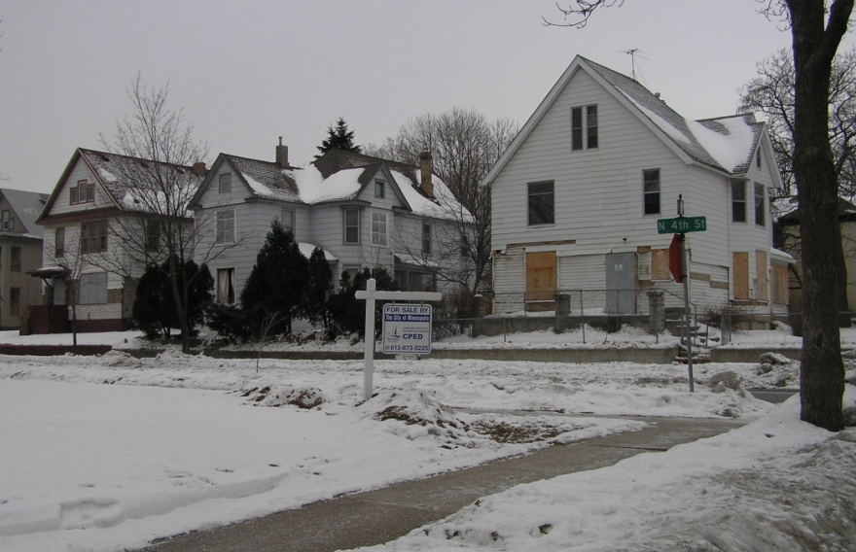
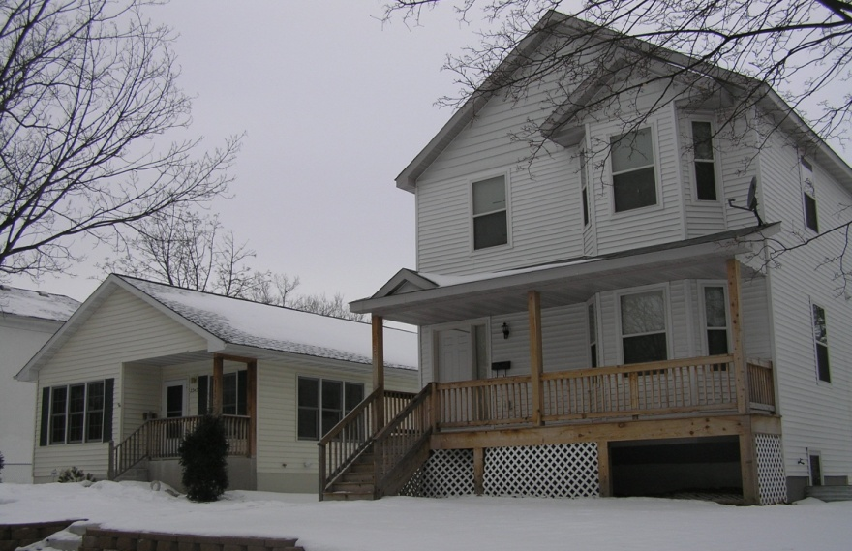
Foreclosures & Problem Properties
A Planning Problem
Neighborhood fabric is eroded by:
  Deteriorated properties
  Vacant homes
  Boarded homes
  Vacant lots
  Incompatible infill housing

Slide 3
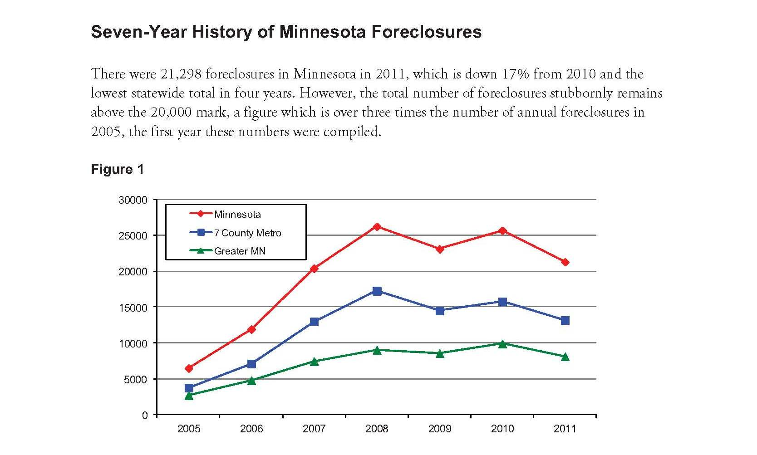

Slide 4
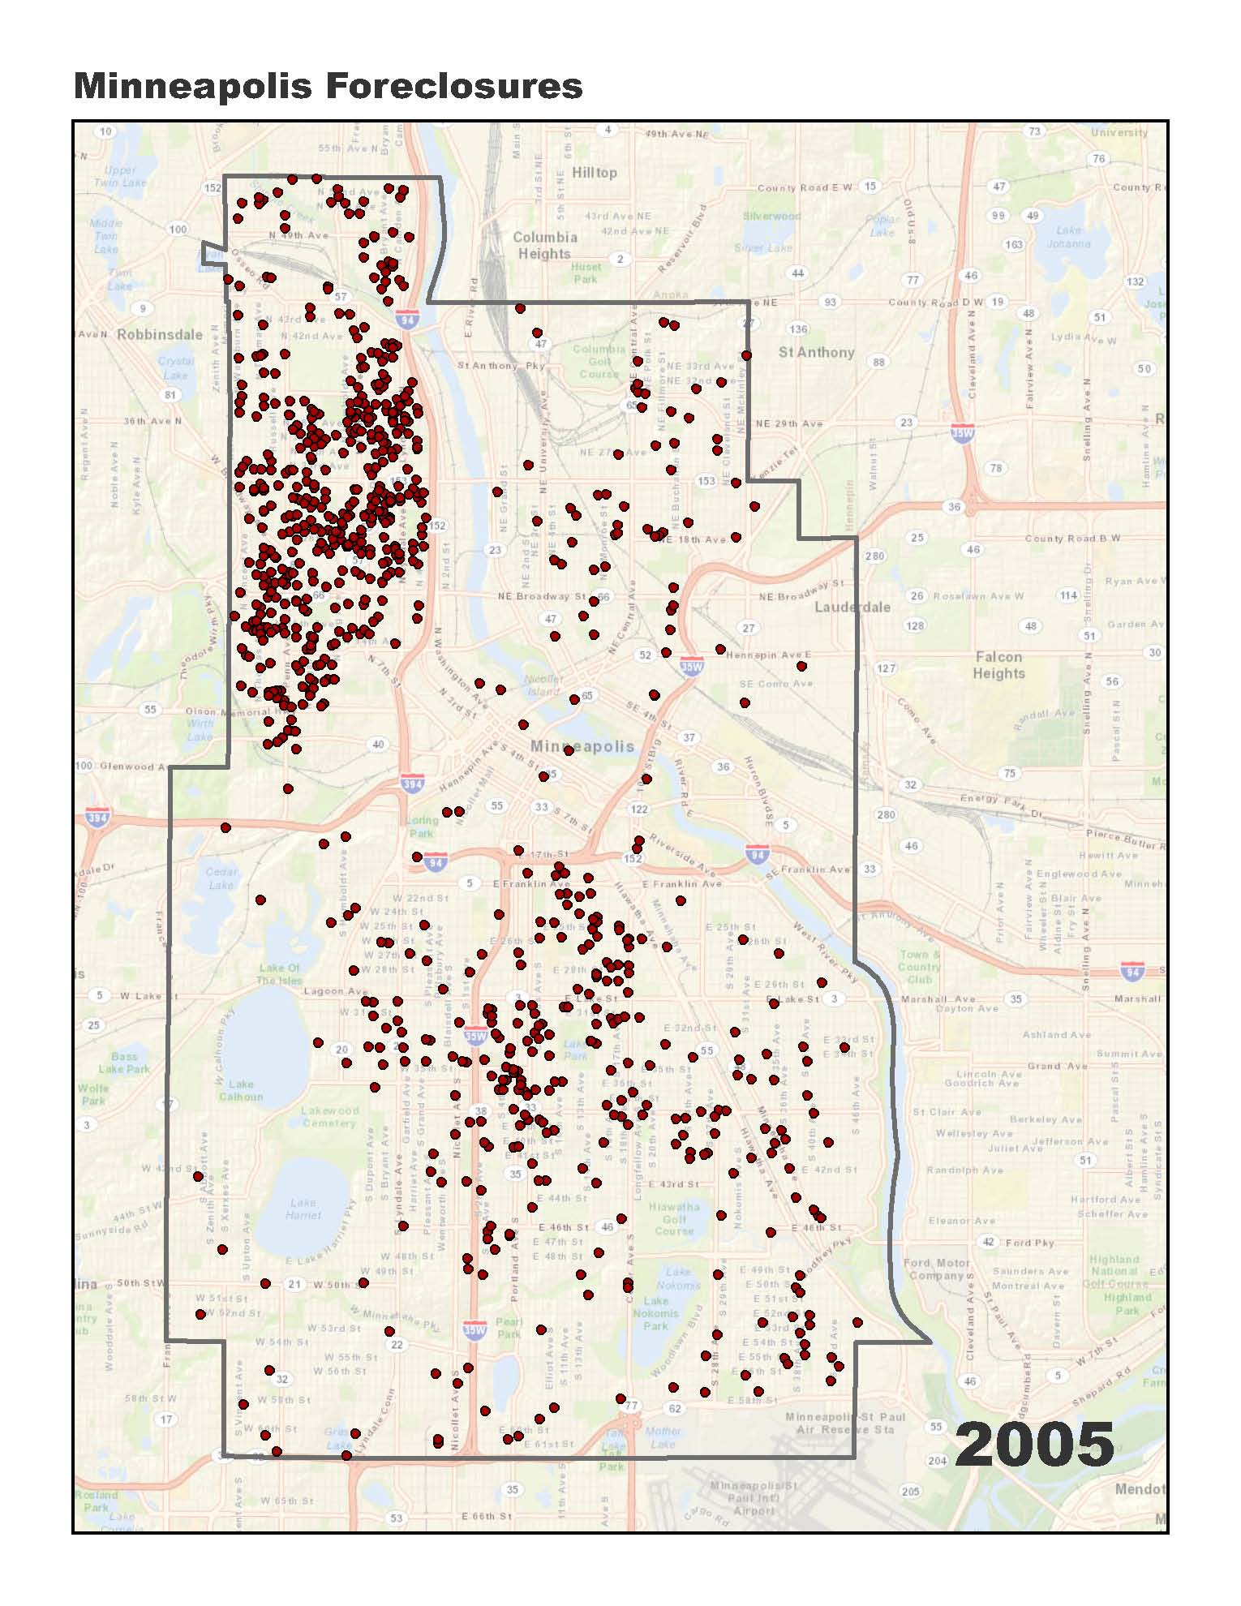

Slide 5
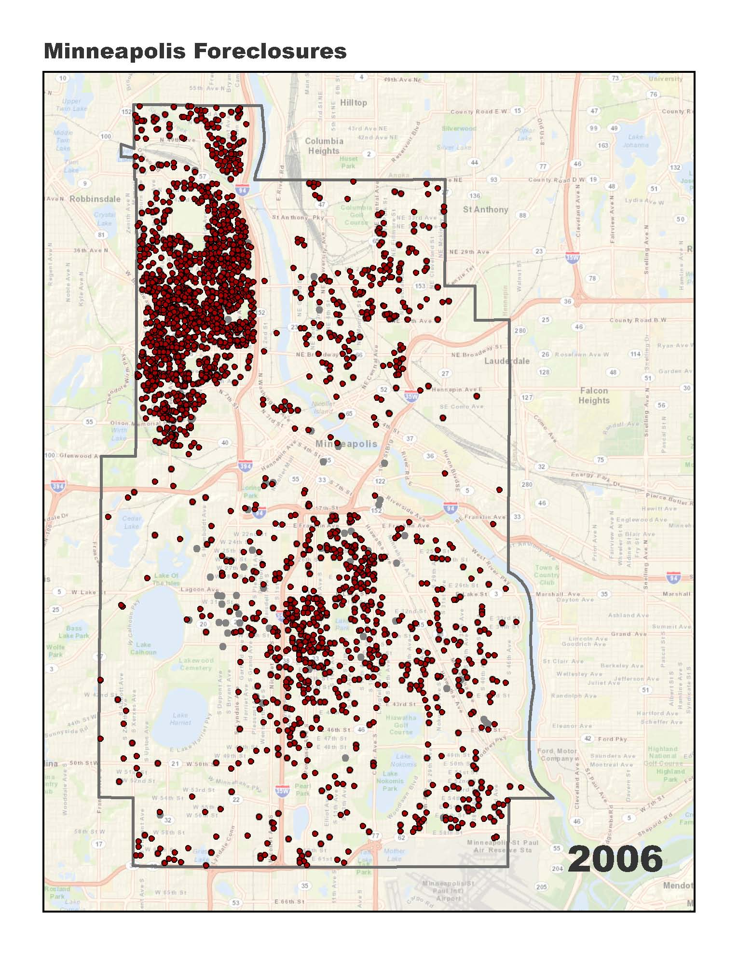

Slide 6
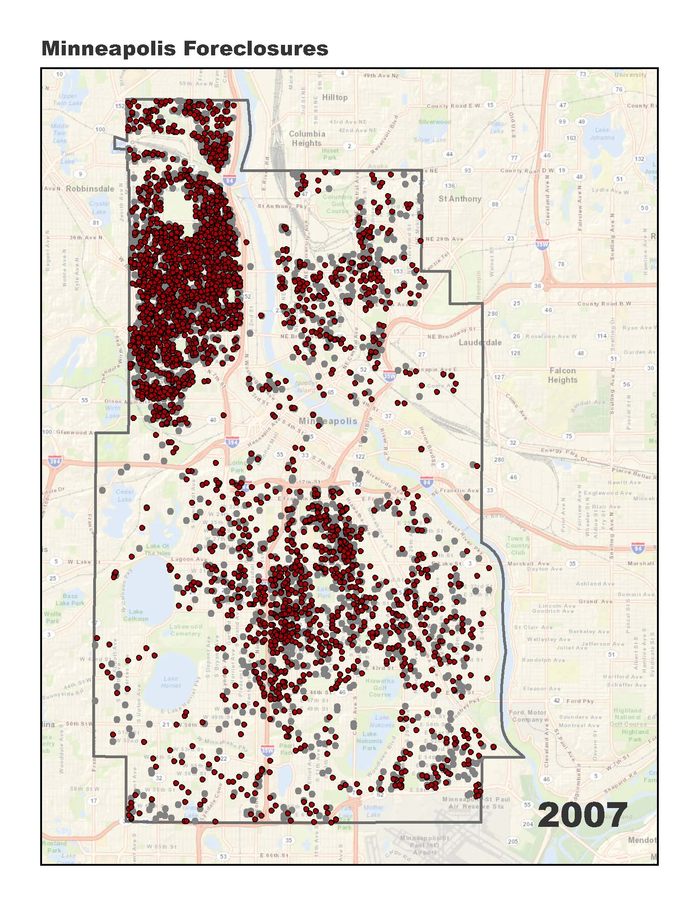

Slide 7
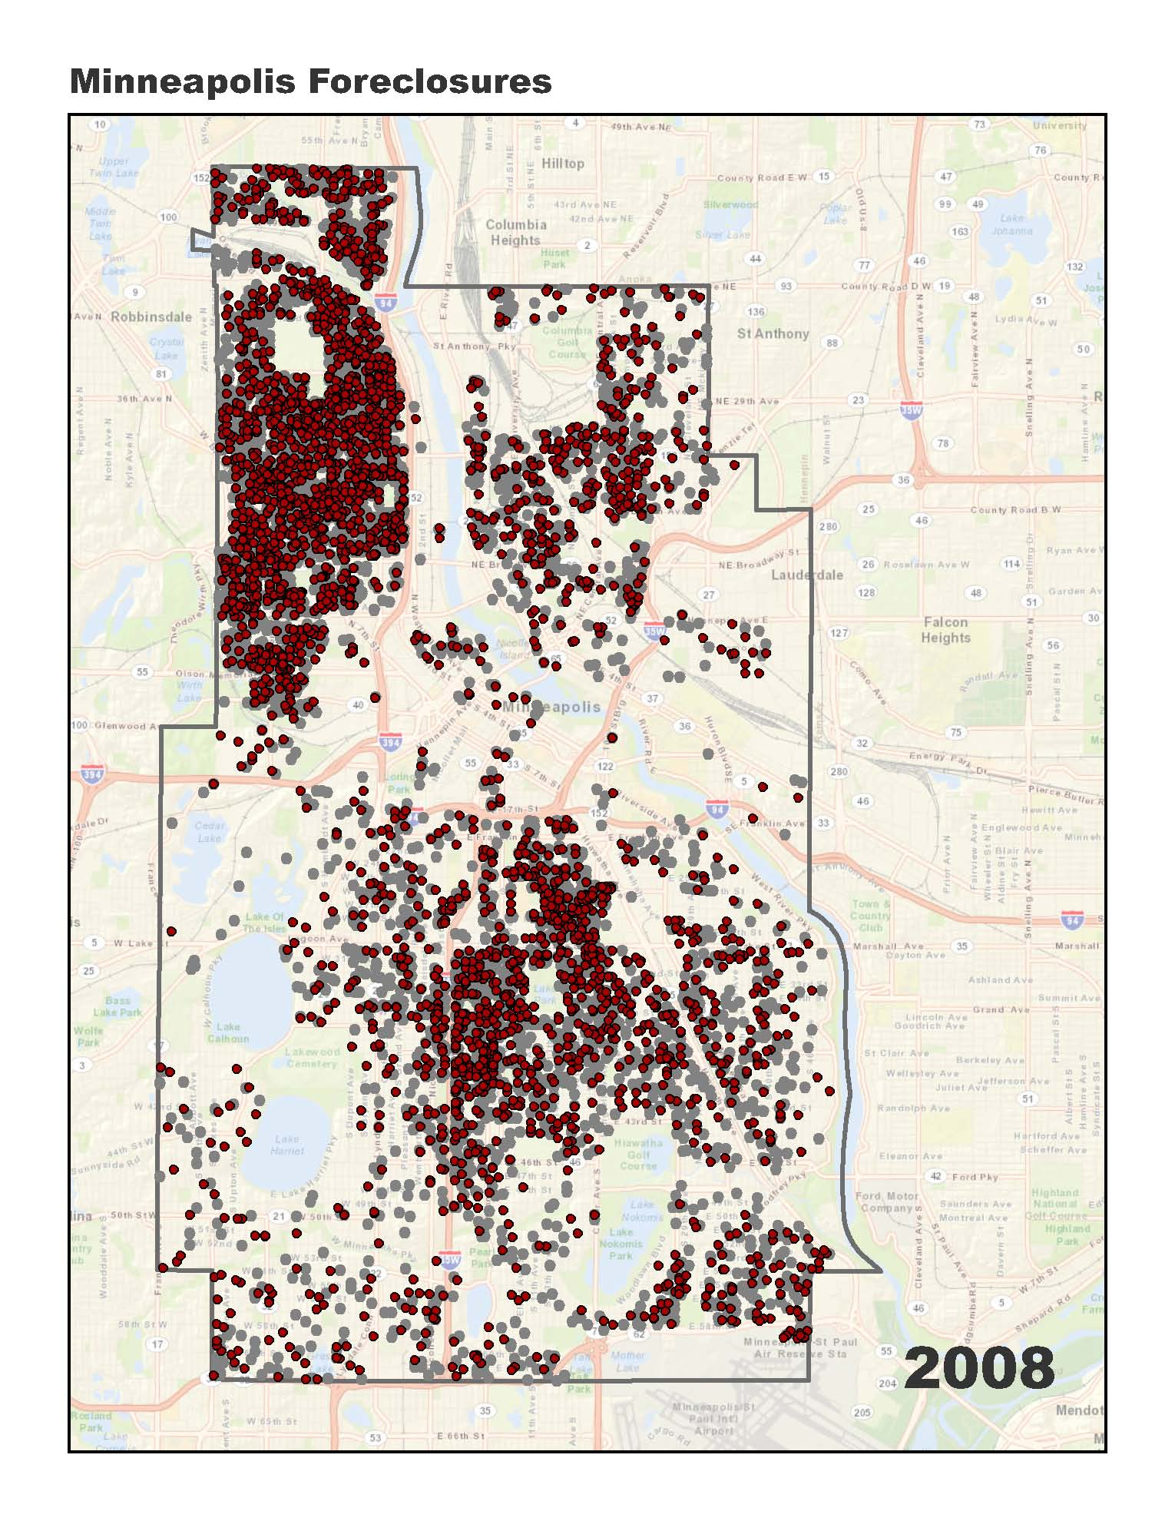

Slide 8
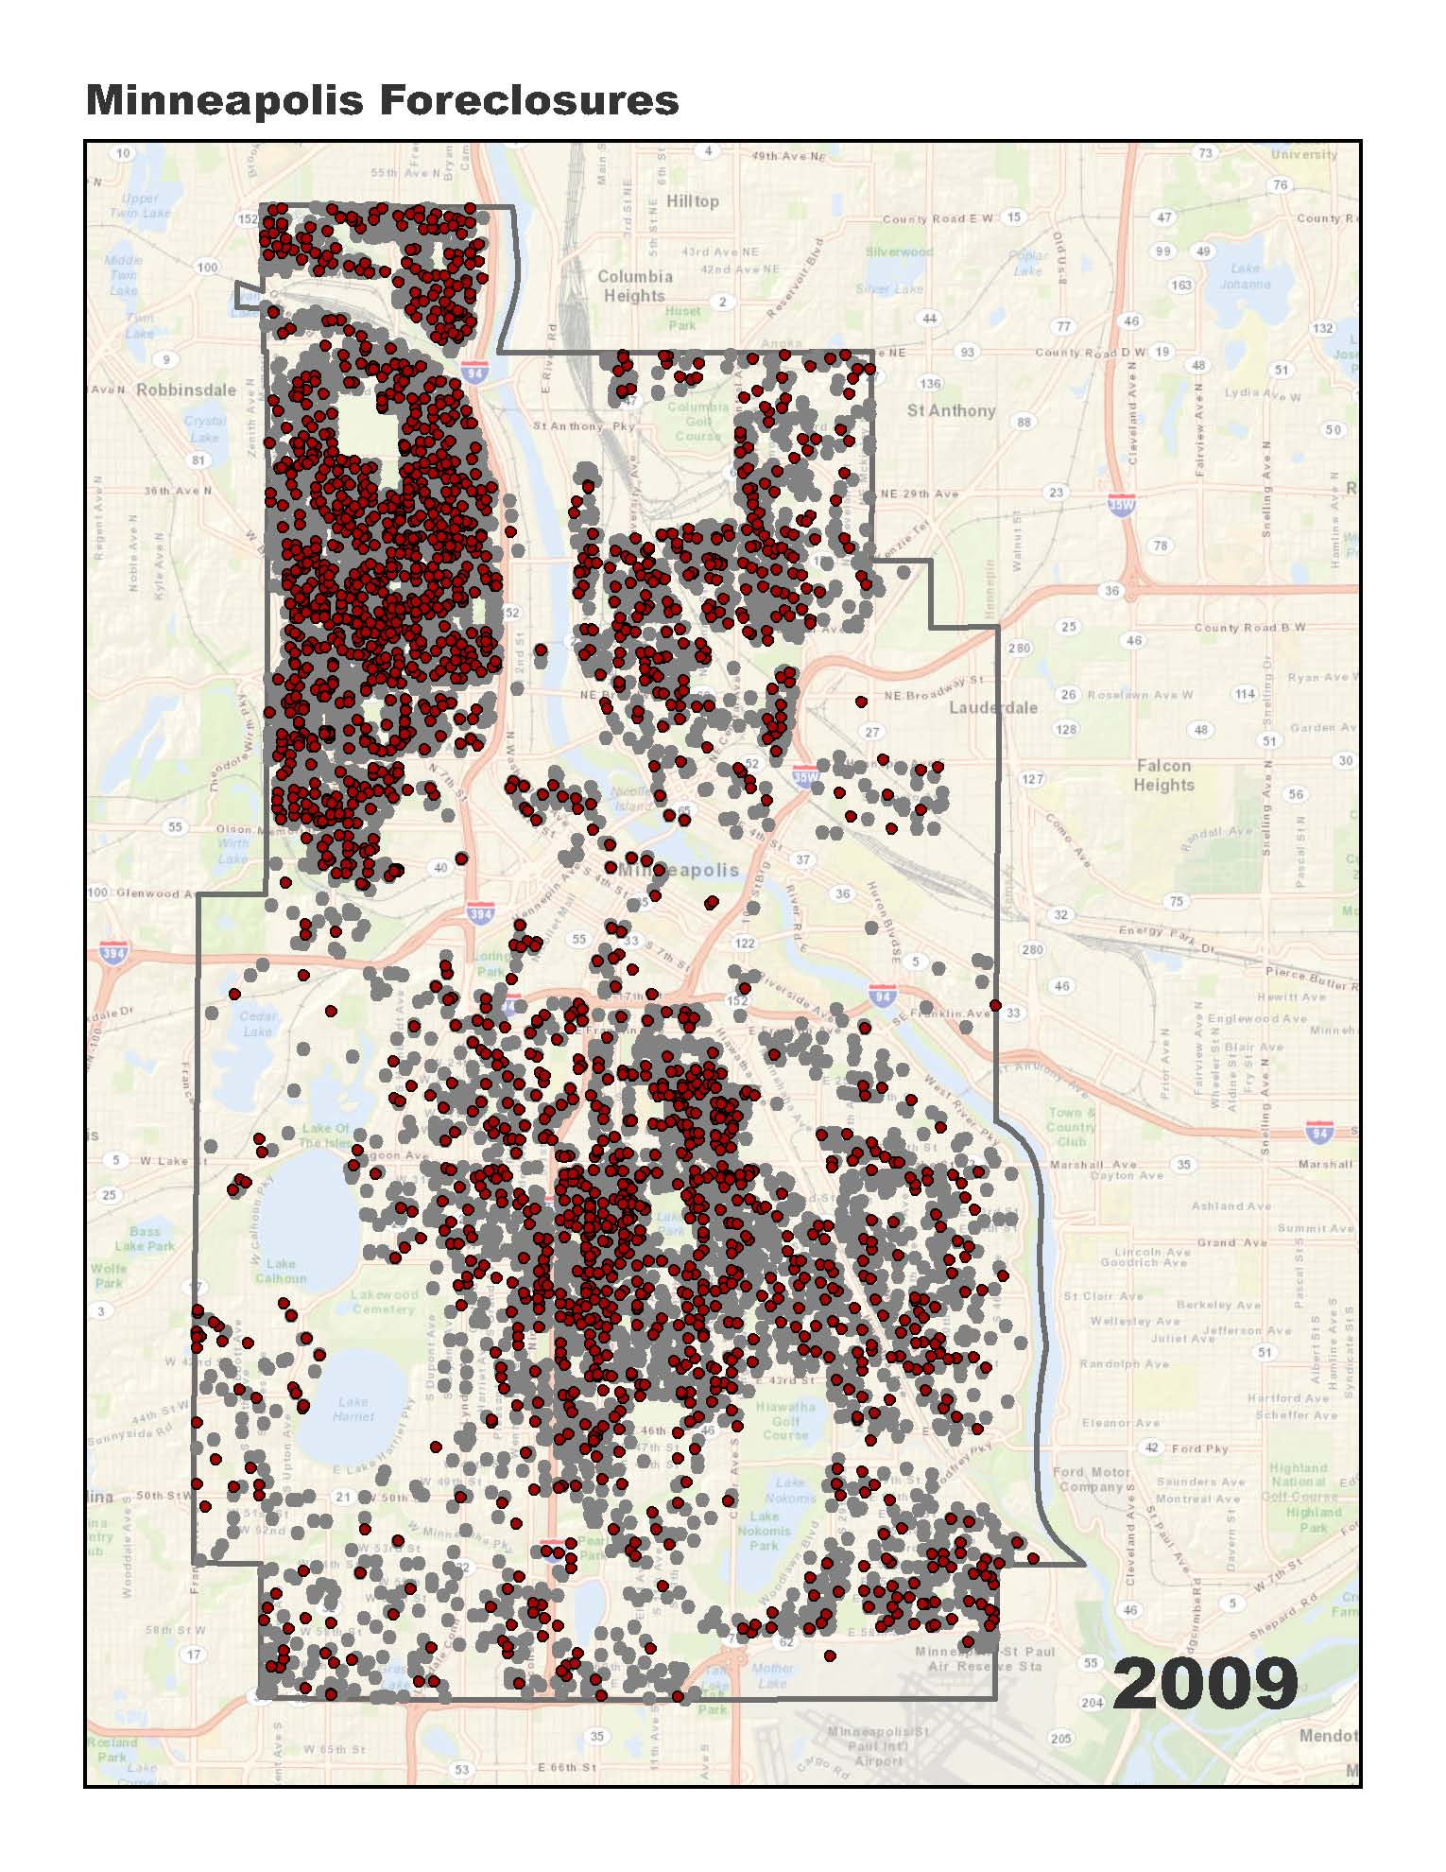

Slide 9
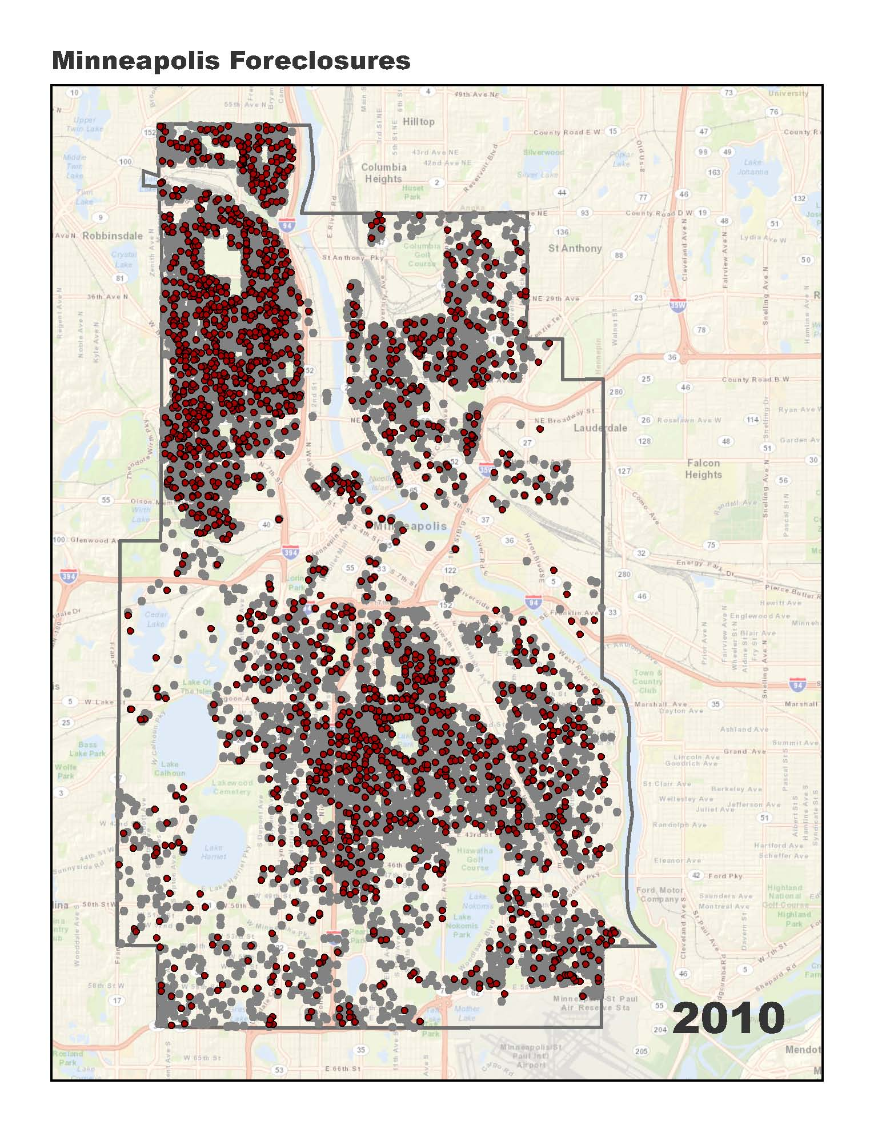

Slide 10
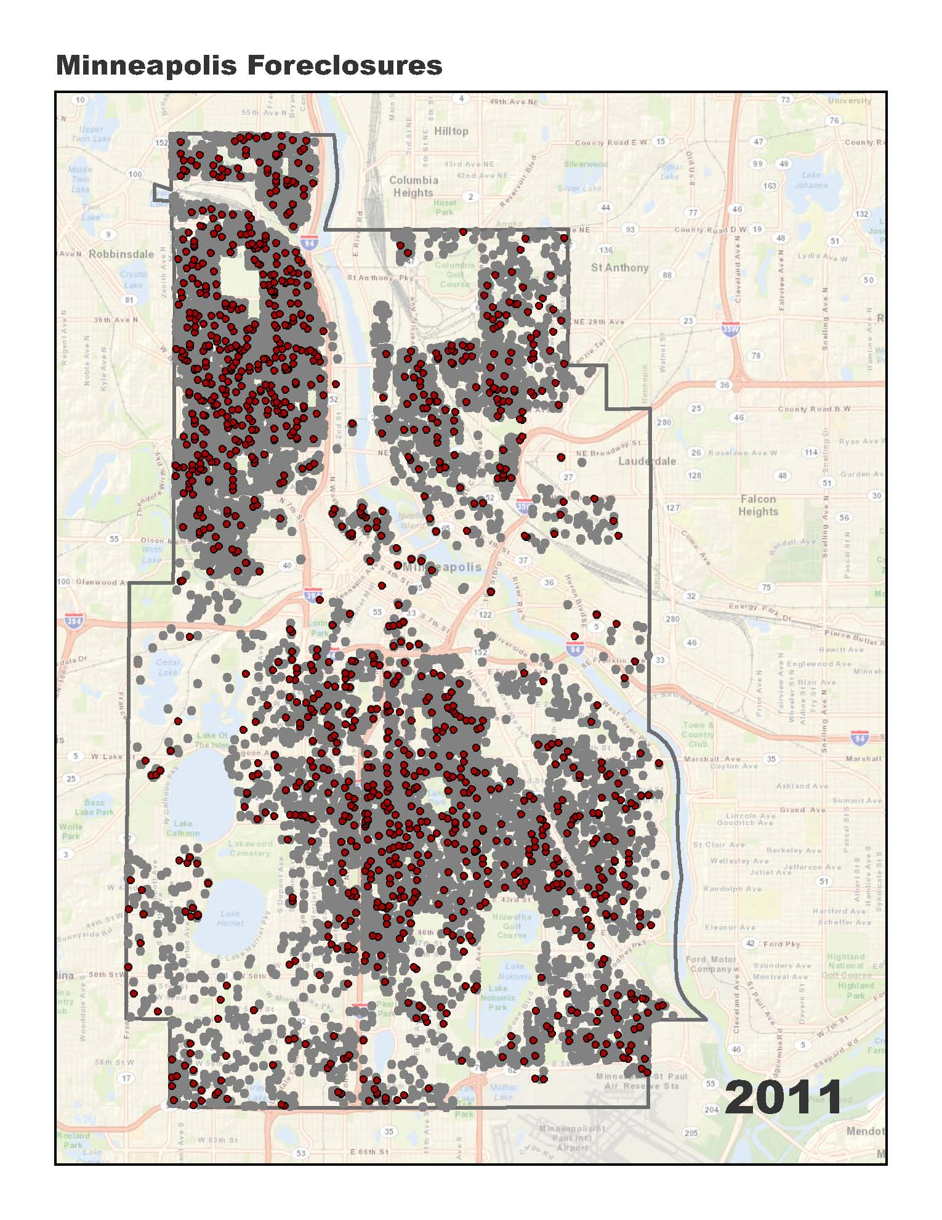

Slide 11
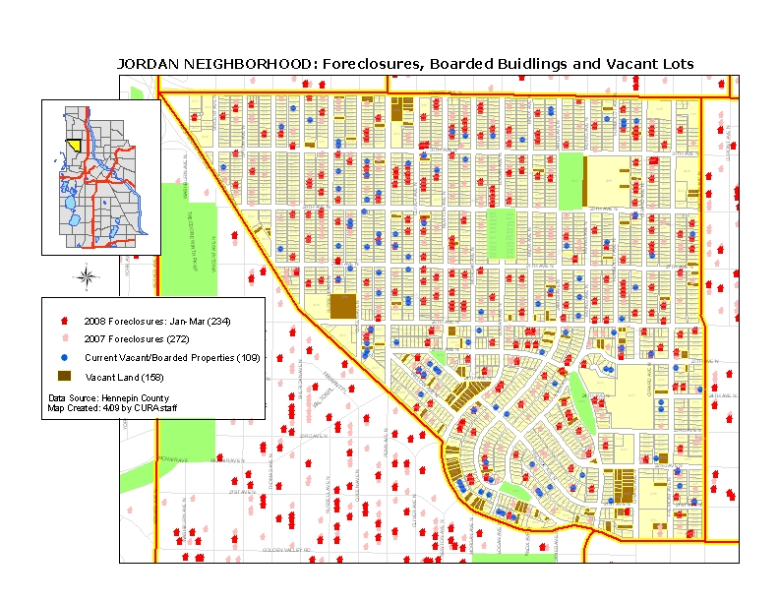

Slide 12
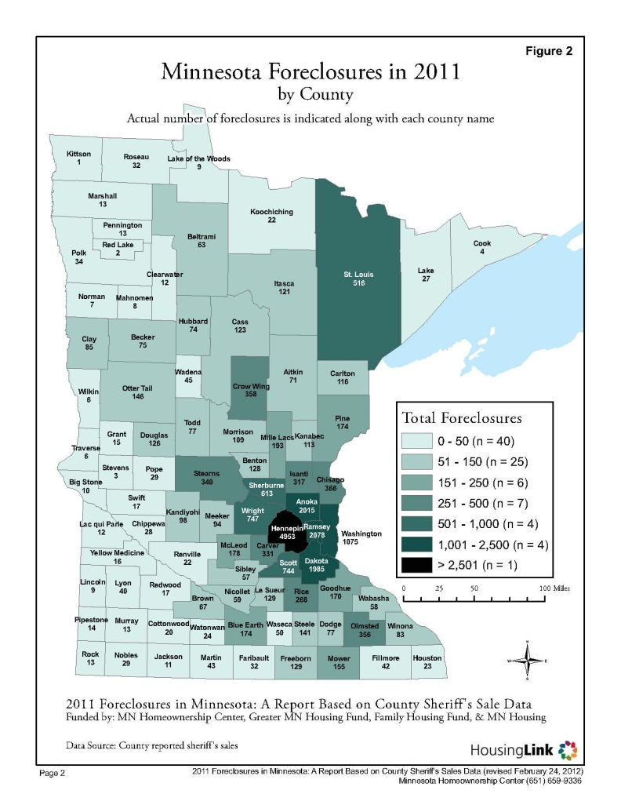

Slide 13
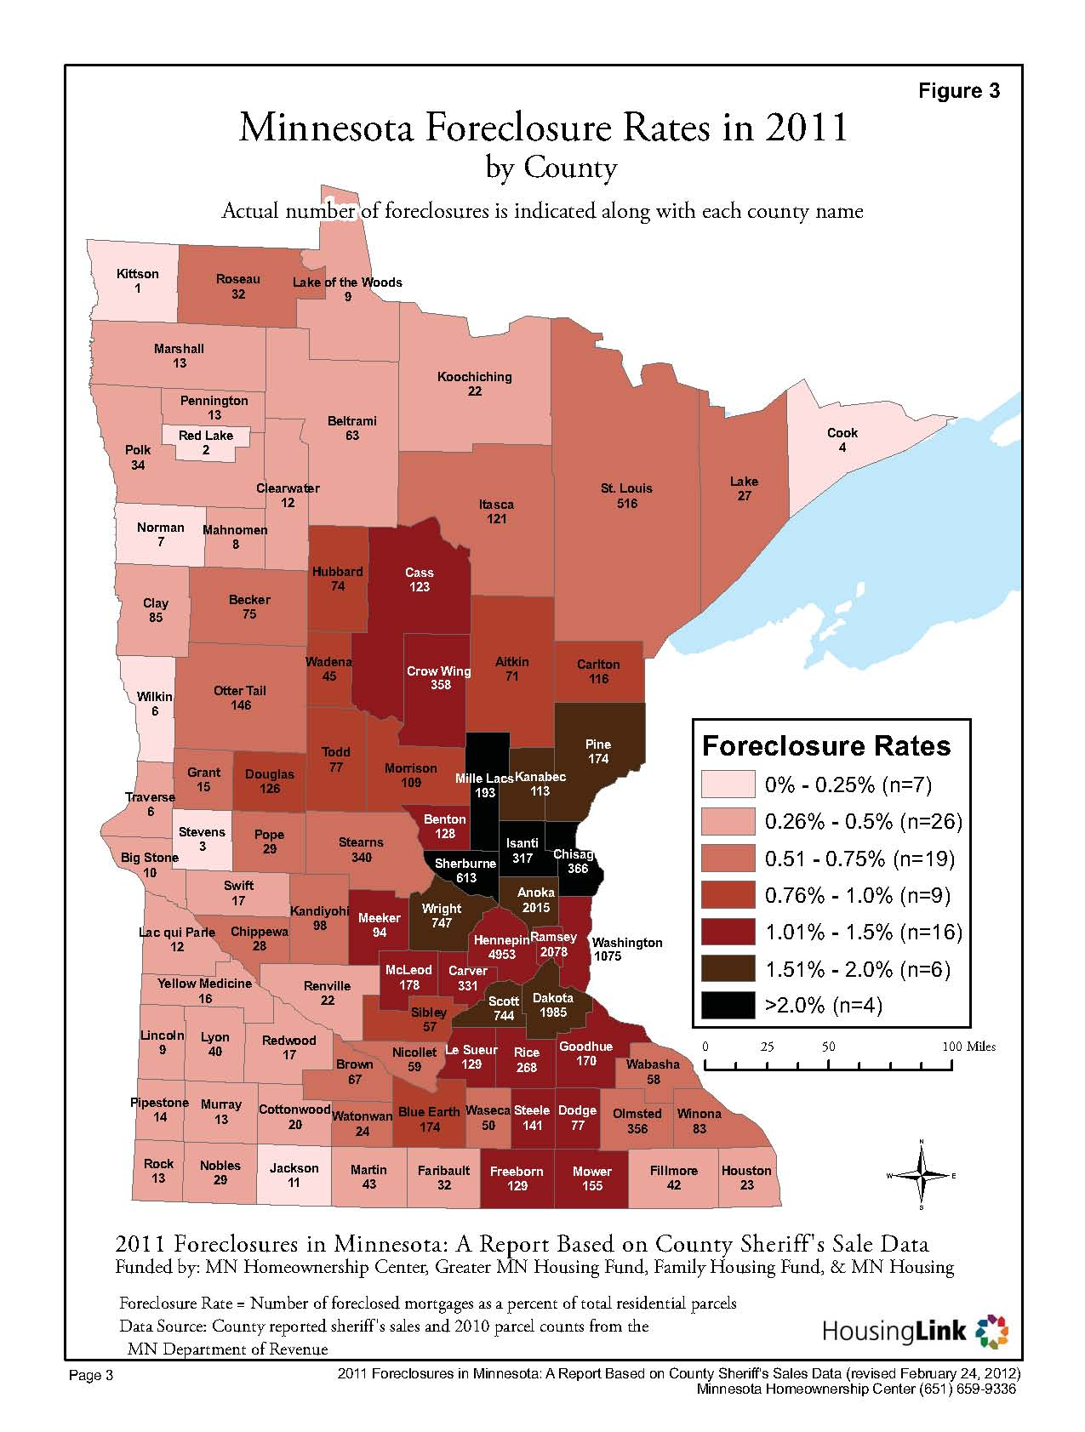

Slide 14
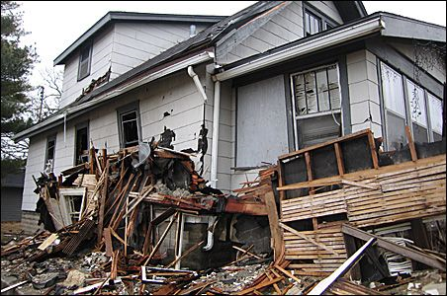
Vacant House Project
Increase in vacancies
Spike in copper pipe theft
Need to develop intervention and stabilization strategies

Slide 15
Who Is Involved?
4th Precinct CARE Task Force
  Folwell Center for Urban Initiatives, Webber Camden Neighborhood Association and area residents
Minneapolis Police Department’s 4th Precinct
City of Minneapolis
Hennepin County
Pohlad Family Foundation
Federal Reserve Bank of Minneapolis
Center for Urban and Regional Affairs

Slide 16
Indicators/Data
Vacancy Indicator
Zero or Low Water Usage
CPED Slated for Demolition
Official Vacancy Building Registration
REO-Owned Properties
Copper Theft
Windshield Survey of Vacant Properties
Tract-Level Vacancy Data
Legal Judgment
Foreclosure Filings
Tax Delinquency
Sheriff Sales
Mortgage Delinquency Rates
Other Tools
Parcel data
Multiple Listing Service data
NSP-First Look data

Slide 17
What These Indicators Produce
Notes:
You have hand outs to look at these closer. The map on the left just gives an overview of the indicators and the entire geographic extent of the 4th police precinct.
The map on the right is a zoomed in overview of the Webber-Camden neighborhood.
The properties with just one indicator, like zero water usage, don’t necessarily mean that a house is vacant. But as multiple indicators begin to stack up, then the likelihood of vacancy increases.

Slide 18
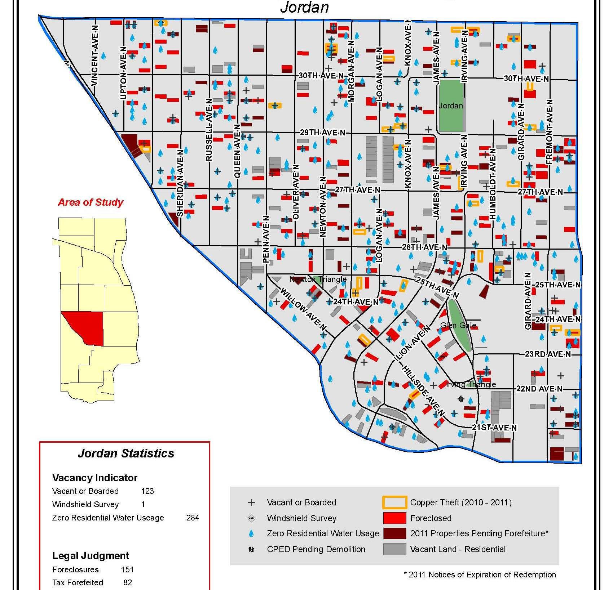

Slide 19
THE CHALLENGE OF NEIGHBORHOOD STABILIZATION
  Need to target funds very efficiently, but easy to make mistakes
    Choose the wrong neighborhoods
    Do the wrong thing in the right neighborhoods
  Good decisions requires data on two measures
    Foreclosure risk
    Market strength
19
Notes:
19

Slide 20
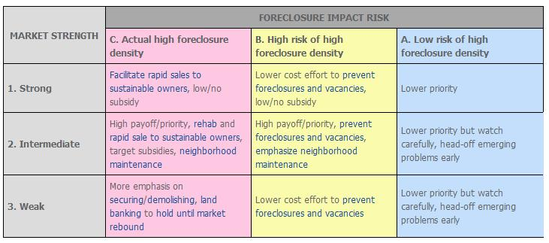
ALIGNING POLICIES WITH NEIGHBORHOOD CONDITIONS
20
Notes:
20

Slide 21
Housing Market Index Variables
Value Retention
Owner-Occupants
Housing Quality Rating
Vacancies

Slide 22
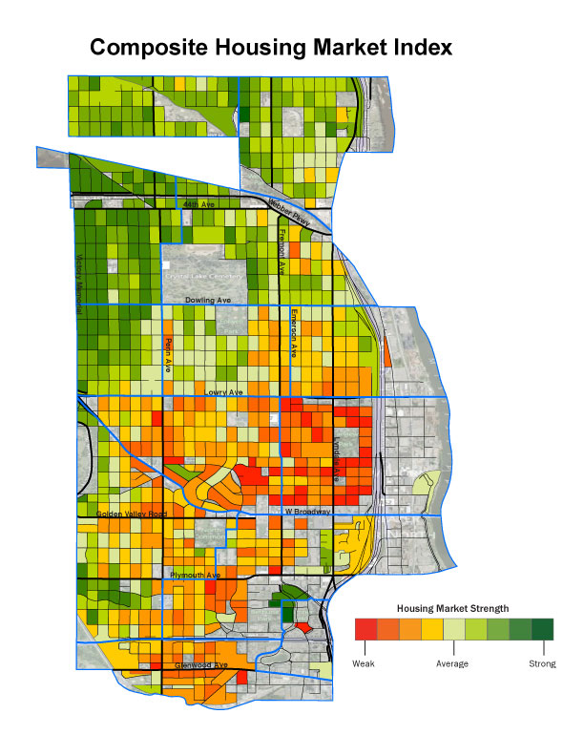

Slide 23
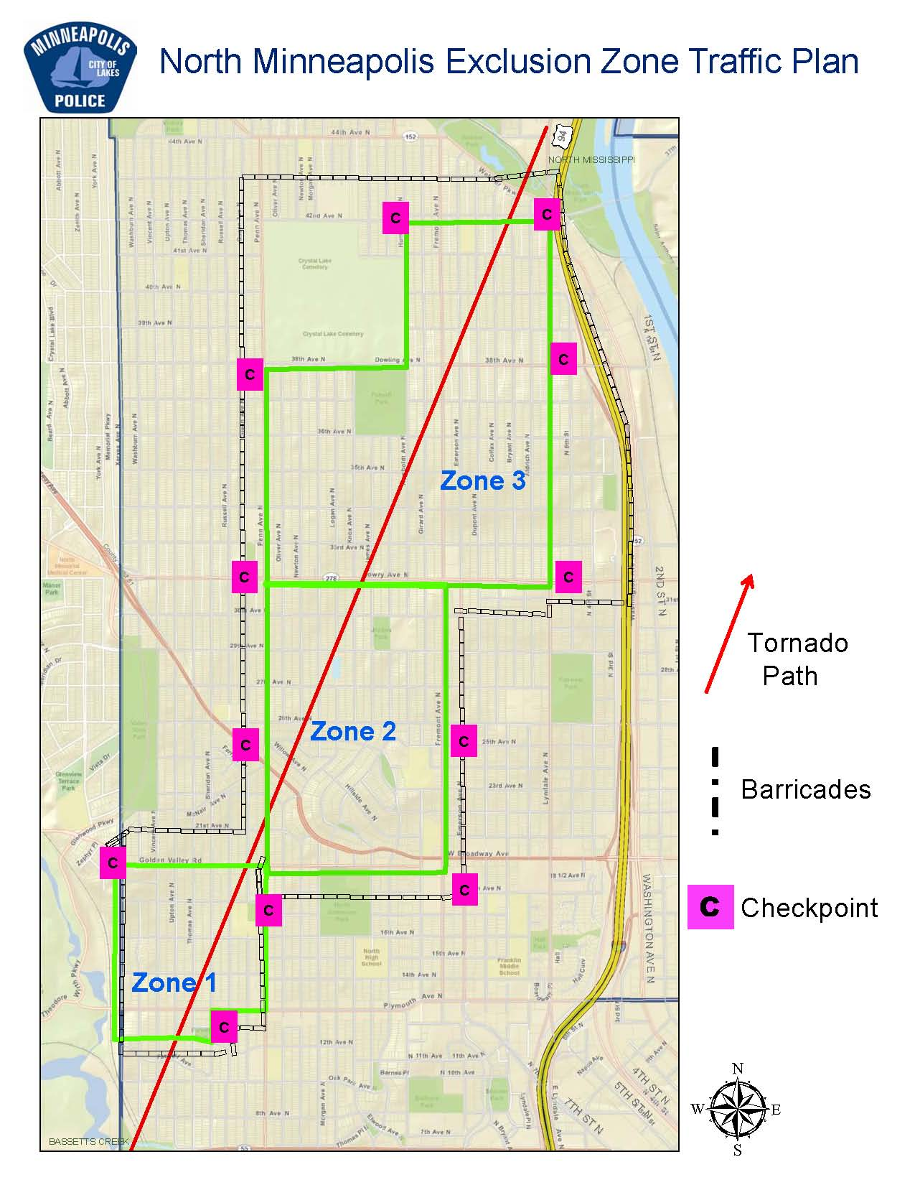
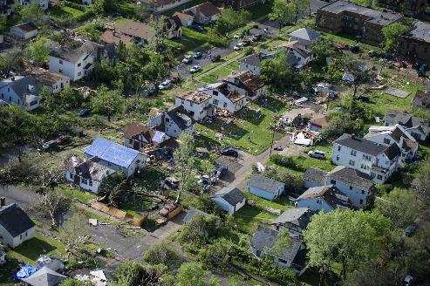
North Minneapolis Tornado – 5/22
Notes:
Value of Partnerships

Slide 24
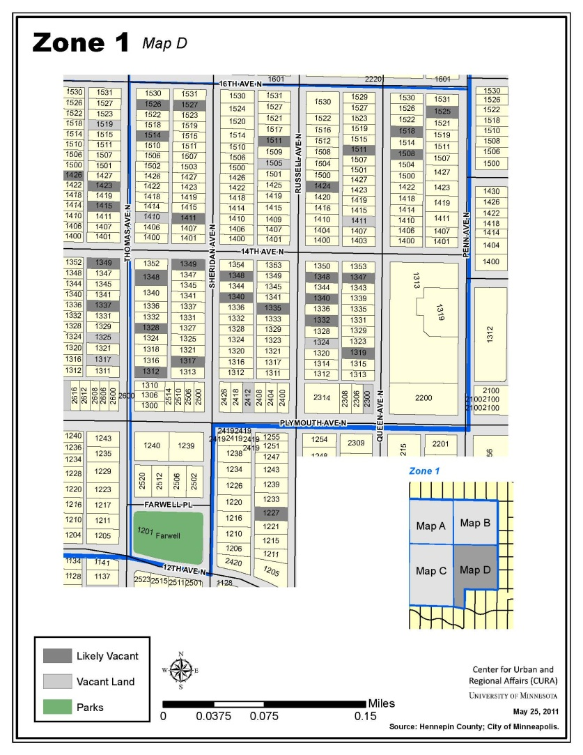

Slide 25
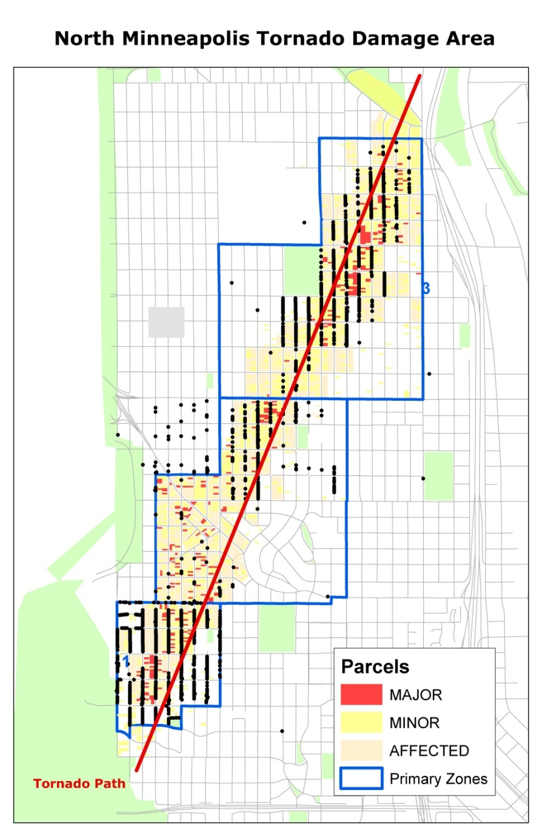

Slide 26
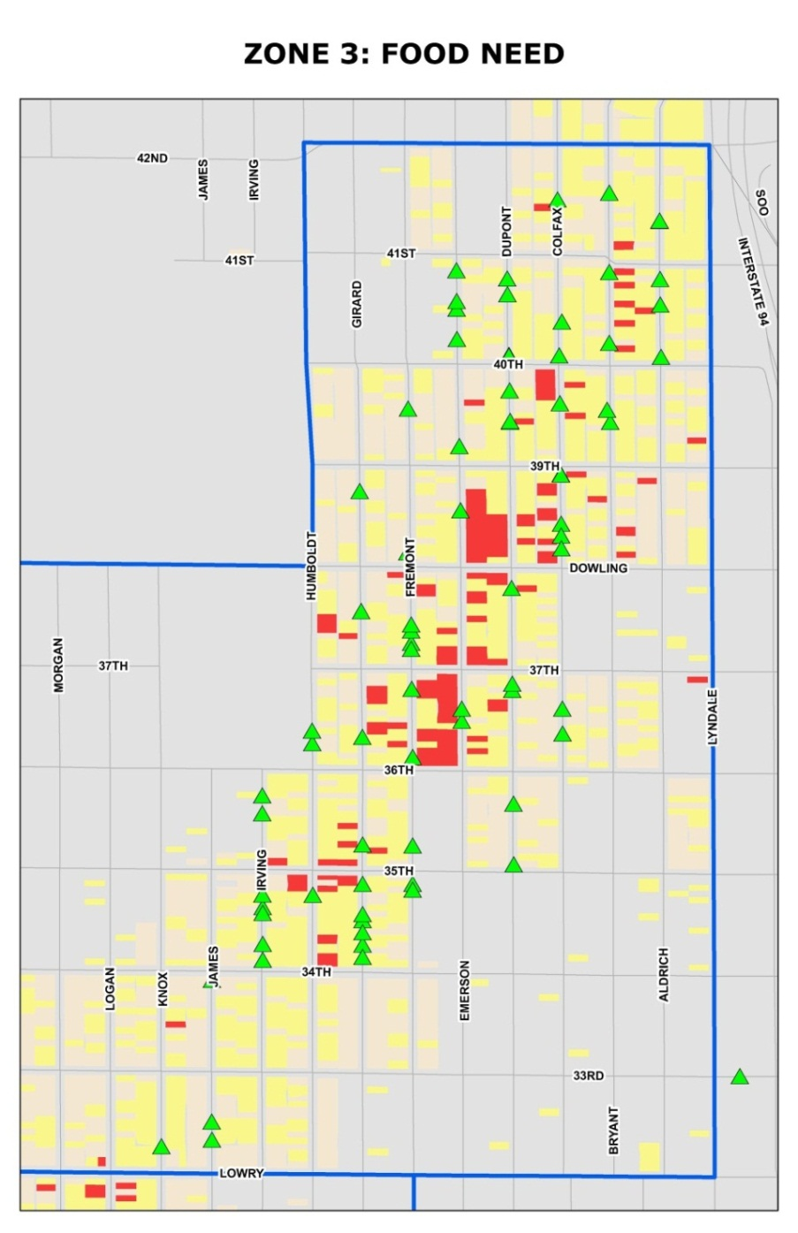

Slide 27
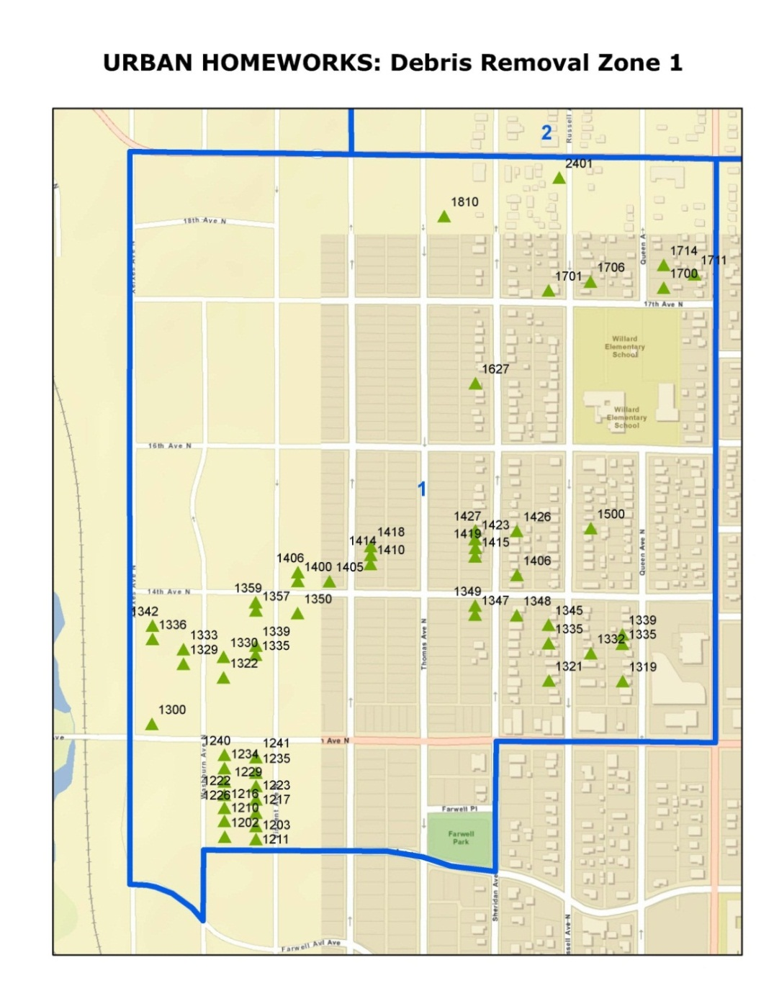

Slide 28
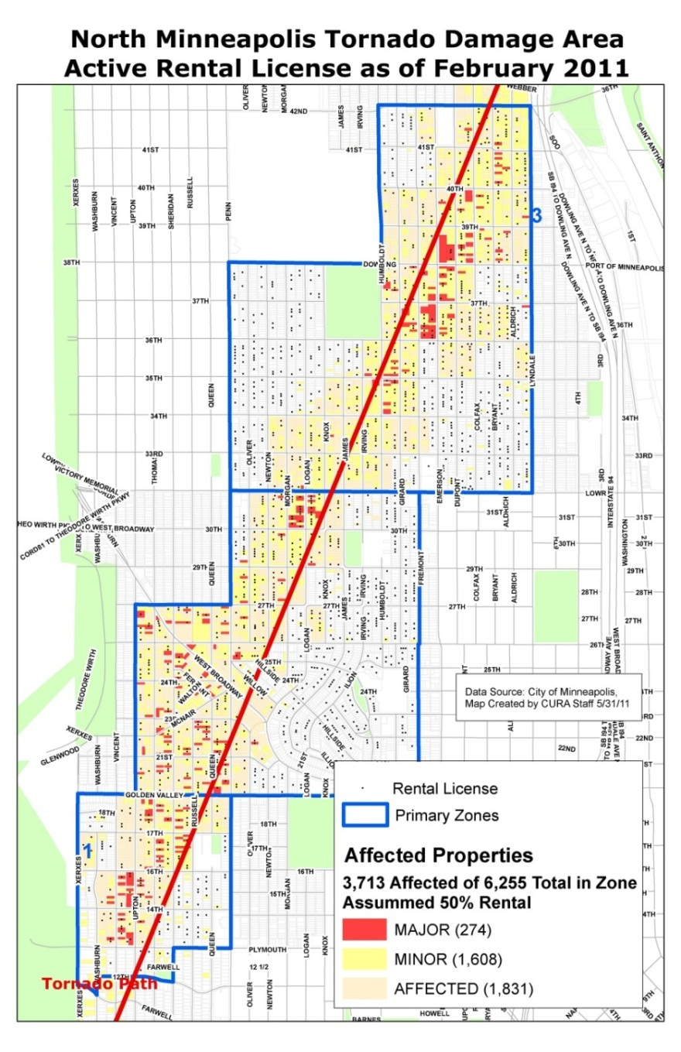
Notes:
On going concerns: Renters (Housing, Insurance, Neglectful Owners)
Owners (Insurance, Rebuilding, Lenders)
City Response, Northside Community Response Team (NCRT)

Slide 29
Current Projects
HMI 2.0
  Updated Data
  Citywide
  Rental Property(?)
Neighborhood Well-being Index
  Variables include (Education, Jobs, Transit, Housing, Amenities)
Regional Opportunity Index
  Related to HUD Fair Housing Equity Assessment

Slide 30
South Minneapolis Index Project Update
Renan Snowden

Slide 31
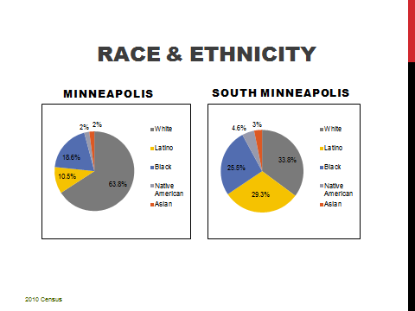
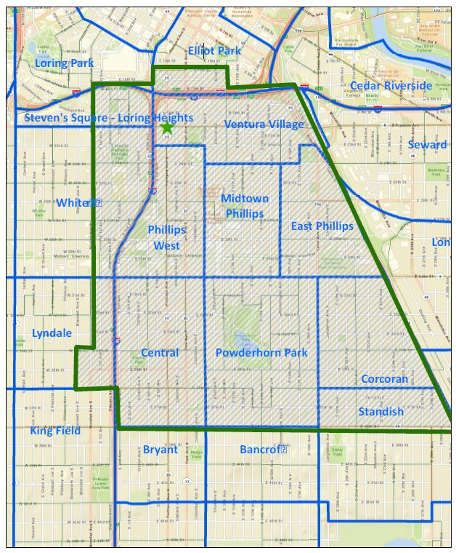
South Minneapolis
14% of Minneapolis’ Pop
Ten neighborhoods
Notes:
Minneapolis minority population: Total Pop – Minneapolis Not Latino White alone population
Study Area minority population: total Pop – Minneapolis
(53,880/382,578*) - *CPED

Slide 32
SOUTH MINNEAPOLIS VALUES
DIVERSITY
OPPORTUNITY
INVESTMENT
ACCESS
CONNECTION
Notes:
Not just pull the data, but put it in a context. What are South Minneapolis’ assets, deficits? How is the area unique in Minneapolis? How has the neighborhood changed since 2000?
Retail, gentrification, heathy, community safety, community building

