Slide 1
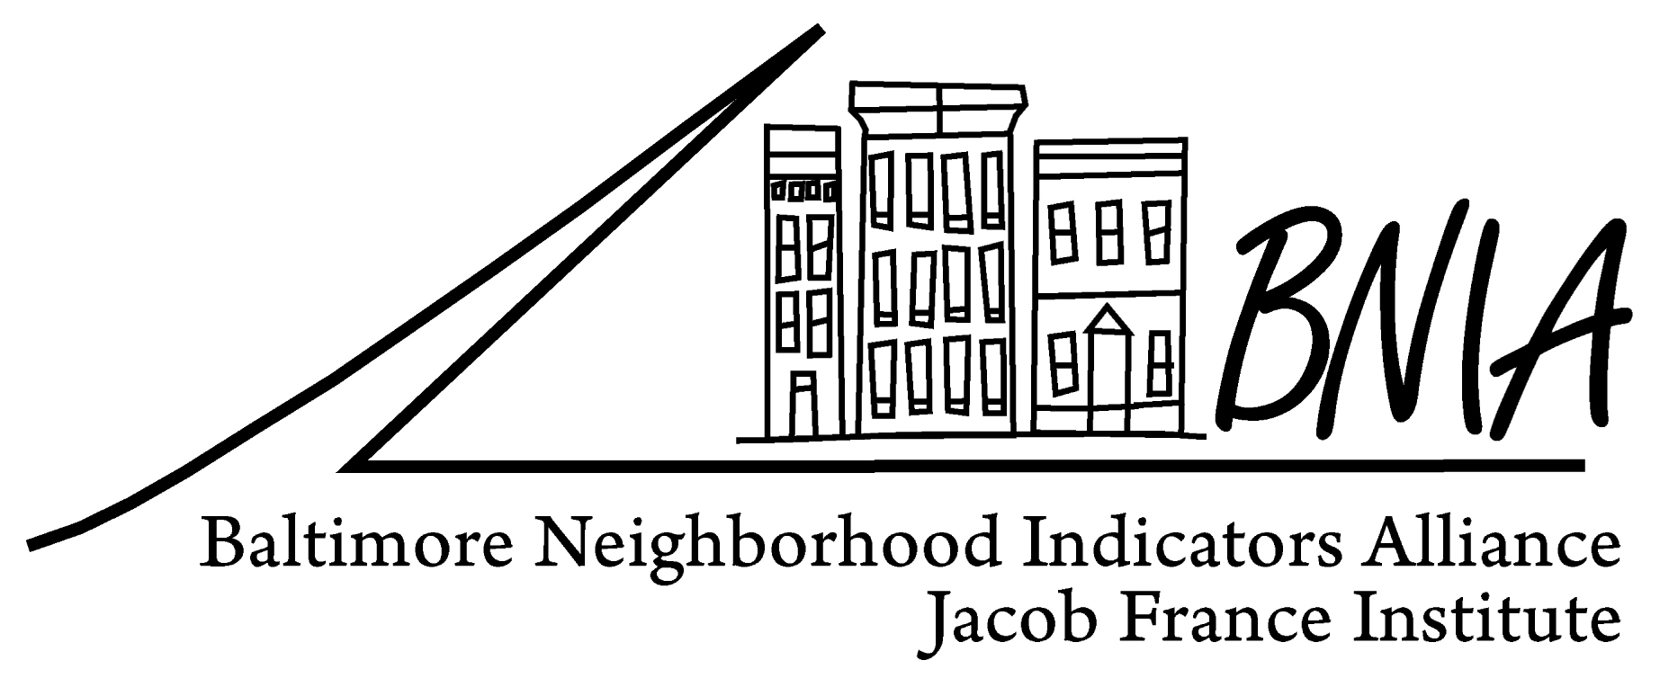
Developing Lead Abatement andWeatherization Indicators to Track Neighborhood Sustainability
Seema D. Iyer, PhD.
Associate Director
Research Assistant Professor
Jacob France Institute
University of Baltimore
siyer@ubalt.edu

Slide 2
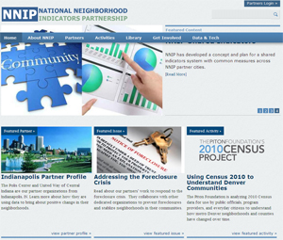
National Neighborhood Indicators Partnership-Urban Institute
Began 20 years ago
Advanced information systems with integrated and recurrently updated information on neighborhood conditions in their cities
Overcome the resistance of local public agencies to sharing data
Indicators of quality of life
Ex: births, deaths, crime
“Democratization of Data”

Slide 3
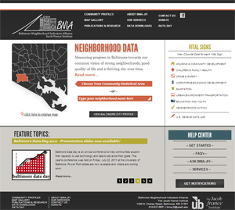
Baltimore Neighborhood Indicators Alliance
SQL Server
GIS Geodatabase
CitiStat
Claritas
InfoUSA
Police
Schools
Vital Statistics

Slide 4
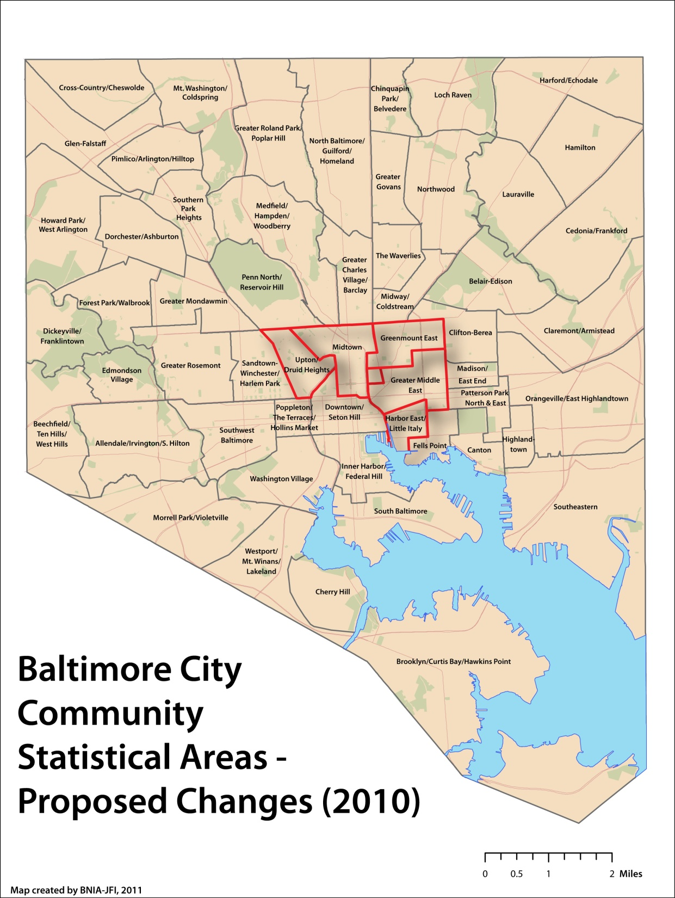
2010 Baltimore City CSAs 2010 - - - Number - 55 Based on 2010 Census boundaries Aggregations of Census tracts (respectful of neighborhoods)
Notes:
Here are the boundaries of the CSAs moving from 2010 forward. While the number remains the same, 5 CSAs have changed due to Census changes – all around the central part of the City. The map you might have seen this morning describes these changes in greater detail. The new map will soon be placed on our website and Facebook page for people to view and we hope to get your comments and feedback.

Slide 5
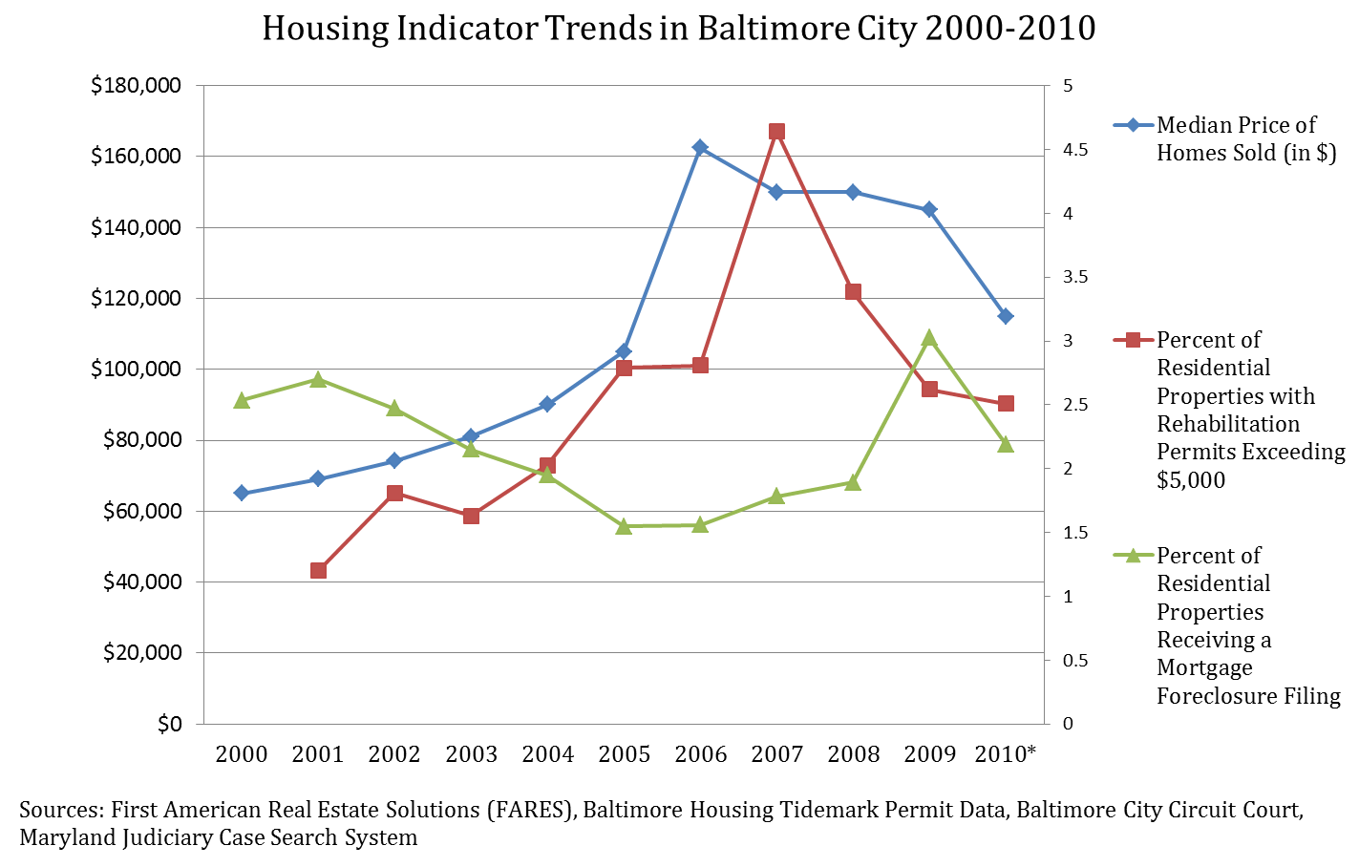
What did We Learn From Vital Signs 10: Ups and Downs
Notes:
Housing Market
City hit highs in median sales price in 2006, rehab permits in 2007 and foreclosure fillings in 2009
Overall for the decade, median sales price is up from $65,000 in 2000 to $115,000 in 2010
Residential rehab permits are up 1.3% over decade
Dramatic swings in Canton, South Baltimore

Slide 6
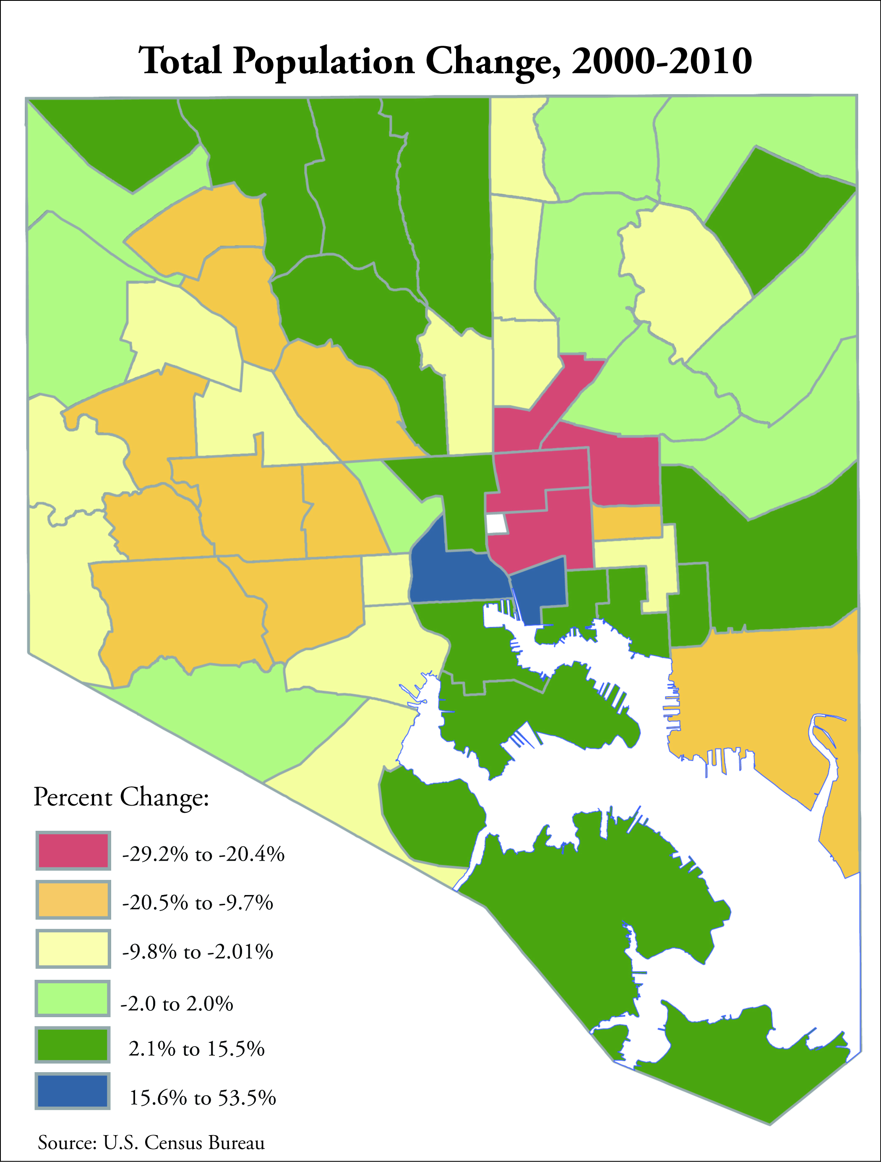
Looking Ahead
Population
Loss of 30,000 people (4.6%)
Occupancy
Owner-occupancy down from 64.9% in 2000 to 60.2% in 2010

Slide 7
Looking Ahead
Housing Affordability
% of population spending more than 30% of income on housing costs
Renters: Up from 40% in 2000 to 52.7% from 2006-2010
Mortgage: Up from 31.6% in 2000 to 40.0% from 2006-2010
Vacant and Abandoned Housing
Vacancy rates increased from 5.3% in 2000 to 7.9% in 2010
All but one neighborhood with a vacancy rate >4% lost population between 2000-2010

Slide 8
Housing Indicators
Rehabilitation Investment above $5,000
Vacant and Abandoned Housing
Housing Violations
Median Sales Price
Total Housing Units Sold
Median Days on the Market
Owner-Occupancy rate
Mortgage Foreclosure Filings
Affordability Index

Slide 9
Neighborhood Housing Sustainability
Neighborhood Stabilization
Investment measured by permit data
Blight elimination measured by code violations including vacant house notices
Place Based
Funded by Capital Budgets
Housing Markets
Stable markets measured by home sales
Rate of foreclosure filing
Affordability Index
Real estate transactions and income levels
Healthy Homes
Reducing health hazards in homes measured by lead
Increasing energy efficiency measured by weatherization
People Based
Funded by Operating Budgets

Slide 10
Healthy Homes Initiative
Healthy Homes Initiative was launched in 1995 to eliminate lead-based paint hazards in privately-owned and low-income housing
U.S. DHHS establishes a goal of eliminating elevated blood lead levels (EBLL) in children by 2010. CDC cited the main source of exposure was in the homes that children were living.
Office of Healthy Homes and Lead Hazard Control was then established in the Department of Housing and Urban Development to develop effective ways to reduce lead-based hazards.
Coordination between public health and housing departments to prevent housing-related health and safety hazards
Notes:
If we can do this for lead, what else could we use this coordinated approach for…

Slide 11
Partnership for Sustainable Communities
Launched in 2009 calls for even greater coordination with environmental programs
Integrating weatherization and other energy-savings programs with health and safety interventions
Green and Healthy Homes in Baltimore (homes visited for either EBLL or energy assistance)
Goals of the project are:
Test the added value of 2 new indicators for communities
% homes abated for lead violations (City Health Department)
% homes weatherized (State Housing Department)

Slide 12
Integrated Administrative Systems
Administrative Data
Secondary source of data, cost of public agency, regularly updated
Legacy systems generally for billing/taxation/administration, not research/analysis
Highly biased
More complete than self-reported data
Methodologies using relative changes
(time series, event history, spatial analysis)
Technical Issues
Data acquisition
Data cleaning, auditing
Record Linkages
Georeferencing, Personal Identification

Slide 13
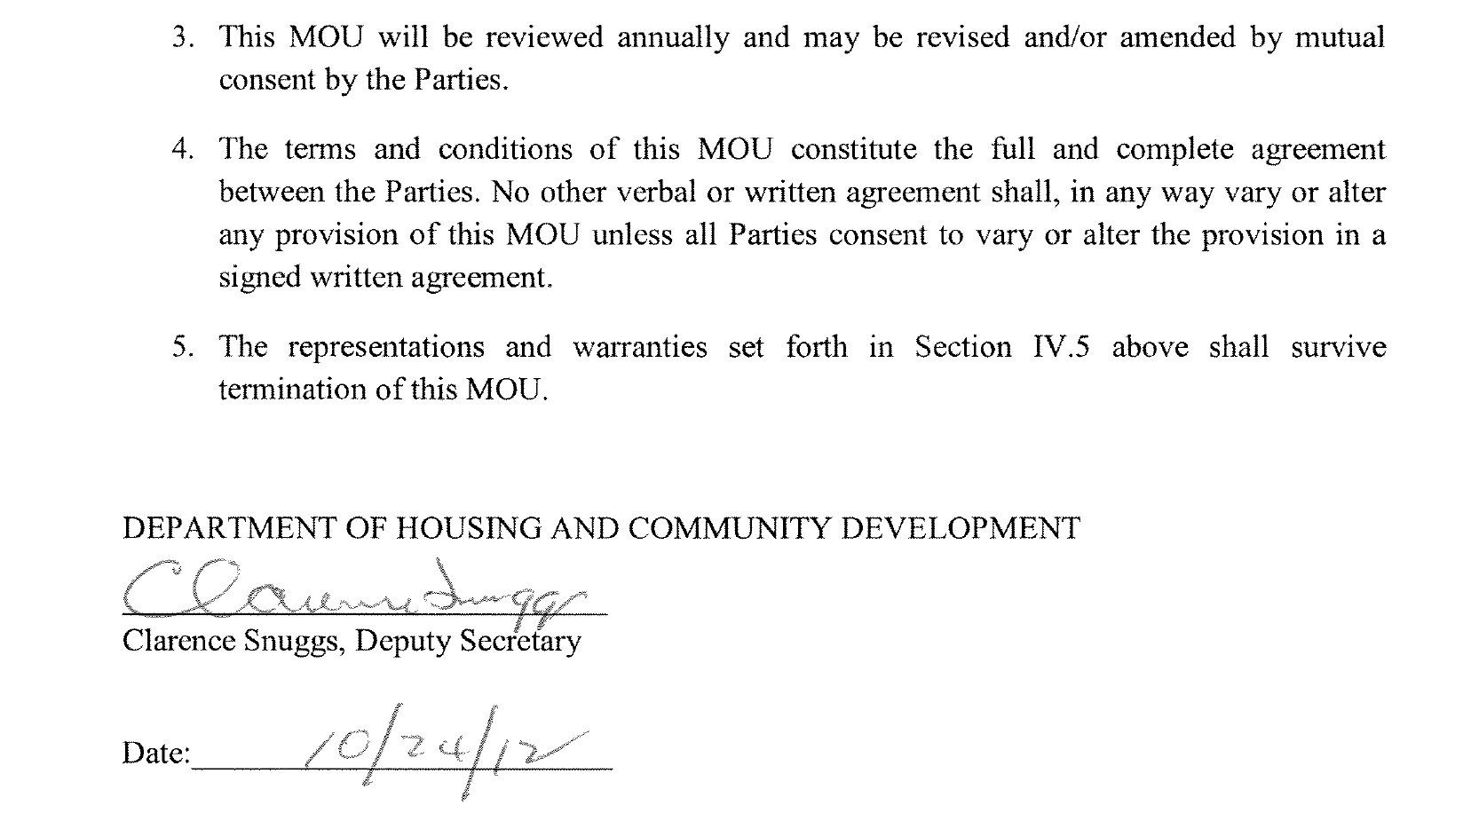
Data Acquisition

Slide 14
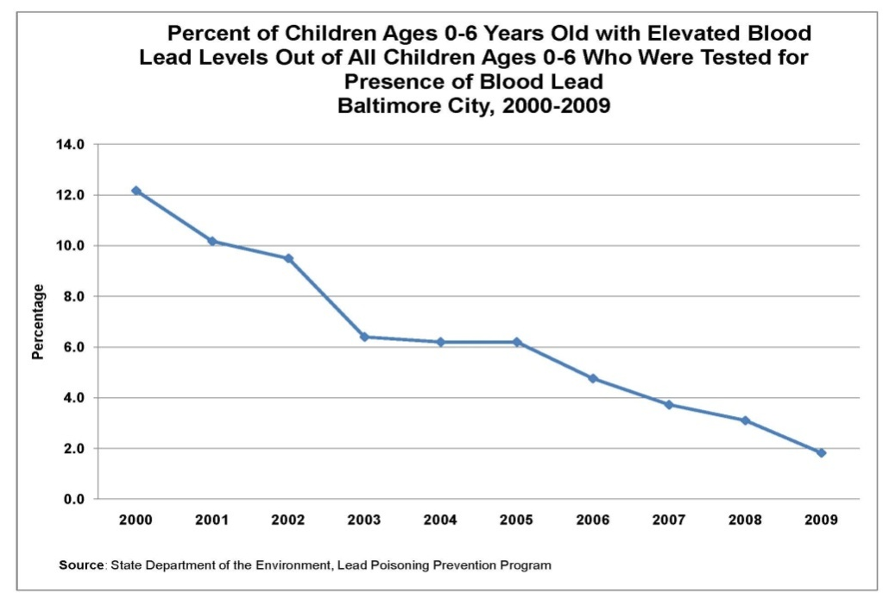
Lead Violations
EBLL down from 12.1% in 2000 to 1.6% in 2010
Abatements include lead paint removal
Percentage of Baltimore City Lead Inspections | 2007 | 2008 | 2009 | 2010
Total Inspected | 243 | 214 | 166 | 185
Violation Notice Issued | 195 | 155 | 95 | 115
Abated by March 2012 | 79.6% | 68.4% | 58.1% | 43.5%
Not Abated by March 2012 | 20.4% | 31.6% | 41.9% | 56.5%

Slide 15
Methodology and Findings
Using bivariate correlations to explain the added value of an indicator
% Owner Occupancy
% Abated Lead
% Vacant Housing
Rent Unaffordability
% Rehab Permits
Total Homes Sold
% Open Violations
% Foreclosure Filing
Mortgage Unaffordability

Slide 16
Lead Violation Indictors
Abated lead violations were not correlated with other measure of housing markets (sales, affordability) or permits
Operational dollars that are impacting “transitional” neighborhoods (vacancy rates)
Open lead violations are correlated with other indicators of neighborhood distress

Slide 17
Pilot Weatherization Project
Weatherization data (3000 Homes in the state)
Energy Assistance data (32,000 homes in Baltimore City)
Goal is to provide weatherization services in addition to healthy homes services. At minimum, do no harm.
2:1 ratio of landlords of renters in the Housing Choice Voucher Program to agree to and qualify for weatherization improvements
% subsidized housing would be a valuable indicator

Slide 18
Next Steps
Developing Neighborhood Sustainability Indicators for Vital Signs 11
Follow us on Facebook and Twitter (@bniajfi)
Indicators are based on relationships, data security, and data analysis
Project funded by the University of Baltimore Renaissance Seed Funding
Thanks to Baltimore Housing, Baltimore Department of Health, Maryland Department of Housing

Slide 19
Questions?

