Slide 1
www.dcpni.org
@dcpni
Helping Families and Community Residents
Use Data
Isaac D. Castillo
Director of Data and Evaluation
@Isaac_outcomes
Promise Neighborhood National Network Conference
June 24, 2014

Slide 2
Community Skepticism of Data
Residents and families (and most people) are initially skeptical of data.
Residents felt DCPNI had focused only on the negative data points.
History of skepticism of government-like entities.
DCPNI was (and still is) new.

Slide 3
Sharing Data with Families and Residents
Data for normal people.
Notes:
Differences:
Respondents—family types are different, some are more/less literate, some have kids and others are singletons
Interviewers—Although everyone undergoes training,…

Slide 4
Sharing Data Involves Multiple Approaches
Publications / printed materials.
Presentations during existing community meetings.
DCPNI hosted meetings and ‘data-walks’

Slide 5
Use Publications / Printed Materials
Variety of easy to understand materials.
I Heart Data booklet
Use of data visualization techniques.
Focus on sharing a few data points (prioritize) that are easy to understand.

Slide 6
Example: Educational Attainment
70% of K-P residents have a high school education or higher
88% in DC

Slide 7
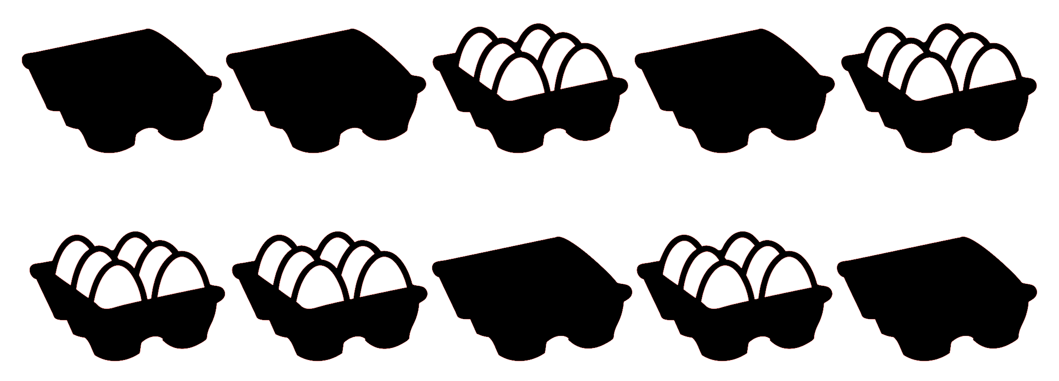
Example: Food Insecurity in Kenilworth-Parkside
49% of Kenilworth-Parkside households have run out of food or money to buy food in the past 12 months.

Slide 8
Example: Grocery Shopping Habits
One Way Travel Time to Get Groceries
5.7% of K-P residents
travel 45+ minutes ONE WAY for groceries

Slide 9
Example using Residents
Can also use residents themselves in community meetings.
Let’s use chronic absenteeism as an example – I need ten volunteers……
Have the volunteers stand up and come to front of room.

Slide 10
Chronic Absenteeism in Kenilworth-Parkside Schools
Average school in the United States:
10% of students are chronically absent
In Kenilworth-Parkside schools:
31% of students are chronically absent

Slide 11
Example Questioning Assumptions
How many people know the Dupont Circle area of DC?
Let’s use some words to describe Dupont Circle and Kenilworth-Parkside – want words to focus on safety and crime.
Dupont Circle (high income) | Kenilworth-Parkside (low-income)

Slide 12
Real Data to Question Assumptions 2013 Crime Data by PSA
Indicator | Dupont Circle (high income) | Kenilworth-Parkside (low income)
Total Crimes | 1,120 | 358
1 Crime (any type) per X # of persons [chance a person experiences any crime] | 15.84 [6.31% chance] | 21.05 [4.75% chance]
1 PROPERTY Crime per X # of persons | 17.12 [5.84% chance] | 32.34 [3.09% chance]
1 VIOLENT Crime per X # of persons | 211.17 [0.47% chance] | 60.29 [1.66% chance]

