Slide 1
A Picture of Local NNIP Finances (Preliminary Results)
SHARON KANDRIS AND MAIA WOLUCHEM
NOVEMBER 20, 2014

Slide 2
NNIP BUSINESS SURVEY
Update of survey conducted in 2009
Today – 2nd round of analysis
Ask about staffing levels and revenues:
General support
Specific projects done for a fee (e.g., studies)
In-kind support
Most partners do other work in addition to NNIP functions
Need to estimate share for NNIP functions only

Slide 3
NNIP FUNCTIONS
All Partners
Assemble, clean, process data
Prepare data products for local clients
Conduct analysis of local conditions, programs, policies
Present results of work at public forums
Provide TA and ad hoc help on how to access/use data
Most Partners
Collaborate with others, strengthen local data capacity (93%)
Maintain a web-site – disseminate data (86%)
Provide training on how to access/use data (86%)
Public education on issues related to this work (62%)
Notes:
In total, 32 organizations responded, with representation of 29 partner cities.

Slide 4
STAFF SIZE – Median 3.5 FTEs But much variation: half 2-9 FTEs
Notes:
Outliers include our multi-partner sites and some of our bigger organizations.

Slide 5
ANNUAL BUDGET: Median $365K Again variation: half $200K-$604K
Notes:
Larger organizations were way above that, five organizations over 1 million.

Slide 6
MOST RECEIVE GENERAL SUPPORT $ Median 32% of revenues
Notes:
Some public organizations (government agency, public university) did not receive general support funding, however an overwhelming majority (93%) did, and the median is about 30 percent.

Slide 7
GENERAL SUPPORT: Local foundations most frequent source

Slide 8
DIVERSITY - GENERAL SUPPORT $ 51% have 2 or more sources

Slide 9
ALL ALSO RECEIVE SPEC. PROJ. $ Median 68% of revenues

Slide 10
SPECIAL PROJECTS: Local foundations most frequent source
Notes:
Local and State Gov’t again really big, as are other non-profits majority
About a 1/3, Nat’l foundations and federal governments, with universities at ¼
Commercials, banks, local foundations and united ways are actually in this space
Amounts
-Local and state government again, giving quite a bit
Local foundations – not super present but when they are, they are big donors
Other non-profits at about 20 percent,
Universities don’t give that much
Other on the shorter end – national foundation, fed gov’t, commercial, united way

Slide 11
DIVERSITY – SPECIAL PROJECT $ 42% have 4 or more sources
Notes:
See a high diversity again – 42 have for or more and 87% at 2 or more
Clustering around this middle range – 73% are between 2 and 5 project-based sources

Slide 12
IN-KIND– 59% of partners have parent organization that provides it
Notes:
Parent orgs play a big role – 59% have a parent organization that provides in-kind support.
Most likely, in terms of IT support and space
About 20% share staff
11% are “other”
Other sources - Commercial interests (13%), local foundations (3%), state government (3%), universities (10%)

Slide 13
CHANGES FROM 2009 to 2014
Comparison of how individual models have changed, not how the face of NNIP has changed.
Notes:
Comparing organizations to themselves, not comparing composite of NNIP at the time.

Slide 14
COMPARISON GROUP: 18 CITIES
18 cities responded in both 2009 and 2014
Atlanta
Baltimore
Camden
Cleveland
Columbus
Dallas
Denver
Grand Rapids
Indianapolis
Miami
Minneapolis-St. Paul
New York City
Oakland
Pittsburgh
Providence
Seattle
St. Louis
Washington, DC
Notes:
One partner is excluded from the budget analysis until we work out a data quality issue.

Slide 15
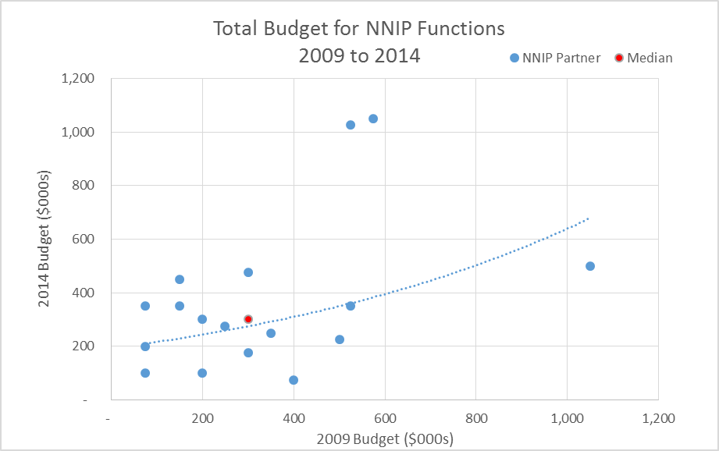
TOTAL BUDGET: NNIP FUNCTIONS Median: 2009 = $300,000; 2014 = $300,000 Median Increase of 33%
Inflation Calculation: $300,000 in 2009 is worth $332,000 in 2014.
Notes:
Those below the line decrease from 2009 to 2014, those above increased
Dig deeper – are we providing more or fewer functions than 5 years ago?

Slide 16
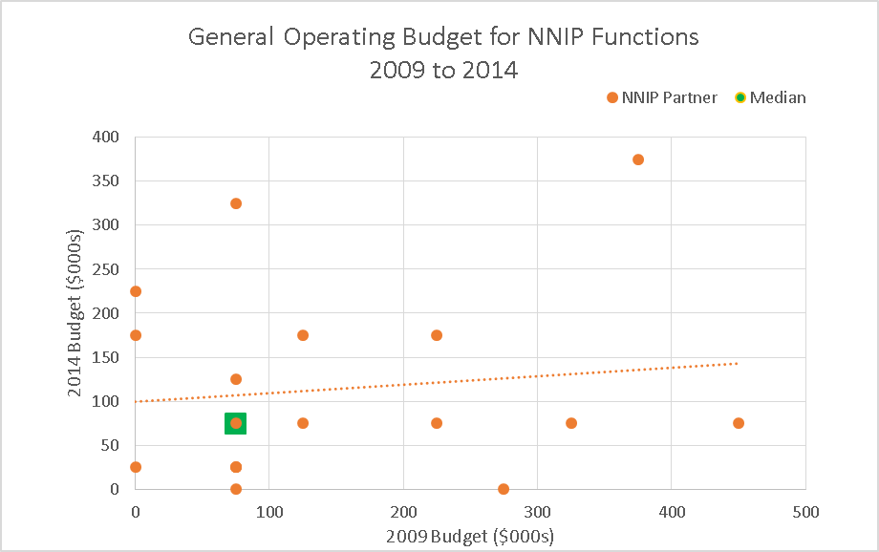
GENERAL SUPPORT Median: 2009 = $75k; 2014 = $75k Median Decrease of 67%

Slide 17
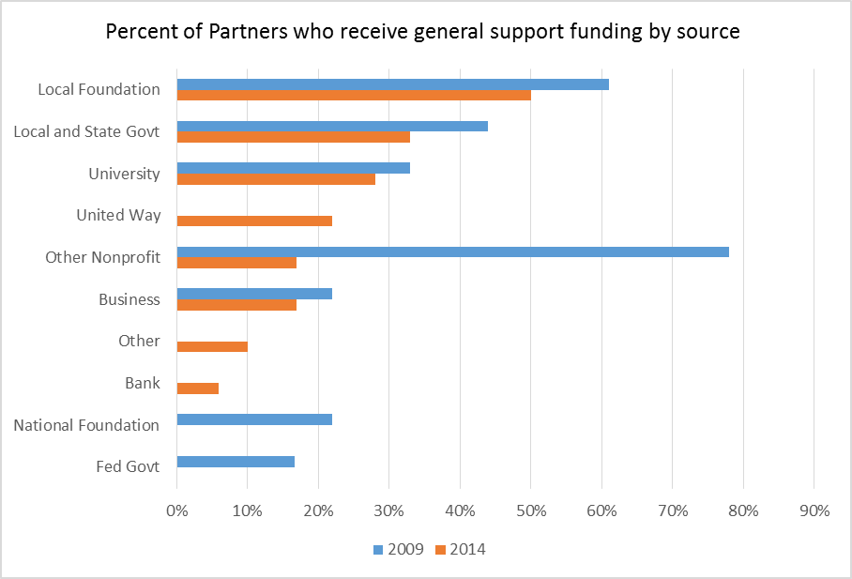
SUSTAINABILITY/FUNDING DIVERSITY: GENERAL SUPPORT

Slide 18
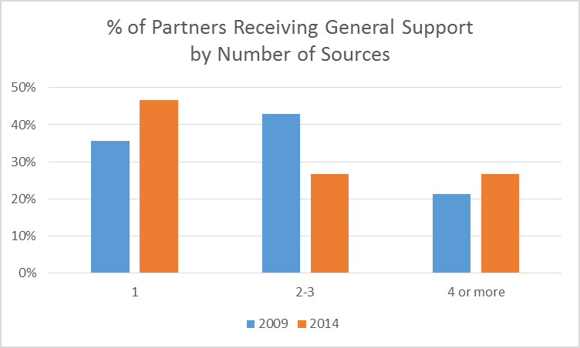
SUSTAINABILITY/FUNDING DIVERSITY: GENERAL SUPPORT
No change in median # of general support funders (2): aside from one partner adding 40 funders in the form of membership dues, the range continues to be 1 to 7 sources
Notes:
Eliminating the outlier drops the median in 2014 to 1.5

Slide 19
LESS DIVERSE IN GENERAL SUPPORT
Percent of Partners
 | 2014 | 2009
100% of general funds from one source | 44% | 33%
# >75% of general funds from 1 source | 61% | 61%
# with 100% from one source - project funds | 6% | 28%

Slide 20
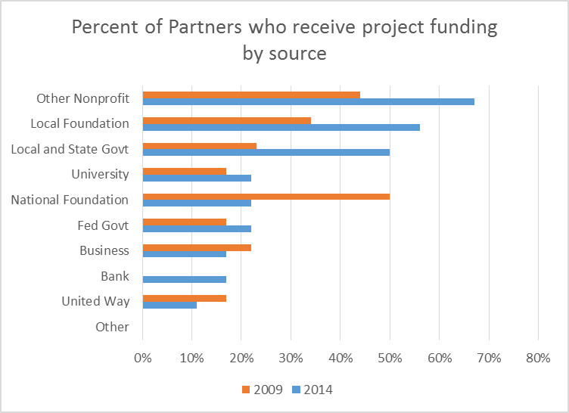
FUNDING DIVERSITY: PROJECT FUNDING

Slide 21
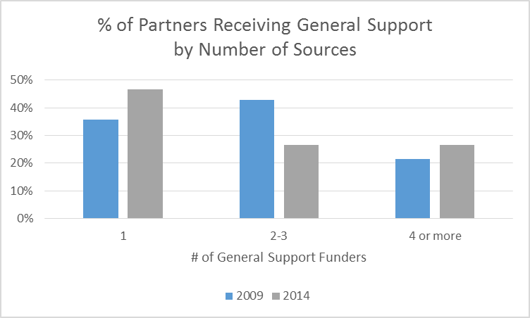
IN-KIND SUPPORT
Not much change in the # of partners receiving in-kind support.
2009: 9 received in-kind support
2014: 11 received in-kind support
The median value of this support in 2014: $34,550*
*N = 6 of the 11 answered that question

Slide 22
STAFFING
More staff are involved in the work:
Increase in median number of full and part-time staff from 5 in 2009 to 6 in 2014)
More man hours:
Increase in median of 2 to 3 FTE
Consistent use of students:
8 partners in 2009 used students, 9 in 2014
Of those that do, the median # of students: 3 in 2009 and 4 in 2014. (FTE was 1.75 for both years)

Slide 23
SUSTAINABILITY: COSTS
Costs have remained the same (except for inflation)
Has the amount of functions we offer increased or decreased?

Slide 24
SUSTAINABILITY: IS FUNDING MORE DIVERSE?
Has the type of funder changed?
Though local foundations are still #1, overall there is less reliance on philanthropic support
What can we learn about funders’ willingness to contribute?
Nonprofits, banks, federal sources more common for project-based work
More to learn here about amount from each source
Is type of support changing?
Increased project-based work as a percent of total budget

Slide 25
SUSTAINABILITY
More partners have developed a business plan since the last survey:
39% in 2014, up from 22% in 2009
Partners are thinking more strategically:
44% have a strategic plan now compared to 33% in 2009
More are relying on project-based work to sustain the NNIP functions
The median project work as a % of the total budget increased from 56% in 2009 to 74% in 2014

Slide 26
NEXT STEPS

Slide 27
Next Steps
More Analysis?
Ideas for analysis of the data we already collected?
Ideas for other data to collect around this issue?
Start-up Guide

Slide 28
Contact
THANK YOU!
www.neighborhoodindicators.org
Contact -
Sharon Kandris : skandris@iupui.edu
Maia Woluchem: mwoluchem@urban.org
Tom Kingsley: tkingsley@urban.org

