Slide 1



The Next 50 Years:
Race, Place, Kids and Poverty
Charles Bruner, Center for Health Equity and Young Children
Partnership of the BUILD Initiative and CFPC
April 2014

Slide 2
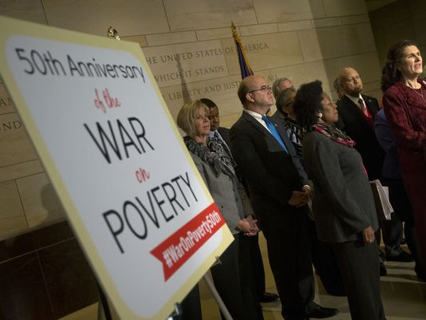
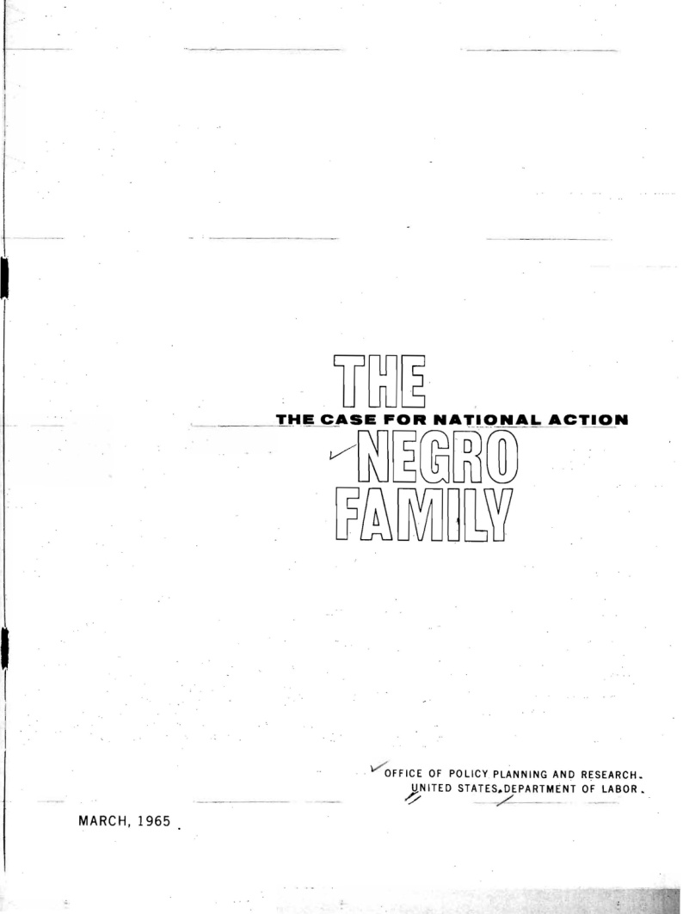
The Last 50 Years
LBJ Announces “War on Poverty” -- 1964
DOL Releases The Negro Family -- 1965

Slide 3
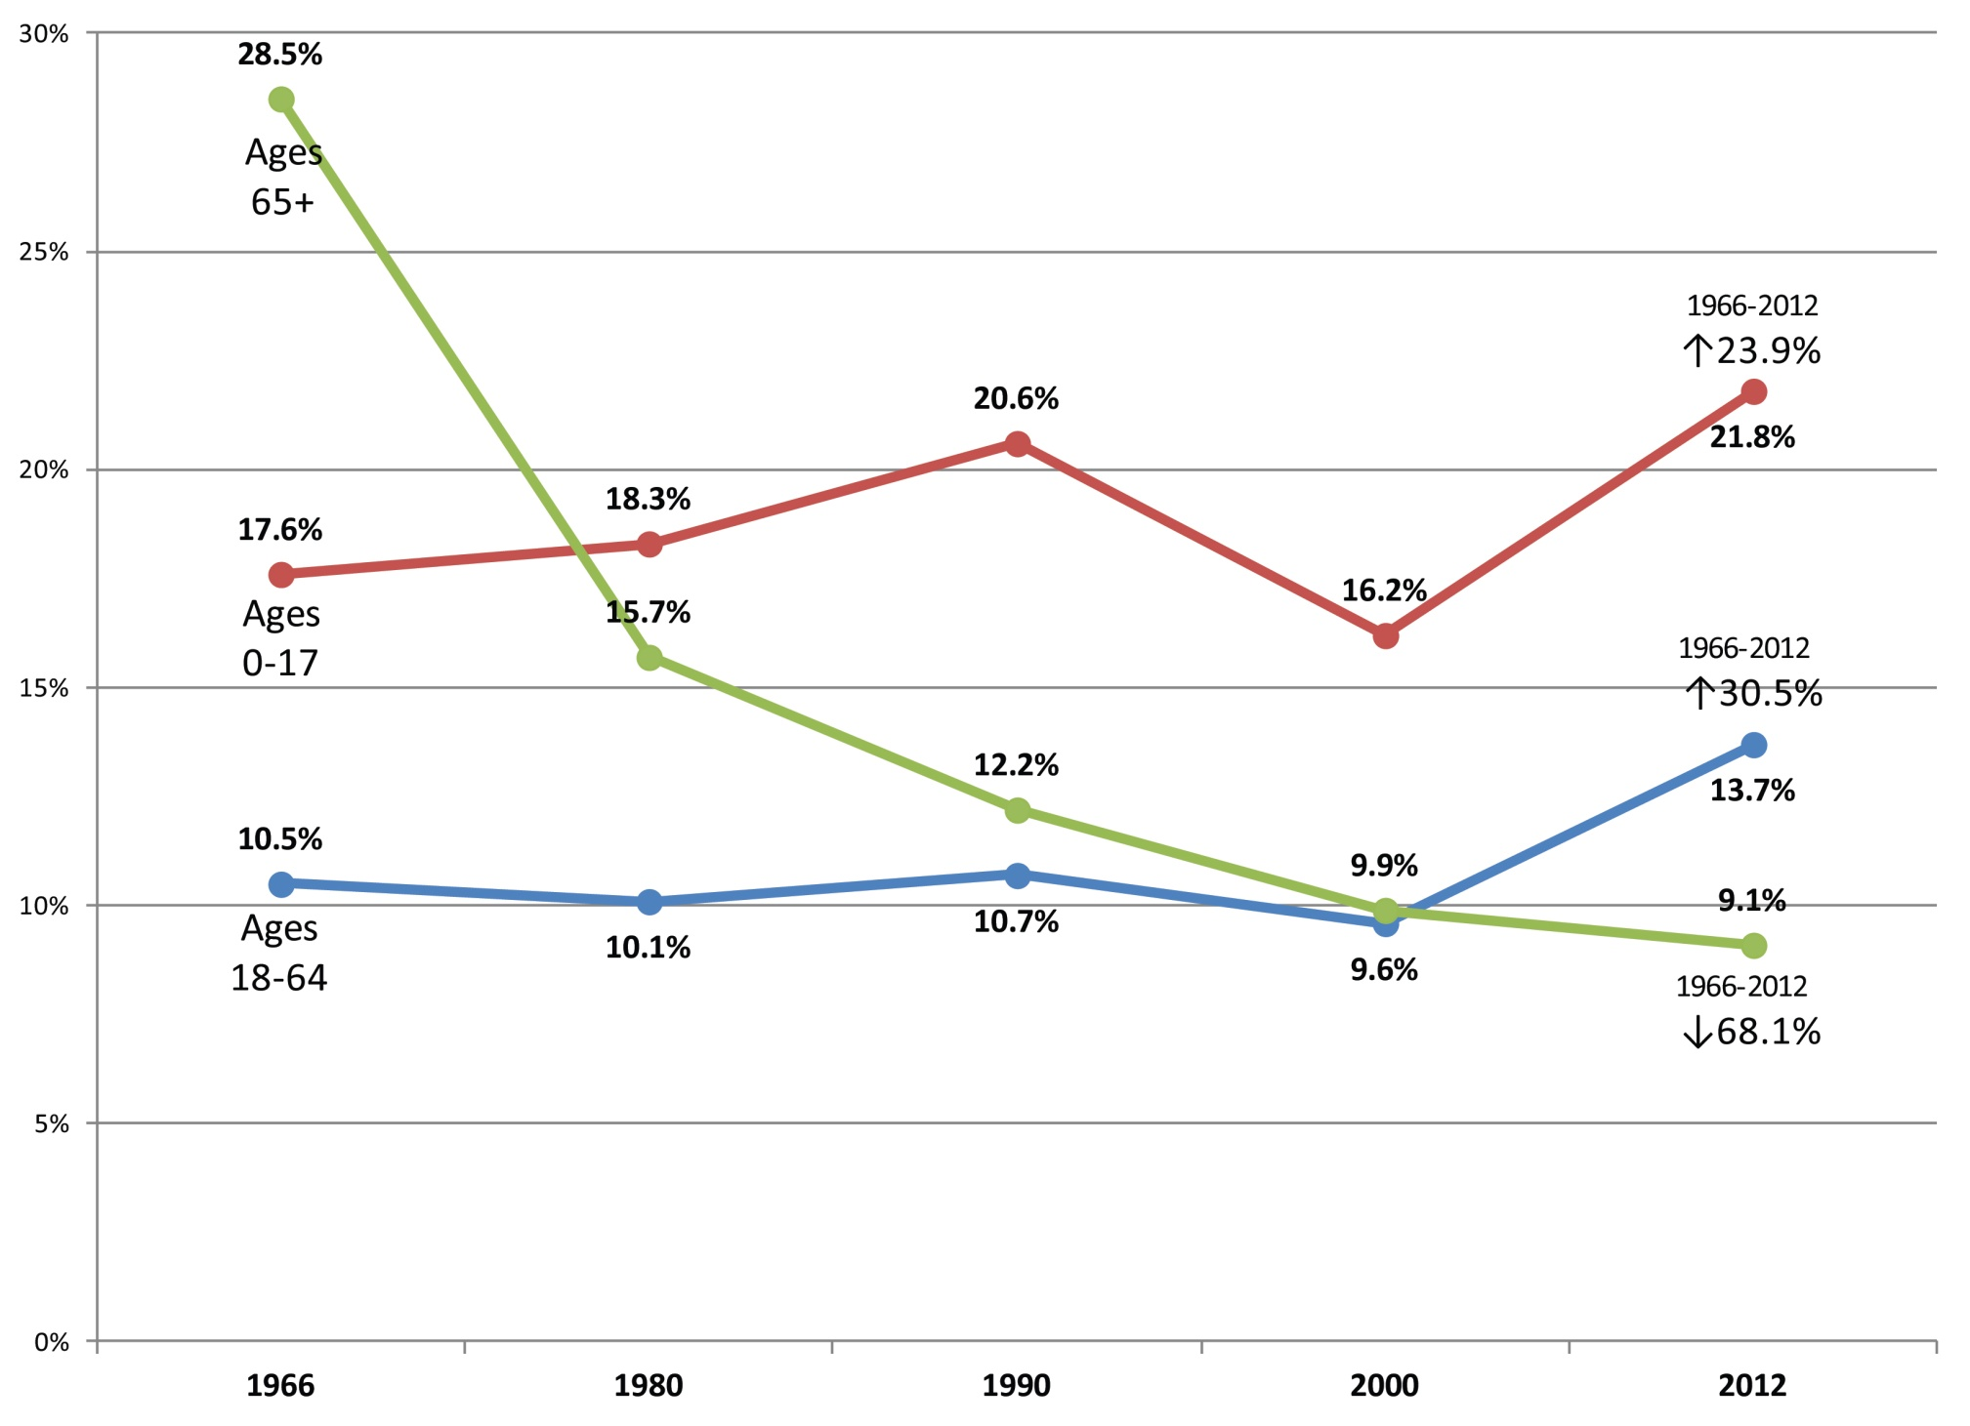
War on Poverty:
“Seniors Win, Kids Lose”
Percentage of people in poverty by age group, 1966-2012
Source: U.S. Census Bureau, Historical Poverty Tables, Table 3. http://www.census.gov/hhes/www/poverty/data/historical/people.html

Slide 4
Family Structure: 2010 White Families are 1960 African American Families
At the heart of the deterioration of the fabric of Negro society is the deterioration of the Negro family. … The object [of national policy] should be to strengthen the Negro family so as to enable it to raise and support its members as do other family. – The Negro Family in America, 1965.

Slide 5
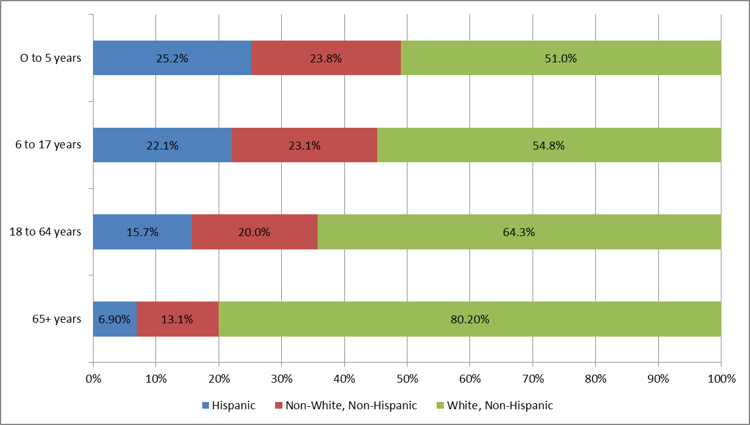
Racial/Ethnic Information By Age
America More Diverse:
Young Kids Lead the Way
Source: United States Census, 2010 American Community Survey

Slide 6
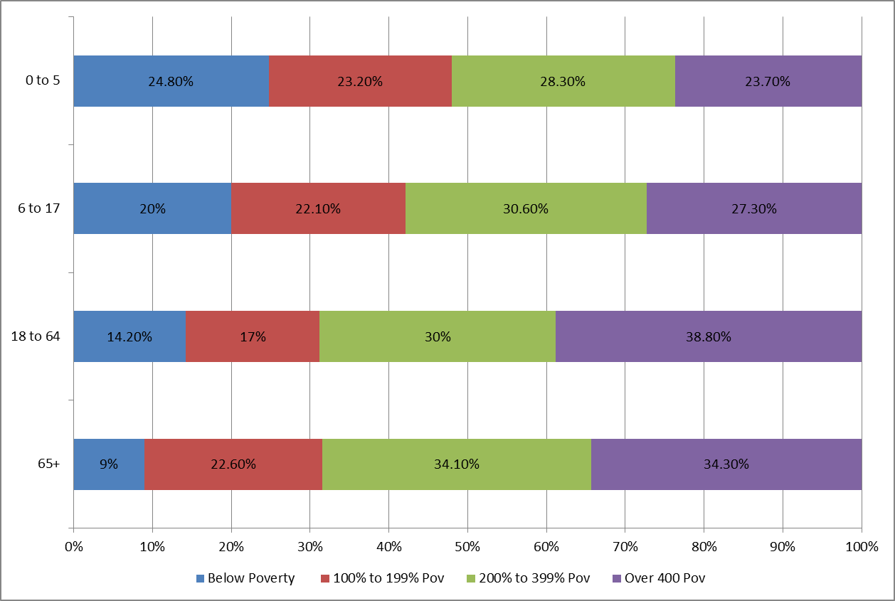
Young Kids Most Likely to Be Poor
Poverty/Income Level by Age Group
Source: United States Census, 2010 American Community Survey

Slide 7
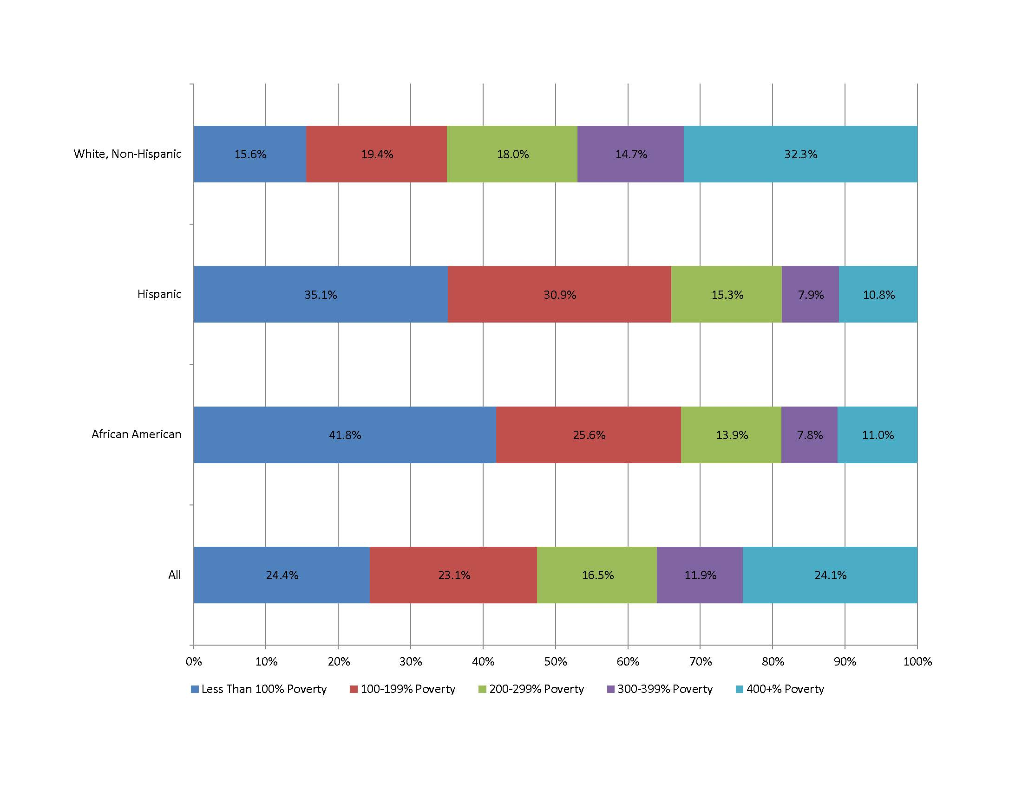
Young Diverse Kids Very Poorest
Poverty/Income Level by Race/Ethnicity: 0-5 Year Olds
Source: United States Census Bureau, 2009-2011 Public Use Microdata Sample

Slide 8
Disparities Start Early …
Child Outcomes
Race/Ethnicity | Concerns About Child’s Development¹ | Low –Birthweight² | Percent Proficient or above on 4th Grade Reading NAEP Assessment³
Hispanic | 47% | 7% | 20%
White, non-Hispanic | 35% | 7% | 46%
Black, non-Hispanic | 45% | 13% | 18%
*= estimates based on sample sizes too small to meet standards for reliability or precision
1 http://www.childhealthdata.org/browse/survey
2 http://www.cdc.gov/nchs/data/nvsr/nvsr61/nvsr61_01.pdf
3 http://nces.ed.gov/nationsreportcard/naepdata/report.aspx

Slide 9
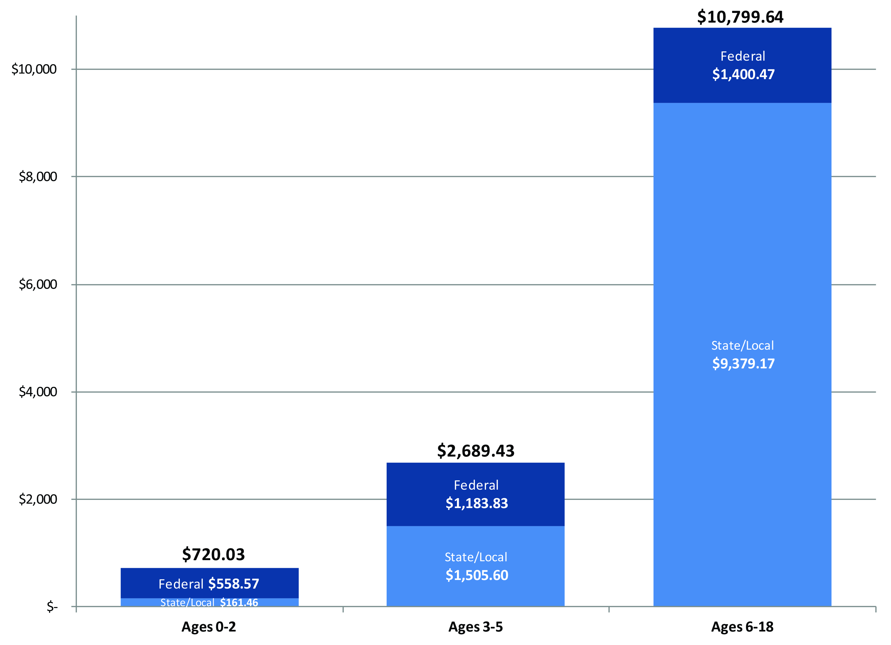
… Investments Don’t
For every dollar invested in the education and development of a school –aged child, only 7 cents is invested in an infant/toddler and 25 cents in a preschooler.
BUILD Initiative. Early Learning Left Out (2013).

Slide 10
Investments Matter,
Particularly in Earliest Years
Brain development and toxic stress
Early childhood adversity/ACEs and future chronic health conditions
Epigenetics
The impact of social determinants
on health– social gradient, early life,
stress, social exclusion and
social support – all related to
health equity
Harry T. Chugani, MD, PET Center Director, Chief of Pediatric Neurology and Developmental Pediatrics, Children’s Hospital of Michigan

Slide 11

Investments Matter:
We Know How to Start Early
Health Leads

Slide 12

If we can’t end child poverty overnight … we can cut the link between poverty and opportunity.
Two Literatures: One Common Message
Social Determinants Protective Factors
Social gradient Concrete services and supports in times of need
Early life Knowledge of healthy early child development
Stress Resiliency
Social exclusion Positive and supportive activities with children
Social support Social ties and connections
Sources: Social Determinants. Social Determinants, the Hard Facts. 2nd Edition, 2003. Protective Factors. Strengthening Families Research Framework. CSSP.

Slide 13
Place Matters: Think and Act Locally
Poor Neighborhoods Rich in Young Children
Highest risk tracts 9.24 % children 0-4
Lowest risk tracts 6.15 % children 0-4
Poor Neighborhoods Home to Most Diverse Children
Highest risk tracts 82.40 % of color
Lowest risk tracts 16.84 % of color

Slide 14
Place Matters: Requires Community-Building as Well as Individual Services
COMPARISON ON TEN INDICATORS OF CENSUS TRACTS WITH NO CHILD VULERNABILITY FACTORS WITH TRACTS WITH 6 OR MORE VULNERABILITY FACTORS
Indicators | No Vulnerability Factors | 6-10 Vulnerability Factors
% Single Parent Families | 20.5 | 53.1
% Poor Families with Children | 7.2 | 41.4
% 25+ no High School | 13.5 | 48.0
% 25+ BA or Higher | 28.7 | 7.1
% 16-19 not working/in school | 3.0 | 15.0
% HoH on Public Assistance | 4.9 | 25.5
% HoH with Wage Income | 80.6 | 69.1
% HoH – Int/Div/Rent/Income | 42.3 | 11.0
% 18+ Limited English | 1.9 | 17.5
% Owner-Occupied Housing | 71.0 | 29.6
Source: Village Building and School Readiness (2007).
Implication: Improving child health in these neighborhoods requires community-building as well as individual child service strategies.

Slide 15
Place Matters – Upper Midwest Has Particular Work To Do
State Kids Count Rankings Overall and by Selected Races (RACE FOR RESULTS) Upper Midwest States
 | Overall Kids Count | White Children | Hispanic Children | African American Children
Iowa | 7 | 17 | 18 | 30
Illinois | 23 | 7 | 13 | 37
Kansas | 16 | 21 | 20 | 26
Minnesota | 4 | 5 | 14 | 24
Nebraska | 8 | 12 | 37 | 29
South Dakota | 18 | 19 | 19 | 8
Wisconsin | 12 | 10 | 17 | 46

Slide 16




We CAN end poverty and disadvantage over the next 25 years IF we focus upon kids today.

Slide 17


Additional Resources: Center on Health Equity and Young Children
Policy Brief: Top 10 Things We Know about Young Children and Health Equity… and Three Things We Need to Do with What We Know
Fifty State Chart Book: Dimensions of Diversity and the Young Child Population
PowerPoint: Health Equity and Young Children: Improving Healthy Development, Closing Health Disparities, and Ensuring School Readiness (customizable with state-specific data)
The Healthy Child Storybook
Notes:
Then use one slide for each of the three roles. Stop on each slide to spend time on each slide talking about it in the context of
current strengths and outputs/ and track record
why/how this will have positive impact going forward, using Susan’s chart as a framework for examples of outputs, outcomes, measures of progress.
The goal here is not to provide so much detail that people get lost in it, but a handful of concrete examples that inspire the funders about the possibilities (in spirit of Zander “Art of Possibilities” from your national meeting a couple of years ago)

Slide 18
About the BUILD Initiative and
Child and Family Policy Center
The BUILD Initiative and the Child and Family Policy Center are collaborating to create a Health Equity and Young Children Center and Learning Community.
The BUILD Initiative is a national initiative which supports state early childhood systems building through a comprehensive approach that integrates health, family support, and early childhood education, with a special focus upon developing inclusive and culturally responsive systems.
The Child and Family Policy Center is the research partner with BUILD and works nationally and in Iowa on developing more comprehensive, community-based systems of services and supports to improve child well-being.
Notes:
Then use one slide for each of the three roles. Stop on each slide to spend time on each slide talking about it in the context of
current strengths and outputs/ and track record
why/how this will have positive impact going forward, using Susan’s chart as a framework for examples of outputs, outcomes, measures of progress.
The goal here is not to provide so much detail that people get lost in it, but a handful of concrete examples that inspire the funders about the possibilities (in spirit of Zander “Art of Possibilities” from your national meeting a couple of years ago)

Slide 19
Contact Information
Child and Family Policy Center:
Charles Bruner, Director
www.cfpciowa.org
BUILD Initiative:
Gerrit Westervelt, Director
www.buildinitiative.org
Center for Health Equity and Young Children:
Mary Nelle Trefz and Angelica Cardenas-Chaisson
mnt@cfpciowa.org; acardenas@cfpciowa.org
Notes:
Then use one slide for each of the three roles. Stop on each slide to spend time on each slide talking about it in the context of
current strengths and outputs/ and track record
why/how this will have positive impact going forward, using Susan’s chart as a framework for examples of outputs, outcomes, measures of progress.
The goal here is not to provide so much detail that people get lost in it, but a handful of concrete examples that inspire the funders about the possibilities (in spirit of Zander “Art of Possibilities” from your national meeting a couple of years ago)

