Slide 1
Boston Youth Jobs App

Slide 3
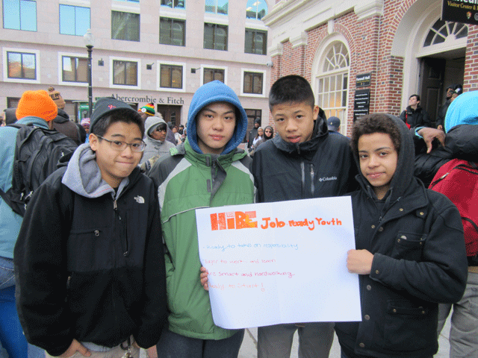
The current program and process
Notes:
A new study shows that low-income teenagers in Boston who have summer jobs are less likely to get caught up in violence.

Slide 4
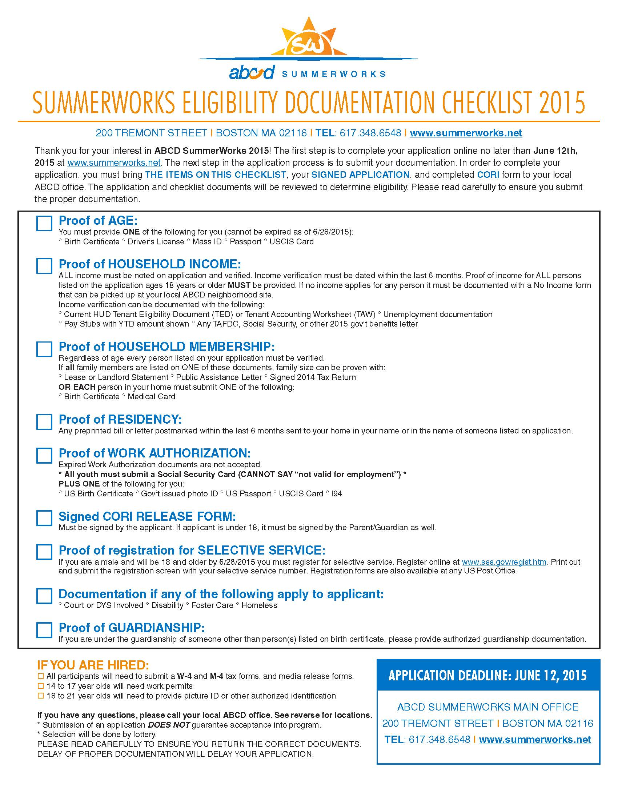
Notes:
Youth Applications to three sites

Slide 5
Notes:
Working with code for Boston fellows and youth we will redesign

Slide 6
Notes:
Look at data to check how representative the participants are of the city and the populations the program seeks to target. Also looking at over time if we can see summer jobs participants have improved student performance.

Slide 7
Boston Youth Jobs App

