Slide 1
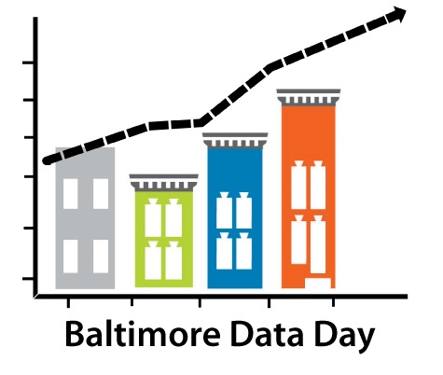
Baltimore Data Day 2015
The Baltimore Neighborhood Indicators Alliance – Jacob France Institute
Cheryl Knott Johanna Busch

Slide 2
Baltimore Data Day 2015
Friday, July 10th at University of Baltimore
Free, open to the public
Non-profits, foundations, community organizations, residents, students, researchers
Thursday pre-session and keynote at Federal Reserve Bank of Richmond

Slide 3
Pre-Session on Creative Placemaking
Jason Schupbach, National Endowment for the Arts
Mark Stern, Social Impact of the Arts Project, School of Social Policy & Practice, University of Pennsylvania
Lindsay Tucker So, Philadelphia Office of Arts, Culture, and the Creative Economy
Ira Goldstein, The Reinvestment Fund
Panel discussion

Slide 4
Strengthening Communities Through Neighborhood Data
Housing: Finding Information about Tax Sale Foreclosures in Your Neighborhood
Arts: The Value of Arts and Culture Data in the Community Development Mix
Public Health: From Awareness to Action
Media: Reporting on Neighborhoods- Using Data to Find the Story Behind the Story
Workforce and Economic Development: Occupational Data for Workforce Programs
Civic Technology: From Tech to Transformation
Arts and Culture: Identifying Opportunities for Creative Placemaking
Public Safety: Using Data to Keep Baltimore Safe

Slide 5
Strengthening Communities Through Neighborhood Data
Data provider
Non-Profit organization or researcher
Data user

Slide 6
Hands-On Workshops
Open Baltimore Data Portal
Open data from city agencies
BNIA-JFI Website and Data Resources
Using our website
Mapping Your Neighborhood
Primary data collection and online mapping
Introduction to R
Statistical data analysis

Slide 7
Data Day 2015 Outreach
Focus on community members
Limited social media presence
Made calls to over 300 community based organizations
Citizen’s Planning and Housing Association
About 310 registrations within two weeks

Slide 8
Data User Census
Goals:
Examine current successes in data usage
Gain a better understanding of gaps
Interactive, live online polling
See results here

