Slide 1
Sustaining Communities of Opportunity: the HUD Community Challenge Grant Airport City in Memphis
Phyllis G. Betts, Director
Center for Community Building and Neighborhood Action
University of Memphis
NNIP Columbus OH
June 2013

Slide 2
CBANA Role
Comprehensive analysis of federal demographic data along with
Local public records and agency databases
Real estate ownership and transactions
Eviction and bankruptcy
Education and health
Memphis Police Department Data Analysis
Physical survey of property vacancy, condition and social indicators for residential, retail, and commercial property
CBANA data and analysis prepared for consultant team

Slide 3
Project Consultants
MASTER PLAN
RTKL Associates, Inc.
Los Angeles - Planning and Urban Design Studio
In collaboration with:
The Carter Malone Group
Gibson Transportation Consulting, Inc.
Community Capital, LLC
SR Consulting, LLC
Dr. Jack Kasarda, PhD
MXD Development Strategists, Ltd.
REAL ESTATE ANALYSIS
MXD Development Strategists, Ltd.
Vancouver - Commercial Development Consulting Firm
In collaboration with:
TRUST Marketing, Inc.
Community Capital, LLC
Dr. John Kasarda, PhD

Slide 4
The Aerotropolis
The Concept
The Data
34% of total employment in the Memphis Region is Airport related
While both cargo and air passenger operations have a substantial impact on the Memphis economy, the largest impact results from the airport’s position as the world’s busiest cargo airport.
“Aerotropolis” is a term coined by Dr. John Kasarda, Director of the Kenan Institute of Private Enterprise at the University of North Carolina at Chapel Hill. It describes a new urban form that is physically and economically centered on an airport, reasoning that airports will shape business location and urban development in the 21st century. In other words, as economies become more globalized, major airports become economic drivers. They attract substantial commercial activity by offering “speed, agility and connectivity,” functioning as key nodes in global supply chains and emerging as vital urban destinations.
From the consultants’ inventory report.
October 2012.

Slide 5
Comparative Advantage: Memphis

Slide 6
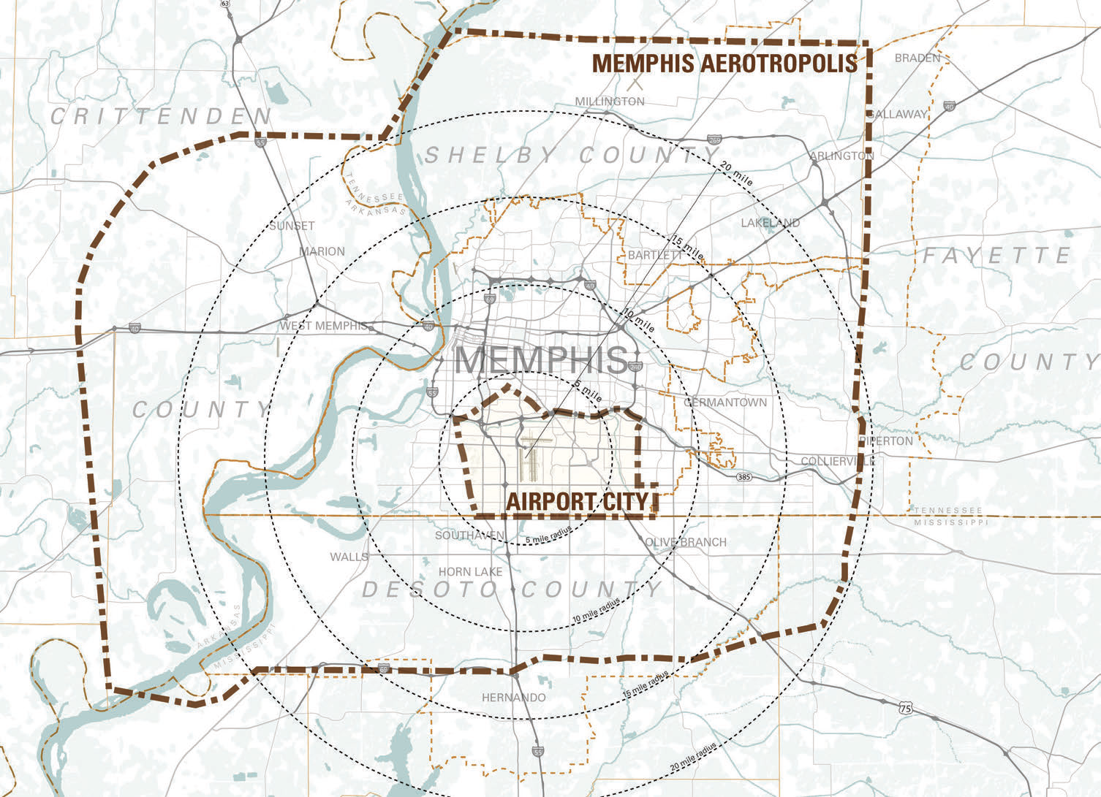

Slide 7
Lessons Learned from Airport City Memphis
Poverty, crime, residential/commercial vacancy and blight, poor transportation and challenged public schools are real issues in Airport City, but …
These highly visible but not insurmountable risk factors belie the arguable comparative advantage of Airport City as an already existing but vulnerable community of opportunity
Strengthening communities of opportunity in place requires highly contextualized, multi-dimensional strategies that in Memphis and comparable environments might compete favorably with inclusive zoning, subsidized housing, and other widely endorsed fair housing tools
Fair housing tools are morally compelling and should merit resources based on measurable economic mobility outcomes . . . As should be community development strategies based on careful consideration of comparative advantage

Slide 8
Implications for national policy . . .
Strengthening communities of opportunity in place requires highly contextualized, multi-dimensional strategies that in Memphis and comparable environments might compete favorably with inclusive zoning, subsidized housing, and other widely endorsed fair housing tools
Fair housing tools are morally compelling and should merit resources based on measurable economic mobility outcomes . . .
As should community development strategies based on careful consideration of comparative advantage

Slide 9
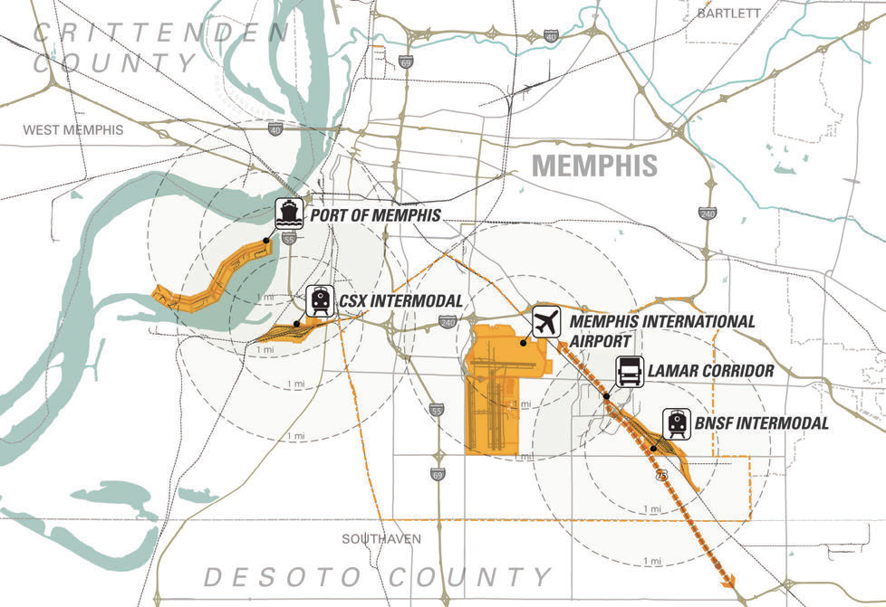
Location, Location, Location

Slide 10
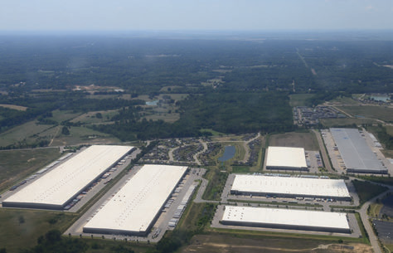
Airport City: the Warehouse District and Beyond

Slide 11
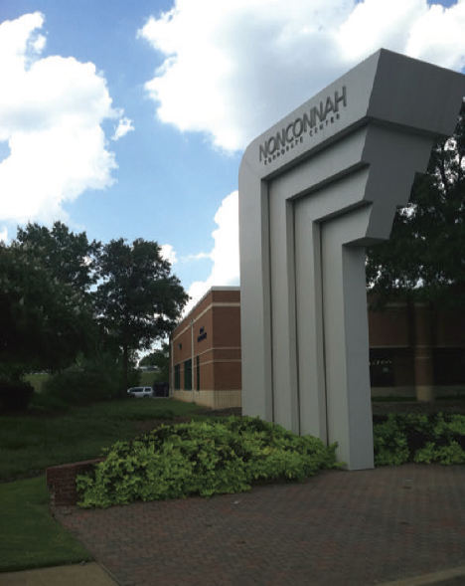
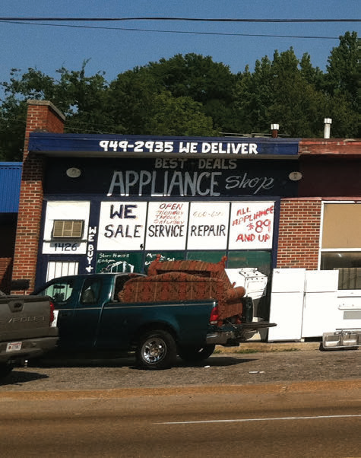
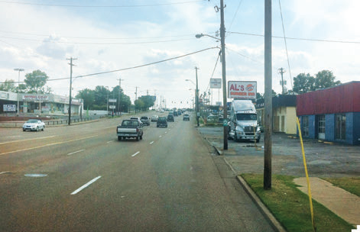
Attractive office options but unattractive routes

Slide 12
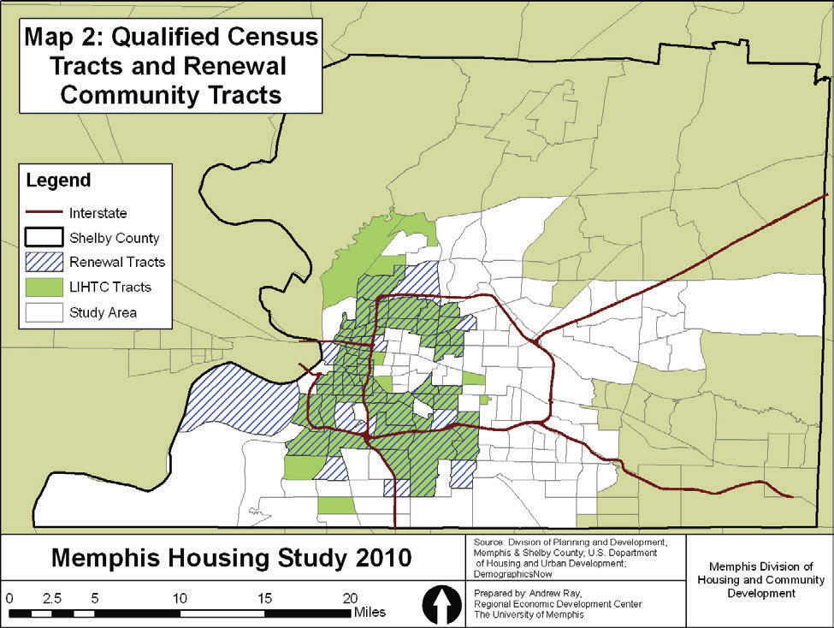
Not your most obvious community of opportunity . . .
Airport City

Slide 13
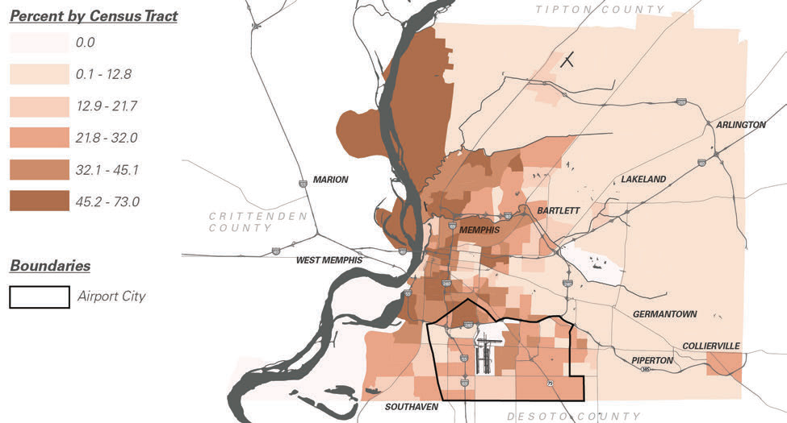
Percent Population in Poverty

Slide 14
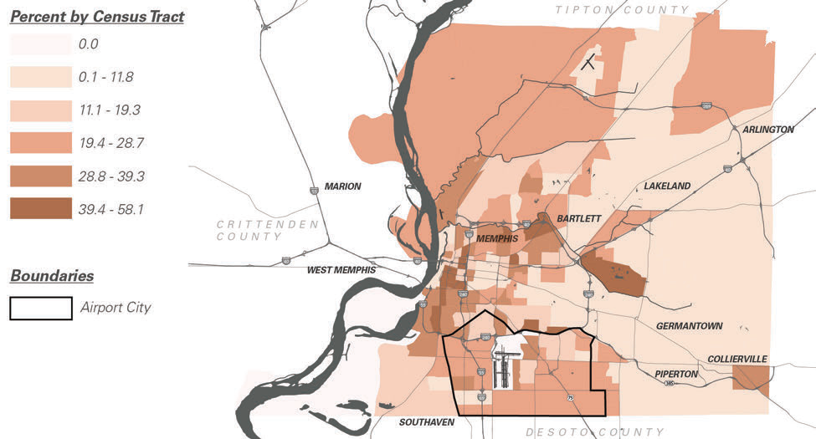
Percent with No HS Degree

Slide 15
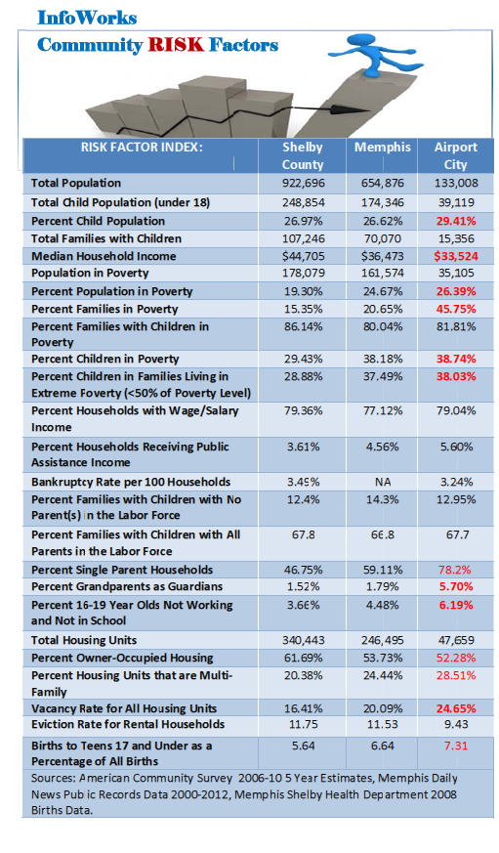
Summary Indicators of Population Vulnerability
Poverty
Child poverty
Single parent families
Grandparent guardians
Low homeownership and high vacancy
16-19 year olds out of school and work
Teen births

Slide 16
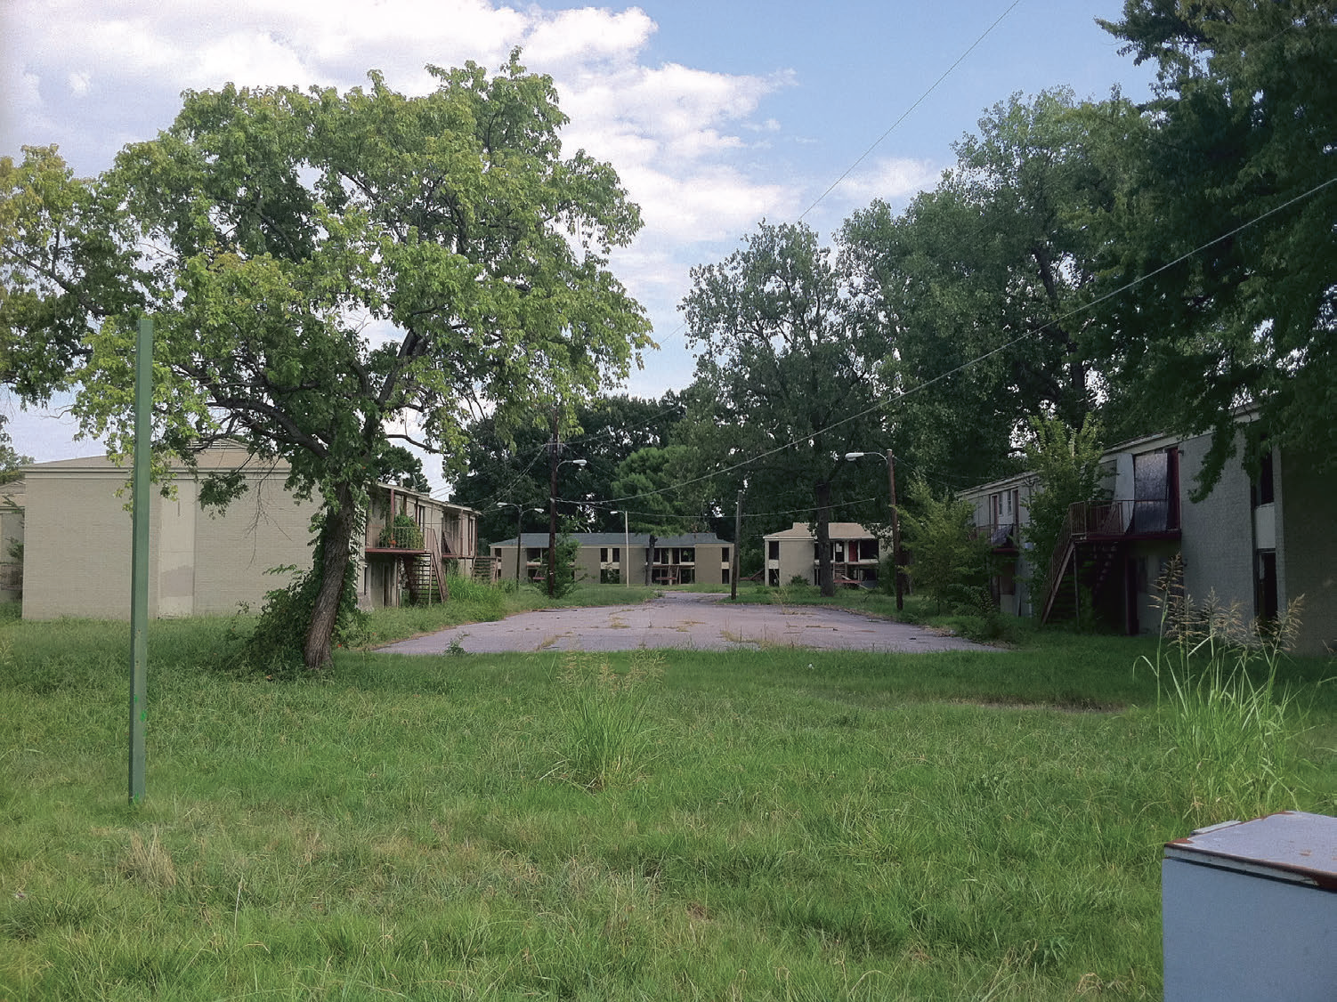
31% of Airport City Land Abandoned, Vacant, or Underutilized

Slide 17
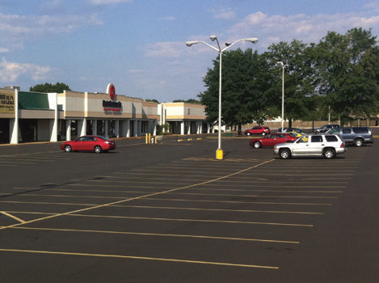
High Vacancy in Obsolete Retails Strips

Slide 18
But Airport City is NOT without Assets
Location
Existing Economic Infrastructure
Greater socioeconomic diversity than first appears
Schools and transportation that are relatively desirable
Crime and blight amenable to hotspot strategies

Slide 19
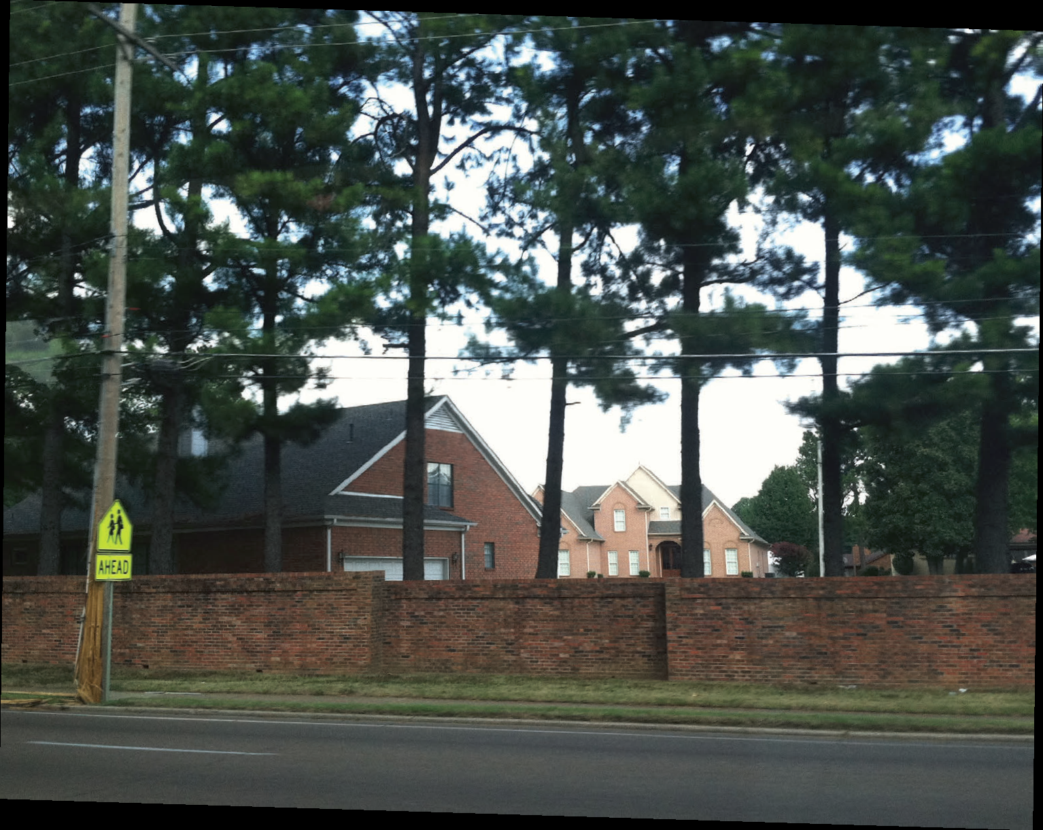
Diverse Neighborhoods

Slide 20
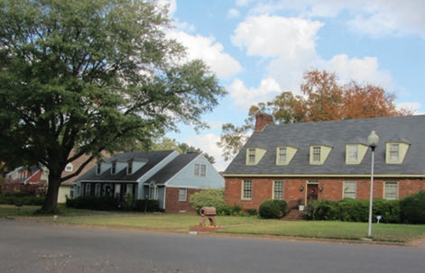
Stable Neighborhood: Fox Meadows

Slide 21
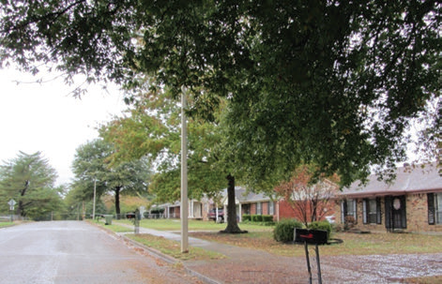
Older but Stable Neighborhood: Parkway Village

Slide 22
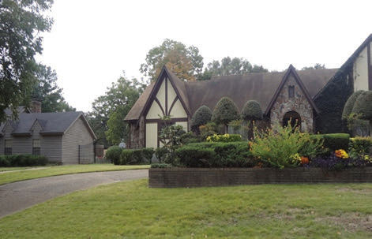
Upscale Neighborhood: Whitehaven

Slide 23
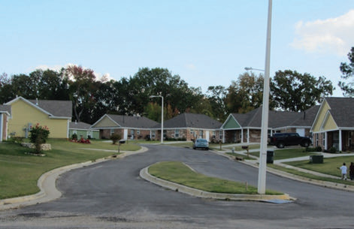
Recently Completed: Habitat’s Wilshire Park

Slide 24
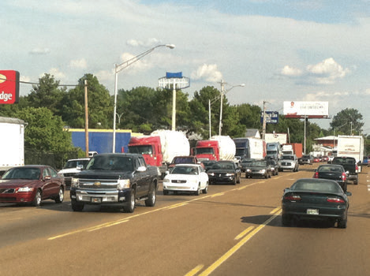
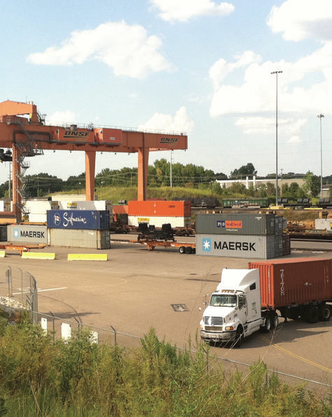
When Neighborhoods Violate New Urbanist Sensibilities . . . Lamar Corridor: Liability or Asset?
Intra-Urban Truck Route
shared with auto traffic
BNSF Intermodal Facility

Slide 25
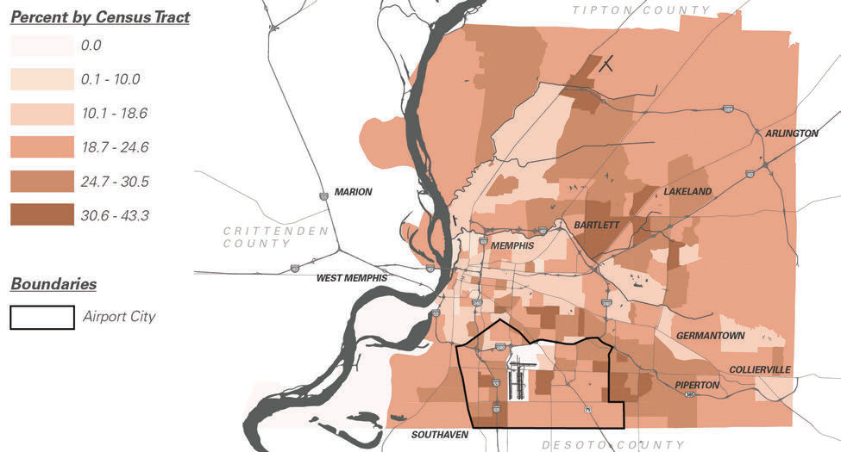
Liability or Asset? Percent with Some College/No Degree

Slide 26
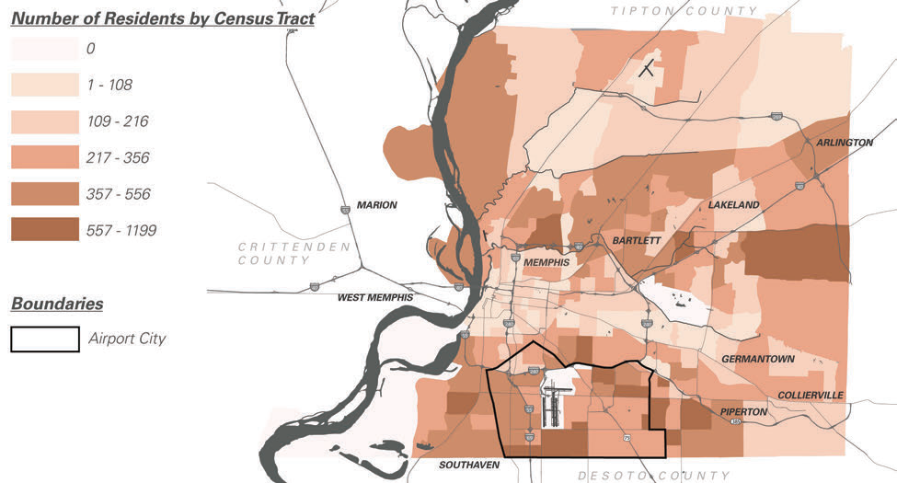
Asset? Clusters of Residents Employed in Production and Logistics Occupations

Slide 27
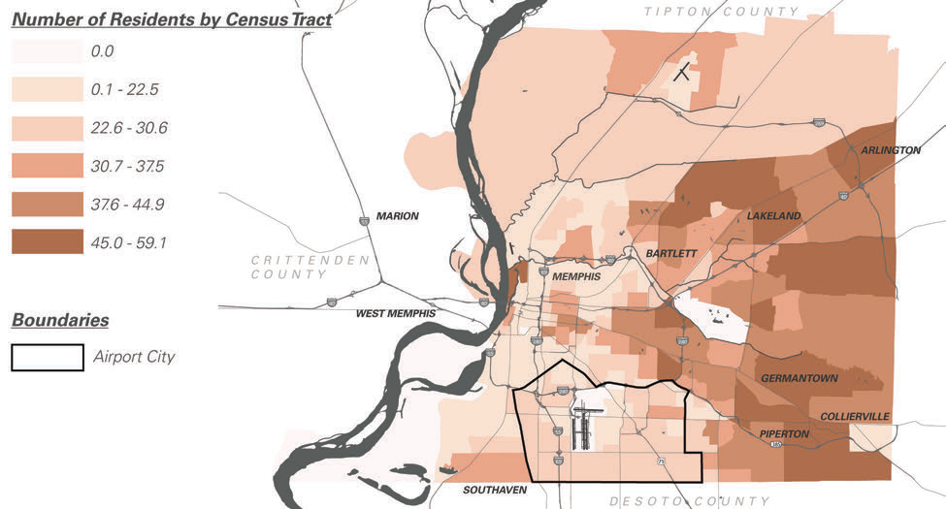
Challenge: Low Percent Residents in Management, Business, and Science Occupations
Percent

Slide 28
Not So Attractive Multi-Family

Slide 29
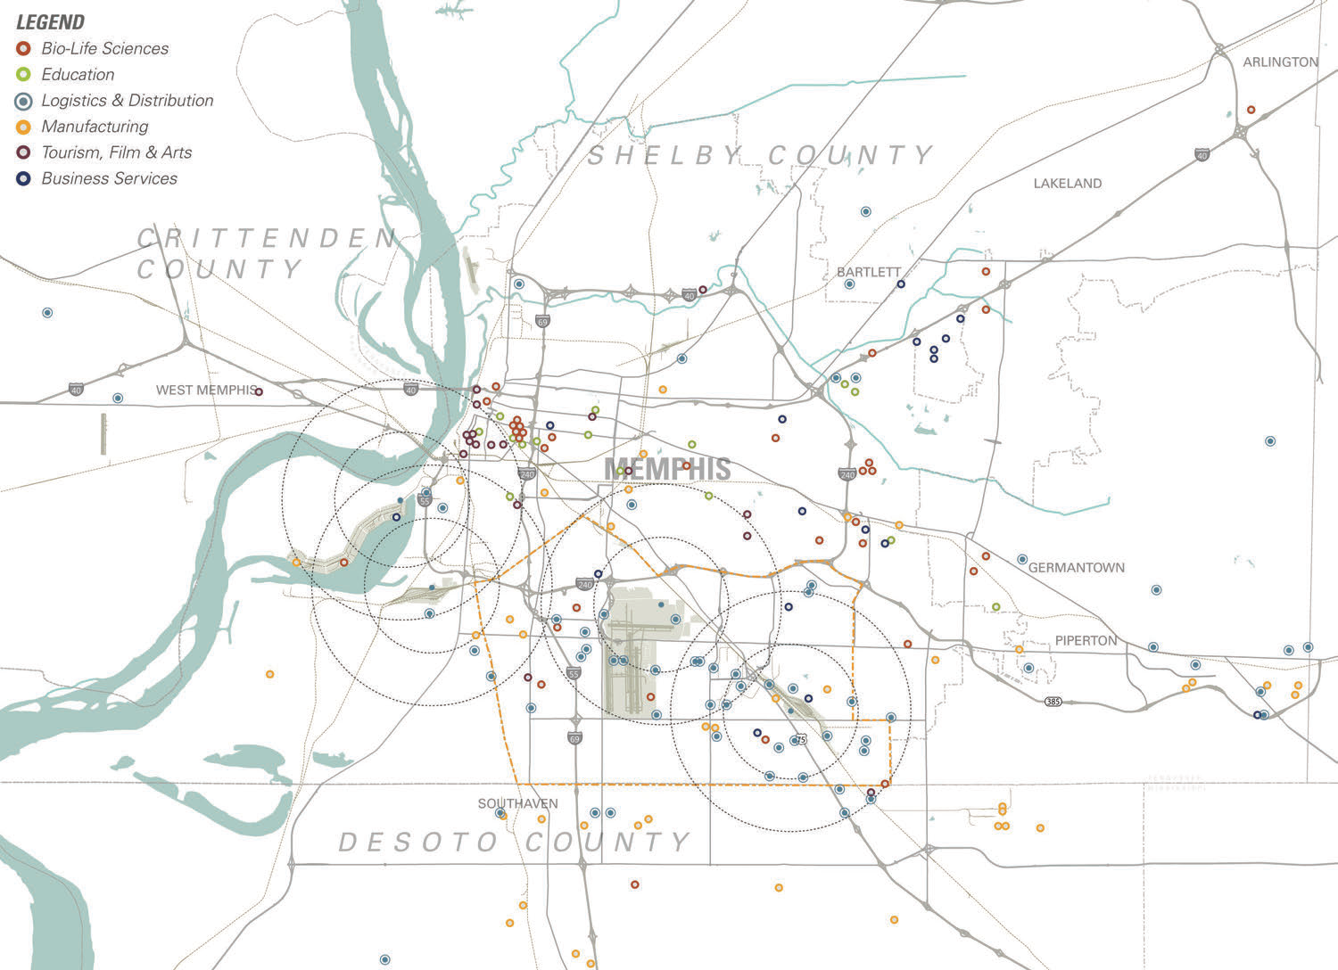
Economic Clustering for Industry Groups: Logistics Leads
Airport City Compares
Favorably with Suburbs

Slide 30
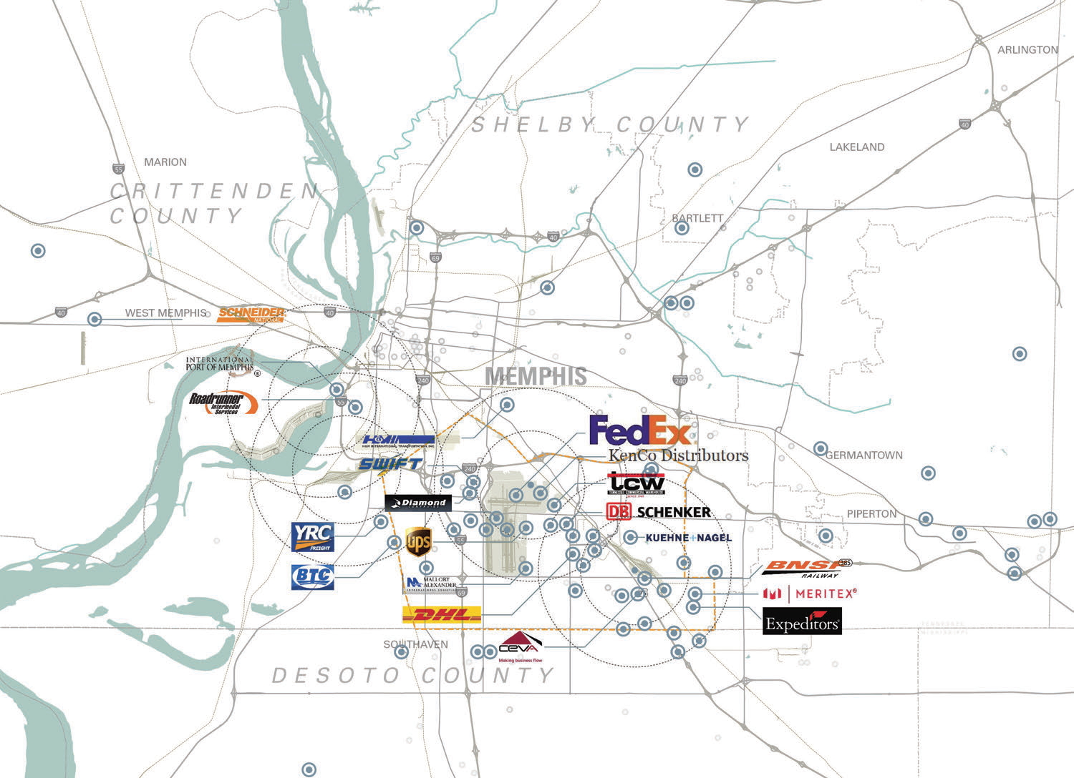
Major Logistics Employers Cluster in Airport City

Slide 31
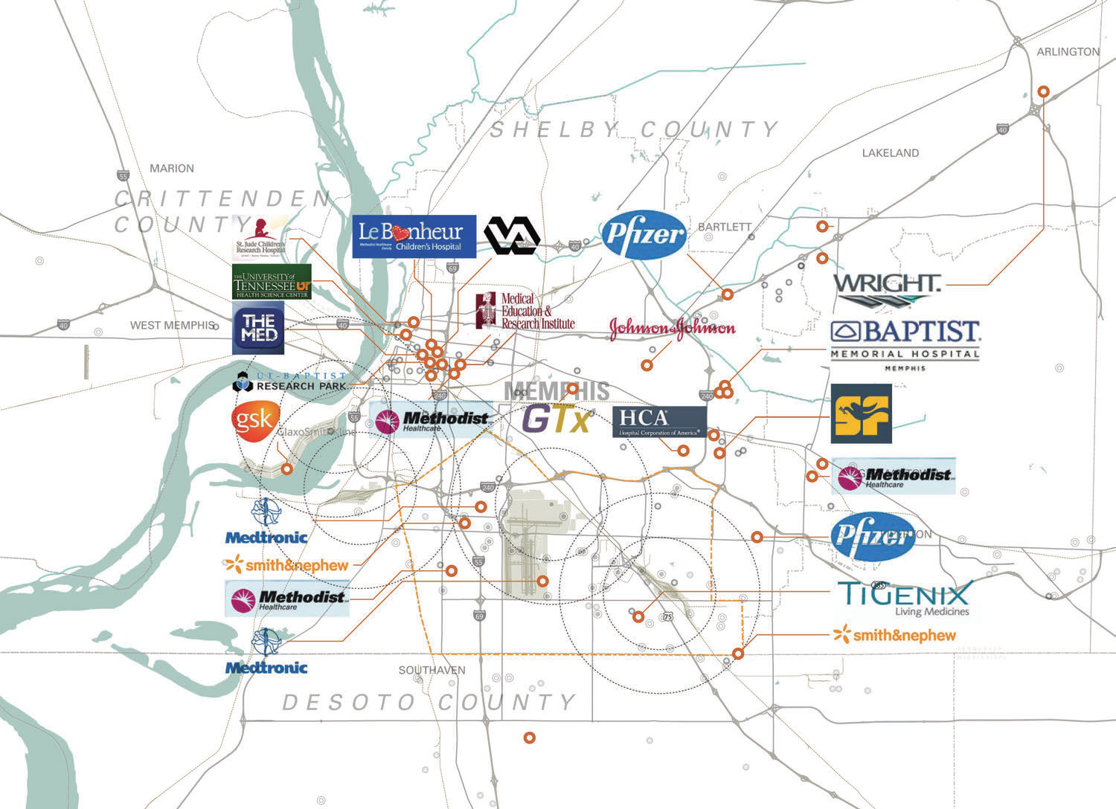
Major BioMedical Employers Cluster in Downtown and Airport City

Slide 32
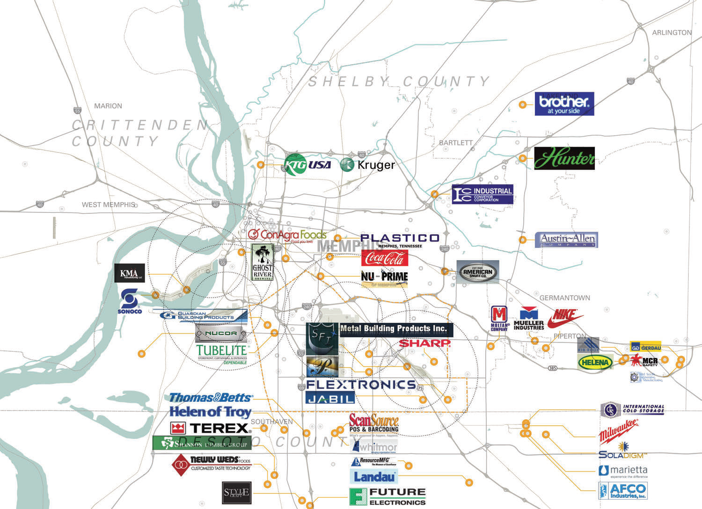
Major Manufacturing Employers Cluster in Airport City and DeSoto County

Slide 33
Be it resolved: Airport City is a community of opportunity and should be supported as such

Slide 34
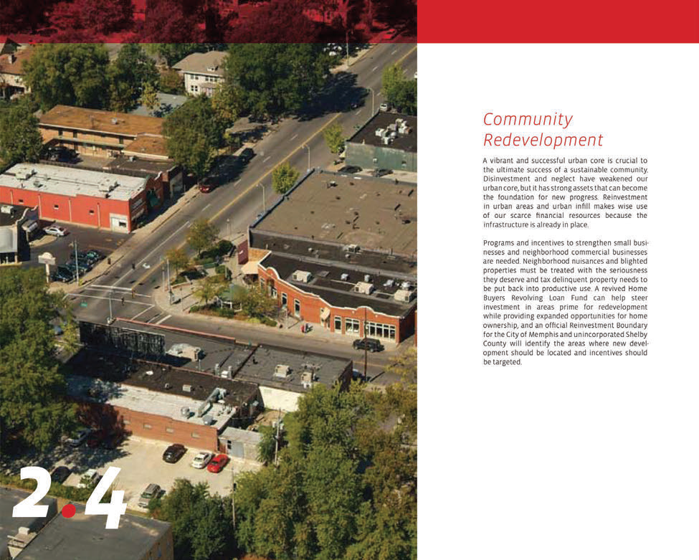
Making Local Choices: Incentives to support Residential Mobility, or Community Redevelopment?
From the Memphis Aerotropolis
Summary Inventory Report

