Slide 2
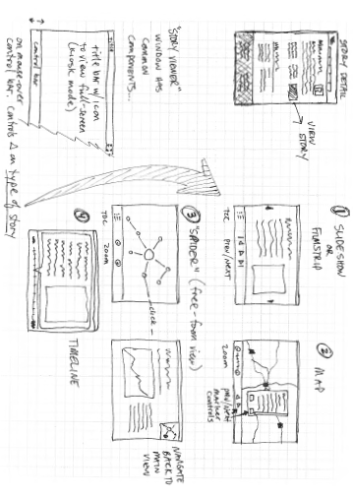
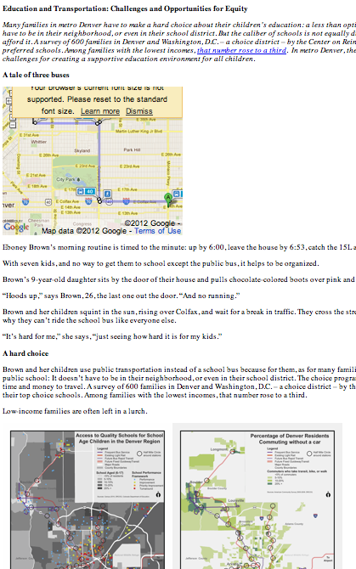

Slide 3
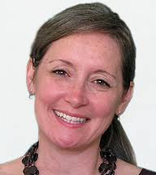
DESIGN GOAL 1
OPEN OWNERSHIP
?
?

Slide 4
DESIGN GOAL 2
Potential Citizen Atlas Use Cases
The goal: Define, "What is your point of view?”
The formula: [USER] needs [VERB] because [INSIGHT]
Ex: Hinkley High School Contact: Ana Bicknase, Gabriela Jacobo
Use case description: A high school teacher, her leadership class and parents are trying to tell the story of the high suspension and expulsion rates of students of color because Hinkley and Aurora Public Schools are unlikely to move to a “Restorative Justice” model of discipline unless “business as usual” is exposed as not working for Aurora students.
Specific needs:
Analyzing data: from over 600 interviews of students; history of suspension rates versus racial make-up of school;
Connecting story to relevant policy (eliminating zero tolerance policies at school and district level)Describe issues through data - compare discipline rates across time as Restorative Justice implemented Has to be “classroom friendly” (easy for teacher and students to use, fits technology level of school)has an educational/skill-building component (can be used to teach/improve data literacy)many authors (i.e., projects authored by groups of students)MultilingualMOP (Metropolitan Organizations for People)Contact: Mike KromreyUse case description: Community organization focused on education and health care reform needs to
USER-CENTERED

Slide 5
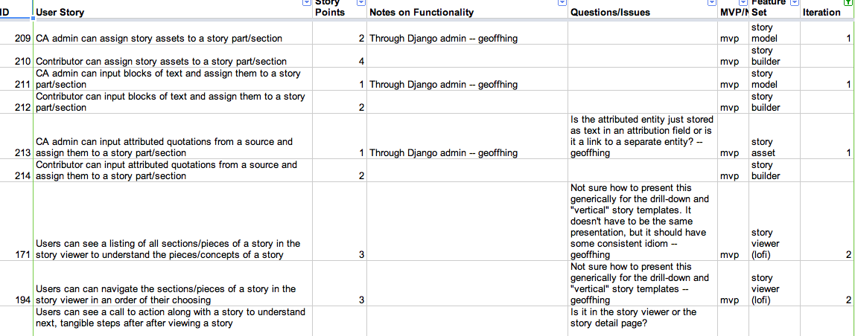
DESIGN GOAL 3
AGILE / ITERATIVE

Slide 6
LESSONS LEARNED SO FAR…
Product Management vs. Collaborative Design
Community Speed vs. Development Speed
Ideation vs. Implementation

