Slide 1


NNIP
Hartford Data Collaborative &
Youth Engagement
November 2023
Notes:
Notes from Kathy--
What was the motivation for you to get involved?
· Basics - What age groups? What was the structure of the engagement? What did it take (staffing/other resources)? Any community partners?
· What was the benefit to your organization/your community? Challenges?

Slide 2
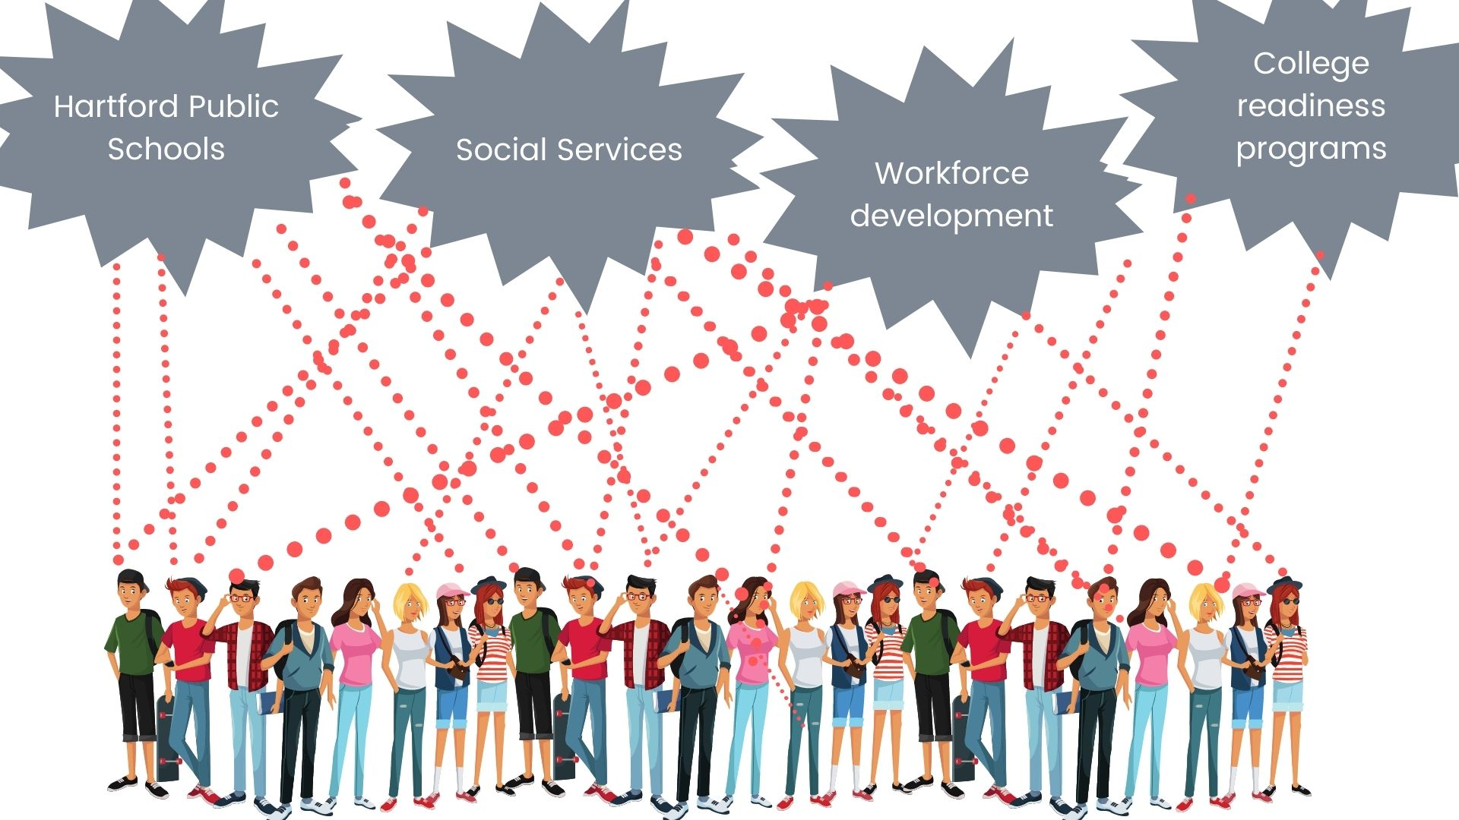
Hartford Data Collaborative
HDC’s mission is to build shared data infrastructure that facilitates data sharing, integration and analysis to optimize services and outcomes for Hartford residents.
Notes:
The Hartford Data Collaborative started as a data integration project. We were designed to provide ethical and permissible data sharing.
The structure of HDC was set up through governance committees, which is made of representatives of data sharing partners and other community leaders.
We have grown with a governance structure that includes data users. Our executive board, made up of leaders of key agencies, and data oversight committee is the people who work directly with the data. What we don't have is the community. HDC is shared data infrastructure supports data sharing across human service agencies, allowing for a more holistic view of individuals, families, and households, often served by multiple government and nonprofit agencies. The development of shared data infrastructure with clear governance and privacy restrictions supports access and use of agency held administrative data to improve the lives of community members.
HDC links and integrate data to answer research questions that require data from multiple sources.

Slide 3
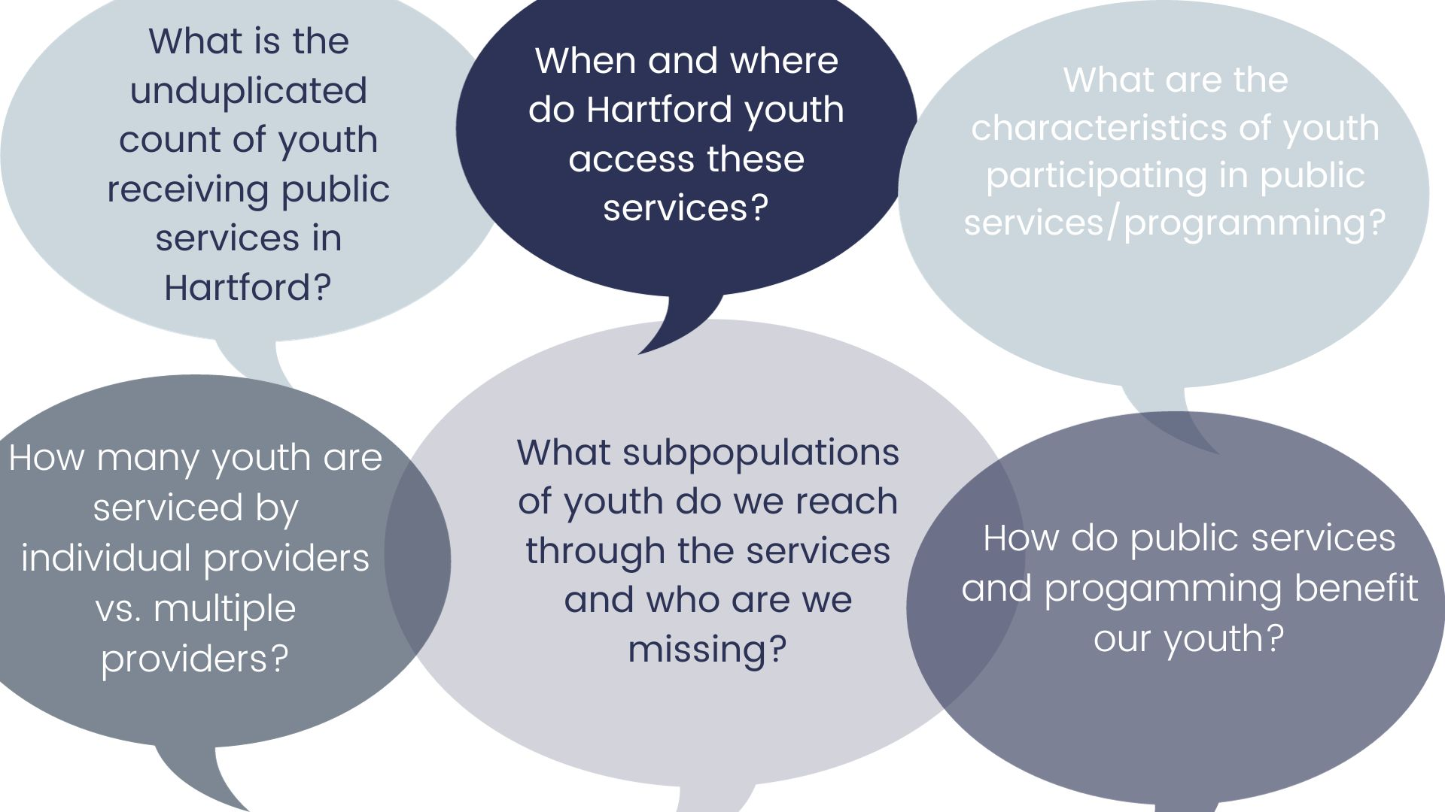
Notes:
Why did we start with youth researchers?
in the first two years of HDC work, our focus has been primarily on programs and agencies serving Hartford youth. But while we were building the infrastructure for sharing data, we were missing members of the community.
We started with a focus on Hartford youth, because there was already some linking for projects involving youth but there was interest in connecting to school data and outcomes and so that's where we came in, again, mostly focused on the infrastructure around the data sharing. Through these data linking projects, which were focused on "opportunity youth"-- those who were disengaged in school and work—we built up relationships in the communities serving those youth.
So while we were building our project, we knew we were missing community voice and perspective, and we knew youth was the perspective we really needed to tap into first and foremost.

Slide 4

Project Origins: Hartford UNITY Program
2021: City of Hartford funded community programs to engage children & youth post-COVID 19
Funded through federal American Rescue Plan Act funds, with input from the community.
City & community interest in reach & scope of programming
Notes:
Why did we start involving the community?
City of Hartford is a founding member, data partner
City of Hartford request for analysis of children and youth participation in summer and year-round enrichment and other programs
In the summer of 2021 the City of Hartford approached us with serving as the data collector and aggregator and funder of their UNITY project. UNITY stands for (Understanding the Needs In Today’s Youth) youth engagement grant program run by The City of Hartford Department of Families, Children, Youth and Recreation (DFCYR).
Starting in 2021, the City of Hartford issued grants to local youth providers to develop and enhance programming for Hartford children, to add enrichment and development after the isolation and disruption caused by the COVID-19 pandemic. Grants were funded through federal American Rescue Plan Act funds,
Grantees receiving over $5,000 were required to join the Hartford Data Collaborative and share data about the children and youth who participated in their programs.
This seemed like a great opportunity to involve youth researchers, because the research questions were pretty straightforward, and the UNITY programs were for all children and youth in Hartford. So our youth researchers from Hartford would know these kids and their programs.

Slide 5
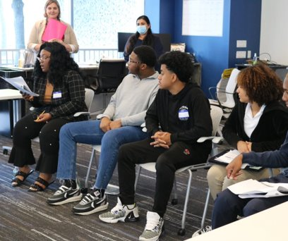
Youth as Co-Researchers
Participate in Data Training Workshops
Develop Data Youth Profile
Develop Learning Agenda
Analyze data and create data visualizations
Present data findings in a Data Walk
Notes:
Aims of the Project—in early 2022
Pretty ambitious at first to accomplish this in 8 weeks, when kids were still in the thick of recovering from COVID
We were planning involve youth directly in the research itself, not as a focus group, not as an add on. We would provide them with training based on the work CTData had done in our public workshops and with our high school civic tech program, we would create youth profile and find out about their data interests, we would create data products that we could present in a Data Walk
Designing/Planning the program
We based the program off of what we wanted to accomplish and also what we already were doing with data trainings.
We put the word out through our community organizations.
We found out two things at the beginning: (1) no one was doing this kind of youth participatory research and (2) there were already 12 youth boards in Hartford. Originally thought we would select one youth from each youth board and they would report back to each board, but we found that some boards did not respond, others had either disbanded from COVID. Other youth boards were more protective of their youth

Slide 6
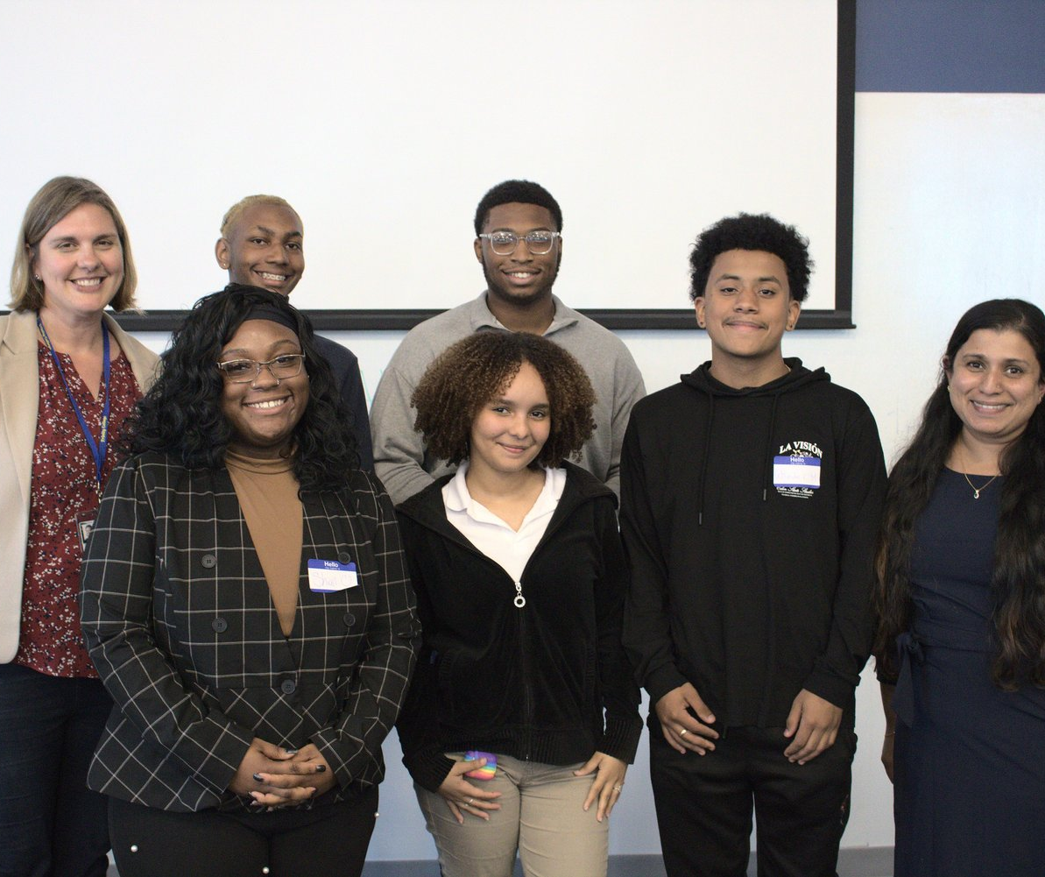
Hartford Youth Researchers 2022
6 youth ages 16-25: 4 high school students; 2 in college
Hartford residents
Lived experience with mental/behavioral health services
Six-week program (April-June)
Attended weekly meetings at our downtown offices
Food/Meals at meetings
Compensation: $1000 plus $200 bonus or completing the program
Notes:
Because this first project was funded through national funder we only had a month or so to recruit
Requirements:
Must be a Hartford resident and between the ages of 16-25
Attend monthly group meetings, weekly phone check-ins, and 3 data workshops from March through June 2022
Engage in data analysis and reporting on Hartford youth programs
Present findings to city and state officials and community members
2-3 hours per week for 8 weeks
Compensation: $1000 plus $200 for bonus for completion; training/meetings only $800 (based off of similar youth programs)
Food at meetings; parking/central location
Interview process
Follow-up to discuss process and commitment

Slide 7
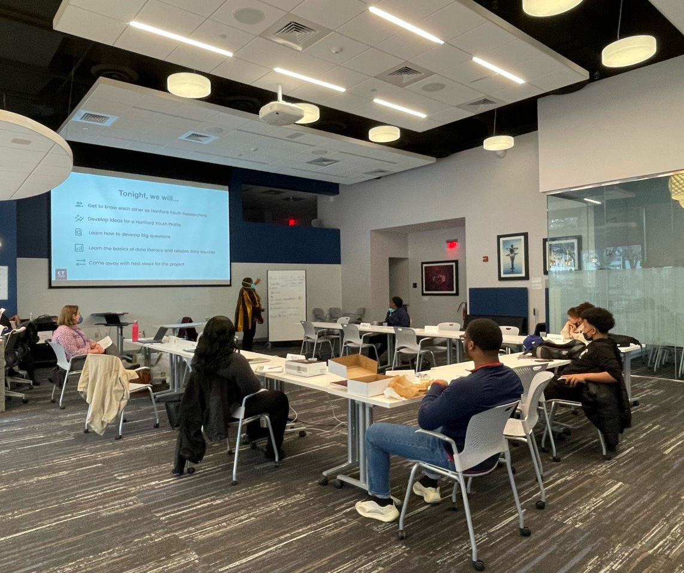
Data Workshop Topics
Data Literacy & Public Data Sources
Data Analysis
Analyzing Integrated Data
Data Storytelling
Creating a Data Walk
Notes:
We adapted the data workshops off of what we had already been doing in the community through CTData workshops and public Trainings
So before we could even talk about making meaning from the data, we had to take stock of where we were.
HYR talked about how they joined HDC this spring to better understand data and how it can be used to advance social change. We brought in youth who were already engaged, who knew the organizations in the city and could help us communicate data findings with others. However, we had to also face reality:
1. There was no real positive profile of Hartford youth, so we were starting from scratch.
2. The UNITY data—which I talked about earlier, was collected without any input form the community as to what would be collected and for what purpose.
In our first meetings we worked on what data was available about youth publicly and what we wanted to find out. So the youth took the focus of "what do you think city leaders and school leaders need to know about youth in our city

Slide 8
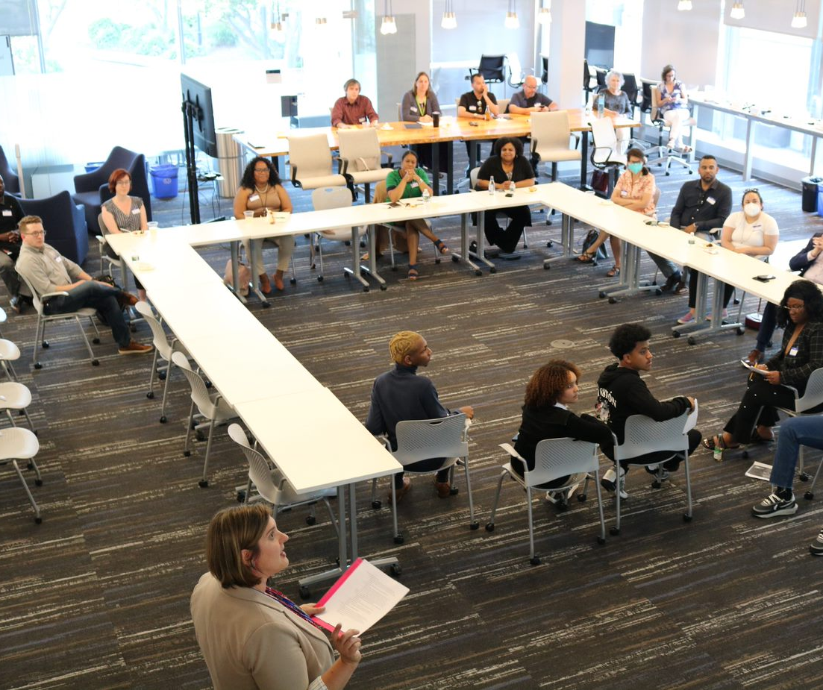
2022 Data Walk
Powerful moments: youth who saw themselves reflected in the data spoke about their experiences
Direct advocacy: HDC connected them with city and community leaders
Led to changes in data collection and training
Two youth continued over the summer to co-write final report on UNITY
Notes:
Develop Learning Agenda: What Topics are Important to Hartford youth?
With 6 weeks not a lot of time to prepare
We had representatives from the Mayor's office, the City Department of Children, Family, Youth, and Rec. Other CBOS that work with youth and
This was held in person in our offices. We're fortunate to have this space and it created an intimate space for sharing. Youth got really candid about their experiences in Hartford institutions and why collecting the data about youth was so important.
Our June 2022 Data Walk focused on the interim findings from UNITY funded programs from June 2021 through mid-April 2022. The biggest finding was that many of the grantees did not provide complete data, so we could only link data based on name. Other grantees had unusable data. Some variables—like race—only had 50 percent complete data.
The lack of data from many of the grantees limited HDC and HYR’s ability to report on the impact of the city’s investment in youth and prompted more discussions on how to improve data quality for the next round of UNITY grantees. As a result, HDC and the City now have standing meetings twice a month to discuss data issues and grantee capacity to collect and report data. HDC and HYR have initiated consultations with grantee organizations to help answer data questions and concerns.
missing from data about themselves, really resonated and motivated them to get more involved in this project. But it was also very painful. One said, I feel depressed looking at Hartford data. That's hard to work with.
83% of Hartford high needs compared with the rest of the state– that was shocking to them and they felt concerned more adults weren’t shocked by this.
In late August 2022, HDC received the final data from the FY2022 UNITY grantees. We have integrated this data and the Hartford Youth Researchers have been analyzing its findings, which we are planning to review with the City of Hartford in mid-September. We will share the final report on these findings on the CTData website and through an additional Data Walk to be held this fall.

Slide 9
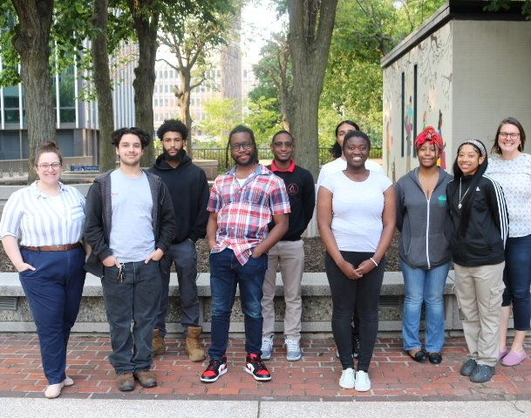
Hartford Youth Data Fellows 2023
10 youth (7 high school students; 3 college students)
5 months (January through May)
Broadened recruitment process to connect to youth not necessarily tied to other organizations
Guest speakers from Hartford who work in different fields engaging data
Hartford history to understand disparities in data
Dinners, bus passes and free parking
Compensation increased to $1500
90% persistence rate
Notes:
We regrouped and started recruiting in the fall of 2022 for our next cohort.
Worked more in the community through some tabling sessions and information sessions at public schools
Our second cohort launched in January 2023 and ran for 5 months.
Longer timeframe to engage
More youth-- something other youth recommended we work on.
CTData now had a separate data engagement/trainer so we had her help
We had 9 youth complete the program

Slide 10
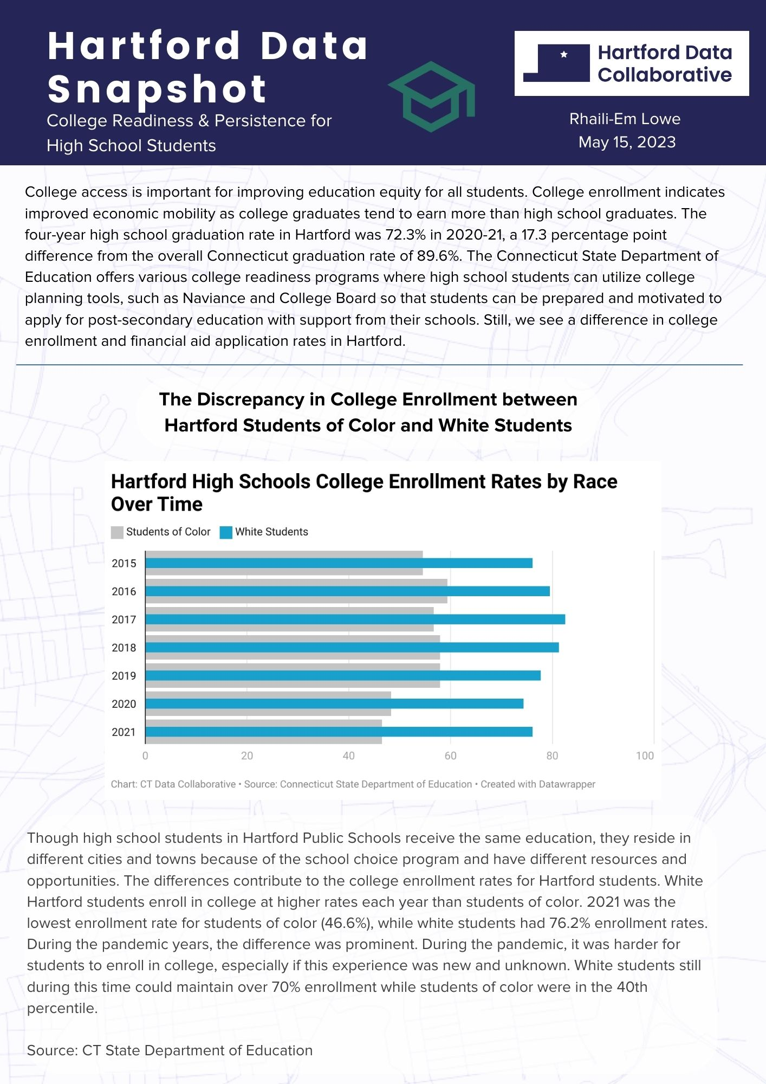
Data Snapshots
Analyzed publicly available data about Hartford (ACS, state agencies, city 3-1-1 complaints)
Four broad categories: fellows picked issue of interest
Youth fellows worked to create 2-3 visualizations
Wrote context based on their experiences living in Hartford—connecting data to their own lives
Youth enjoyed doing their own research
Notes:
Worked with publicly available data (city data was unavailable in a timely way)
Education from state department of education website
Youth mental health data scraped from reports from state department of public health PDF reports, which we combed through together.
311 data from city of Hartford
Use free tools (that they can implement in other settings): Canva—created our own team; Datawrapper (had a template)
Worked with data analyst on geocoding address data; making a Hartford map in Datawrapper
Khamari Thornton, who researched children and youth in poverty, said he enjoyed doing his own research, not just receiving facts to recite.

Slide 11
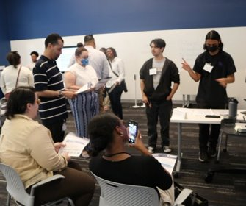
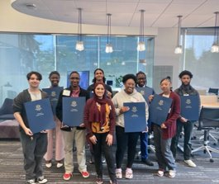
2023 Data Walk
Fellows grouped by topic areas; smaller crowd sizes, more personal engagement
Multiple rounds of presentations over two-hour period
Youth taught parents, teachers, city and community leaders their findings
State Representative Khan (also a Hartford high school teacher) presented each youth with citation
Notes:
Format changed
Focus on data snapshots by category
Data Snapshots uploaded to CTdata website
Created powerpoints for Data walk itself
Food/drinks to keep it festive
Rep Khan– also the special ed teacher and knew several of the youth
The Data Walks were separated by topic areas, with multiple rounds of presentations as community members and leaders came by throughout the timeframe. Tatiana Watson said she appreciated having a “bite-sized crowd” to present to, which allowed her to refine her talk for each group. Nasere Lewin presented on chronic absenteeism, noting that everyone was surprised by the nearly 80% average chronic absenteeism rate for non-magnet high school students in Hartford. Yandell Alvarez said the data he and Isaiah Perez presented on youth mental health services was well received. A nurse who attended was interested in the data on discharge rates for youth receiving emergency mental health services.

Slide 12
Hartford Youth Data Fellowship Goals
Provide youth with improved data science, research skills, and data confidence
Strengthen Hartford youth post-secondary and career opportunities
Include community voice in Hartford data projects & model ethical data practices.
Increase community access to Hartford data projects
Ensure sustainable fellowship for underserved youth
Create new & support existing CTData partnerships
Notes:
After 2 years and more reflection we've summarized the program's goals
Provide youth with improved data science, research skills, and data confidence
Number of workshops held
number of topics covered
# of youth who report advanced skills
2. Strengthen Hartford youth post-secondary and career opportunities
Number of youth reporting increased skills
# of youth reporting interest in data science
Number of professional pathways youth explore that may not have previously been considered
Number of advocates, public officials, and legislators who engage with fellows
3. Include community voice in Hartford data projects & model ethical data practices.
Number of public data reports created by youth fellows
Number and diversity of people who hear from youth about their data projects—prove it can be done
Staff and Hartford organizations report insights gleaned from including youth with lived experience
4. Increase community access to Hartford data projects
Number of attendees at data presentations
Number of publicly available projects about Hartford resident data
Number of data walks, data platforms, and data maps
5. Ensure sustainable fellowship for underserved youth
Number of stipends provided; food served at meetings, transportation vouchers issued
Number of youth with attendance over 90%
Number of youth who begin and complete fellowship
6. Create new & support existing CTData partnerships
Number of Hartford organizations that refer youth—part of the recruitment process
Number of organizations that rely on youth-created data projects for programming and decision-making

Slide 13
Youth as Co-Researchers
Benefits
Challenges
Passionate about Change
Direct connection to organizational mission & community
Cohort as support group; re-engaging with community
Creating safe space
Personal development & growth
Improved data insights
Strengthens ties in community
Adapting curriculum to be relevant and accessible to youth after school hours
Barriers to Access & Personal challenges (family/childcare, mental health, other jobs)
Accessible data projects
Finding sustainable financial support
Notes:
Benefits
This is a really rewarding group to work with, but recognize that this is hard work for them. Some days they just wanted to talk about concert tickets, prom outfits and what's going on in their lives.
I loved that this group was so supportive of each others—mentoring.
Youth have strong sense of justice/not yet "numb" to data and statistics about their community
Youth in marginalized communities distrustful of local institutions
Needing a safe space
I'm a parent of a middle schooler, and while that's a bit different, I've seen up close the struggles this year with this age group and how they are feeling so bombarded with different expectations and even those who appear to be doing well are really impacted by their peers who are no.
We used Google folders so youth had access to materials outside of meeting times and could work on their projects independently. Only a few youth did this, so we had more meetings in person so they could ask questions and review data with us.
Talking to other youth participatory action researchers was helpful in bouncing ideas and asking questions about their structure.
Keeping the meetings as a safe space helped youth feel comfortable sharing their insights. We also tried to glean from interviews whether youth would be comfortable.
Validating youth experiences and perspectives helped. We told them the goal was to change the narrative of Hartford youth, and all supported that goal. HDC staff were encouraged by their fresh perspectives and enthusiasm for the project.
Challenges
giving them a common set of tools and language from which to engage in the data with us. CTData does a lot of data training and has a create curriculum in place, and had done some training with high school and college students, but those were in school sessions with a set class. In the end, we had to really breakdown our set curriculum and adapt it for the group of 6 researchers that were a part of this. A three hour workshop with aa 10 minute break isn't going to work as well in the afternoon for youth who had already had a full day of high school, college classes, or work before that. So we ended up breaking these down into smaller chunks of topics and then let them marinate on one topic each week.
We also found that given our tight schedule, and the busy lives of our students, that I was constantly running make-up classes for those who missed a session. We had to keep in touch – mostly by text—to let them know what they were missing. I also had them sign an agreement as part of their compensation, so they knew the training was important. And in the end, the youth all reported that their knowledge increased and they found the training and discussion really valuable.

Slide 14
Thank you
CTData.org
@CTOpenData
#CTDataConf2023

