Slide 1
Collaborating with Young People
Notes:
Danya
Put in the chat - your name, your organization

Slide 2
“Their perspective, unclouded by the biases of the past and unburdened by convention, bring fresh, innovative solutions. Empowering our youth with data literacy is not just an educational endeavor. It’s a pledge to a future where every voice, regardless of age, can contribute meaningfully to any initiative.”
Notes:
Poll with org type and if you’ve used the portraits

Slide 3
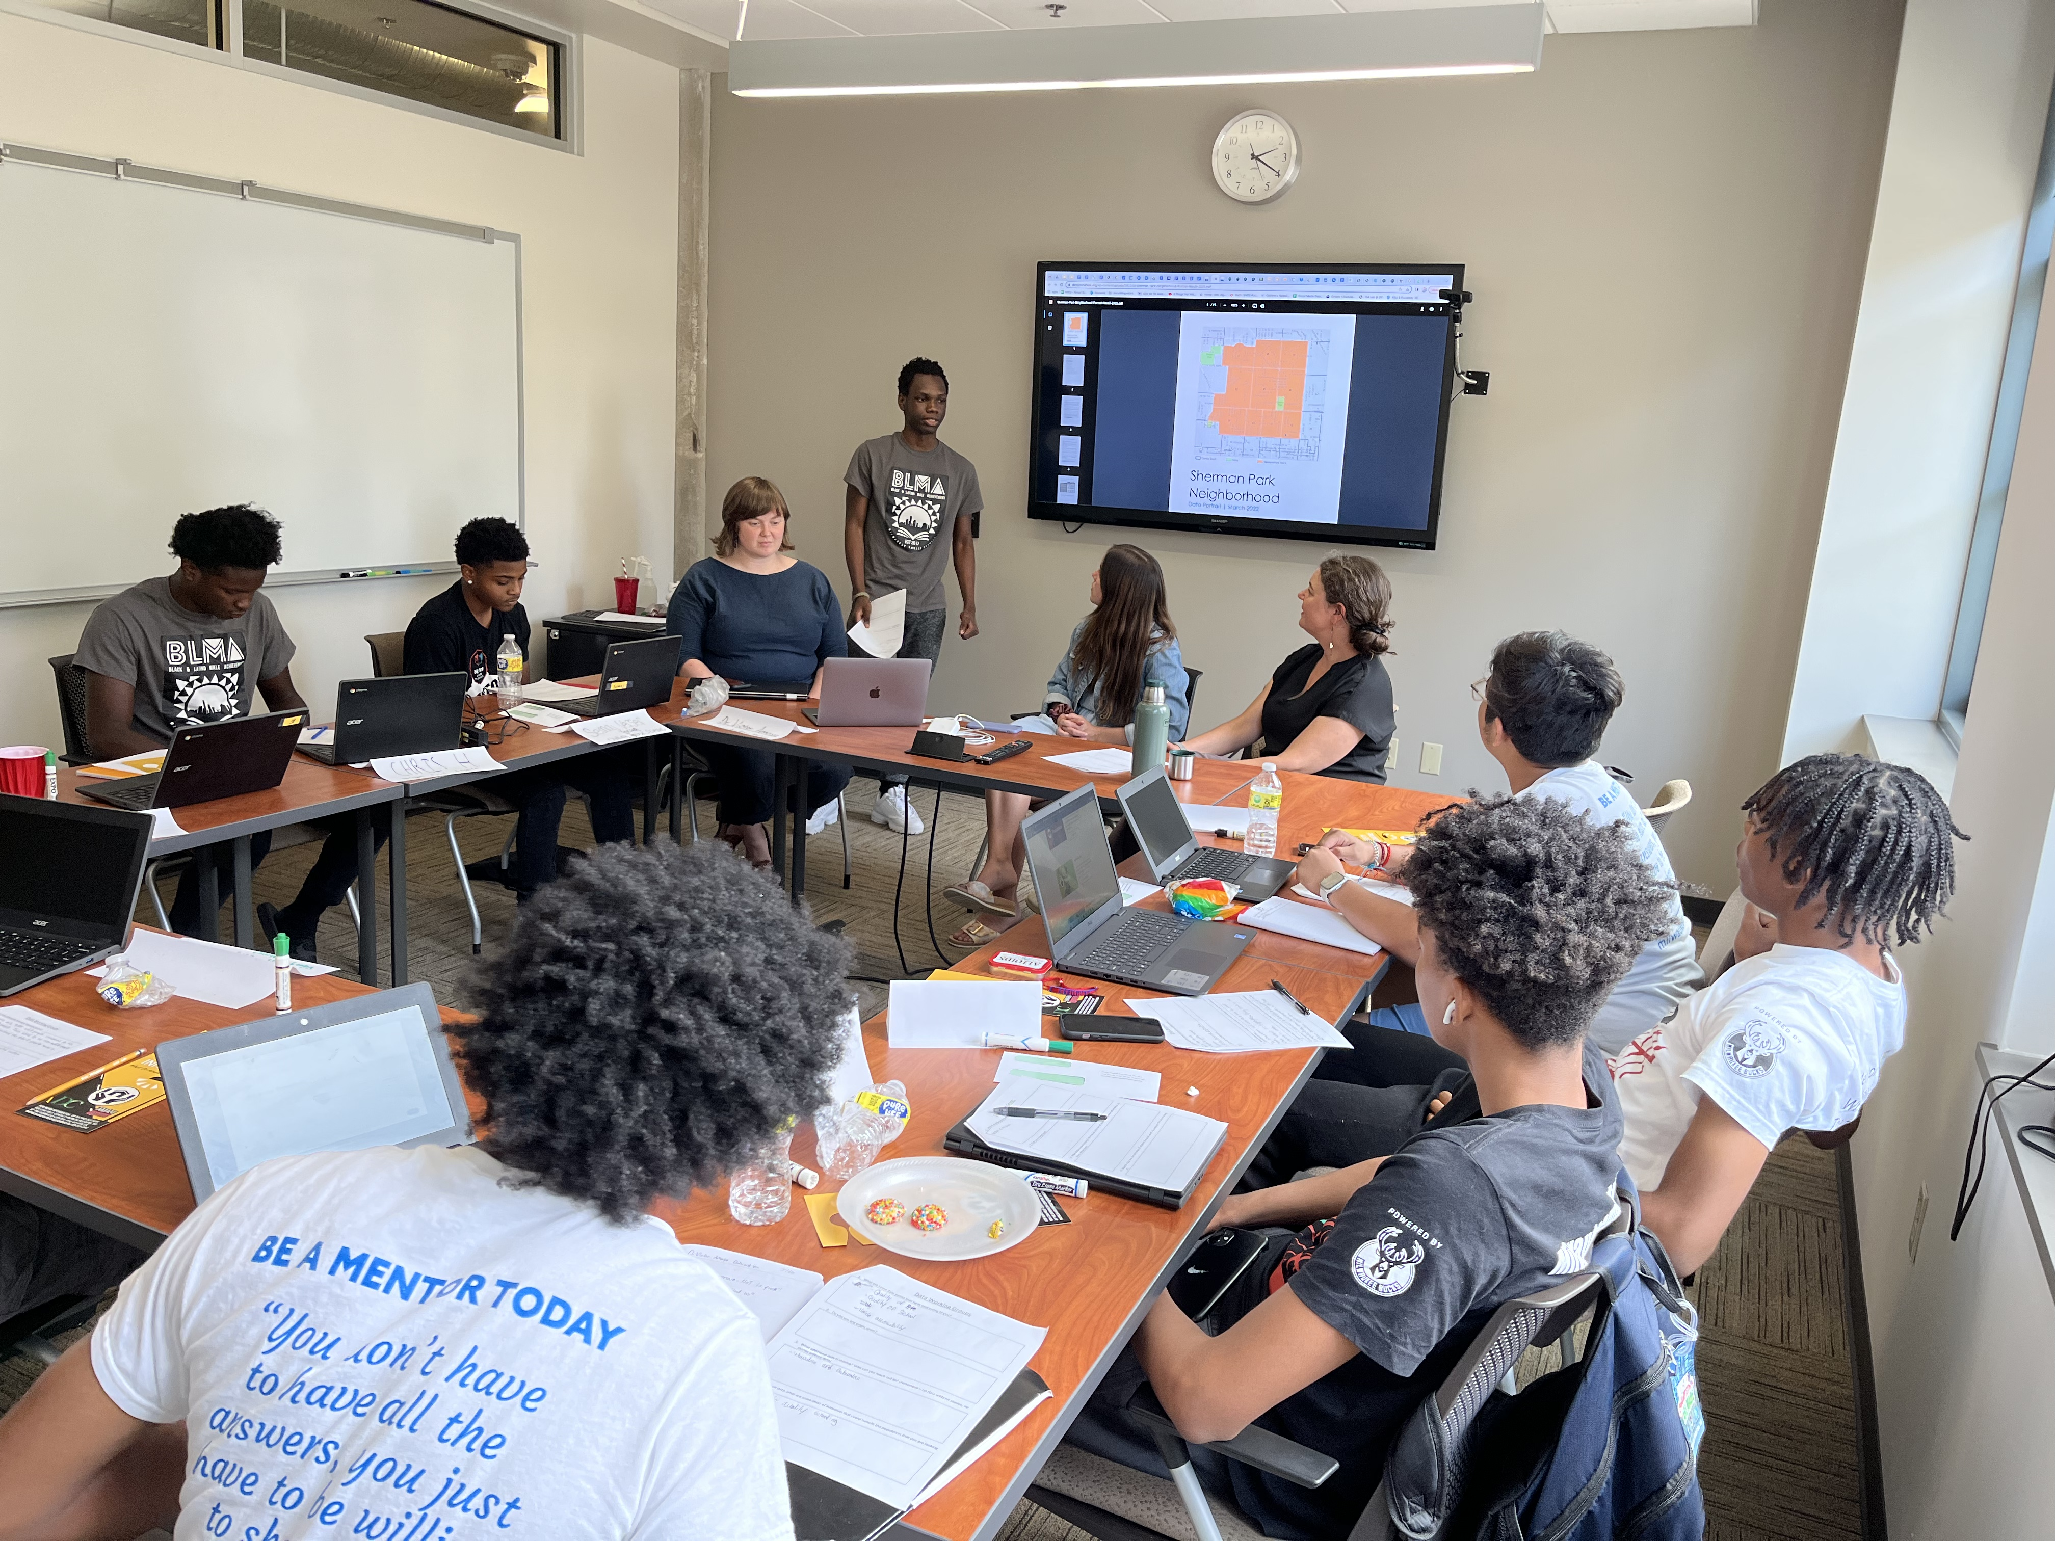
Summer Data Literacy Workshop
Partnered with Mentor Greater Milwaukee and the Black and Latino Male Achievement team from Milwaukee Public Schools
Understanding and best practices for data
Project Highlights – MKE Indicators and Neighborhood Portraits
Practical application
Notes:
Additional tables/topics per the request of neighborhoods and/or funders

Slide 4
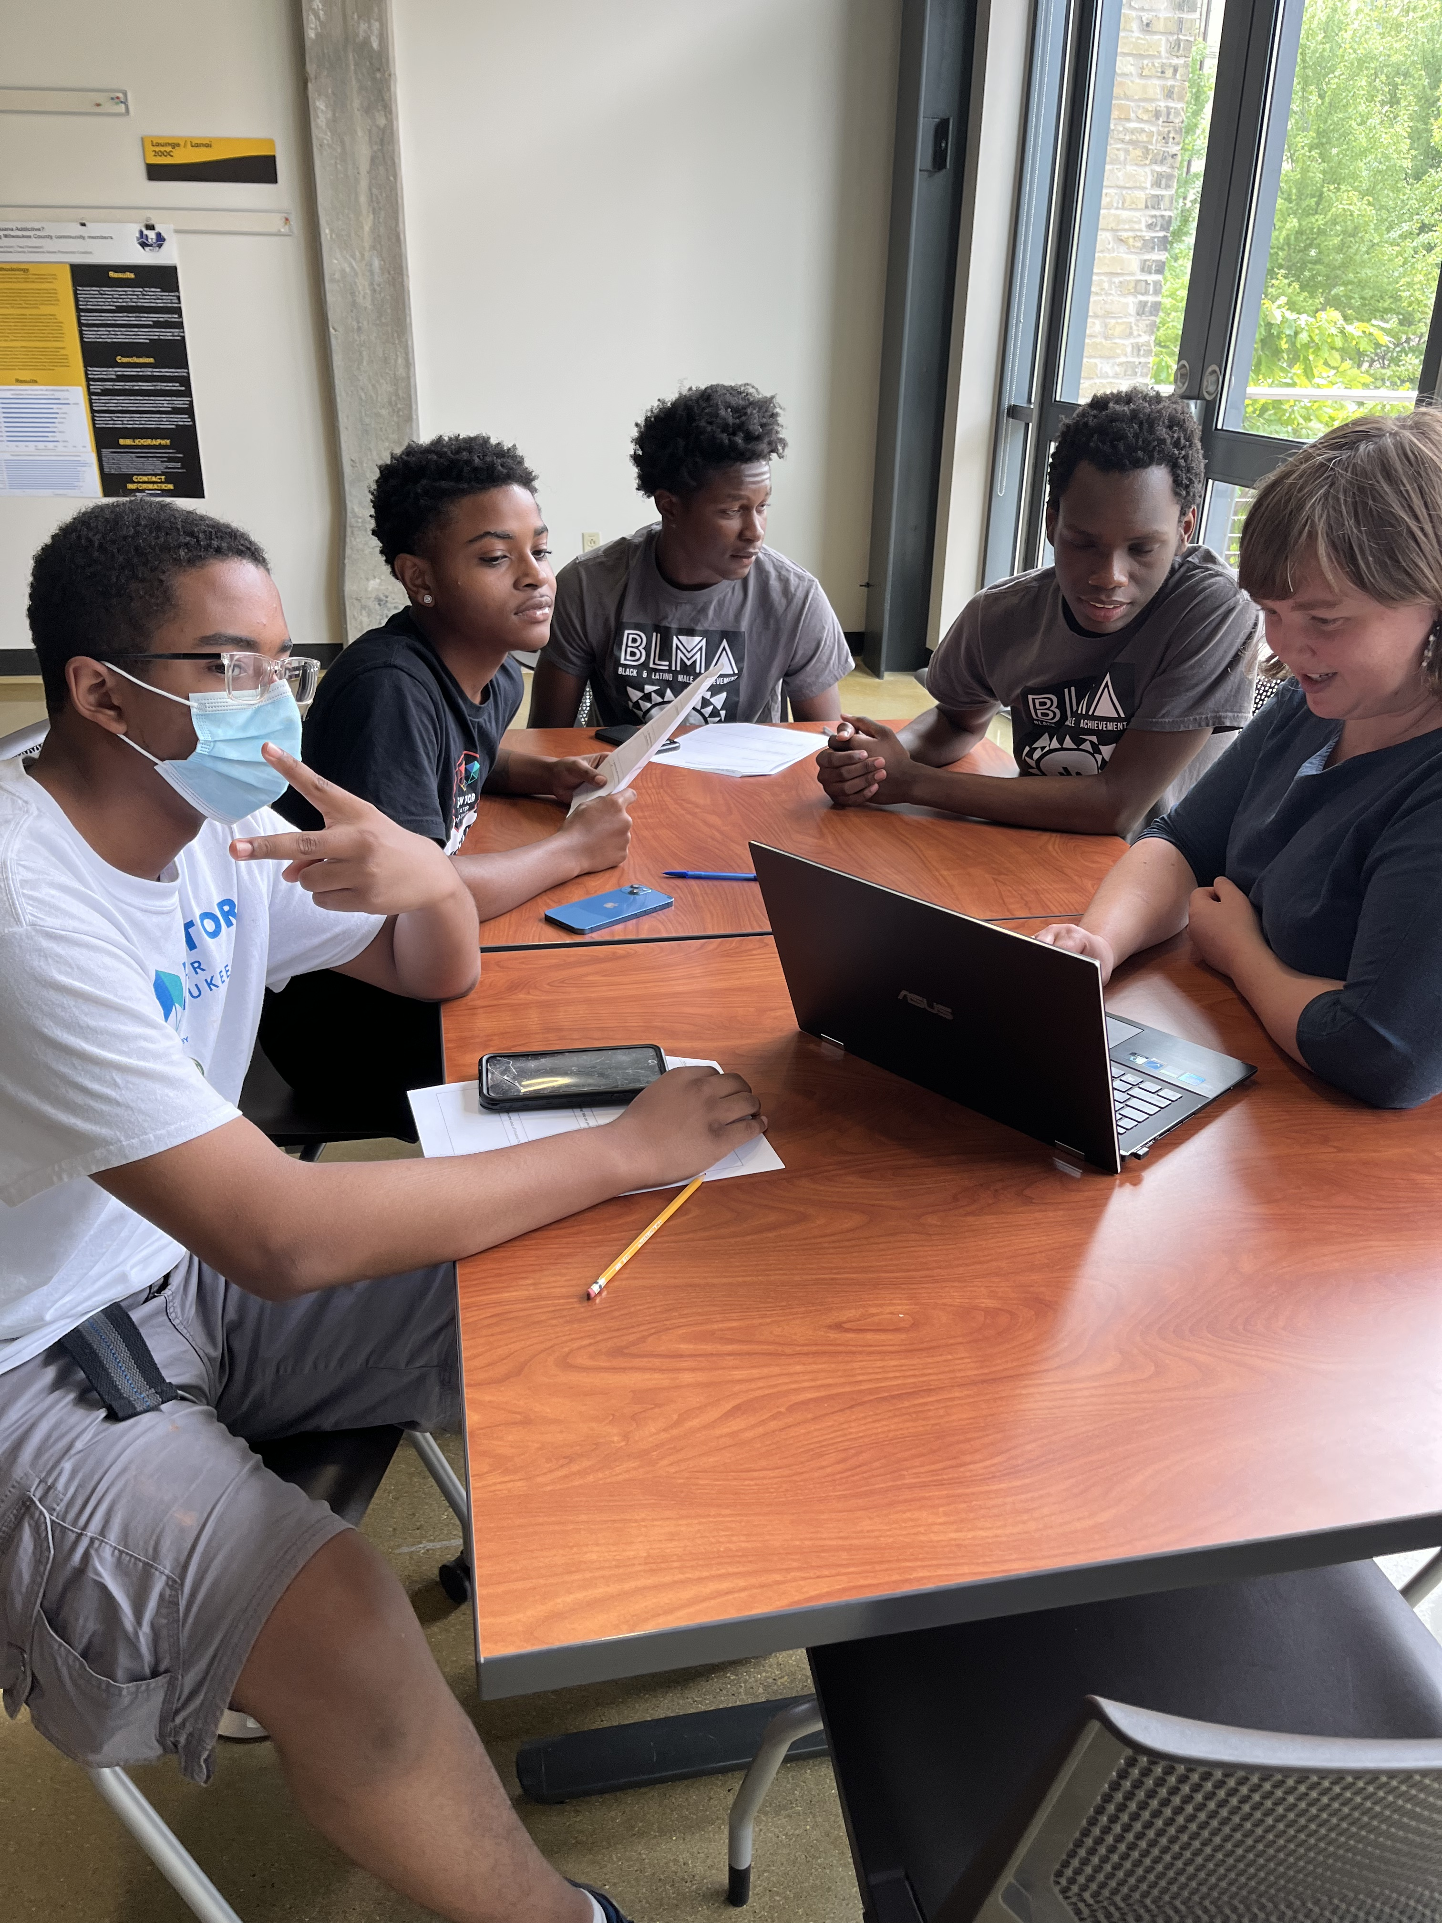
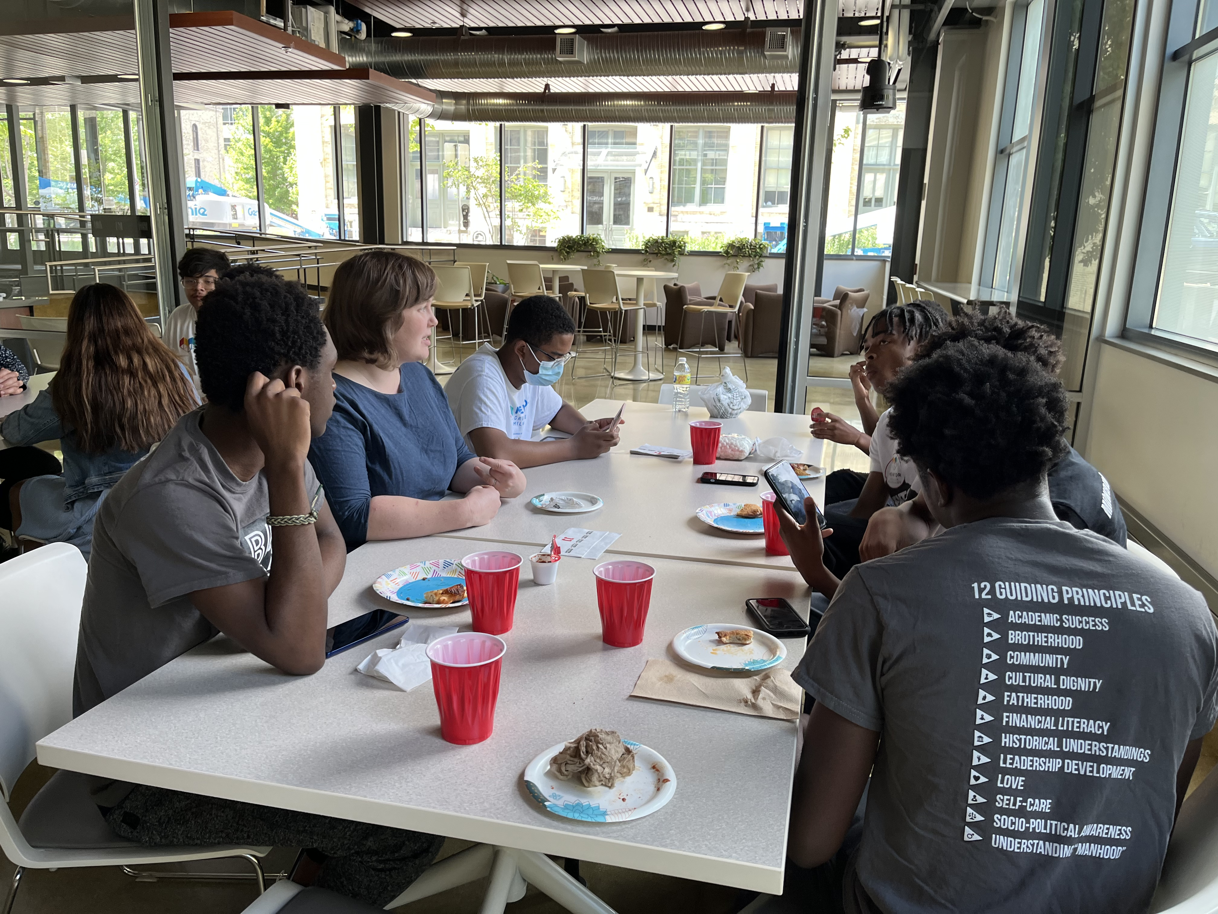
Summer Data Literacy Workshop
Ice breakers
Group lunch
Engaging Activities
Targeted learning styles
Visual
Auditory
Kinesthetic
Notes:
Additional tables/topics per the request of neighborhoods and/or funders

Slide 5
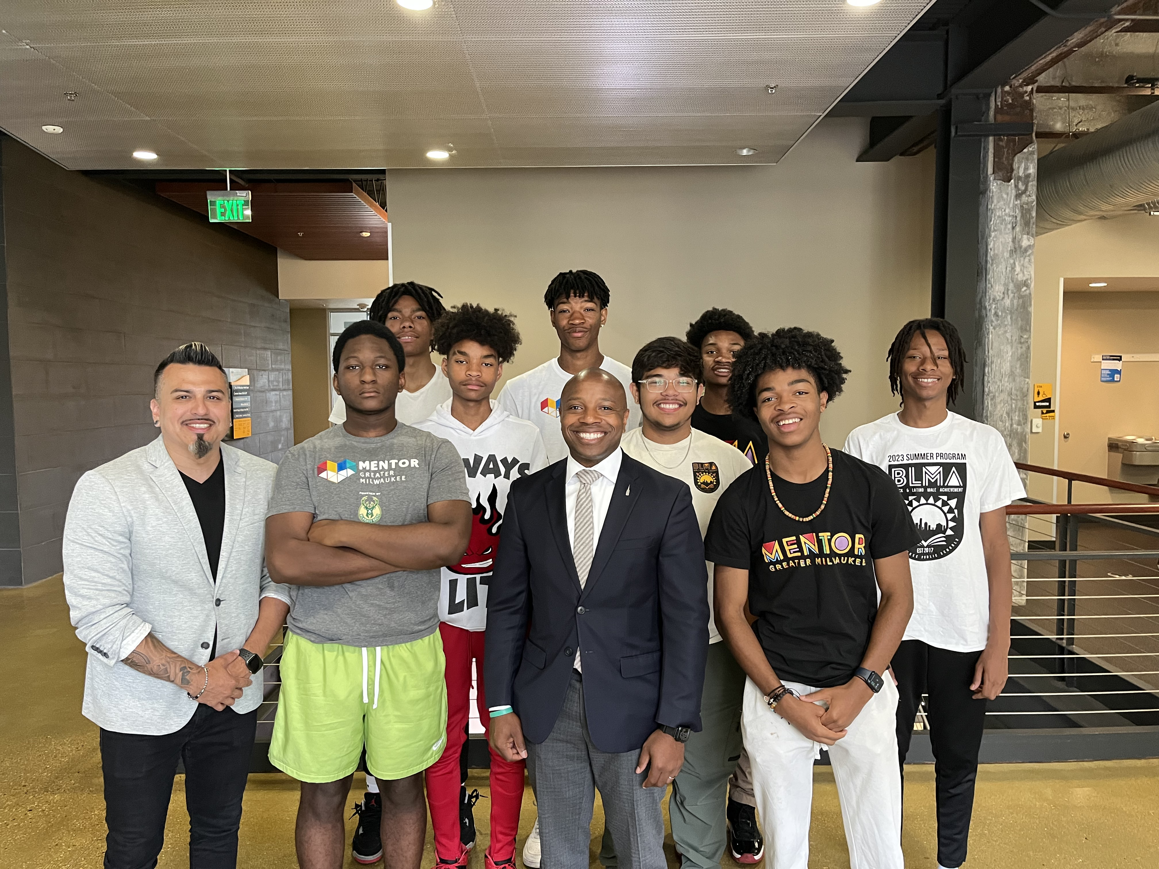
Summer Data Literacy Workshop II
Notes:
Additional tables/topics per the request of neighborhoods and/or funders

Slide 6
Notes:
Additional tables/topics per the request of neighborhoods and/or funders

Slide 7
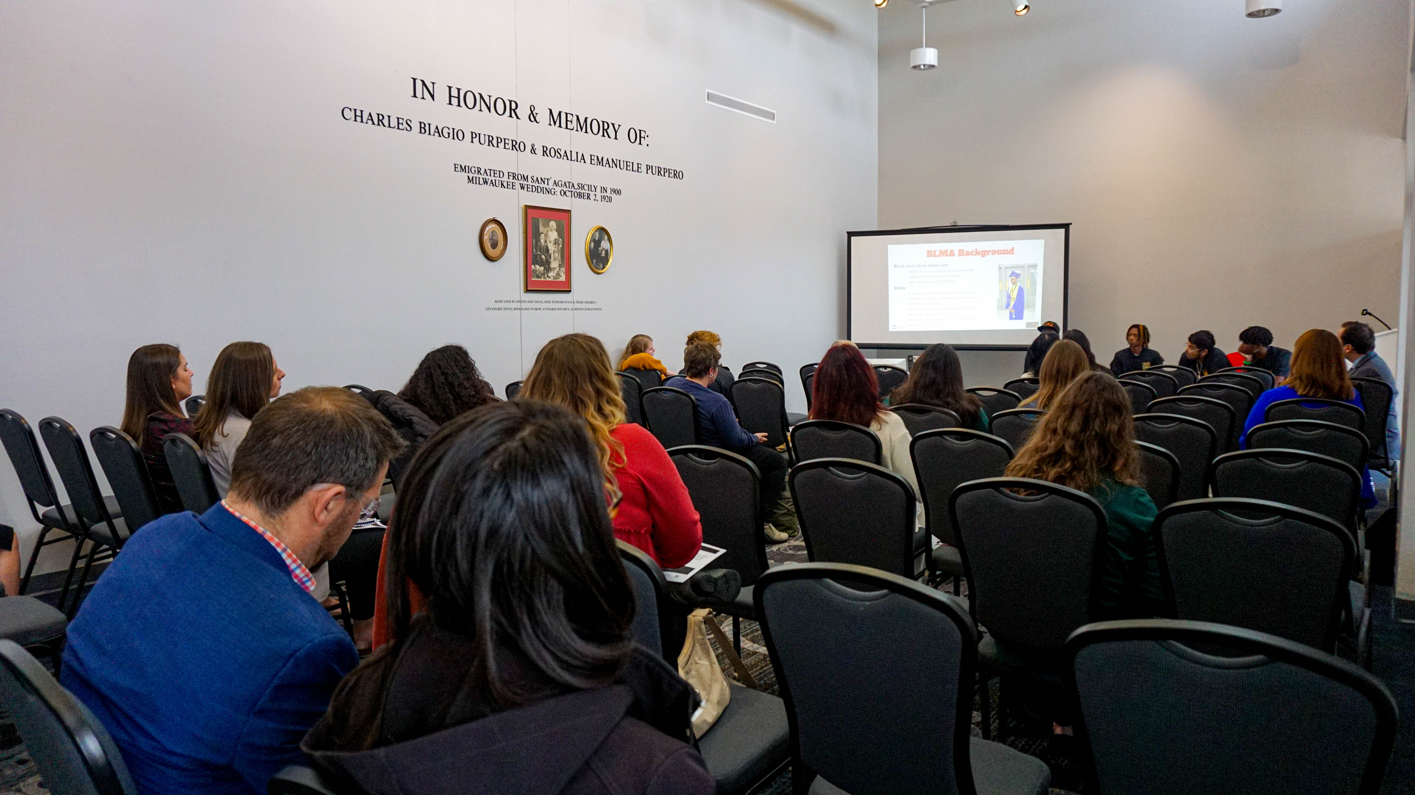
Summer Data Literacy Workshop II
Notes:
Additional tables/topics per the request of neighborhoods and/or funders

Slide 8
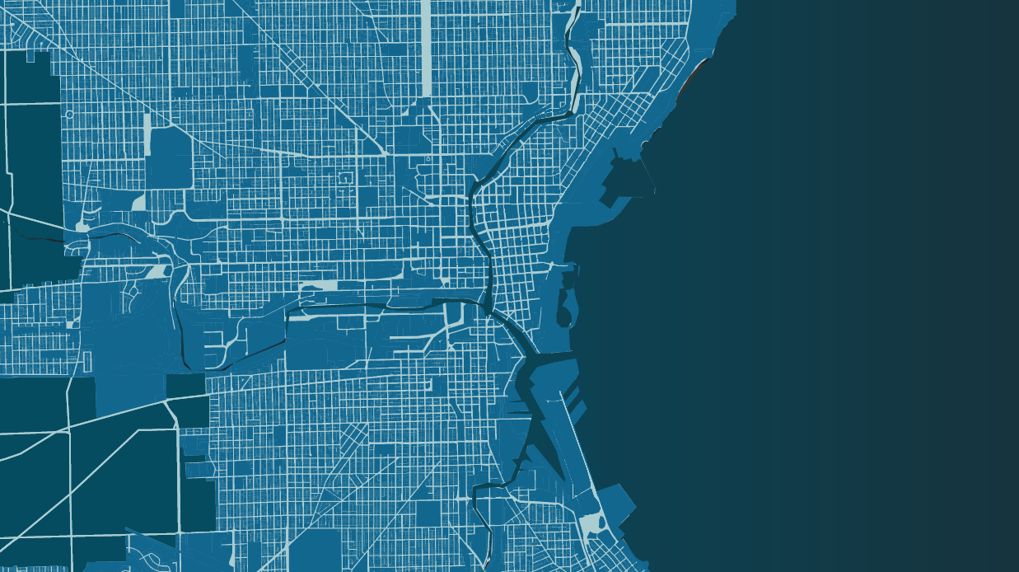
Report
Black Youth Achievement in Milwaukee
Made possible thanks to the support of the Robert Wood Johnson Foundation

Slide 9
Black Youth Achievement in Milwaukee
Looking at the bright spots of data in African American youth ages 6-24
Data Chat Model
20 different organizations engaged
8 organizations participated in the project
Notes:
Additional tables/topics per the request of neighborhoods and/or funders

Slide 10
Mental health
Participants highlighted barriers to mental health services such as a lack of culturally competent care for Black youth, social stigma and cultural norms, as well as stressors and traumas that are especially common experiences for the Black population.
“There have to be more therapists that understand the Black experience.”
“Black people are not allowed to have mental health issues that we can talk about.”
“Mental health in Black youth is at a crisis point in terms of the exposure. It is constant. It is not one person you know; it is several.”

Slide 11
After high school
Participants suggested that Black youth have doubts about the value of attending a traditional 4-year college.
Black student participation in Career Technical Education programs jumped in the 2020-21 school to three times the participation rate of the year before.
Entrepreneurship was highlighted by many participants as an area of growing interest to Black youth.
“What about the wage gap? Why are Black people going to go to college if I’m going to make less money than my White counterparts?”
“There are more programs for apprenticeship. I heard a kid say, ‘I want to be a welder’. I would not have heard that in the past. It is hard to get those jobs, but once you get them, it is good.”
“I see many of our youth go into entrepreneurship. They’d rather make money than rack up debt and pay thousands of dollars for school. They want to be their own boss.”

Slide 12
Black youth resiliency
Milwaukee’s Black youth face a variety of notable and unique challenges. Participants felt that the resiliency of Milwaukee’s black youth is not measured or highlighted in the proper ways.
“For me, in my experience, for this part of my life, I had to already overcome a lot of stuff. I come from a bad neighborhood, and for me, making it here and making it to 18, that’s an accomplishment.”
“The Black experience is a form of resiliency.”
“The data doesn’t capture the resilience of young people by going through these experiences. It is striking to me that there is not more data to show their resiliency.”

Slide 13
What resources are need in Milwaukee?
Participants highlighted:
Concerns about the negative narrative of Black youth in Milwaukee that perpetuates negative cycles.
The importance of authentically connecting with Milwaukee’s Black youth and considering what opportunities and limitations influence their daily lives.
The need for improved coordination among the nonprofits that support Black youth.
“When kids are labeled then they act according to their label.”
“We need more people that look like us to be in more programs and have the lived experience and resources.”
“We need long-term commitment. Nothing changes in a year.”

Slide 14
Next steps and research recommendations
Continue to update the data collected through this project in to identify what may be anomalies that were a result of the Covid pandemic and what may indicate trends.
1
Determine how definitions of homelessness may be affecting the data and how incarceration rates might affect population data.
2
Develop a plan for identifying, collecting, and analyzing indicators around Black youth resiliency, leadership, and entrepreneurism. Research how other cities collect this data.
3
Engage with local mental health organizations and advocacy groups to build a collaborative network for the support of Black youth.
4
Ensure alternative educational pathways are effectively communicated to students, offering them choices that fit their personal circumstances and goals.
5
Explore public-private partnerships to bridge the resource gap in technology and infrastructure available in Milwaukee schools.
6

Slide 15
Connect with us to learn more datayoucanuse.org
Thank you!
Dr. Victor Amaya
President and Executive Director
Data You Can Use
victor@datayoucanuse.org
Amy Rohan
Program Manager – Data Access and Community Engagement
Data You Can Use
amy@datayoucanuse.org
Danya Littlefield
Program Manager – Community Research and Data Communication
Data You Can Use
danya@datayoucanuse.org

