Slide 1



Equity &
Community Data Governance
Dr. Lori Thomas, UNC Charlotte Urban Institute + Charlotte Regional Data Trust
Dr. Jackie Tynan, City of Charlotte
Notes:
Photo Myles Gelbach, posted by WFAE – Lori inquiring about purchasing
We would like to share key initiatives on equity and community data governance, that include the development of a criminal justice and violence prevention data collaborative, a Community Data Advisory Committee, and the Impact, Data and Evaluation Academy (IDEA). We'll identify the early challenges, persistent tensions, and collaborative solutions in the work and we'll discuss how the data collaborative fits into the data strategy at the City of Charlotte and how all three strategies help scaffold the strategic equity work of the UNC Charlotte Urban Institute + Charlotte Regional Data Trust.

Slide 2
Institute + Data Trust
Strategic Equity Initiatives
Notes:
Photo Myles Gelbach, posted by WFAE – Lori inquiring about purchasing

Slide 3
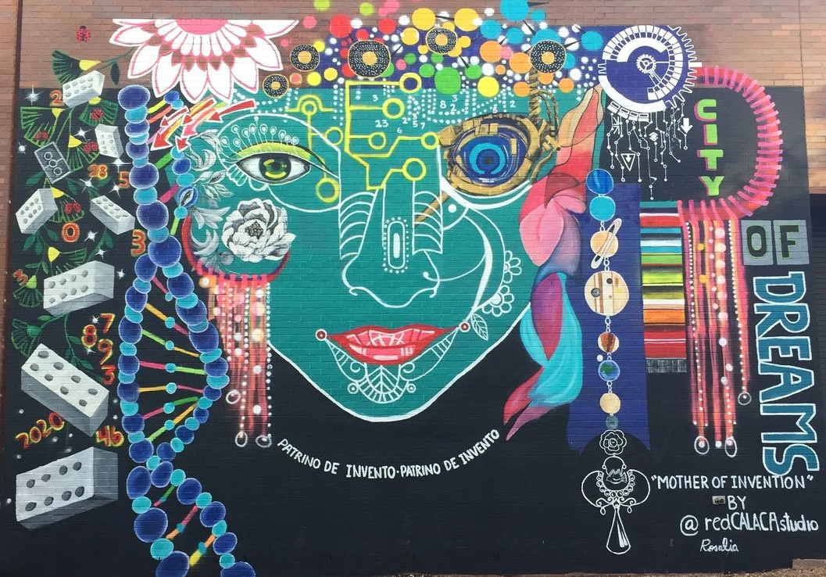
Strategic Equity Initiatives
People
Operations
Representation
Staff
Faculty
Students
Guiding values
Business model
Data + Research
Collaboration
Metadata
Context
Advisory committees
Capacity Building
Research agenda
Data walks
Data collaboratives
Notes:
Location: 301 N. Tryon Street wall along E. 6th Street
Artist: Rosalia Torres-Weiner
Date: 2019
Media: Acrylic paint
Artist Info: @redcalacastudio

Slide 4

Community Data Advisory Committee
Vision
of CDAC Planning Team
To create intentional and formal processes to share oversight of the Charlotte Regional Data Trust data with those whose lives are represented, and particularly overrepresented in the data,
To integrate community expertise and insight,
To ensure ethical and accurate use and interpretation of the data, and
To structure meaningful community involvement.

Slide 5
Community Data Advisory Committee
1
Ethical use
2
Relevant Qs
Goals:
Ensure ethical and respectful data and research practices
Provide strategic guidance on research questions relevant to the community
3
Shared
4
Accountable
5
Capacity
Ensure that research using Data Trust data is relevant, available and shared with the community
Build collective accountability with the Charlotte-Mecklenburg community
Coach, train, and share information with the Charlotte-Mecklenburg community

Slide 6

Community Data Advisory Committee
Engagement
Lived experience
Criteria:
Social service, community organizing, civic or community engagement experience
Direct lived or work experience or another connection to partner systems/agencies
Accountable
Values
Representative
Accountable to a group of community members, leaders, and organizers
Has values that align with CDAC’s work
Representative of the individuals represented and overrepresented in the Data Trust’s data
Notes:
Also:
-Clear vision for own work
-at least 1-2 years organzing/engagement experience

Slide 7
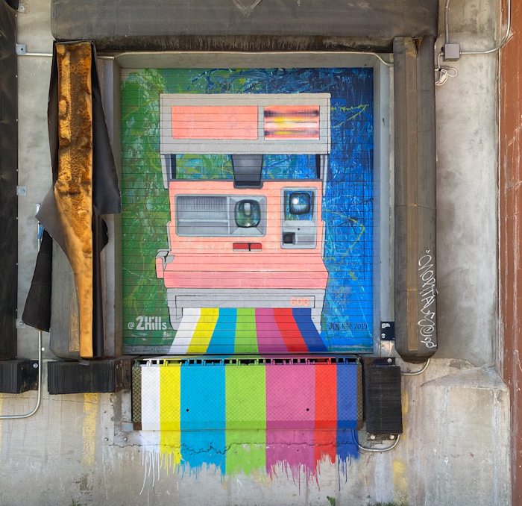
Impact, Data & Evaluation Academy (IDEA)
A community-built and driven continuing education and capacity building initiative with three core intentions:
Participatory development of the curriculum to best meet the needs of organizations in our community,
Affordable access to quality education on evaluation and data management, and
Equitable practices that value the needs and lived expertise in the Charlotte region, particularly in small and grassroots organizations.

Slide 8
Impact, Data & Evaluation Academy (IDEA)
1
The IDEA Training and Certificate Program
2
The IDEA Data Stewardship Program
provides practical and affordable short courses on the key components of effective and equitable data and research/evaluation infrastructures, as well as elective offerings on specific research and data tools (for example, participatory mapping or using Canva for storytelling). Participants can choose to work toward the IDEA Certificate or simply enroll in the courses they are most interested in.
assesses the data infrastructure of small and grassroots human service organizations and provides practical and feasible recommendations to strengthen data practices for use in decision making and to document impact. Stewardship services are provided by graduate students. Participating organizations can engage concurrently with certificate courses or as a separate engagement.

Slide 9
Impact, Data & Evaluation Academy (IDEA)
Process
People
Participatory Group Level Assessment to identify curricular features
Pilot year of course and stewardship engagements
Course correction & implementation
Advisory workgroup
Assessment & curriculum development workgroup
Assessment participants
Community review workgroup
Staff leadership & participation

Slide 10
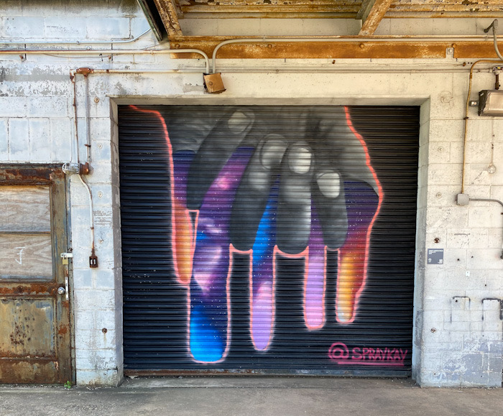
Criminal Justice & Violence Prevention Data Collaborative (VPCD)
A collaborative, cross-sector approach that is data-driven, evidence-informed, and guided by a robust evaluation framework
Governed by a formal MOU
  Identified partners
  Governance
  Priorities
  Expectations

Slide 11
Criminal Justice & Violence Prevention Data Collaborative (VPCD)
Purpose
Priorities
Share and analyze data
Addresses Community violence as a serious public health problem that impacts people in all stages of life, from infancy to adulthood
Drive cross-sector collaboration
Development of and reporting on shared indicators
Facilitating data sharing to support implementation of violence prevention programs,
Analysis and interpretation of available data
Development and implementation of evaluation plans

Slide 12
Criminal Justice & Violence Prevention Data Collaborative (VPCD)
Partners
Mecklenburg County Health Department, Co-Chair
City of Charlotte I&T Department, Co-Chair
Mecklenburg County
  Criminal Justice Services
  Community Support Services
  Sherriff’s Office
  Department of Social Services
Charlotte-Mecklenburg
  Police Department
  Board of Education
Atrium Health
Johnson C. Smith University
University of North Carolina at Charlotte
Charlotte Regional Data Trust
Projects
Actionable Intelligence for Social Policy - Equity in Practice Learning Community (EiPLC)
  Grant awarded to Charlotte Regional Data Trust in 2022
  Collaboration of VPDC
Dashboards
Evaluations
Research Project using integrated data from the Charlotte Regional Data Trust
Dissemination

Slide 13
City of Charlotte
Data Strategy
Notes:
Photo Myles Gelbach, posted by WFAE – Lori inquiring about purchasing

Slide 14
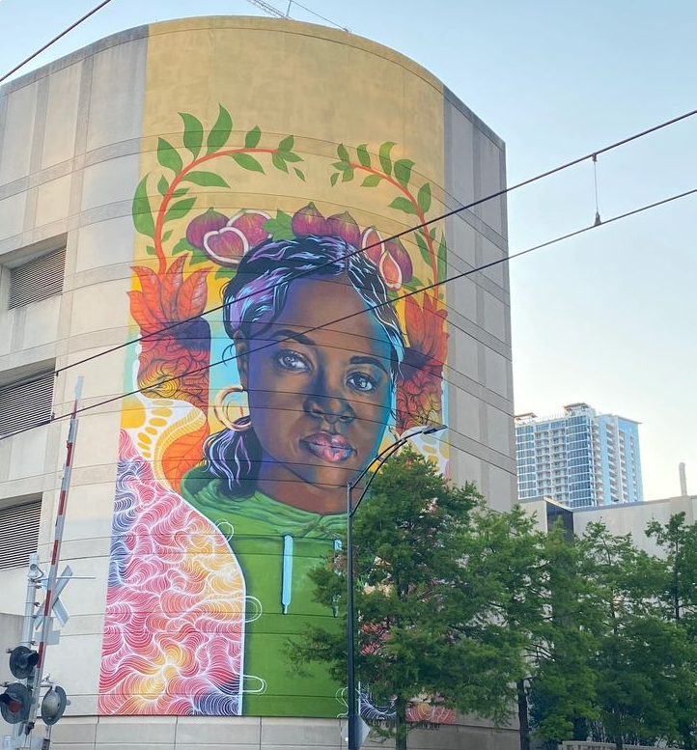
Applying to City of Charlotte Data Strategy
1
Internal
2
External
Data Governance
Data Integration
Mindful Transparency
Open data portal
Smart Cities program
3
Collaborations
4
Metadata
Data Collaborative & Equity in Practice Learning Community
Bloomberg Philanthropies Evaluation Track
Documenting and contextualizing
Notes:
Title: “Where Inspiration and Strength Blooms”
Location: Beside Convention Center at light rail
Artist: Owl, Sam Guzzie, Kalin Renee Devone
Date: 2022
Media: Spray paint
Artist Info: @owl.clt, @samguzzie, @kalin_renee

Slide 15
Shout Out to Featured Charlotte Creatives!
Sunset in the Carolinas
Myles Gelbach
Camp North End Mural
Jen Hill
Camp North End Mural
Kristi Kirkpatrick
Where Inspiration and Strength Bloom
Owl, Sam Guzzie, Kalin Renee Devone
CHARLOTTE
Bree Stallings x Various Artists
(Deneer Davis, 2 G’s, Mike Wirth, Dammit Wesley, Owl, King Carla, Frankie Zombie)
City of Dreams
Rosalia Torres-Weiner
Thank you!
LoriThomas@charlotte.edu
Jackie.Tynan@charlottenc.gov
Notes:
Photo Myles Gelbach, posted by WFAE – UI has purchased copyright
We would like to share key initiatives on equity and community data governance, that include the development of a criminal justice and violence prevention data collaborative, a Community Data Advisory Committee, and the Impact, Data and Evaluation Academy (IDEA). We'll identify the early challenges, persistent tensions, and collaborative solutions in the work and we'll discuss how the data collaborative fits into the data strategy at the City of Charlotte and how all three strategies help scaffold the strategic equity work of the UNC Charlotte Urban Institute + Charlotte Regional Data Trust.

