Slide 1
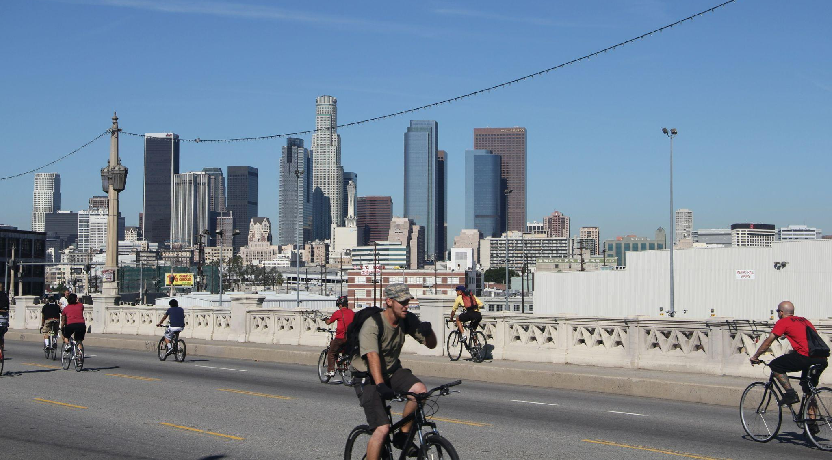
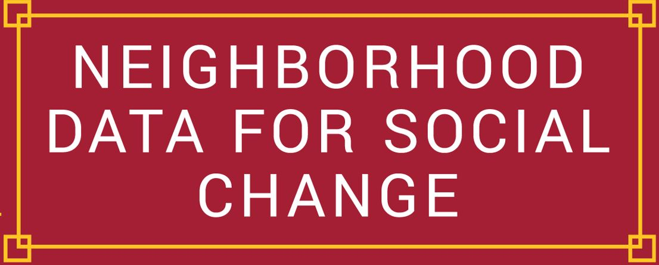
Lessons from
California Community Foundation’s
Regional Recovery Hub
Elly Schoen, Systems & Data Manager
Photo via lasubwayblog on Flickr
@USC_NDSC

Slide 2
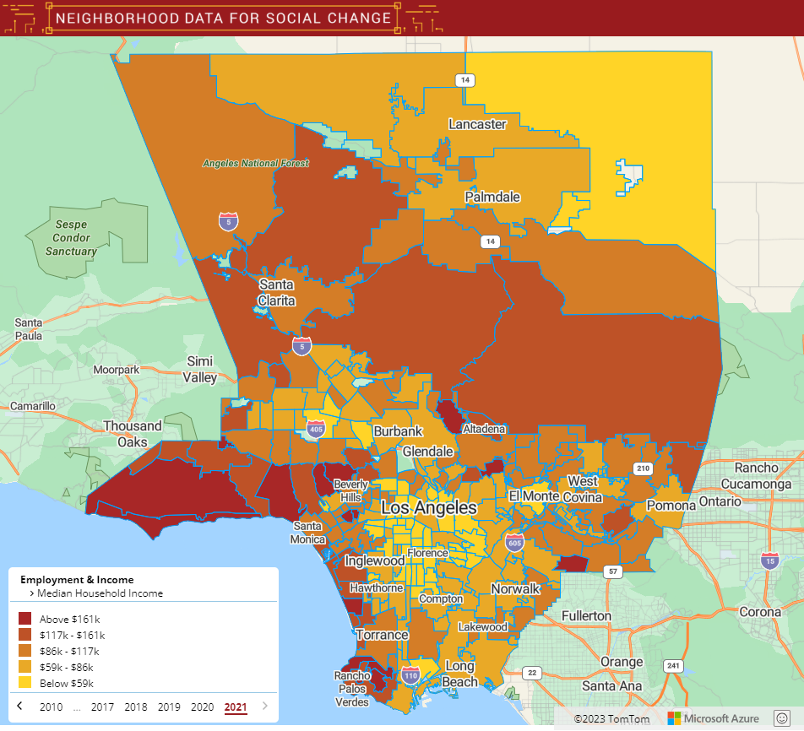
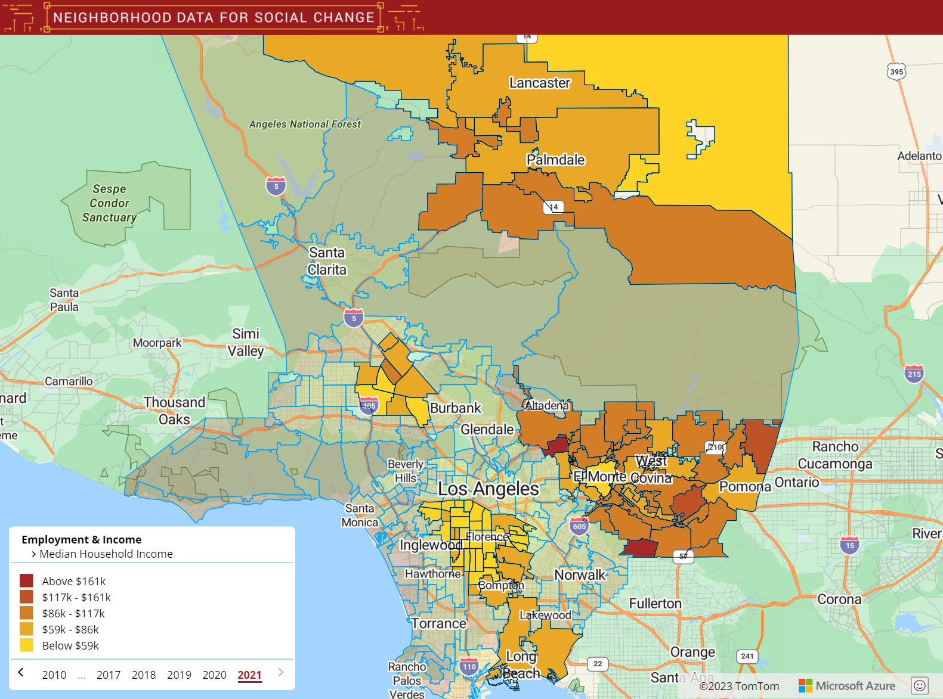
Regional Approaches to Big Challenges
275 Neighborhoods
6 Regions
@USC_NDSC

Slide 3
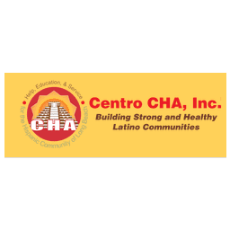
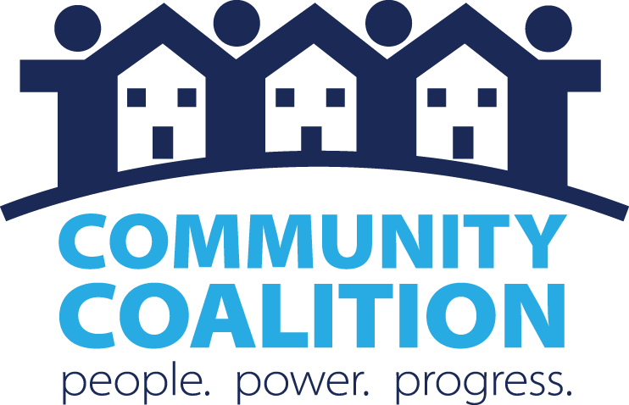
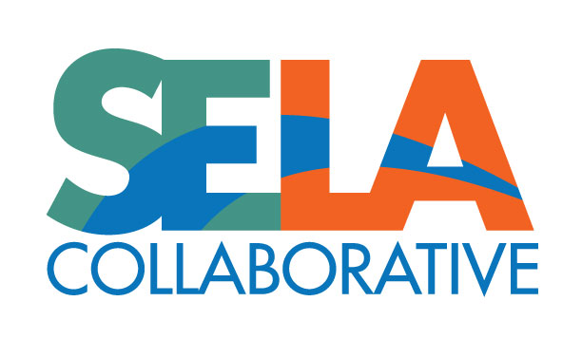
Regional Recovery Hub
Antelope Valley
$7 million
San Gabriel Valley
San Fernando Valley
South LA
Southeast LA
Long Beach
@USC_NDSC

Slide 4
Regional Recovery Hub
Antelope Valley
$7 million
San Gabriel Valley
San Fernando Valley
South LA
Southeast LA
Long Beach
@USC_NDSC

Slide 5
Regional Recovery Hub
Shared Framing:
Structural Racism & Historic Disinvestment as the Root Causes of Inequities
Shared Values:
Community Leadership
Partnering Authentically
Asset Framing Approach to Problem Solving
@USC_NDSC

Slide 6
Regional Recovery Hub
Shared Framing:
Structural Racism & Historic Disinvestment as the Root Causes of Inequities
Shared Values:
Community Leadership
Partnering Authentically
Asset Framing Approach to Problem Solving
@USC_NDSC

Slide 7
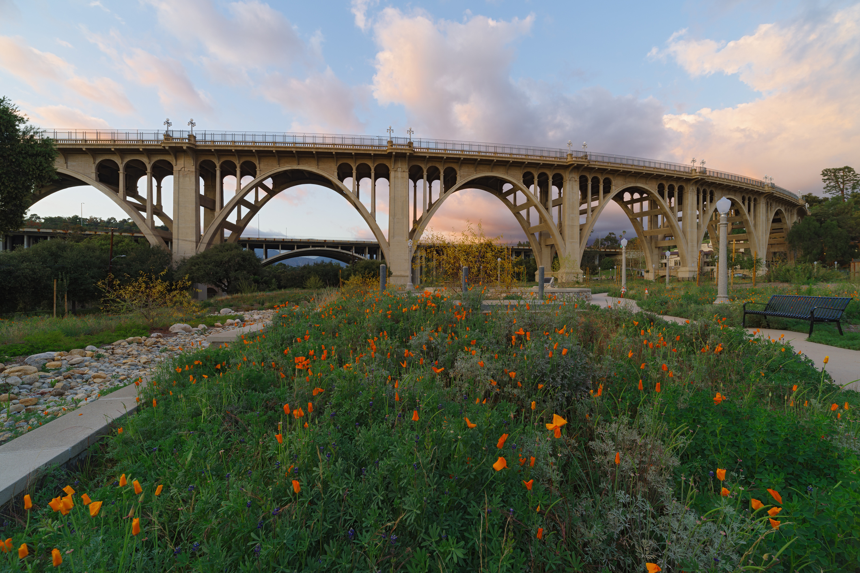
Lessons: Community Voice
We strive to incorporate community voice and collaborate with residents on research design, data collection, interpretation, and dissemination.
We strive to produce and share data analyses to benefit the people and communities that have been harmed in the past.
@USC_NDSC

Slide 8
Lessons: Community Voice
We strive to incorporate community voice and collaborate with residents on research design, data collection, interpretation, and dissemination.
We strive to produce and share data analyses to benefit the people and communities that have been harmed in the past.
@USC_NDSC

Slide 9
Lessons: Community Voice
We strive to incorporate community voice and collaborate with residents on research design, data collection, interpretation, and dissemination.
We strive to produce and share data analyses to benefit the people and communities that have been harmed in the past.
@USC_NDSC

Slide 10
Lessons: Community Voice
We strive to incorporate community voice and collaborate with residents on research design, data collection, interpretation, and dissemination.
We strive to produce and share data analyses to benefit the people and communities that have been harmed in the past.
@USC_NDSC

Slide 11
Lessons: Community Voice
We strive to incorporate community voice and collaborate with residents on research design, data collection, interpretation, and dissemination.
We strive to produce and share data analyses to benefit the people and communities that have been harmed in the past.
@USC_NDSC

Slide 12
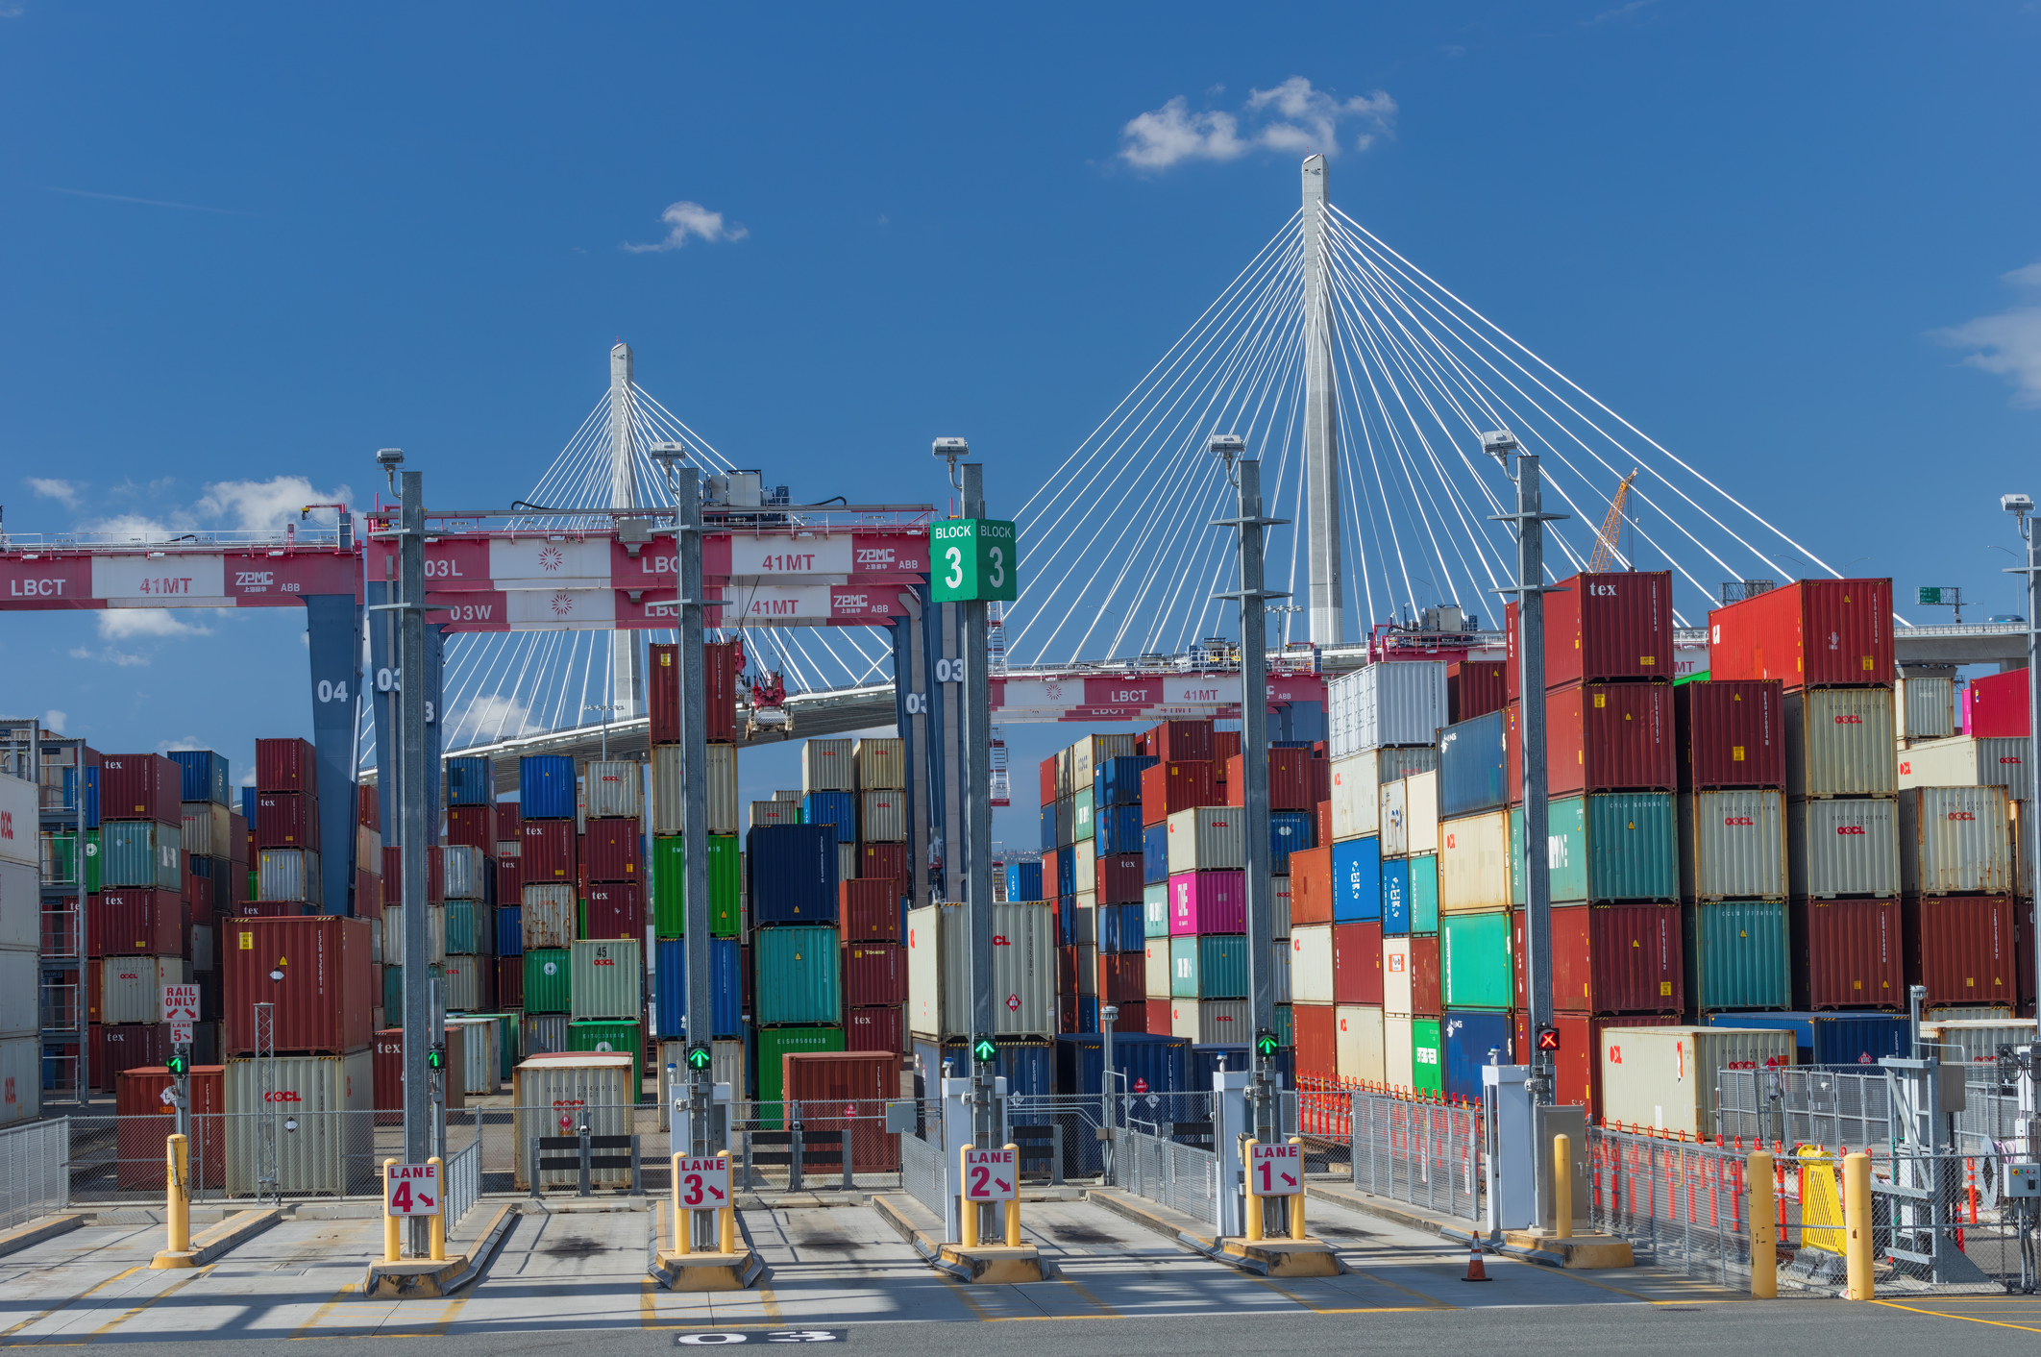
Lessons: Systems Framing
We strive to identify and name the root causes and the systems that perpetuate inequities.
@USC_NDSC

Slide 13
Lessons: Systems Framing
We strive to identify and name the root causes and the systems that perpetuate inequities.
@USC_NDSC

Slide 14
Closing & Thanks
ebschoen@usc.edu
@elly_schoen
@USC_NDSC

Slide 15
Closing & Thanks
ebschoen@usc.edu
@elly_schoen
@USC_NDSC

