Slide 1
Community Surveying in Oakland
Violence Prevention & Public Safety
Maya Salcido White
Urban Strategies Council

Slide 2
Measure Z: Public Safety and Violence Prevention Evaluation
Measuring impact of Measure Z funding (2014)
Urban Strategies Council local partner to Urban Institute
Evaluation dates: June 2022 - June 2025

Slide 3
Data Sources
City databases for Department of Violence Prevention and Oakland Police Department services
What services are funded, who they serve, effectiveness of services
Interviews and focus groups with service providers and participants
Community surveys

Slide 4
Community Survey 2023 Domains
Neighborhood safety
Experiences with violence in Oakland
Perception of Oakland Police Department
Encounters with Police Department
Knowledge and accessibility of public services

Slide 5
Community Survey Collection Method:
Town Nights
Funded as a part of the Department of Violence Prevention’s Community Healing & Restoration strategy
6 Friday nights in the summer
9 locations across Oakland

Slide 6
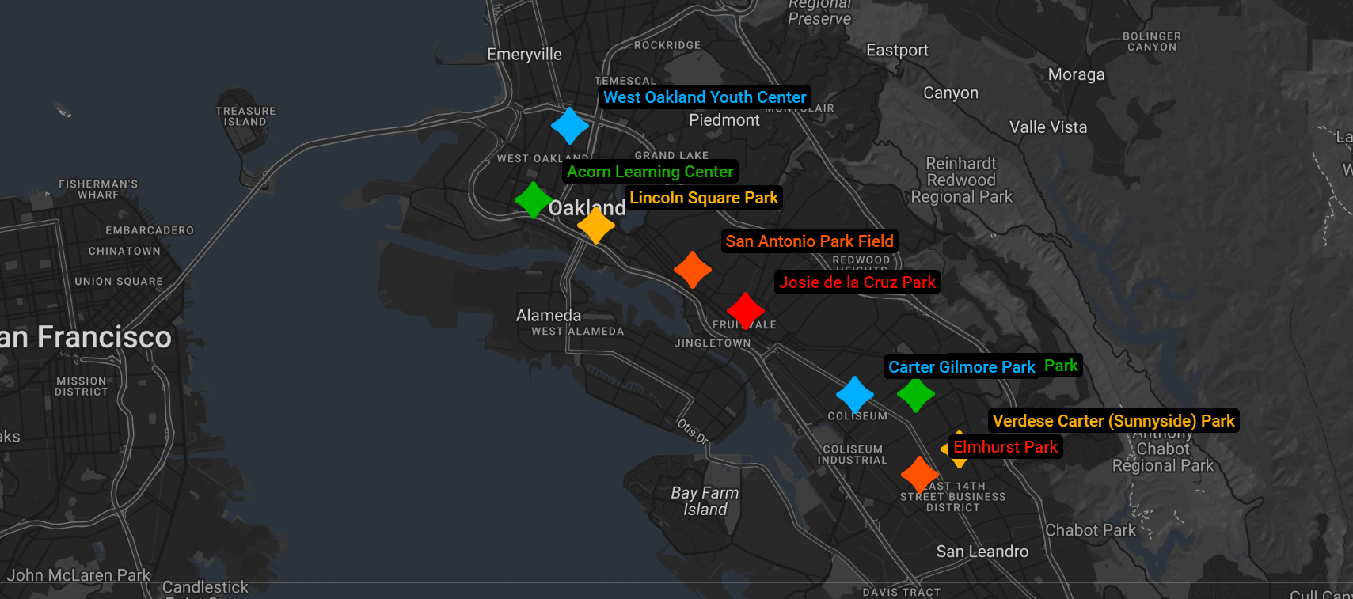
Town Nights Locations

Slide 7
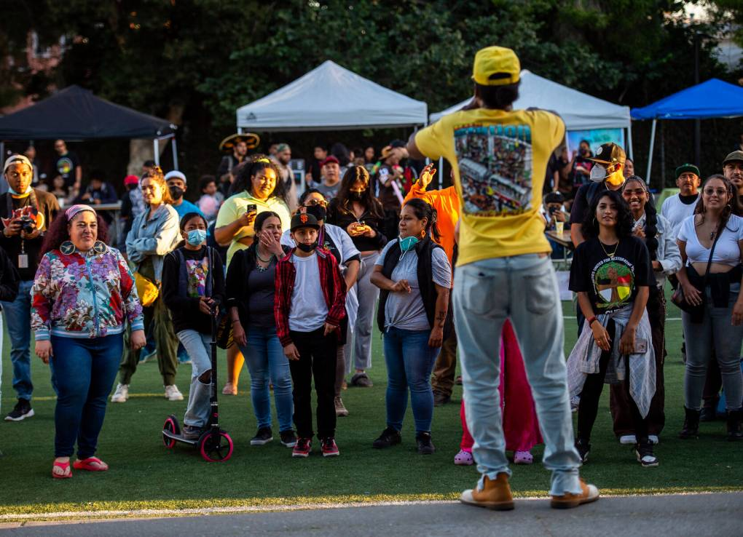
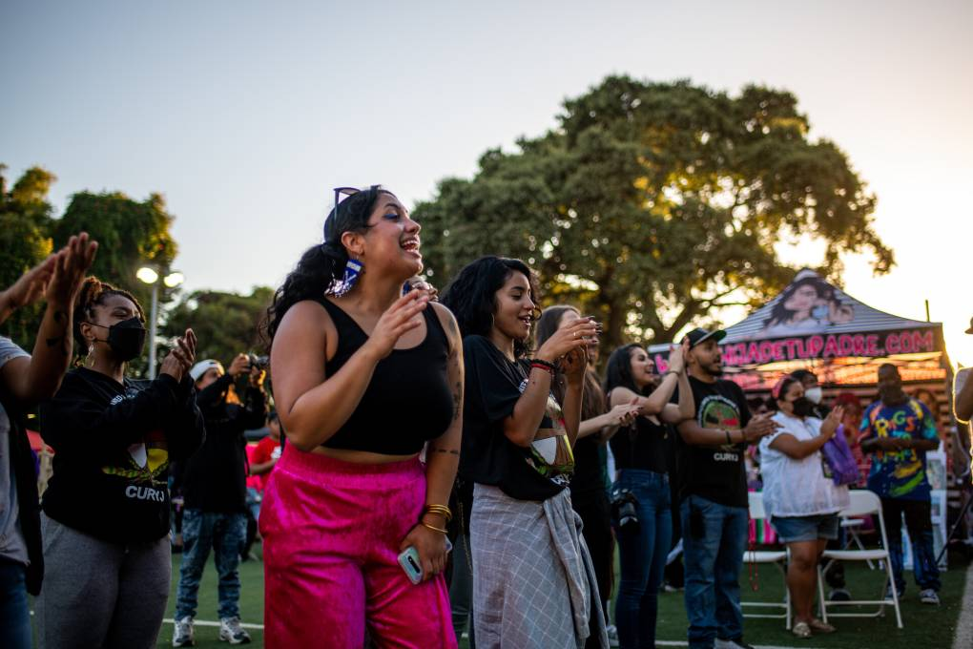
Activities at Town Nights
Food
Entertainment
Dance competitions, bouncy houses, face painters, local artists, basketball tournaments, prizes
Services
Massages, haircuts, health services
Everything free of charge

Slide 8
Surveying at Town Nights
Options: electronic surveys (phone & tablets), paper surveys
Translations into Spanish, Chinese, Arabic
30 minutes to complete survey
$50 gift card

Slide 9
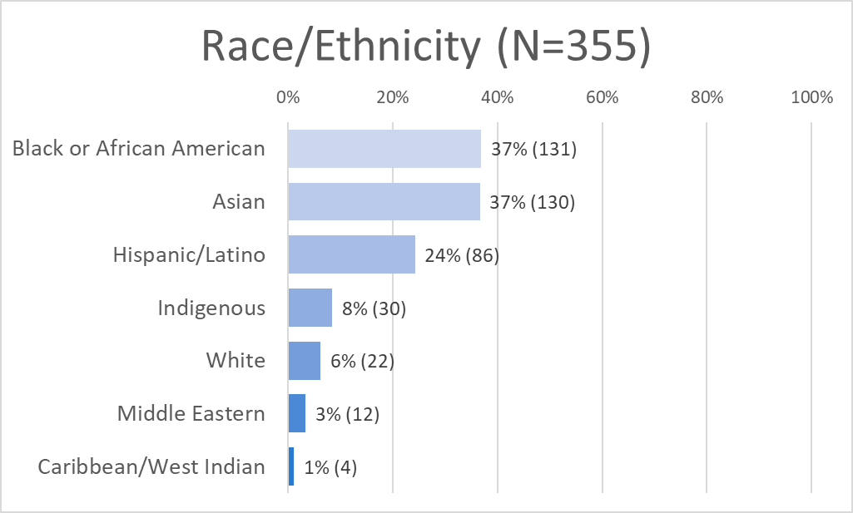
Survey Results - Demographics

Slide 10
Concerns about Public Safety
Percentage of survey respondents who were concerned about becoming victims to the following crimes in their daily routines:
Car theft: 81% (N=282)
Shooting or shooting attempts: 79% (N=276)
Homicide: 74% (N=260)
Stabbing or stabbing attempts: 73% (N=259)

Slide 11
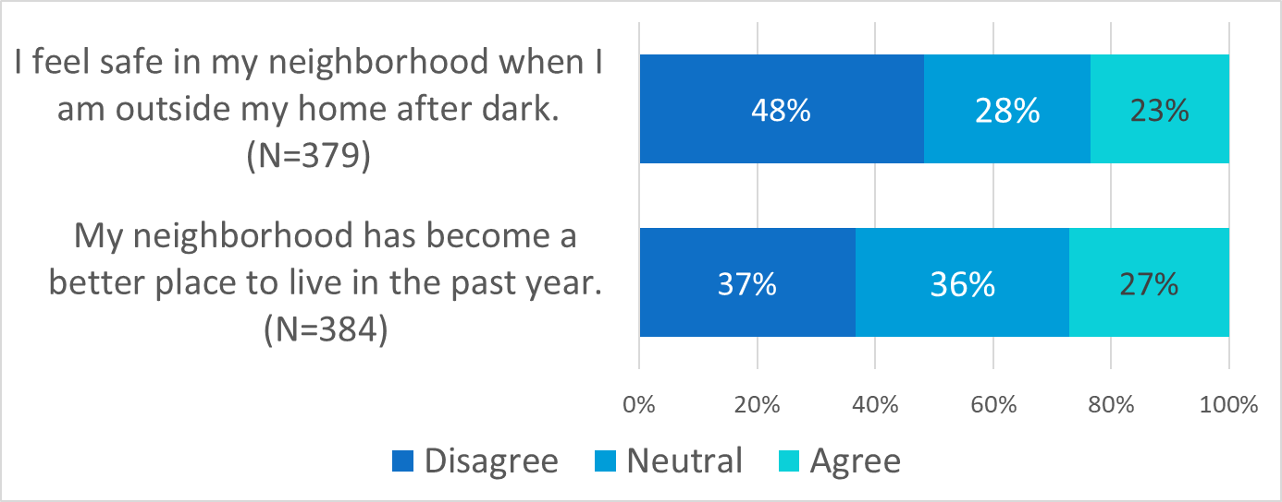
Perceptions of Neighborhood Safety
Notes:
Nearly half of residents who took the survey expressed that they didn’t feel safe in their neighborhood after dark.
Only 27% of residents who took the survey agreed that their neighborhood has become a better place to live in the past year.

Slide 12
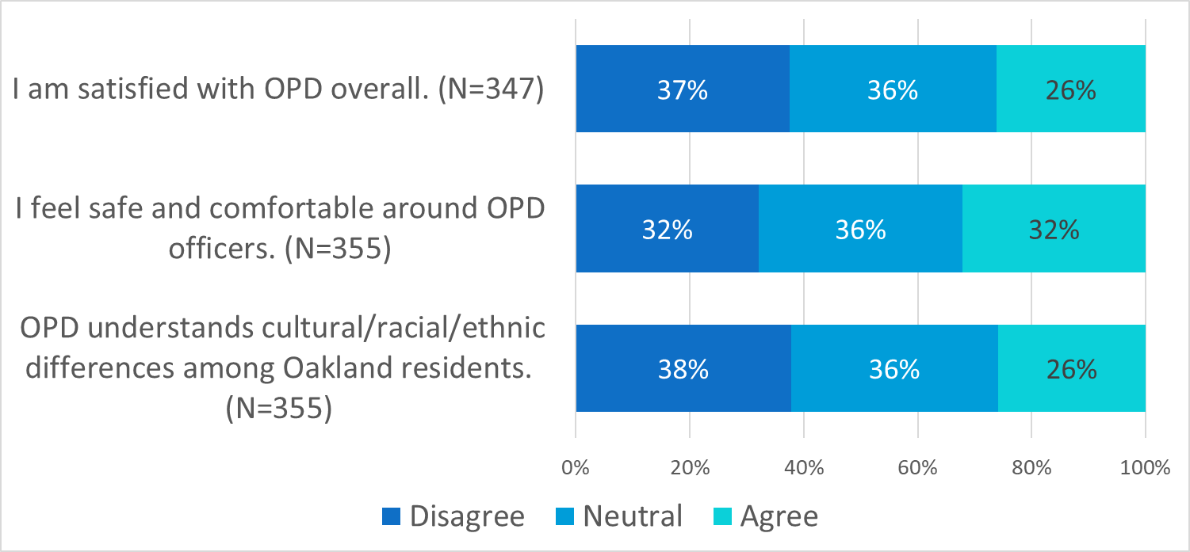
Perceptions of Oakland Police Department

Slide 13
Perceptions of Oakland Police Department
“I am satisfied with OPD overall.”
38% of Black/African American respondents disagreed (42% neutral)
45% of Hispanic/Latinx respondents disagreed (26% neutral)
“I feel safe and comfortable around OPD officers.”
39% of Black/African American respondents disagreed (34% neutral)
33% of Hispanic/Latinx respondents disagreed (31% neutral)

Slide 14
Qualitative Responses
“If more OPD officers actually grew up in the Town & not in other areas they would have more sympathy & authentic ideals in the way they police us.”
“Hard to comment on how well police do their job when they don't show up.”
“Police need to get out of schools and more counselors available for children.”

Slide 15
Future Work Planned
Continuation of community survey in Summer 2024
Extensive qualitative data collection - service providers & participants, OPD officers

