Slide 1
Opportunity & Innovation in Los Angeles
Gary Painter
Director
USC Sol Price Center for Social Innovation

Slide 2
About the USC Price Center for Social Innovation
The USC Sol Price Center for Social Innovation was established in 2011 with a generous gift from Price Philanthropies to name and endow the USC Price School of Public Policy.
Mission: The Price Center develops ideas and illuminates strategies to improve the quality of life for people in low-income, urban communities.
We fulfill this mission through research, education, and community engagement, with a particular eye toward understanding large-scale change efforts in places and populations.

Slide 3
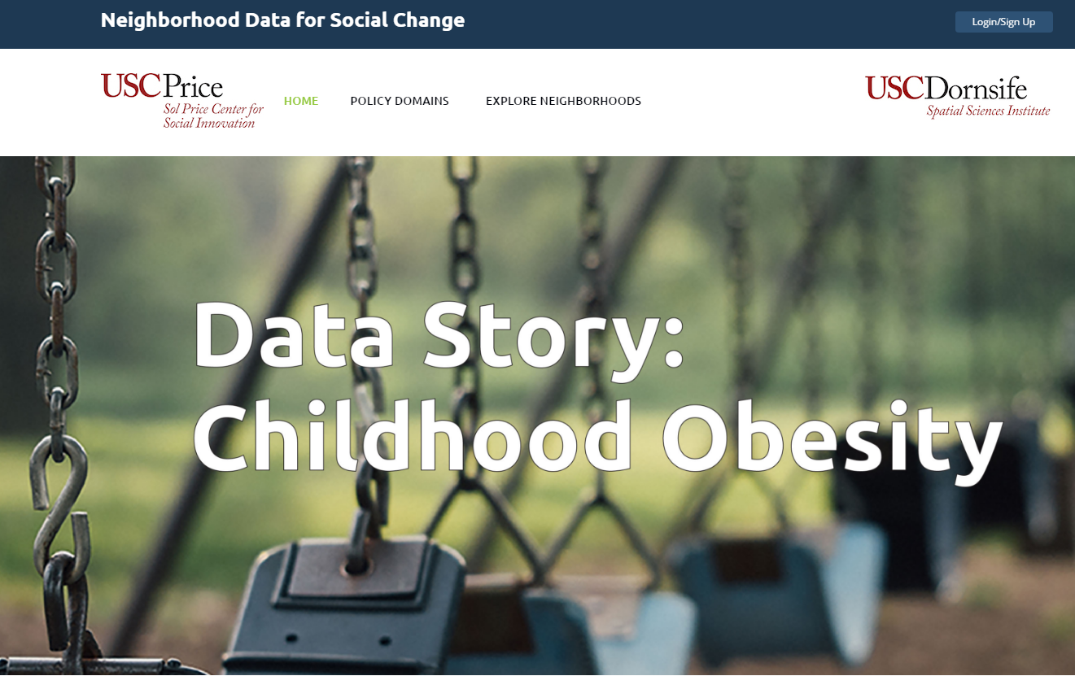
Neighborhood Data for Social Change
The Neighborhood Data for Social Change (NDSC) platform is the Price Center’s new user-friendly online data resource that allows nonprofit organizations, advocacy groups, and government agencies to access reliable, aggregated data at the neighborhood level.
The NDSC platform will feature a series of narrative-based data stories on a variety of policy issues.
Notes:
NDSC houses data from ten different policy domains, including: demography, employment & income, education, housing & real estate, food insecurity, health, transportation, public safety, social connectedness & awareness, and environment.
The platform pairs data with narrative-based explanations and visualization tools, such as data analysis, digital mapping, and report creation.
These narrative and visual components set the NDSC platform apart form other data repositories, making the tool widely accessible and user friend for all levels of data literacy.
The platform, which will be open to the public, will empower local governments, nonprofit organizations, and the broader public to better incorporate data into their local programs, helping them develop evidence-based policy solutions to address the most urgent challenges facing their communities.

Slide 4
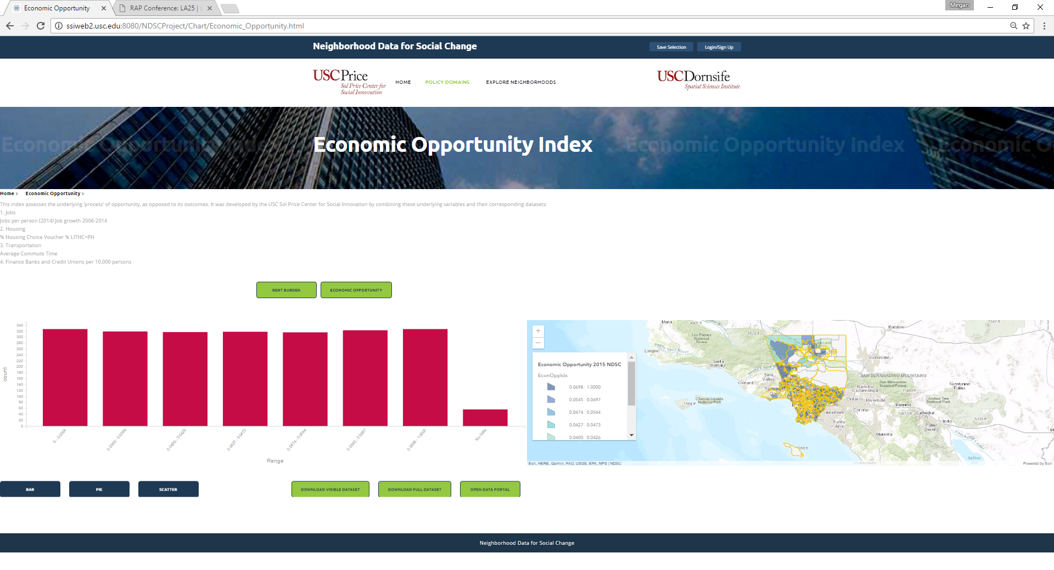
Neighborhood Data for Social Change
Notes:
Add content about “economic opportunity” index, as well as “risk and vulnerability” index, and “connectedness” index

Slide 5
Other Recent Price Center Projects
Opportunity Youth in the City of Los Angeles
With funding from the Mayor’s Fund of LA, the Price Center analyzed the challenges and opportunities facing opportunity youth in Los Angeles.
Coachella Valley Poverty Coalition
The Price Center is working with the Coachella Valley Poverty Coalition to develop community-level indicators and evaluation systems to help inform their work in the greater Riverside area.
April 27 – 28: Forward LA: Race, Arts, and Inclusive Placemaking After the 1992 Civil Unrest
This two-day conference reflected on the policies that have developed in Los Angeles since the 1992 civil unrest, and explored the additional changes that must take place to move Los Angeles toward a more just and equitable city.

Slide 6
Future Plans
Focus on developing innovative cradle to career solutions for low income urban communities
Developing new models of Social Innovation and models to evaluate Social Innovation
Use NDSC to engage the community
Develop new indices to measure opportunity, risk/vulnerability, and social engagement
Discover how to best inform community work with the platform

