Slide 1
Houston Community Data Connections

Slide 2
HCDC Mission
HCDC seeks to provide a cluster of data and research services to facilitate the direct practical use of data by city and community leaders to build the capacities of institutions and residents in Houston’s distressed neighborhoods.

Slide 3
HCDC Services
Access to a wide array of neighborhood level indicators
Data visualization services
Rigorous data analysis
Consultation on research design

Slide 4
Kinder Team
Jie Wu, Director of Research Management
Mingming Zhang, Research Analyst
Amanda Macune, Outreach Coordinator

Slide 5
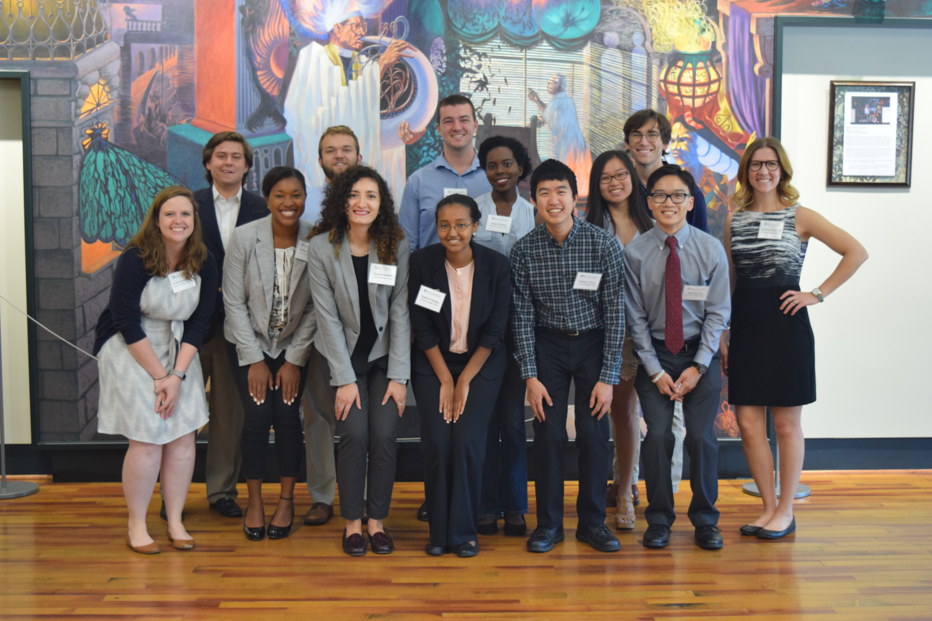
Community Bridges

Slide 6
Community Bridges Students
(Rice Undergrads)
HCDC services
Local Community Organizations

