Slide 1
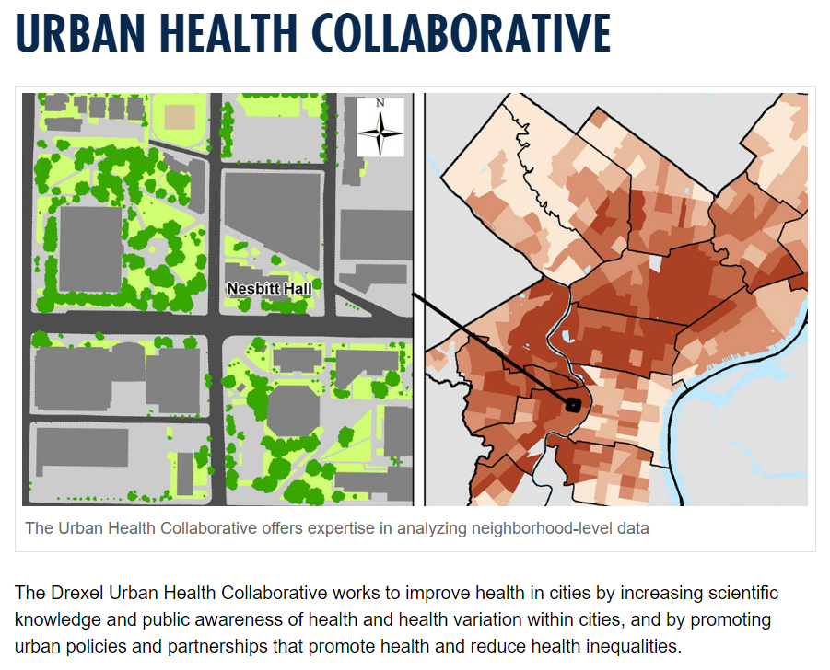
http://drexel.edu/dornsife/research/research-centers/UrbanHealthCollaborative

Slide 2
The Urban Health Collaborative Aims to…
Data for action: generating information on the magnitude and causes of urban health problems that are useful to city residents and policymakers
Evidence for policy: identifying the interventions and policies best suited to improving health and rigorously evaluating their implementation
Community engagement: working with communities and policy makers to translate and disseminate information, promote public awareness, and catalyze action to build healthy cities

Slide 3
UHC in the Community
Trainings
GIS workshops; UHC data workshops; Summer urban health institute; Research seminar series
Philadelphia Data briefs
Opioid overdoses; Alcohol Sales and Violence; Violence Disparities and Prevention Resources in North Philadelphia
Neighborhood Health Profiles
Community Health Profile: West Philadelphia Promise Zone
Community/Cross-Systems Research Partnerships
Promise Neighborhoods
Home Preservation Initiative
CHOP Big Data

Slide 4
Pilot Research Projects
Reasons for Uninsurance Among ACA Eligible Adults in an Urban Safety Net Setting
An investigation of associations between heat and infant mortality, and effect modification by greenness in Philadelphia
Using Data Integration to Create a Profile of Violence Needs and Assets to Inform Solutions in the Latino Community of Eastern North Philadelphia
Intergenerational Associations between Adult Past Exposure to Adverse Childhood Experiences and Offspring Child Health Outcomes: The Philadelphia Urban ACE Study
The Effects of Housing Discrimination Across the Generations: A Proof of Concept
Using Electronic Health Records for Population-Level Surveillance of Cardiovascular Risk in Patients with Metabolic Disorder: The Heart of Philadelphia Project

Slide 5
Upcoming Events
Urban Health Collaborative seminar
Talk Title: Year in Review and Looking Forward: Growing UHC Partnerships
Date: Friday, June 2, 2017
Time: 2:00PM - 3:30PM
Urban Health Summer Institute
2017 Summer Short Courses
June 26-30, 2017
Topics: Introduction to Multilevel Analysis for Urban Health Research, Health Impact Assessments and Applied Public Health Research, What is a Health Department?, Introduction to Bayesian Analysis for Public and Urban Health
2017 Urban Health Symposium
Thursday & Friday, September 7 & 8, 2017
Would like to convene meeting 9/6 with nearby/regional NNIP partners

