Slide 1
Developing local indicators to monitor the health impacts of climate change in King County, WA
Mariko Toyoji, MPH
NNIP Partner Meeting, September 2024

Slide 2
Background: Public Health – Seattle & King County, Climate + Health Equity Initiative
Data Monitoring and Research
Develop and expand monitoring of climate-related health impacts to inform actions for climate change adaptation and response
Communication and Community Collaboration
Increase communities' access to information to help them make informed decisions about risks to health, safety, and the environment
Response and Adaptation
Provide strategic direction and assistance on climate adaptation and response actions to prevent adverse health outcomes and disparities

Slide 3
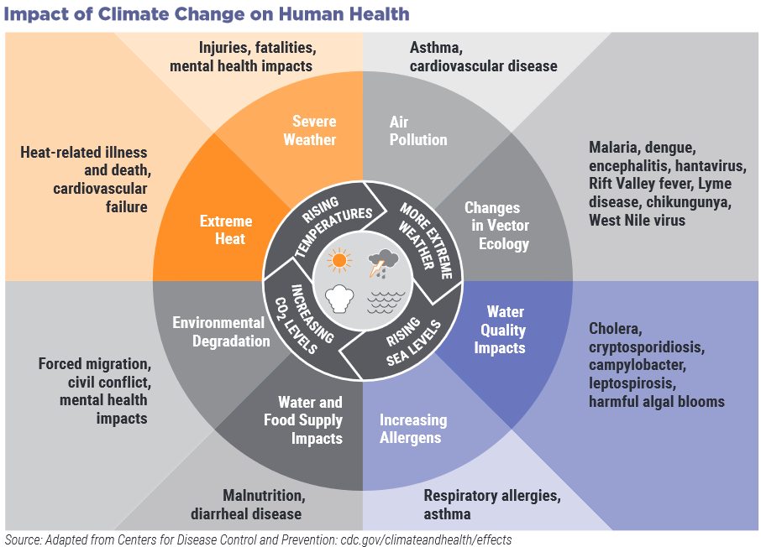

Slide 4
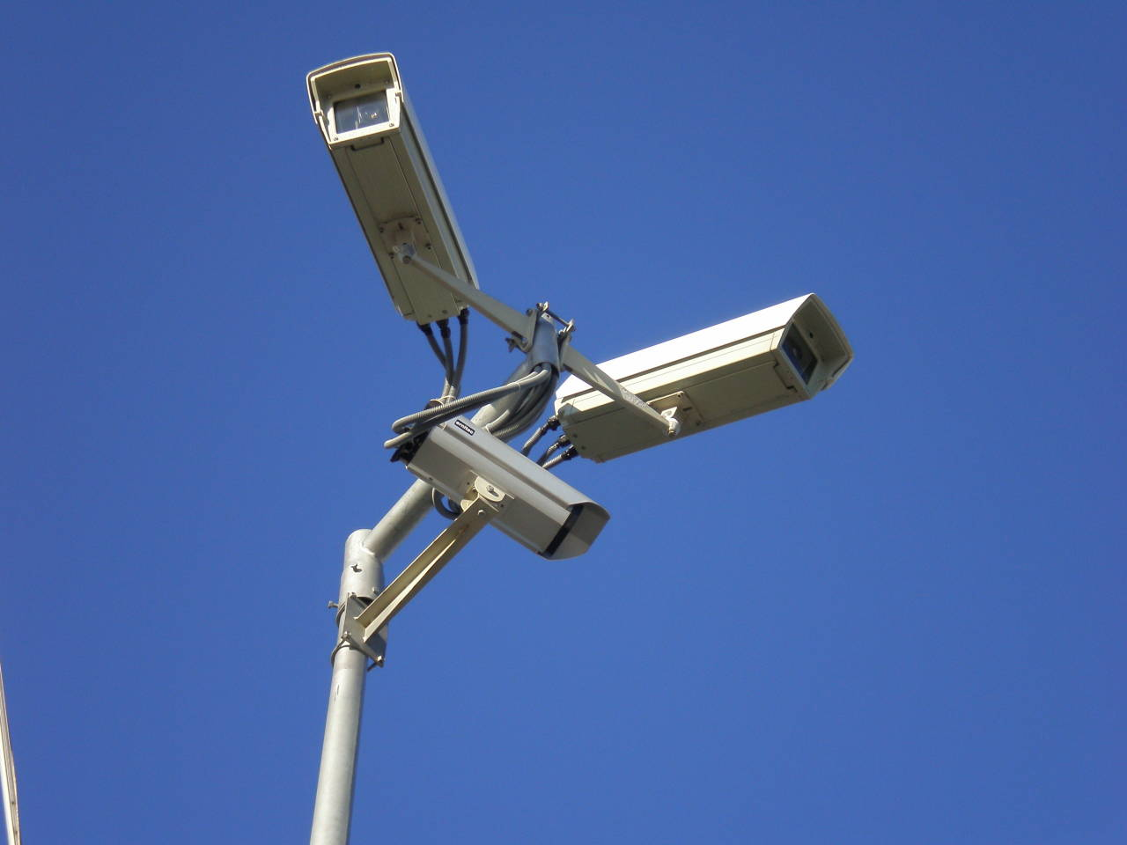
Surveillance?
What do we mean by public health surveillance?
Ongoing systematic collection, analysis and interpretation of health related data
These data can be used to inform equitable climate programs and policy development
Notes:
A data surveillance system will provide access to data resources on climate exposures and health that can support county agencies and community partners.

Slide 5
Process: Develop surveillance infrastructure
Review
Review literature and national examples
Form
Form data advisory group
Identify
Identify priority criteria to evaluate indicators
Select
Select initial set of indicators
Share
Share out with climate groups
Iterate
Conduct user testing, identify future areas of development
Notes:
Data are available to show trends over time and can be disaggregated by geography, race/ethnicity, and/or other demographics
Is there a value add for our program to analyze it
Does the data tell an equity story or challenge assumptions

Slide 6
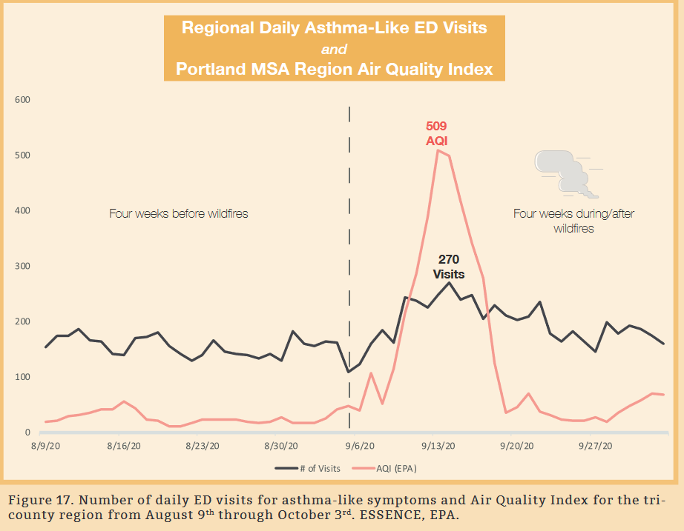
Literature review and landscape analysis
Drew examples from…
Council of State and Territorial Epidemiologists
Washington State Department of Health
University of Washington
Multnomah County
And more! (including NNIP partners)
Potential Internal Data
Communicable Disease
Emergency Medical Services
Health Care System
Environmental Health
Environmental Exposure Data
Notes:
Council of state and territorial epidemiologists
National Association of C

Slide 7
Climate & Health Data Advisory Group
Purpose: gather internal and external partners to guide climate & health data work
Convene monthly to work on a broad scope of data-related projects
Advisory group participants:
Public Health: Environmental Health, Emergency Medical Services, Prevention, Communicable Disease, Jail Health Services, Assessment
External: Department of Natural Resources & Parks, University of Washington, WA Department of Health, City of Seattle

Slide 8
Indicator purpose and selection criteria
Purpose: Assess trends to help inform policies, programs, and/or interventions
Key Criteria for selecting indicators:
Data available to show trends over time and can be disaggregated by geography (sub-county), race/ethnicity, and/or other demographics
Is there a value add for our program to analyze it (i.e. it’s a high priority indicator for partners, stakeholders, or community)
Does the data tell an equity story or challenge assumptions?

Slide 9
Climate and health data indicators
-Asthma ED visits
-Allergic disease ED visits
-Asthma diagnosis
-Locally-acquired vector borne disease cases
-Heat- & cold-related illness ED visits
-EMS patients treated for heat- & cold-related illness
-Campylobacteriosis cases
-Cryptosporidiosis cases
-Giardiasis cases
-Vibriosis cases
Data sources: Syndromic surveillance (emergency department), Emergency Medical Services, Medicaid Claims, Communicable Disease database
Notes:
On the data side, this is a project will be coming online this fall
A data dashboard that will be publicly available that shows some of the climate impacts on health in king county residents.
We have been gathering data from a number of different sources and are putting it together in one place
Idea is transparency, to make this publicly available to community organizations, mediam public, policy makers so everyone is able to dig through and see what is happening in our communities health as a result of climate change
And again for that to inform our long term planning, policy, and response actions.
Our Current work includes: finalizing a list of health indicators for ongoing data monitoring, incorporating data into community reports, and expanding processes to provide near time data during climate related events.

Slide 10
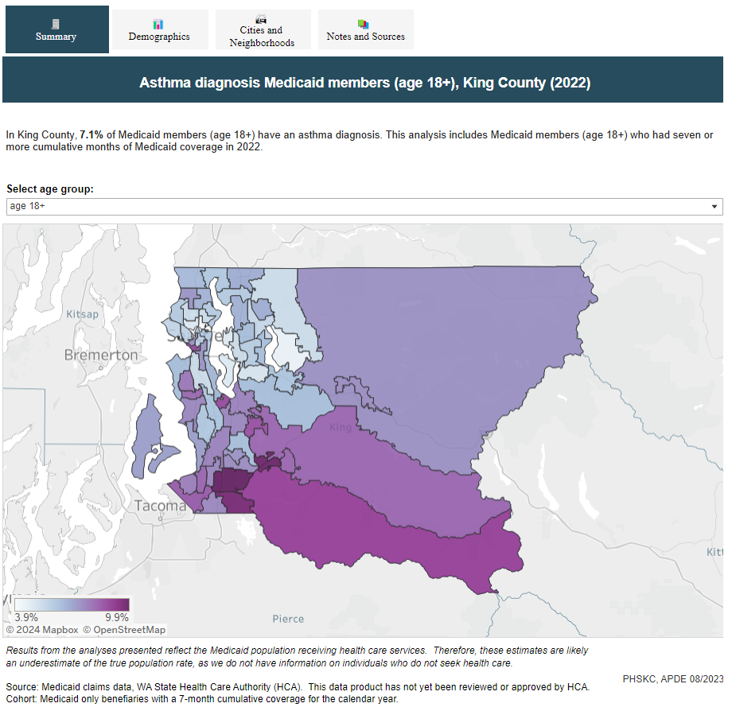
Air Quality
Asthma Emergency Department visits
Asthma diagnosis (Medicaid)
Allergic disease Emergency Department visits

Slide 11
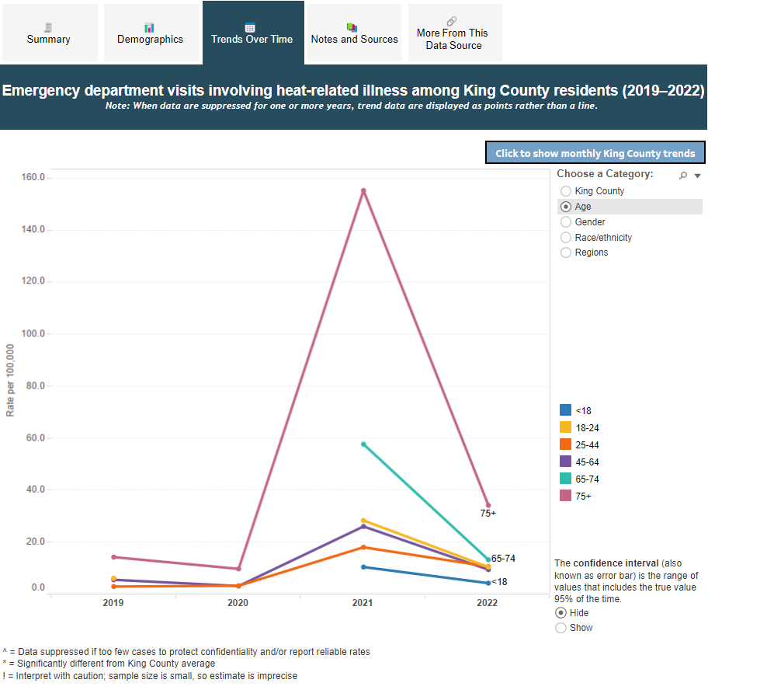
Extreme Weather
Heat & cold-related illness Emergency Department visits
Emergency Medical Service patients treated for heat & cold-related illness

Slide 12
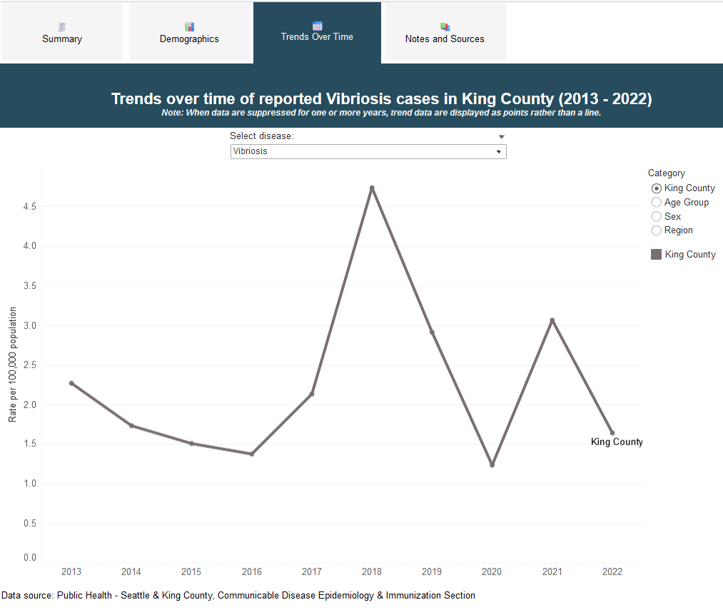
Food and Water Borne Disease
Campylobacteriosis cases
Cryptosporidiosis cases
Giardiasis cases
Vibriosis cases

Slide 13
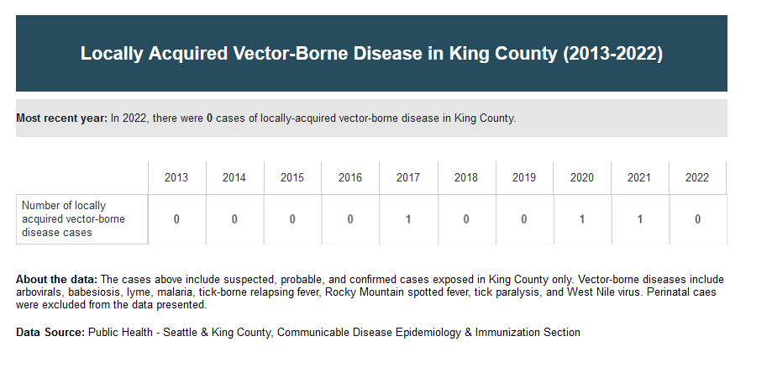
Vector Borne Disease
Locally-acquired vector borne disease cases

Slide 14
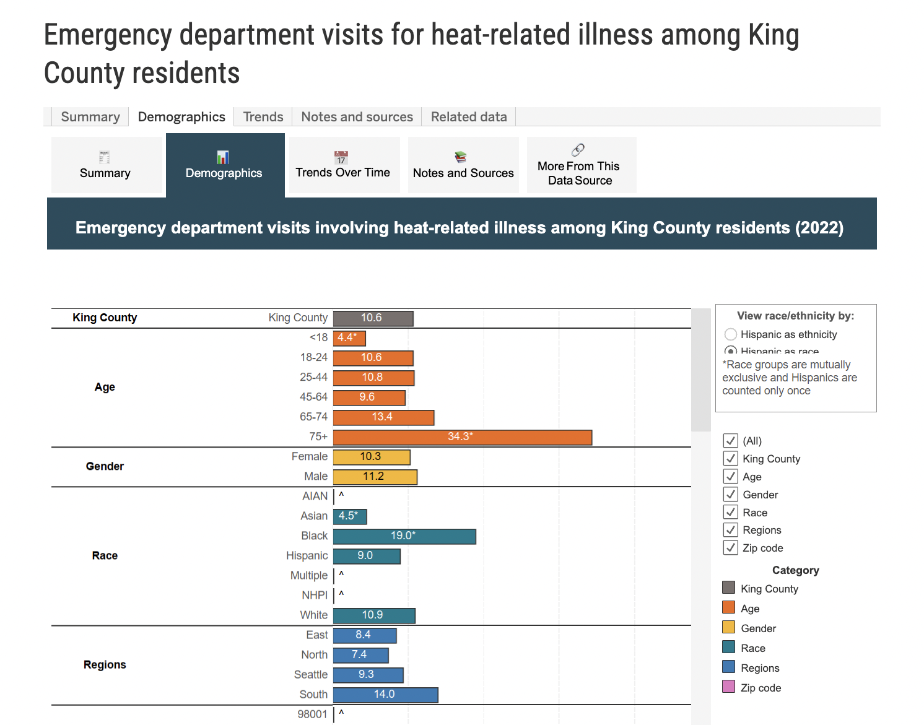
Climate and health data dissemination
Data dashboards by each domain that summarize:
Trends over time
Demographics (pending data availability)
Age
Gender
Race/ethnicity
Region
Geographic distribution
Explore the climate and health
data dashboards:
kingcounty.gov/climateandhealth/data

Slide 15
Climate and health data dissemination

Slide 16
Climate and health data in King County’s Community Health Needs Assessment
Selection of indicators included in the 2024-2025 Community Health Needs Assessment
Three indicators of the 12 were selected by partnering hospitals for inclusion
Marks the first-time climate is included in the CHNA
Opportunity: very few CHNAs nationally use climate

Slide 17
Challenges and Lessons Learned
Climate and health data exist across many systems, requiring partnerships for success
Lack of data on certain topics, such as climate-related mental health
Currently indicators only include health outcome data; difficult to integrate environmental exposure data
Initiating and sustaining resources and staff-time for a multi-disciplinary participatory process

Slide 18
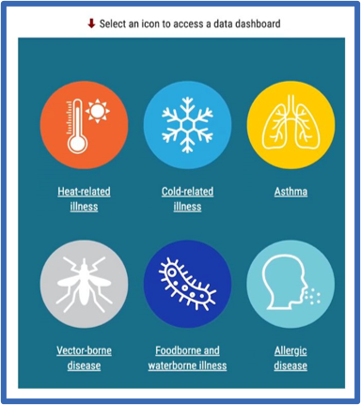
Next steps
Data updates, process and staffing
Gather community input on incorporating select indicators into Communities Count
Possible modifications to meet emerging use cases/programmatic needs
Preparedness for extreme heat/cold events
Continued engagement with partners and initiatives

Slide 19
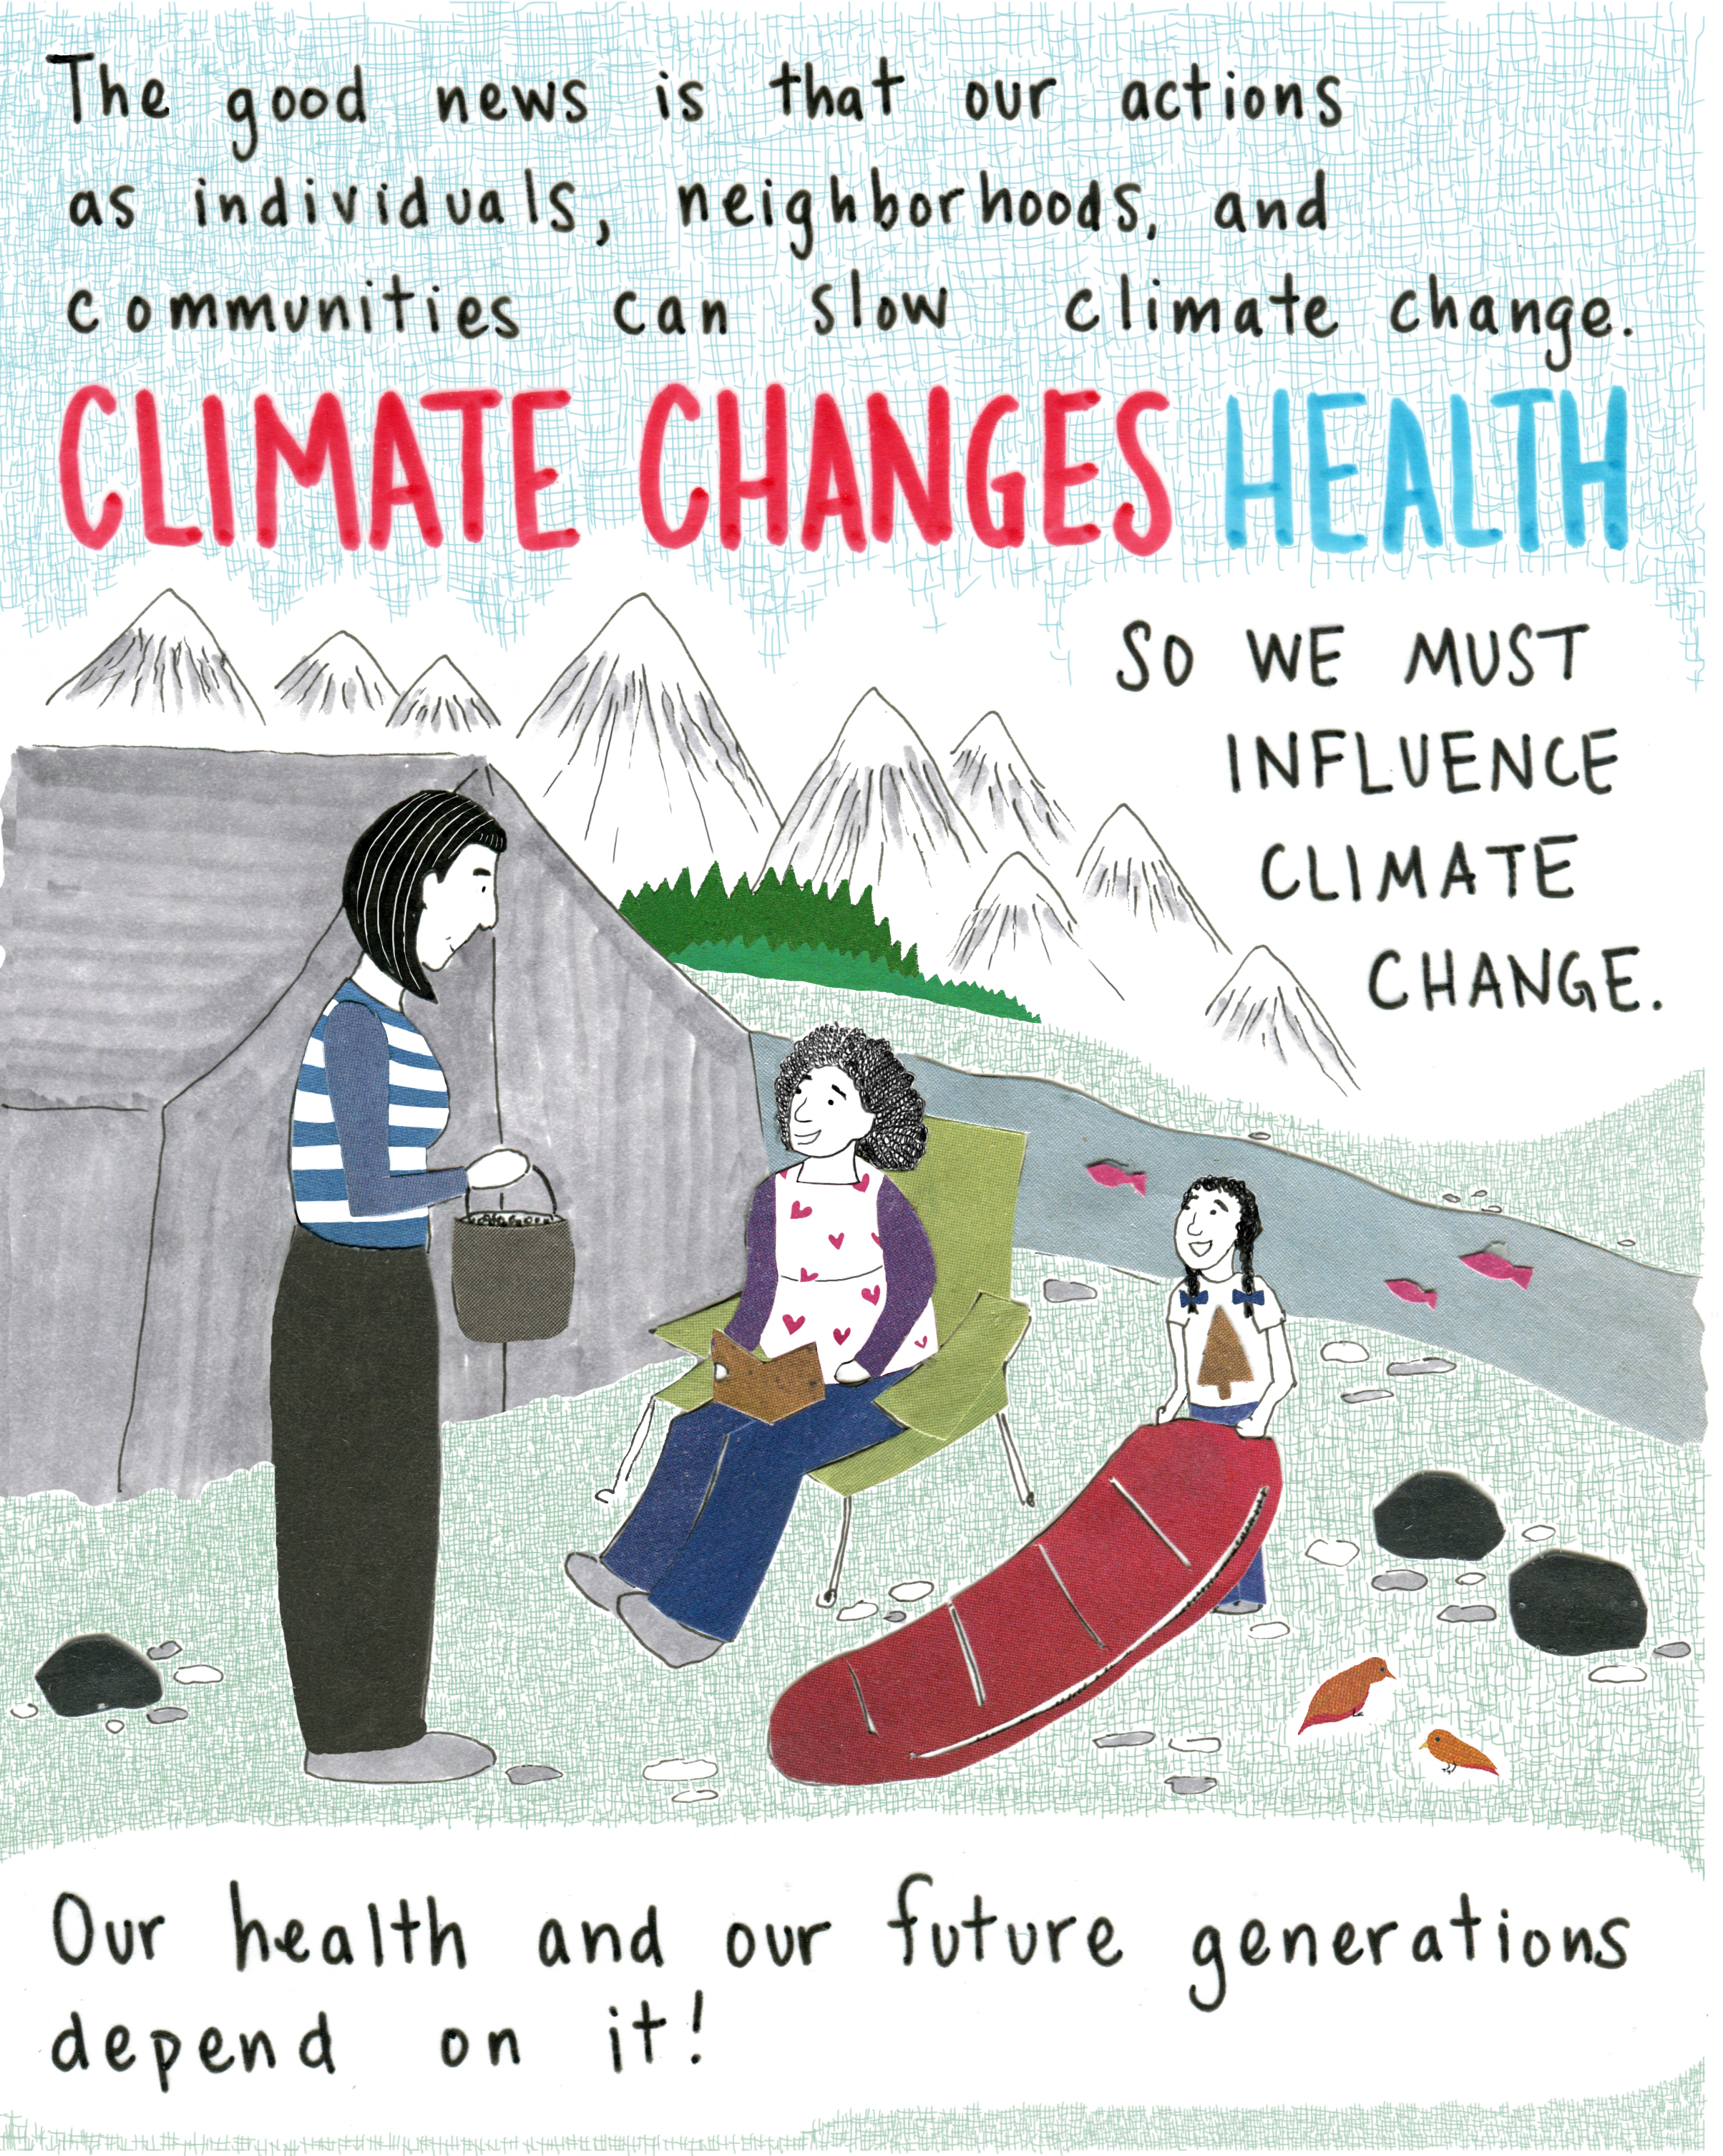
Thank you!
Mariko Toyoji mtoyoji@kingcounty.gov
kingcounty.gov/climateandhealth/data
Communitiescount.org
Notes:
Work on climate justice and health equity has definitely been a journey for us, and we are continuing to learn.
Elements that have helped us with success are:
Building Equity into our program from the beginning… and continuing to weave equity practices into our strategies and investments
Taking the time needed for Meaningful partnership development and finding ways to maintain these partnerships.
This includes co-developing with and funding communities who are most exposed to the climate hazards to work with us so that efforts are relevant and equitable –and supports their climate and health priorities
Focusing on capacity building and action (within our agency and with community)….
Finally, we know communities who are already experiencing health and environmental inequities are often already experiencing climate inequities as well – so we have focused on helping to meet current needs while learning how to address longer term issues.

