Slide 1
Using Mortality Data to Illustrate Health Disparities in Connecticut
Kelly Davila, Principal Research Associate
DataHaven, New Haven, CT

Slide 2
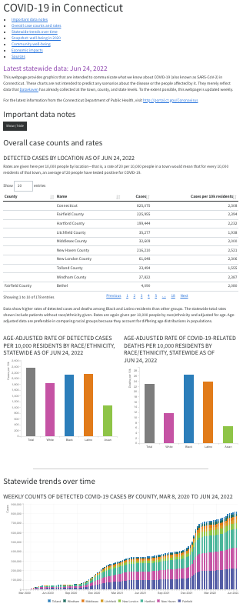
Let’s Go Back to Spring 2020
First COVID data published. So. Many. Dashboards. →
Soon, our partners begin asking us
Who is affected most?
What about food/evictions/job loss?
What resources do people need?
How can we help?

Slide 3
Indirect Answers
Social and demographic indicators can help us talk about inequities. That could help us find solutions to emerging problems.
But we are still conducting the “COVID wave” of the DataHaven Community Wellbeing Survey. Collecting that data could take a while. Household Pulse hasn’t been published yet, either.
So, let’s look at older trends…

Slide 4
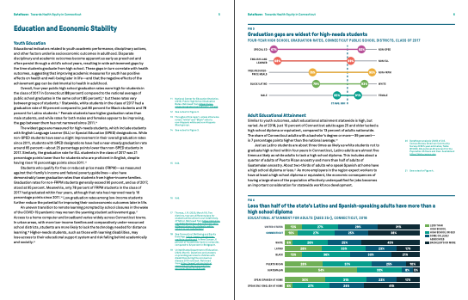
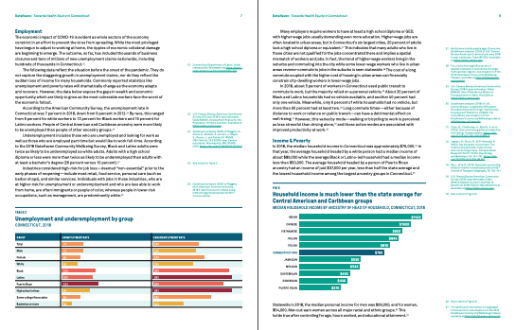
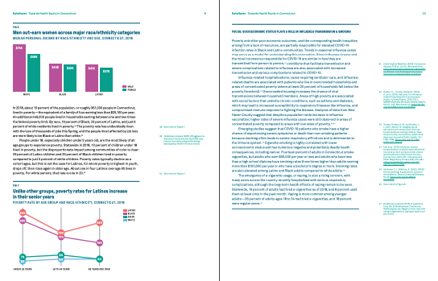
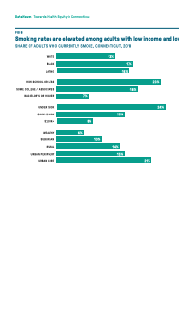
What We Produced
June 2020: Towards Health Equity in Connecticut. 48 pages and 8 chapters linking trends from education, employment, income, housing, and social supports to health outcomes.
Each chapter included a “Focus” section tying a topic to a specific health outcome, but the report featured very little direct health data.

Slide 5
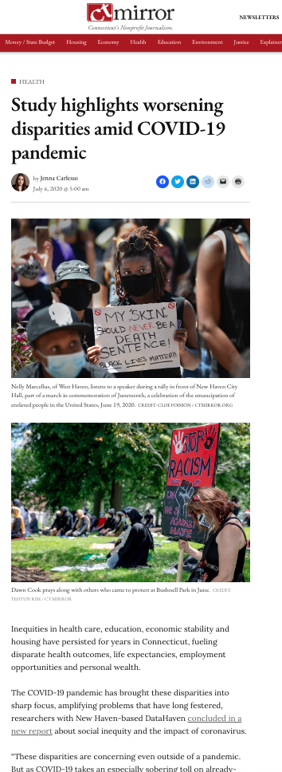
How the Message Got Across
✅ News media able to quickly summarize racial/ethnic and income-based disparities.
✅ General public made more aware of how social determinants affect health outcomes.
BUT
🫤 The report is long, and the upshot is complex.
🧐 What are the actual outcomes?

Slide 6
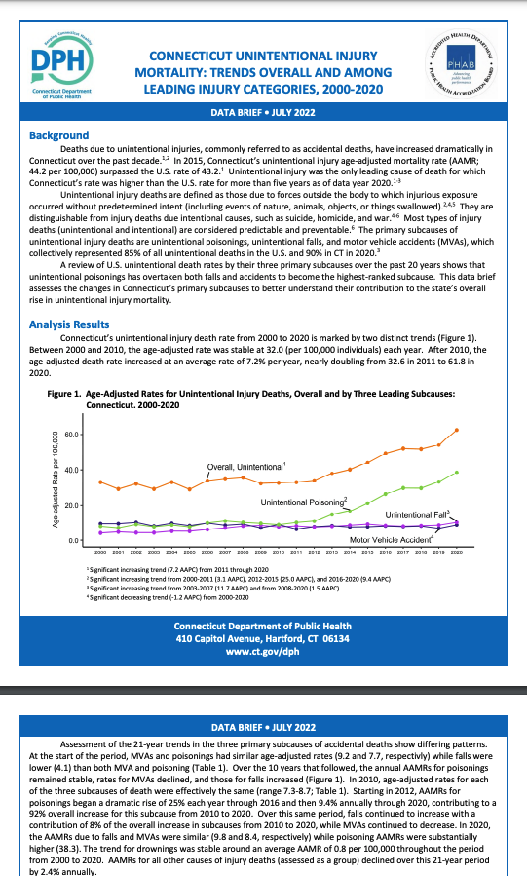
Fast-Forward: 2023
Time to update our health equity report!
Hmm, CT-DPH publishes statewide mortality summaries, and the data looks pretty detailed.
Should we just ask if we can have the data?
A few emails later…

Slide 7
What We Received
Individual, record-level data containing demographics like…
Race/ethnicity, sex, age, ZIP code, town of residence, location of death, etc…
And up to 14(!) cause of death codes from ICD-10…
For the years 2010 through 2022.
Psst: A request form is now available online for researchers: https://portal.ct.gov/dph/vital-records/research-and-data

Slide 8
The New Data Opened Doors
We could make links between behavioral and social determinants to health clearer.
Having cause of death also let us track top causes and drill down into specific causes.
We could go beyond CDC WONDER’s county-level data and create custom geographies: think hospital regions or legislative districts.
Although preliminary, the data are more timely than WONDER.

Slide 9
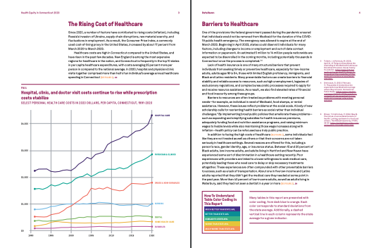
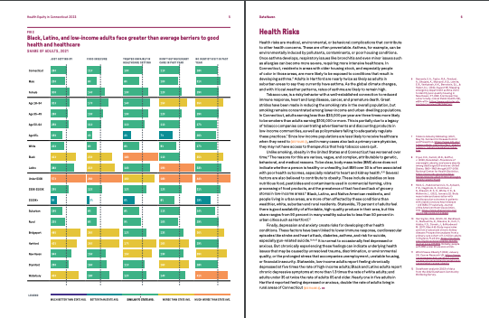
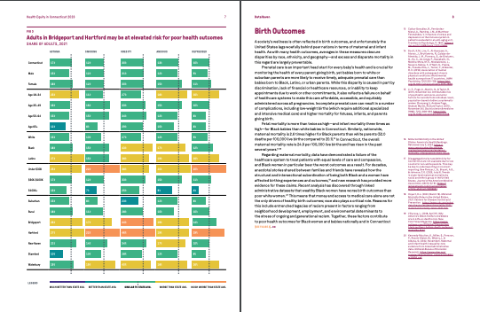
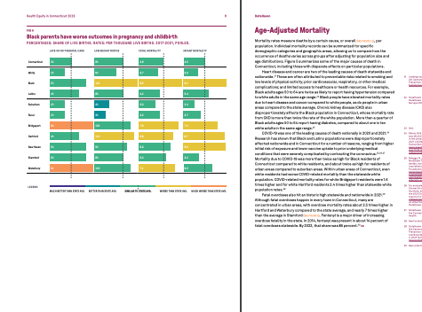
Health Equity in Connecticut, 2023
The result was a shortened, streamlined report.
The upshot was clearer: social determinants (Figures 1-3) contribute directly to health outcomes (Figures 4-5).
With new data, we could do a deep dive into a single “Focus” section.

Slide 10
Analyzing the Mortality Data: Prep Work
Because Connecticut is a small state, we pooled 6 years of data (2017–2022).
To age-adjust, we needed population by town in consistent age bands, by race/ethnicity so we used ACS 5-year estimates that fit neatly within the range.
Surprisingly little cleanup to drop unknowns, out-of-staters, and wacky entries, but overall a rare, tidy csv from a state agency.
Thankfully, they haven’t changed the file format or content so our cleanup scripts continue to work. 🤞🤞🤞

Slide 11
Analyzing the Mortality Data: Causes of Death
ICD-10 codes: medical examiners use these standard codes to record causes of death.
First, a quick sanity check: are there middle aged people dying from SIDS? Babies with Alzheimer's?
Generally, the top COD was prioritized.
Although 14 COD fields were provided, most records had between 1 and 3 codes. Multiple codes are used in specific circumstances.

Slide 12
Analyzing the Mortality Data: Automating the Analysis
Some ICD-10 R packages exist, but I didn’t care for them. I used an ICD-10 codebook.
I wrote an R script to quickly process data by identifying records by COD, then age-adjust using the CDC US standard weights, and output top-cause and all-cause rates by race/ethnicity and region.
A couple more lines of code calculate years of potential life lost to age 75, useful in explaining excess deaths.

Slide 13
How the Data Expanded Our Story
We could make clear connections between disparities in ex. diagnosed diabetes and disparities in deaths due to CKD.
We could look at very, very specific causes of death, such as police-related gun homicide.
We could also estimate excess deaths, which is to say, if Black people had the same death outcomes as white people, how many fewer people would have died? (Answer: ~14,000)

Slide 14
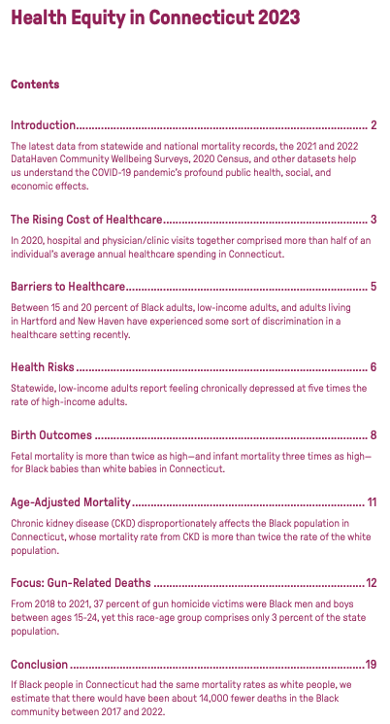
How We Showed the Data
One of the comments on the original report was that it was long and overly detailed, so we reduced as much as possible.
Ex: the Table of Contents also serves as the Executive Summary.

Slide 15
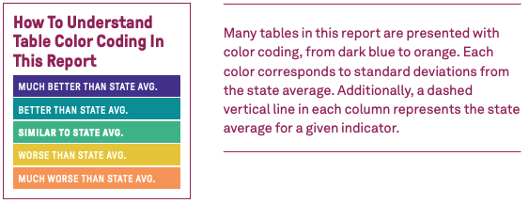
How We Showed the Data
In order to reduce the overall number of visualization types in the report, we created a graphic language that visually distinguishes disparities using standard deviations from the state average. The legends reprise this summary.

Slide 16
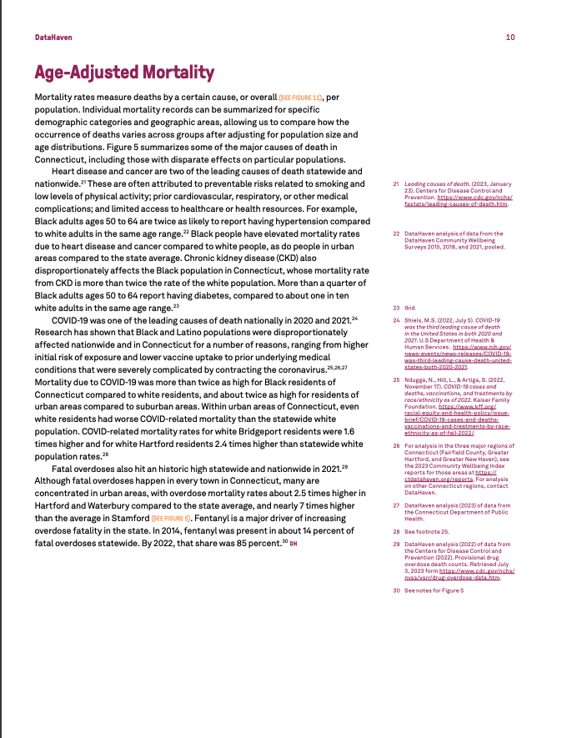
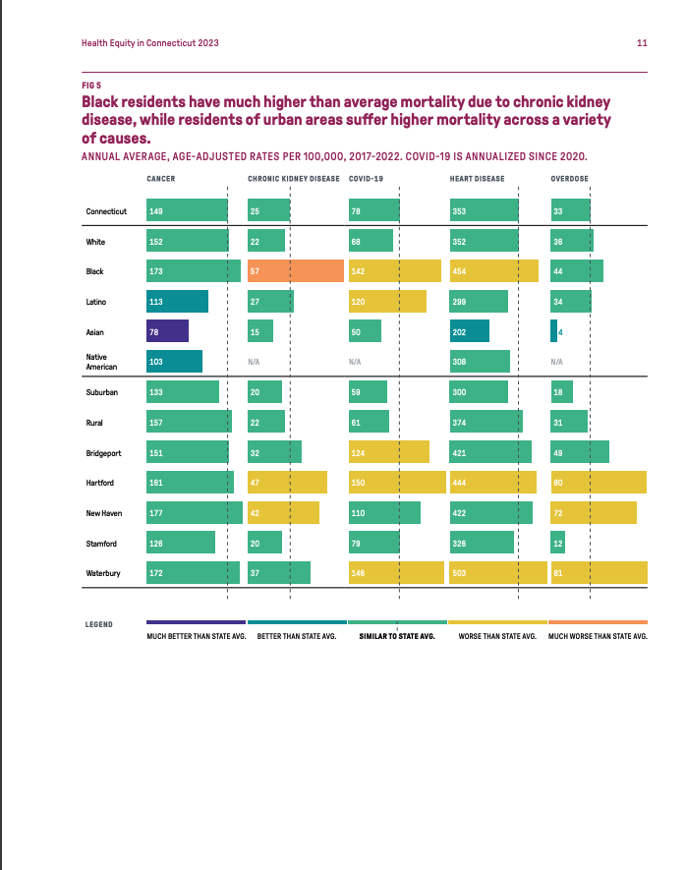
How We Showed the Data
By using the same chart style throughout, color patterns visually remind the reader of disparities. The spread has text on the left to further explain the data, but it is not geared towards subject-matter experts or data nerds.

Slide 17
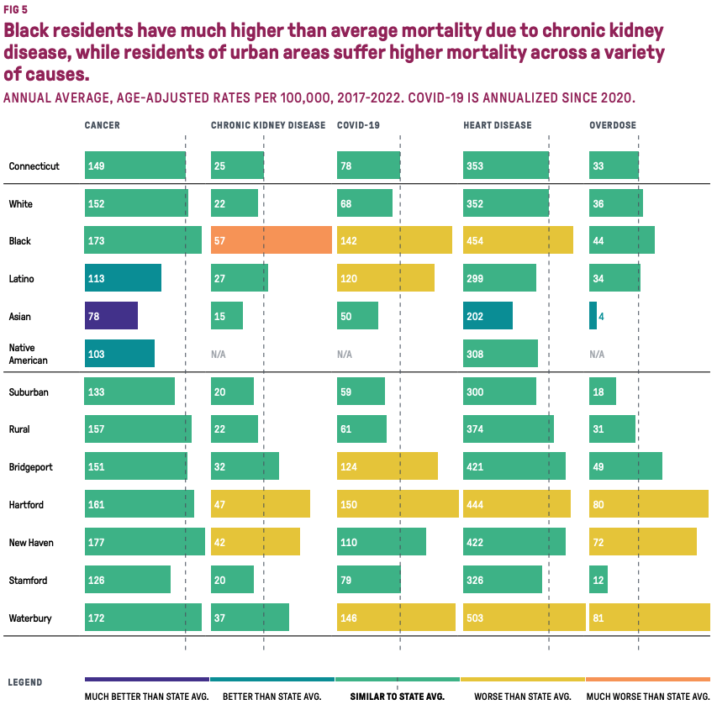

Slide 18
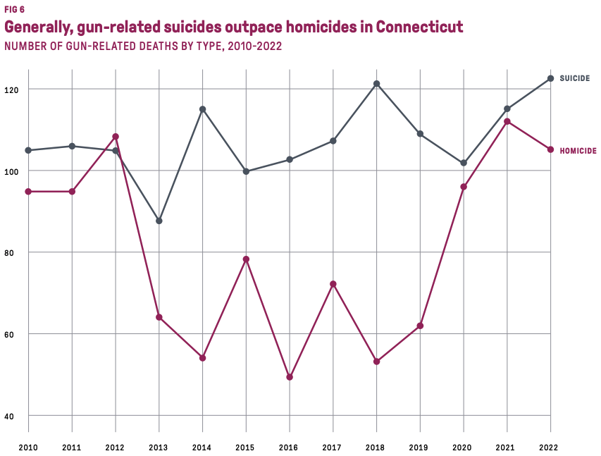
Focus: Gun Violence
Starting with the myth that gun violence is primarily homicide, we wanted to see who is affected and how.
A 7-page section analyzes the impact guns have on primarily men and boys.

Slide 19
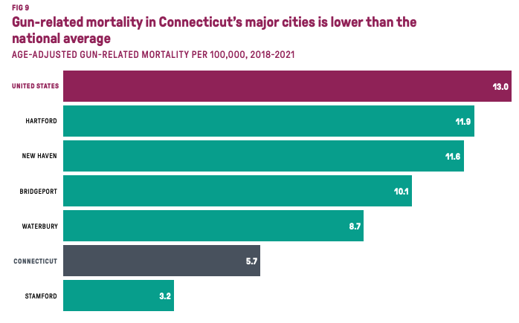
Focus: Gun Violence
Ages in our death data showed us Black men and boys are losing excessive years of life to guns, even though white men are the most common victims of gun violence in CT.
Town-level data also let us debunk the myth that our cities are gun violence capitals.

Slide 20
Thanks, everyone!
Kelly Davila, Principal Research Associate
DataHaven, New Haven, CT

