Slide 1
North Hartford Promise Neighborhood Resource Mapping Tool
September 2024
Geethika Fernando, Jill Walsh (CTData)
Notes:
Introductions

Slide 2
What is the North Hartford Promise Neighborhood Resource Mapping Tool?
Requested by the promise neighborhood community to:
Locate programs, services & neighborhood resources
Target audience: front line service providers & residents
Developed by CT Data Collaborative
Data partnership with 211 resource directory, Hartford Public Schools & other youth programs
Dynamic map to locate services closest to users:
Type of service (childcare, afterschool programming)
Notes:
Kate
As you’ll see in a minute, this project allows us to Visually present all NHAP pipeline providers
It will be easily accessible on the HDC website
We plan to offer interactive and static versions
The map will show providers by service category and developmental stage
Also allows us to better understand the service catchment population or population served

Slide 3
Resource Mapping Tool Development Process
Participatory design and development process
Prototype creation
Beta testing with care coordinators
Pilot testing with a cohort of frontline providers
Resident focus group
All community conversation
Notes:
Kate
As you’ll see in a minute, this project allows us to Visually present all NHAP pipeline providers
It will be easily accessible on the HDC website
We plan to offer interactive and static versions
The map will show providers by service category and developmental stage
Also allows us to better understand the service catchment population or population served

Slide 4
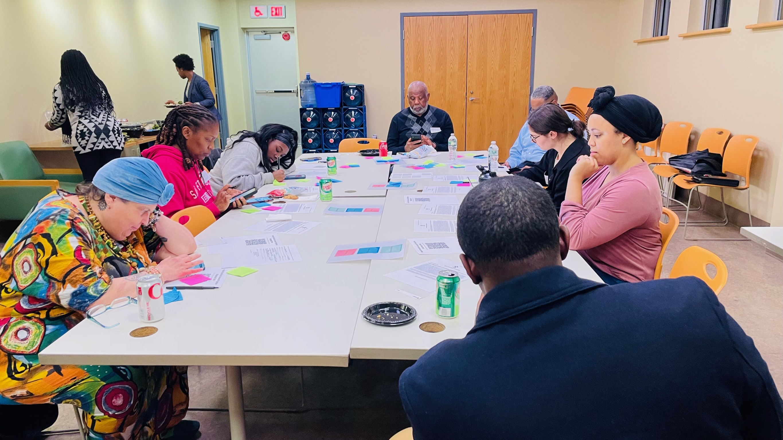
Human Centered Design Process
"Think out loud" method
Rose-Thorn-Bud
Built-in feedback loop

Slide 5
What we learned & improved
Types of resources and information to include
Information to filter on
Accessibility
Table view
Language
Design for mobile and tablet users
Off-line use
Partnership ideas
Marketing and training

Slide 6
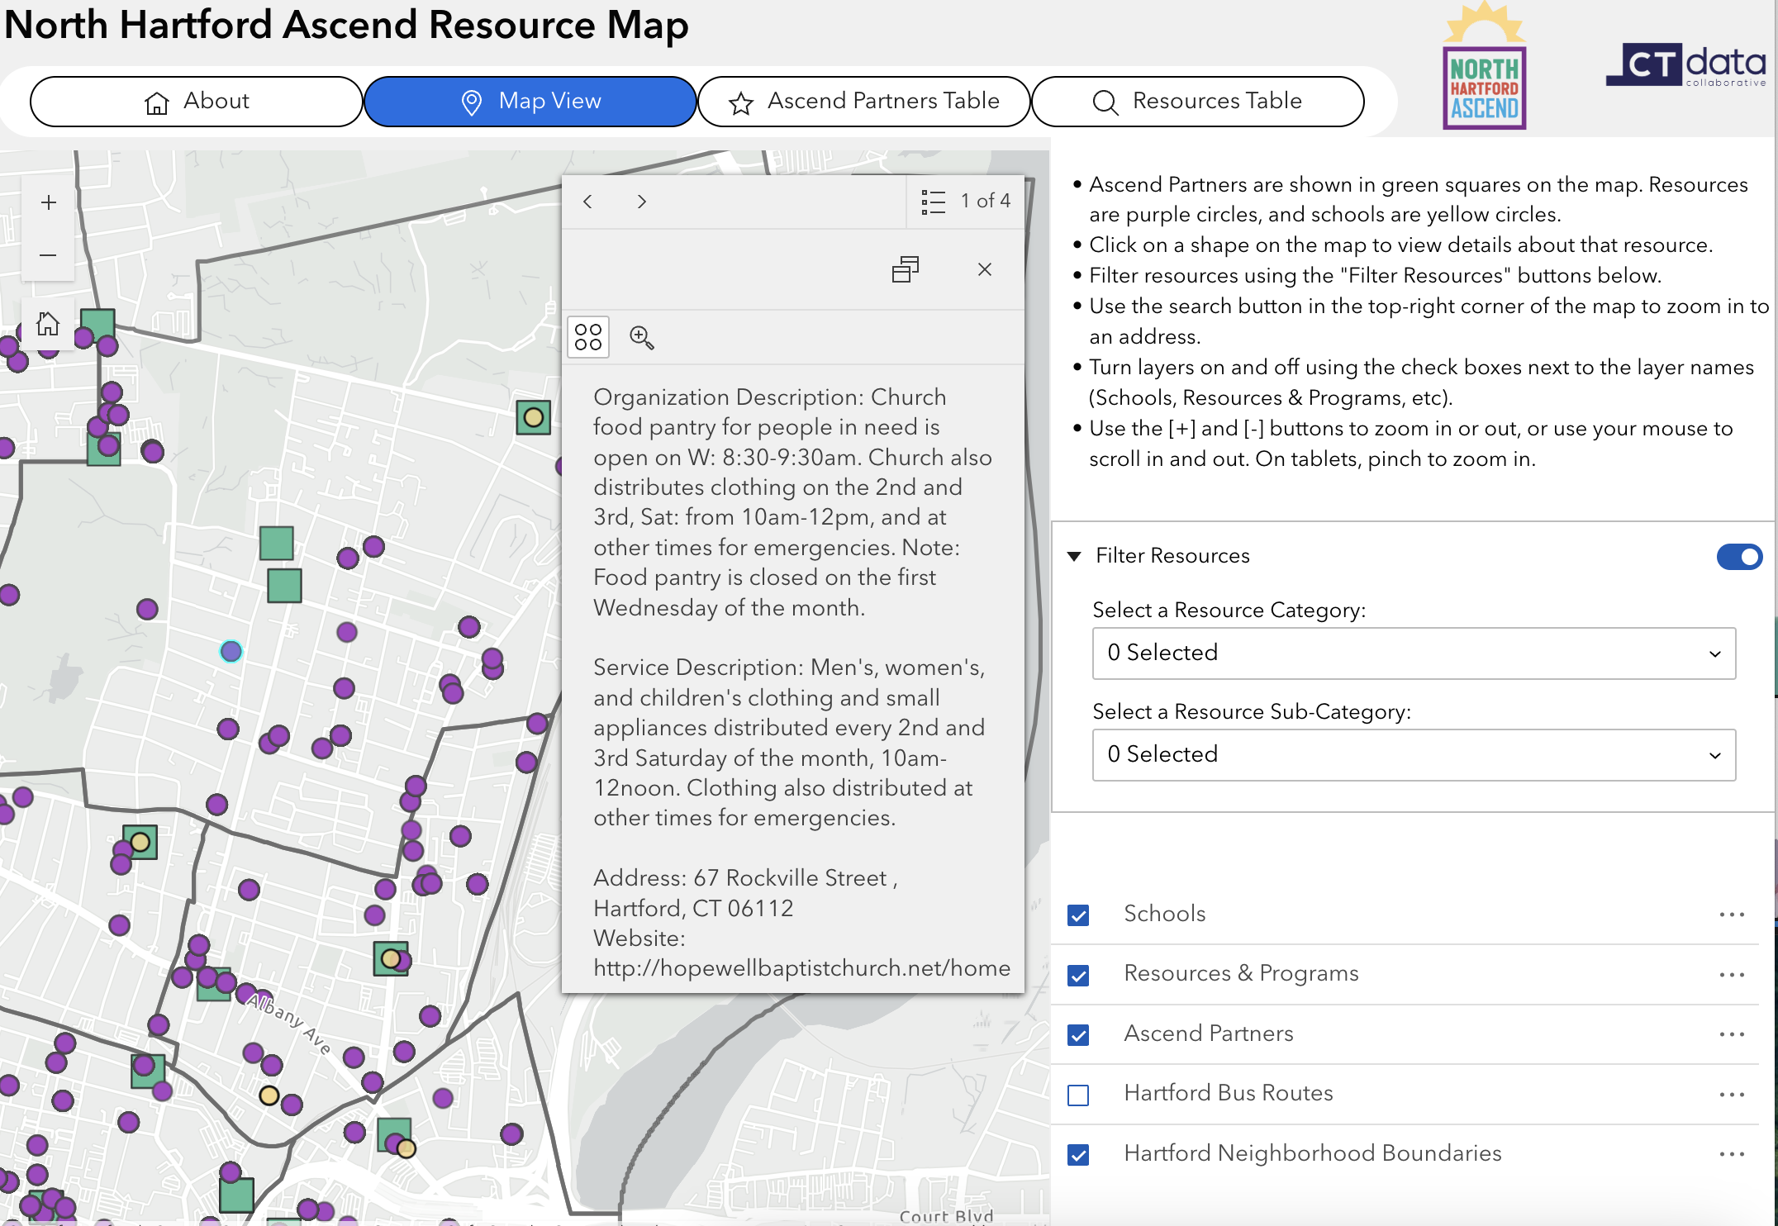
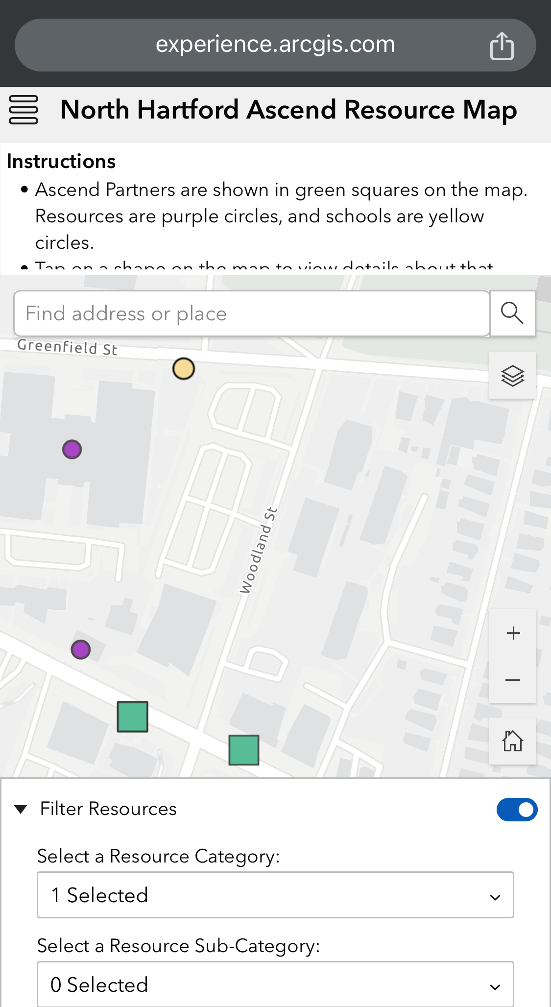
North Hartford Promise Zone Resource Map
Notes:
Jill

Slide 7
Thank you
CTData.org
@CTOpenData

