Slide 1
Equity Committee: Four Year Reflections
Elly Schoen, Systems & Data Manager
@USC_NDSC

Slide 2
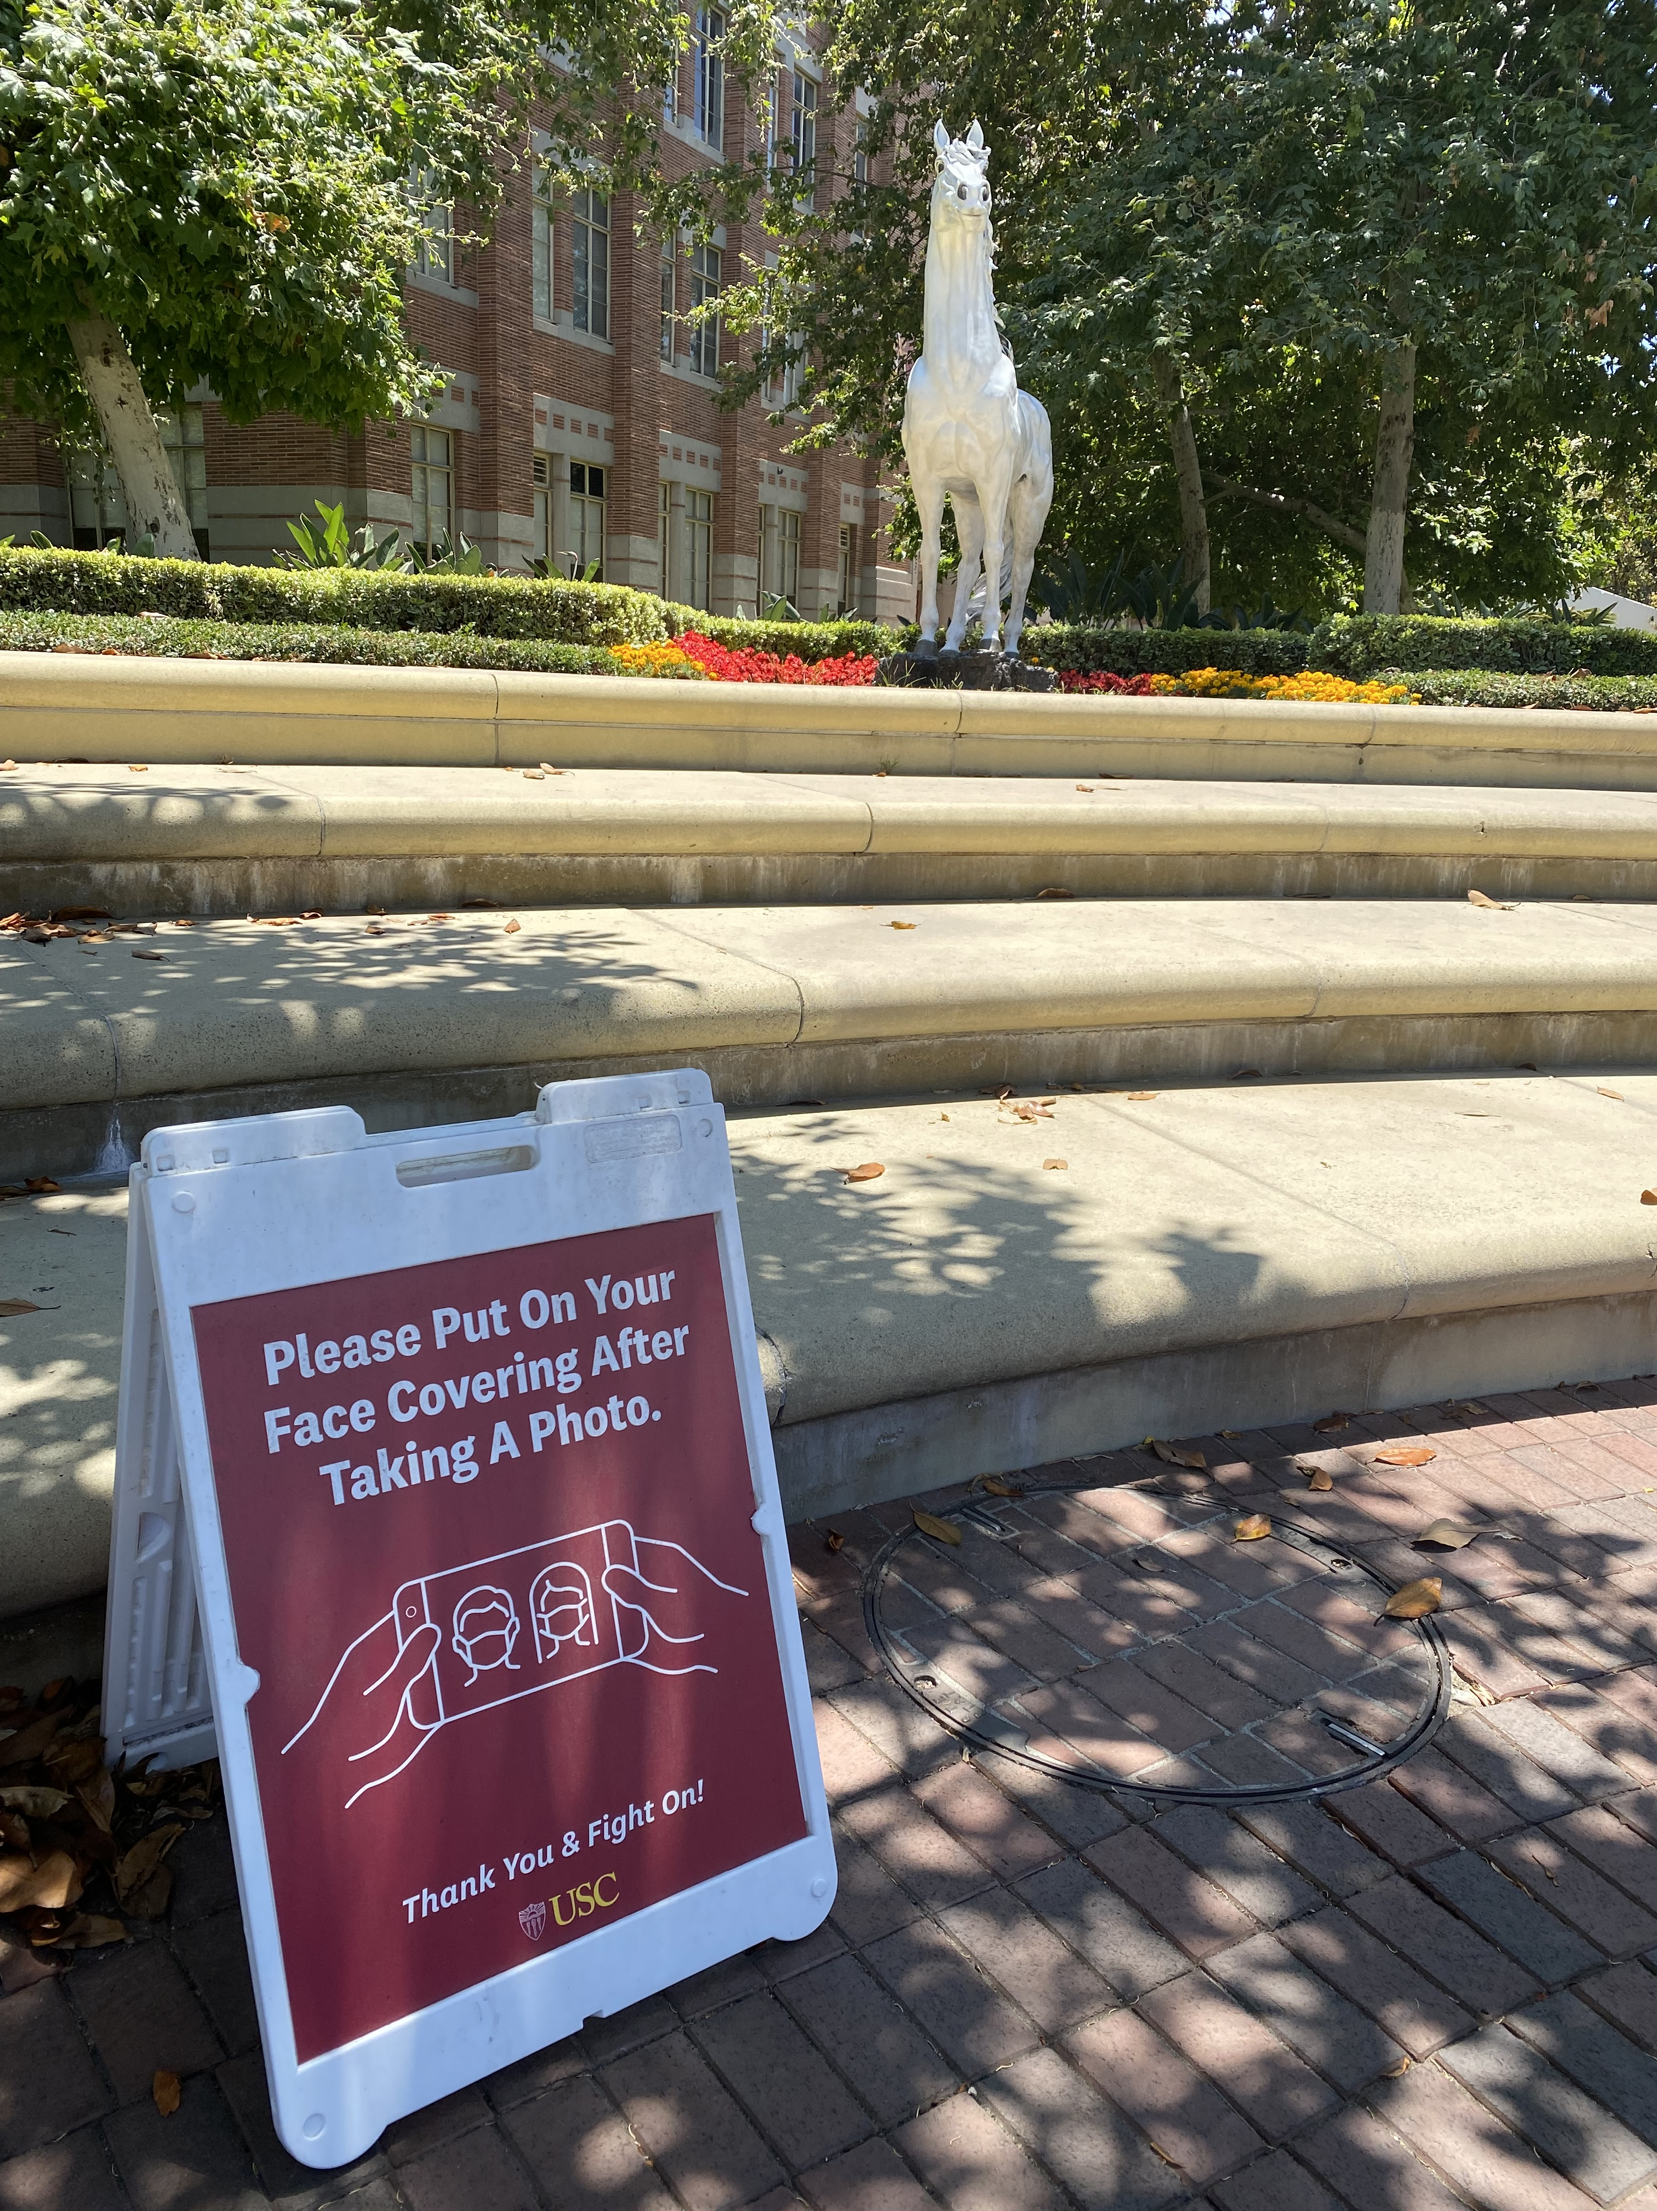
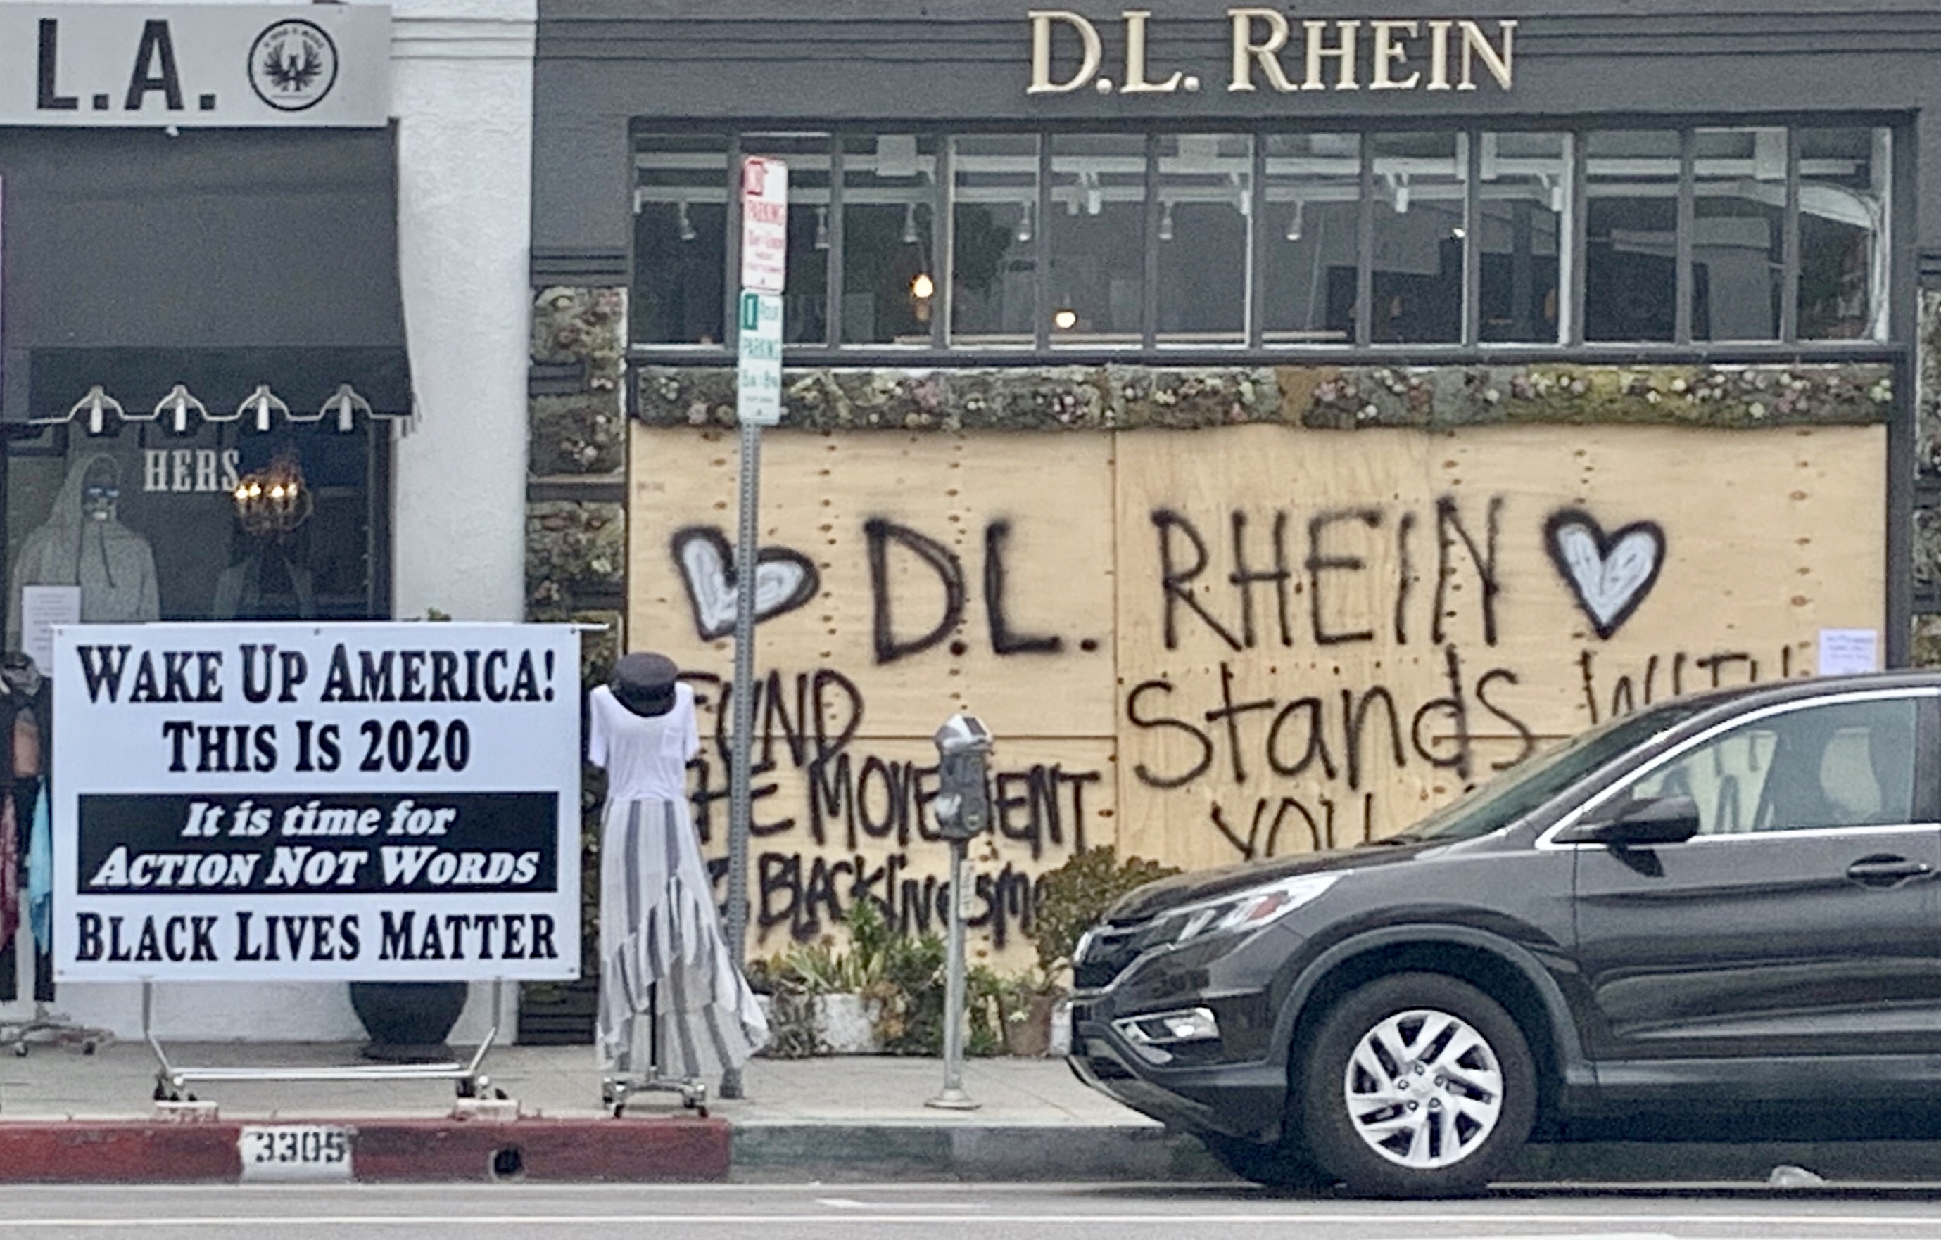
Photo via James Tapparo II on Flickr
Left photo:

Slide 3
Create and practice a shared set of values
Slow down and be intentional with each other and our decisions
Collaboration
Inclusivity
Joy
Community
Equity
Victoria Ciudad-Real
Equity Committee Founding Chair

Slide 4
Activities
Creating a labor acknowledgment
Establishing shared values
Creating a land acknowledgment
“…[our] economies rest on the ingenuity, cultural treasures and stolen labor of African-Americans and Black people throughout the diaspora.”
Collaboration
“… the Gabrielino/Tongva peoples as the traditional land caretakers.
…presence on the ancestral and unceded territory of the Chumash, Kizh, and Tataviam nations.”
Inclusivity
Joy
Building a glossary of terms and definitions
Community
e.g. racial equity as an outcome vs. as a process
Equity

Slide 5
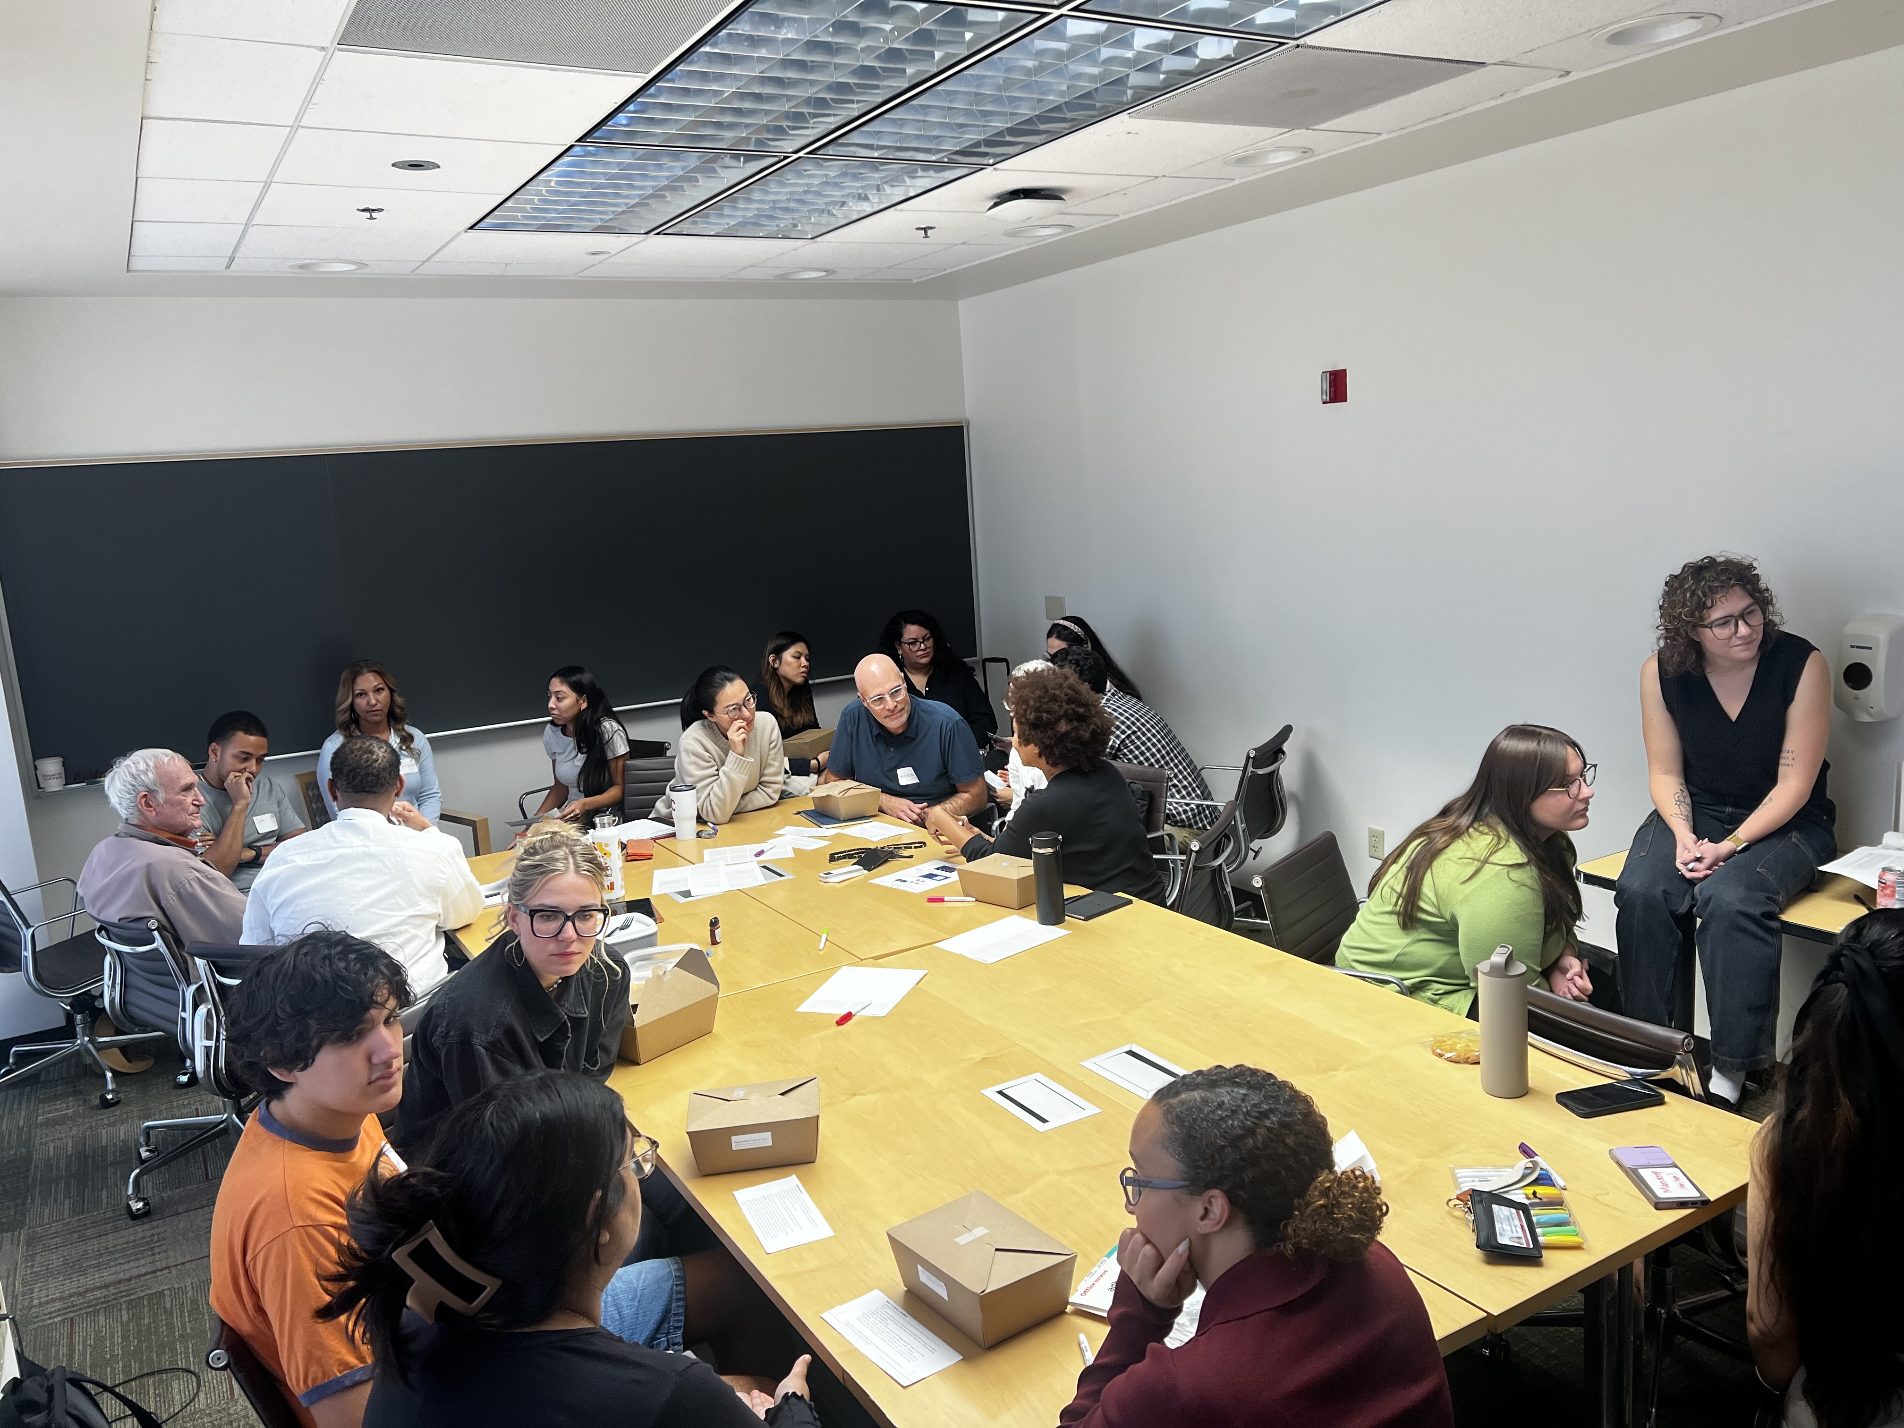
Activities
Lunch & learn series
White supremacy culture
Love / appreciation languages
Asset Framing &
Data Equity
Afro-Asian solidarity
Microaggressions
Racial trauma
Dinner Club
Self education for allyship & liberation

Slide 6
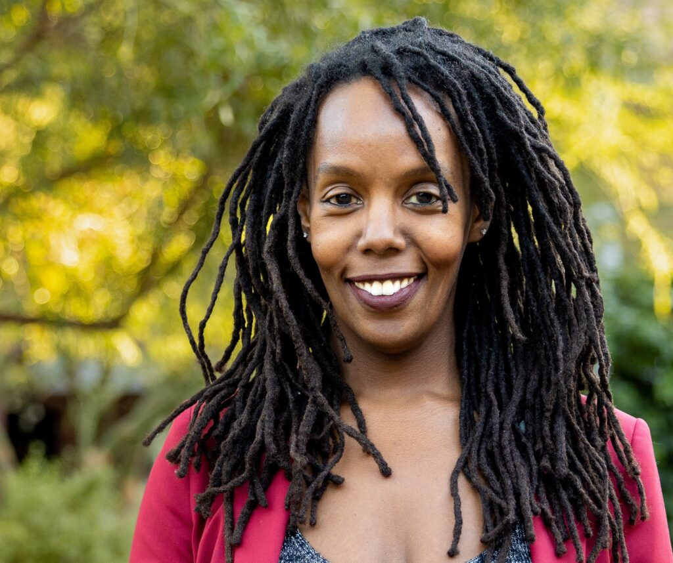
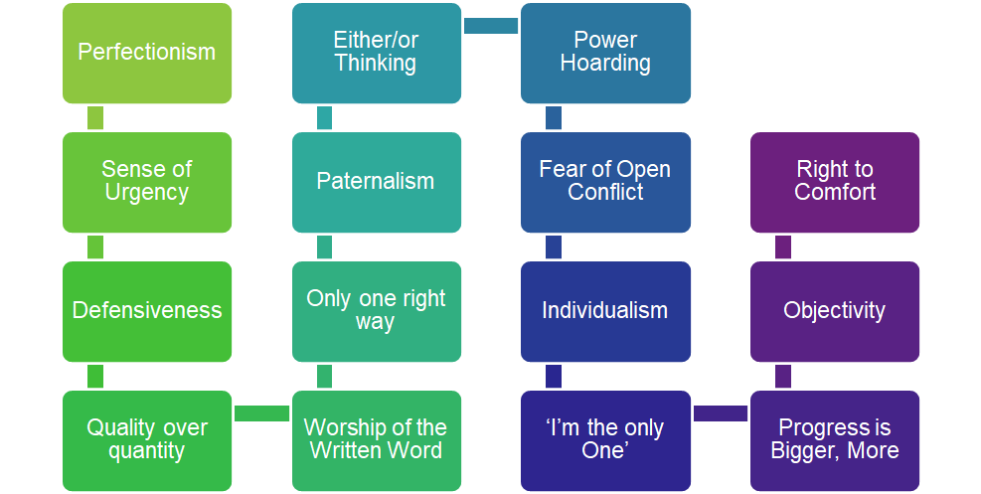
Impactful Frameworks
Elements of white supremacy culture
Saba Mwine-Chang
Equity Committee Member

Slide 7
Impactful Frameworks
Elements of white supremacy culture
Saba Mwine-Chang
Equity Committee Member

Slide 8
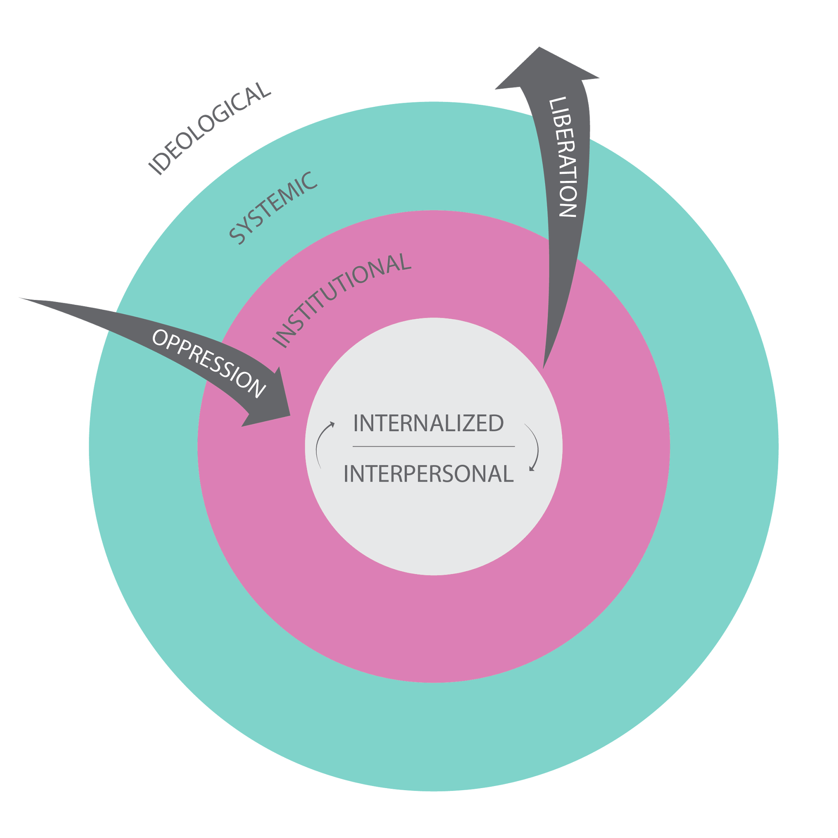
Impactful Frameworks
Languages of Appreciation in the Workplace
Fighting White Supremacy: “Inside Out” Process
Word of Affirmation
Quality Time
Acts of Service
Gifts
High Fives and Hugs
Liberation definitions copyright Equity Design Collaborative, 201; Oppression definitions Inspired, Remixed and Adjusted from http://www.coloradoinclusivefunders.org/uploads/1/1/5/0/11506731/the_four_is_of_oppression.pdf, NEP Coaching for Equity, from Grant-Thomas, Andrew, and john a. powell (2006).“Forms of Racism.” Poverty & Race.

Slide 9
Impactful Frameworks
Languages of Appreciation in the Workplace
Fighting White Supremacy: “Inside Out” Process
Word of Affirmation
Quality Time
Acts of Service
Gifts
High Fives and Hugs
Liberation definitions copyright Equity Design Collaborative, 201; Oppression definitions Inspired, Remixed and Adjusted from http://www.coloradoinclusivefunders.org/uploads/1/1/5/0/11506731/the_four_is_of_oppression.pdf, NEP Coaching for Equity, from Grant-Thomas, Andrew, and john a. powell (2006).“Forms of Racism.” Poverty & Race.

Slide 10
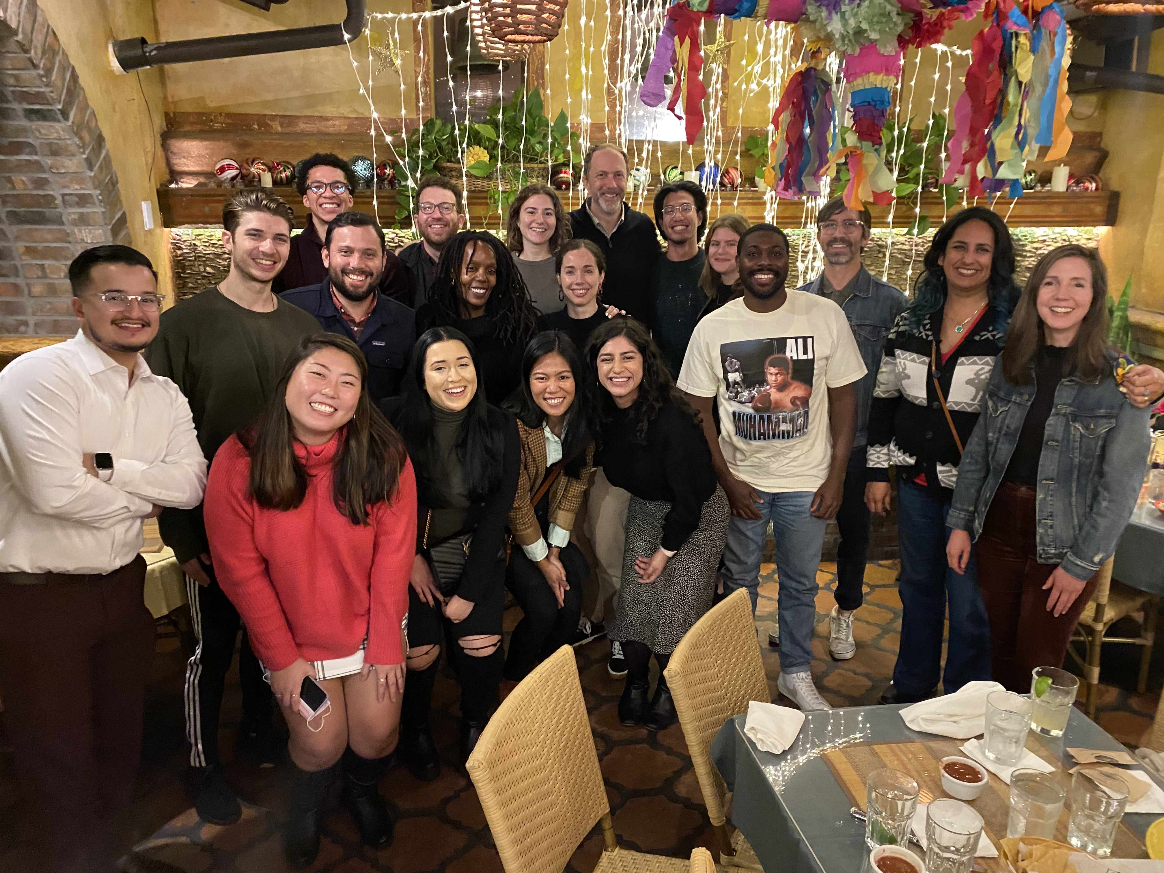
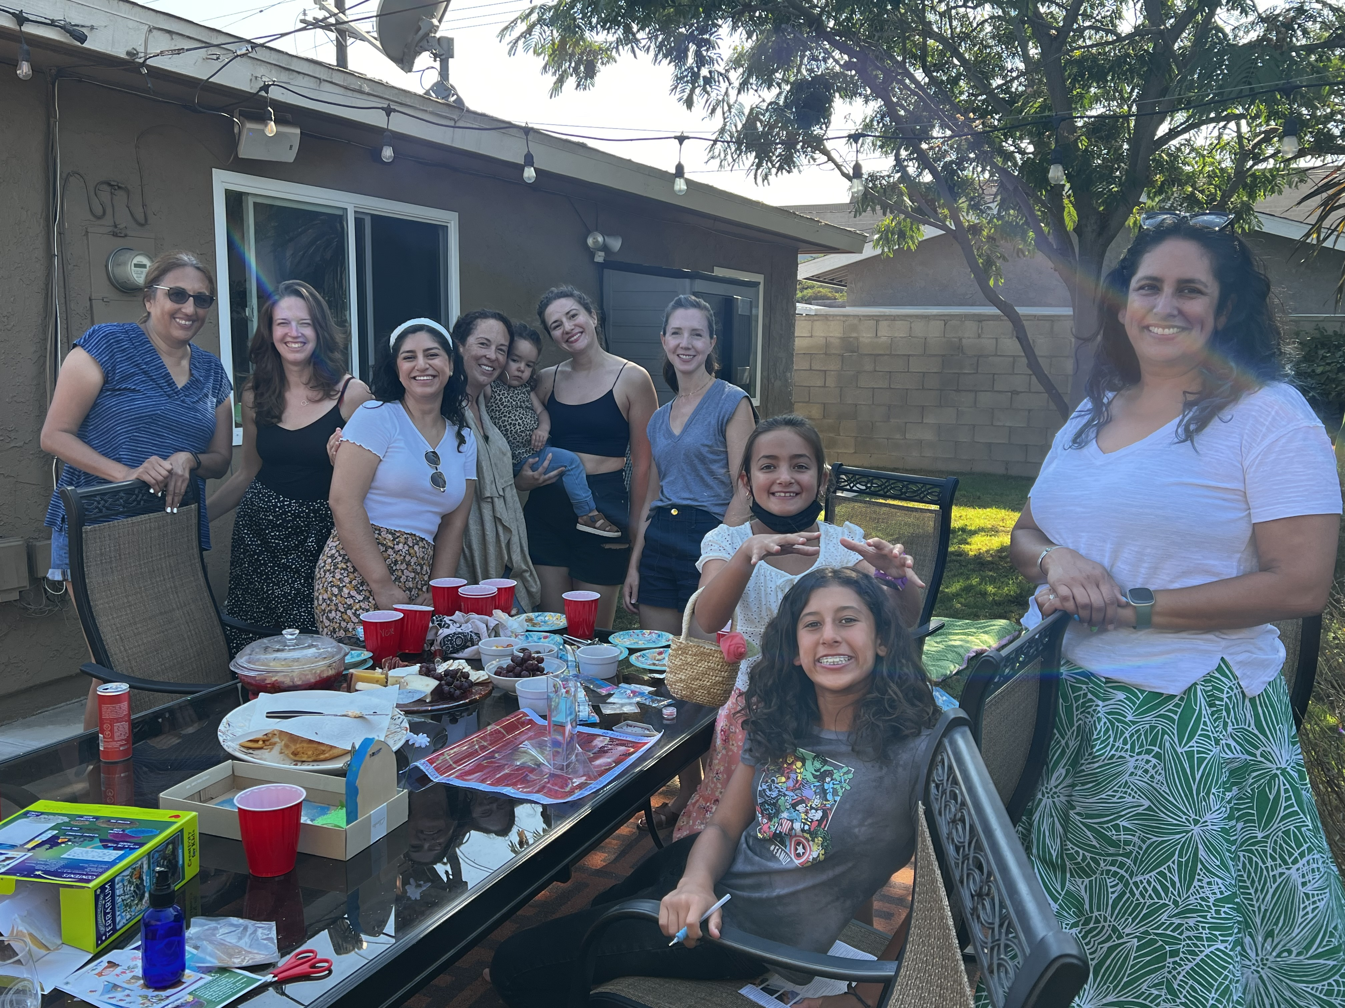
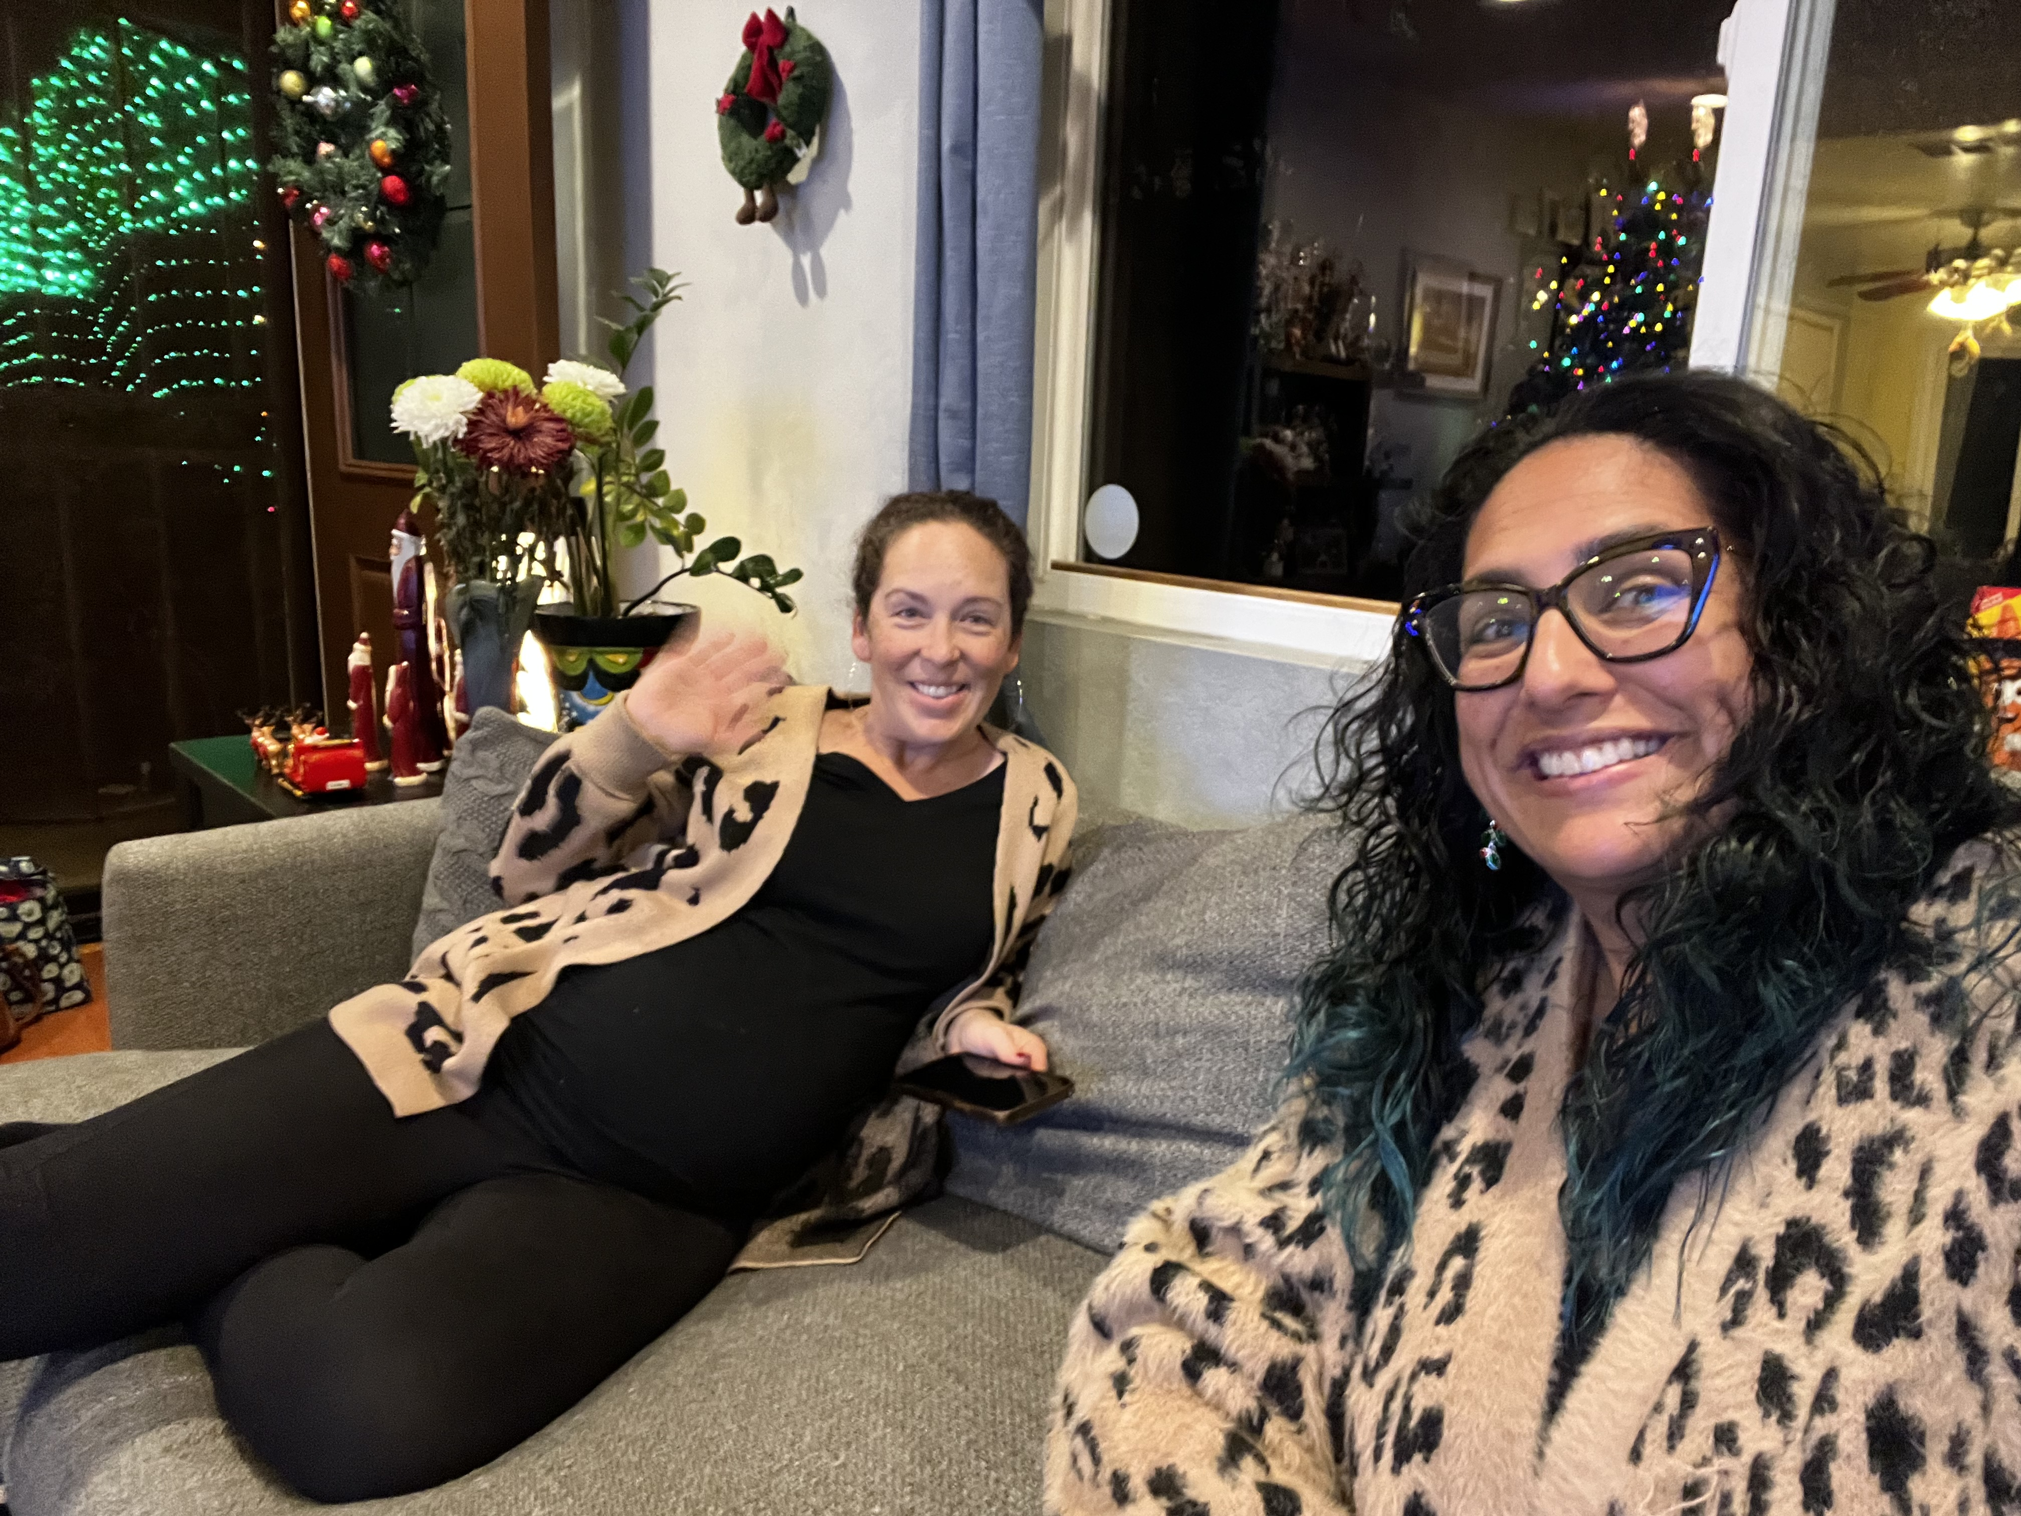
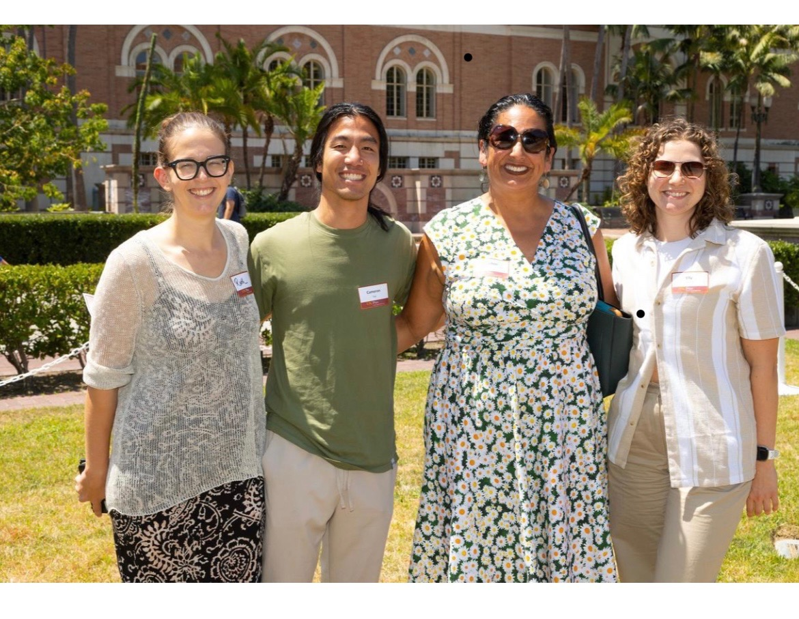
Reflections on Building a Culture that Values Equity

Slide 11
Reflections on Building a Culture that Values Equity

Slide 12
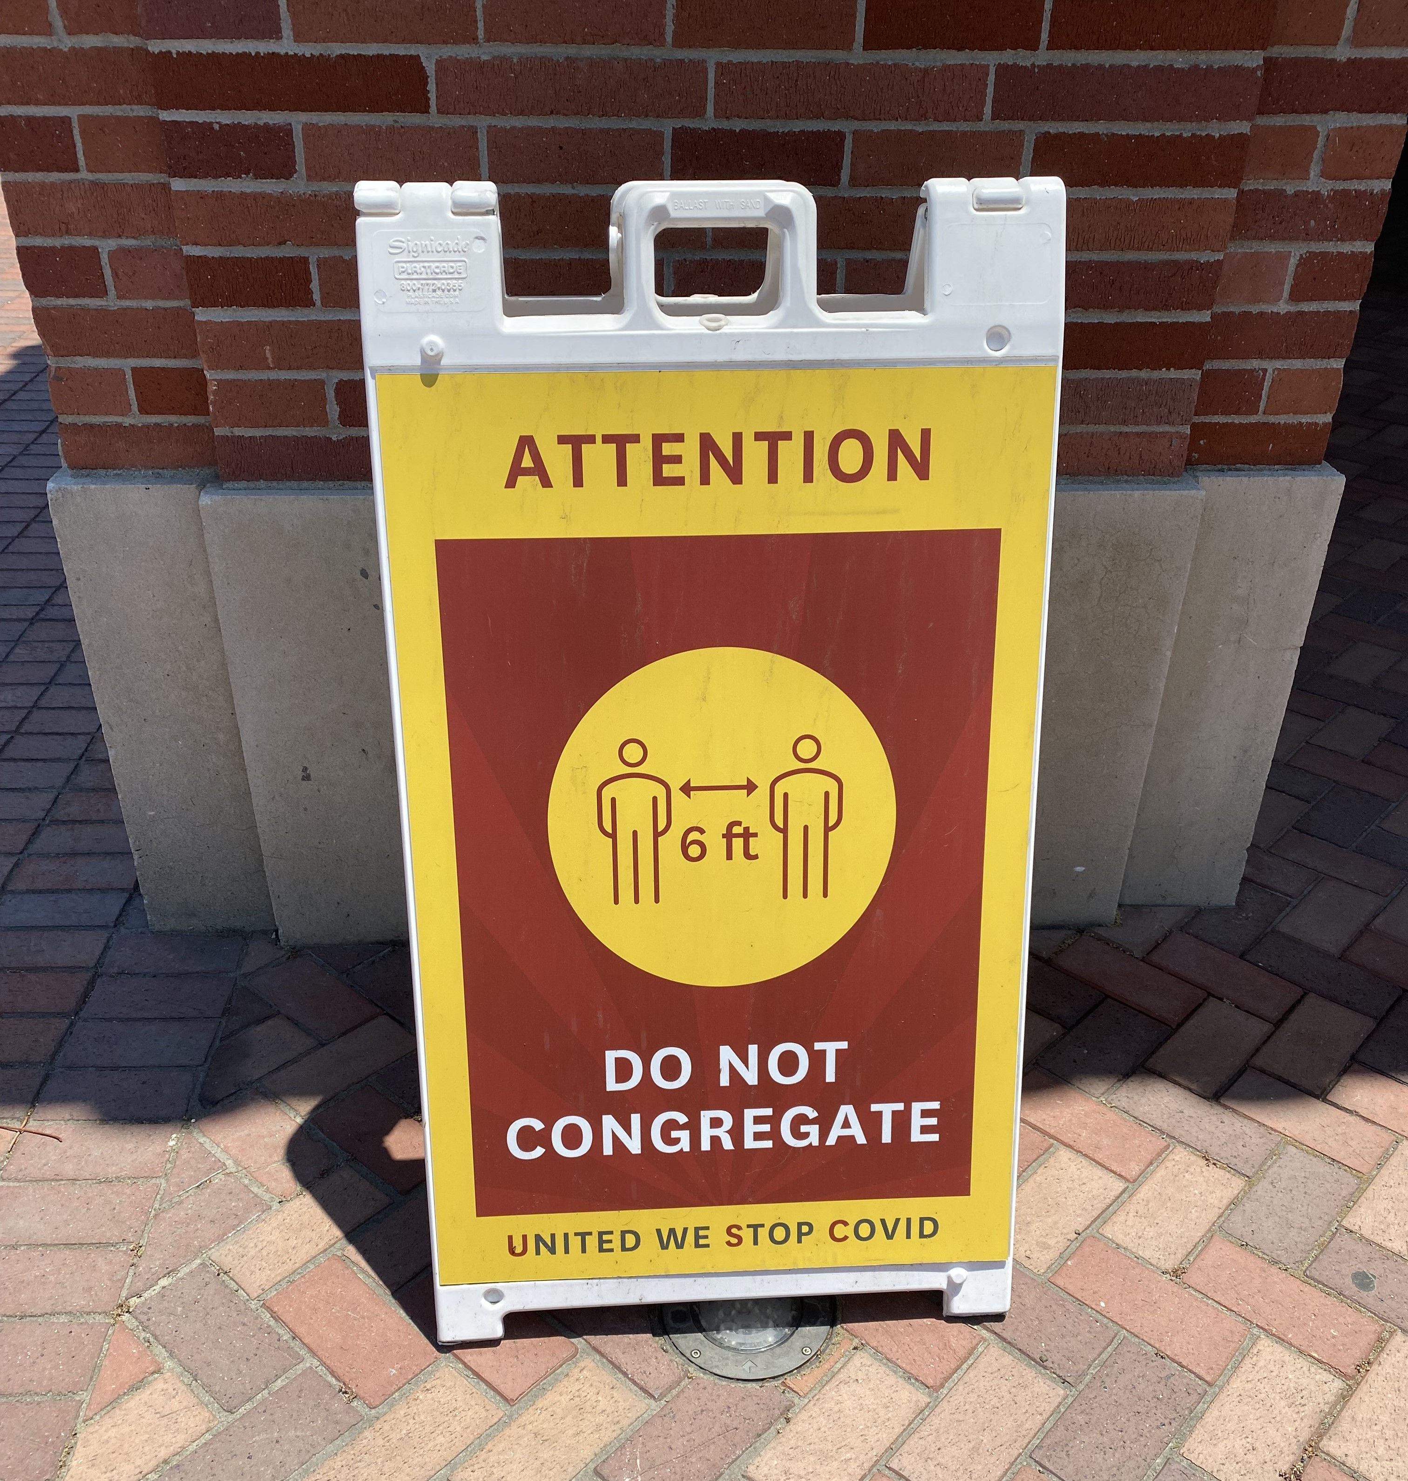
Challenges
Prioritizing and Scheduling Unfunded Work
An Ongoing Practice in a Project-Based Paradigm

Slide 13
Challenges
Prioritizing and Scheduling Unfunded Work
An Ongoing Practice in a Project-Based Paradigm

Slide 14
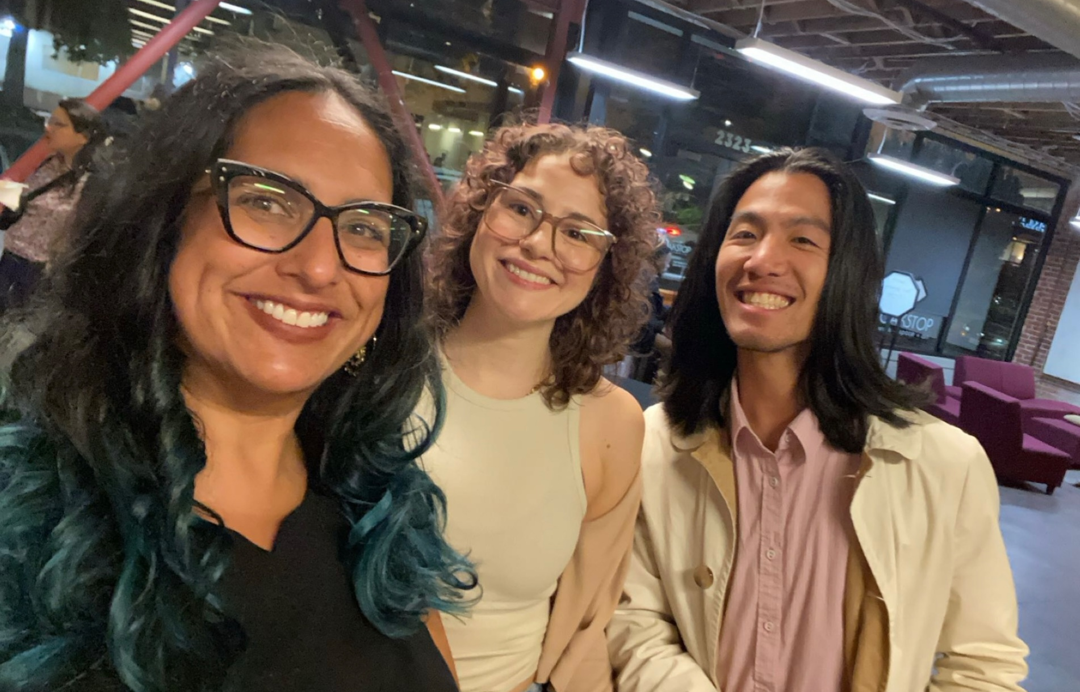
Closing & Gratitude
“Give yourself permission to begin over and over and over again.”
- Chani Nicholas

Slide 15
Closing & Gratitude
“Give yourself permission to begin over and over and over again.”
- Chani Nicholas

