Slide 1
DETROIT EXCELLENCE IN YOUTH ARTS
Youth Arts Mapping Project
In collaboration with Data Driven Detroit (D3)
September 2024

Slide 2
MAPPING PROJECT PURPOSE
DEYA and Connect Detroit have partnered with Data Driven Detroit
to conduct an in-depth scan of the youth arts ecosystem in Detroit.
DEYA and D3 sought to gain insights on the capacity of the city's youth arts ecosystem and highlight opportunities for collaboration, programming, and investment to the public,
stakeholders, and educational leaders.

Slide 3
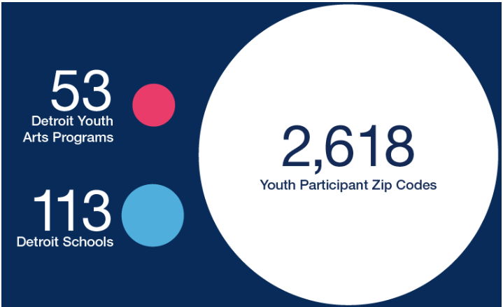
2,628

Slide 4
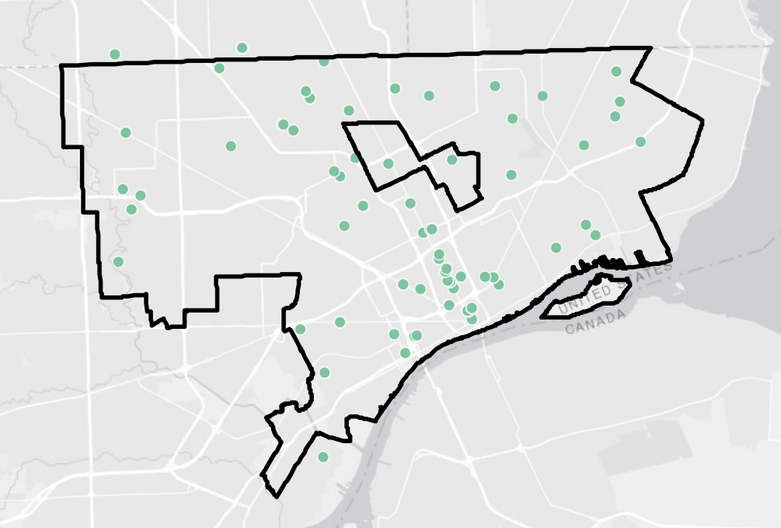
Distribution of Youth
Arts Programs
Detroit has an abundance of high quality arts opportunities for young people.

Slide 5
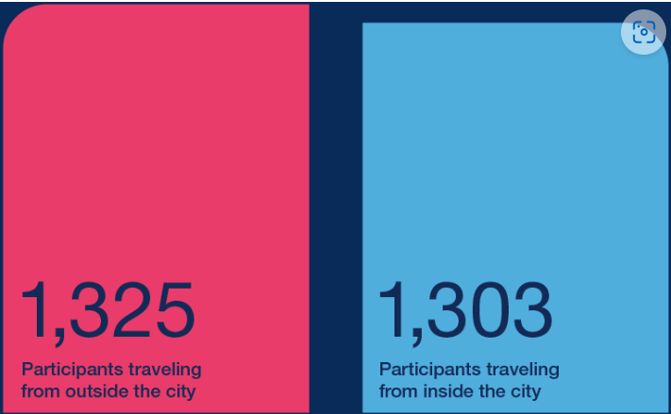
NOTE: This data only includes participation in Detroit programs.

Slide 6
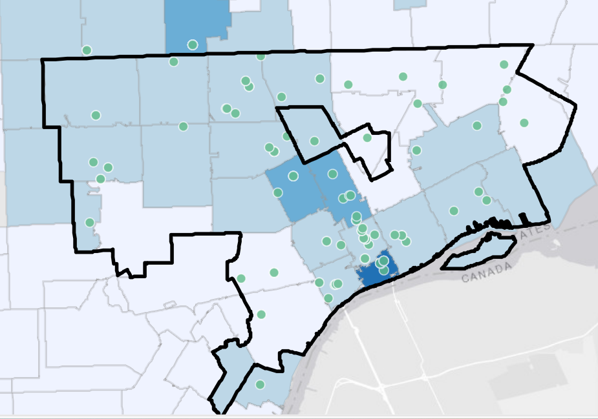
Percentage
of Youth Participants
This map divides the number of youth participants with the total population of youth under the age of 18 in each zip-code, allowing us to estimate the percentage of youth in each zip-code who are participating in the arts.
The lowest rate of youth participation are in the zip-codes 48228, 48210, 48209, 48211, 48212, 48234, 48205, and 48224.

Slide 7
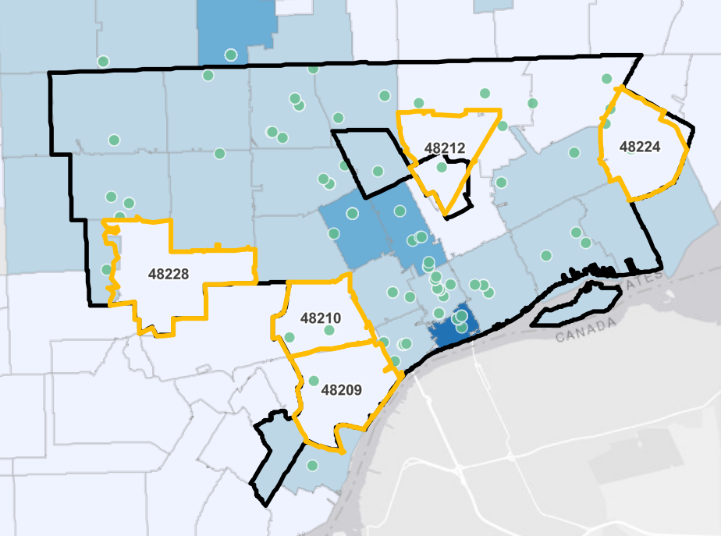
Youth Arts Opportunity
Zip Codes
These zip-codes represent the areas which have the greatest current gap in access to youth arts opportunities, both in terms of low participation rates and low number of arts programs in their general vicinity.
The five zip-codes we are designating as Youth Arts Opportunity Zip-Codes are 48228, 48210, 48209, 48212 and 48224.
To demonstrate the disparity, there are more youth in the Oak Park zip-code of 48237 participating in youth arts offerings than all five Youth Arts Opportunity Zip-Codes combined.

Slide 8
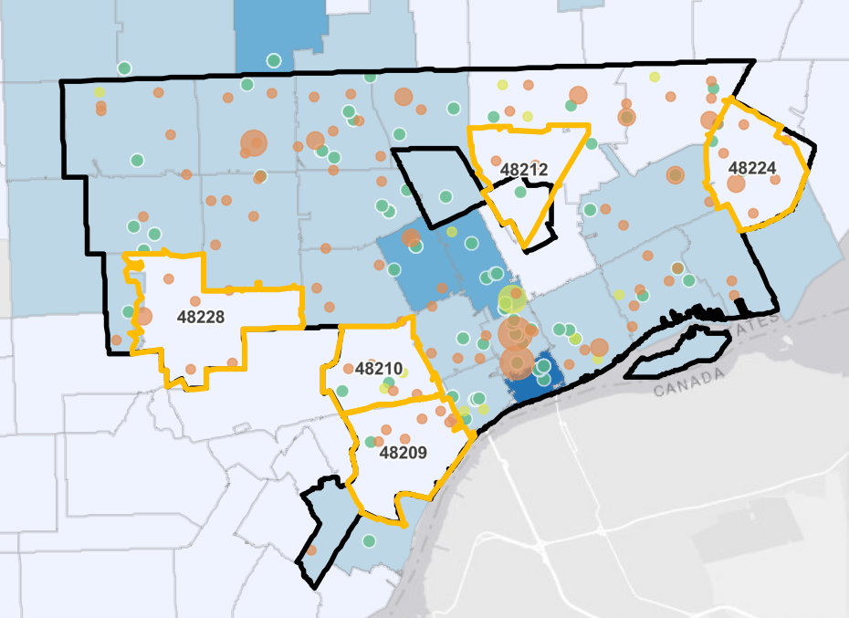
Youth Arts
In School
Offerings
DPSCD and charter schools that have identified arts offerings (orange dots for DPSCD, light green dots for charters, size of dot indicates number of arts classes offered) we see a similar trend in levels of access.
While arts classes are offered by schools in the Youth Arts Opportunity Zip-Codes, the schools with the largest arts curriculums and offerings tend to be located in midtown, downtown and northwest Detroit.

Slide 9
High Youth Population
36% of all Detroit residents under the age of 18-years-old live in the five Youth Arts Opportunity Zip Codes

Slide 10
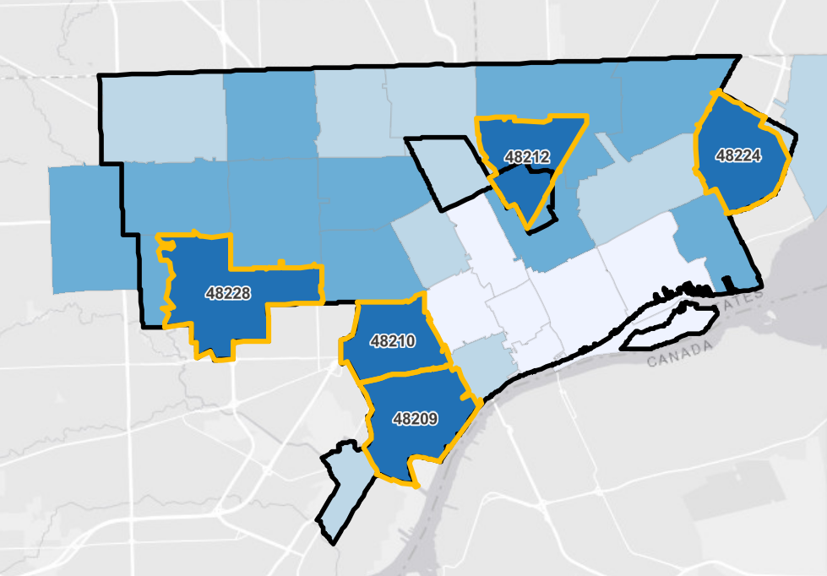
Youth
Opportunity
Zones:
Youth Density
As shown in this map, the five zip-codes have the highest ratio of youth to adults of any zip-codes in Detroit, which also holds true for the rest of Southeast Michigan.
The Youth Arts Opportunity Zip-Codes have the highest percentage (more than 30%) of youth under 18 years old – roughly 1 youth for every 2 adults.

Slide 11
High Youth Density
The five Youth Arts Opportunity Zip Codes have the highest youth DENSITY (i.e. ratio of youth to adults) compared with any other Detroit Zip Codes.

Slide 12
High Foreign Born Population
The 4 of the 5 Youth Arts Opportunity Zip Codes have among the highest number of Foreign-born compared with any other Detroit Zip Codes.

